Slide 1
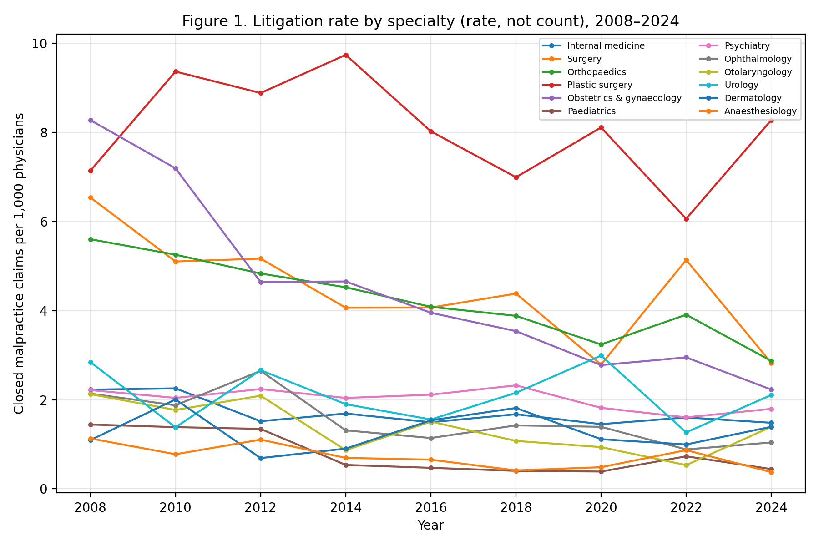
Figure 1
Closed malpractice claims per 1,000 physicians by specialty, 2008-2024 (rates, not counts).

Slide 2
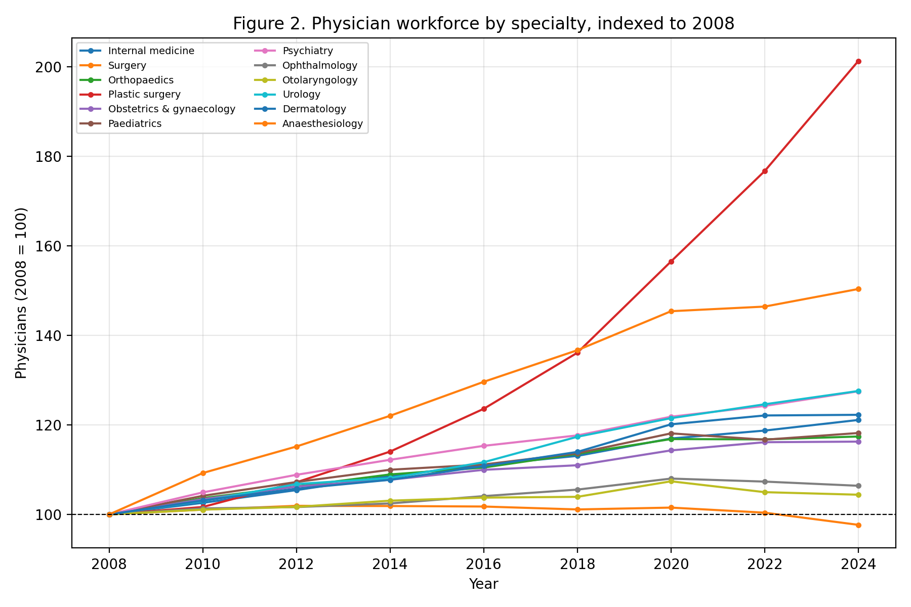
Figure 2
Physician workforce by specialty, indexed to 2008 (=100).

Slide 3
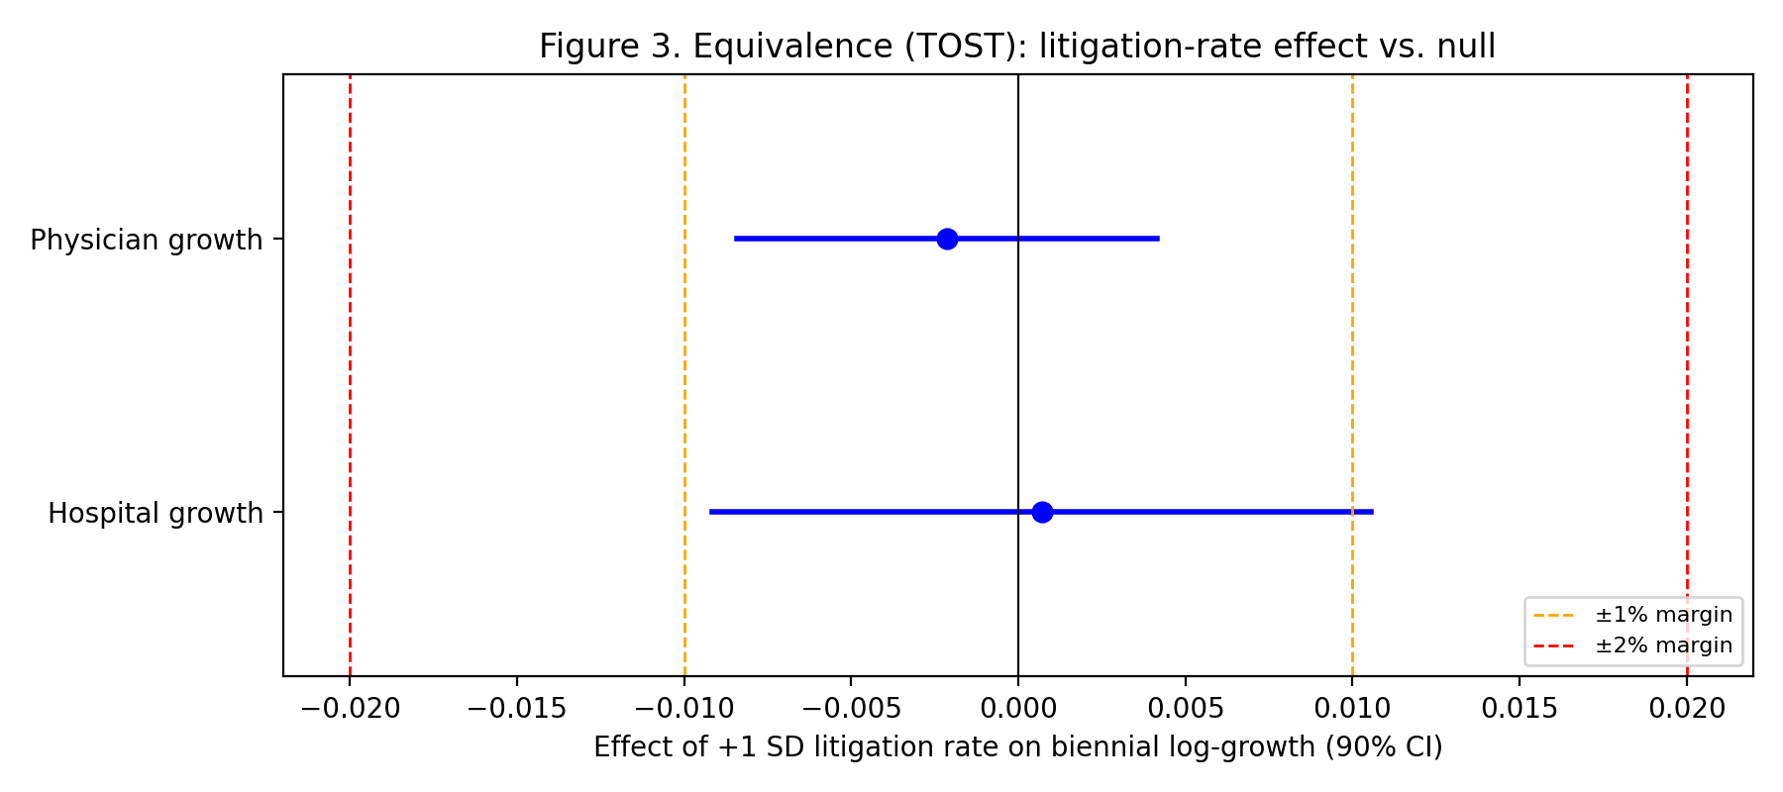
Figure 3
Equivalence (TOST) of the litigation-rate effect against ±1% and ±2% margins (90% CIs).

Slide 4
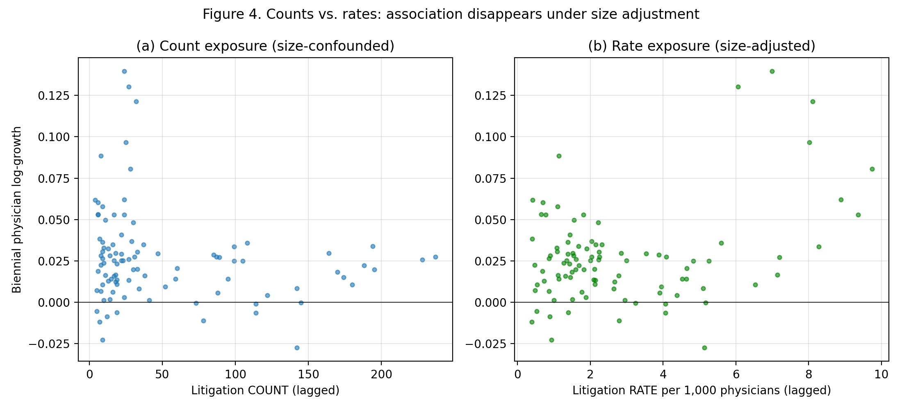
Figure 4
Biennial physician growth against lagged litigation exposure as counts (a) and rates (b).

