Slide 1
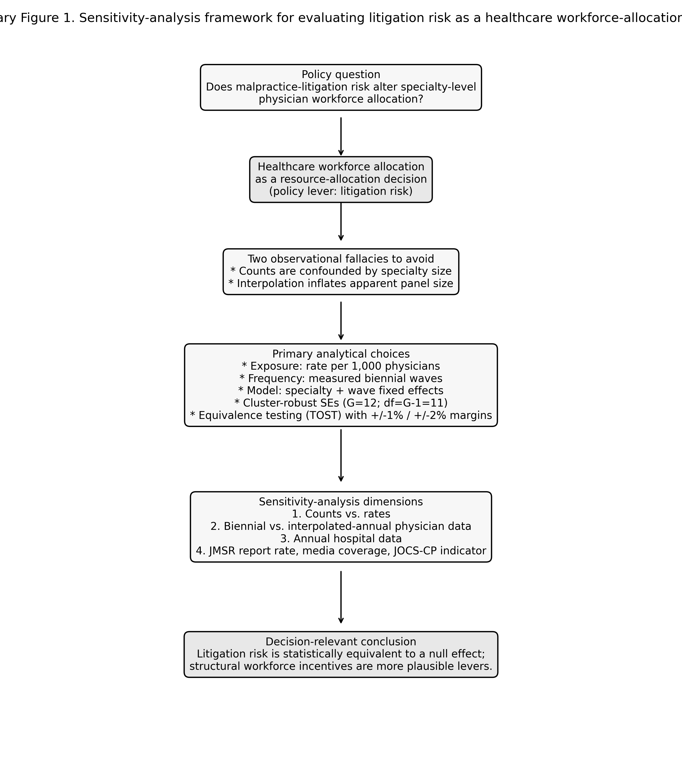
Supplementary Figure 1
Sensitivity-analysis framework for evaluating malpractice-litigation risk as a healthcare workforce-allocation instrument.

Slide 2
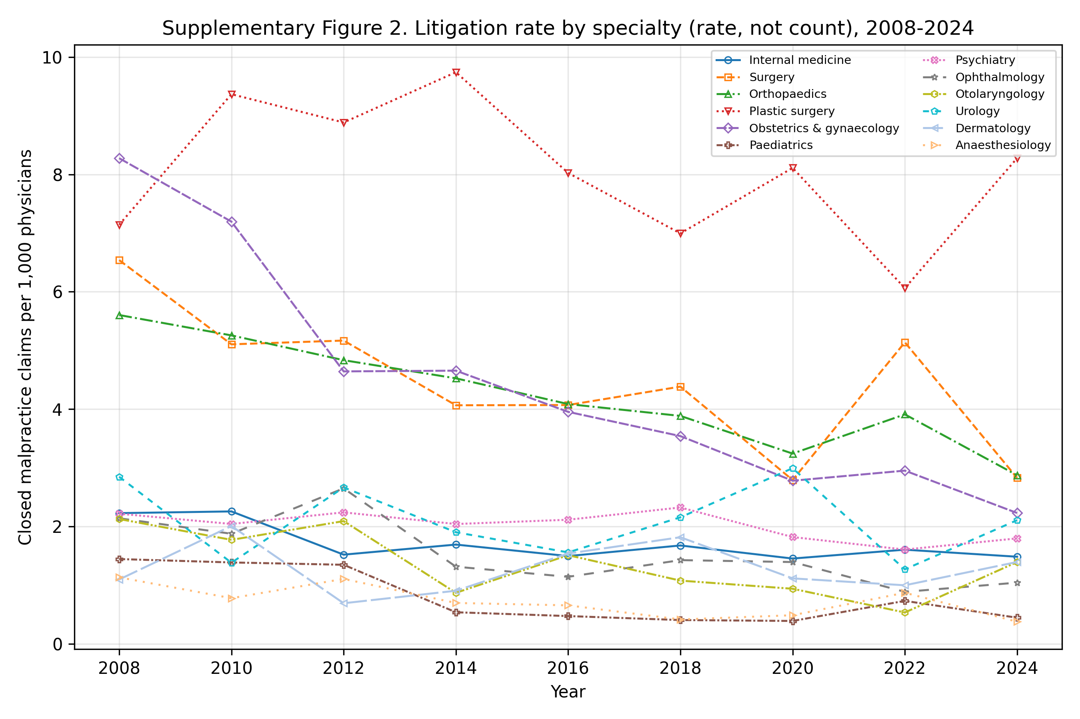
Supplementary Figure 2
Closed malpractice claims per 1,000 physicians by specialty, 2008-2024 (rates, not counts).

Slide 3
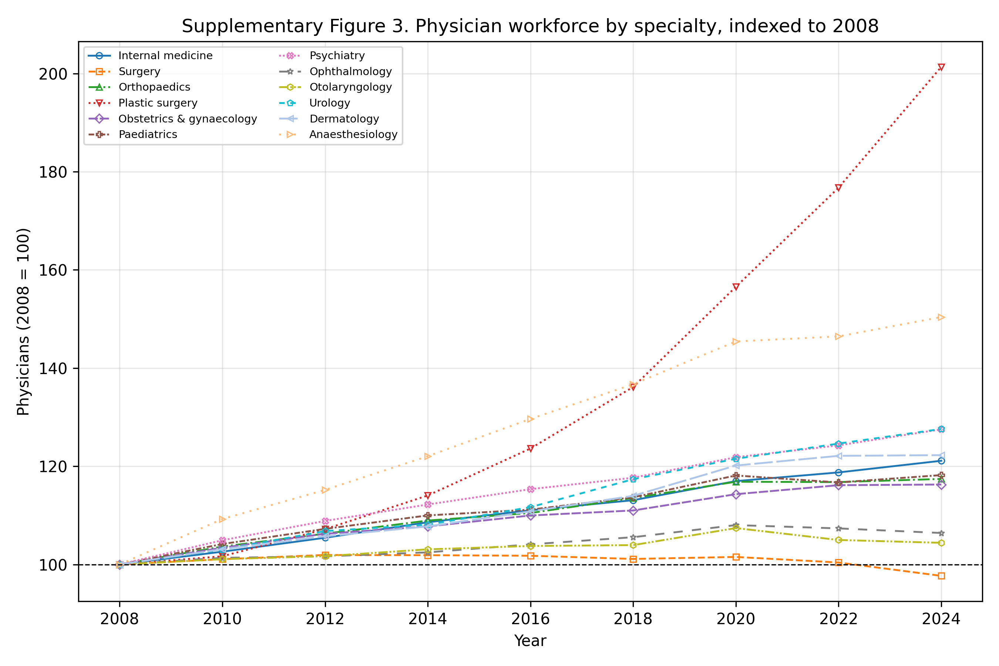
Supplementary Figure 3
Physician workforce by specialty, indexed to 2008 (=100).

