Slide 1
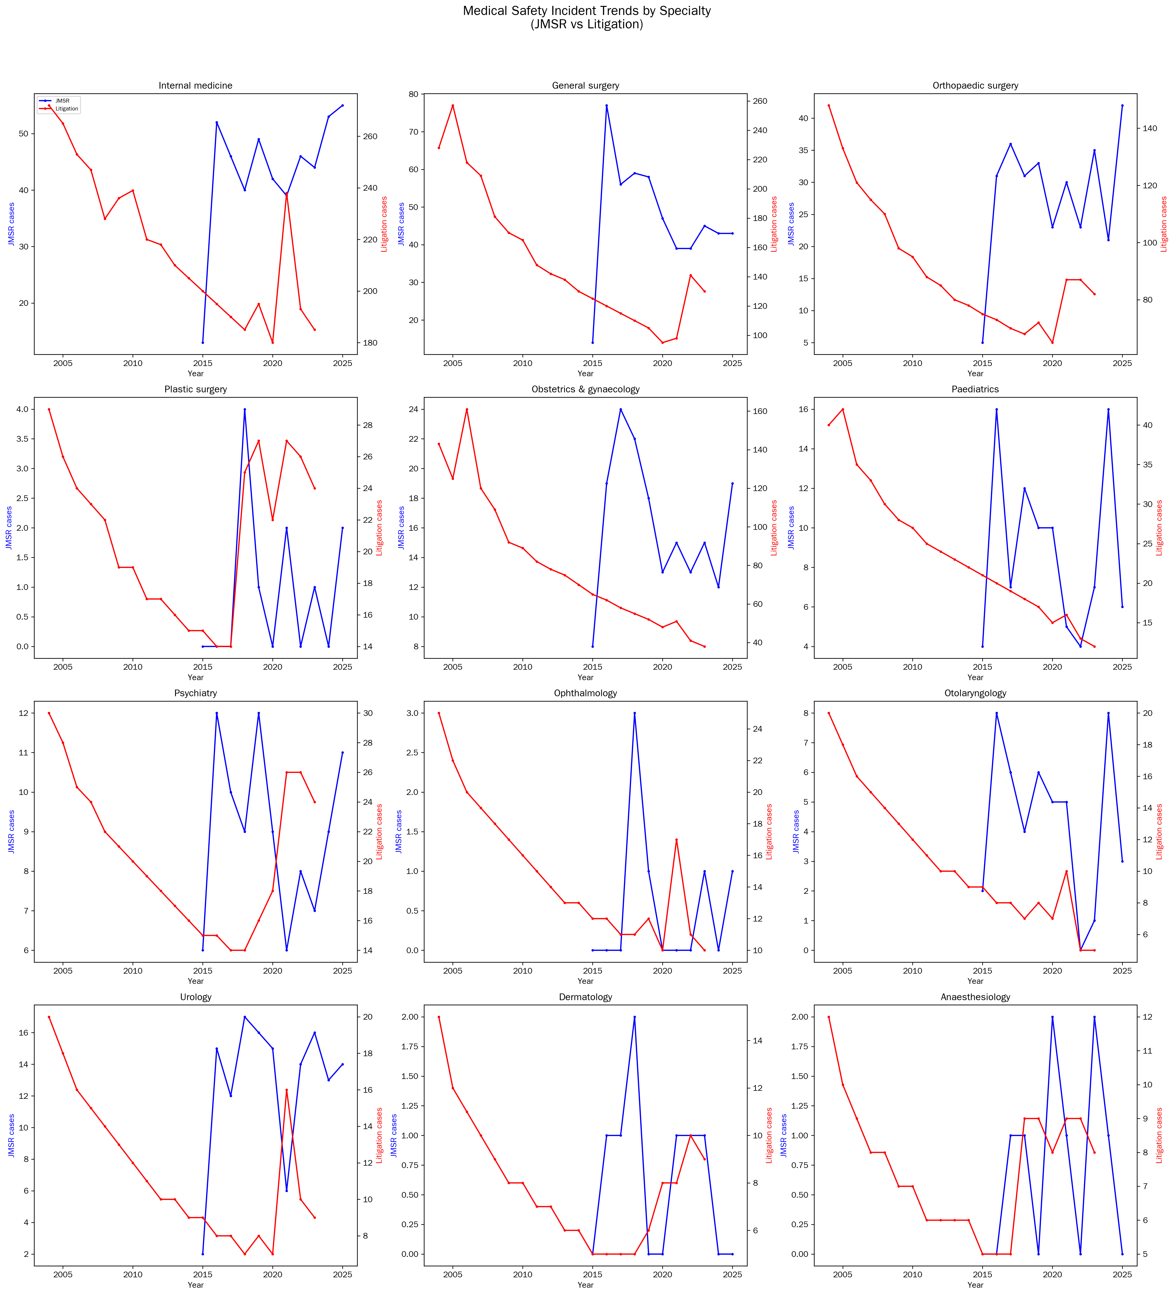
Figure 1
Trends in medical safety incident counts by specialty

Slide 2
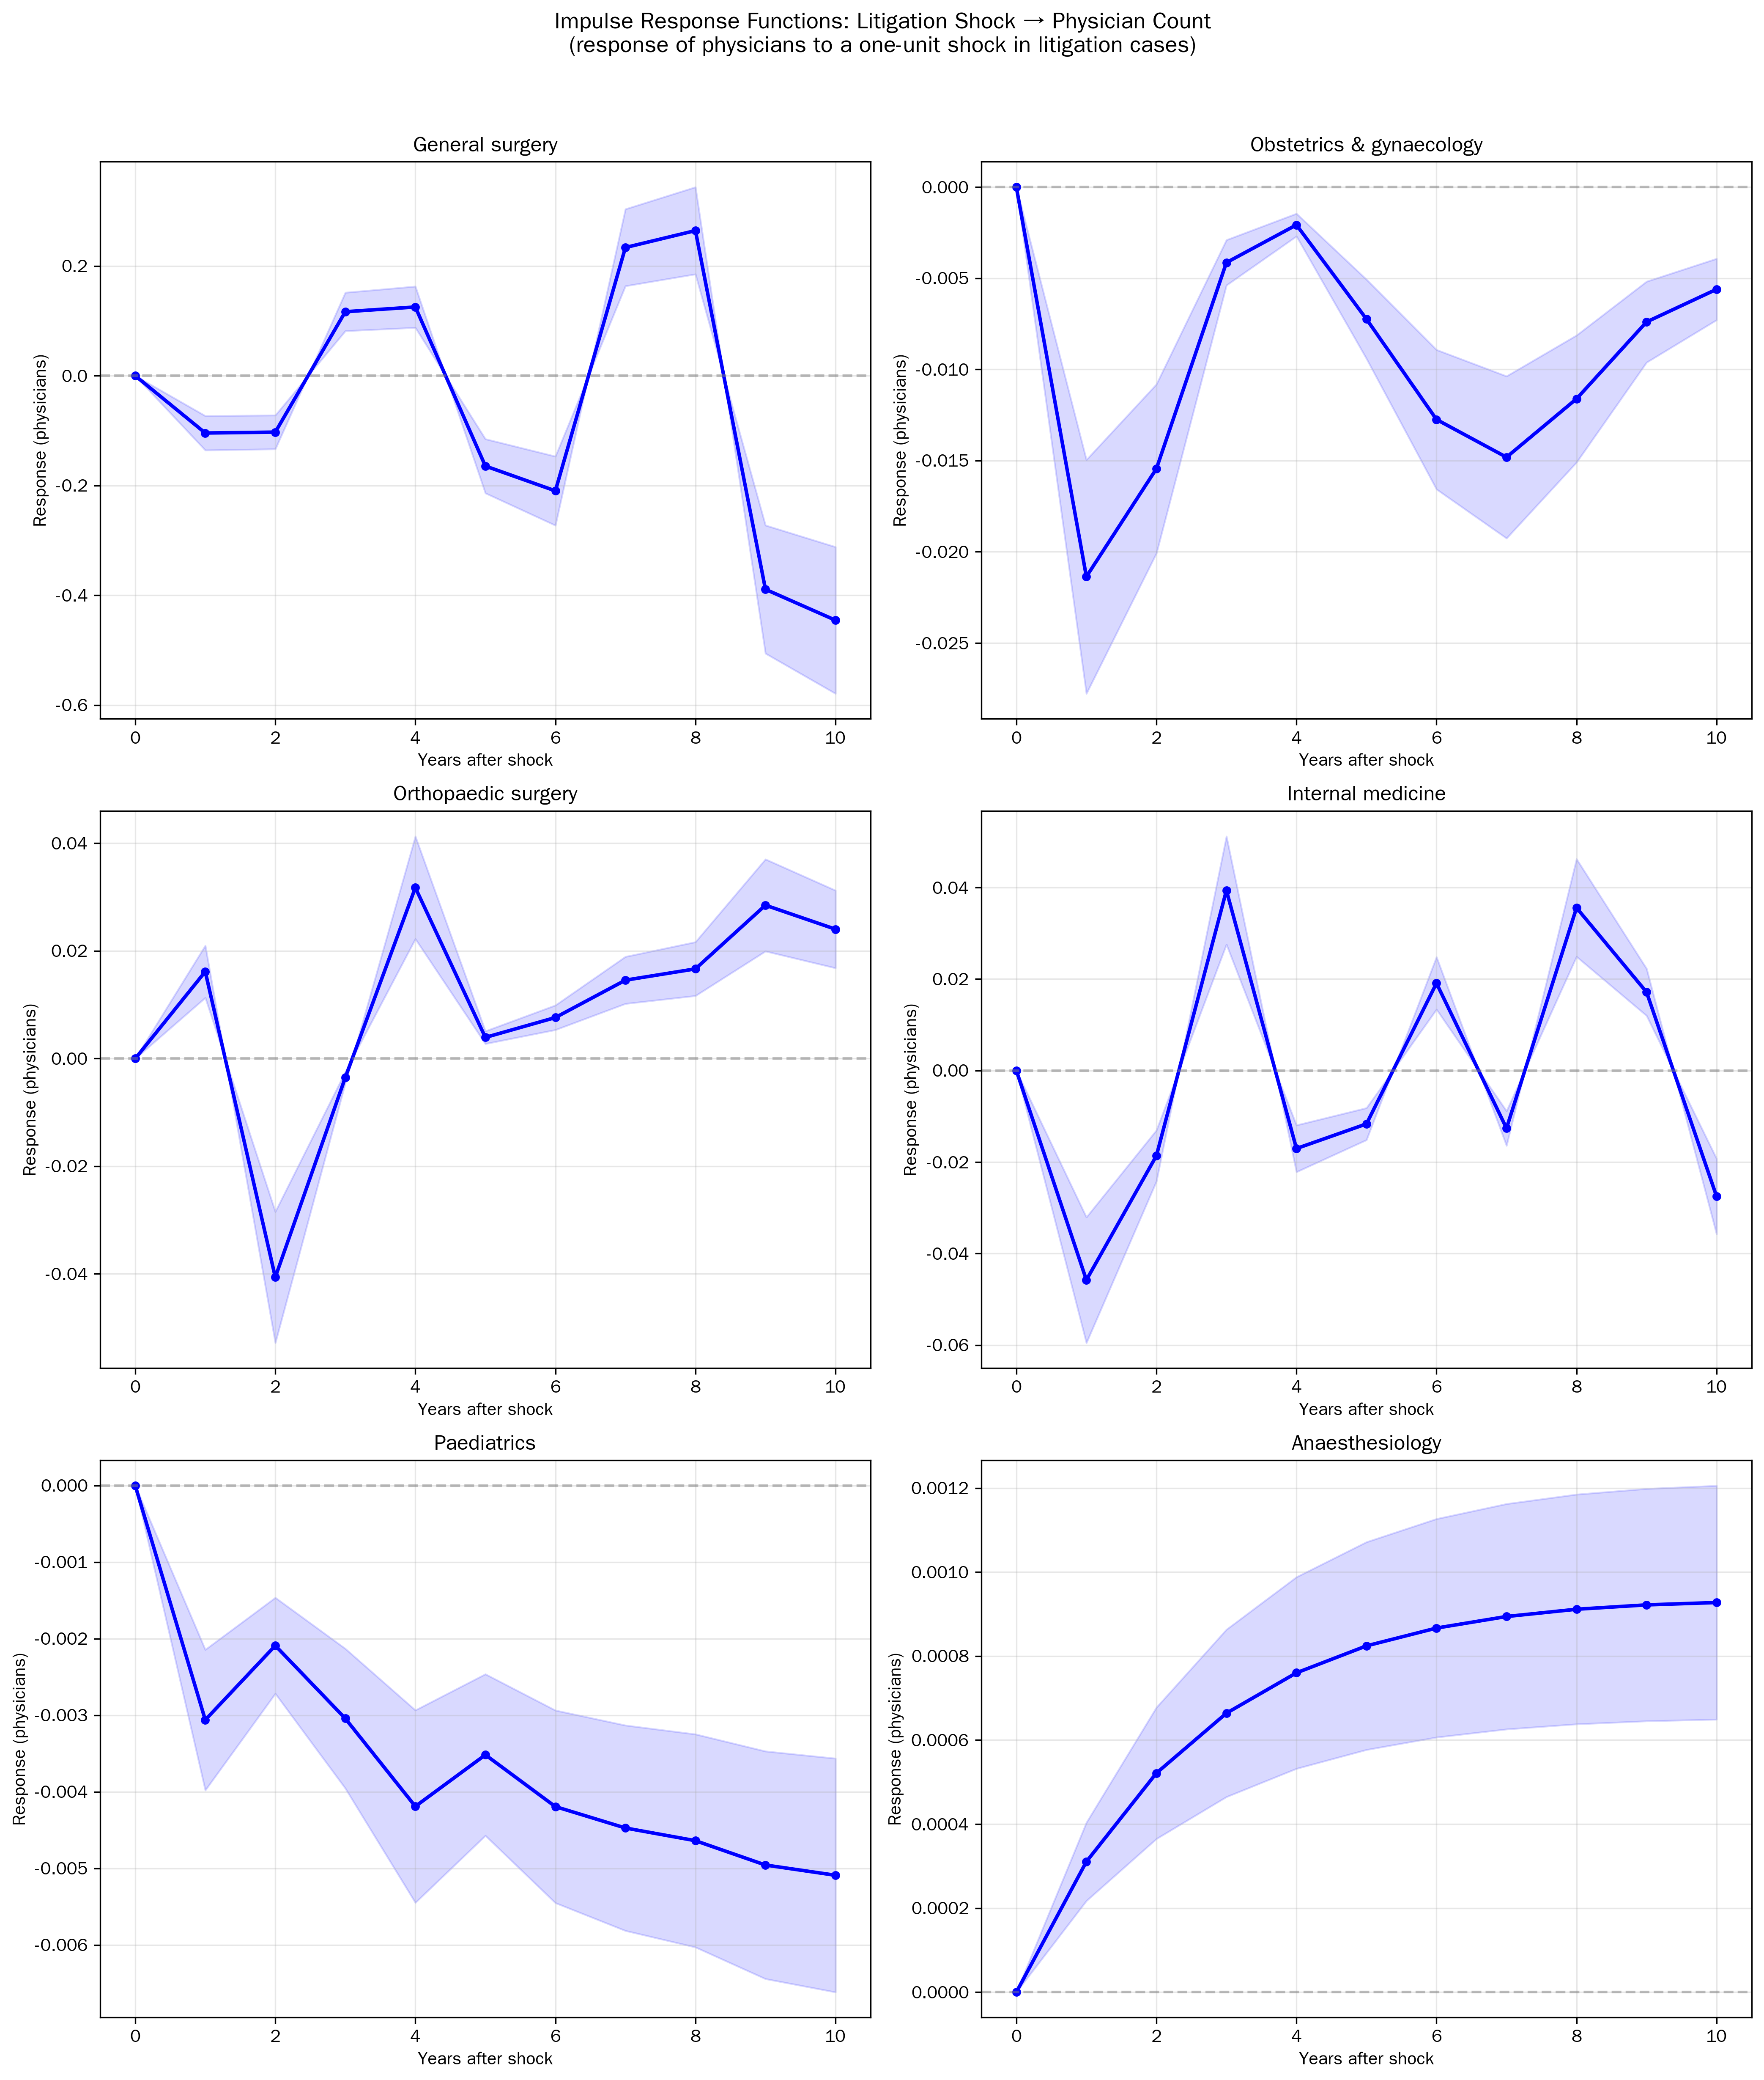
Figure 2
IRF: physician count response to litigation shock

Slide 3
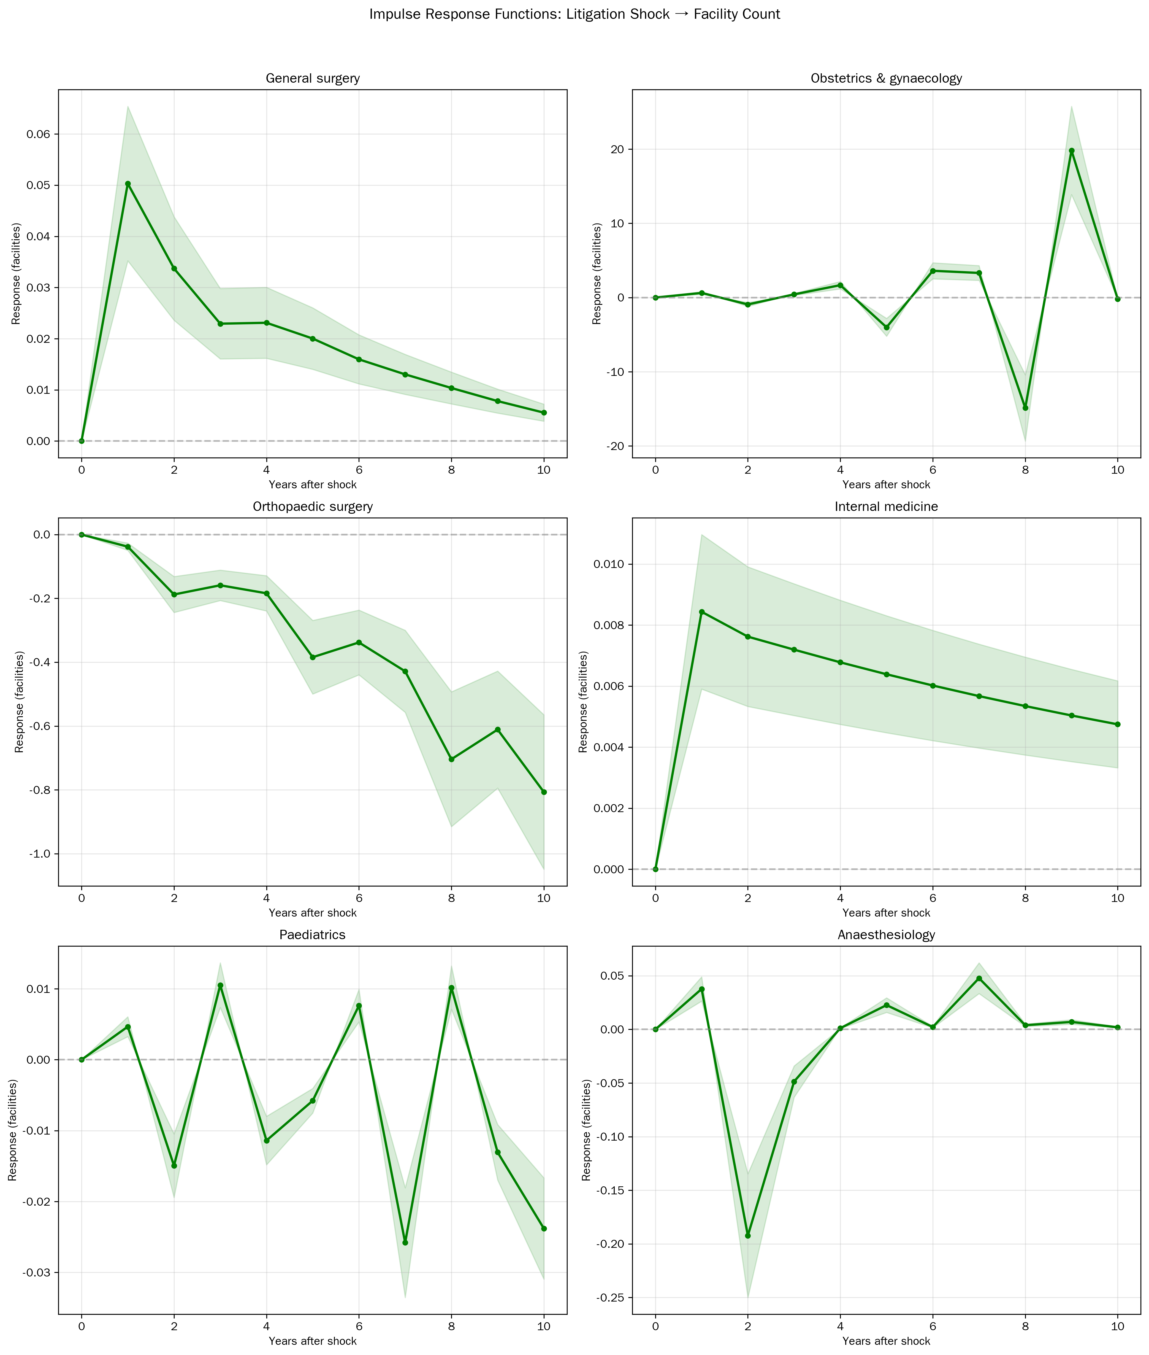
Figure 3
IRF: facility count response to litigation shock

Slide 4
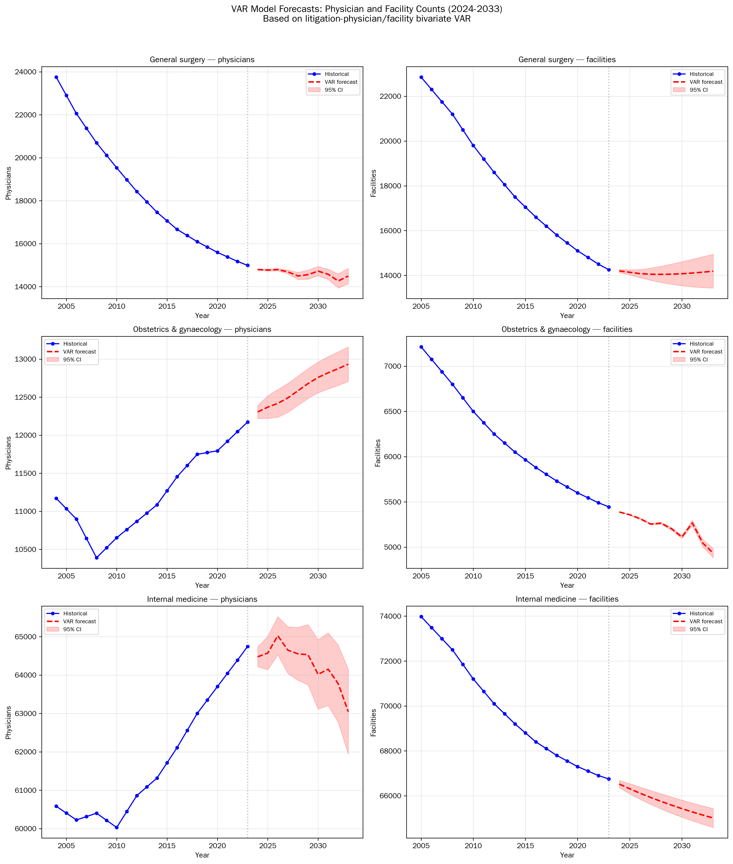
Figure 4
VAR-based workforce forecasts (2024-2033)

