Slide 1
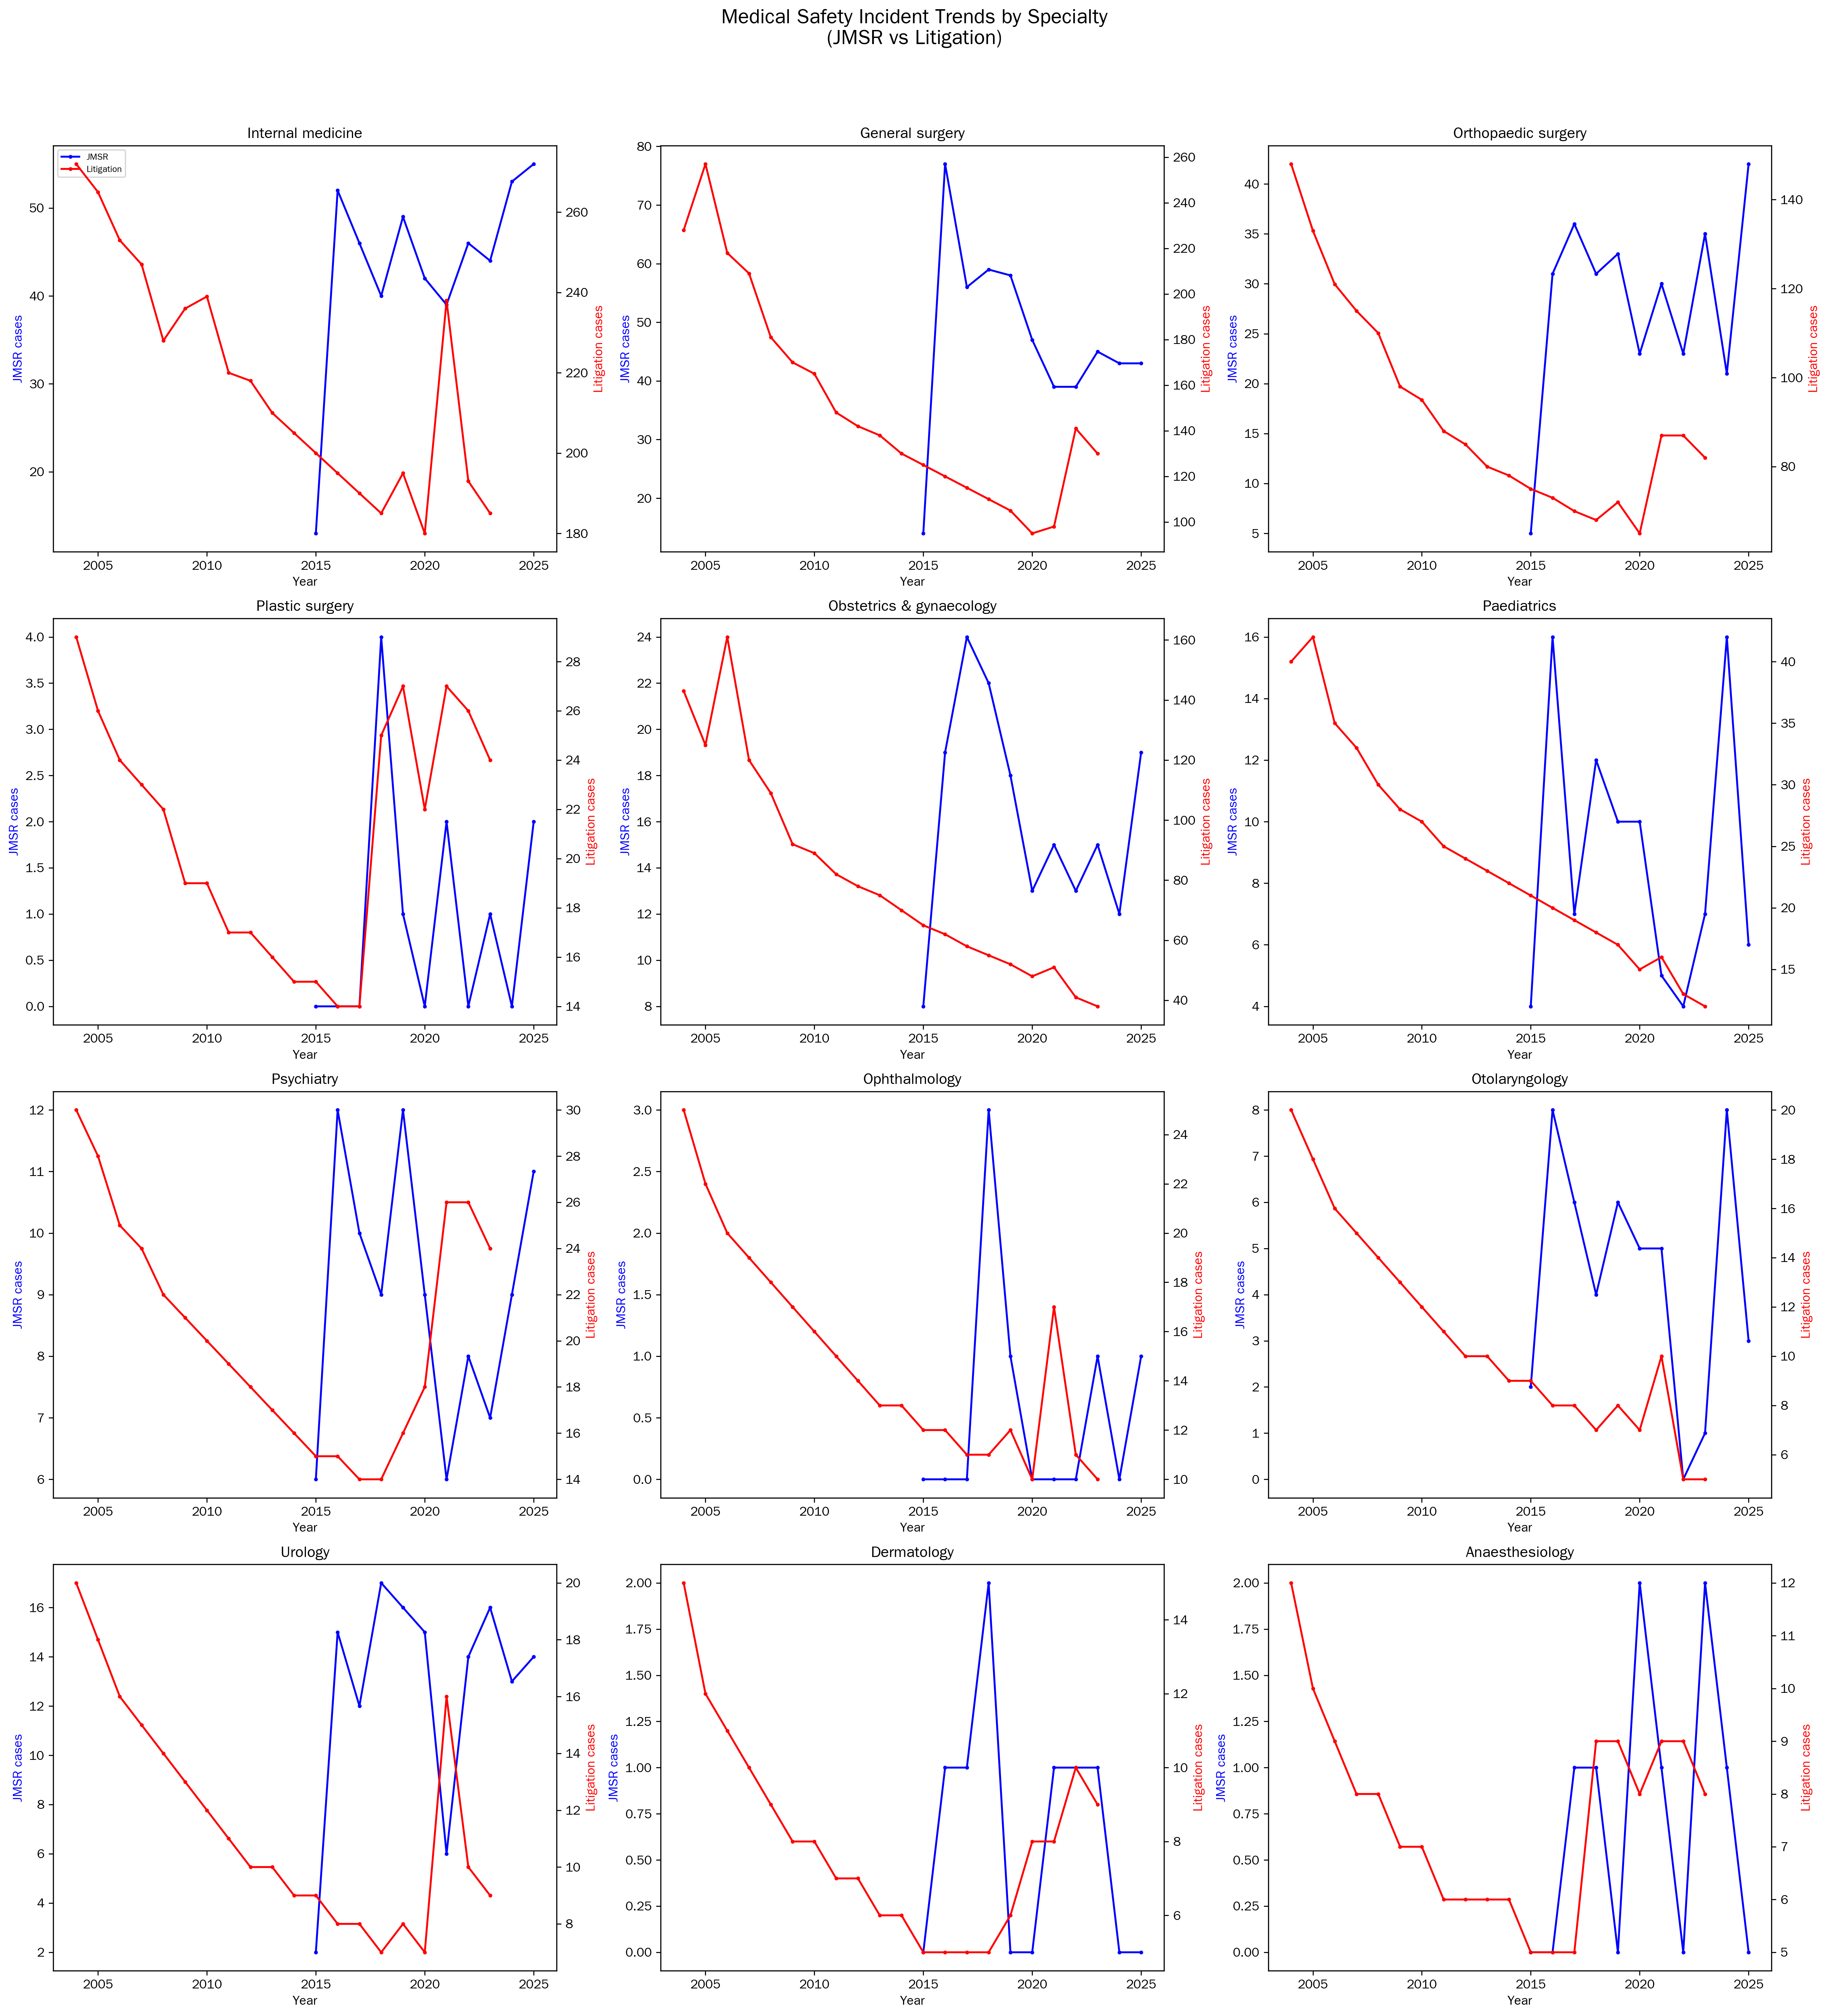
Figure 1. Medical Safety Incident Trends by Specialty
JMSR mandatory reports (2015-2025) and litigation statistics (2004-2023) for the 12 core specialties.

Slide 2
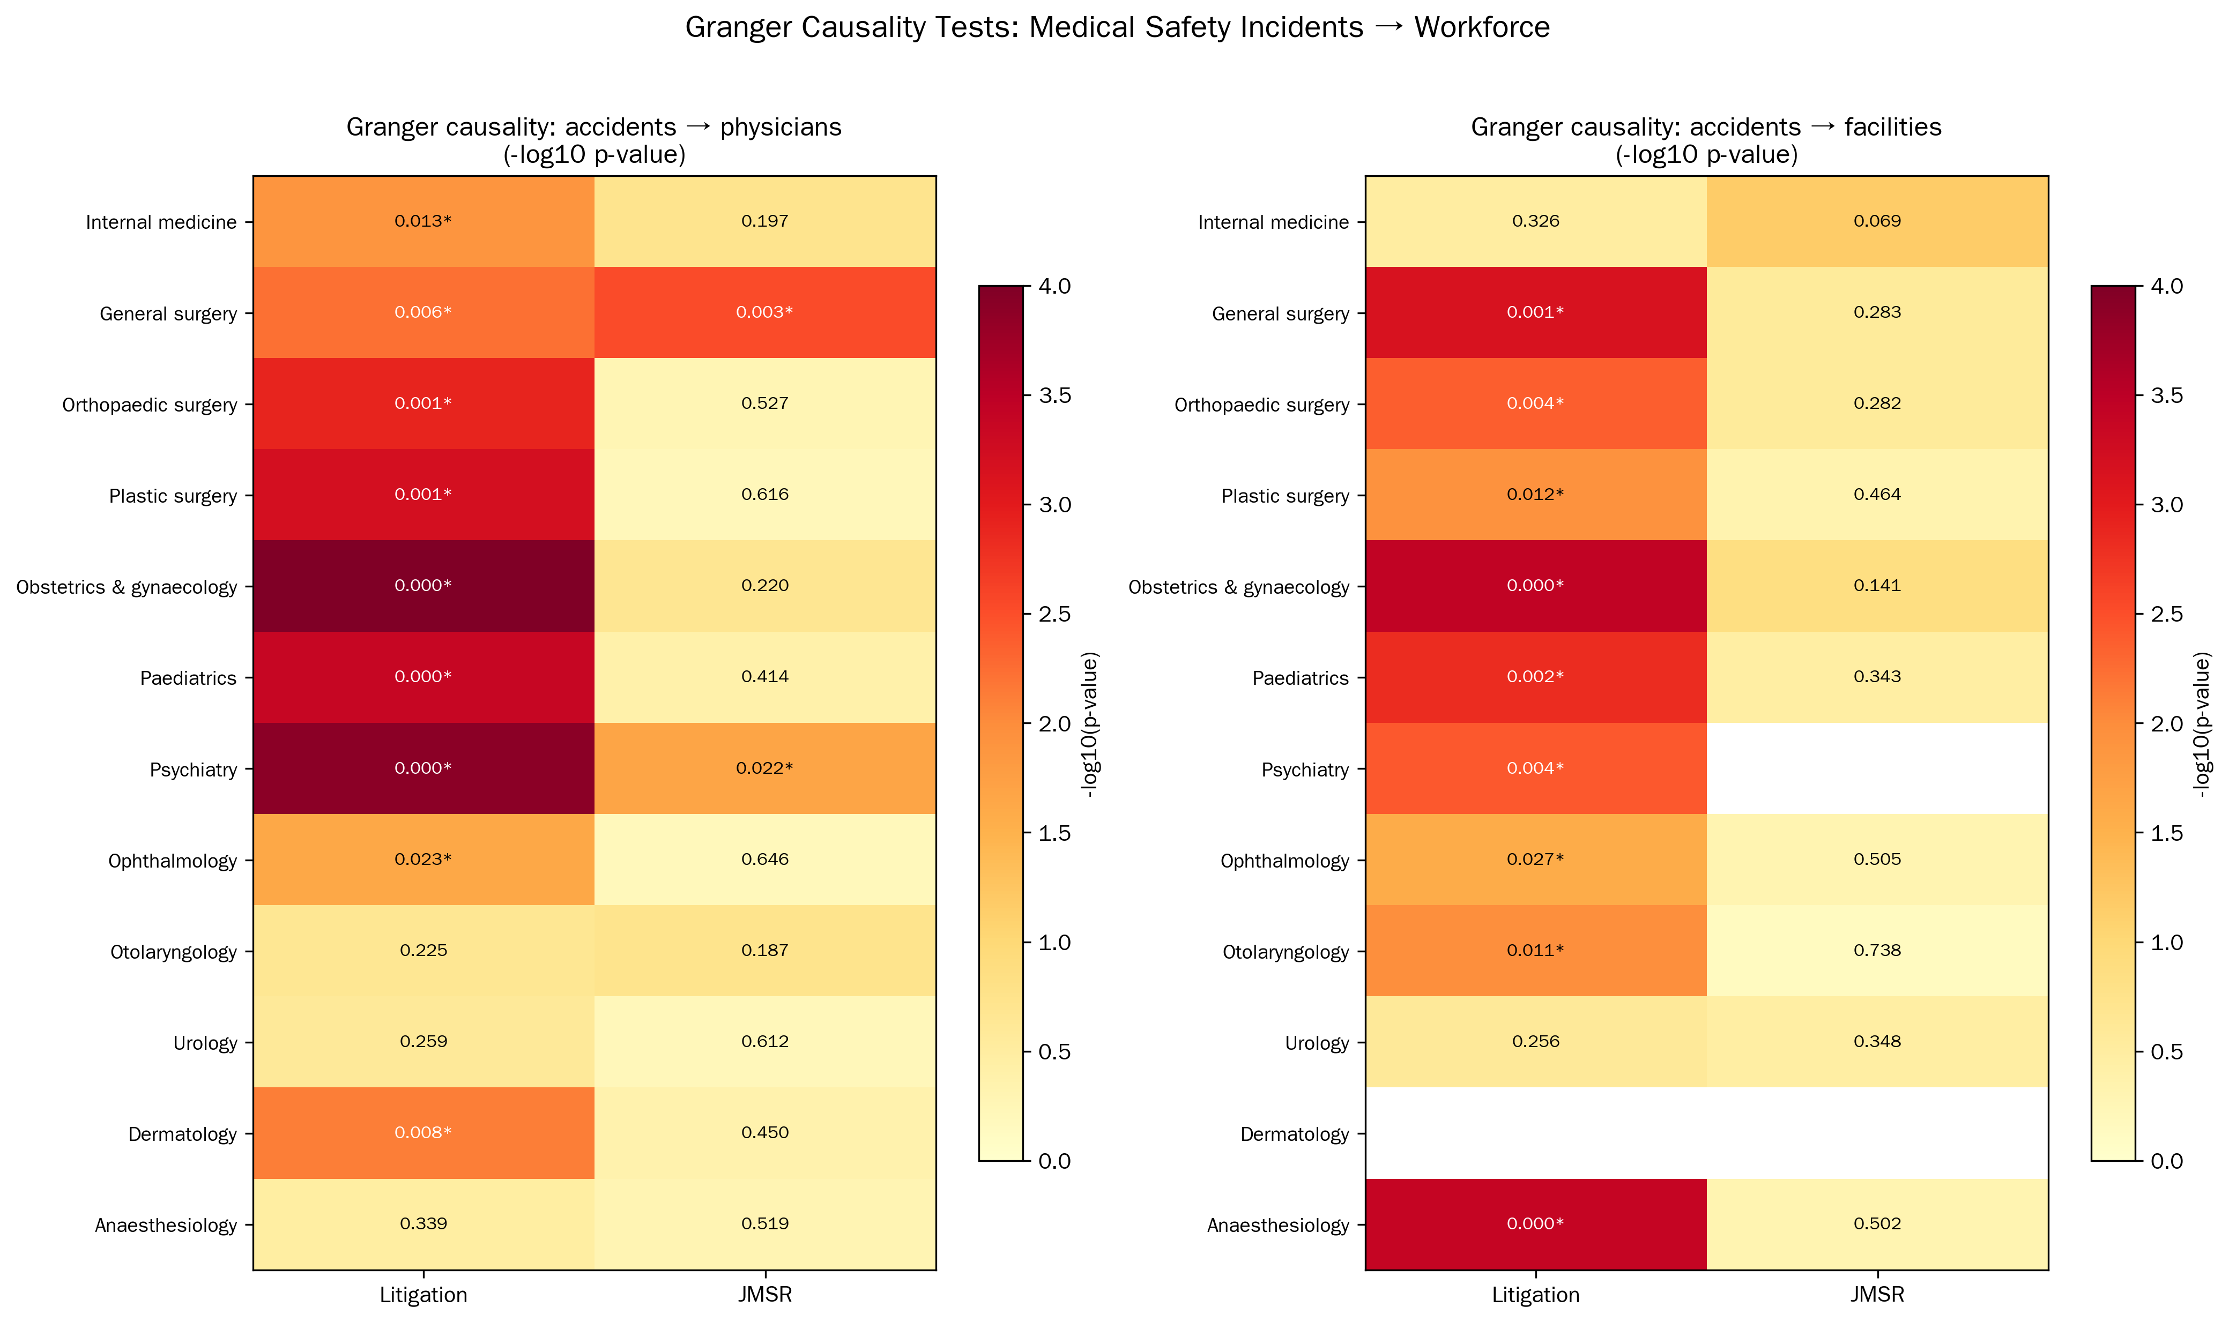
Figure 2 (Supplementary). Granger Causality Heatmap
Forward Granger causality p-values (-log10 scale) for incidents → workforce. Rows: specialties; columns: incident definitions.

Slide 3
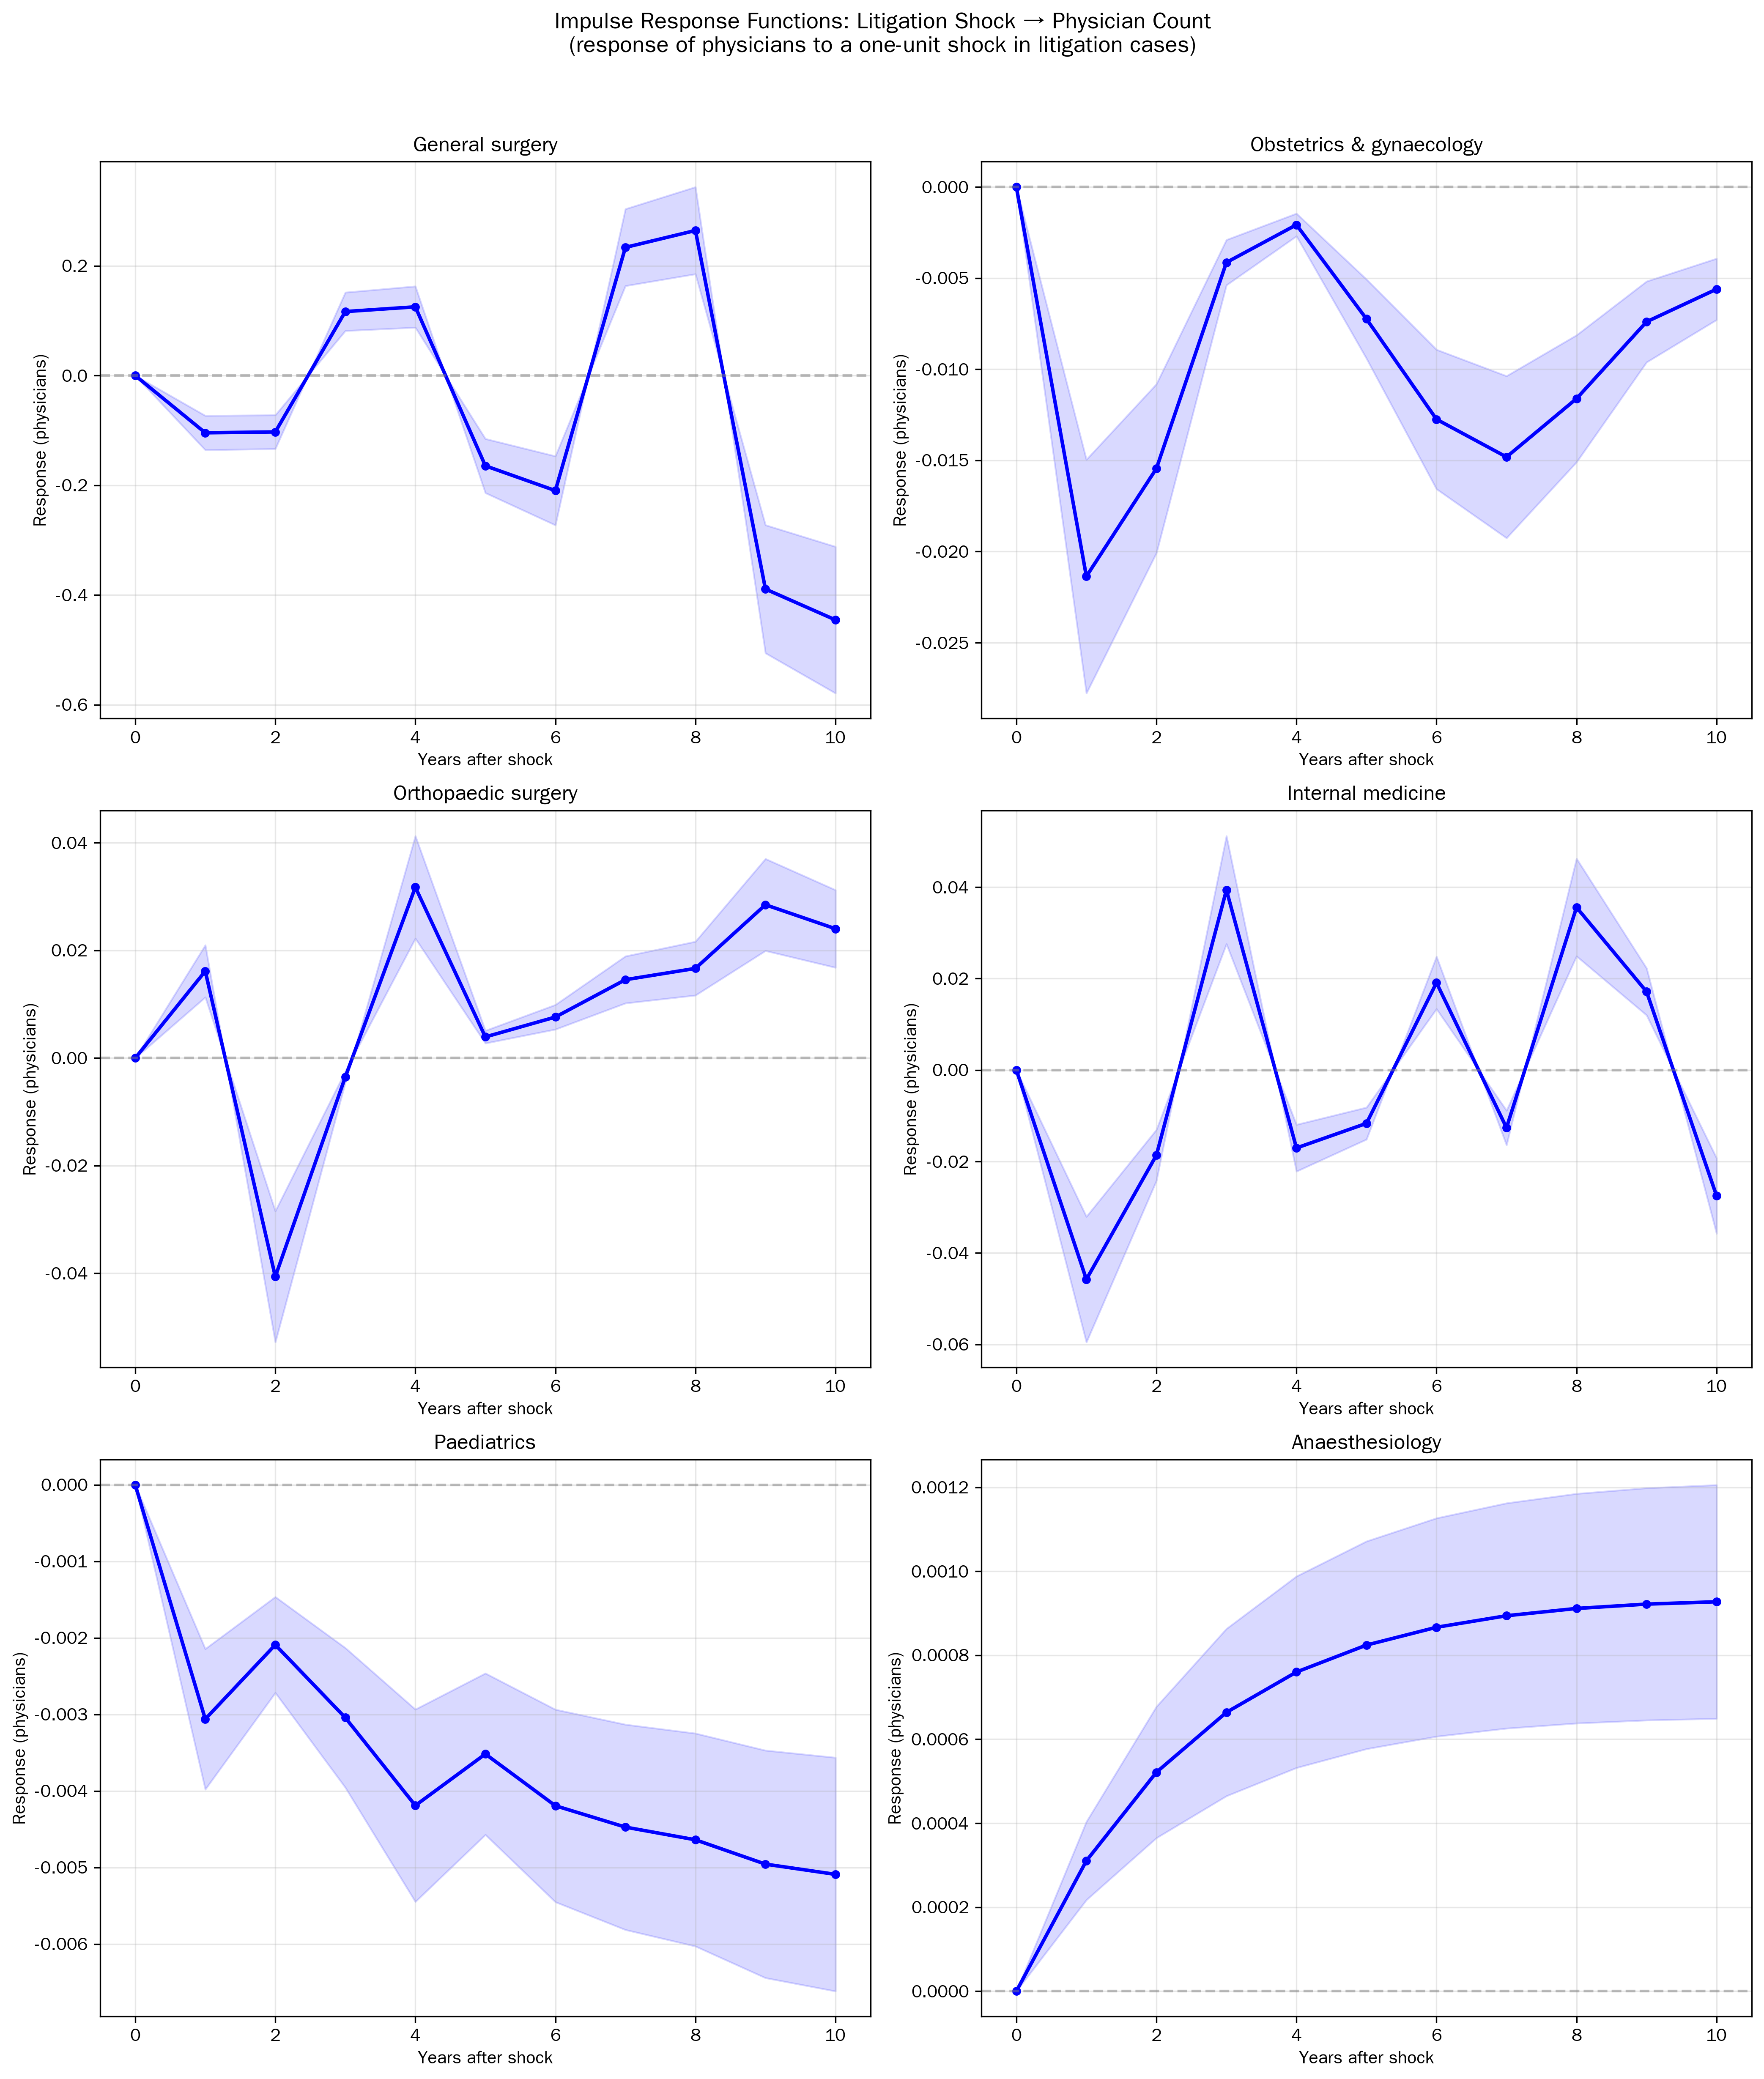
Figure 2. Impulse Response Functions: Litigation → Physicians
Response of physician counts to a one-unit shock in litigation cases for six key specialties. Shaded areas: approximate 95% CI.

Slide 4
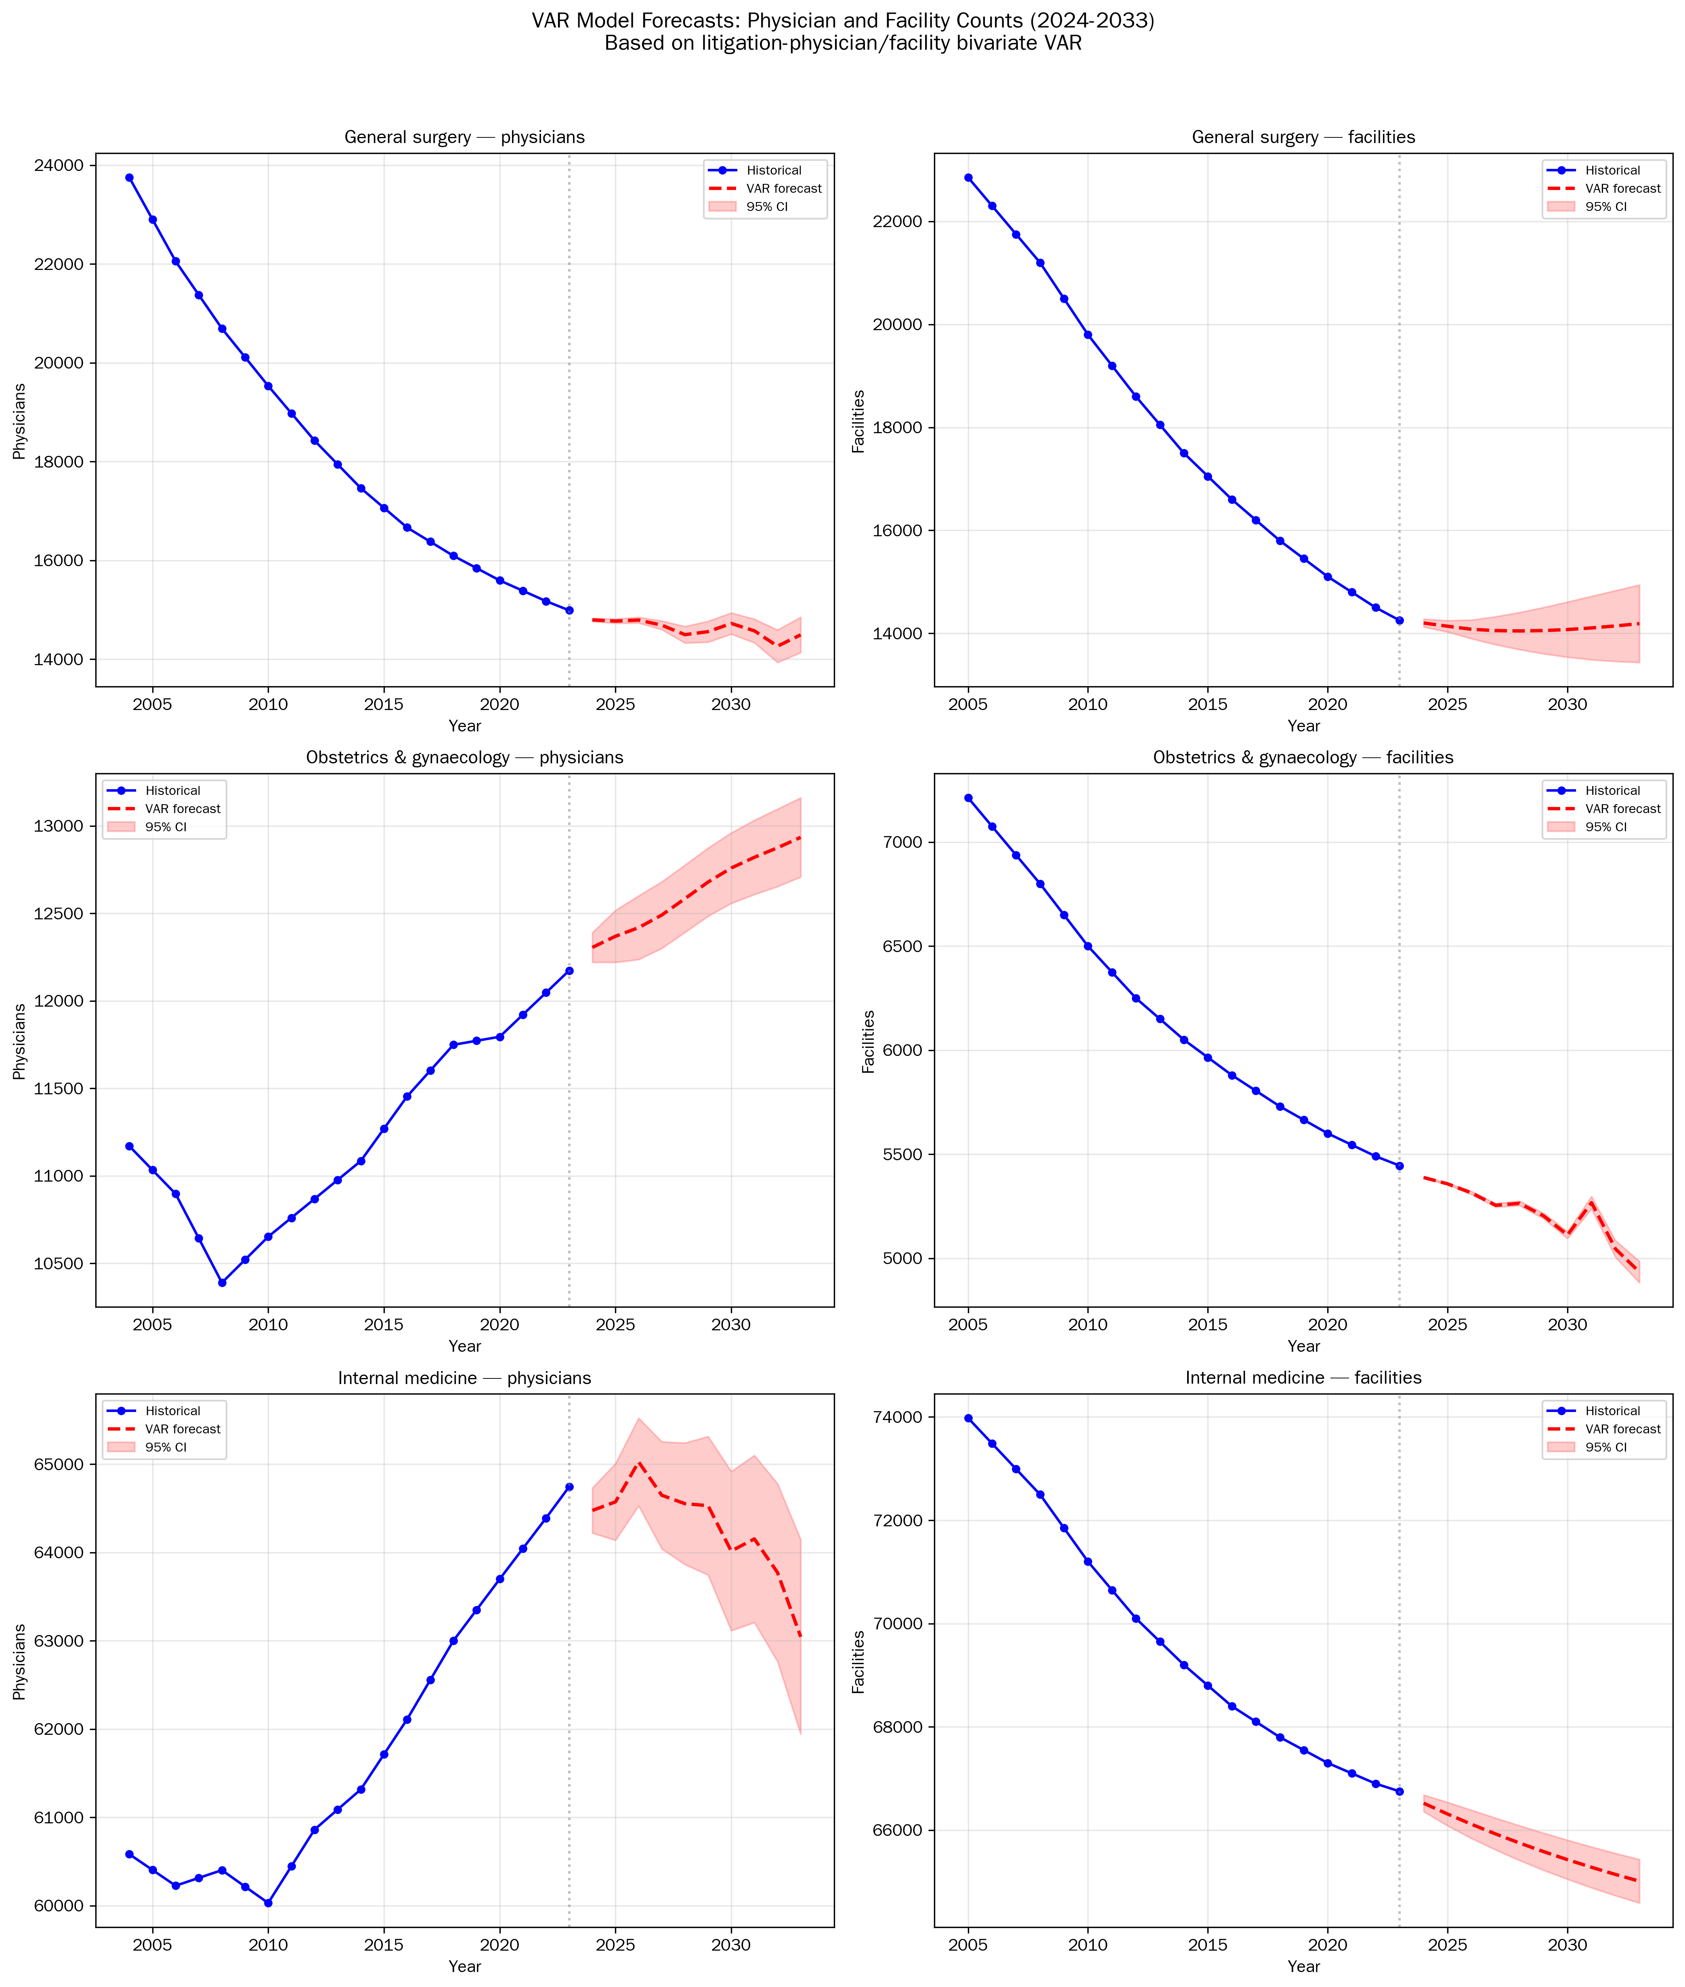
Figure 3. VAR-Based Forecasts
Physician and facility count forecasts (2024-2033) for general surgery, obstetrics & gynaecology, and internal medicine.

Slide 5
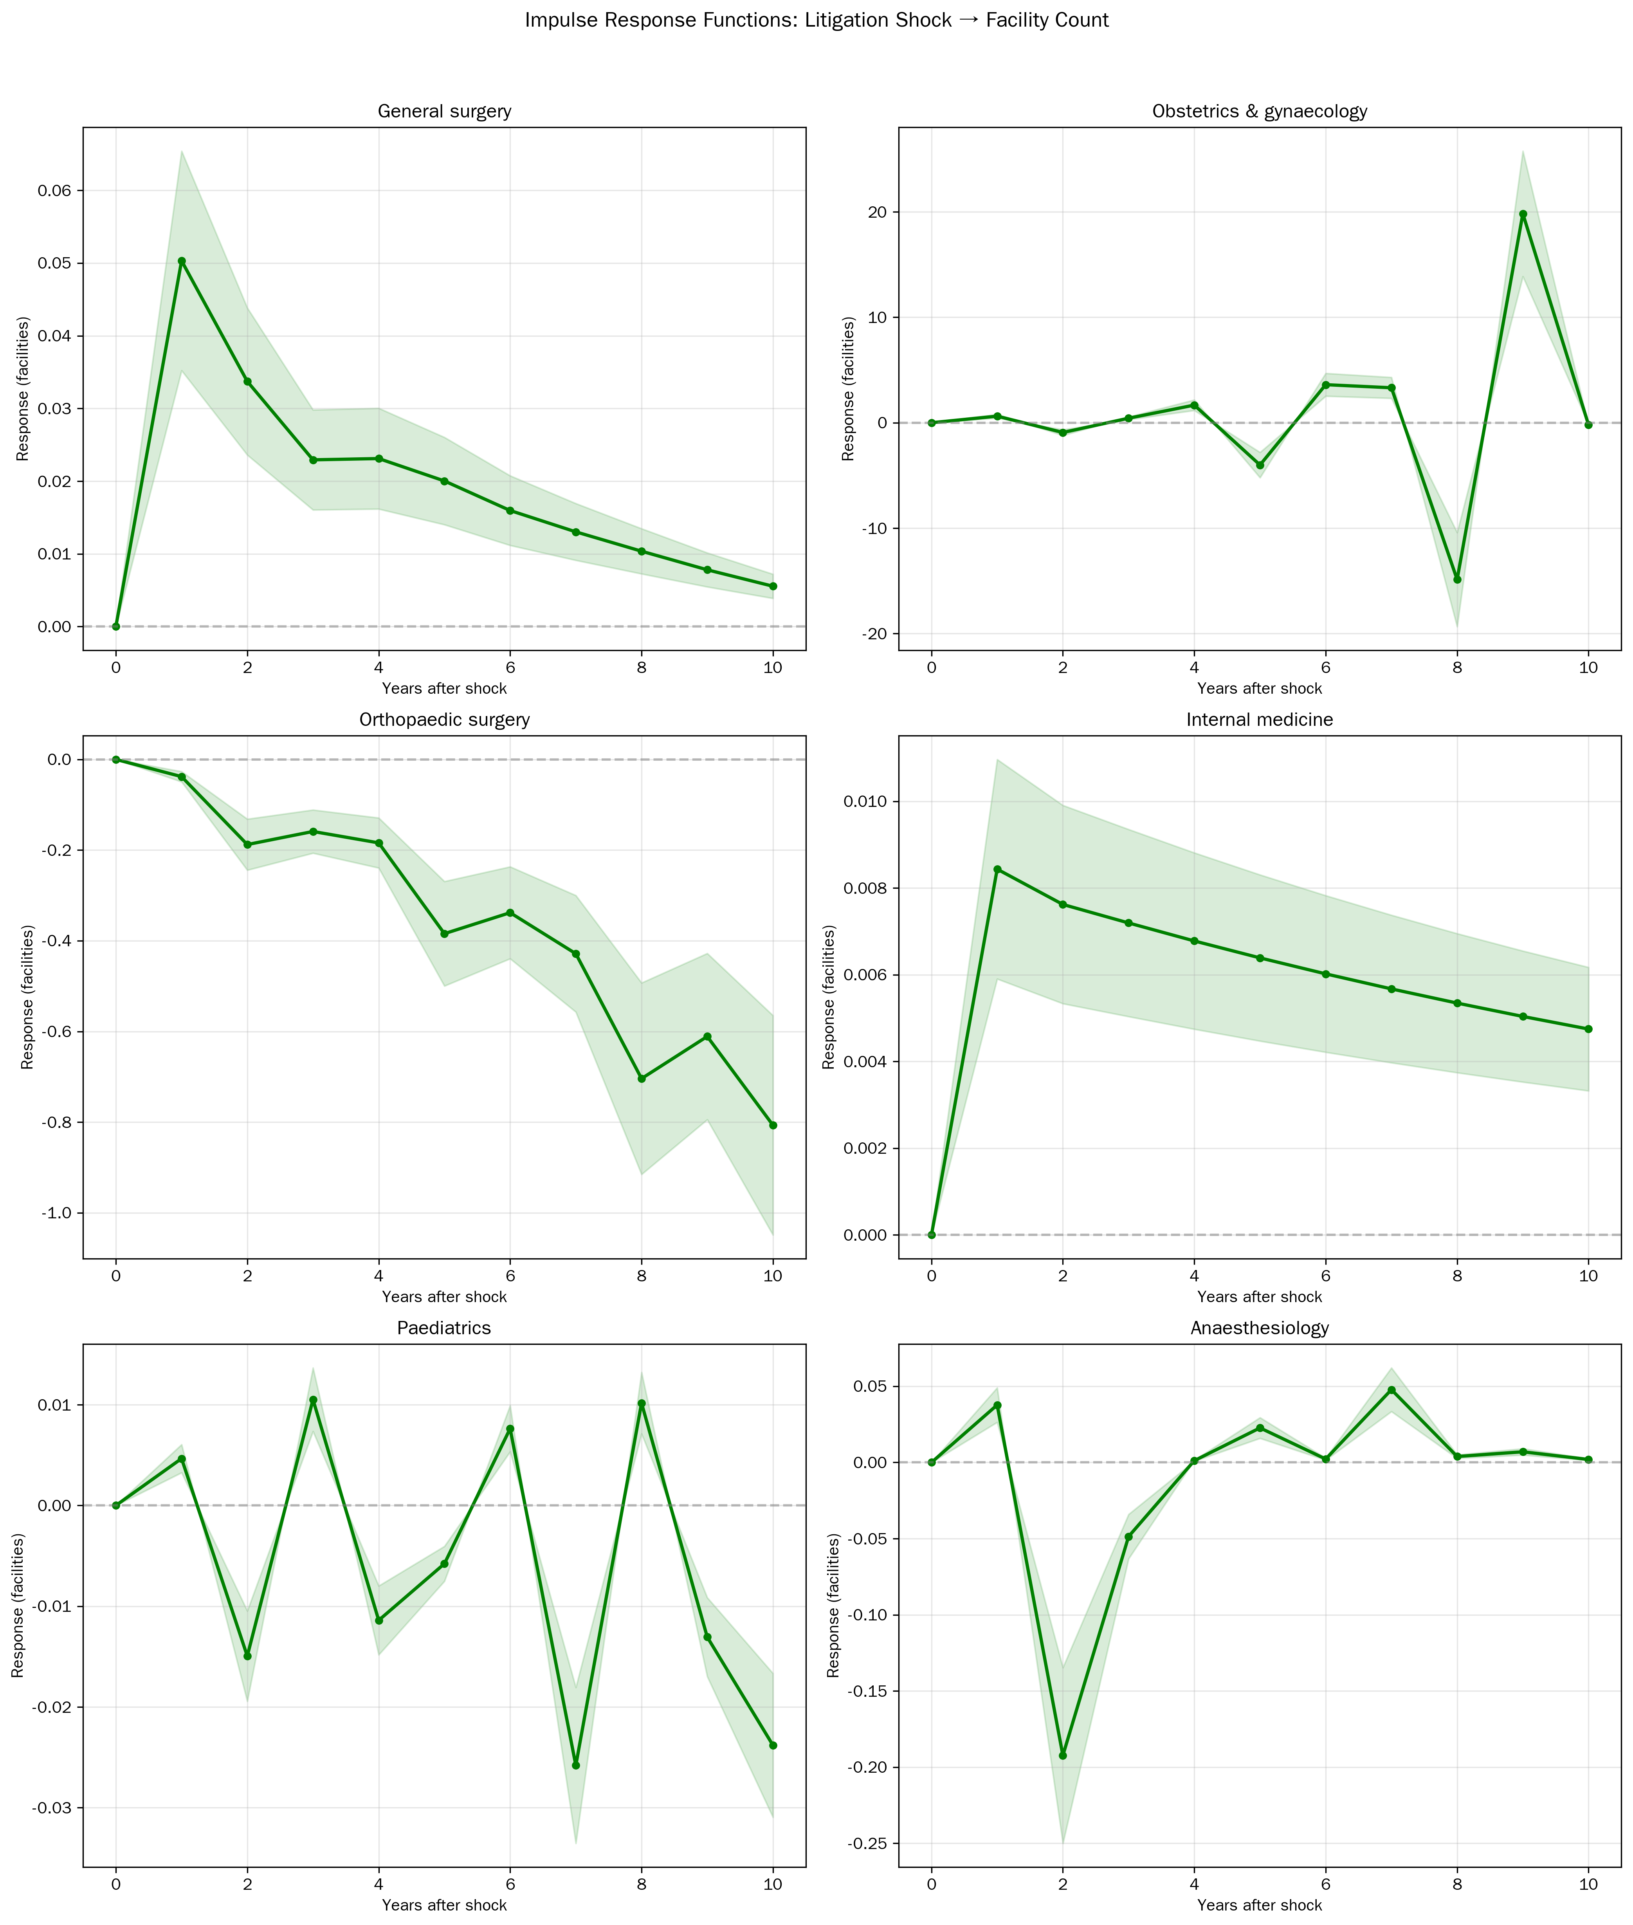
Supplementary Figure S1. IRF: Litigation → Facilities
Response of facility counts to a one-unit shock in litigation cases.

