Slide 1
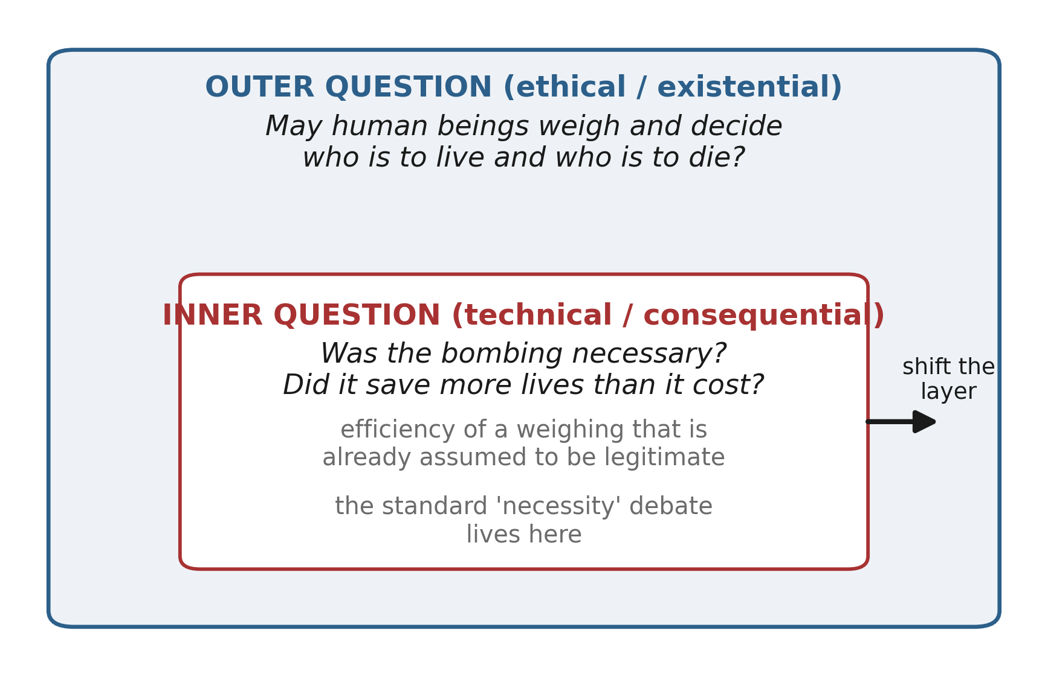
Figure 1. Two layers of the question
Figure 1. Two layers of the question. The standard “was it necessary?” debate audits a weighing from inside the calculus; the ethical question asks, from outside, whether such a weighing is ours to perform.

Slide 2
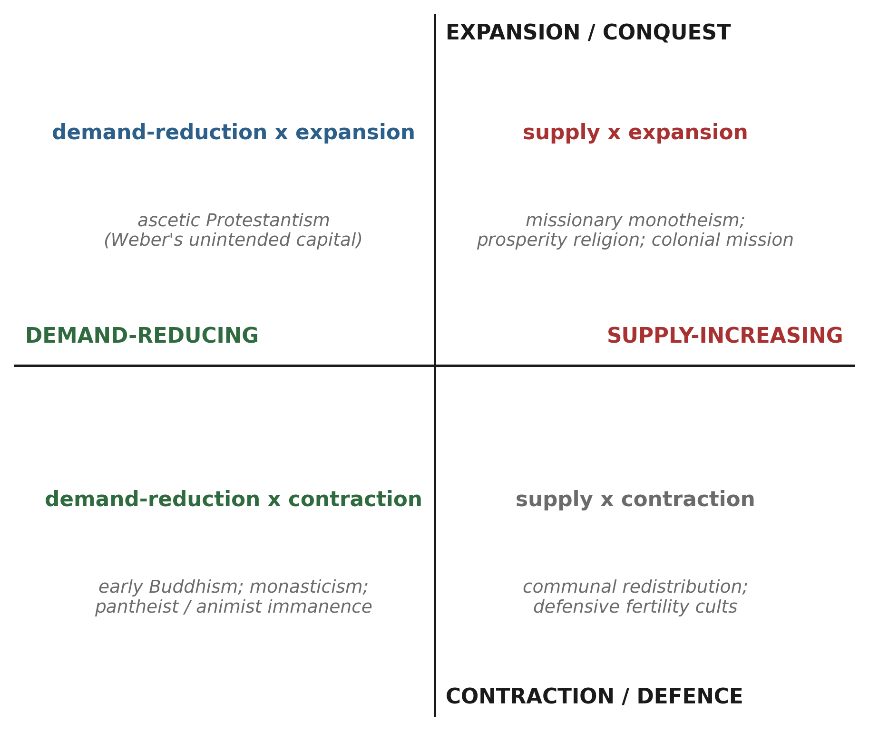
Figure 2. Supply–demand × expansion–contraction
Figure 2. Two independent axes—supply-increasing vs. demand-reducing, and expansion vs. contraction—with illustrative religious and economic types. The naive alignment of monotheism with expansion and pantheism with restraint holds only as a tendency; ascetic Protestantism and expansionist polytheism occupy the off-diagonal cells.

Slide 3
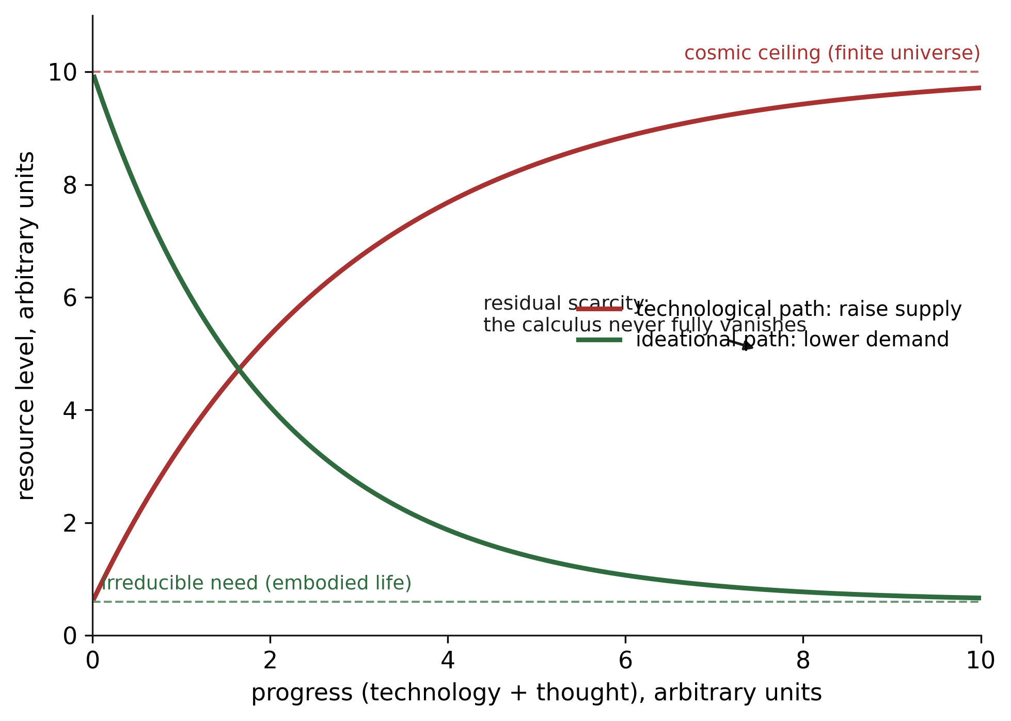
Figure 3. Asymptotic relief from the calculus
Figure 3. Asymptotic model of relief from the calculus. Raising supply approaches a cosmic ceiling; reducing demand approaches an irreducible floor set by embodied need. Neither reaches zero scarcity, so a residue of tragic weighing always remains; the claim is directional, not utopian.

