Slide 1
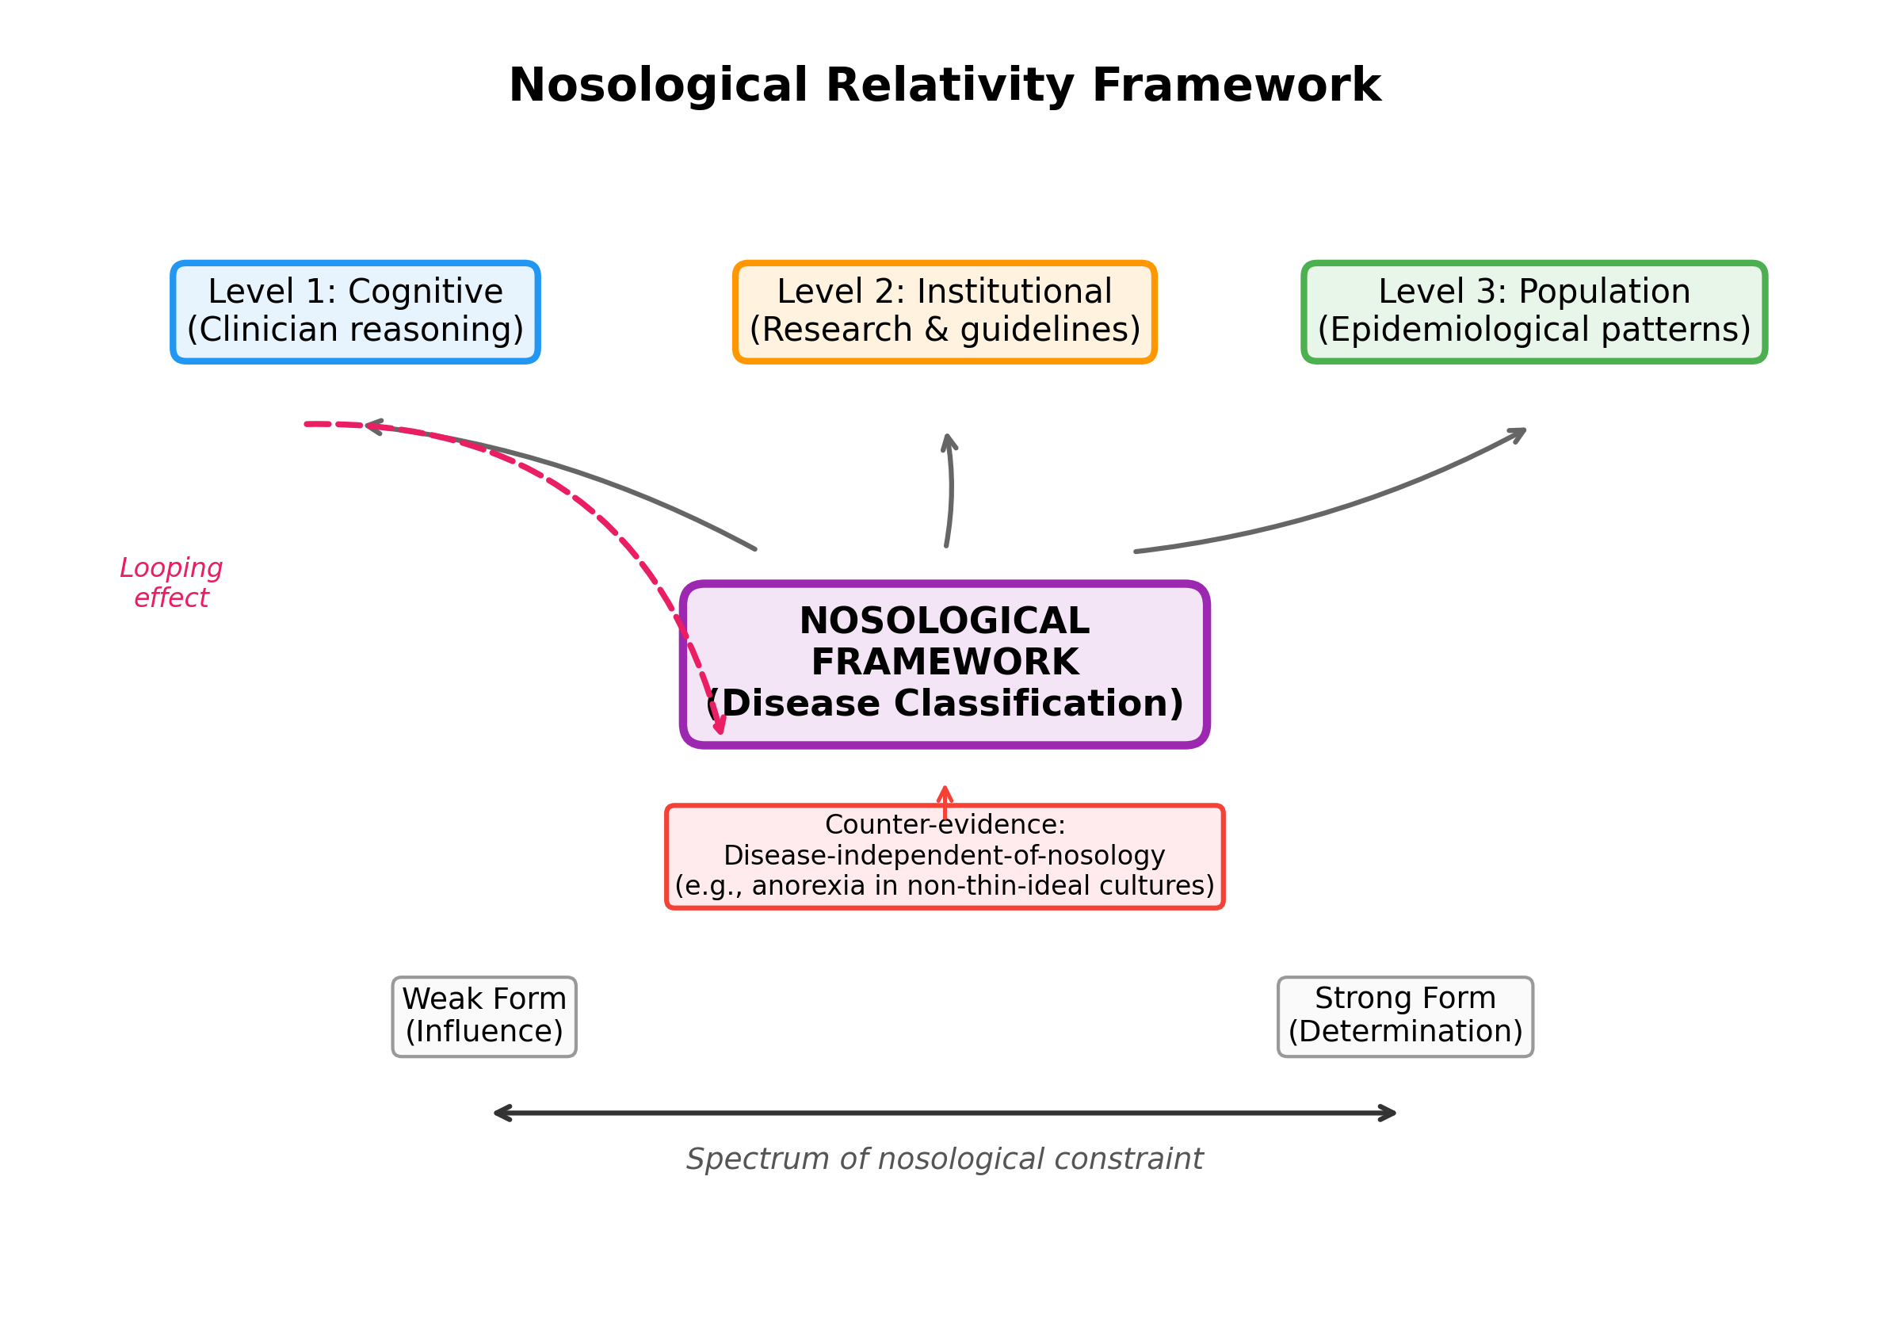
Fig. 1. The Nosological Relativity Framework
Nosological categories shape medical practice at three levels (cognitive, institutional, population) via the looping mechanism.

Slide 2
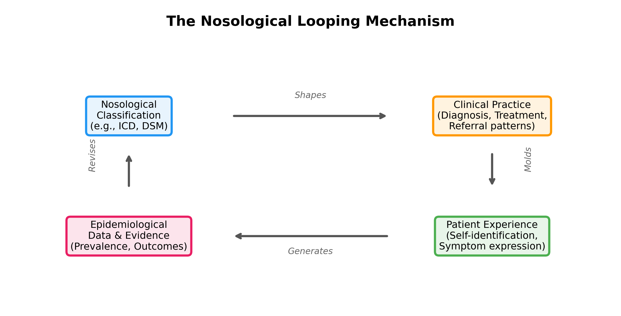
Fig. 2. The Nosological Looping Mechanism
A four-stage cycle: classification → practice → experience → data → classification.

