Slide 1
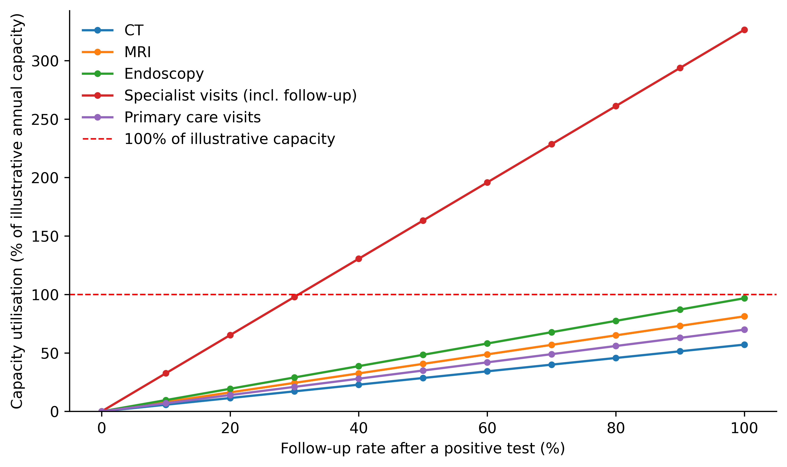
Figure 1
Capacity utilisation (%) for CT, MRI, endoscopy, specialist and primary care visits as the follow-up rate increases. Values above 100% indicate demand exceeding the illustrative annual capacity available for a direct-to-consumer screening wave.

Slide 2
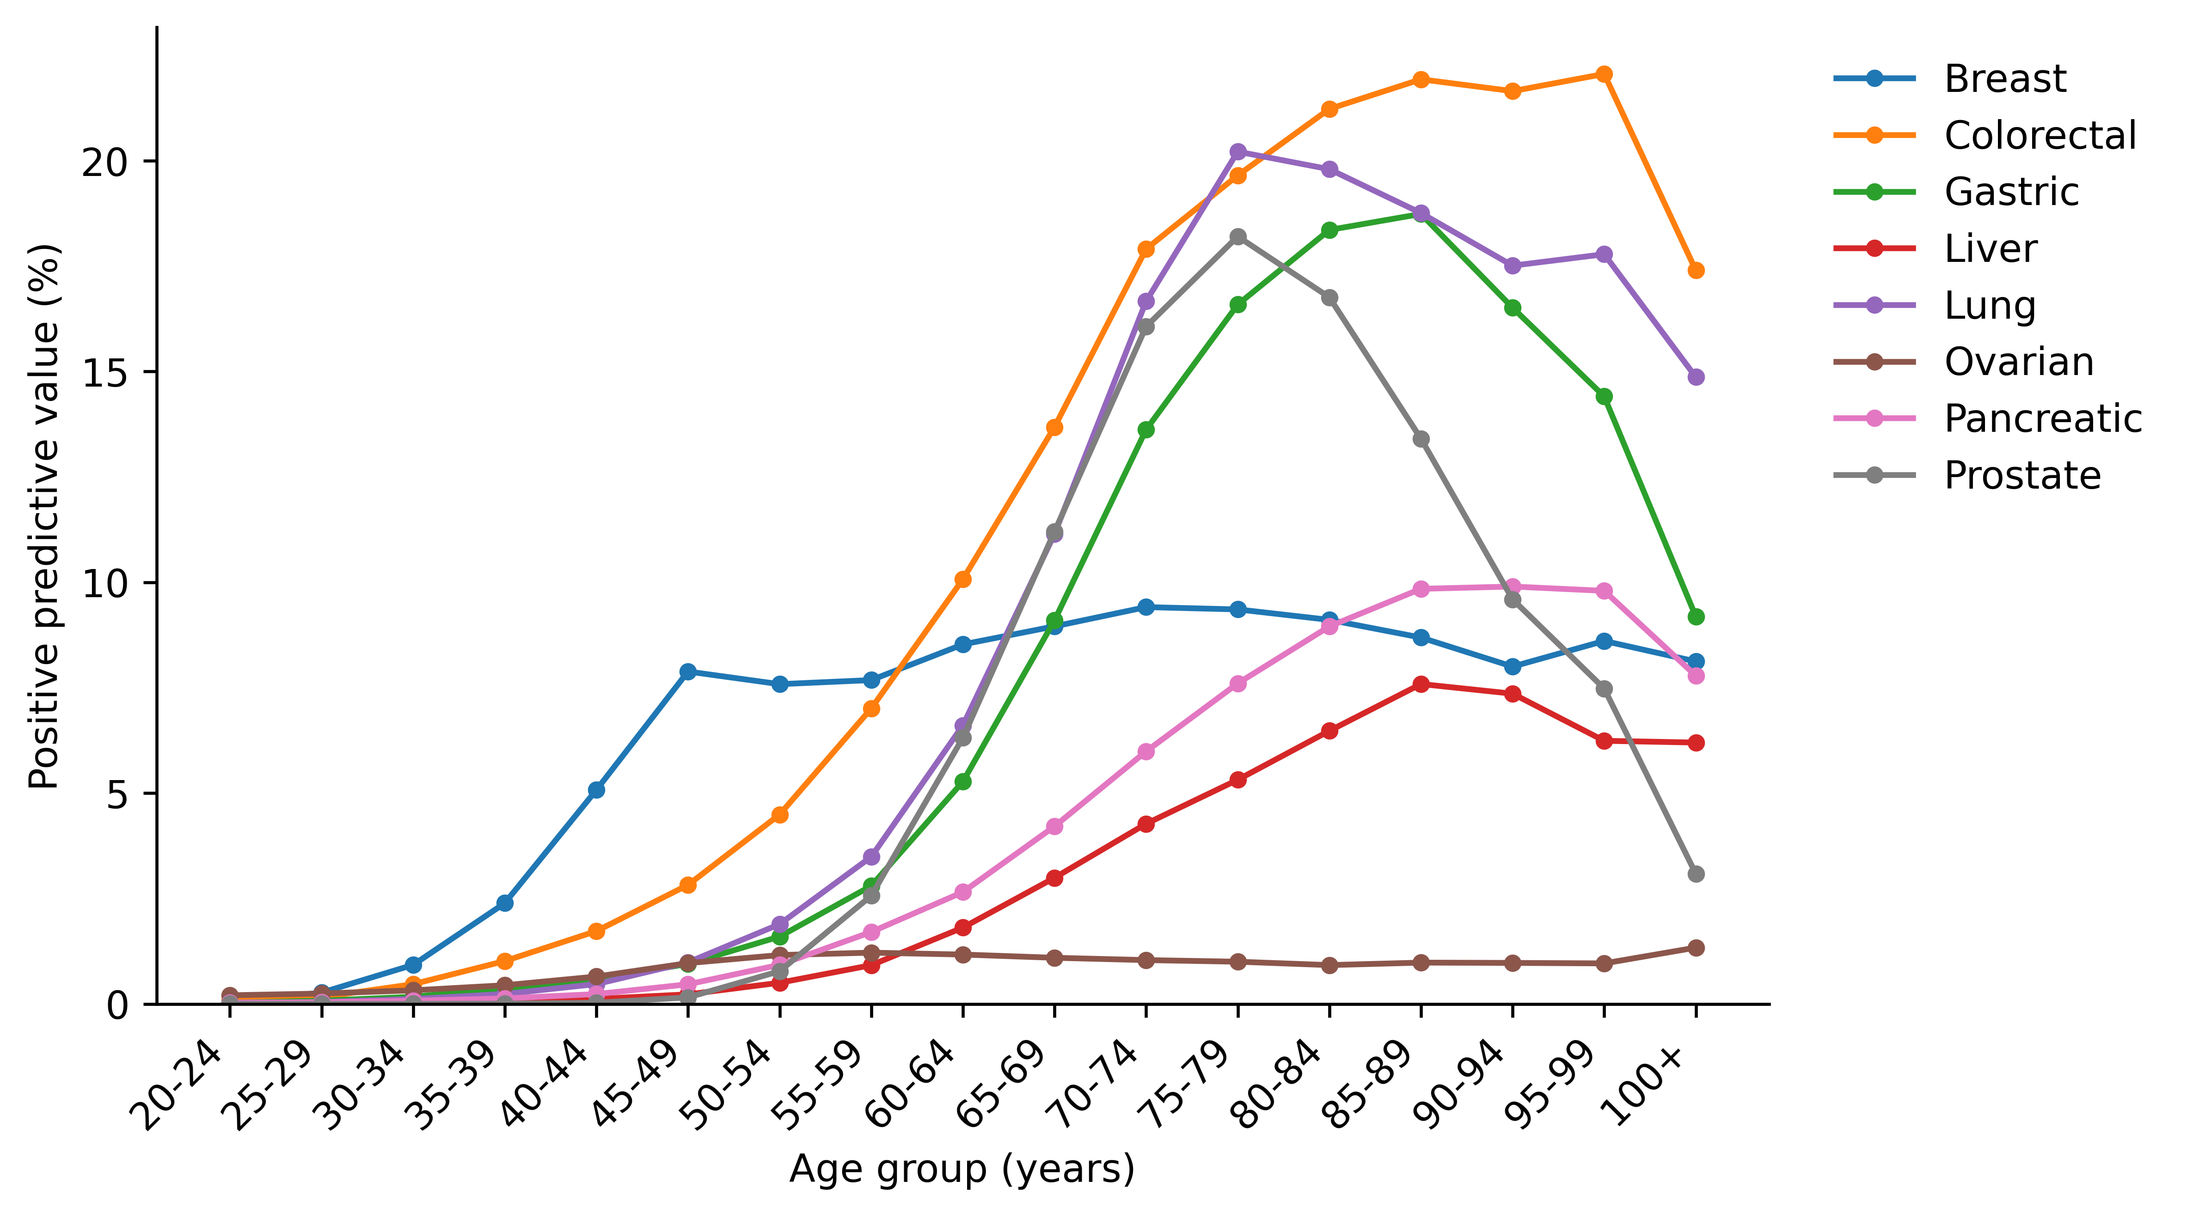
Figure 2
Age-specific positive predictive value for each cancer among adults aged 20 years and over, assuming sensitivity 0.70 and specificity 0.990 and using 2023 age-specific incidence as the prevalence proxy.

Slide 3
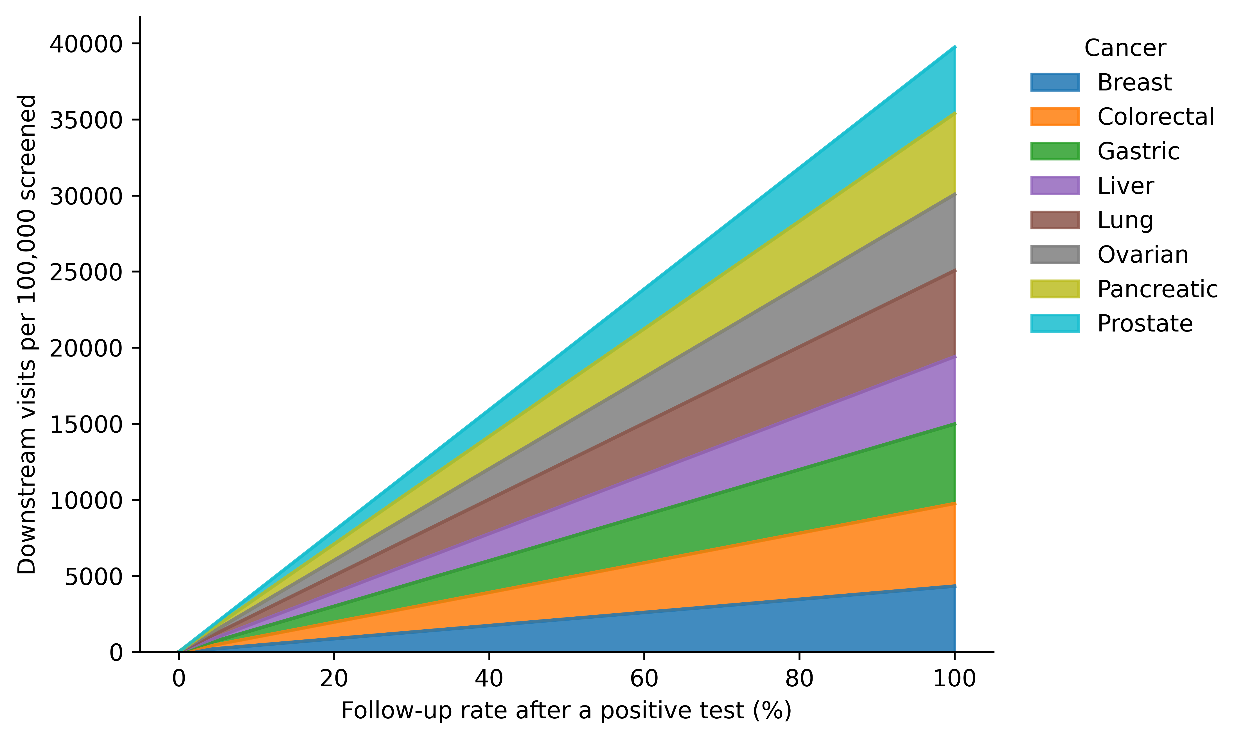
Supplementary Figure S1
Total downstream diagnostic, primary care and specialist visits generated by a blood-based MCED screening wave of 100,000 persons, by follow-up rate.

Slide 4
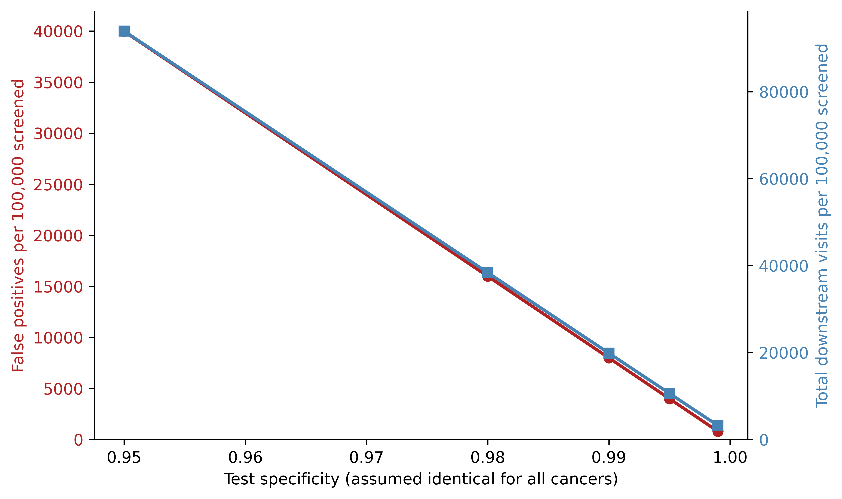
Supplementary Figure S2
False positives and total downstream visits per 100,000 screened across test specificity values (0.950-0.999) at a 50% follow-up rate.

Slide 5
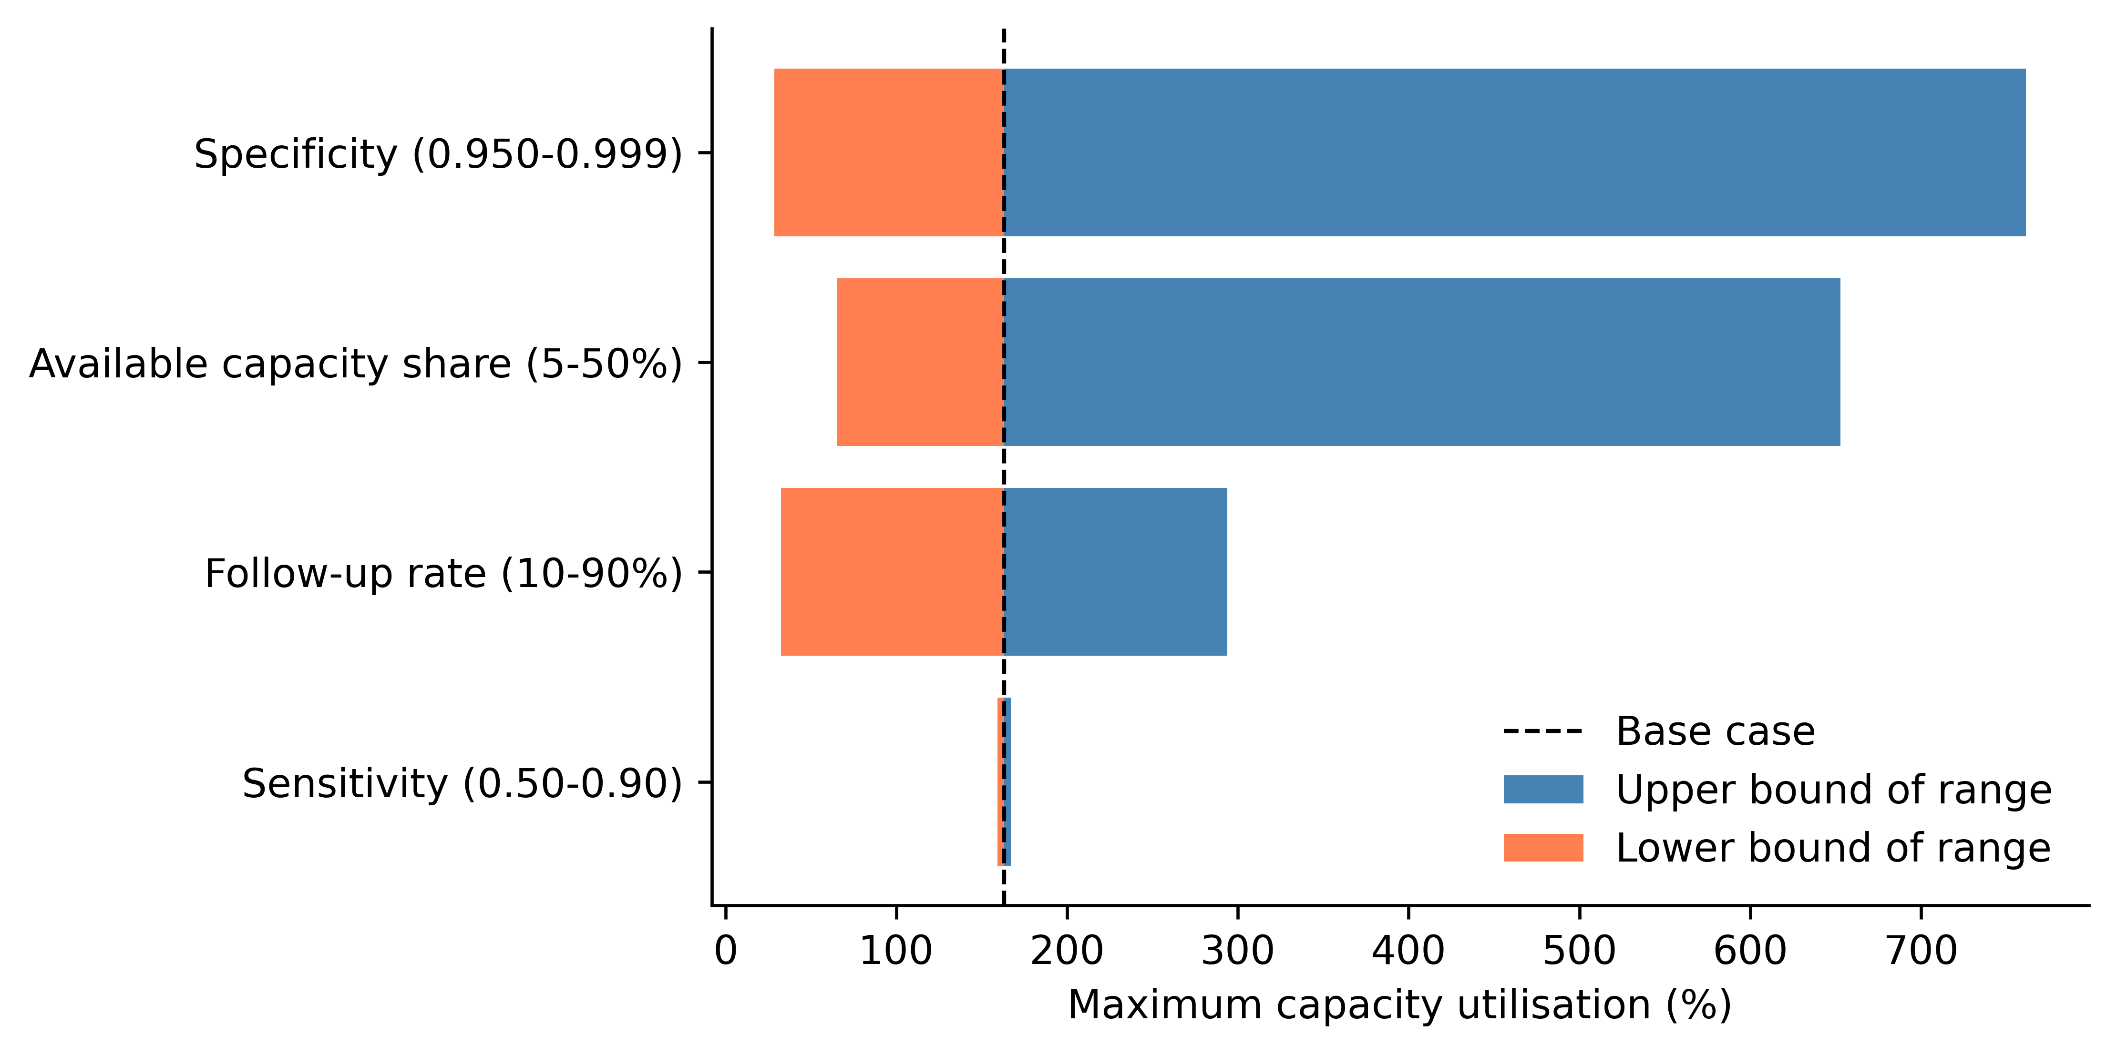
Supplementary Figure S3
Tornado diagram showing the effect of varying specificity, follow-up rate, available capacity share and sensitivity on maximum capacity utilisation (base case = 50% follow-up, 0.990 specificity, 0.70 sensitivity, 20% capacity share). Parameters are ordered by the width of their effect.

Slide 6
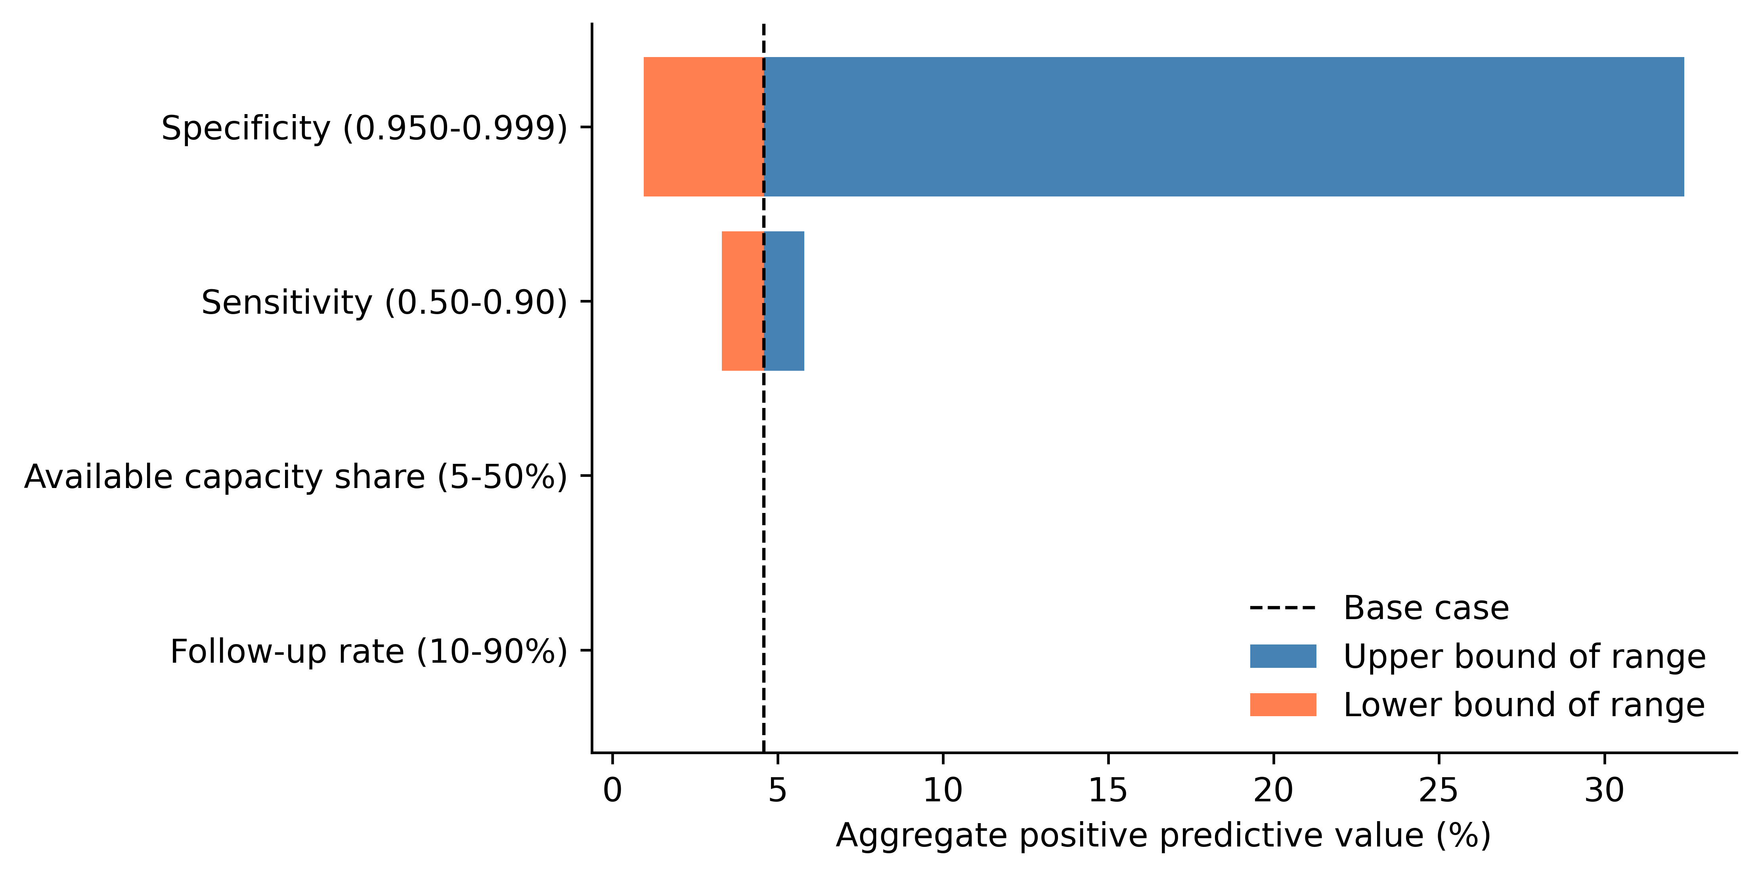
Supplementary Figure S4
Tornado diagram showing the effect of the same four parameters on aggregate positive predictive value.

Slide 7
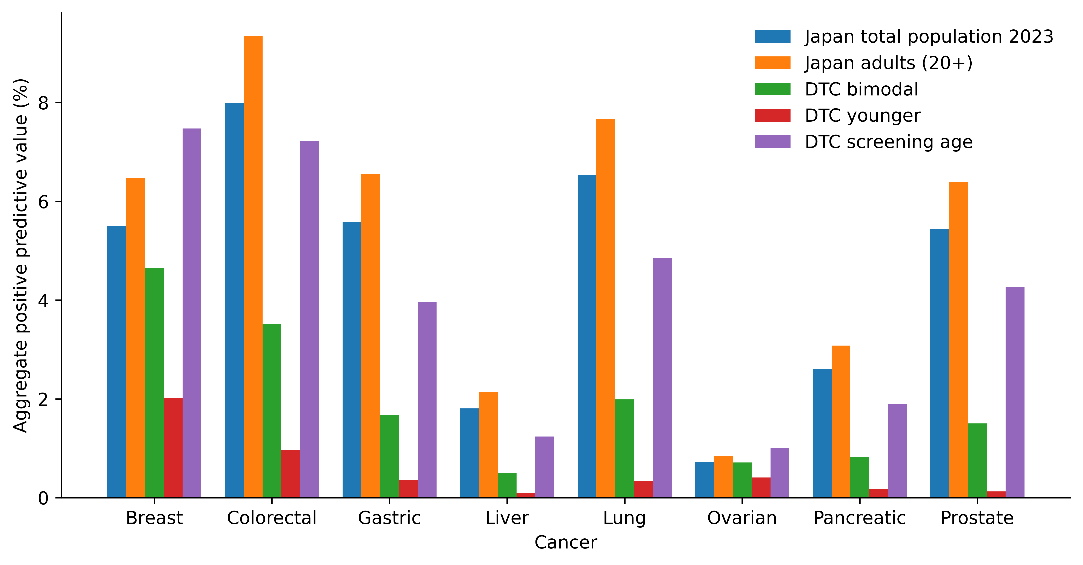
Supplementary Figure S5
Aggregate positive predictive value for each cancer type under the 2023 national total-population distribution and four hypothetical direct-to-consumer purchaser age profiles.

