Slide 1
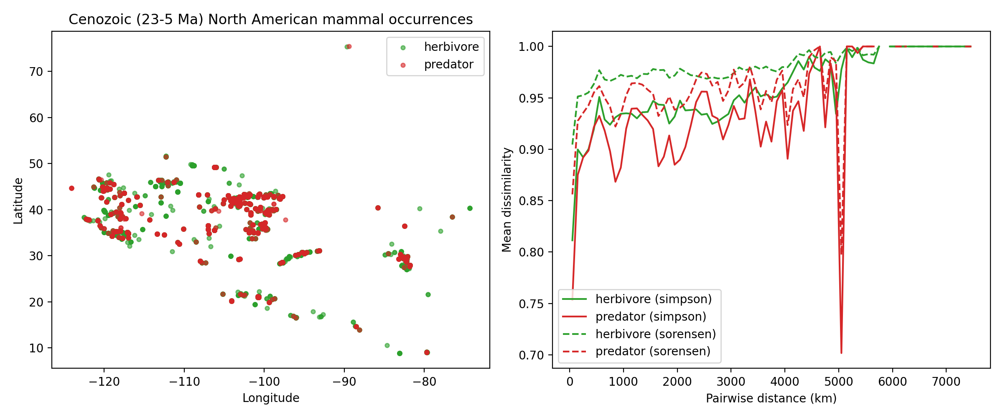
Figure 1. Cenozoic mammal occurrences and guild turnover vs distance
Simpson (solid) and Sorensen (dashed) turnover, herbivore vs predator.

Slide 2
Table 1. Sampling-pool sensitivity
correction | delta_beta_mean | lo95 | hi95 | prop_gt0 | n_rep
raw | -0.0284 | -0.0284 | -0.0284 | 0.0 | 1
no_dominant_quarries | -0.0252 | -0.0252 | -0.0252 | 0.0 | 1
no_singletons | -0.0104 | -0.0104 | -0.0104 | 0.0 | 1
equalized_collections | -0.0283 | -0.0338 | -0.0225 | 0.0 | 999
spatial_thinning_1deg | -0.0263 | -0.0504 | -0.0045 | 0.001 | 999

Slide 3
Table 2. Temporal aggregation
binning | delta_beta | delta_vs_pooled
pooled | -0.0284 | 0.0
epoch | -0.0873 | -0.059
ma5 | -0.0807 | -0.0524
ma1 | -0.0784 | -0.05

Slide 4
Table 3. Genus-pool nulls
null | observed | null_mean | null_lo | null_hi | quantile | n_rep | notes
size_matched_split | -0.0284 | -0.0288 | -0.0805 | 0.0037 | 0.3413 | 999 | random 131/378 genus splits
label_shuffle | -0.0284 | -0.0278 | -0.0805 | 0.003 | 0.3273 | 999 | permute guild labels across genera, keep pool sizes

Slide 5
Table 4. Observation-model matrix (condensed)
system | fossil_or_modern | temporal_resolution | preservation_bias | observer_bias | major_correction_method
dinosaur | fossil | formation-pooled (~10 Myr) | high (taphonomic filter; monodominant bone beds) | collector/quarry bias | dominant-quarry + singleton exclusion; equalized collections
cenozoic | fossil | interval-pooled 23-5 Ma (subepoch sensitivity) | high (mass-death beds; cave/tarpit accumulations) | collector bias (screen-wash vs quarry) | same five-correction battery + aggregation ladder
quaternary | fossil | fine (100-20 kyr secondary; coarse primary) | high (cave/tarpit predator-accumulated) | collector bias | same battery + fine-resolution ladder
ancient_marine | fossil | stage/subepoch (condensation) | very high (mineralization; facies tracking; condensation) | collection-intensity bias | facies-stratified turnover + intensity normalization + Lager
modern_terrestrial | modern | annual (multi-decade) | none | high (observer turnover/identity) | route demeaning; prevalence inclusion; matched-environment c
modern_marine | modern | event-based (3-14 d) | none | platform/effort bias | tow-anchored matching; LOEO; placebos/reverse-time; capelin

