Slide 1
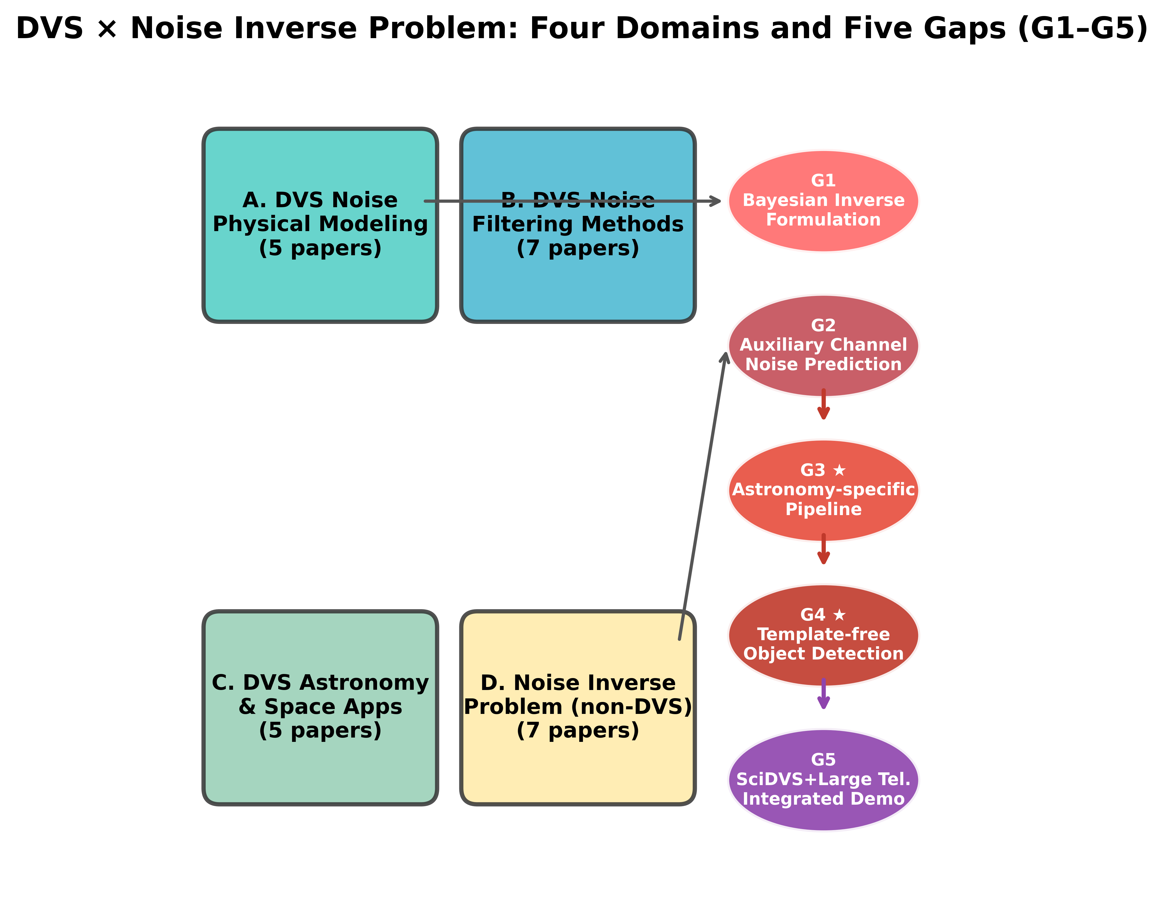
Fig. 1: DVS × Noise Inverse Problem — Four Domains and Five Gaps (G1–G5)
Prior work categorized into four domains (A: DVS noise modeling, B: DVS noise filtering, C: DVS astronomical applications, D: Noise inverse problem in non-DVS fields). Five gaps (G1–G5) identified. G3 (astronomy pipeline) and G4 (template-free detection) are the highest-priority unexplored areas.

Slide 2
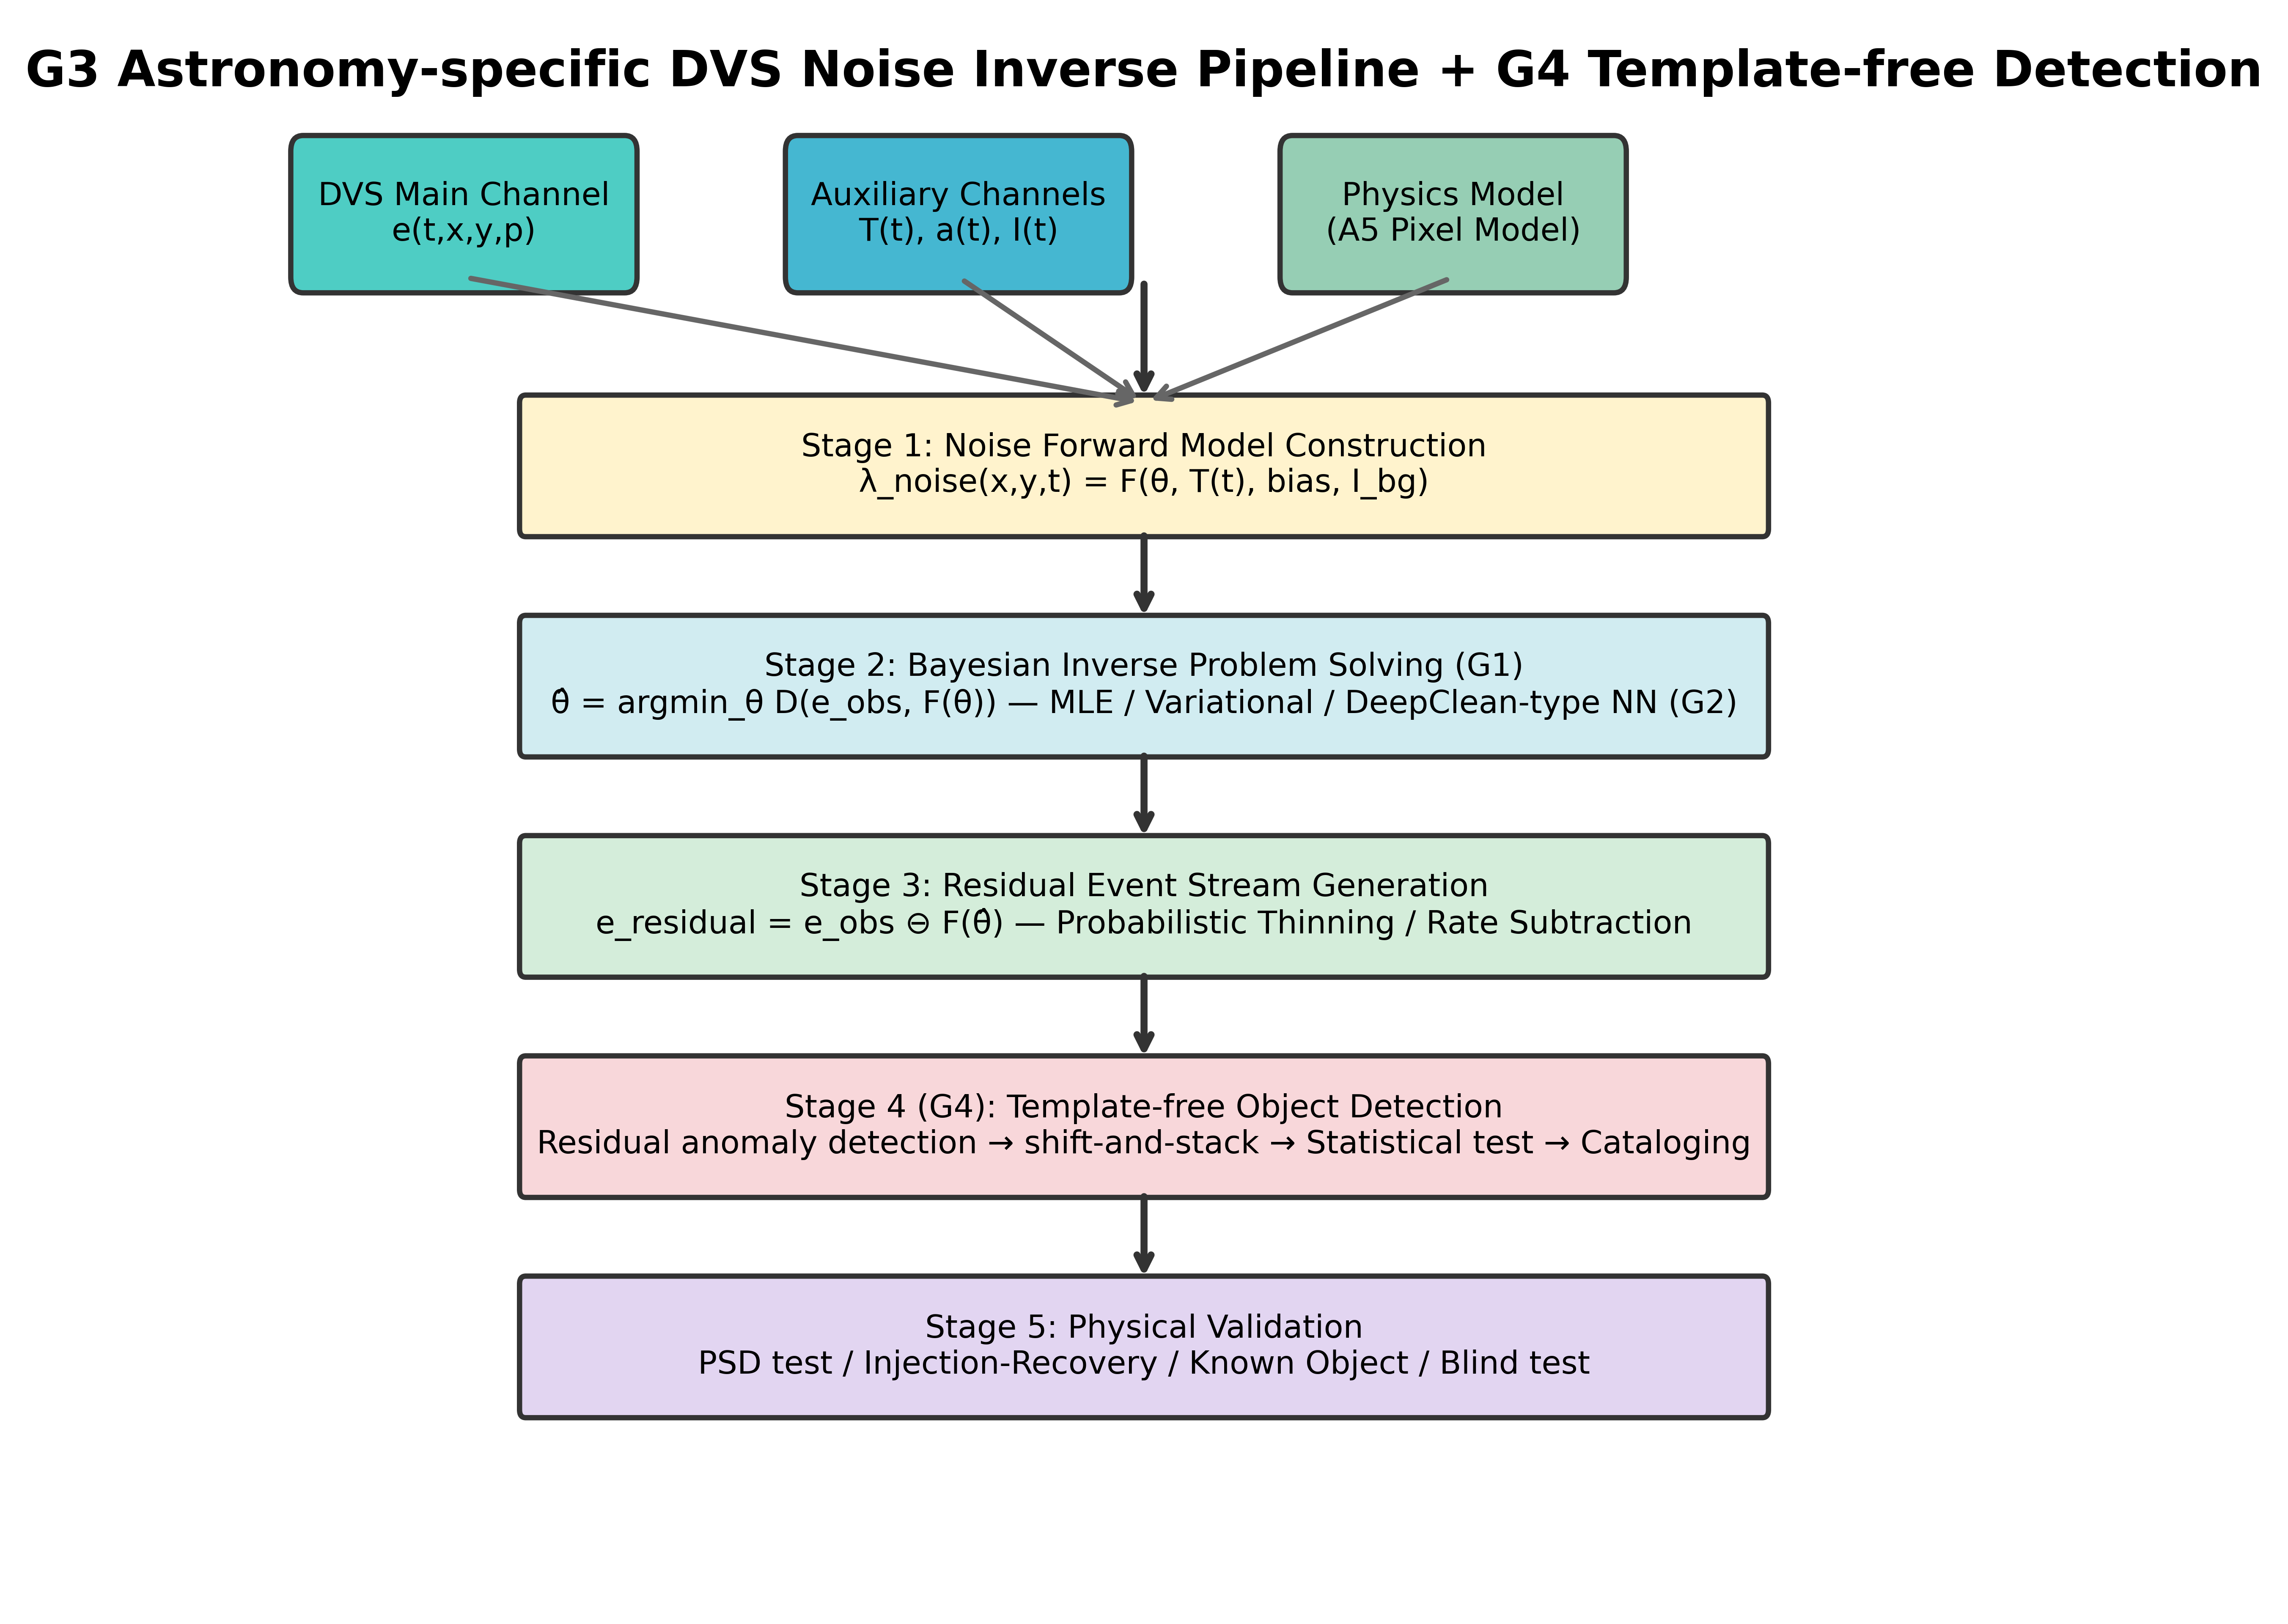
Fig. 2: G3 Astronomy Pipeline + G4 Template-free Detection
Four-stage architecture transplanting the LIGO noise reconstruction pipeline (Vajente et al. 2020) to DVS astronomy (G3). Stage 4 integrates G4 template-free detection—solving for noise and discovering objects in residuals without signal templates. Inputs: DVS main channel, auxiliary sensors, and physics-based pixel model (A5).

