Slide 1
Noise removal for dynamic vision sensors: a physics-informed stochastic resonance framework
IEEE Sensors Journal submission figures

Slide 2
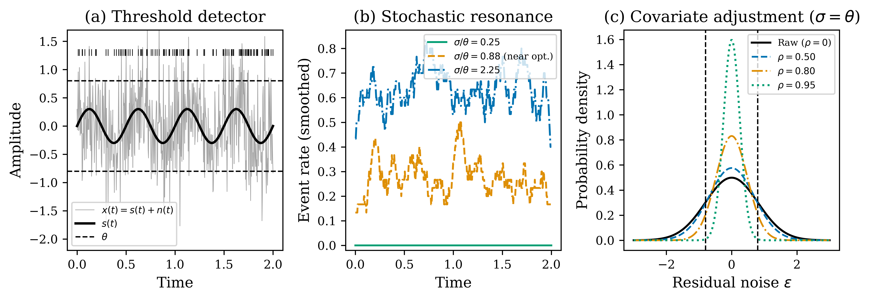
Figure 1
Conceptual schematic of covariate-adjusted stochastic resonance. (a) Threshold detector; (b) SR effect; (c) covariate adjustment narrows residual noise and shifts the operating point.

Slide 3
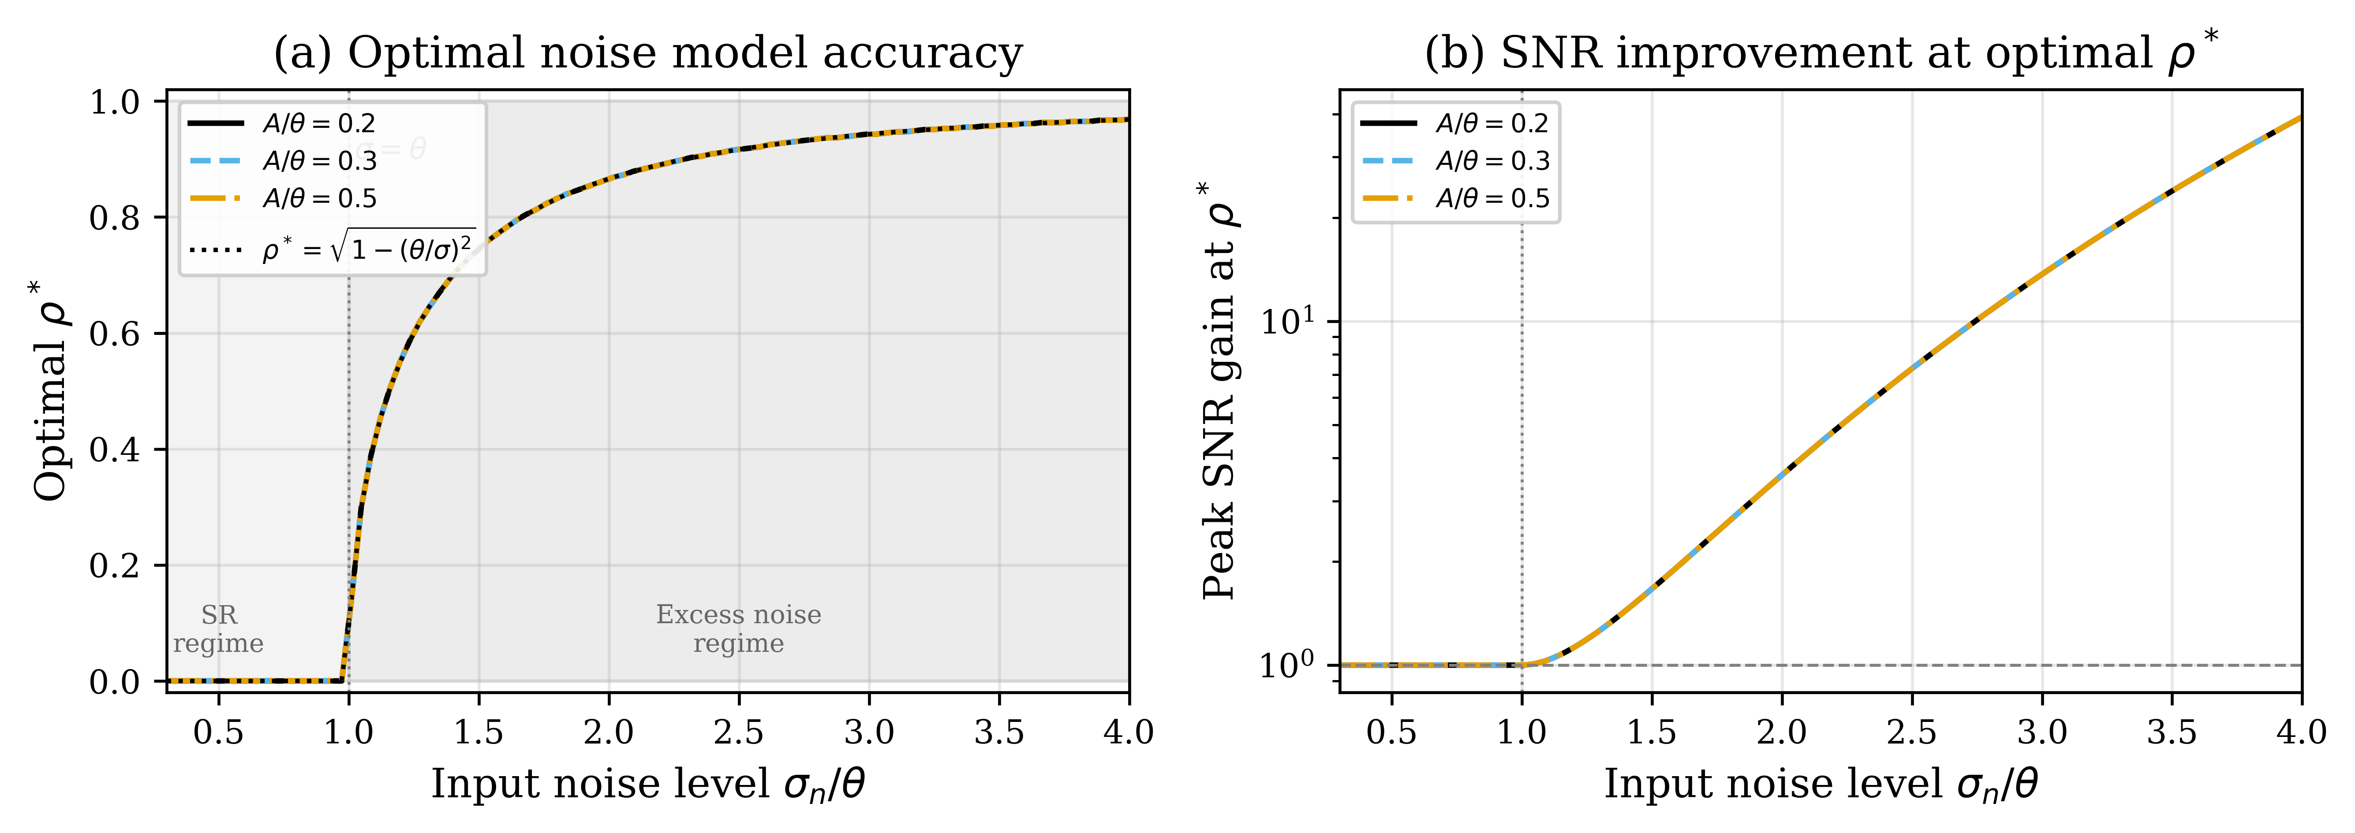
Figure 2
Optimal noise model accuracy ρ*. (a) ρ* vs. input noise; yellow: SR regime, blue: excess-noise regime. (b) Peak SNR gain vs. σ/θ.

Slide 4
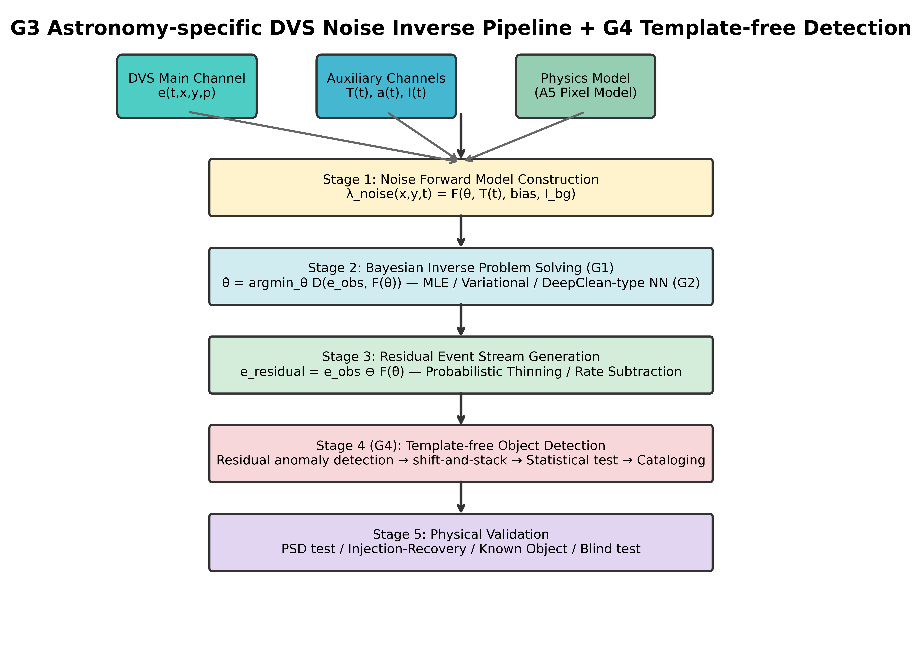
Figure 3
PI-DC-DVS pipeline: (1) A5 noise model + auxiliary channels; (2) Bayesian inverse solution; (3) probabilistic thinning; (4) template-free detection; (5) physical validation.

Slide 5
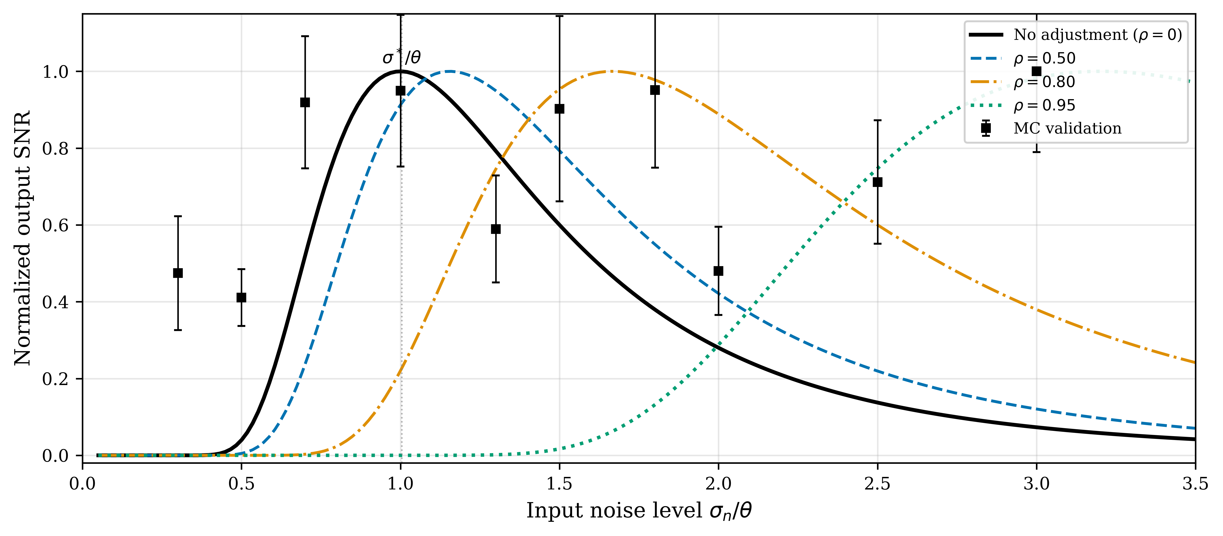
Figure 4
Stochastic resonance curves (A/θ = 0.3). Solid lines: analytical; squares: Monte Carlo. Covariate adjustment shifts the peak rightward.

Slide 6
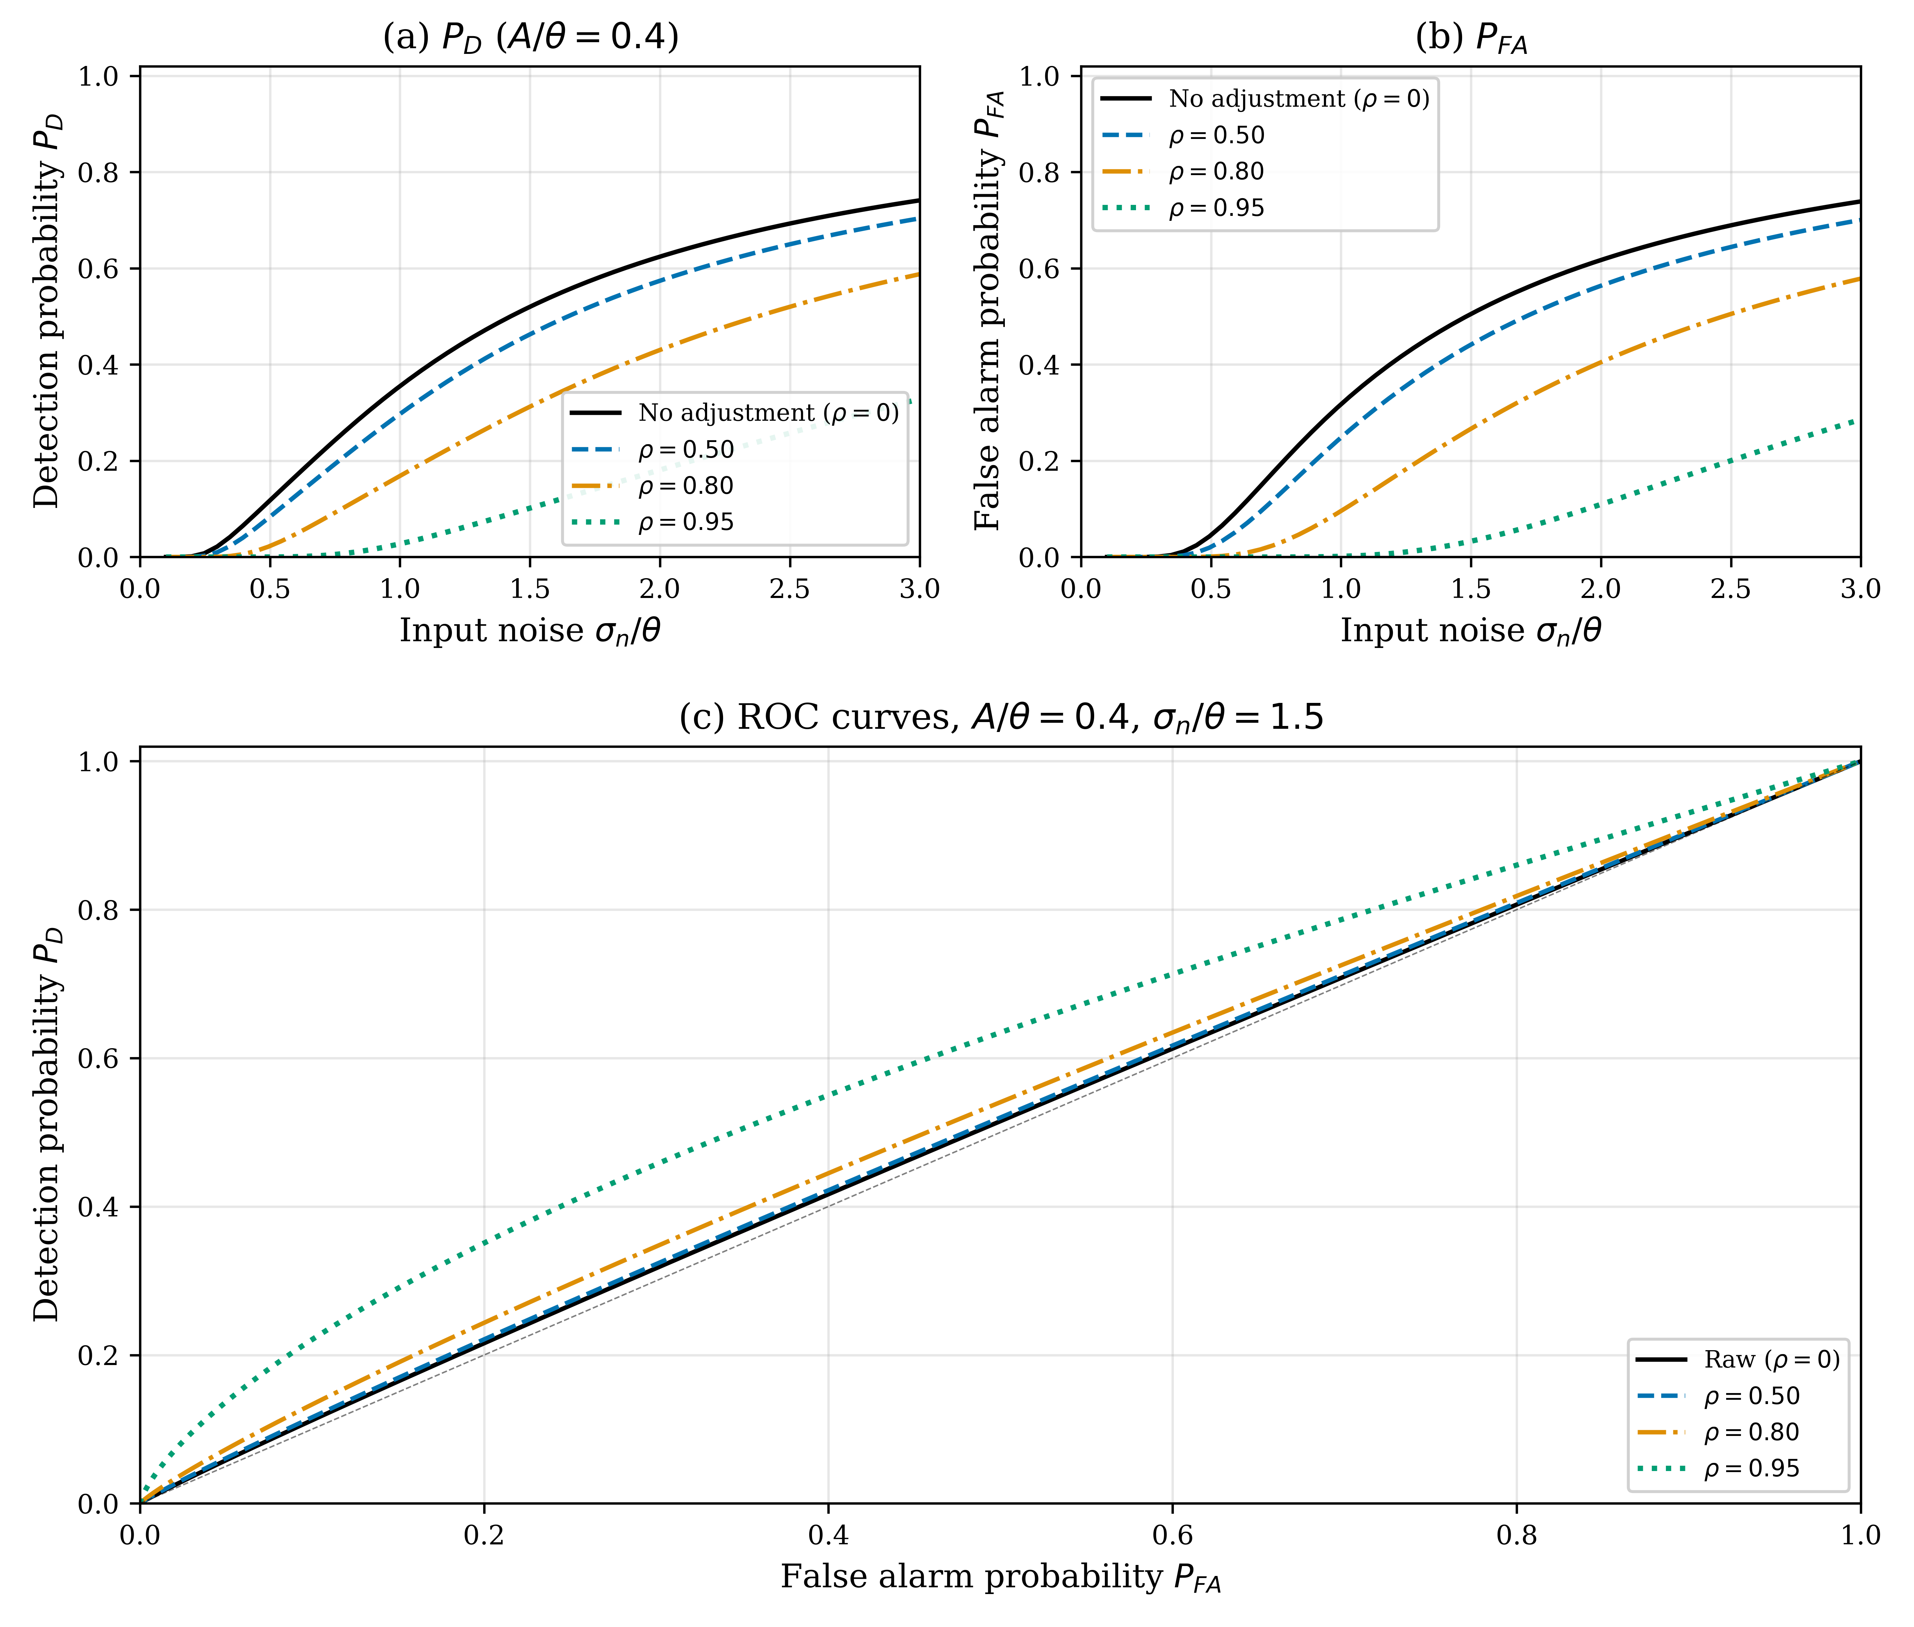
Figure 5
Detection and classification performance (A/θ = 0.4). (a) P_D; (b) P_FA; (c) ROC curves at σ_n/θ = 1.5.

Slide 7
Figure 6
Experimental evaluation on EBSSA. (a) NRR, (b) SPR, (c) F1, (d) ROC-AUC, (e) AUC comparison, (f) NRR vs. SPR trade-off.

Slide 8
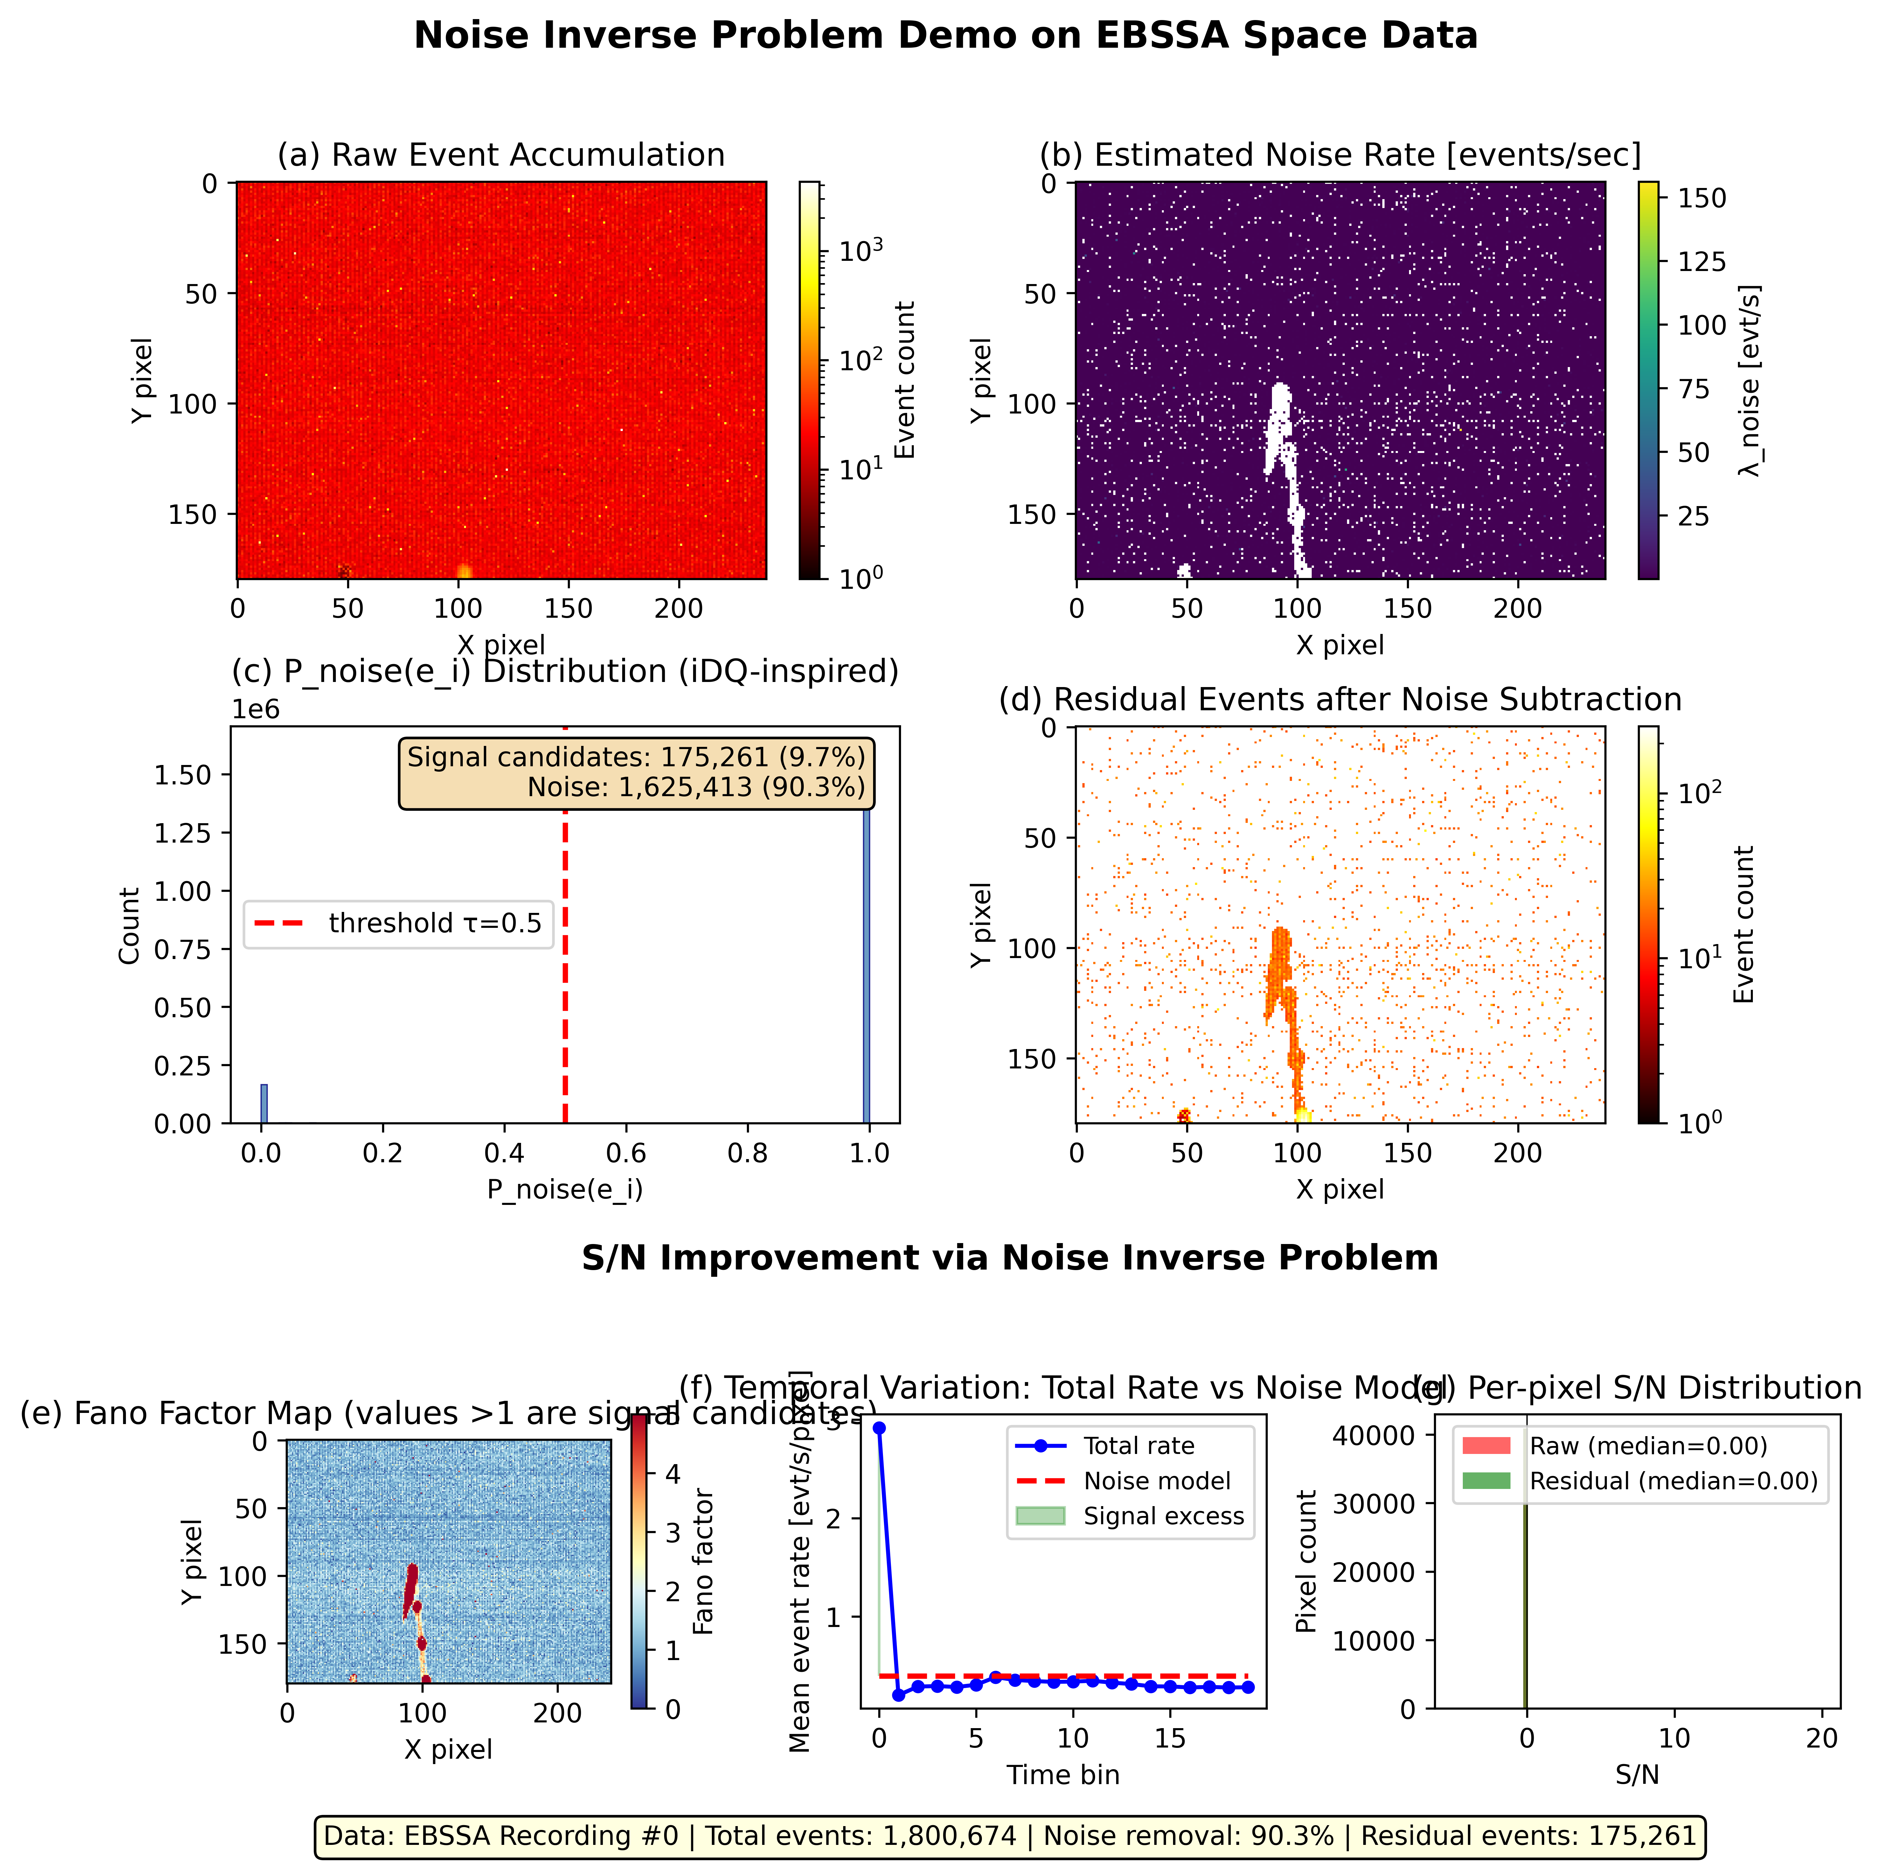
Figure 7
Proof-of-concept on EBSSA Recording #0. (a) Raw events; (b) noise rate map; (c) per-event noise probability; (d) residual events; (e) Fano factor map; (f) temporal rate; (g) per-pixel S/N.

Slide 9
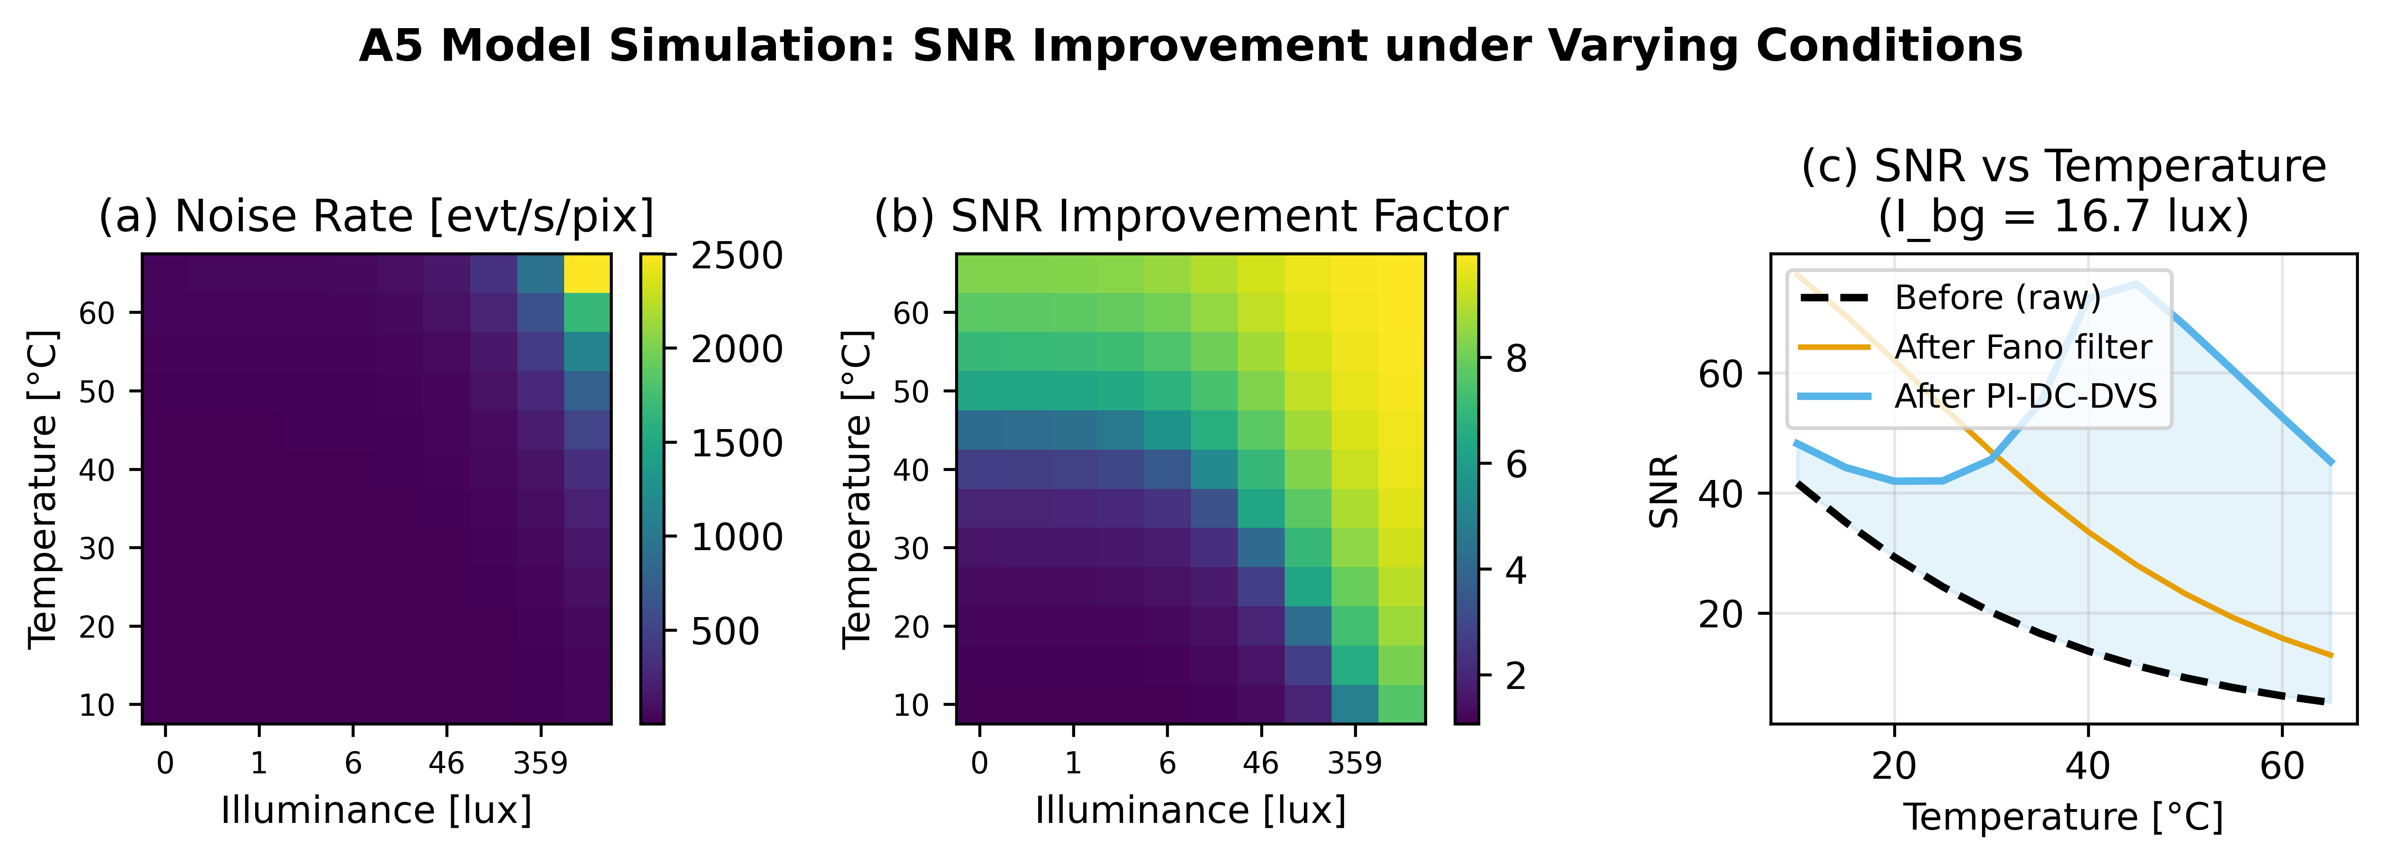
Supplementary Figure S1
A5-based noise rate simulation. (a) Predicted noise rate [evt/s/pix]; (b) SNR improvement factor at 90% model accuracy; (c) SNR vs. temperature at fixed illuminance.

