Slide 1
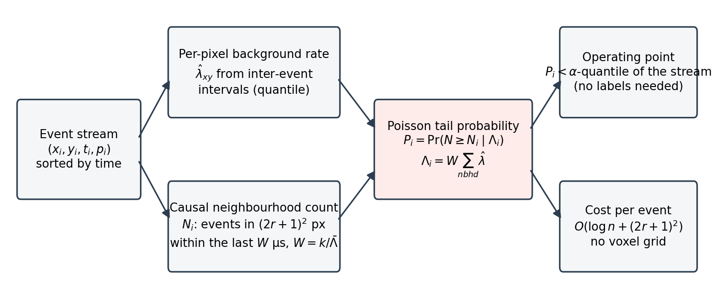
Fig. 1 Event-driven Poisson likelihood-ratio detector
Each event is scored from the estimated background rate of its neighbourhood and the number of events that arrived in that neighbourhood during the preceding window; the tail probability is the noise probability, so the operating point can be set from a false-alarm budget without labels and no voxel grid is constructed.

Slide 2
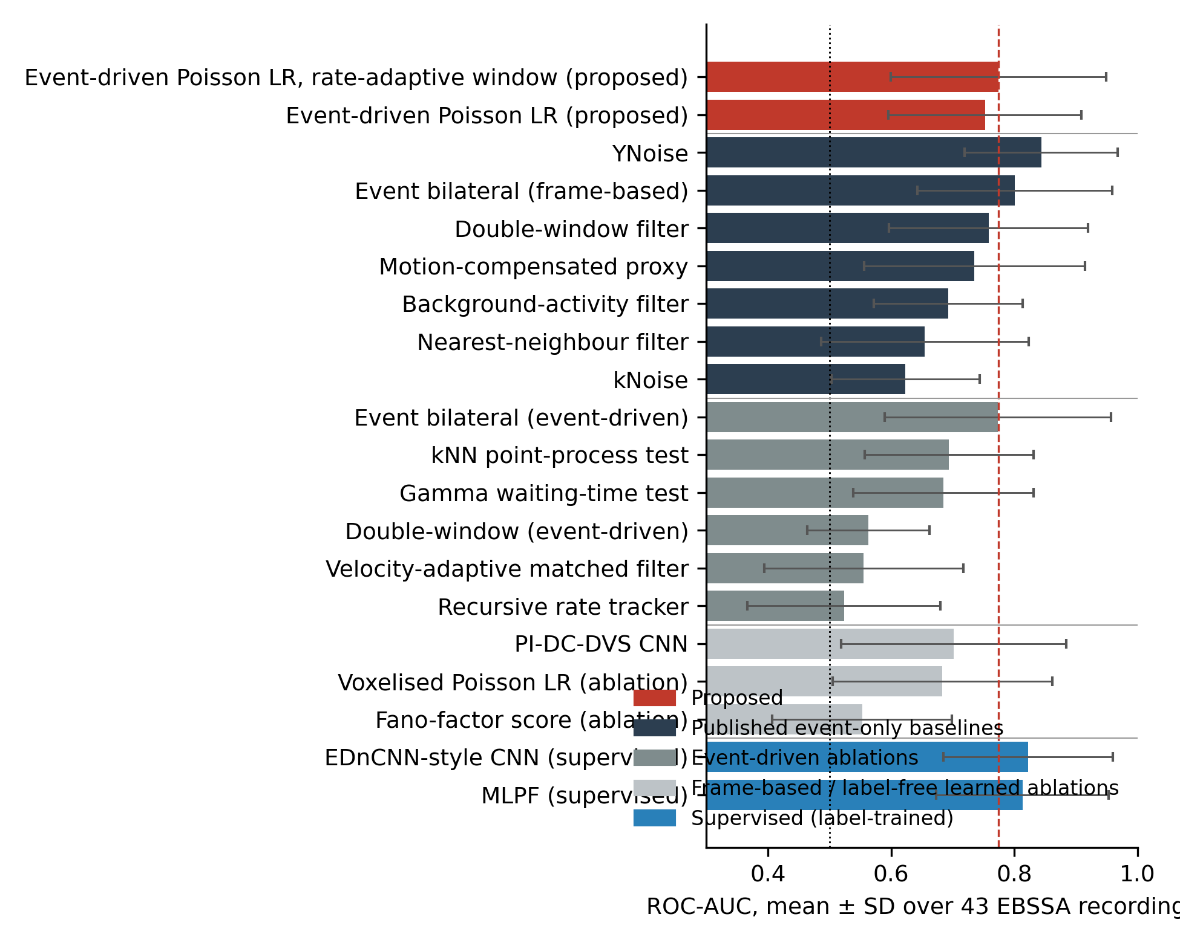
Fig. 2 Detection performance across methods
Mean ROC-AUC with standard deviation over the 43 EBSSA recordings. Dashed line: proposed detector; dotted line: chance. Colours group the proposed method, published unsupervised event filters, event-driven ablations, frame-based and label-free learned ablations, and supervised networks.

Slide 3
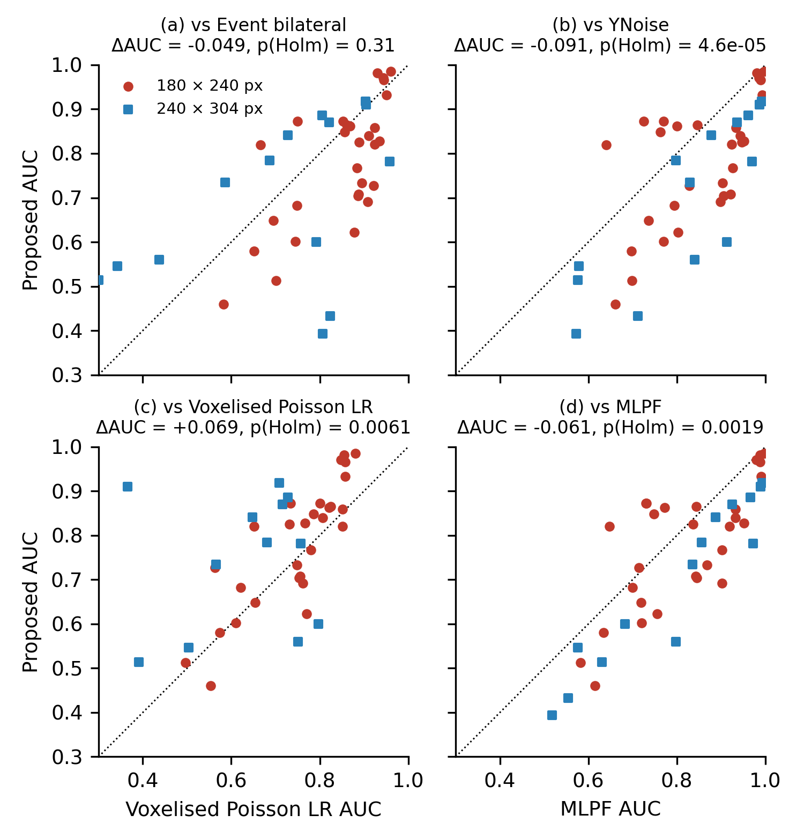
Fig. 3 Per-recording paired comparison
Per-recording ROC-AUC of the proposed detector against (a) the event bilateral filter, (b) YNoise, (c) its voxelised, frame-based form and (d) the supervised MLPF. Circles: 180 x 240-pixel sensor; squares: 240 x 304-pixel sensor. Points above the diagonal favour the proposed detector.

Slide 4
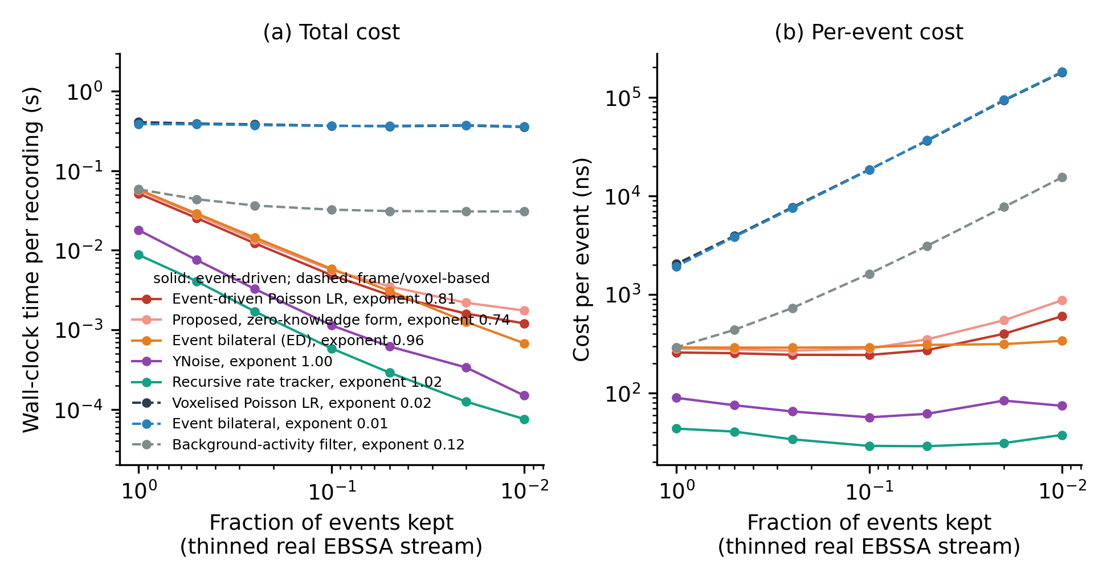
Fig. 4 Computational cost versus event sparsity
(a) Wall-clock time per recording and (b) time per event as a real EBSSA stream is thinned (medians over 3 repeats). Solid: event-driven methods; dashed: frame- or voxel-based methods. Legend entries give the fitted cost exponent.

Slide 5
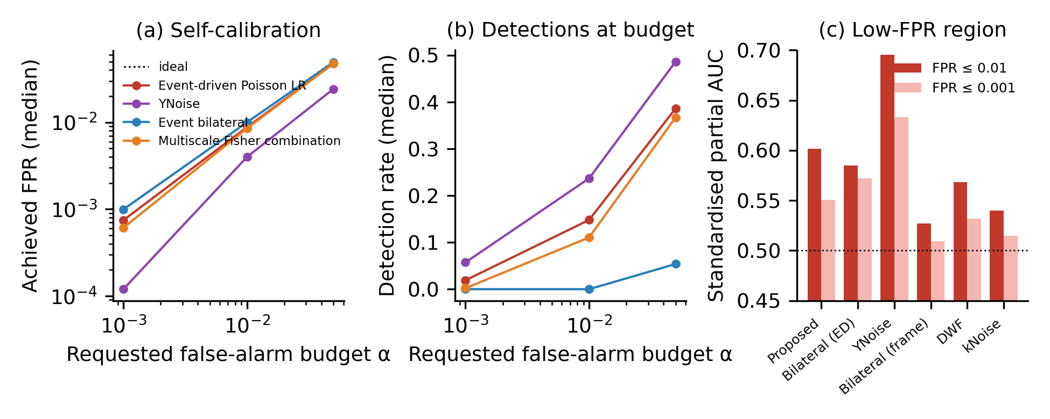
Fig. 5 Self-calibrated operating points
(a) Median achieved false-positive rate against the requested budget when each score is cut at its own quantile; dotted line: ideal. (b) Median detection rate at the same budgets. (c) Standardised partial AUC below false-positive rates of 0.01 and 0.001 (0.5 is chance).

Slide 6
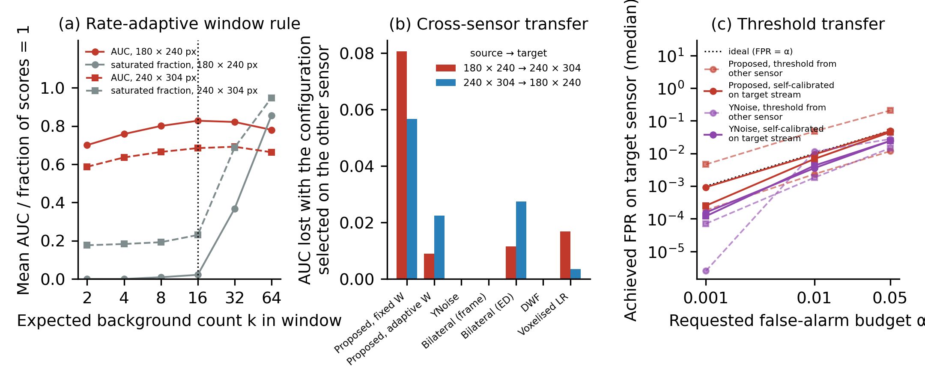
Fig. 6 Zero-knowledge deployment
(a) Mean AUC and median fraction of saturated scores of the rate-adaptive proposal against the dimensionless window k on the two sensor models; dotted line: deployment value. (b) AUC lost when the configuration selected on one sensor is applied to the other. (c) Median achieved false-positive rate on the target sensor with a threshold carried over from the other sensor (dashed) and recalibrated on the target stream without labels (solid).

Slide 7
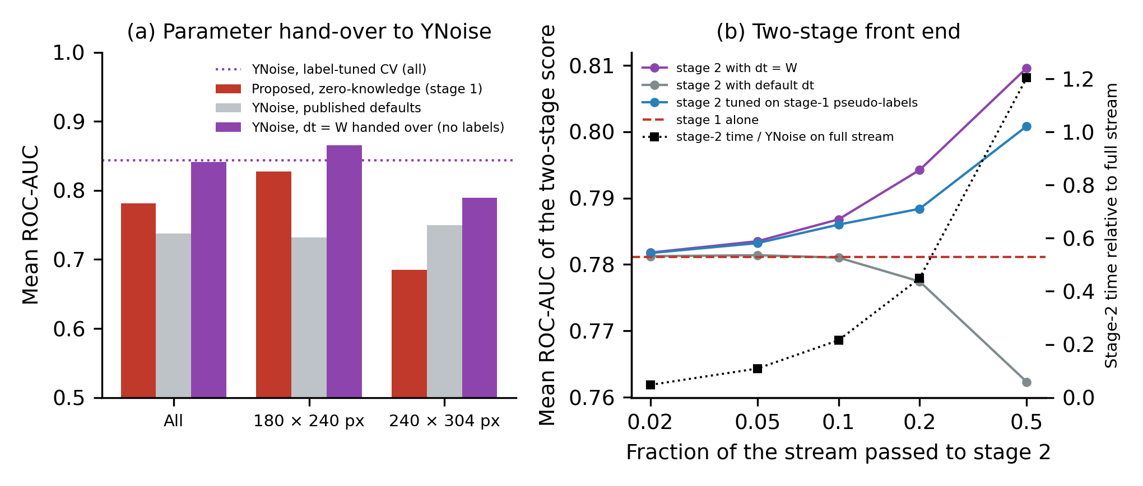
Fig. 7 Parameter hand-over and two-stage front end
(a) Mean AUC of the zero-knowledge proposal, of YNoise at its published default and of YNoise with its time constant set to the rate-adaptive window W handed over from the proposal, pooled and per sensor model; dotted line: YNoise with label-tuned cross-validation. (b) Mean AUC of the two-stage score against the fraction of the stream passed by stage 1 (hand-over, default and pseudo-label parameterisation of stage 2); dashed line: stage 1 alone; black squares (right axis): median stage-2 time relative to YNoise on the whole stream.

Slide 8
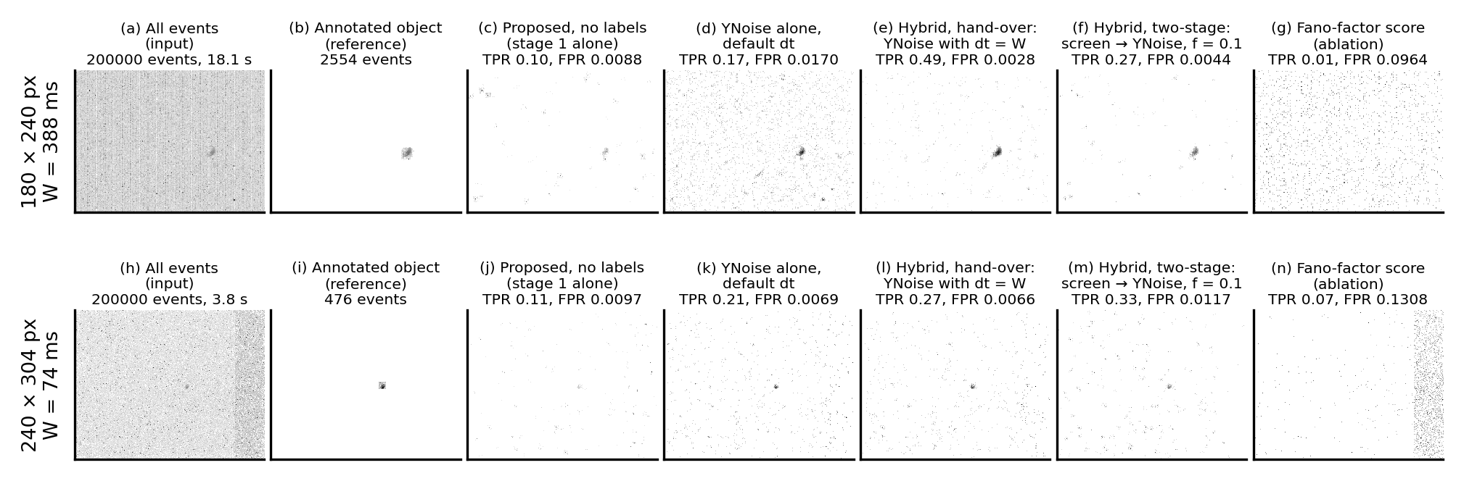
Fig. 8 The same two recordings processed by every stage
Rows: one recording per sensor model (SL8RB_1957_davis_td, canopus_leos_11_26_atis_td), the recording whose stage-1 AUC is closest to the median of that sensor, with its rate-adaptive window W. Columns: all events; annotated object events; events passed at a requested false-alarm rate of 0.01 by the zero-knowledge proposal, YNoise at its published default, the hybrid hand-over (YNoise with dt = W from the proposal), the hybrid two-stage form (proposal screens, YNoise confirms) with f = 0.1, and the Fano-factor score. Per-pixel count of passed events on a logarithmic grey scale; achieved detection and false-positive rates above each panel.

