Slide 1
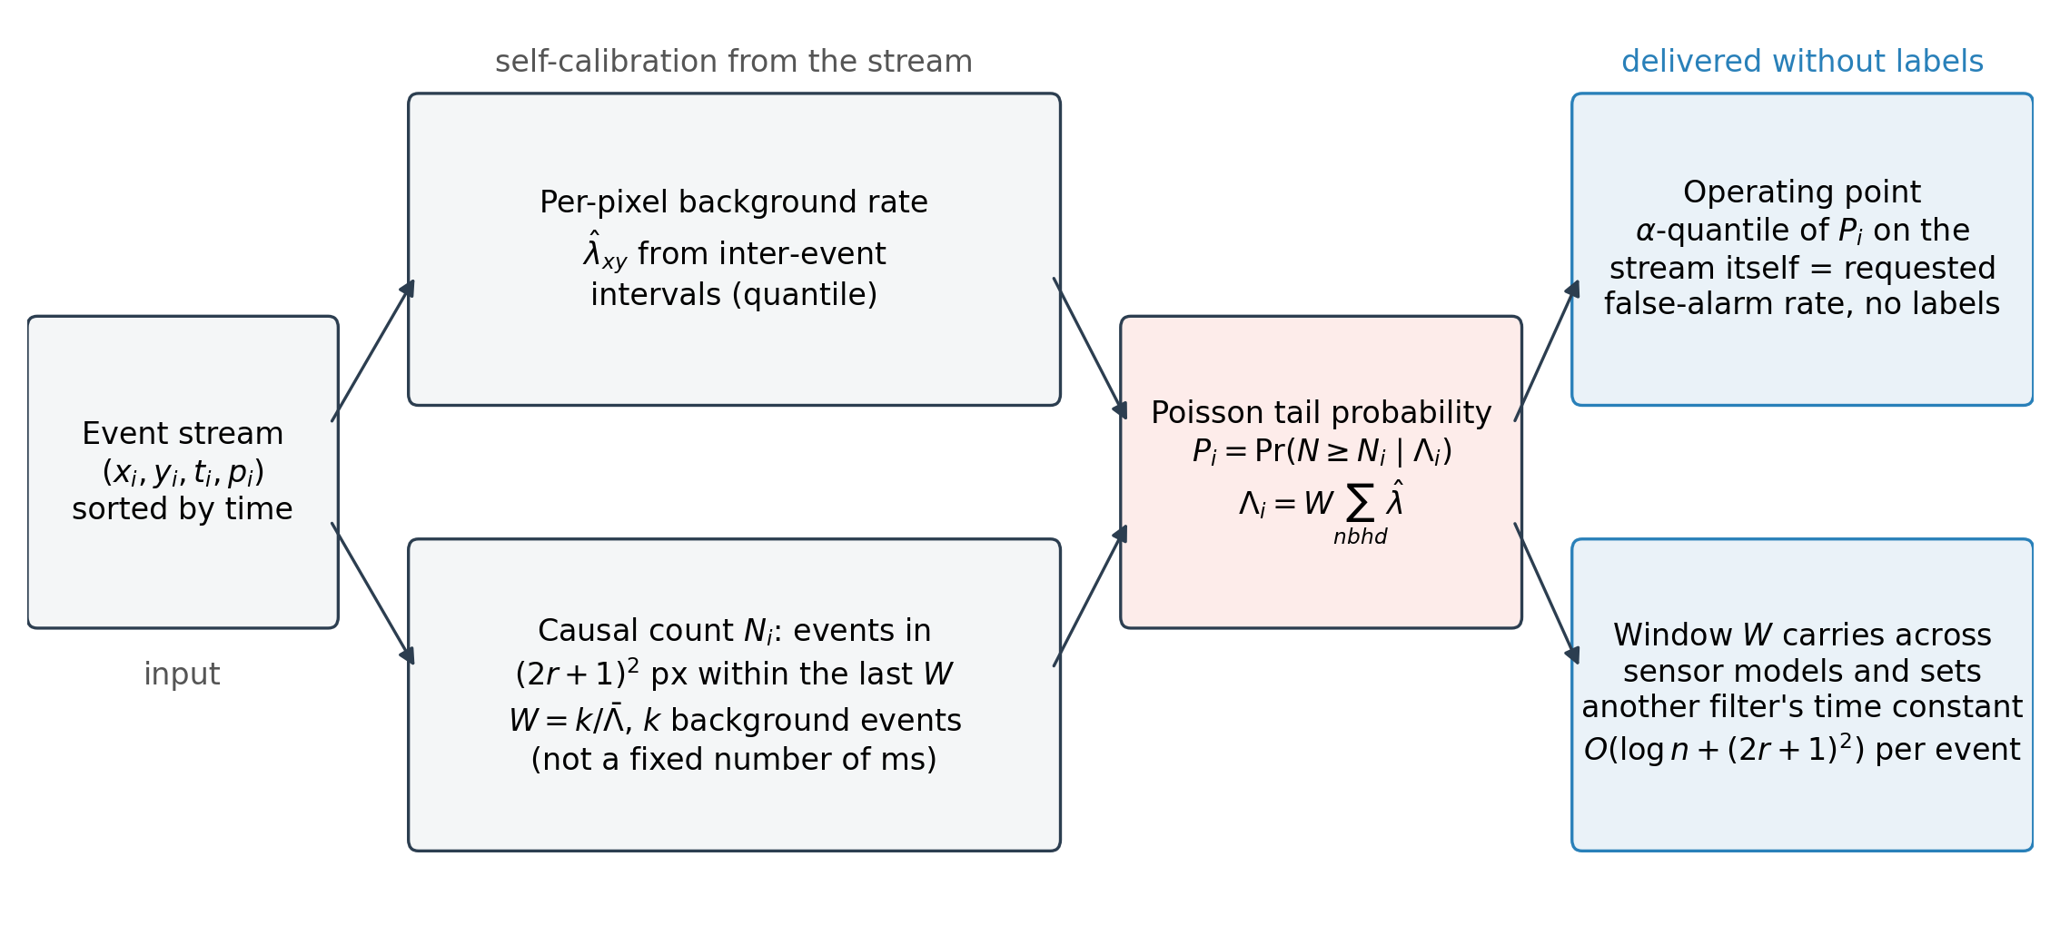
Fig
Fig. 1. Event-driven Poisson likelihood-ratio detector. Each event is scored from the estimated background rate of its neighbourhood and the number of events that arrived in that neighbourhood during the preceding window W, which is stated as an expected background count k rather than a fixed number of milliseconds; the tail probability is used directly as the noise probability. Blue boxes: what the stream itself delivers without labels, the operating point at a requested false-alarm rate, a window W that carries across sensor models and can set the time constant of another filter, and a per-event cost without a voxel grid.

Slide 2
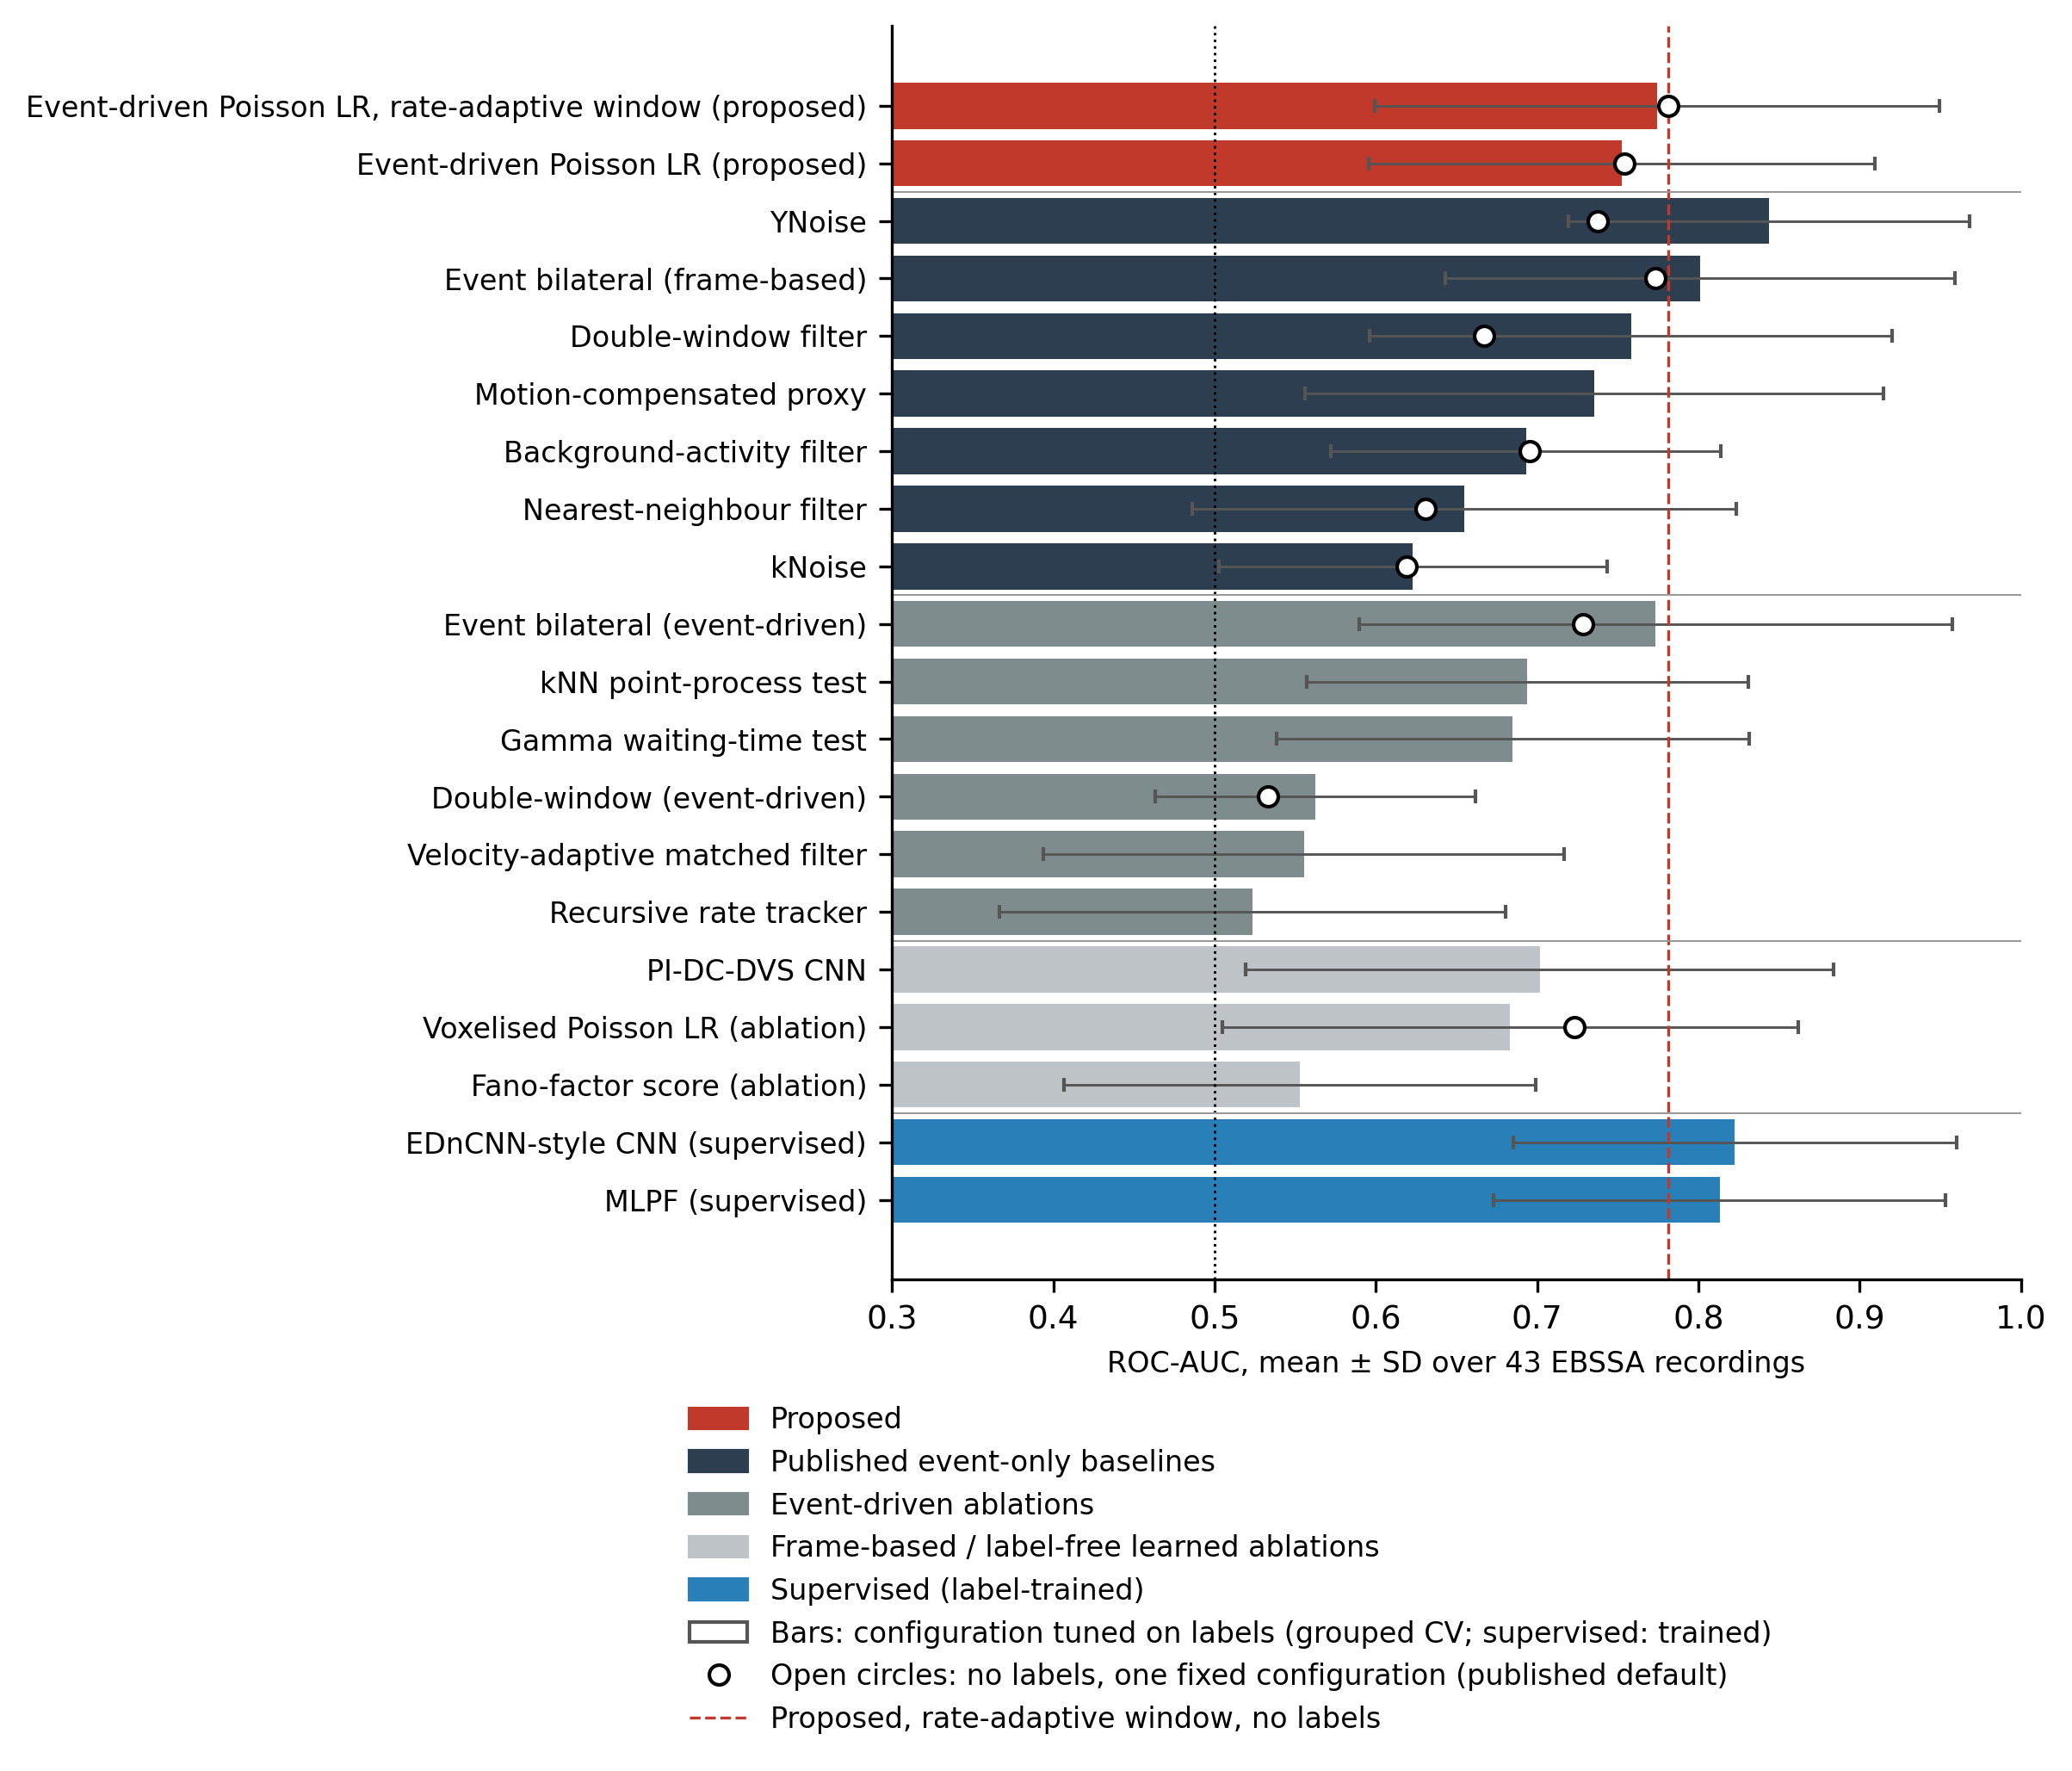
Fig
Fig. 2. Mean ROC-AUC with SD over the 43 EBSSA recordings for all methods in Table 1. Bars: configuration tuned on labels by grouped cross-validation (supervised networks: trained). Open circles: the same method at one fixed configuration chosen without labels (published default; deployment configuration of the proposal), where one exists. Dashed line: the proposed rate-adaptive detector without labels; dotted line: chance. Colours group the proposed method, published unsupervised event filters, event-driven ablations, frame-based and label-free learned ablations, and supervised networks.

Slide 3
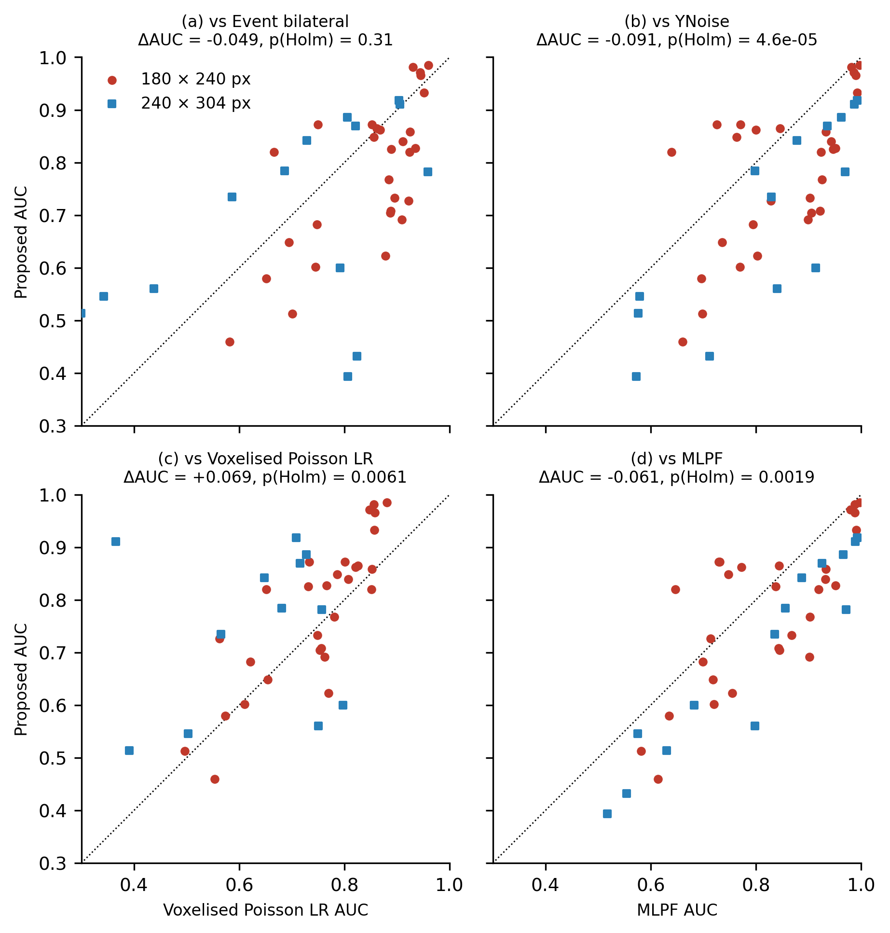
Fig
Fig. 3. Per-recording ROC-AUC of the proposed detector against (a) the event bilateral filter, (b) YNoise, (c) its voxelised, frame-based form and (d) the supervised MLPF-style network. Circles: 180 x 240-pixel sensor; squares: 240 x 304-pixel sensor. Points above the diagonal favour the proposed detector. ΔAUC and Holm-adjusted p refer to the paired Wilcoxon test over 43 recordings.

Slide 4
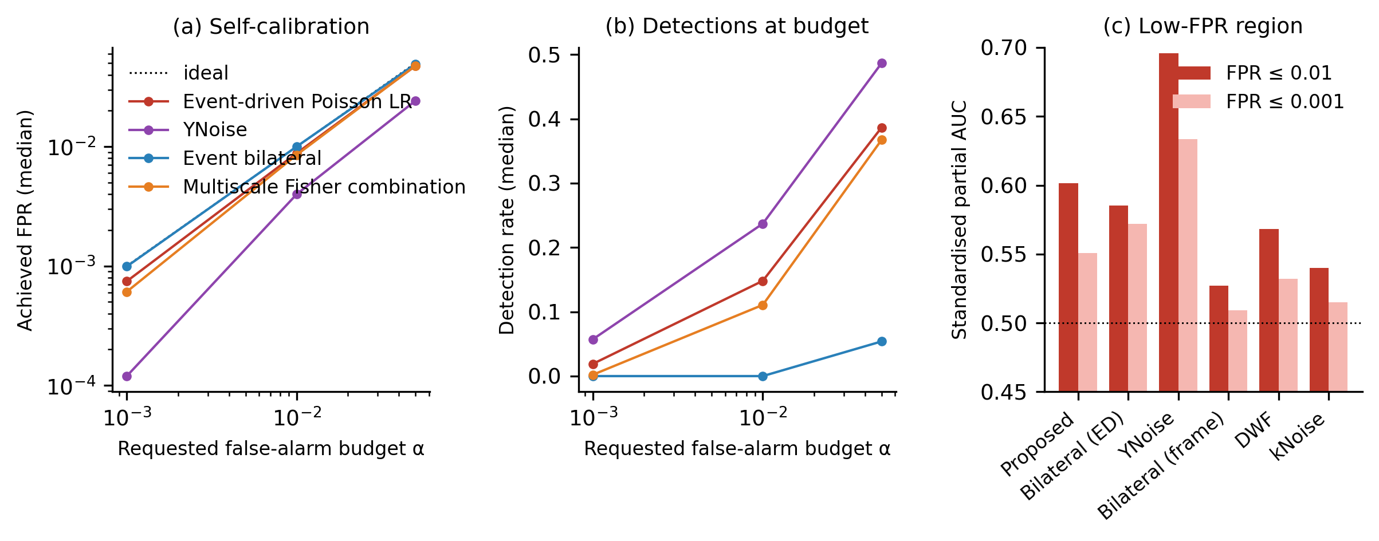
Fig
Fig. 4. Self-calibrated operating points and low-false-positive performance on EBSSA. (a) Median achieved false-positive rate on background events against the requested budget α when each score is cut at its own α-quantile (Eq. (5)); dotted line: ideal calibration. (b) Median detection rate of object events at the same budgets. (c) Standardised partial AUC below false-positive rates of 0.01 and 0.001 (0.5 is chance).

Slide 5
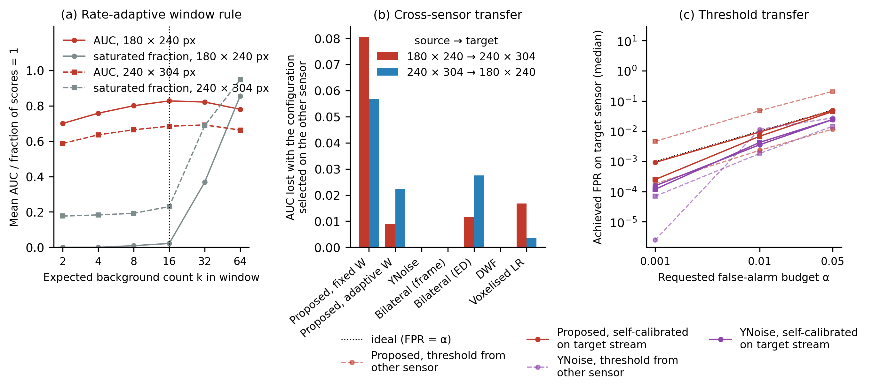
Fig
Fig. 5. Zero-knowledge deployment on EBSSA. (a) Mean AUC (red) and median fraction of saturated scores (grey) of the rate-adaptive proposal against the dimensionless window k on the two sensor models; dotted line: deployment value. (b) AUC lost when the configuration selected on one sensor is applied to the other. (c) Median achieved false-positive rate on the target sensor with a threshold carried over from the other sensor (dashed) and recalibrated on the target stream without labels (solid); dotted line: ideal calibration.

Slide 6
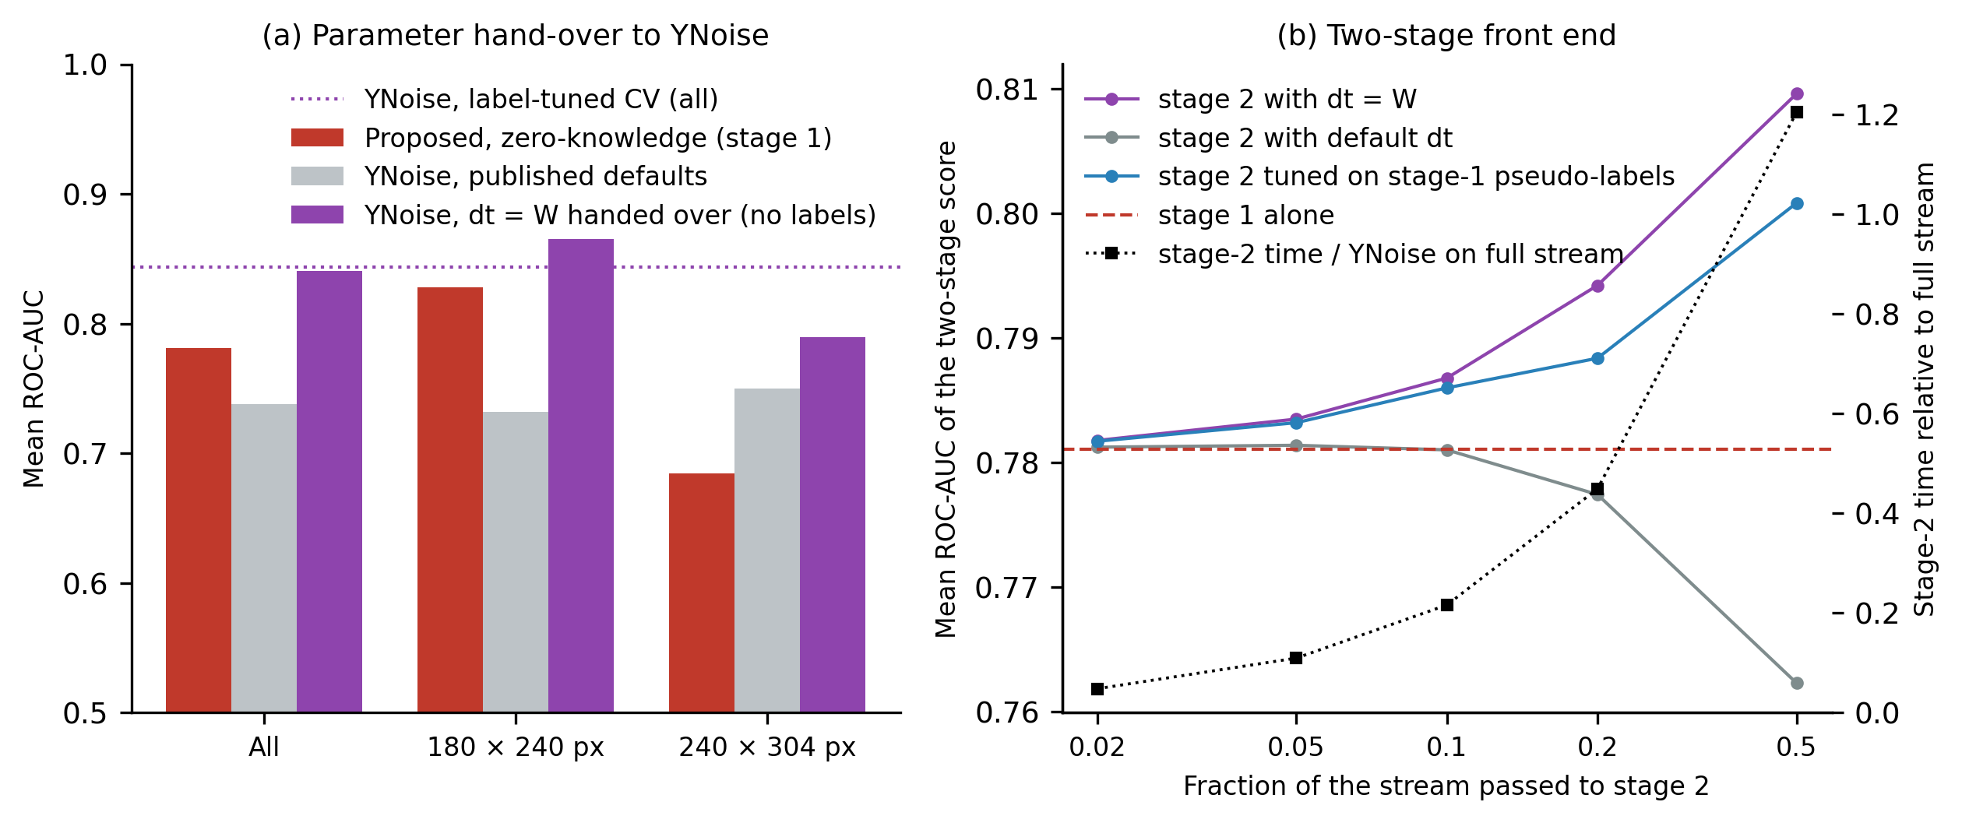
Fig
Fig. 6. Parameter hand-over and two-stage cascade on EBSSA. (a) Mean AUC of the zero-knowledge proposal, of YNoise at its published default and of YNoise with dt set to the rate-adaptive window W handed over from the proposal, pooled and per sensor model; dotted line: YNoise with label-tuned cross-validation (Table 1). (b) Mean AUC of the two-stage score against the fraction of the stream passed by stage 1, with stage 2 parameterised by the hand-over, the published default and a pseudo-label choice; dashed line: stage 1 alone; black squares (right axis): median stage-2 time relative to YNoise on the whole stream.

Slide 7
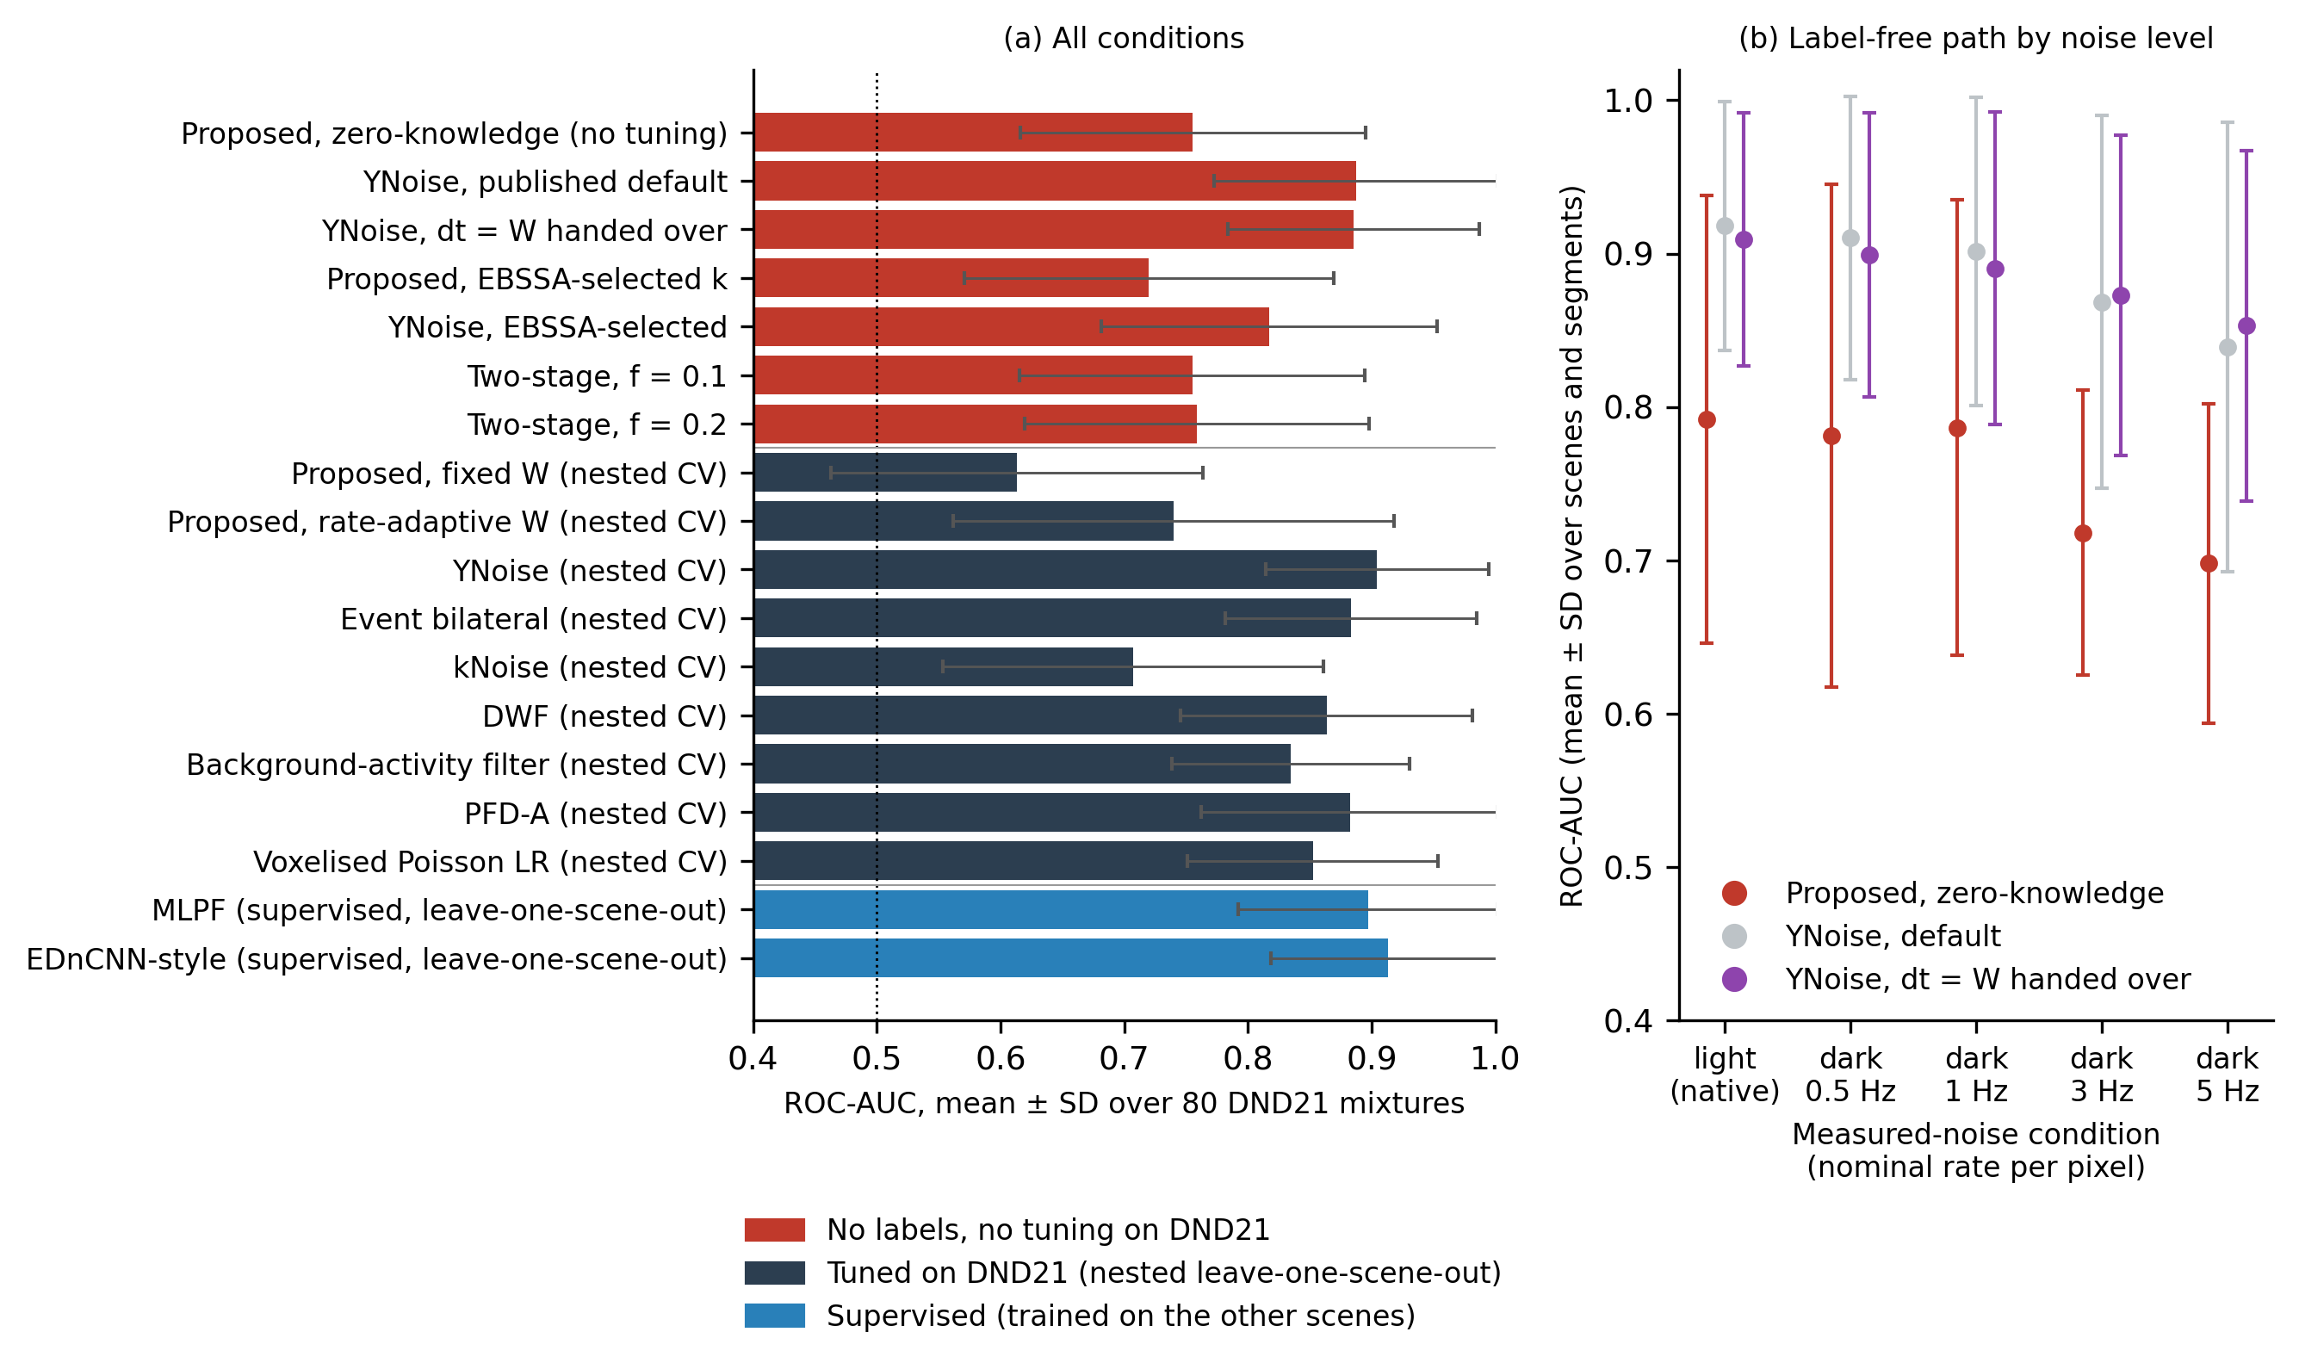
Fig
Fig. 7. DND21 evaluation on 80 mixtures recorded with a third sensor (DAVIS346). (a) Mean ROC-AUC with SD for every configuration of Table 4, grouped by how the parameters were obtained: without labels or tuning on DND21, by nested leave-one-scene-out selection, or by supervised training on the other scenes. (b) Mean AUC with SD of the label-free path (zero-knowledge proposal, YNoise at its default, YNoise with the handed-over window) against the measured-noise condition; the nominal per-pixel rate of the thinned dark recording is given, and "light (native)" is the unthinned recording under uniform illumination.

Slide 8
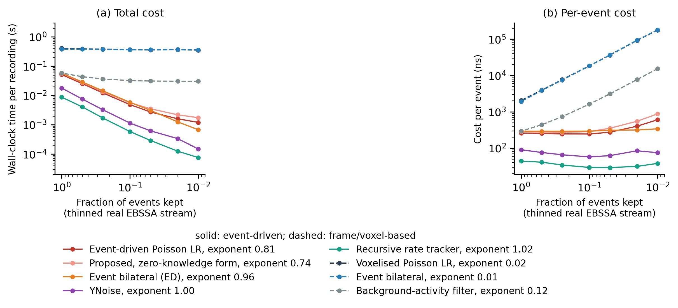
Fig
Fig. S1. Computational cost as the real EBSSA stream is thinned. (a) Wall-clock time per recording and (b) time per event, medians over 3 repeats, against the fraction of events kept (array and recording interval unchanged). Solid lines: event-driven methods; dashed lines: frame- or voxel-based methods. Legend entries give the fitted cost exponent β of Eq. (7).

Slide 9
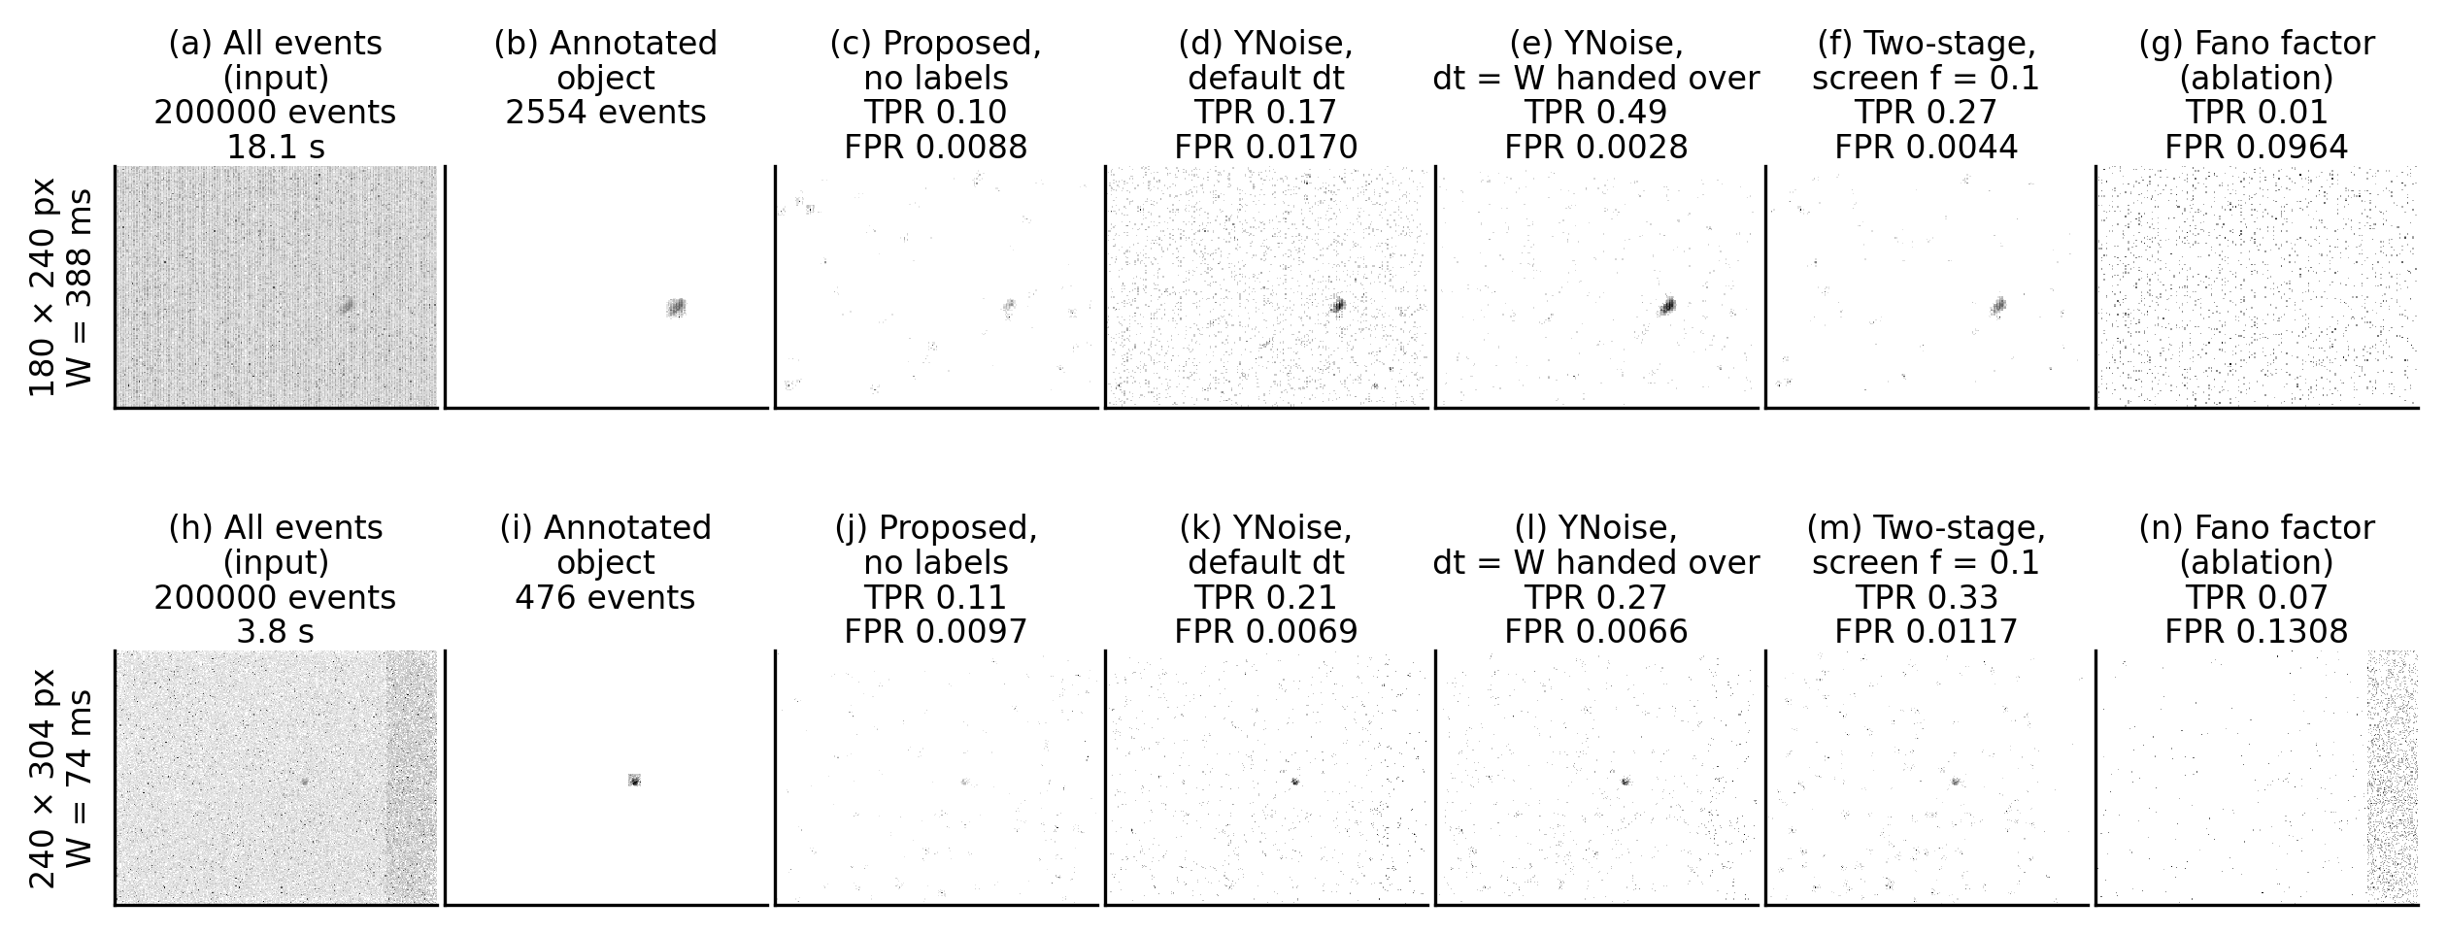
Fig
Fig. S2. The same two EBSSA recordings processed by every stage. Rows: one recording per sensor model (SL8RB_1957_davis_td, canopus_leos_11_26_atis_td), the recording whose stage-1 AUC is closest to the median of that sensor, with its rate-adaptive window W. Columns: all events; events inside the annotated object boxes; events passed at a requested false-alarm rate of 0.01 by the zero-knowledge proposal alone, by YNoise at its published default, by the hand-over (YNoise with dt = W), by the two-stage cascade with f = 0.1, and by the Fano-factor score. Each panel is the per-pixel count of passed events over the analysed interval on a logarithmic grey scale; achieved detection and false-positive rates are given above each panel.

Slide 10
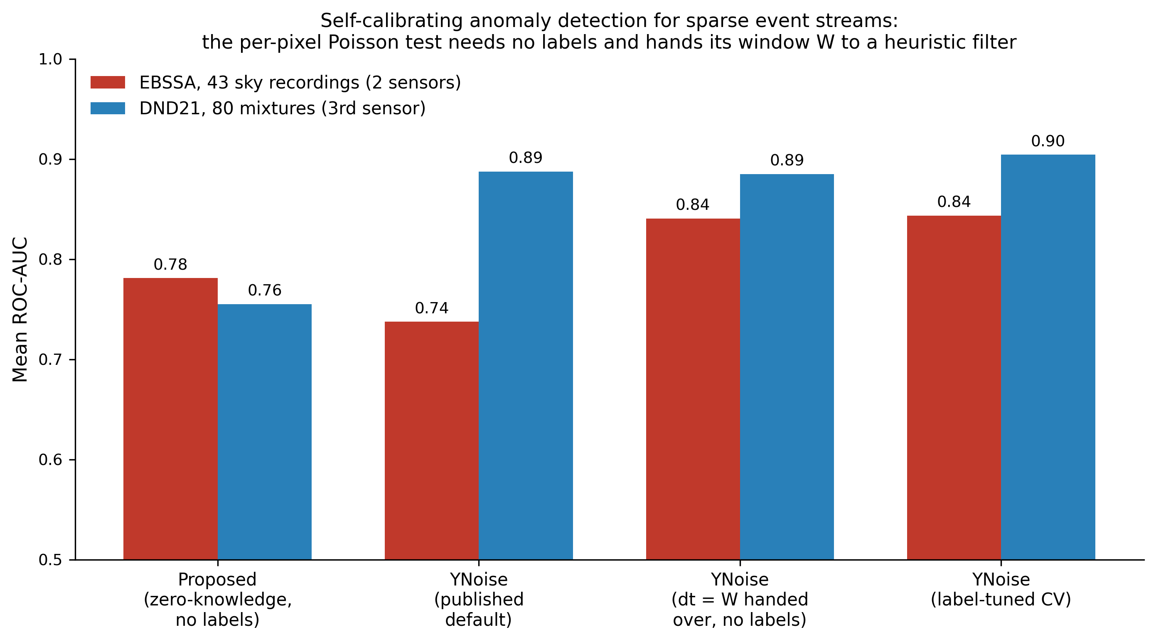
Graphical abstract
Graphical abstract. Label-free path of the proposed detector on EBSSA and DND21.

Slide 11
Table 1
Method | Labels used | AUC (mean ± SD) | AUC, no labels | F1 | NRR | SPR | ΔAUC | 95% CI | p (Holm)
Event-driven Poisson LR filter (proposed) | tuning | 0.753 ± 0.157 | 0.754 | 0.204 | 0.979 | 0.269 | - | - | -
Event-driven Poisson LR filter, rate-adaptive window (proposed) | tuning | 0.774 ± 0.175 | 0.781 | 0.205 | 0.990 | 0.211 | -0.022 | [-0.044, +0.002] | 0.041
Event bilateral filter | tuning | 0.801 ± 0.158 | 0.774 | 0.069 | 0.568 | 0.843 | -0.049 | [-0.093, -0.007] | 0.308
YNoise | tuning | 0.844 ± 0.124 | 0.738 | 0.075 | 0.631 | 0.823 | -0.091 | [-0.123, -0.058] | <0.001
Motion-compensated proxy | tuning | 0.735 ± 0.179 | - | 0.064 | 0.561 | 0.773 | +0.017 | [-0.034, +0.068] | 1.000
Background-activity filter | tuning | 0.693 ± 0.121 | 0.696 | 0.102 | 0.798 | 0.588 | +0.060 | [+0.032, +0.086] | <0.001
Double-window filter | tuning | 0.758 ± 0.162 | 0.667 | 0.080 | 0.686 | 0.716 | -0.006 | [-0.049, +0.034] | 1.000
Nearest-neighbour filter | tuning | 0.655 ± 0.169 | 0.631 | 0.088 | 0.735 | 0.476 | +0.098 | [+0.049, +0.147] | 0.003
kNoise | tuning | 0.623 ± 0.120 | 0.619 | 0.092 | 0.880 | 0.287 | +0.130 | [+0.091, +0.165] | <0.001
Event bilateral filter (event-driven form) | tuning | 0.774 ± 0.184 | 0.728 | 0.060 | 0.513 | 0.816 | -0.021 | [-0.071, +0.028] | 1.000
kNN point-process test (event-driven) | tuning | 0.694 ± 0.137 | - | 0.104 | 0.817 | 0.373 | +0.059 | [+0.010, +0.103] | 0.006
Gamma waiting-time test (event-driven) | tuning | 0.685 ± 0.147 | - | 0.103 | 0.837 | 0.365 | +0.068 | [+0.017, +0.113] | 0.003
Velocity-adaptive matched filter (event-driven) | tuning | 0.555 ± 0.162 | - | 0.031 | 0.391 | 0.628 | +0.197 | [+0.131, +0.267] | <0.001
Double-window filter (event-driven form) | tuning | 0.563 ± 0.099 | 0.533 | 0.044 | 0.606 | 0.531 | +0.190 | [+0.135, +0.242] | <0.001
Recursive rate tracker (event-driven) | tuning | 0.523 ± 0.157 | - | 0.094 | 0.845 | 0.328 | +0.229 | [+0.189, +0.267] | <0.001
Voxelised Poisson LR filter (frame-based ablation) | tuning | 0.683 ± 0.178 | 0.723 | 0.033 | 0.009 | 0.997 | +0.069 | [+0.030, +0.110] | 0.006
PI-DC-DVS CNN | tuning | 0.702 ± 0.183 | - | 0.033 | 0.002 | 0.998 | +0.051 | [+0.001, +0.102] | 0.523
Fano-factor score (ablation) | tuning | 0.553 ± 0.146 | - | 0.105 | 0.888 | 0.222 | +0.200 | [+0.155, +0.243] | <0.001
EDnCNN-style CNN (supervised) | training | 0.823 ± 0.138 | - | 0.238 | 0.922 | 0.551 | -0.070 | [-0.096, -0.043] | <0.001
MLPF (supervised) | training | 0.813 ± 0.140 | - | 0.211 | 0.918 | 0.535 | -0.061 | [-0.086, -0.033] | 0.002
Table 1. Event-level detection performance on the 43 labelled EBSSA recordings (mean over recordings; AUC also with SD). Labels used: how the labels entered the main AUC, F1, NRR and SPR columns, to tune the configuration by grouped cross-validation (tuning) or to train the model (training); no method in these columns is label-free. AUC, no labels: mean AUC of the same method at one fixed configuration chosen without labels (the published default of each filter, the deployment configuration of the proposal; Section 5.6), where such a configuration exists. ΔAUC is the mean paired difference of the proposed detector minus the comparator, both label-tuned, with its 95% bootstrap confidence interval (CI); p is the Holm-adjusted two-sided Wilcoxon signed-rank p-value. NRR: noise-removal rate; SPR: signal-preservation rate at a probability threshold of 0.5. Rows are grouped as proposed (fixed window; rate-adaptive window), published unsupervised filters, event-driven ablations, frame-based and label-free learned ablations, and supervised references.

Slide 12
Table 2
Method | FPR (α = 0.001) | TPR (α = 0.001) | FPR (α = 0.01) | TPR (α = 0.01) | FPR (α = 0.05) | TPR (α = 0.05)
Event-driven Poisson LR filter (proposed) | 0.0007 | 0.019 | 0.0088 | 0.148 | 0.0474 | 0.386
Multiscale Fisher combination (proposed, 3 scales) | 0.0006 | 0.002 | 0.0085 | 0.111 | 0.0476 | 0.367
YNoise | 0.0001 | 0.057 | 0.0040 | 0.237 | 0.0242 | 0.487
Event bilateral filter (event-driven form) | 0.0010 | 0.000 | 0.0100 | 0.000 | 0.0492 | 0.054
Table 2. Median achieved false-positive rate (FPR) and detection rate (TPR) over EBSSA recordings when each detector is cut at the α-quantile of its own score, without labels.

Slide 13
Table 3
Configuration | AUC, all | AUC, 180 x 240 | AUC, 240 x 304 | Recall of stage 1 | Stage-2 time
Proposed, zero-knowledge form (stage 1 alone) | 0.781 | 0.828 | 0.685 | n/a | n/a
YNoise, published default | 0.738 | 0.732 | 0.750 | n/a | 1.00
YNoise, dt = W handed over | 0.841 | 0.865 | 0.790 | n/a | 1.00
YNoise, label-tuned CV (Table 1) | 0.844 | n/a | n/a | n/a | 1.00
Two-stage, f = 0.02, stage 2 dt = W | 0.782 | n/a | n/a | 0.32 | 0.05
Two-stage, f = 0.05, stage 2 dt = W | 0.784 | n/a | n/a | 0.45 | 0.11
Two-stage, f = 0.1, stage 2 dt = W | 0.787 | n/a | n/a | 0.55 | 0.22
Two-stage, f = 0.2, stage 2 dt = W | 0.794 | n/a | n/a | 0.66 | 0.45
Two-stage, f = 0.5, stage 2 dt = W | 0.810 | n/a | n/a | 0.81 | 1.20
Table 3. Parameter hand-over and two-stage cascade on all 43 EBSSA recordings. AUC: mean over recordings (pooled and per sensor model). Recall: fraction of object events passed by stage 1. Stage-2 time: median wall-clock time of YNoise on the passed events relative to YNoise on the whole stream. No labels are used by any row except the label-tuned reference.

Slide 14
Table 4
Configuration | AUC (mean ± SD) | ΔAUC | 95% CI | p (Holm) | p (segment) | Sources
Proposed, rate-adaptive, fixed deployment (no tuning) | 0.755 ± 0.140 | - | - | - | - | -
Proposed, rate-adaptive, EBSSA-selected k | 0.720 ± 0.149 | +0.035 | [-0.008, +0.078] | <0.001 | = 0.144 | 3/4
Proposed, rate-adaptive, nested CV on DND21 | 0.740 ± 0.178 | -0.127 | [-0.178, -0.062] | <0.001 | = 0.003 | 1/4
Proposed, fixed window, nested CV on DND21 | 0.613 ± 0.150 | - | - | - | - | -
YNoise, published default | 0.888 ± 0.115 | -0.132 | [-0.165, -0.098] | <0.001 | < 0.001 | 1/4
YNoise, EBSSA-selected | 0.817 ± 0.136 | -0.062 | [-0.092, -0.031] | <0.001 | = 0.002 | 1/4
YNoise, dt = W handed over (no labels) | 0.885 ± 0.102 | -0.130 | [-0.166, -0.098] | <0.001 | < 0.001 | 0/4
Two-stage cascade, f = 0.1 (no labels) | 0.755 ± 0.139 | +0.000 | [-0.000, +0.001] | 0.017 | = 0.375 | 2/4
Two-stage cascade, f = 0.2 (no labels) | 0.759 ± 0.139 | -0.003 | [-0.008, +0.000] | <0.001 | = 0.016 | 1/4
YNoise, nested CV | 0.904 ± 0.090 | -0.291 | [-0.316, -0.267] | <0.001 | < 0.001 | 0/4
Event bilateral, nested CV | 0.883 ± 0.102 | -0.270 | [-0.303, -0.241] | <0.001 | < 0.001 | 0/4
PFD-A (approximation), nested CV | 0.882 ± 0.120 | -0.269 | [-0.306, -0.230] | <0.001 | < 0.001 | 0/4
DWF, nested CV | 0.864 ± 0.118 | -0.250 | [-0.277, -0.229] | <0.001 | < 0.001 | 0/4
kNoise, nested CV | 0.707 ± 0.154 | -0.094 | [-0.149, -0.042] | <0.001 | = 0.003 | 1/4
Background-activity filter, nested CV | 0.835 ± 0.096 | -0.222 | [-0.251, -0.193] | <0.001 | < 0.001 | 0/4
Voxelised Poisson LR, nested CV | 0.853 ± 0.101 | -0.239 | [-0.266, -0.215] | <0.001 | < 0.001 | 0/4
MLPF-style (supervised, other scenes) | 0.897 ± 0.105 | -0.284 | [-0.317, -0.250] | <0.001 | < 0.001 | 0/4
EDnCNN-style (supervised, other scenes) | 0.913 ± 0.094 | -0.300 | [-0.334, -0.266] | <0.001 | < 0.001 | 0/4
Table 4. DND21 (DAVIS346, third sensor): mean ± SD ROC-AUC over 80 mixtures with exact origin labels. ΔAUC and p (Holm): for tuned and supervised rows, the paired difference of the nested-CV fixed-window proposal minus the method with Holm adjustment over mixtures; for label-free rows, the paired difference of the fixed-deployment proposal minus the method. 95% CI: cluster bootstrap over signal segments (16 clusters). p (segment): unadjusted paired Wilcoxon over the 16 segments (sensitivity analysis). Sources: number of the 4 signal sources on which the proposal has the higher mean AUC (descriptive). Nested CV: leave-one-scene-out. EBSSA-selected: configuration chosen on EBSSA and applied unchanged.

Slide 15
Table S1
Method | Type | Input | Training labels | Extra sensors | Public code | Executed here
MLPF (multilayer-perceptron filter) | supervised, event-driven | local time-surface patch (age and polarity of recent events) around each event | per-event signal/noise labels (published training used DND21-style mixes of clean recordings with measured noise) | none | jAER (Java); C++ re-implementation in E-MLB (cuke-emlb, CUDA) | yes: MLPF-style MLP on the same patch features, trained inside each grouped-CV fold (sp_evaluation.MLPF); EBSSA and DND21
EDnCNN (event denoising CNN) | supervised, patch-based CNN | spatio-temporal feature volume built from events around each event (event-only at inference) | Event Probability Mask (EPM): per-event probabilities computed from co-registered APS intensity frames and IMU motion (DVSNOISE20) | APS frames + IMU for label generation only | MATLAB (bald6354/edncnn); C++/CUDA re-implementation in E-MLB | yes: EDnCNN-style 2-channel time-surface CNN trained inside each grouped-CV fold on the exact labels available (bounding boxes on EBSSA, origin labels on DND21) instead of EPM labels (sp_evaluation.EDnCNNStyle)
AEDNet (asynchronous event denoising network) | supervised, point-set network on raw asynchronous events | (x, y) offsets of the 50 nearest-in-time events inside a 25 x 15 px neighbourhood of each event, treated as an irregular point set | per-event labels from DVSCLEAN (simulated + real-world; 1280x720 sensor) | none | PyTorch (github.com/Fanghuachen/AEDNet, commit 4fca5c5) with one set of released weights (GitHub release "AEDNet", AEDNet_model.pth, SHA-256 e20c3da6...583e30; DVSCLEAN background-activity model, 1280x720); official inference script is CUDA-only | yes: released weights applied unchanged (zero-shot transfer, CPU) to the EBSSA recordings and the DND21 mixtures on a stratified event subset (aednet_transfer.py); no re-training
WedNet (window-based event denoising network) | supervised, window-based deep network (temporal window + learned sparse coding) | stack of events in a spatio-temporal window; labels the whole stack at once | per-event labels; trained on 39 simulated DVSCLEAN scenes, tested on DVSCLEAN, DVSNOISE20 and ED-KoGTL (per the paper) | none | none located (checked 2026-09-12): the paper (arXiv 2402.09270) gives no code link; the first author's GitHub account (Fanghuachen) exposes only AEDNet; GitHub repository search for "WedNet" and "window-based event denoising" returns no implementation, and GitHub code search for "WedNet event denoising" returns only third-party paper summaries | no
PFD-A (polarity-focused denoising) | hand-crafted two-stage filter (no learning), event-driven | timestamps and polarities of the 8-neighbourhood; polarity-change FIFO per pixel | none | none | C++ (shicy17/PFD), GPL-3.0 | yes: re-implemented in numba (sp_evaluation.pfd_filter) with the reference thresholds; DND21 only (added after the EBSSA runs were frozen)
Table S1. Comparator feasibility under the common protocol (event-only input, exact or annotated labels, grouped cross-validation). "Executed here" states whether the method was scored in this paper and on which dataset; caveats are given in the text and in results/comparator_feasibility.json.

Slide 16
Table S2
Method | Mean ΔAUC | Median ΔAUC | 95% CI | Proposal ahead | r
Event-driven Poisson LR filter, rate-adaptive window (proposed) | -0.022 | -0.020 | [-0.044, +0.002] | 12/43 | -0.47
Event bilateral filter | -0.049 | -0.046 | [-0.093, -0.007] | 18/43 | -0.33
YNoise | -0.091 | -0.095 | [-0.123, -0.058] | 7/43 | -0.76
Motion-compensated proxy | +0.017 | +0.008 | [-0.034, +0.068] | 22/43 | +0.08
Background-activity filter | +0.060 | +0.058 | [+0.032, +0.086] | 36/43 | +0.70
Double-window filter | -0.006 | -0.008 | [-0.049, +0.034] | 18/43 | +0.01
Nearest-neighbour filter | +0.098 | +0.064 | [+0.049, +0.147] | 32/43 | +0.60
kNoise | +0.130 | +0.139 | [+0.091, +0.165] | 37/43 | +0.82
Event bilateral filter (event-driven form) | -0.021 | -0.024 | [-0.071, +0.028] | 15/43 | -0.15
kNN point-process test (event-driven) | +0.059 | +0.066 | [+0.010, +0.103] | 33/43 | +0.57
Gamma waiting-time test (event-driven) | +0.068 | +0.073 | [+0.017, +0.113] | 32/43 | +0.61
Velocity-adaptive matched filter (event-driven) | +0.197 | +0.172 | [+0.131, +0.267] | 37/43 | +0.79
Double-window filter (event-driven form) | +0.190 | +0.218 | [+0.135, +0.242] | 39/43 | +0.86
Recursive rate tracker (event-driven) | +0.229 | +0.238 | [+0.189, +0.267] | 42/43 | +0.97
Voxelised Poisson LR filter (frame-based ablation) | +0.069 | +0.062 | [+0.030, +0.110] | 31/43 | +0.57
PI-DC-DVS CNN | +0.051 | +0.024 | [+0.001, +0.102] | 25/43 | +0.27
Fano-factor score (ablation) | +0.200 | +0.191 | [+0.155, +0.243] | 41/43 | +0.95
EDnCNN-style CNN (supervised) | -0.070 | -0.081 | [-0.096, -0.043] | 8/43 | -0.69
MLPF (supervised) | -0.061 | -0.074 | [-0.086, -0.033] | 7/43 | -0.63
Table S2. Effect sizes of the paired comparison on EBSSA (43 recordings): mean and median paired ΔAUC of the proposed fixed-window detector minus each method, 95% percentile bootstrap CI (10,000 resamples of recordings), number of recordings on which the proposal is ahead, and matched-pairs rank-biserial correlation r (−1 to +1; positive favours the proposal).

Slide 17
Table S3
Stratum | n | Proposed | Bilateral | YNoise | Voxelised LR | MLPF-style | EDnCNN-style
180 x 240-pixel sensor | 29 | 0.779 | 0.847 | 0.853 | 0.744 | 0.820 | 0.830
240 x 304-pixel sensor | 14 | 0.698 | 0.707 | 0.825 | 0.558 | 0.799 | 0.808
Event rate below median | 22 | 0.747 | 0.826 | 0.825 | 0.718 | 0.784 | 0.794
Event rate above median | 21 | 0.758 | 0.775 | 0.863 | 0.647 | 0.844 | 0.852
Table S3. Mean ROC-AUC on EBSSA by sensor model and by event-rate stratum (split at the median rate of 12.2 k events/s). Supervised networks for reference.

Slide 18
Table S4
Method | Family | Exponent β | Time dense (ms) | Time sparse (ms) | ns/event dense | ns/event sparse | Memory dense (MB) | Memory sparse (MB)
Event-driven Poisson LR filter | event-driven | 0.81 ± 0.05 | 52.8 | 1.39 | 264 | 696 | 12.9 | 1.90
Event-driven Poisson LR, zero-knowledge form | event-driven | 0.74 ± 0.06 | 55.1 | 2.02 | 276 | 1008 | 14.9 | 2.34
Event bilateral filter (event-driven form) | event-driven | 0.96 ± 0.01 | 58.2 | 0.68 | 291 | 341 | 7.0 | 0.49
YNoise | event-driven | 1.00 ± 0.04 | 16.3 | 0.15 | 82 | 77 | 6.8 | 0.49
Recursive rate tracker (event-driven) | event-driven | 1.02 ± 0.07 | 8.1 | 0.08 | 41 | 39 | 7.3 | 0.97
Voxelised Poisson LR filter | frame-based | 0.02 ± 0.01 | 500.0 | 448.77 | 2500 | 224383 | 170.2 | 170.20
Event bilateral filter | frame-based | 0.01 ± 0.00 | 461.4 | 444.95 | 2307 | 222477 | 48.1 | 42.56
Background-activity filter | frame-based | 0.12 ± 0.01 | 55.5 | 29.81 | 278 | 14905 | 4.0 | 0.78
Table S4. Cost-scaling summary from Fig. S1. Exponent: mean ± SD of β over repeats. Dense: all events; sparse: one percent of events. Memory is the peak Python-level allocation.

Slide 19
Table S5
Method | No tuning (all recordings) | Transfer 180 x 240 to 240 x 304 | Transfer 240 x 304 to 180 x 240
Proposed, fixed window | 0.754 | 0.632 (-0.081) | 0.744 (-0.057)
Proposed, rate-adaptive window | 0.781 | 0.685 (-0.009) | 0.805 (-0.022)
YNoise | 0.738 | 0.825 (-0.000) | 0.853 (-0.000)
Event bilateral (frame-based) | 0.774 | 0.721 (-0.000) | 0.851 (-0.000)
Event bilateral (event-driven) | 0.728 | 0.689 (-0.011) | 0.787 (-0.028)
Double-window filter | 0.667 | 0.700 (-0.000) | 0.787 (-0.000)
kNoise | 0.619 | 0.589 (-0.000) | 0.633 (-0.006)
Background-activity filter | 0.696 | 0.678 (-0.020) | 0.694 (-0.012)
Voxelised Poisson LR | 0.723 | 0.618 (-0.017) | 0.794 (-0.003)
Table S5. Zero-knowledge evaluation on EBSSA. No tuning: mean AUC over all 43 recordings at one fixed configuration (publication defaults for the comparators). Transfer: mean AUC on the target sensor with the configuration selected on the source sensor, and in parentheses the AUC lost relative to the best configuration on the target itself (negative values are losses).

Slide 20
Table S6
A | B | Mix. Δ | Mix. 95% CI | Mix. p | r | Seg. Δ | Seg. p | Seg. A ahead | Sources A ahead
edlr | edlr adaptive | -0.127 | [-0.178, -0.062] | < 0.001 | -0.80 | -0.127 | = 0.003 | 1/16 | 1/4
edlr | ynoise | -0.291 | [-0.316, -0.267] | < 0.001 | -1.00 | -0.291 | < 0.001 | 0/16 | 0/4
edlr | bilateral | -0.270 | [-0.303, -0.241] | < 0.001 | -1.00 | -0.270 | < 0.001 | 0/16 | 0/4
edlr | pfd | -0.269 | [-0.306, -0.230] | < 0.001 | -1.00 | -0.269 | < 0.001 | 0/16 | 0/4
edlr | dwf | -0.250 | [-0.277, -0.229] | < 0.001 | -1.00 | -0.250 | < 0.001 | 0/16 | 0/4
edlr | knoise | -0.094 | [-0.149, -0.042] | < 0.001 | -0.70 | -0.094 | = 0.003 | 3/16 | 1/4
edlr | temporal | -0.222 | [-0.251, -0.193] | < 0.001 | -1.00 | -0.222 | < 0.001 | 0/16 | 0/4
edlr | plr | -0.239 | [-0.266, -0.215] | < 0.001 | -0.99 | -0.239 | < 0.001 | 0/16 | 0/4
edlr | mlpf | -0.284 | [-0.317, -0.250] | < 0.001 | -1.00 | -0.284 | < 0.001 | 0/16 | 0/4
edlr | edncnn | -0.300 | [-0.334, -0.266] | < 0.001 | -1.00 | -0.300 | < 0.001 | 0/16 | 0/4
zero knowledge | edlr adaptive ebssa | +0.035 | [-0.008, +0.078] | < 0.001 | +0.53 | +0.035 | = 0.144 | 11/16 | 3/4
zero knowledge | ynoise default | -0.132 | [-0.165, -0.098] | < 0.001 | -0.87 | -0.132 | < 0.001 | 1/16 | 1/4
zero knowledge | ynoise ebssa | -0.062 | [-0.092, -0.031] | < 0.001 | -0.55 | -0.062 | = 0.002 | 3/16 | 1/4
zero knowledge | ynoise handoff | -0.130 | [-0.166, -0.098] | < 0.001 | -0.95 | -0.130 | < 0.001 | 0/16 | 0/4
zero knowledge | hybrid 0.1 | +0.000 | [-0.000, +0.001] | = 0.017 | -0.31 | +0.000 | = 0.375 | 4/16 | 2/4
zero knowledge | hybrid 0.2 | -0.003 | [-0.008, +0.000] | < 0.001 | -0.58 | -0.003 | = 0.016 | 3/16 | 1/4
ynoise handoff | ynoise default | -0.003 | [-0.024, +0.020] | = 0.034 | -0.27 | -0.003 | = 0.706 | 6/16 | 2/4
edlr adaptive | edlr | +0.127 | [+0.063, +0.178] | < 0.001 | +0.80 | +0.127 | = 0.003 | 15/16 | 3/4
Table S6. Dependence-aware sensitivity analysis on DND21. Mixture level: 80 mixtures, paired difference A minus B with cluster-bootstrap 95% CI over signal segments, unadjusted Wilcoxon p and rank-biserial r. Segment level: mean AUC over the noise conditions of each of the 16 signal segments, paired difference, Wilcoxon p and number of segments with A ahead. Source level: number of the 4 signal sources with A ahead (no test). Method keys as in the result files: edlr, nested-CV fixed-window proposal; edlr adaptive, nested-CV rate-adaptive proposal; zero knowledge, fixed-deployment proposal; ebssa suffix, configuration selected on EBSSA; hybrid f, two-stage cascade passing fraction f.

Slide 21
Table S7
Stratum | AEDNet (subset) | Proposal (subset) | YNoise default (subset) | Proposal (full) | YNoise default (full) | Events | n
EBSSA, 180 x 240-pixel sensor | 0.697 | 0.830 | 0.734 | 0.828 | 0.732 | 2777 | 29
EBSSA, 240 x 304-pixel sensor | 0.664 | 0.688 | 0.749 | 0.685 | 0.750 | 2540 | 14
EBSSA, all recordings | 0.686 | 0.783 | 0.739 | 0.781 | 0.738 | 2700 | 43
DND21 scene: hotel_bar | 0.855 | 0.827 | 0.968 | 0.828 | 0.969 | 3000 | 25
DND21 scene: driving | 0.789 | 0.718 | 0.847 | 0.718 | 0.846 | 2978 | 25
DND21 scene: dots5 | 0.784 | 0.693 | 0.689 | 0.692 | 0.688 | 2612 | 10
DND21 scene: accel_dot | 0.941 | 0.742 | 0.938 | 0.742 | 0.937 | 2826 | 20
DND21 condition: light native | 0.883 | 0.794 | 0.919 | 0.792 | 0.918 | 2965 | 16
DND21 condition: dark 0.5 Hz | 0.863 | 0.782 | 0.911 | 0.781 | 0.910 | 3000 | 16
DND21 condition: dark 1 Hz | 0.848 | 0.786 | 0.902 | 0.787 | 0.902 | 3000 | 16
DND21 condition: dark 3 Hz | 0.825 | 0.714 | 0.868 | 0.718 | 0.869 | 2808 | 16
DND21 condition: dark 5 Hz | 0.815 | 0.698 | 0.840 | 0.698 | 0.839 | 2732 | 16
DND21, all mixtures | 0.847 | 0.755 | 0.888 | 0.755 | 0.888 | 2901 | 80
Table S7. Zero-shot transfer of the released AEDNet weights to EBSSA and DND21 (Section 4.3): mean ROC-AUC on stratified subsets of at most 1,500 signal and 1,500 background events per recording, next to the untuned proposal and YNoise at its published default on the same subsets and on the full streams. Rows: EBSSA by sensor and overall; DND21 by signal scene, by noise condition and overall. Events: mean number of scored events per recording. n: number of recordings or mixtures. Adaptations from the published protocol: CPU inference (official test_net.py is CUDA-only); sensor frame set to the recording sensor; 25x15 px neighbourhood kept; whole recording as one shape (official: 100000-event chunks); softmax noise probability used as a ranking score for ROC-AUC; stratified subset of <= 1500 signal + 1500 noise events per recording. Environment: PyTorch 2.13.0+cpu, CUDA not available. Code https://github.com/Fanghuachen/AEDNet at commit 4fca5c5; weights SHA-256 e20c3da6c43345b8905380b62bc7f9ce4535fc2b135eb0f60096701651583e30.

