Slide 1
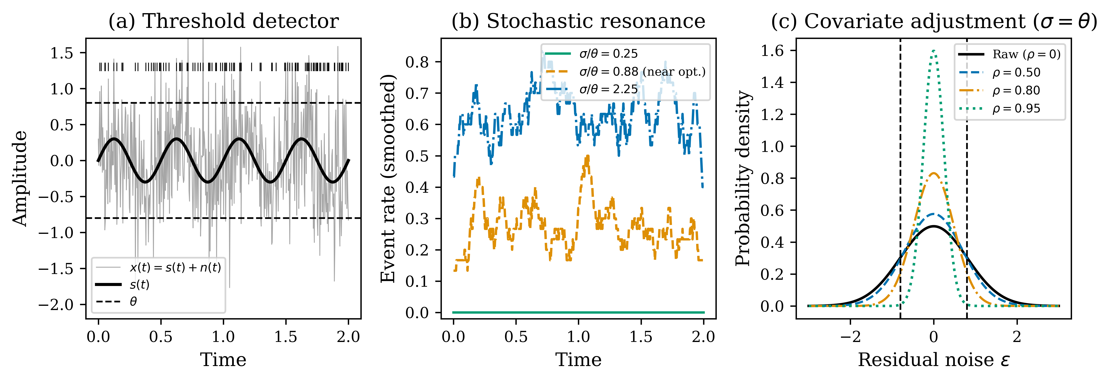
Figure 1
Conceptual schematic of covariate-adjusted stochastic resonance. (a) Threshold detector: subthreshold signal + noise triggers events. (b) SR: event-rate modulation peaks at intermediate noise. (c) Covariate adjustment narrows residual noise, shifting the operating point.

Slide 2
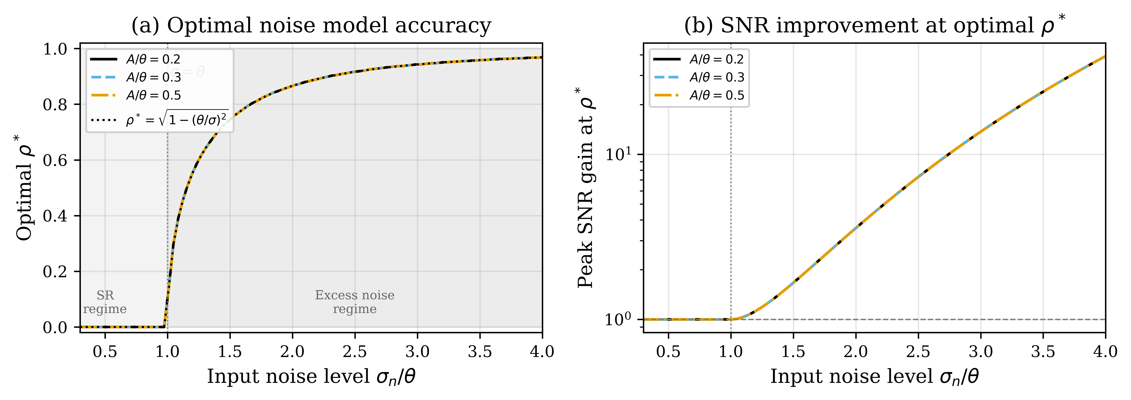
Figure 2
Optimal noise model accuracy. (a) ρ* vs. input noise: 0 in the SR regime, √(1 − θ²/σ²) in the excess-noise regime. (b) Peak SNR gain grows exponentially with σ/θ.

Slide 3
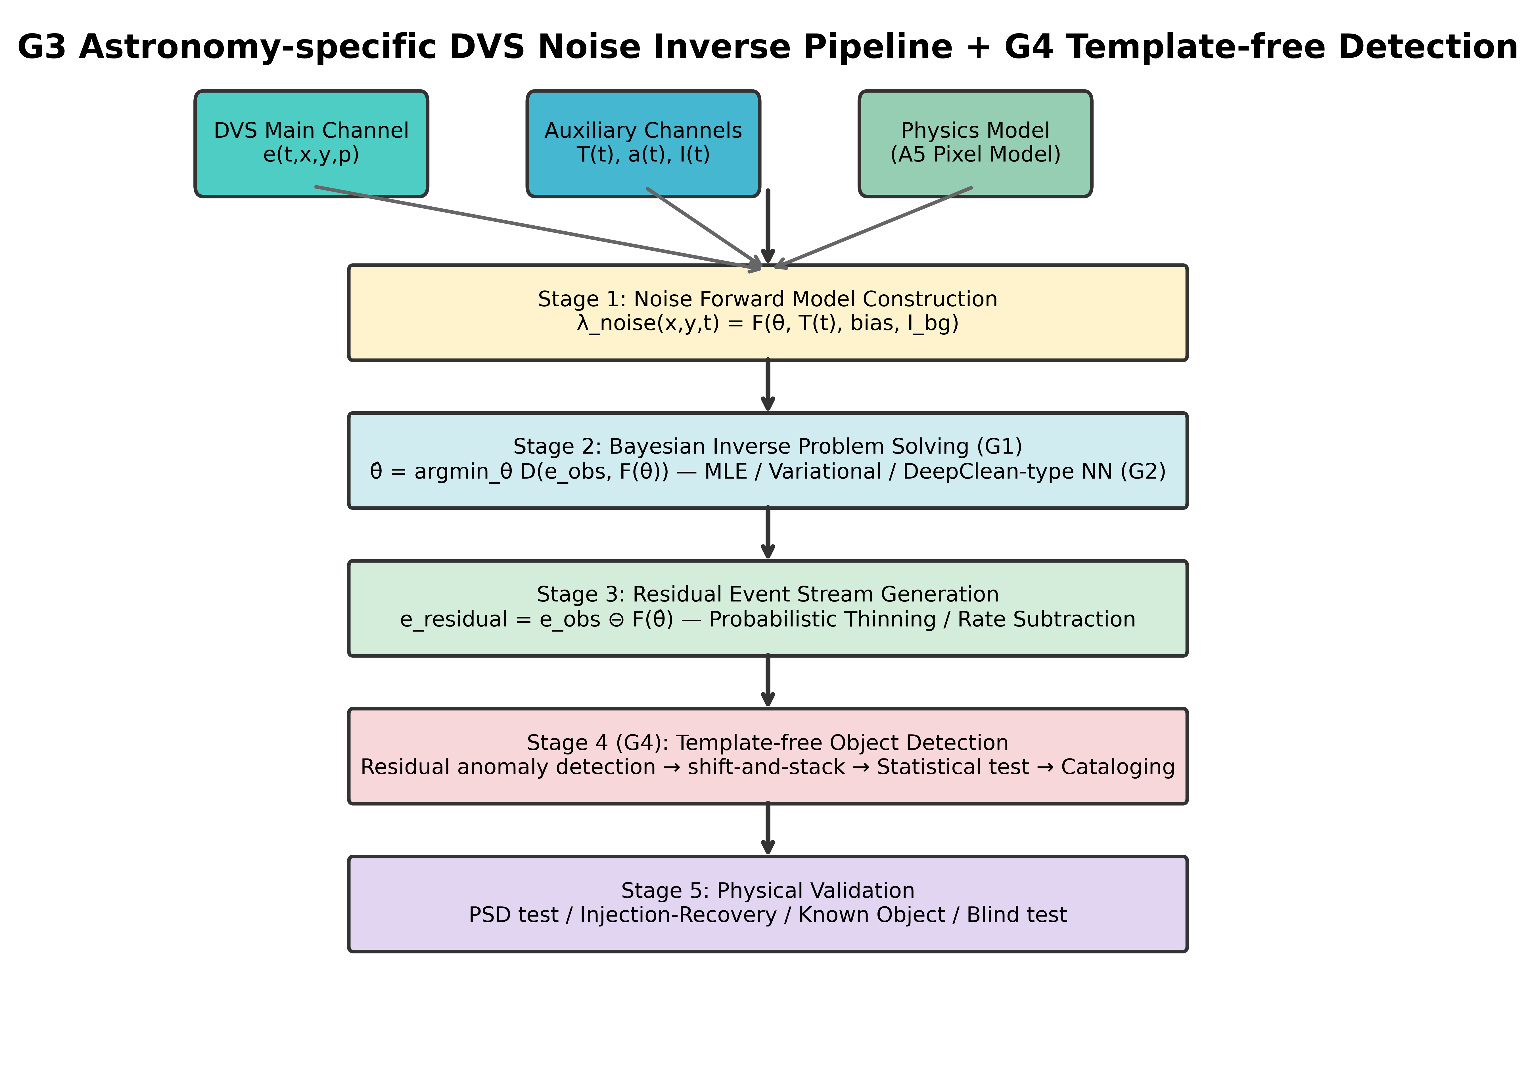
Figure 3
PI-DC-DVS pipeline: (1) A5 noise model + auxiliary channels; (2) Bayesian inverse solution; (3) probabilistic thinning; (4) template-free object detection; (5) physical validation including Cal-6 satellite-trail calibration.

Slide 4
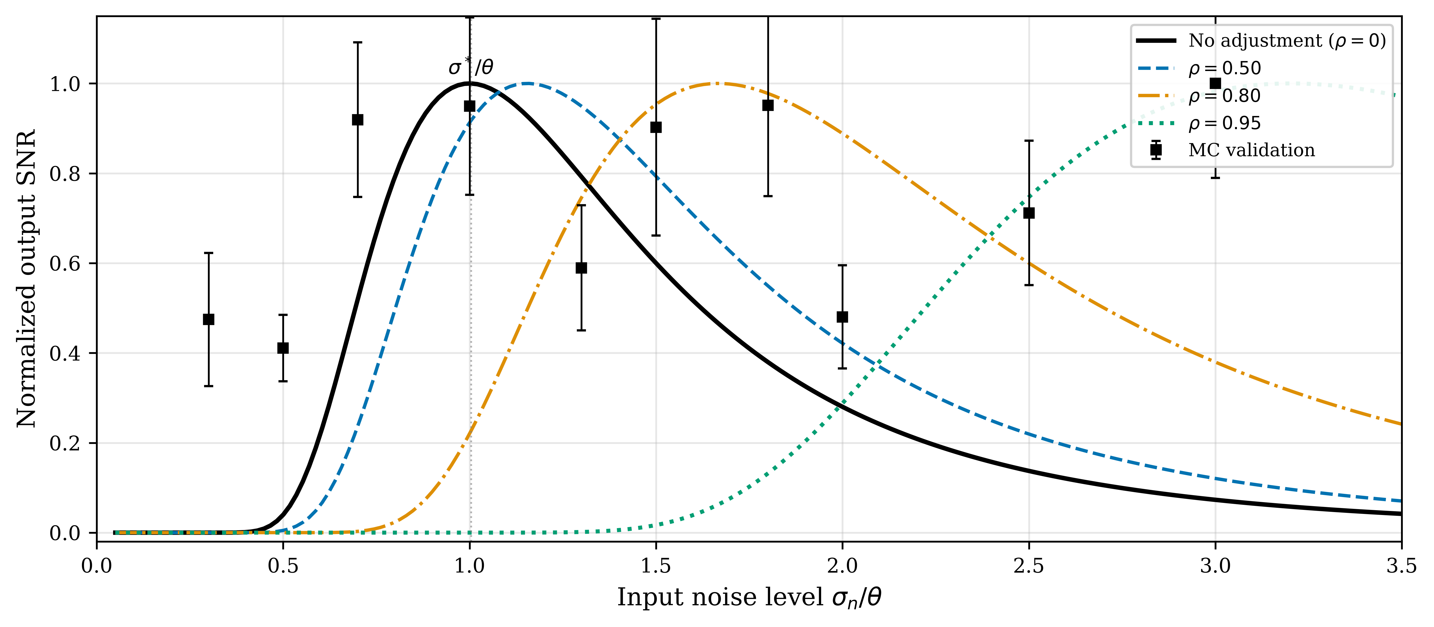
Figure 4
Stochastic resonance curves (A/θ = 0.3). Analytical curves (solid) and Monte Carlo validation (squares). Covariate adjustment shifts the peak rightward.

Slide 5
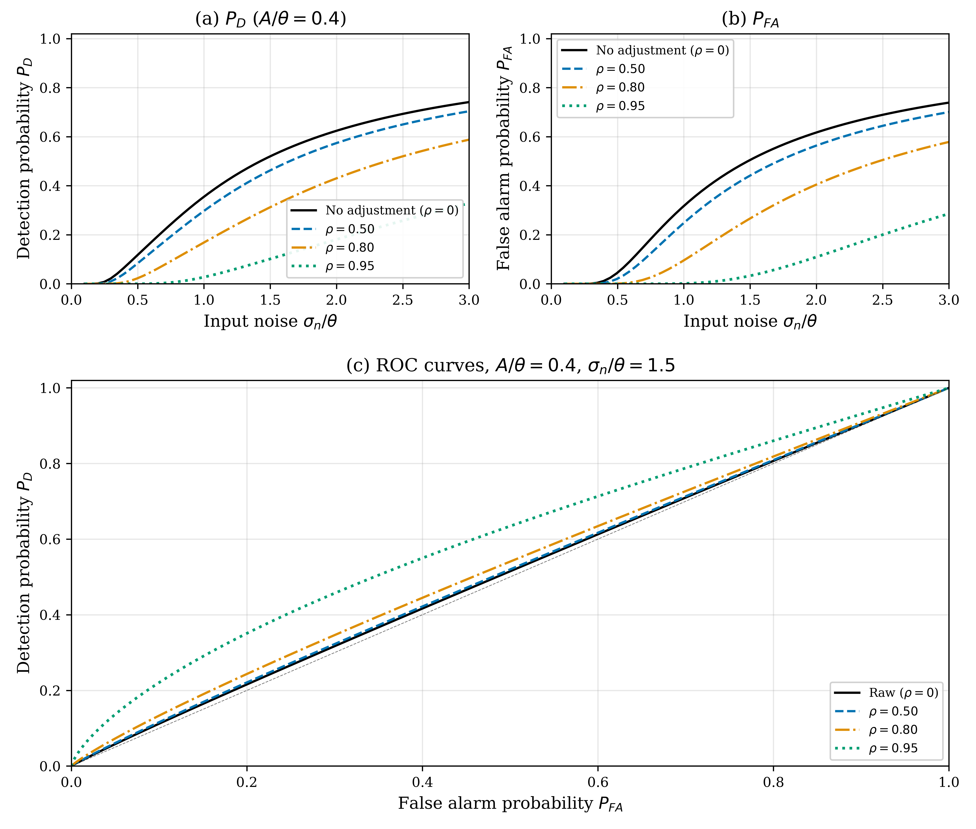
Figure 5
Detection and classification performance (A/θ = 0.4). (a) Detection probability P_D; (b) false-alarm probability P_FA; (c) ROC curves at σ_n/θ = 1.5.

Slide 6
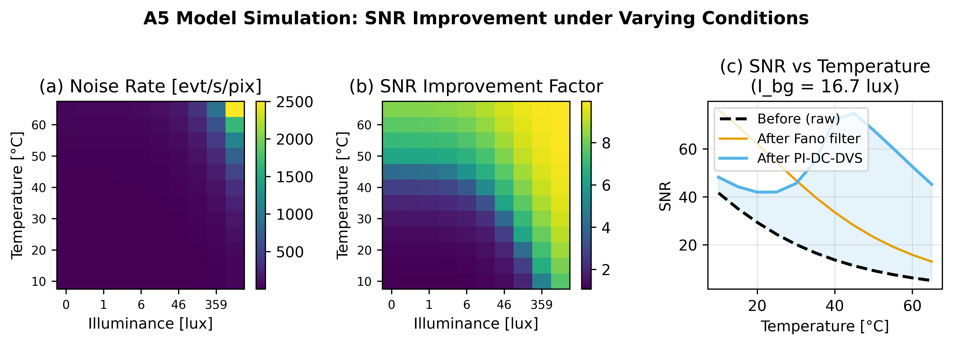
Figure 6
A5-based noise rate simulation. (a) Predicted noise rate [evt/s/pix]; (b) SNR improvement factor at 90% model accuracy; (c) SNR vs. temperature.

Slide 7
Figure 7
Experimental evaluation on EBSSA and SR interpretation (20 recordings). (a) NRR, (b) SPR, (c) F1, (d) ROC-AUC; (e) ROC-AUC comparison; (f) NRR vs SPR trade-off (Fano AUC = 0.866).

Slide 8
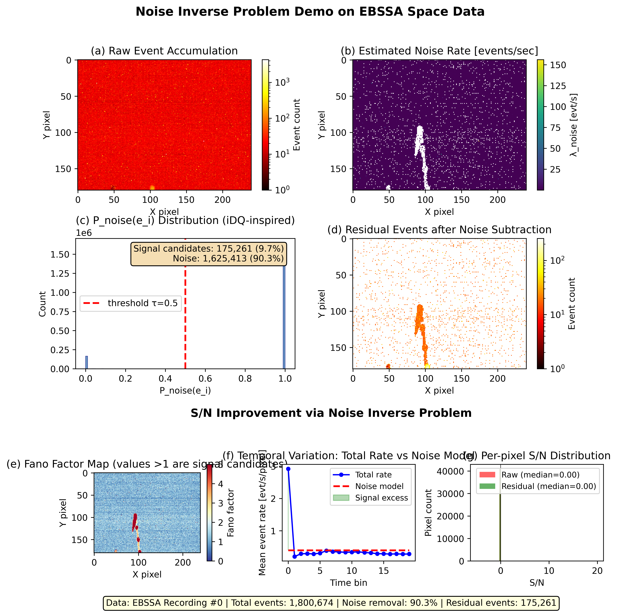
Figure 8
Proof-of-concept on EBSSA Recording #0. (a) Raw event accumulation; (b) estimated noise rate map; (c) per-event noise probability; (d) residual after 90.3% noise removal; (e) Fano spatial map; (f) temporal dynamics; (g) per-pixel S/N distribution.

