Slide 1
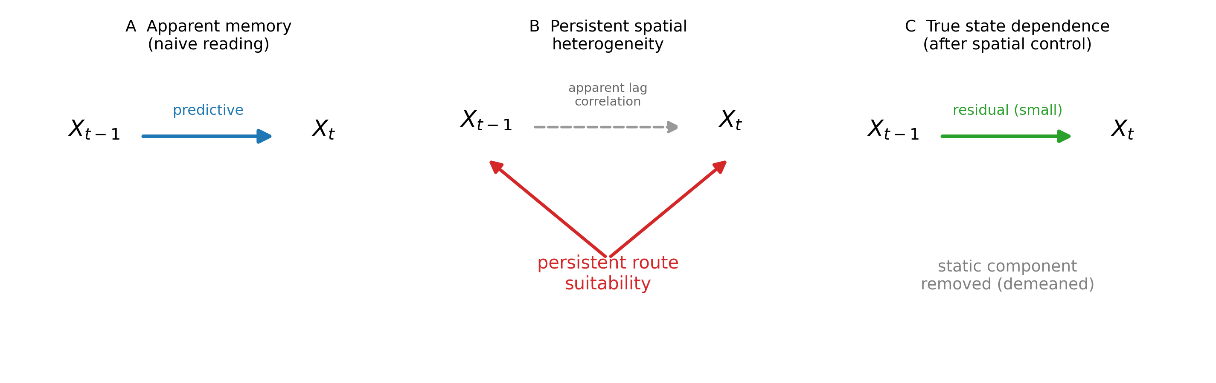
Figure 1
Conceptual decomposition of lagged-state predictability.

Slide 2
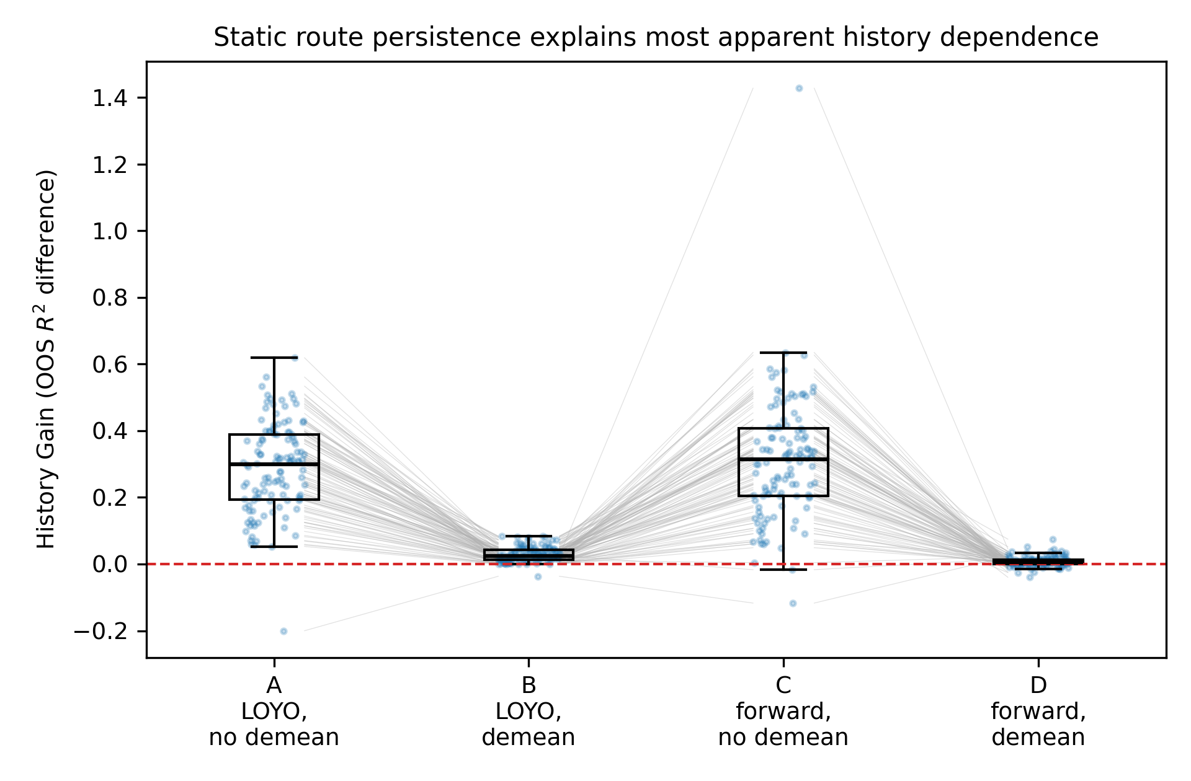
Figure 2
2×2 decomposition: CV scheme × route demeaning.

Slide 3
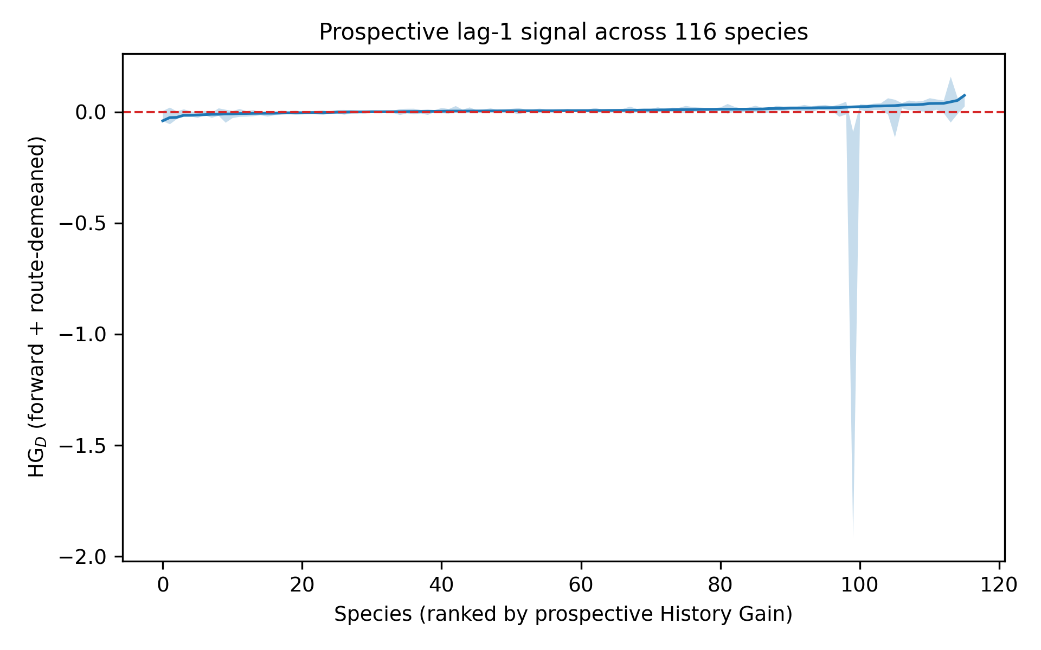
Figure 3
Prospective HG_D across species with 95% CIs.

Slide 4
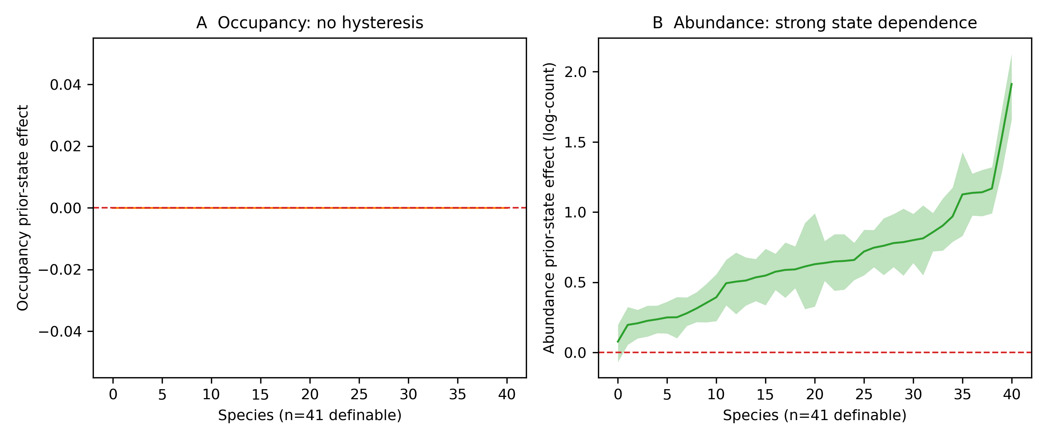
Figure 4
Occupancy vs abundance prior-state effects at matched environment.

Slide 5
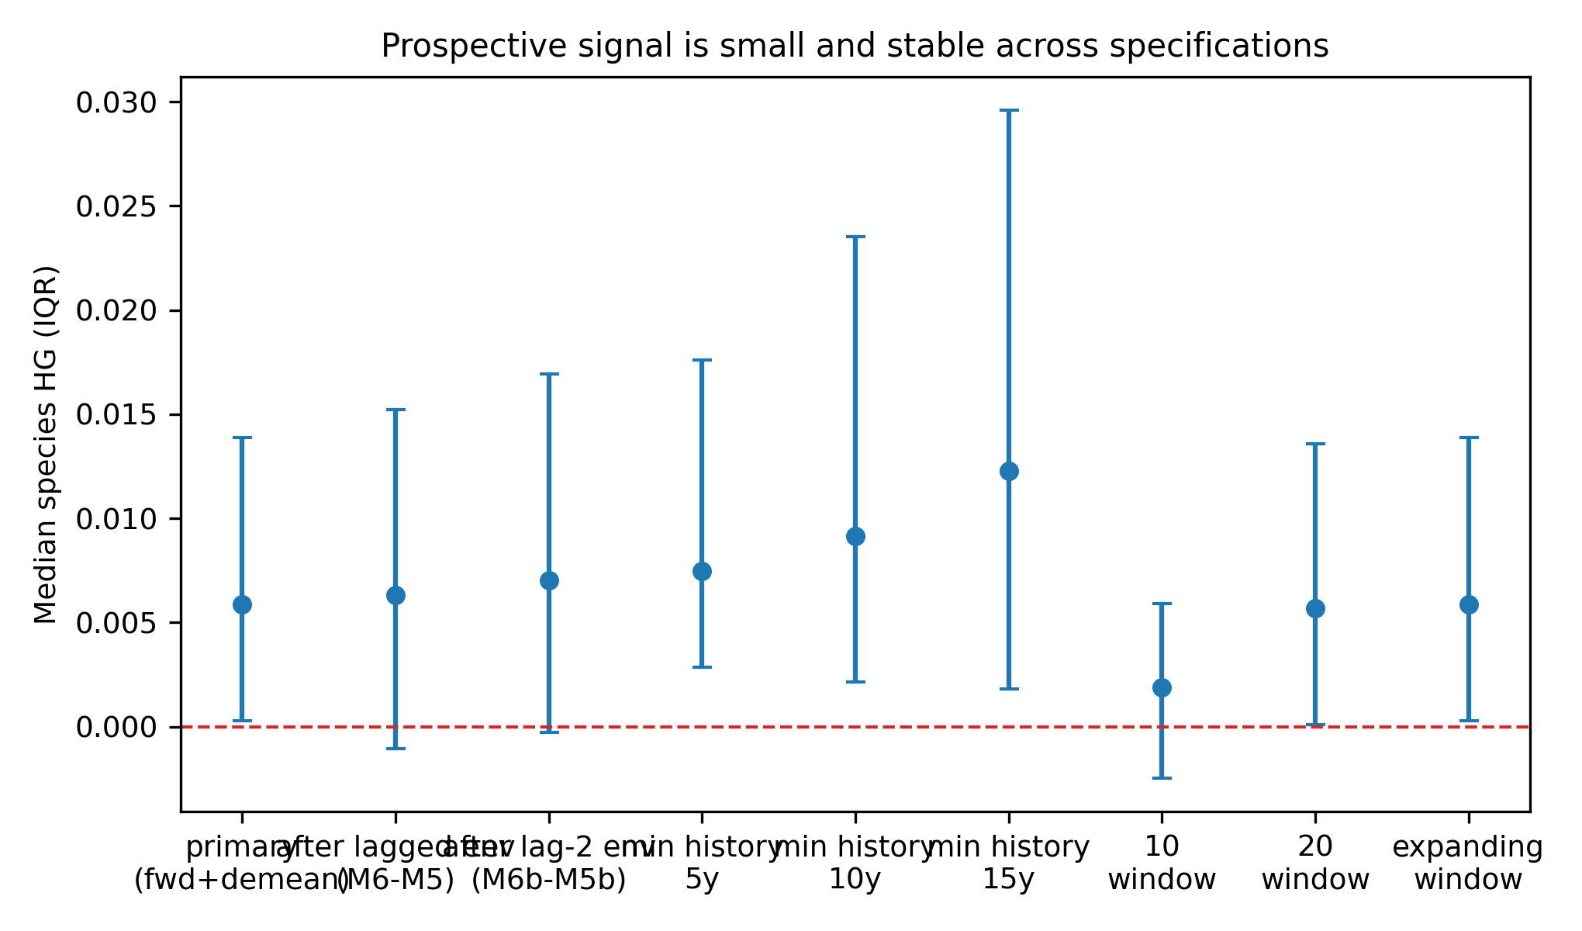
Figure 5
Specification curve: lagged env, training history, windows.

Slide 6
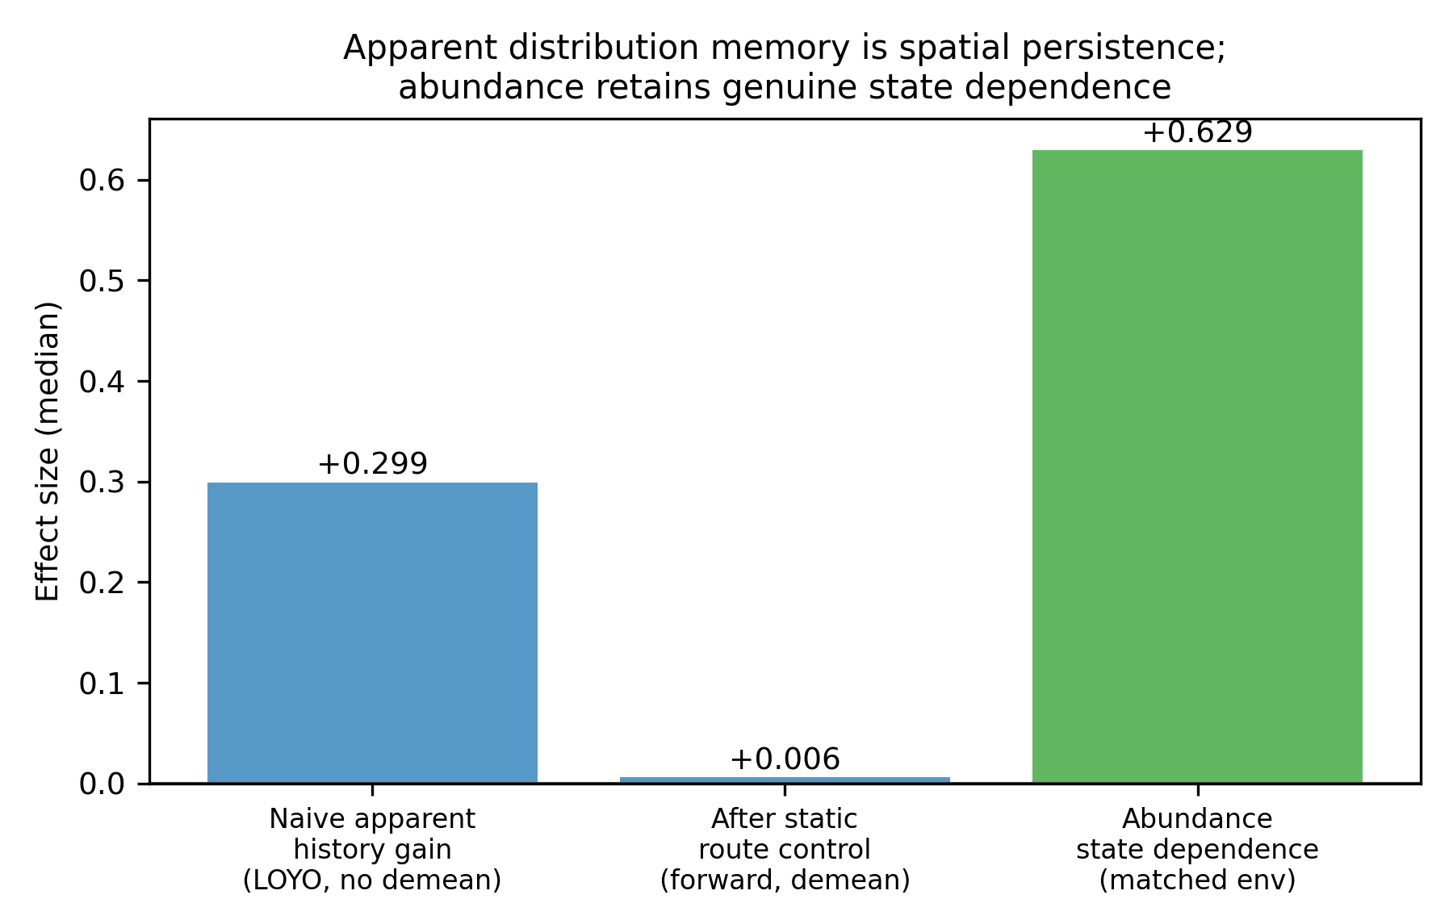
Figure 6
Interpretation: static persistence vs abundance state dependence.

