Slide 1
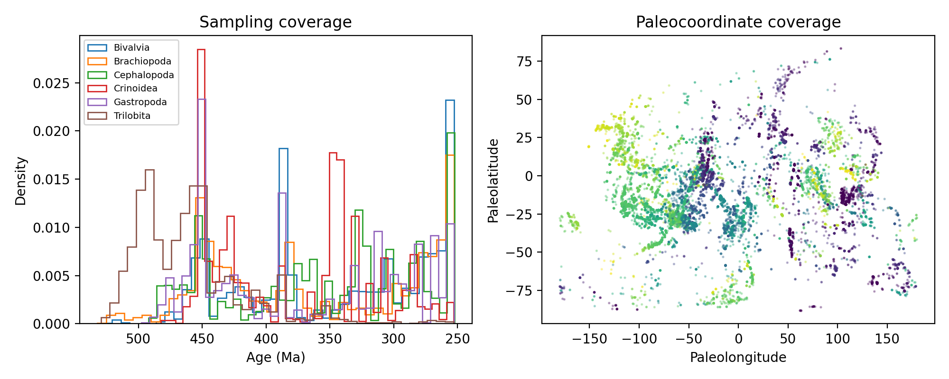
Figure 1
Figure 1. Study design and Paleozoic sampling coverage. Occurrence density by age (left) and paleocoordinate coverage coloured by age (right).

Slide 2
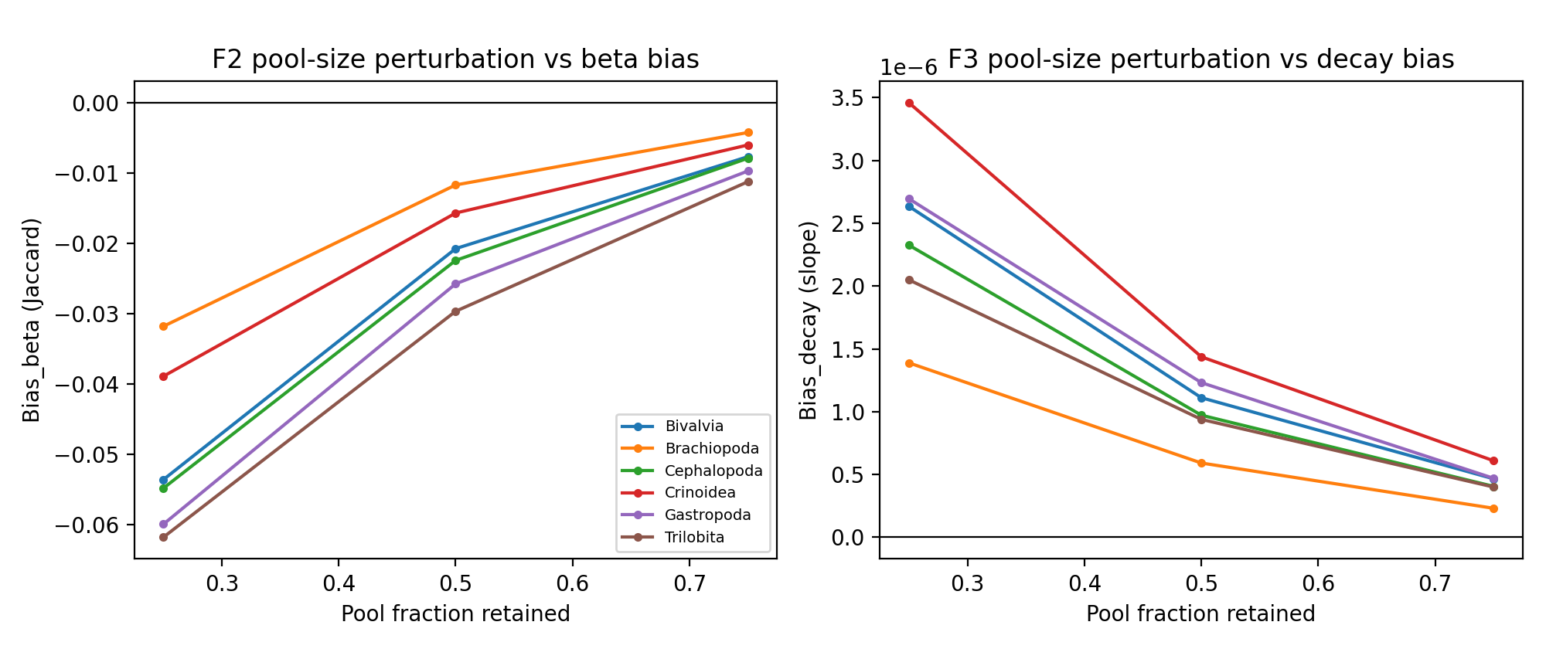
Figure 2
Figure 2. Taxonomic-pool perturbation vs beta-diversity bias. Points are means over Monte Carlo replicates per clade; Bias_beta = beta_perturbed - beta_reference (Jaccard).

Slide 3
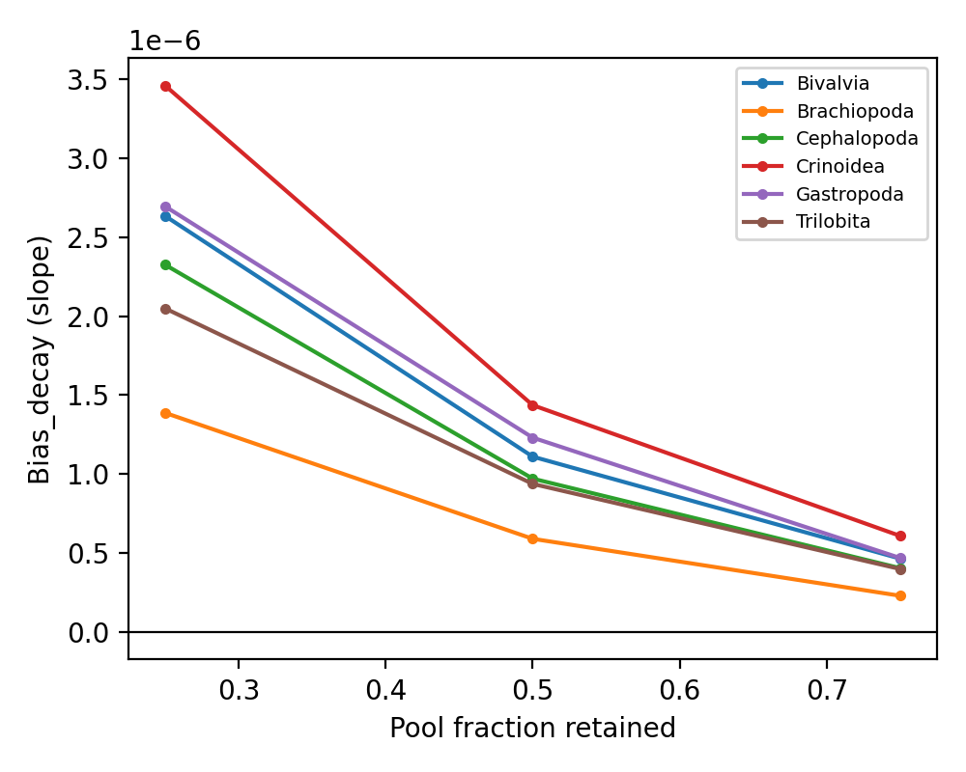
Figure 3
Figure 3. Taxonomic-pool perturbation vs distance-decay bias. Median change in the OLS Jaccard-distance slope relative to the unperturbed reference.

Slide 4
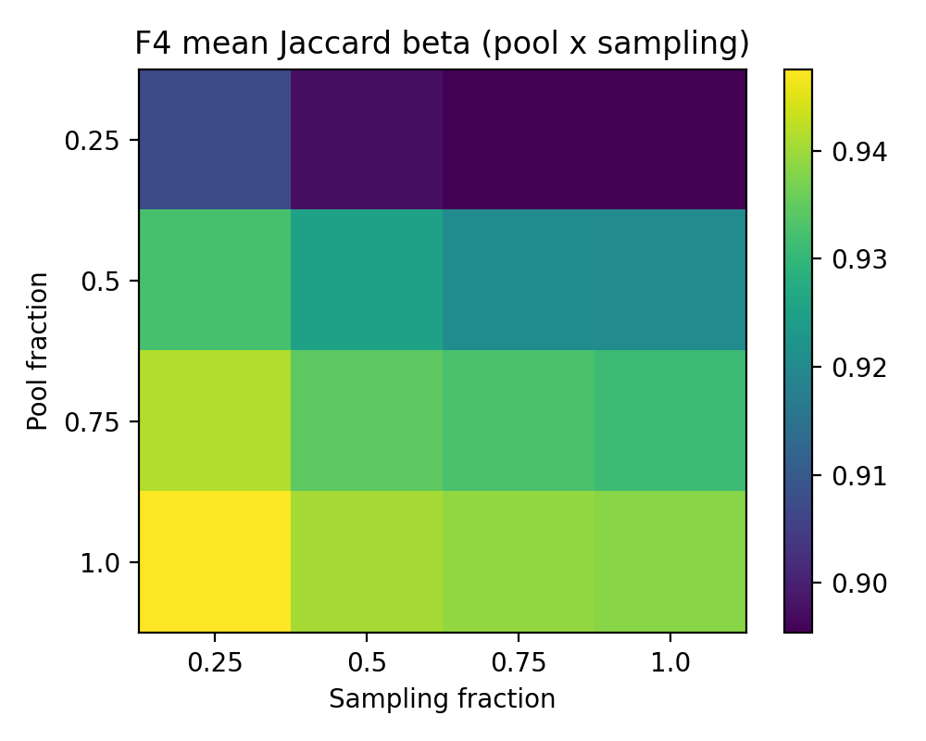
Figure 4
Figure 4. Sampling x pool-size interaction. Mean Jaccard beta across the factorial grid (stage-level bins).

Slide 5
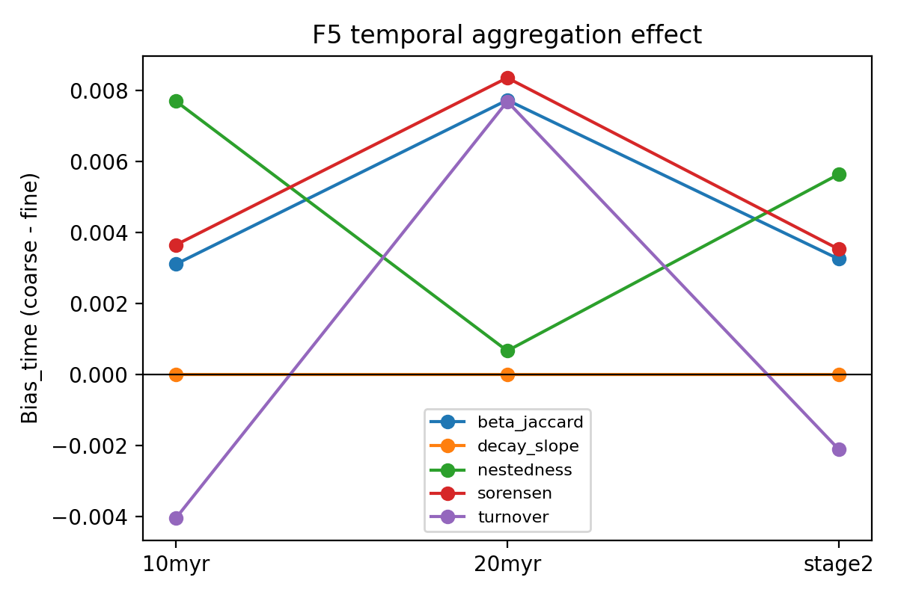
Figure 5
Figure 5. Temporal aggregation effect. Mean Bias_time (coarse minus fine resolution) per metric and aggregation ladder.

Slide 6
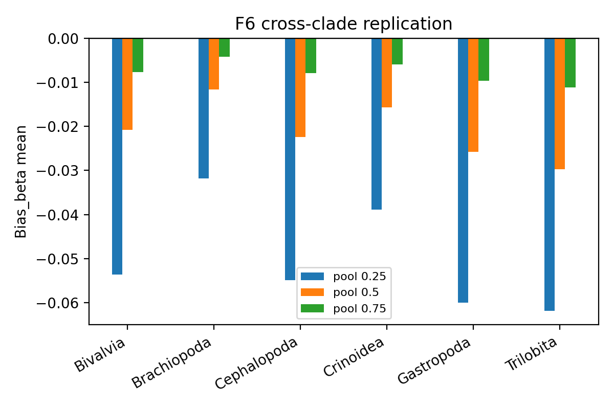
Figure 6
Figure 6. Cross-clade replication. Mean Bias_beta by clade and retained pool fraction.

