Slide 1
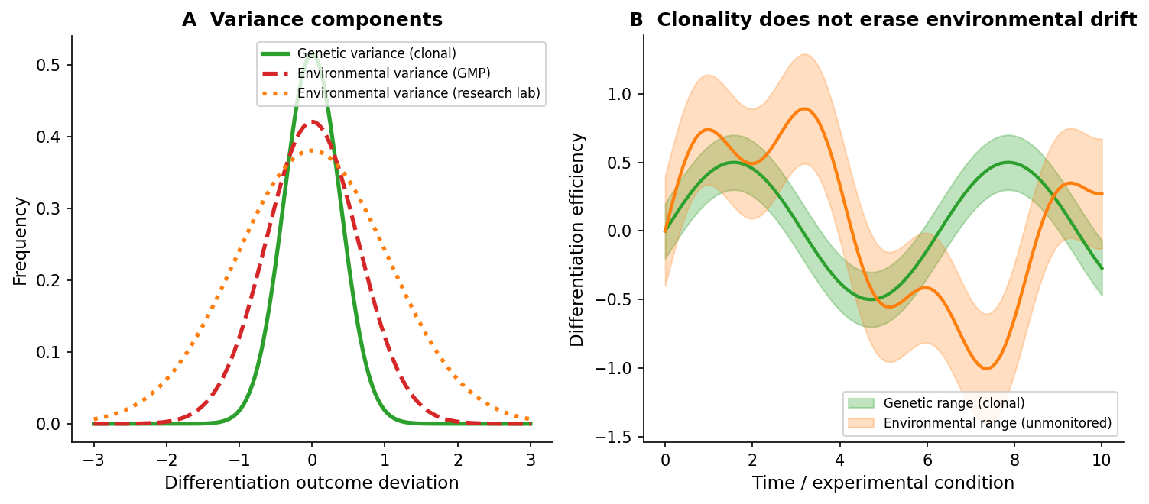
Figure 1. Clonality reduces genetic variance but does not eliminate environmental variance
Conceptual model of the clonal complacency trap. (A) A clonal population has narrow genetic variance (green) but can still experience wide environmental variance (orange), especially in research laboratories that do not monitor environmental parameters. (B) Over time, unmonitored environmental drift can produce outcome variation comparable to-or larger than-genetic effects, even when all cells are isogenic.

