Slide 1
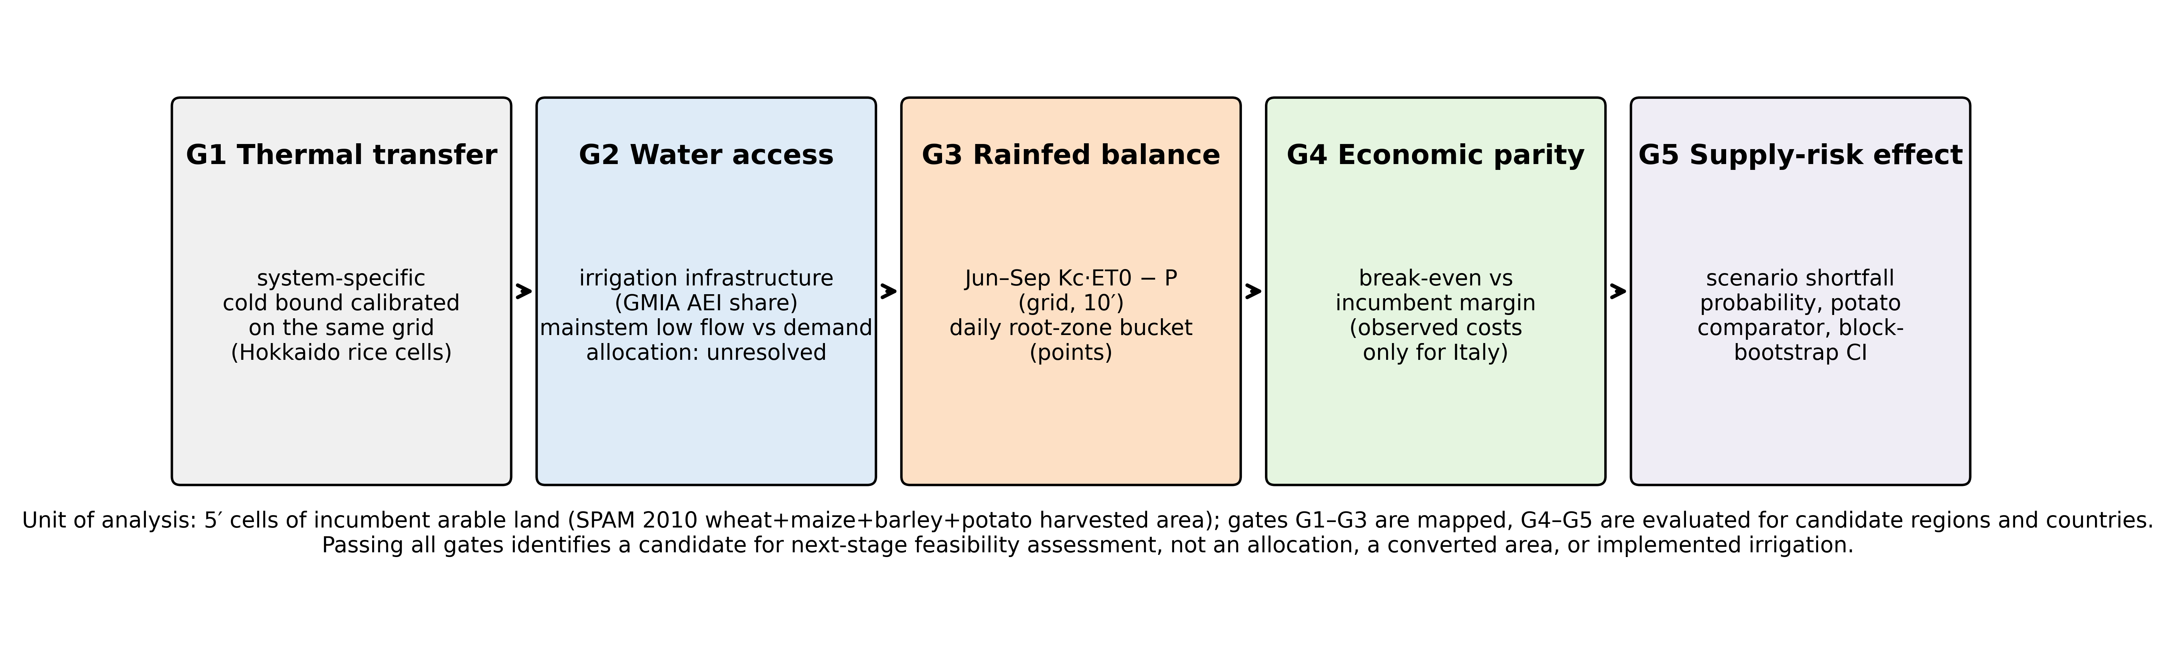
Figure 1
Gate framework. Five sequential, non-compensatory gates evaluated for a transferable cold-region japonica rice system on incumbent arable land. Passing all gates identifies a candidate for next-stage feasibility assessment, not an allocation or converted area.

Slide 2
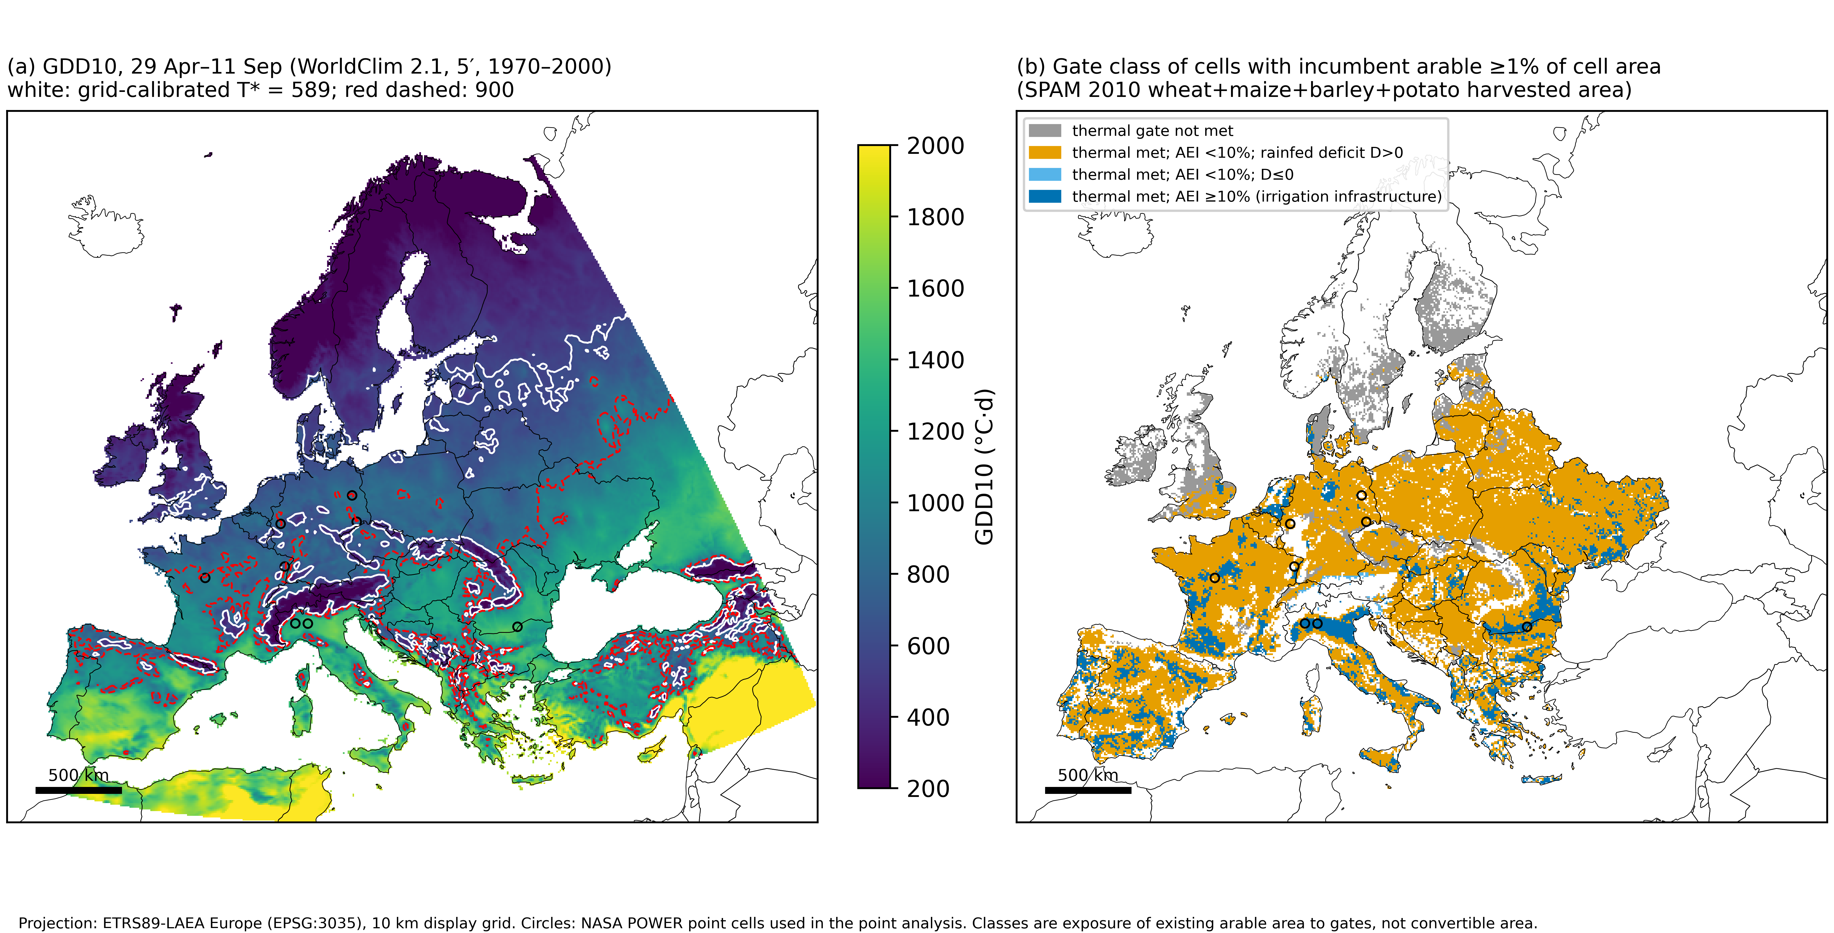
Figure 2
(a) GDD10 for 29 April–11 September from WorldClim 2.1 (5′, 1970–2000), with the grid-calibrated Hokkaido bound T* = 589 (white) and the point-derived 900 GDD10 (red, dashed). (b) Gate class of 5′ cells with incumbent arable land ≥1% of cell area. AEI, area equipped for irrigation (GMIA v5). Circles mark NASA POWER point cells. ETRS89-LAEA projection. Cells outside the European domain (Natural Earth Europe excluding Russia) are not classified.

Slide 3
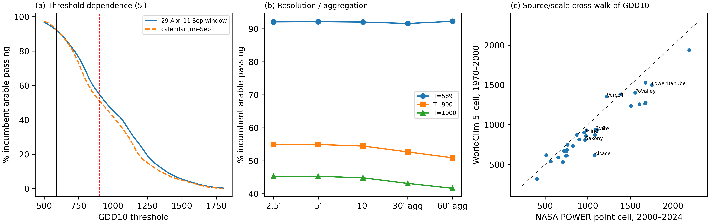
Figure 3
Sensitivity of the thermal gate. (a) Share of incumbent arable land passing as a function of the GDD10 threshold for two seasonal windows (vertical lines: T* and 900). (b) Share passing by native resolution (2.5′, 5′, 10′) and after aggregation of 5′ GDD10 to 30′ and 60′. (c) NASA POWER point-cell GDD10 (2000–2024) versus the containing WorldClim 5′ cell (1970–2000); dotted line 1:1.

Slide 4
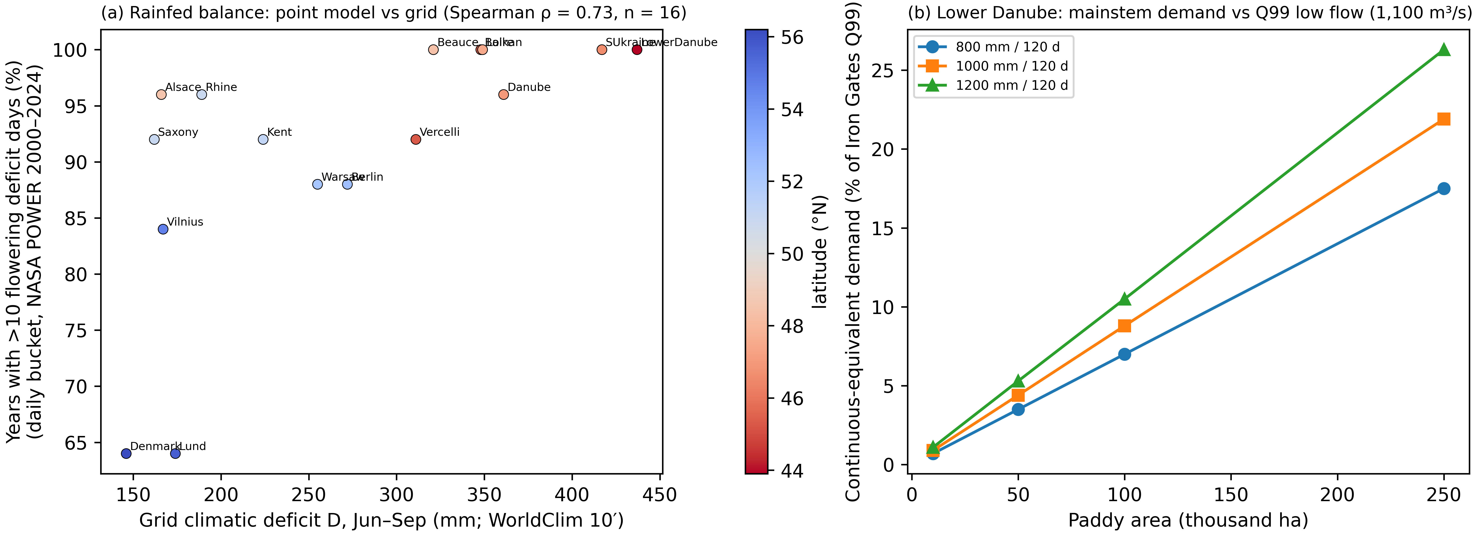
Figure 4
Water geography. (a) Grid Jun–Sep climatic deficit D (WorldClim 10′) versus the share of years with >10 flowering-stage deficit days from the daily bucket model at NASA POWER point cells (Spearman ρ = 0.73, n = 16); colour shows latitude. (b) Continuous-equivalent paddy water demand on the Lower Danube as a percentage of Iron Gates Q99 low flow (1,100 m³/s) for three seasonal depths over 120 days; mainstem comparison only.

Slide 5
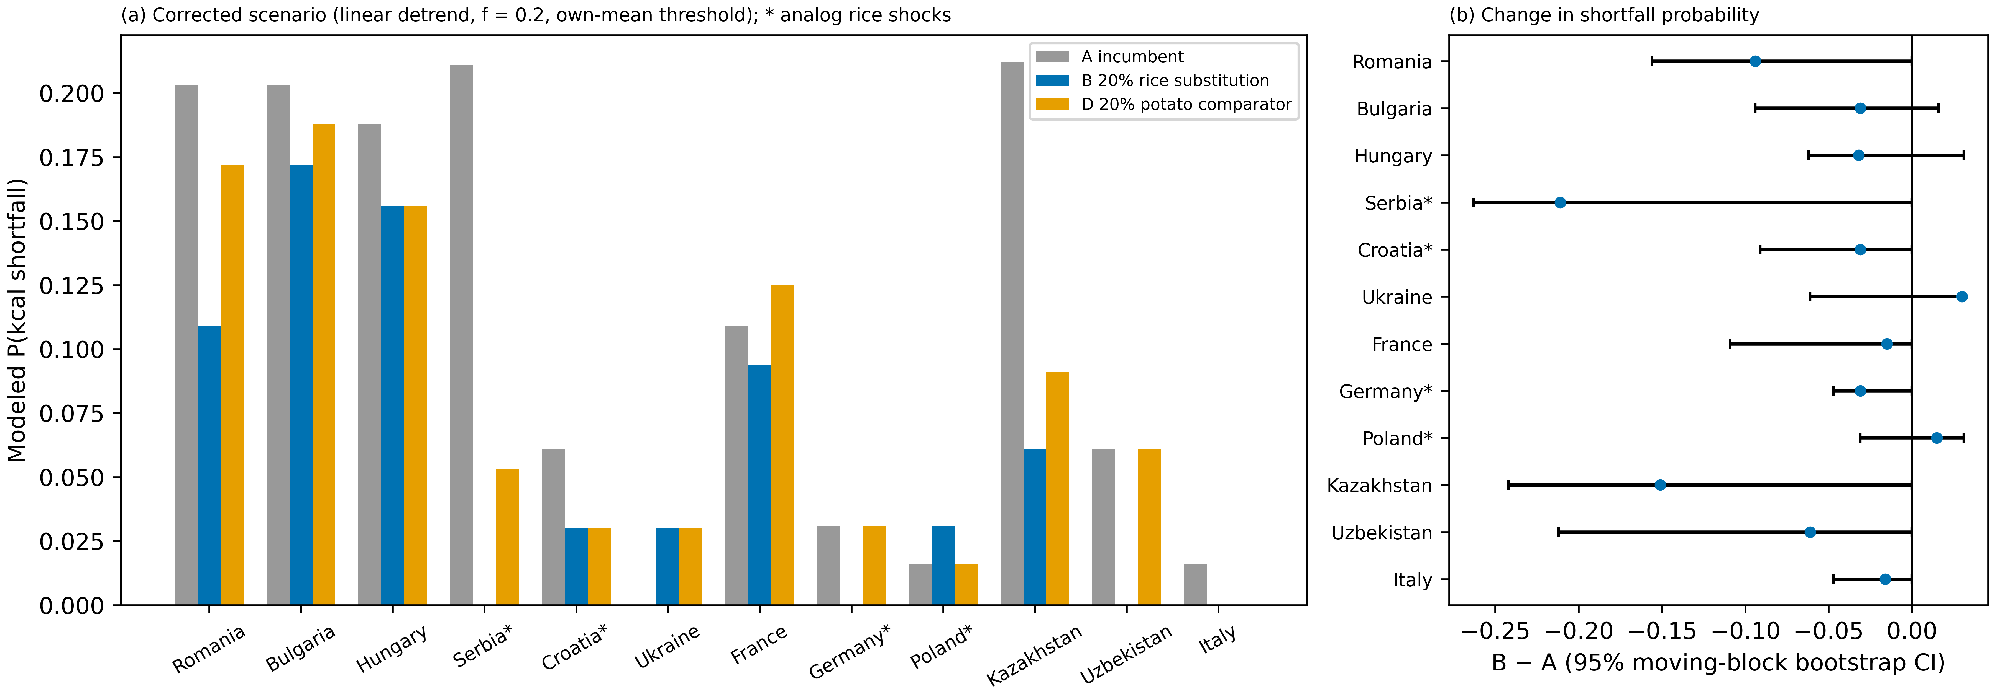
Figure 5
Corrected food-supply portfolio scenarios. (a) Modeled probability that portfolio calories fall below 80% of their mean for the incumbent portfolio (A), 20% rice substitution (B) and 20% potato comparator (D). (b) Change B − A with 95% moving-block bootstrap intervals (3-year blocks, 2,000 resamples). * Rice shocks and yield level from an analog country.

