Slide 1
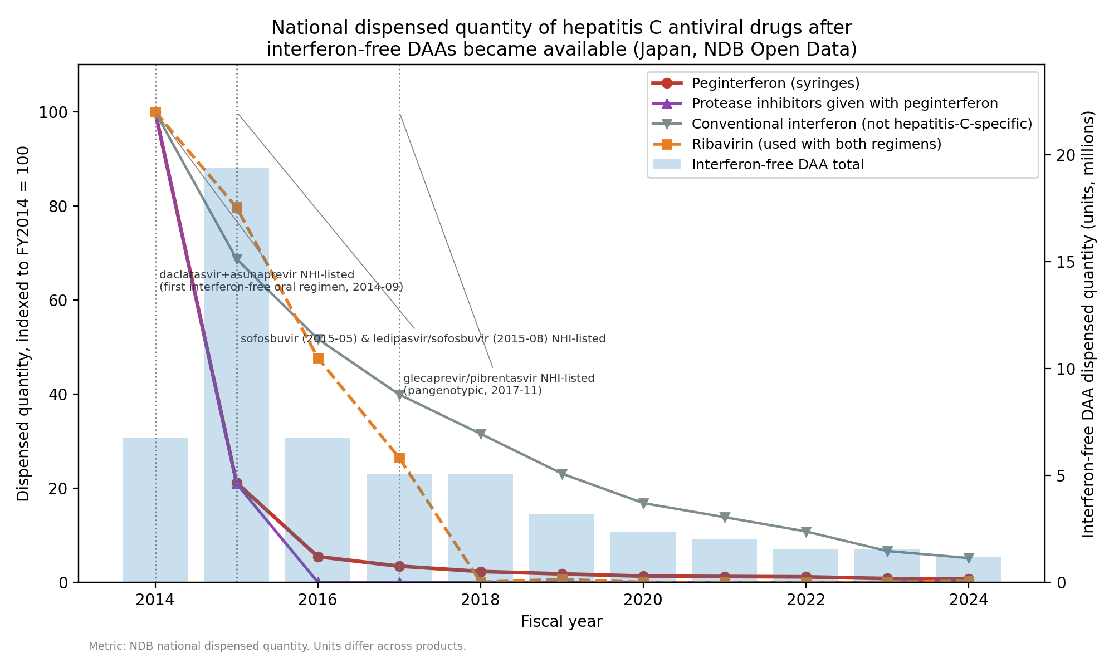
Figure 1. National dispensed quantity of hepatitis C antiviral drugs

Slide 2
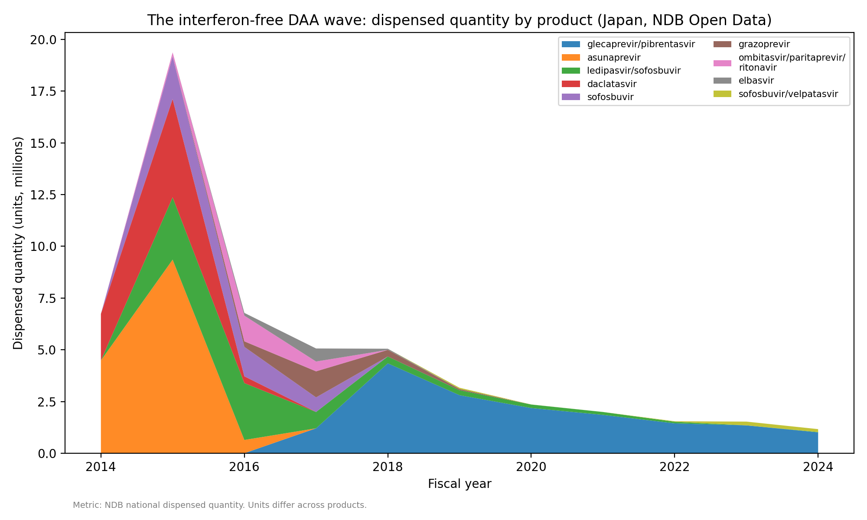
Figure 2. Interferon-free DAA dispensed quantity by product

Slide 3
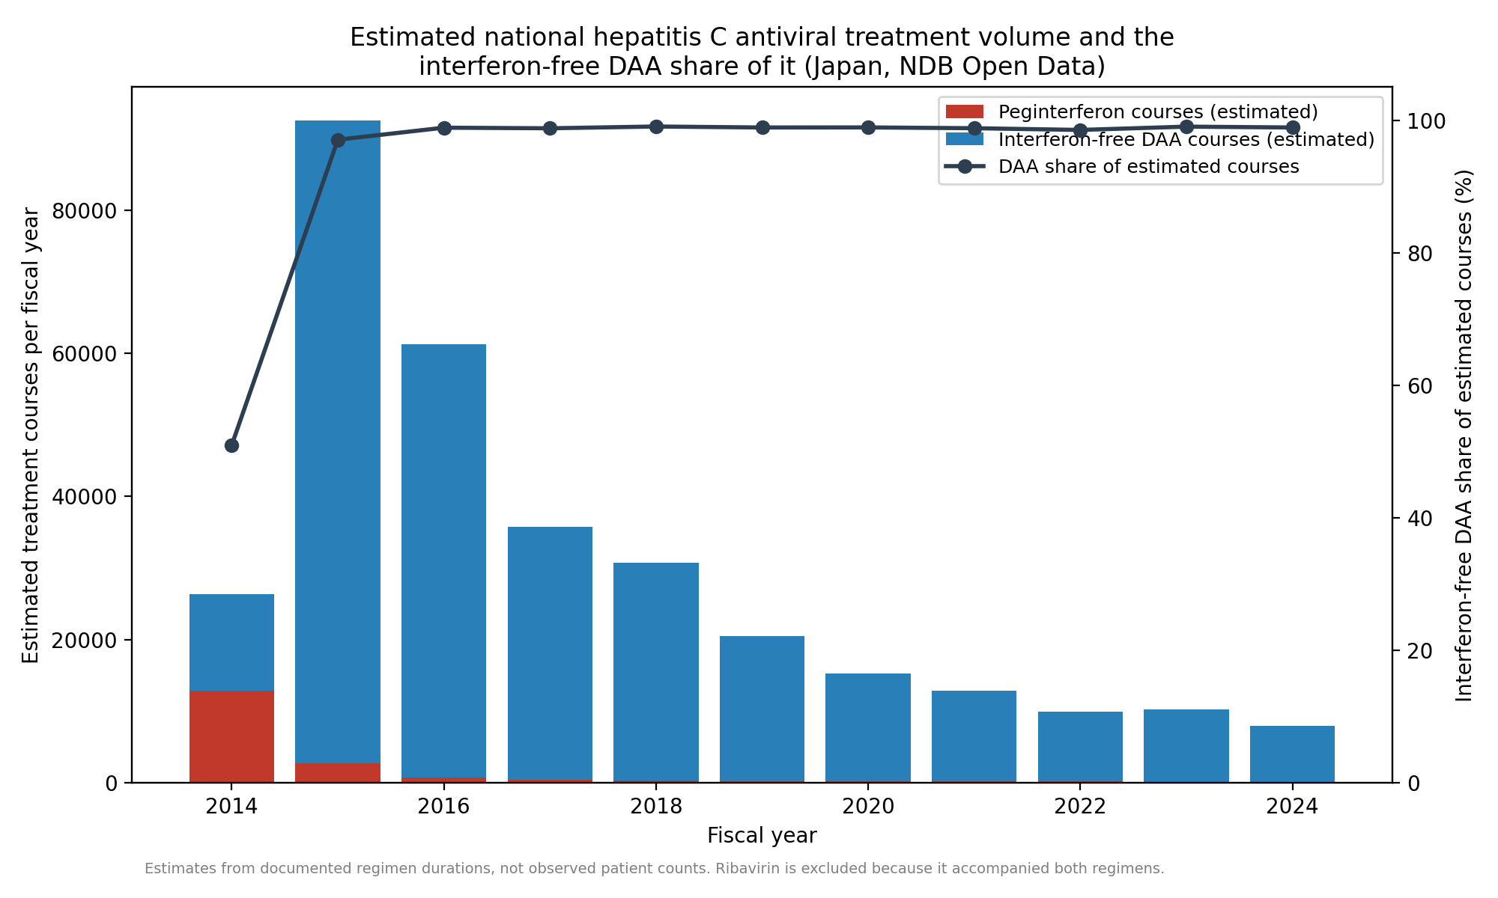
Figure 3. Estimated treatment volume and the interferon-free DAA share of it

