Slide 1
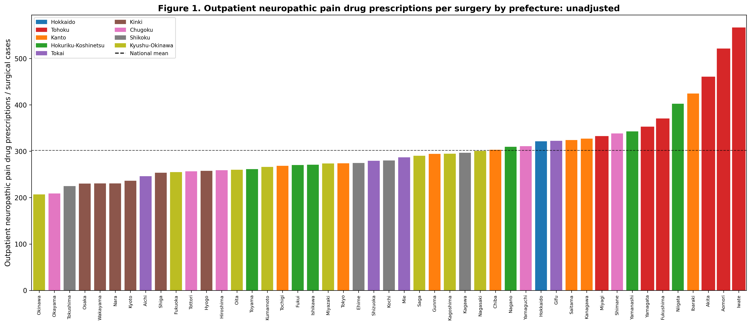
Figure 1
Outpatient neuropathic pain drug prescribing per surgery by prefecture (unadjusted). Tohoku prefectures (red bars) cluster at the high end. Dashed line = national mean.

Slide 2
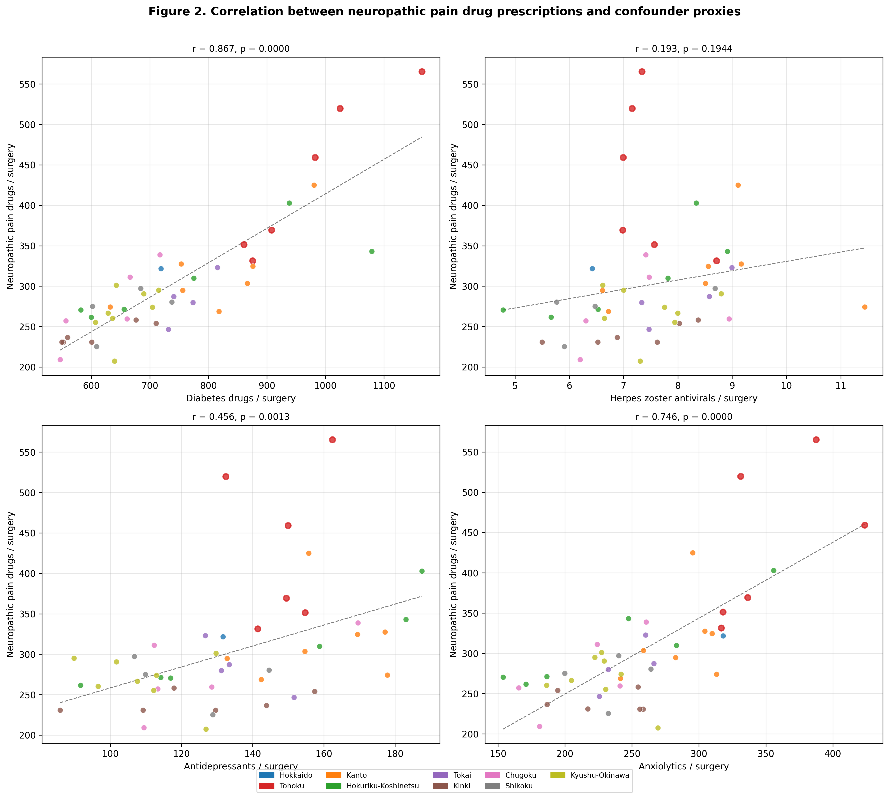
Figure 2
Correlation between outpatient neuropathic pain drug prescribing and confounder disease proxies. Diabetes drugs show the strongest correlation (r = 0.87).

Slide 3
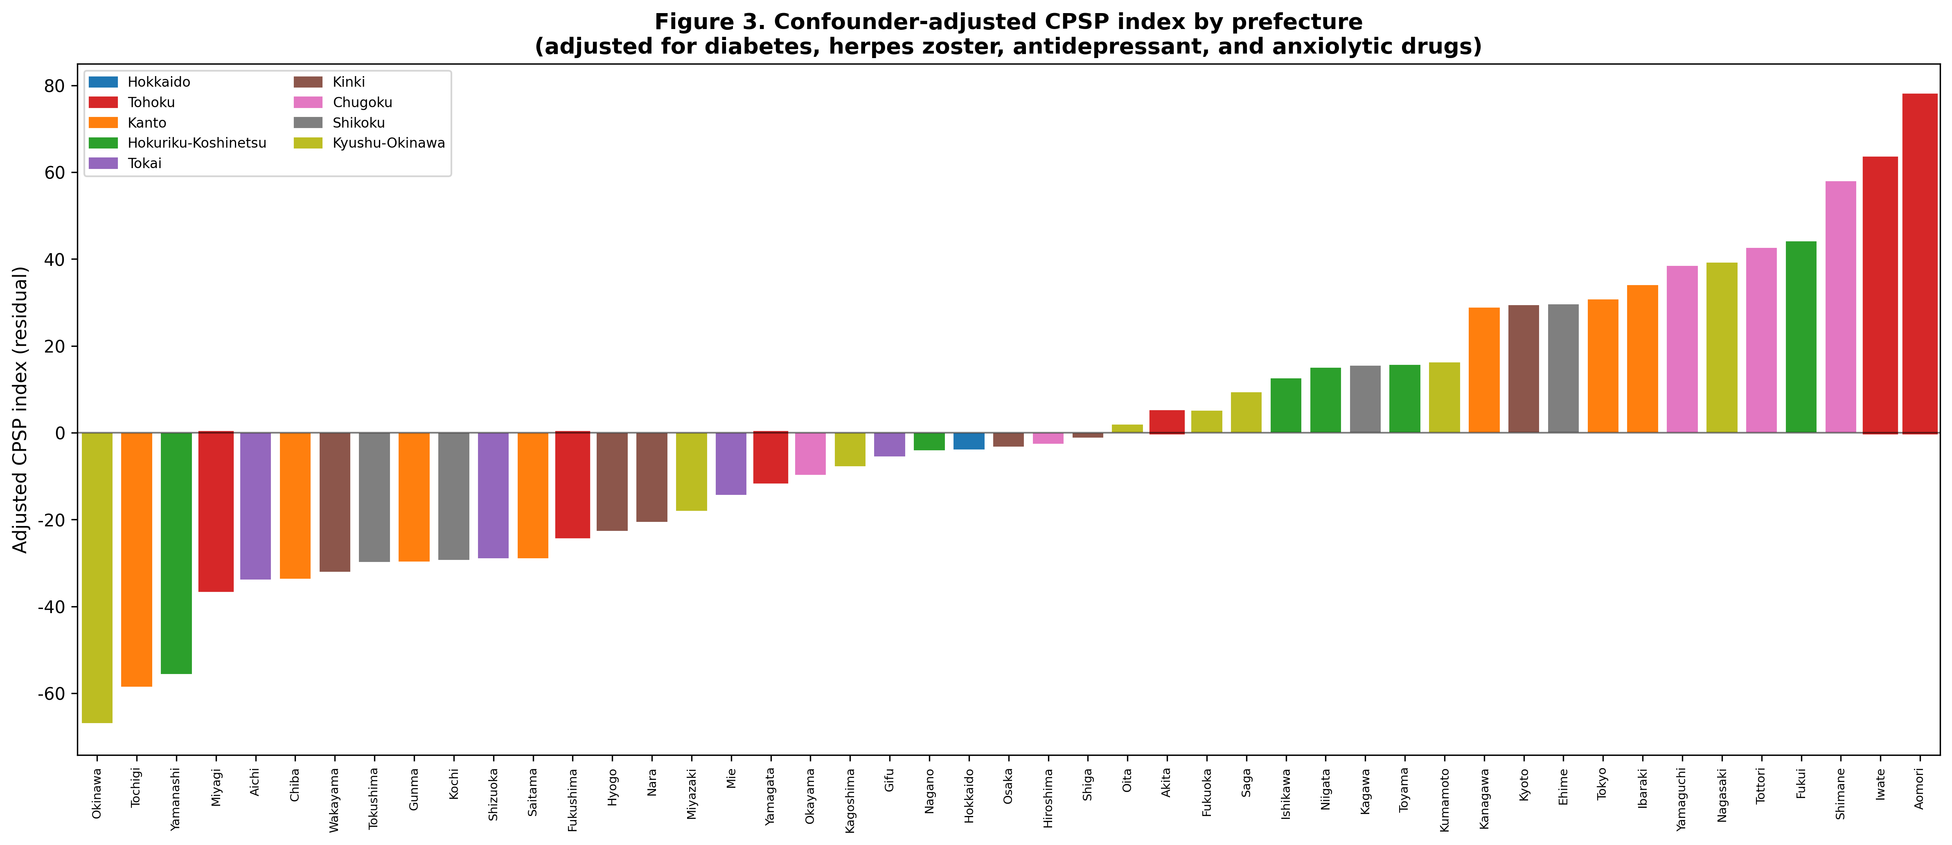
Figure 3
Confounder-adjusted CPSP index by prefecture. Residuals from regressing neuropathic pain prescribing on four confounder proxies. Tohoku prefectures (red borders) are dispersed after adjustment.

Slide 4
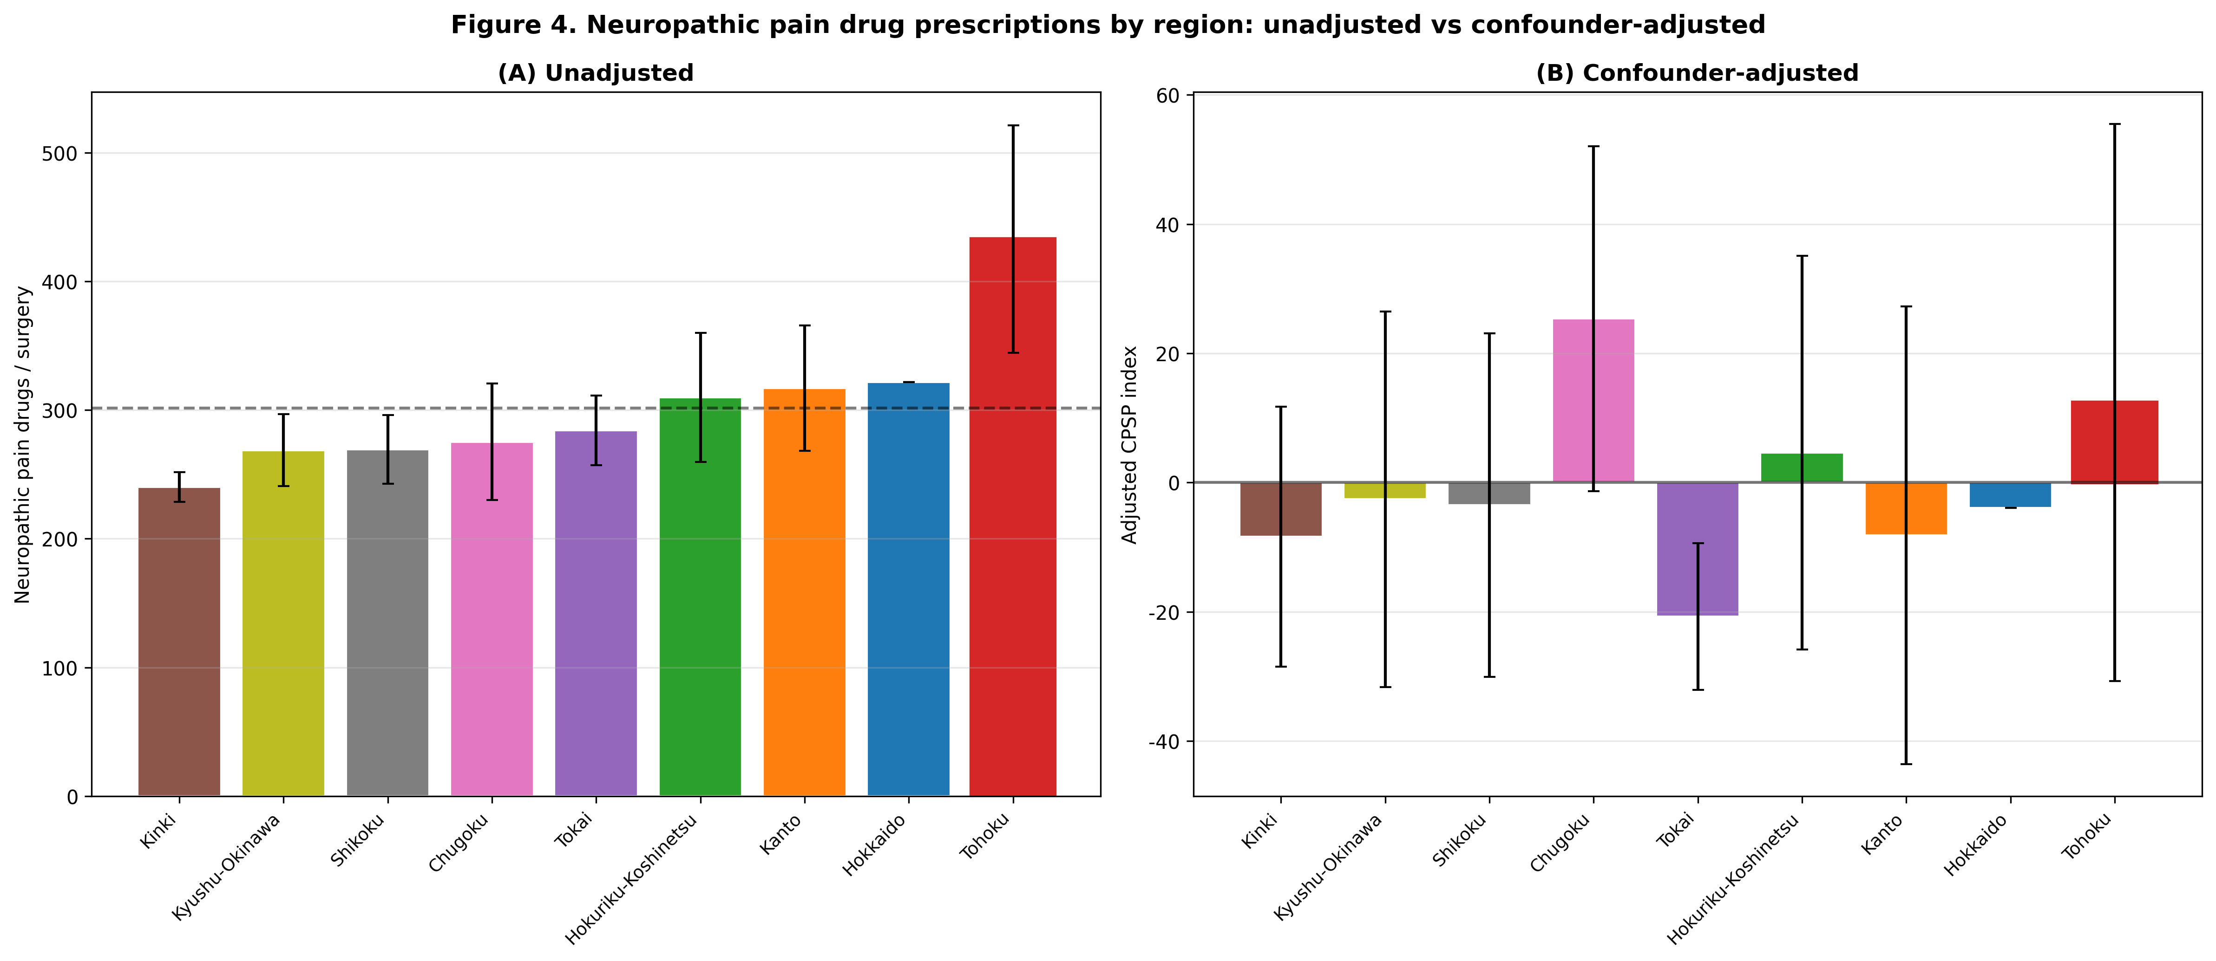
Figure 4
Regional comparison of neuropathic pain prescribing: (a) unadjusted and (b) after confounder adjustment. Tohoku shifts from highest to mid-range after adjustment.

Slide 5
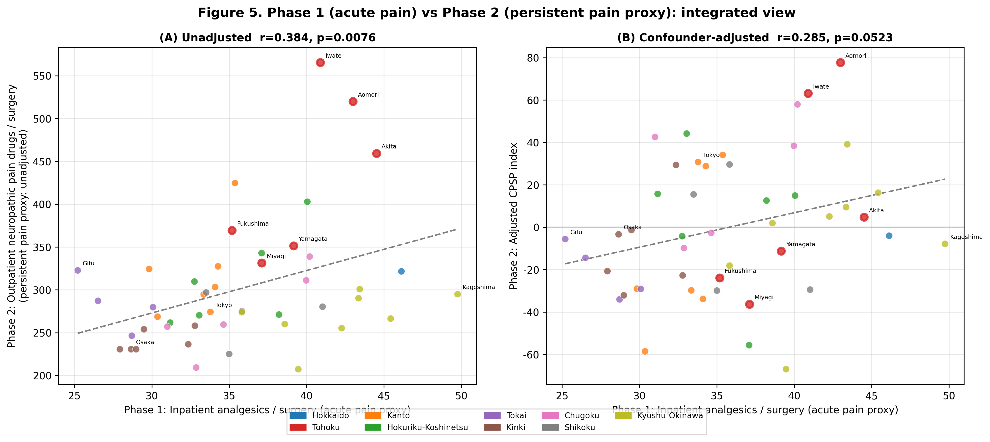
Figure 5
Integration of Phase 1 (acute) and Phase 2 (chronic CPSP proxy). (a) Unadjusted: r = 0.38, P = 0.008. (b) Confounder-adjusted: r = 0.29, P = 0.052.

Slide 6
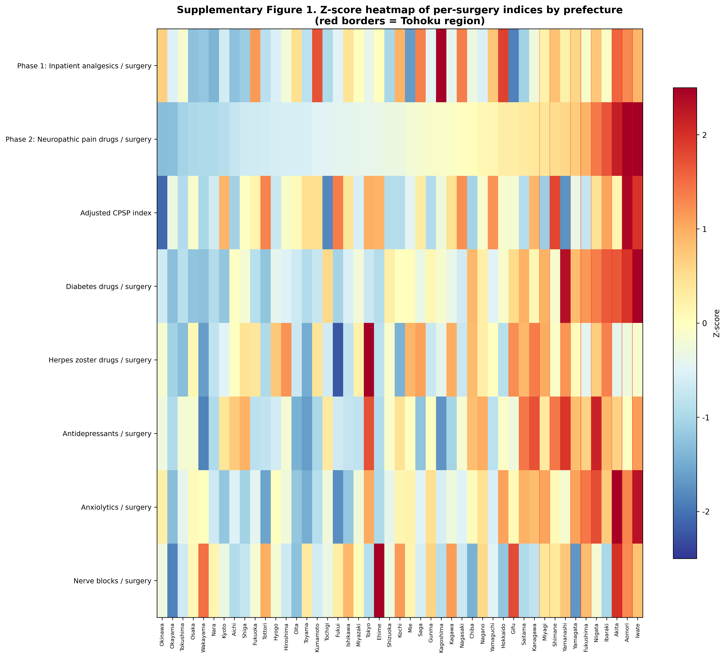
Supplementary Figure 1
Z-score heatmap of all indices by prefecture. Red = above average; blue = below average. Tohoku prefectures marked with red vertical lines.

