Slide 1
Regional Variation in Perioperative and Chronic Pain-Related Prescribing Across Japan
An Integrated Ecological Study Using the NDB Open Data Phase 1: Acute Pain | Phase 2: Chronic Postsurgical Pain (CPSP)

Slide 2
Study Design: Data Sources and Analytical Framework
NDB Open Data 10th Ed.
(Apr 2023 - Mar 2024)
Inpatient analgesic prescriptions
(Classes 114, 811, 821)
Outpatient neuropathic pain drugs
(PGB, MGB, DLX, TRM, NTP)
Inpatient surgery counts
(K Surgery section)
Confounder proxies (outpatient):
Diabetes drugs | Herpes antivirals
Antidepressants | Anxiolytics
Phase 1: Acute Pain Index
Analgesic qty / Surgery count
Phase 2: CPSP Proxy
Neuropathic drugs / Surgery count
Adjusted CPSP Index
(Residuals after confounders)
Integration: Acute pain vs Chronic pain correlation | Tohoku comparison | Regional ranking

Slide 3
Table 1. Phase 1: Inpatient Analgesic-per-Surgery Index by Regional Block
Regional Block | n | Mean (SD) | Range | Rank
Tokai | 4 | 27.62 (2.18) | 25.20–30.07 | 1
Kinki | 6 | 30.02 (2.03) | 27.92–32.33 | 2
Kanto | 7 | 33.00 (2.09) | 29.82–34.78 | 3
Hokuriku-Koshinetsu | 6 | 35.38 (3.54) | 31.18–40.08 | 4
Chugoku | 5 | 35.73 (4.18) | 31.01–40.17 | 5
Shikoku | 4 | 36.33 (3.27) | 33.49–41.02 | 6
Tohoku | 6 | 39.97 (3.53) | 35.18–44.51 | 7
Kyushu-Okinawa | 8 | 42.26 (4.33) | 35.82–49.75 | 8
Hokkaido | 1 | 46.12 (—) | 46.12 | 9
National | 47 | 35.78 (5.56) | 25.20–49.75 | —

Slide 4
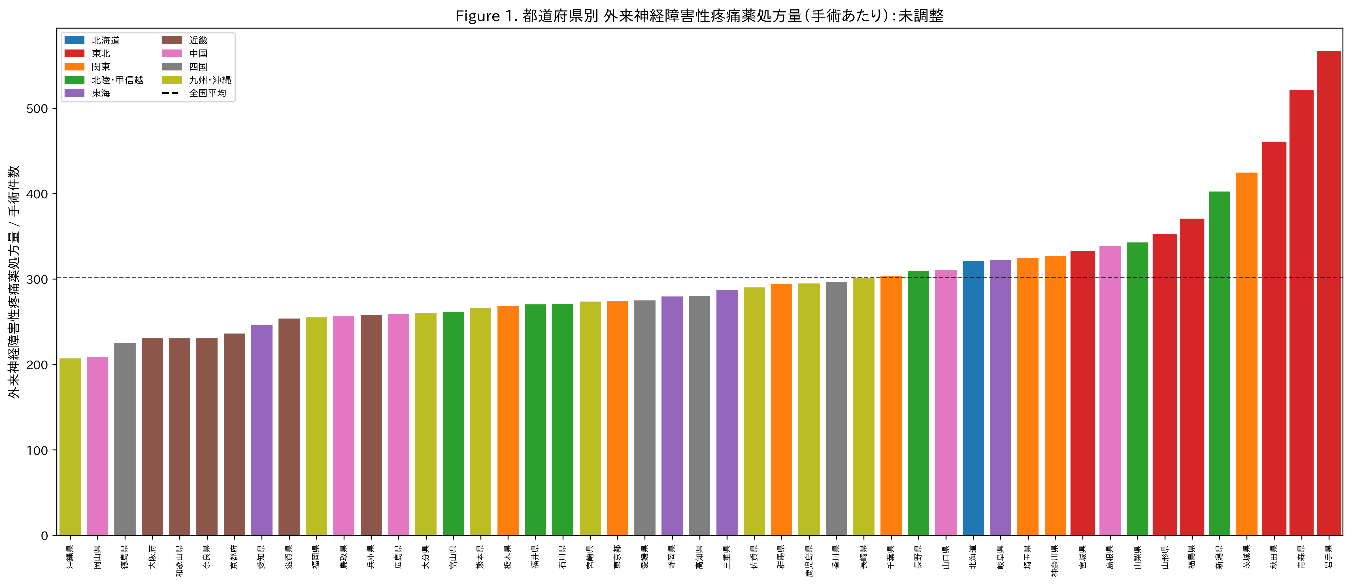
Figure 1. Outpatient Neuropathic Pain Drug Prescribing per Surgery by Prefecture (Unadjusted)
Bars = total neuropathic Rx (PGB+MGB+DLX+TRM+NTP) / inpatient surgeries. Tohoku (red borders) clusters at the high end.

Slide 5
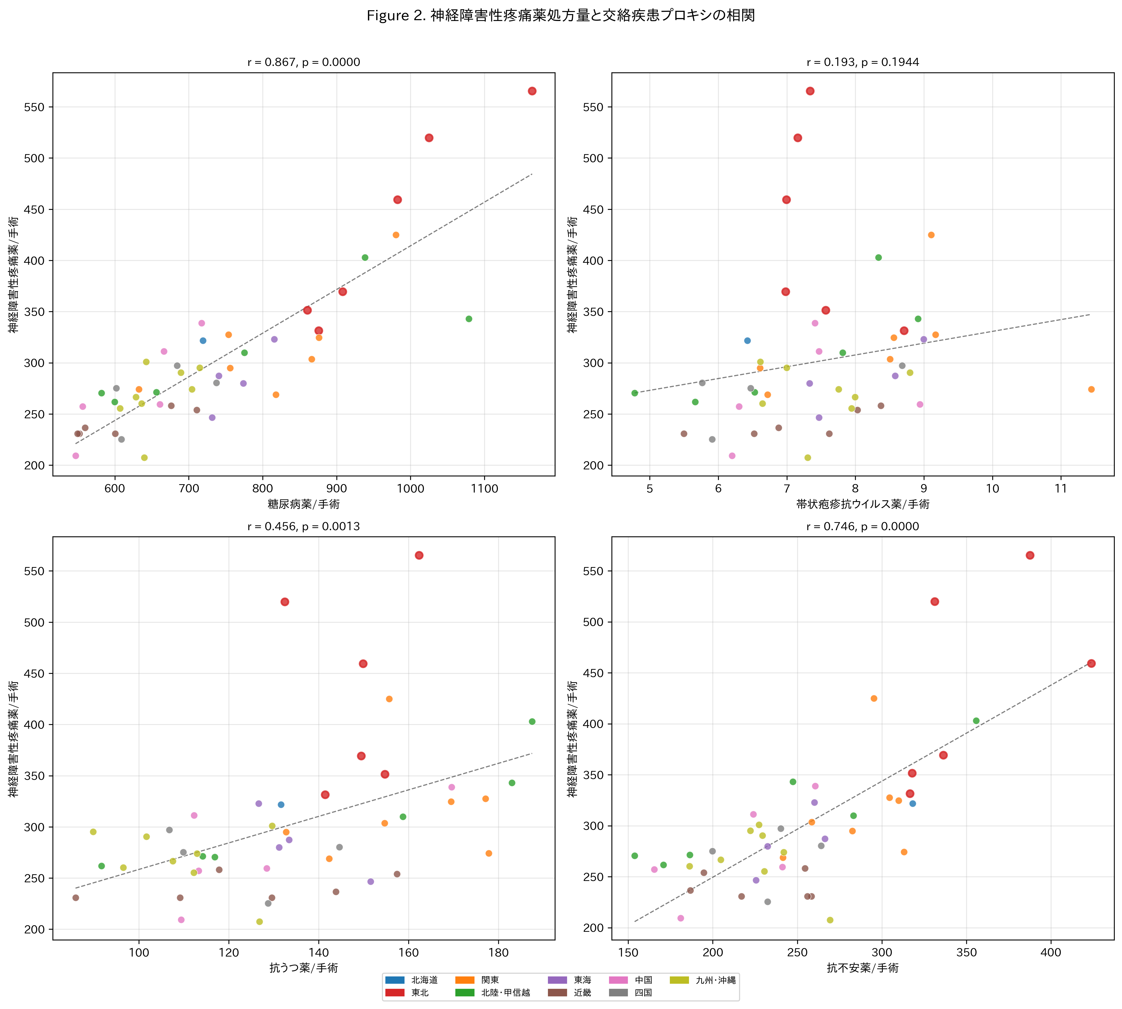
Figure 2. Correlation Between Neuropathic Pain Prescribing and Confounder Disease Proxies
Each dot = 1 prefecture. Tohoku = red borders. Diabetes drugs show strongest correlation (r=0.87).

Slide 6
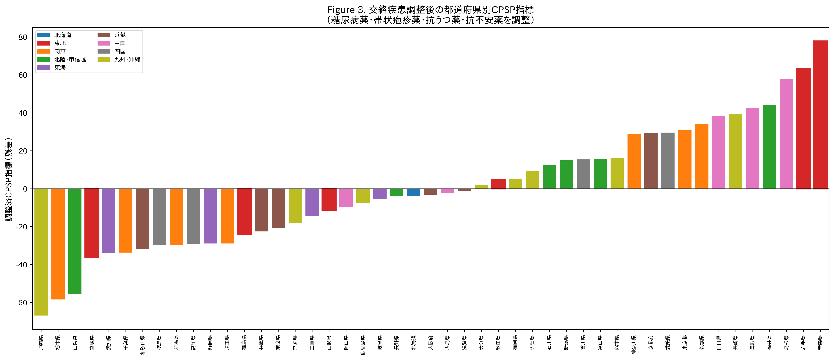
Figure 3. Confounder-Adjusted CPSP Index by Prefecture
Residuals after regressing neuropathic Rx on diabetes, herpes, antidepressant, anxiolytic proxies. Tohoku disperses after adjustment.

Slide 7
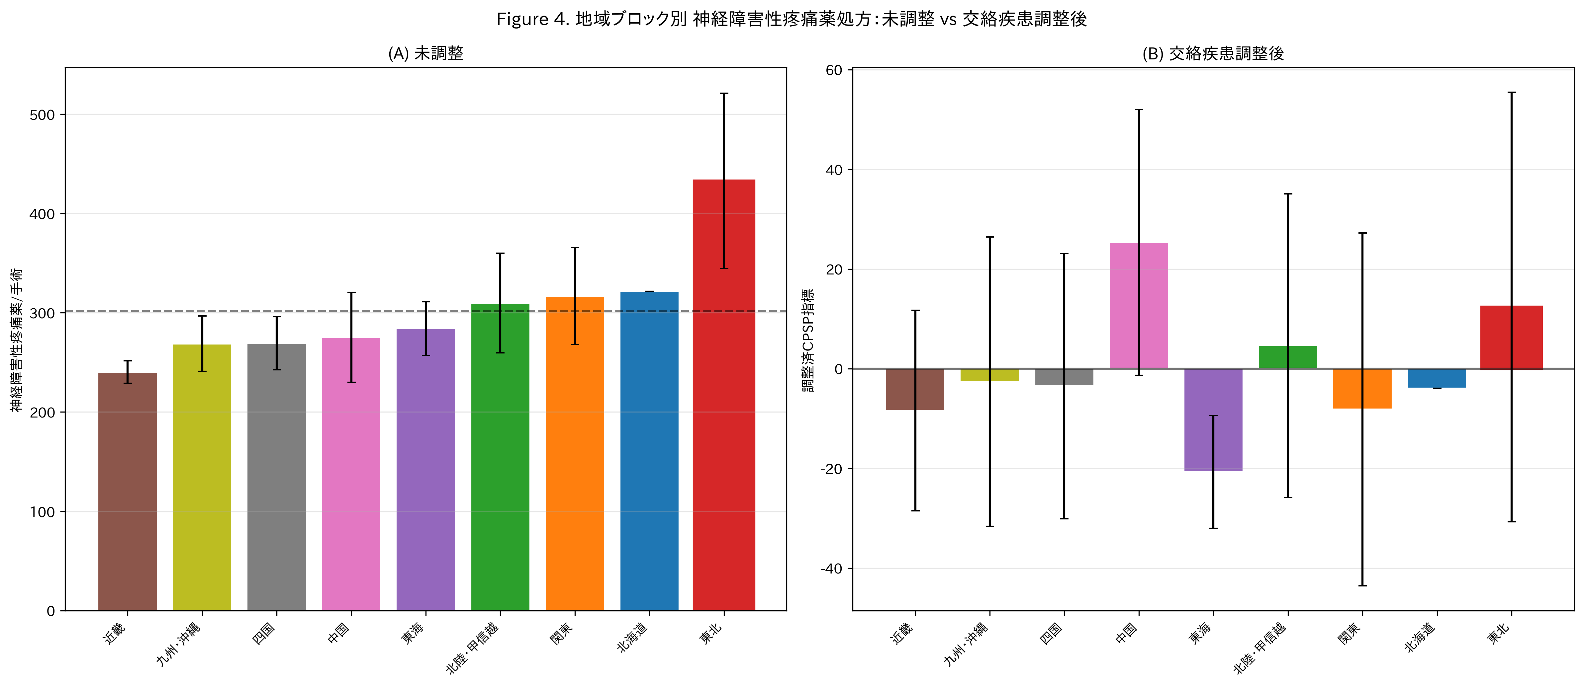
Figure 4. Regional Comparison: Unadjusted (A) vs Confounder-Adjusted (B)
Tohoku (red border) shifts from highest region to mid-range after adjustment. Error bars = SD.

Slide 8
Table 2. Regression Models: Tohoku Effect Before and After Confounder Adjustment
Model | Dependent Variable | Tohoku Effect | P value | Interpretation
1 (unadjusted) | Neuropathic/surgery | d = 2.07 | 7.4e-08 | Significant ***
2 (all confounders) | Neuropathic/surgery | β = 32.6 | 0.150 | Not significant
3 (core drugs) | PGB+MGB/surgery | β = 15.7 | 0.229 | Not significant
4 (nerve blocks) | Blocks/surgery | β = 0.08 | 0.863 | Not significant
5 (integrated) | Neuropathic/surgery | β = 31.5 | 0.149 | Not significant
Adj. CPSP index | Residuals | d = 0.44 | 0.323 | Not significant

Slide 9
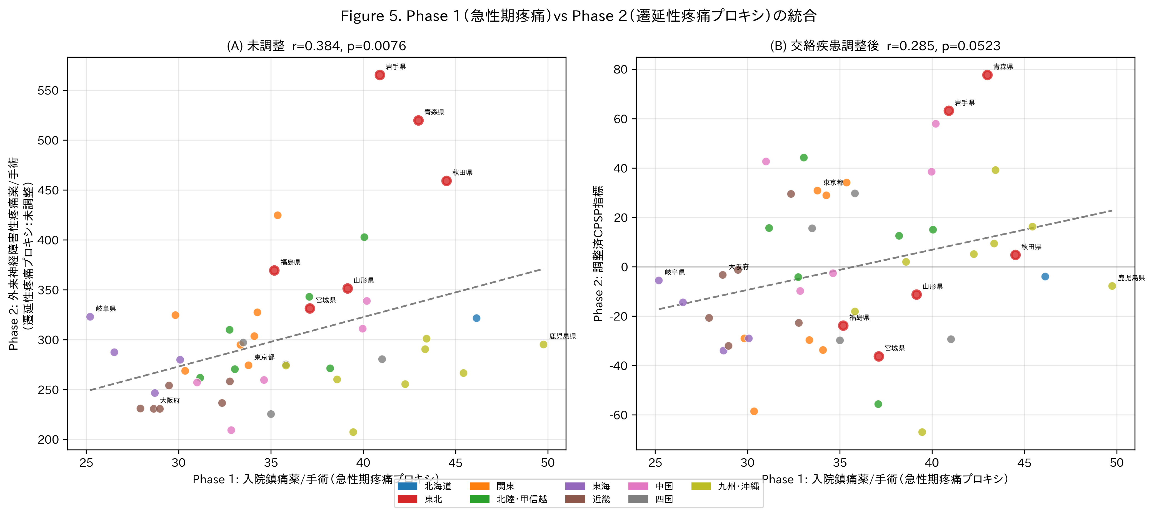
Figure 5. Phase 1 (Acute Pain) vs Phase 2 (CPSP Proxy) Integration
(A) Unadjusted: r=0.38, P=0.008. (B) Confounder-adjusted: r=0.29, P=0.052. Tohoku = red borders.

Slide 10
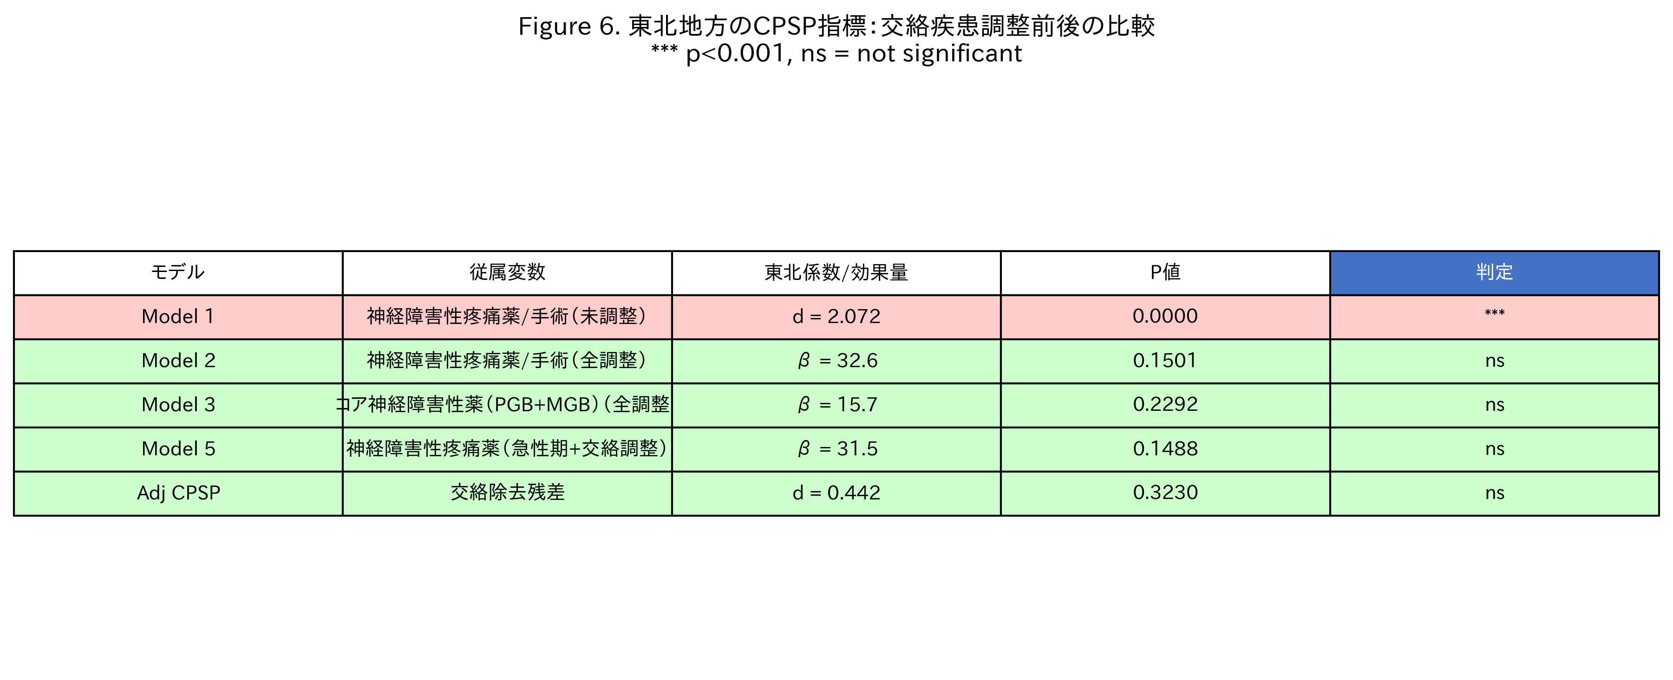
Figure 6. Summary: Tohoku Effect Across All Models
Model 1 (unadjusted) shows highly significant excess; all adjusted models show non-significant results.

Slide 11
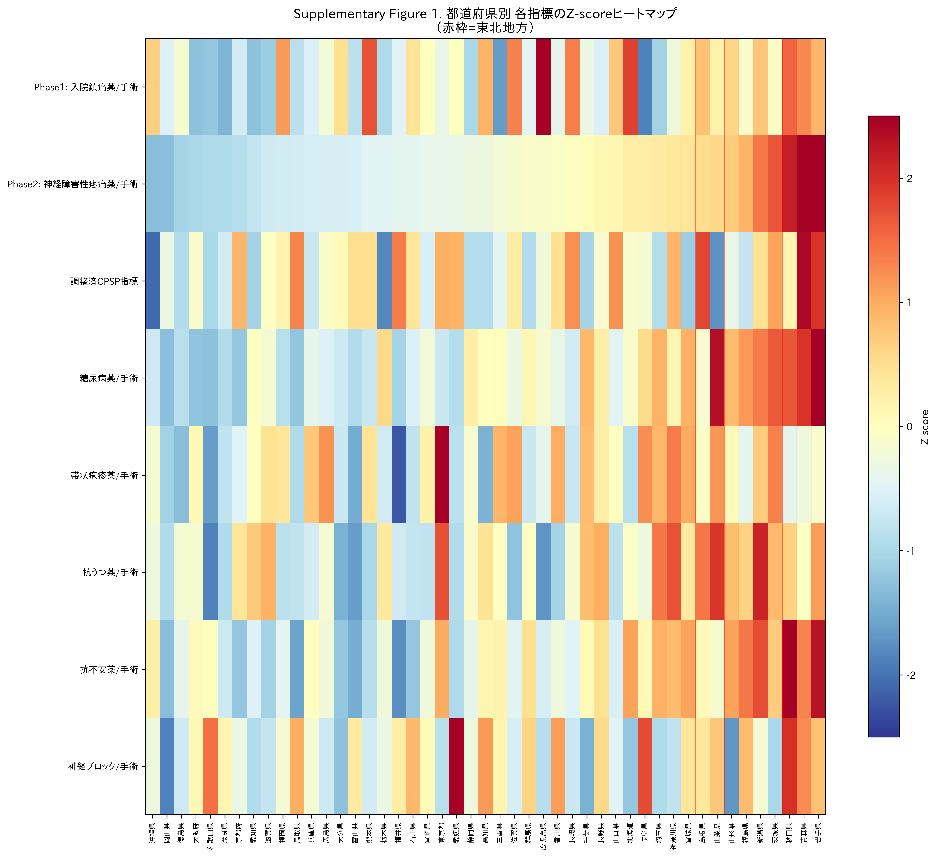
Supplementary Figure 1. Z-Score Heatmap of All Indices by Prefecture
Each row = variable; each column = prefecture (sorted by neuropathic Rx). Red = above average; blue = below average. Tohoku = red lines.

Slide 12
Key Findings Summary
Hypothesis: Tohoku "stoicism" → less analgesic use
Phase 1: Acute perioperative analgesics
Tohoku HIGHER (d=0.87, P=0.031)
→ Stoicism hypothesis REJECTED
Phase 2 (unadjusted): Neuropathic pain drugs
Tohoku HIGHEST (d=2.07, P<0.001)
But confounders not controlled
Confounder adjustment: Diabetes (r=0.87) + Herpes + Depression + Anxiety
Phase 2 (adjusted): Tohoku effect NON-SIGNIFICANT
(d=0.44, P=0.323) → Excess explained by diabetes prevalence
Integration: Acute pain ↔ Chronic pain modest correlation (r=0.29, P=0.052 after adjustment)

Slide 13
Confounder Adjustment Framework ("Noise Dilution")
Outpatient neuropathic pain drug Rx
(pregabalin, mirogabalin, duloxetine, tramadol, neurotropin)
CPSP signal
(target)
Diabetic
neuropathy
Postherpetic
neuralgia
Depression
(off-label)
Anxiety
(off-label)
Oral hypoglycaemics
(261 formulations)
Herpes antivirals
(47 formulations)
Antidepressants
(128 formulations)
Anxiolytics
(112 formulations)
OLS Regression: Neuropathic Rx = β₀ + β₁·Diabetes + β₂·Herpes + β₃·Antidep + β₄·Anxiolytic + ε
Residuals (ε) = Adjusted CPSP Index
"Unexplained" neuropathic pain after removing confounders

