Slide 1
“Japanese Patient”? — A Patient.
Regional Heterogeneity in Pain-Related Prescribing Across Japan’s 47 Prefectures Challenges the Stereotype of a Stoic Monolith An Integrated Ecological Study Using the NDB Open Data Phase 1: Acute Pain | Phase 2: Chronic Postsurgical Pain (CPSP)

Slide 2
Study Design: Data Sources and Analytical Framework
NDB Open Data 10th Ed.
(Apr 2023 - Mar 2024)
Inpatient analgesic prescriptions
(Classes 114, 811, 821)
Outpatient neuropathic pain drugs
(PGB, MGB, DLX, TRM, NTP)
Inpatient surgery counts
(K Surgery section)
Confounder proxies (outpatient):
Diabetes drugs | Herpes antivirals
Antidepressants | Anxiolytics
Phase 1: Acute Pain Index
Analgesic qty / Surgery count
Phase 2: CPSP Proxy
Neuropathic drugs / Surgery count
Adjusted CPSP Index
(Residuals after confounders)
Integration: Acute pain vs Chronic pain correlation | Regional ranking

Slide 3
Table 1. Phase 1: Inpatient Analgesic-per-Surgery Index by Regional Block
Regional Block | n | Mean (SD) | Range | Rank
Tokai | 4 | 27.62 (2.18) | 25.20–30.07 | 1
Kinki | 6 | 30.02 (2.03) | 27.92–32.33 | 2
Kanto | 7 | 33.00 (2.09) | 29.82–34.78 | 3
Hokuriku-Koshinetsu | 6 | 35.38 (3.54) | 31.18–40.08 | 4
Chugoku | 5 | 35.73 (4.18) | 31.01–40.17 | 5
Shikoku | 4 | 36.33 (3.27) | 33.49–41.02 | 6
Tohoku | 6 | 39.97 (3.53) | 35.18–44.51 | 7
Kyushu-Okinawa | 8 | 42.26 (4.33) | 35.82–49.75 | 8
Hokkaido | 1 | 46.12 (—) | 46.12 | 9
National | 47 | 35.78 (5.56) | 25.20–49.75 | —

Slide 4
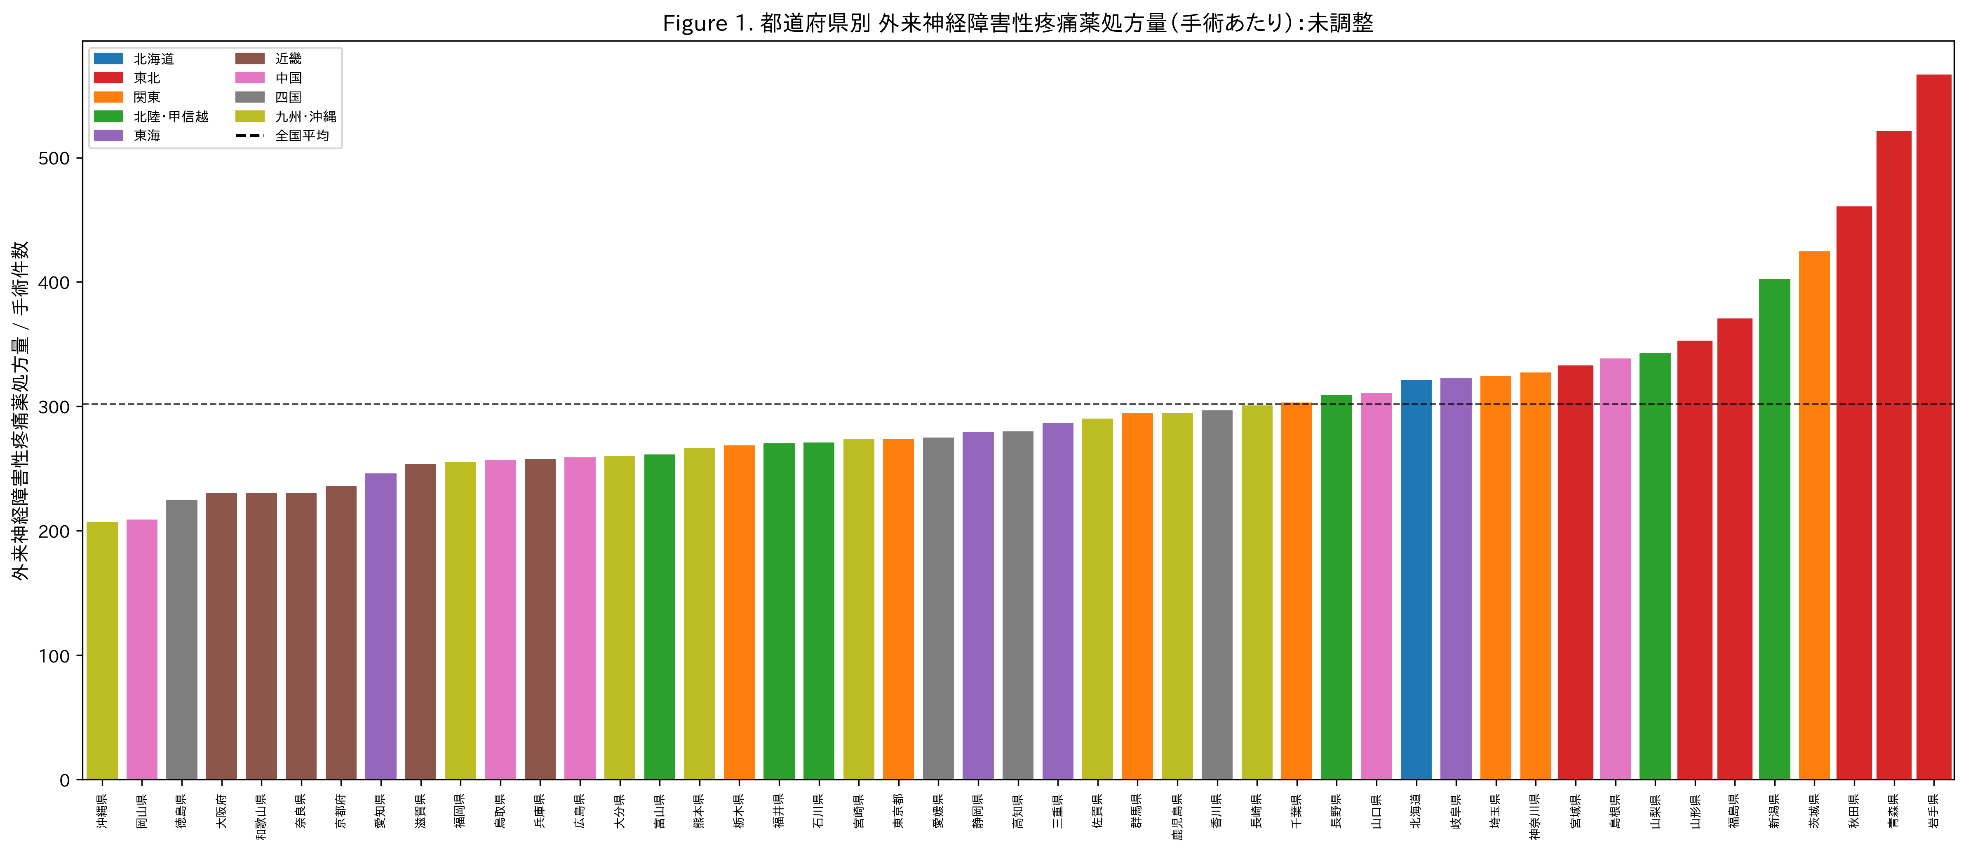
Figure 1. Outpatient Neuropathic Pain Drug Prescribing per Surgery by Prefecture (Unadjusted)
Bars = total neuropathic Rx (PGB+MGB+DLX+TRM+NTP) / inpatient surgeries. Tohoku (red borders) clusters at the high end.

Slide 5
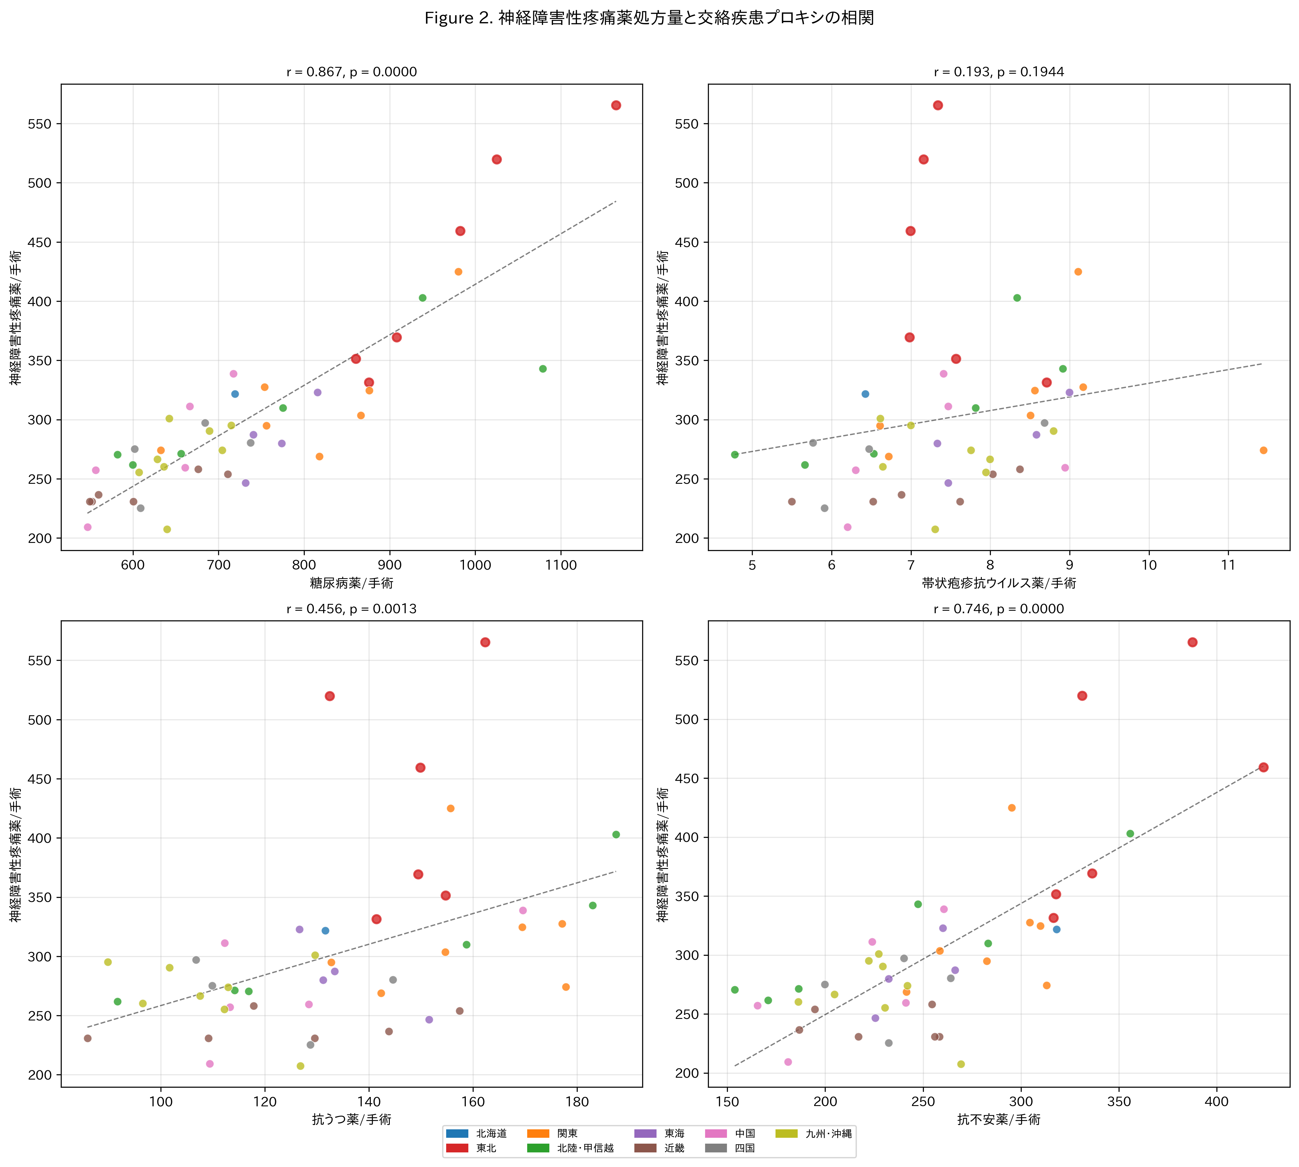
Figure 2. Correlation Between Neuropathic Pain Prescribing and Confounder Disease Proxies
Each dot = 1 prefecture. Tohoku = red borders. Diabetes drugs show strongest correlation (r=0.87).

Slide 6
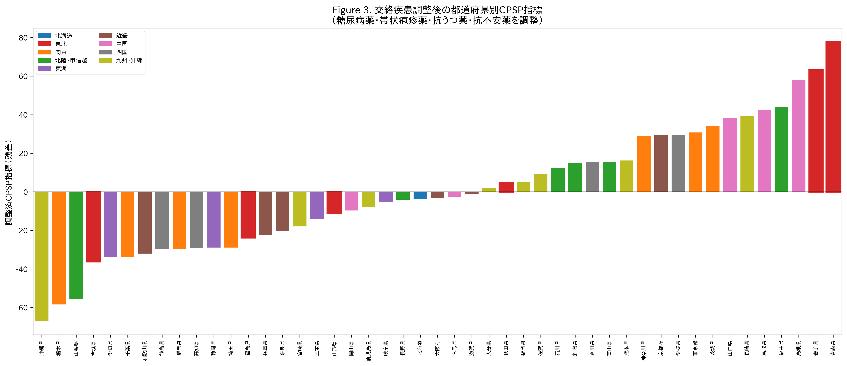
Figure 3. Confounder-Adjusted CPSP Index by Prefecture
Residuals after regressing neuropathic Rx on diabetes, herpes, antidepressant, anxiolytic proxies. Tohoku disperses after adjustment.

Slide 7
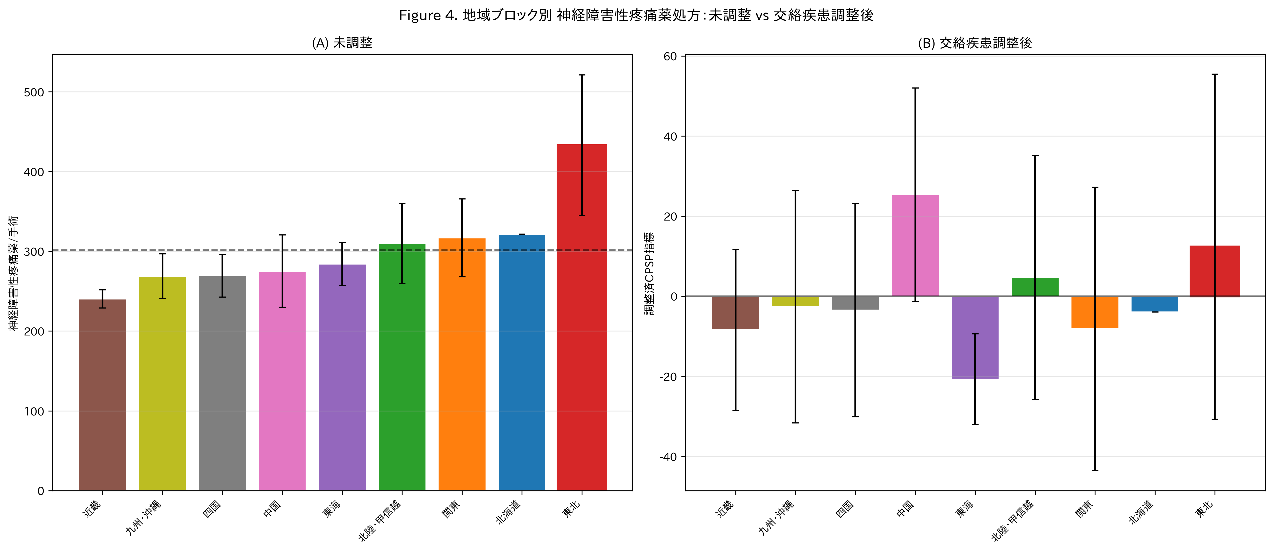
Figure 4. Regional Comparison: Unadjusted (A) vs Confounder-Adjusted (B)
Tohoku (red border) shifts from highest region to mid-range after adjustment. Error bars = SD.

Slide 8
Table 2. Regression Models: Effect of Confounder Adjustment on Regional Patterns
Model | Dependent Variable | Tohoku Effect | P value | Interpretation
1 (unadjusted) | Neuropathic/surgery | d = 2.81 | 7.4e-08 | Significant ***
2 (all confounders) | Neuropathic/surgery | β = 32.6 | 0.150 | Not significant
3 (core drugs) | PGB+MGB/surgery | β = 15.7 | 0.229 | Not significant
4 (nerve blocks) | Blocks/surgery | β = 0.08 | 0.863 | Not significant
5 (integrated) | Neuropathic/surgery | β = 31.5 | 0.149 | Not significant
Adj. CPSP index | Residuals | d = 0.44 | 0.323 | Not significant

Slide 9
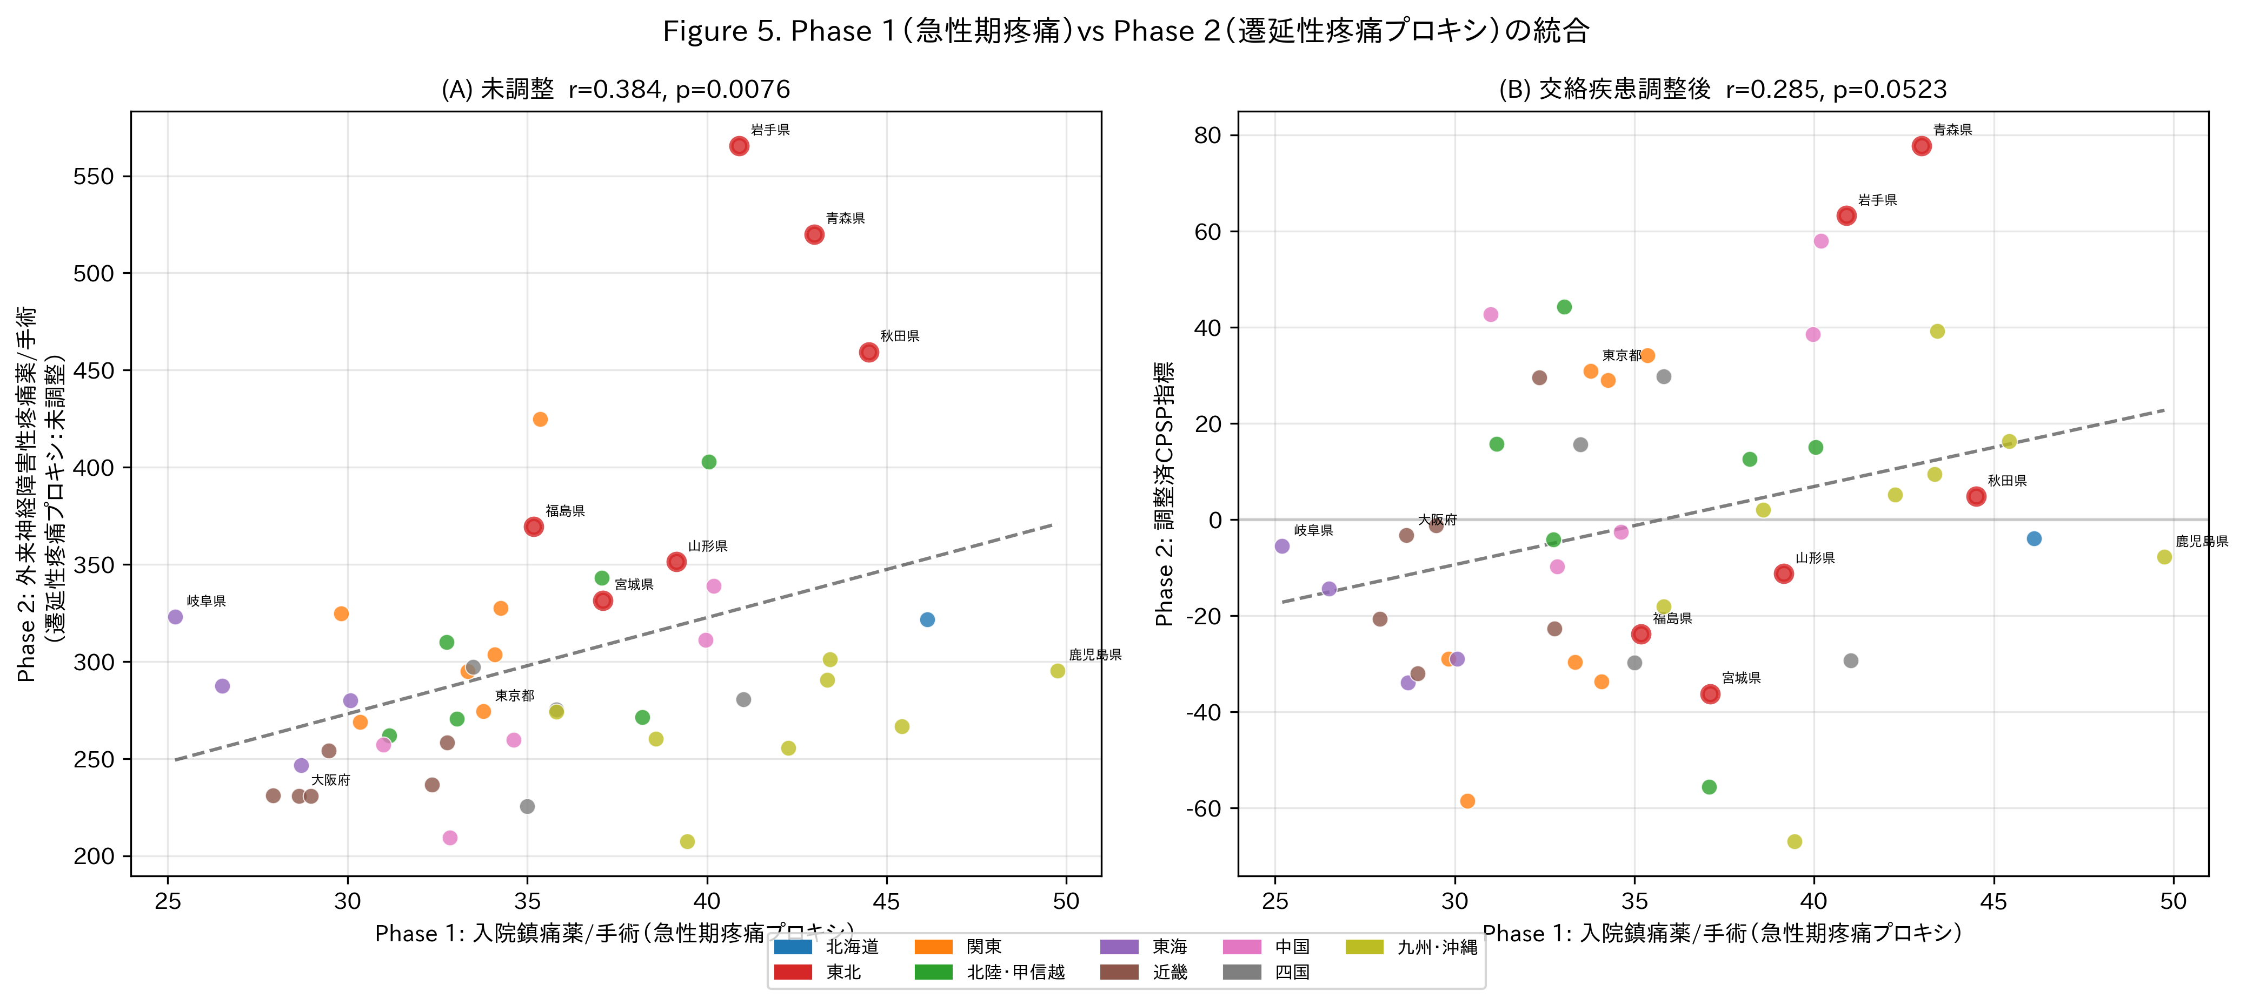
Figure 5. Phase 1 (Acute Pain) vs Phase 2 (CPSP Proxy) Integration
(A) Unadjusted: r=0.38, P=0.008. (B) Confounder-adjusted: r=0.29, P=0.052. Tohoku = red borders.

Slide 10
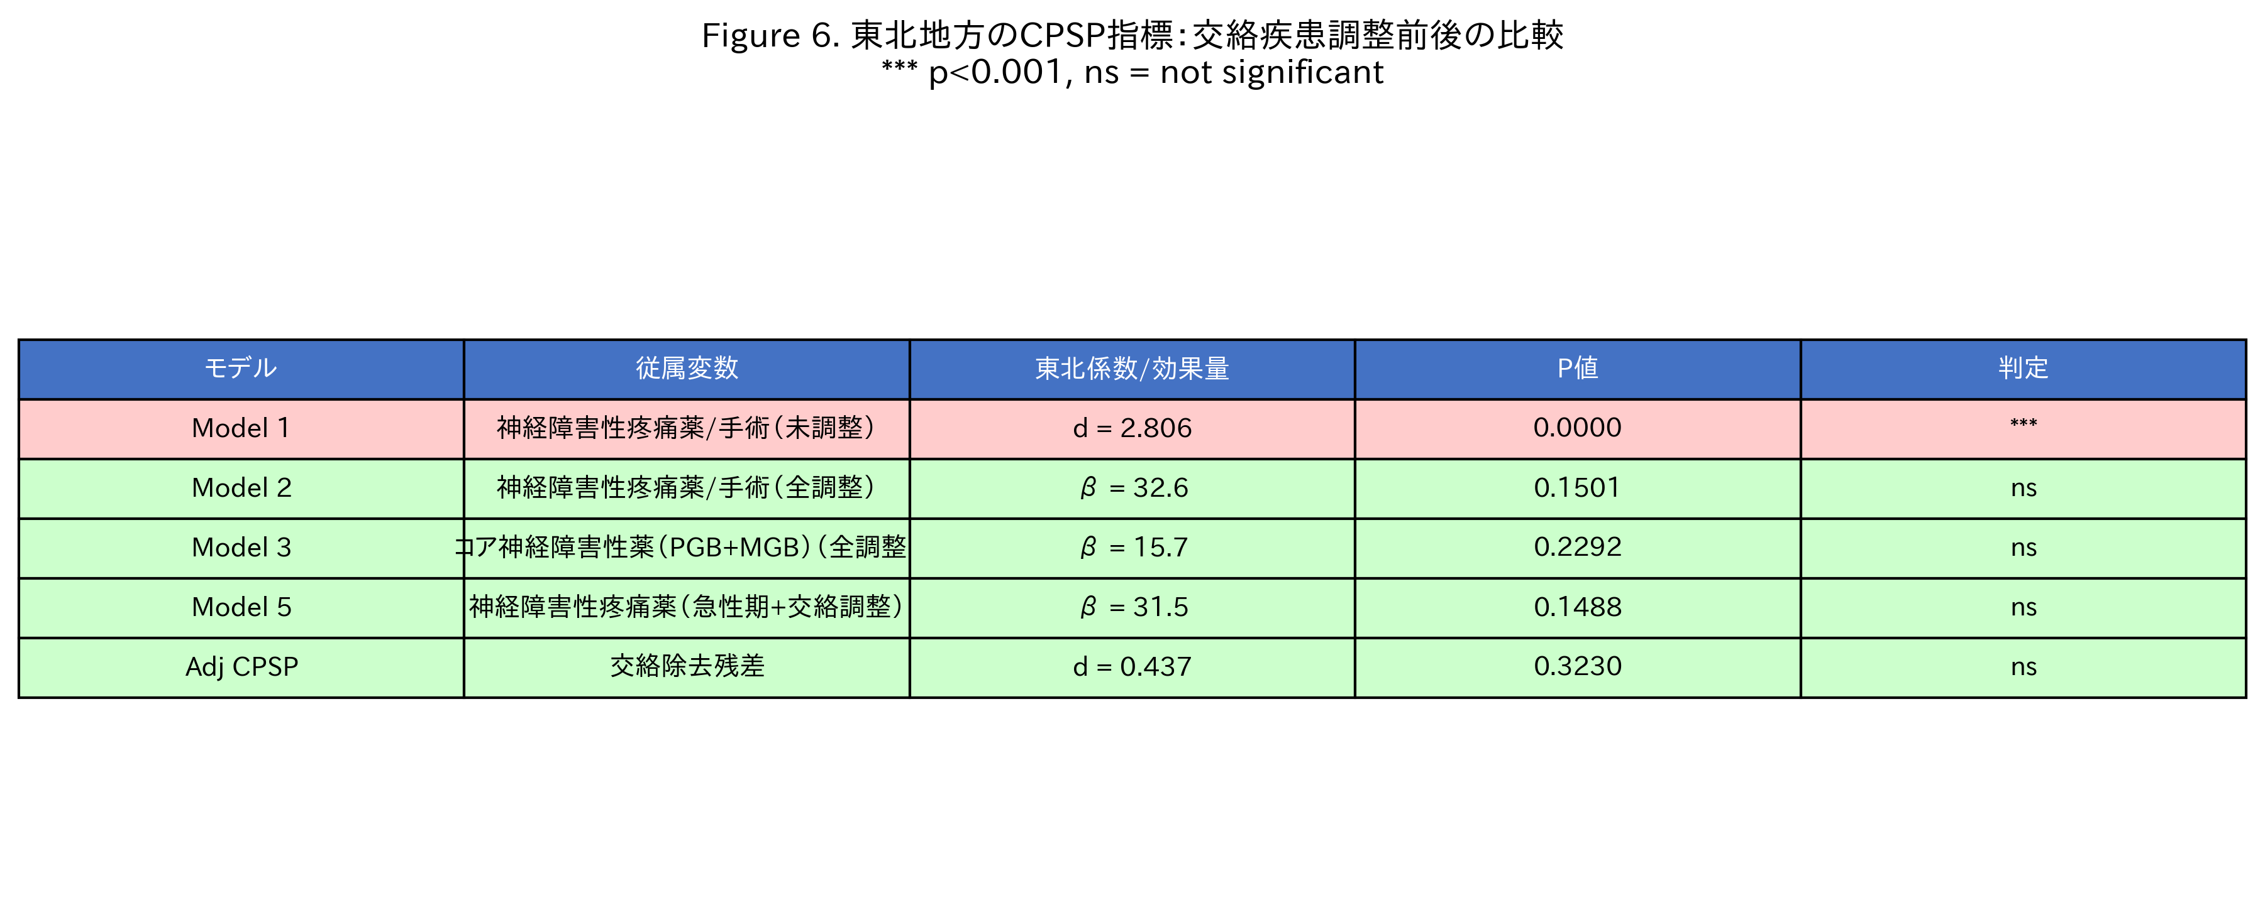
Figure 6. Summary: Regional Effect Across All Models
Model 1 (unadjusted) shows highly significant excess; all adjusted models show non-significant results.

Slide 11
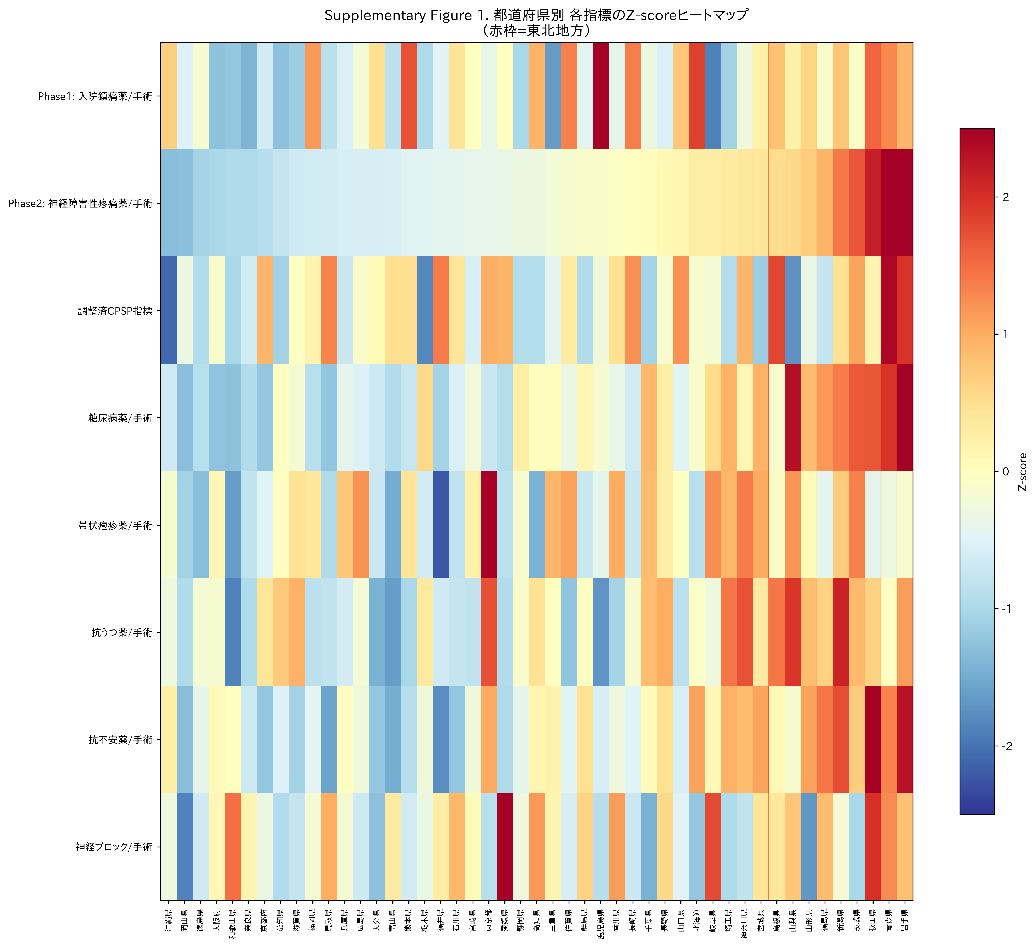
Supplementary Figure 1. Z-Score Heatmap of All Indices by Prefecture
Each row = variable; each column = prefecture (sorted by neuropathic Rx). Red = above average; blue = below average.

Slide 12
Key Findings Summary
Premise: Japanese are culturally stoic toward pain (Hobara 2005, Feng 2017)
Question: Is there regional variation WITHIN Japan?
Phase 1: Acute perioperative analgesics
1.97-fold variation across 47 prefectures
(Kruskal-Wallis P < 0.001)
Phase 2 (unadjusted): Neuropathic pain drugs
Dramatic regional variation
But confounders not controlled
Confounder adjustment: Diabetes (r=0.87) + Herpes + Depression + Anxiety
Phase 2 (adjusted): Regional patterns change dramatically
Confounding diseases explain much of apparent variation
Conclusion: Japan’s pain culture is NOT monolithic → No cultural label can substitute for individualized assessment
Cultural stereotypes narrow treatment options for ALL patients, not just Japanese

Slide 13
Confounder Adjustment Framework ("Noise Dilution")
Outpatient neuropathic pain drug Rx
(pregabalin, mirogabalin, duloxetine, tramadol, neurotropin)
CPSP signal
(target)
Diabetic
neuropathy
Postherpetic
neuralgia
Depression
(off-label)
Anxiety
(off-label)
Oral hypoglycaemics
(261 formulations)
Herpes antivirals
(47 formulations)
Antidepressants
(128 formulations)
Anxiolytics
(112 formulations)
OLS Regression: Neuropathic Rx = β₀ + β₁·Diabetes + β₂·Herpes + β₃·Antidep + β₄·Anxiolytic + ε
Residuals (ε) = Adjusted CPSP Index
"Unexplained" neuropathic pain after removing confounders

