Slide 1
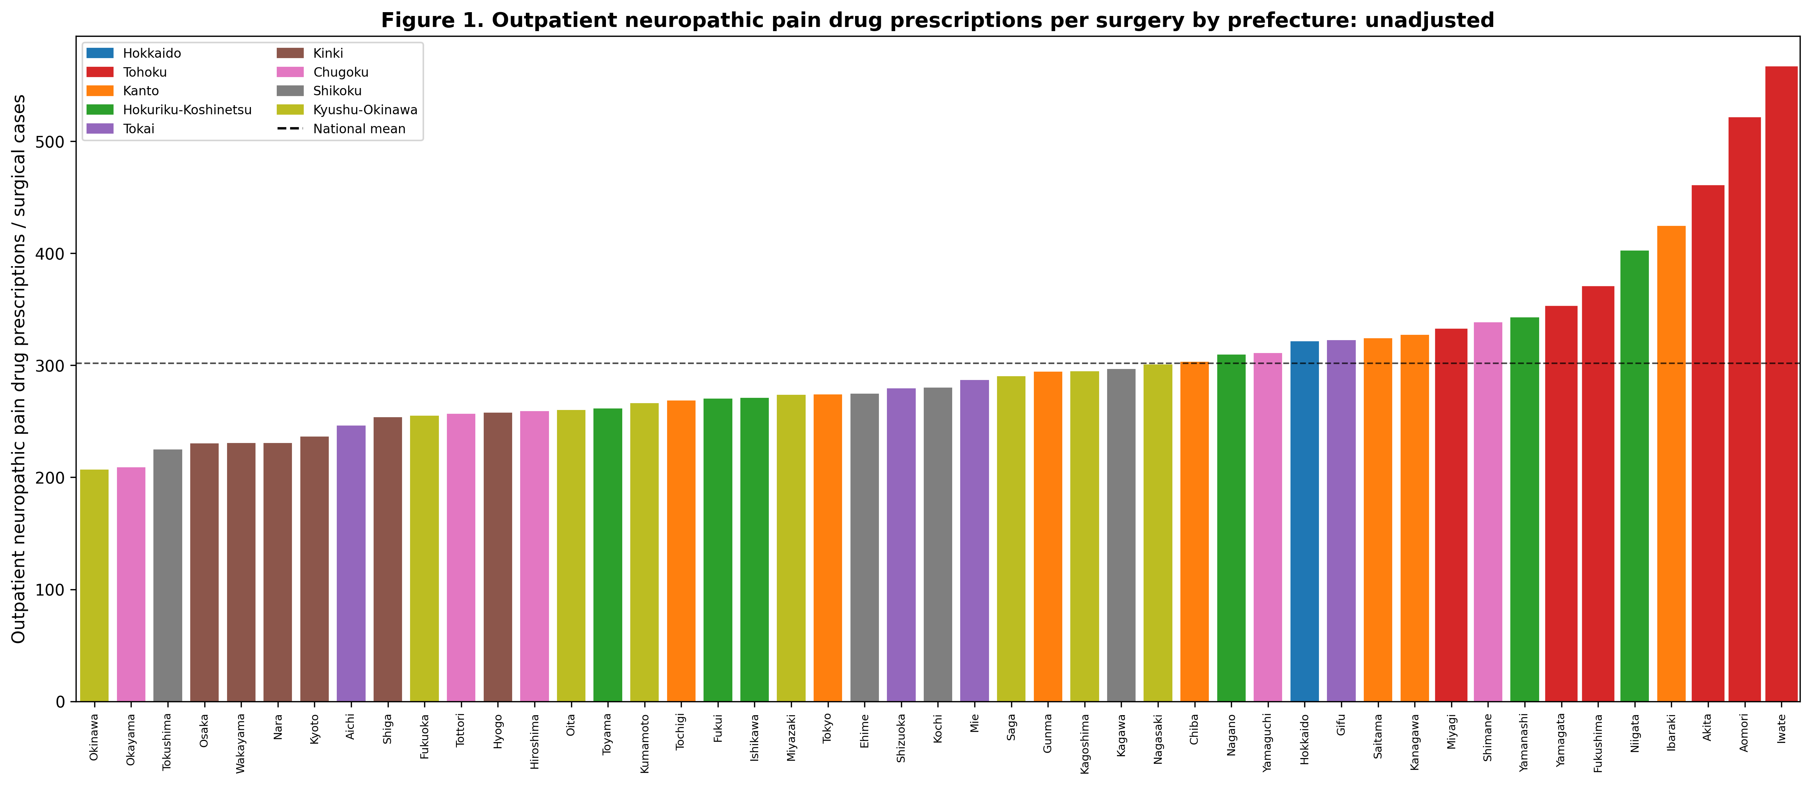
Figure 1
Outpatient neuropathic pain drug prescribing per surgery by prefecture (unadjusted). Tohoku prefectures (red) cluster at the high end. Dashed line = national mean.

Slide 2
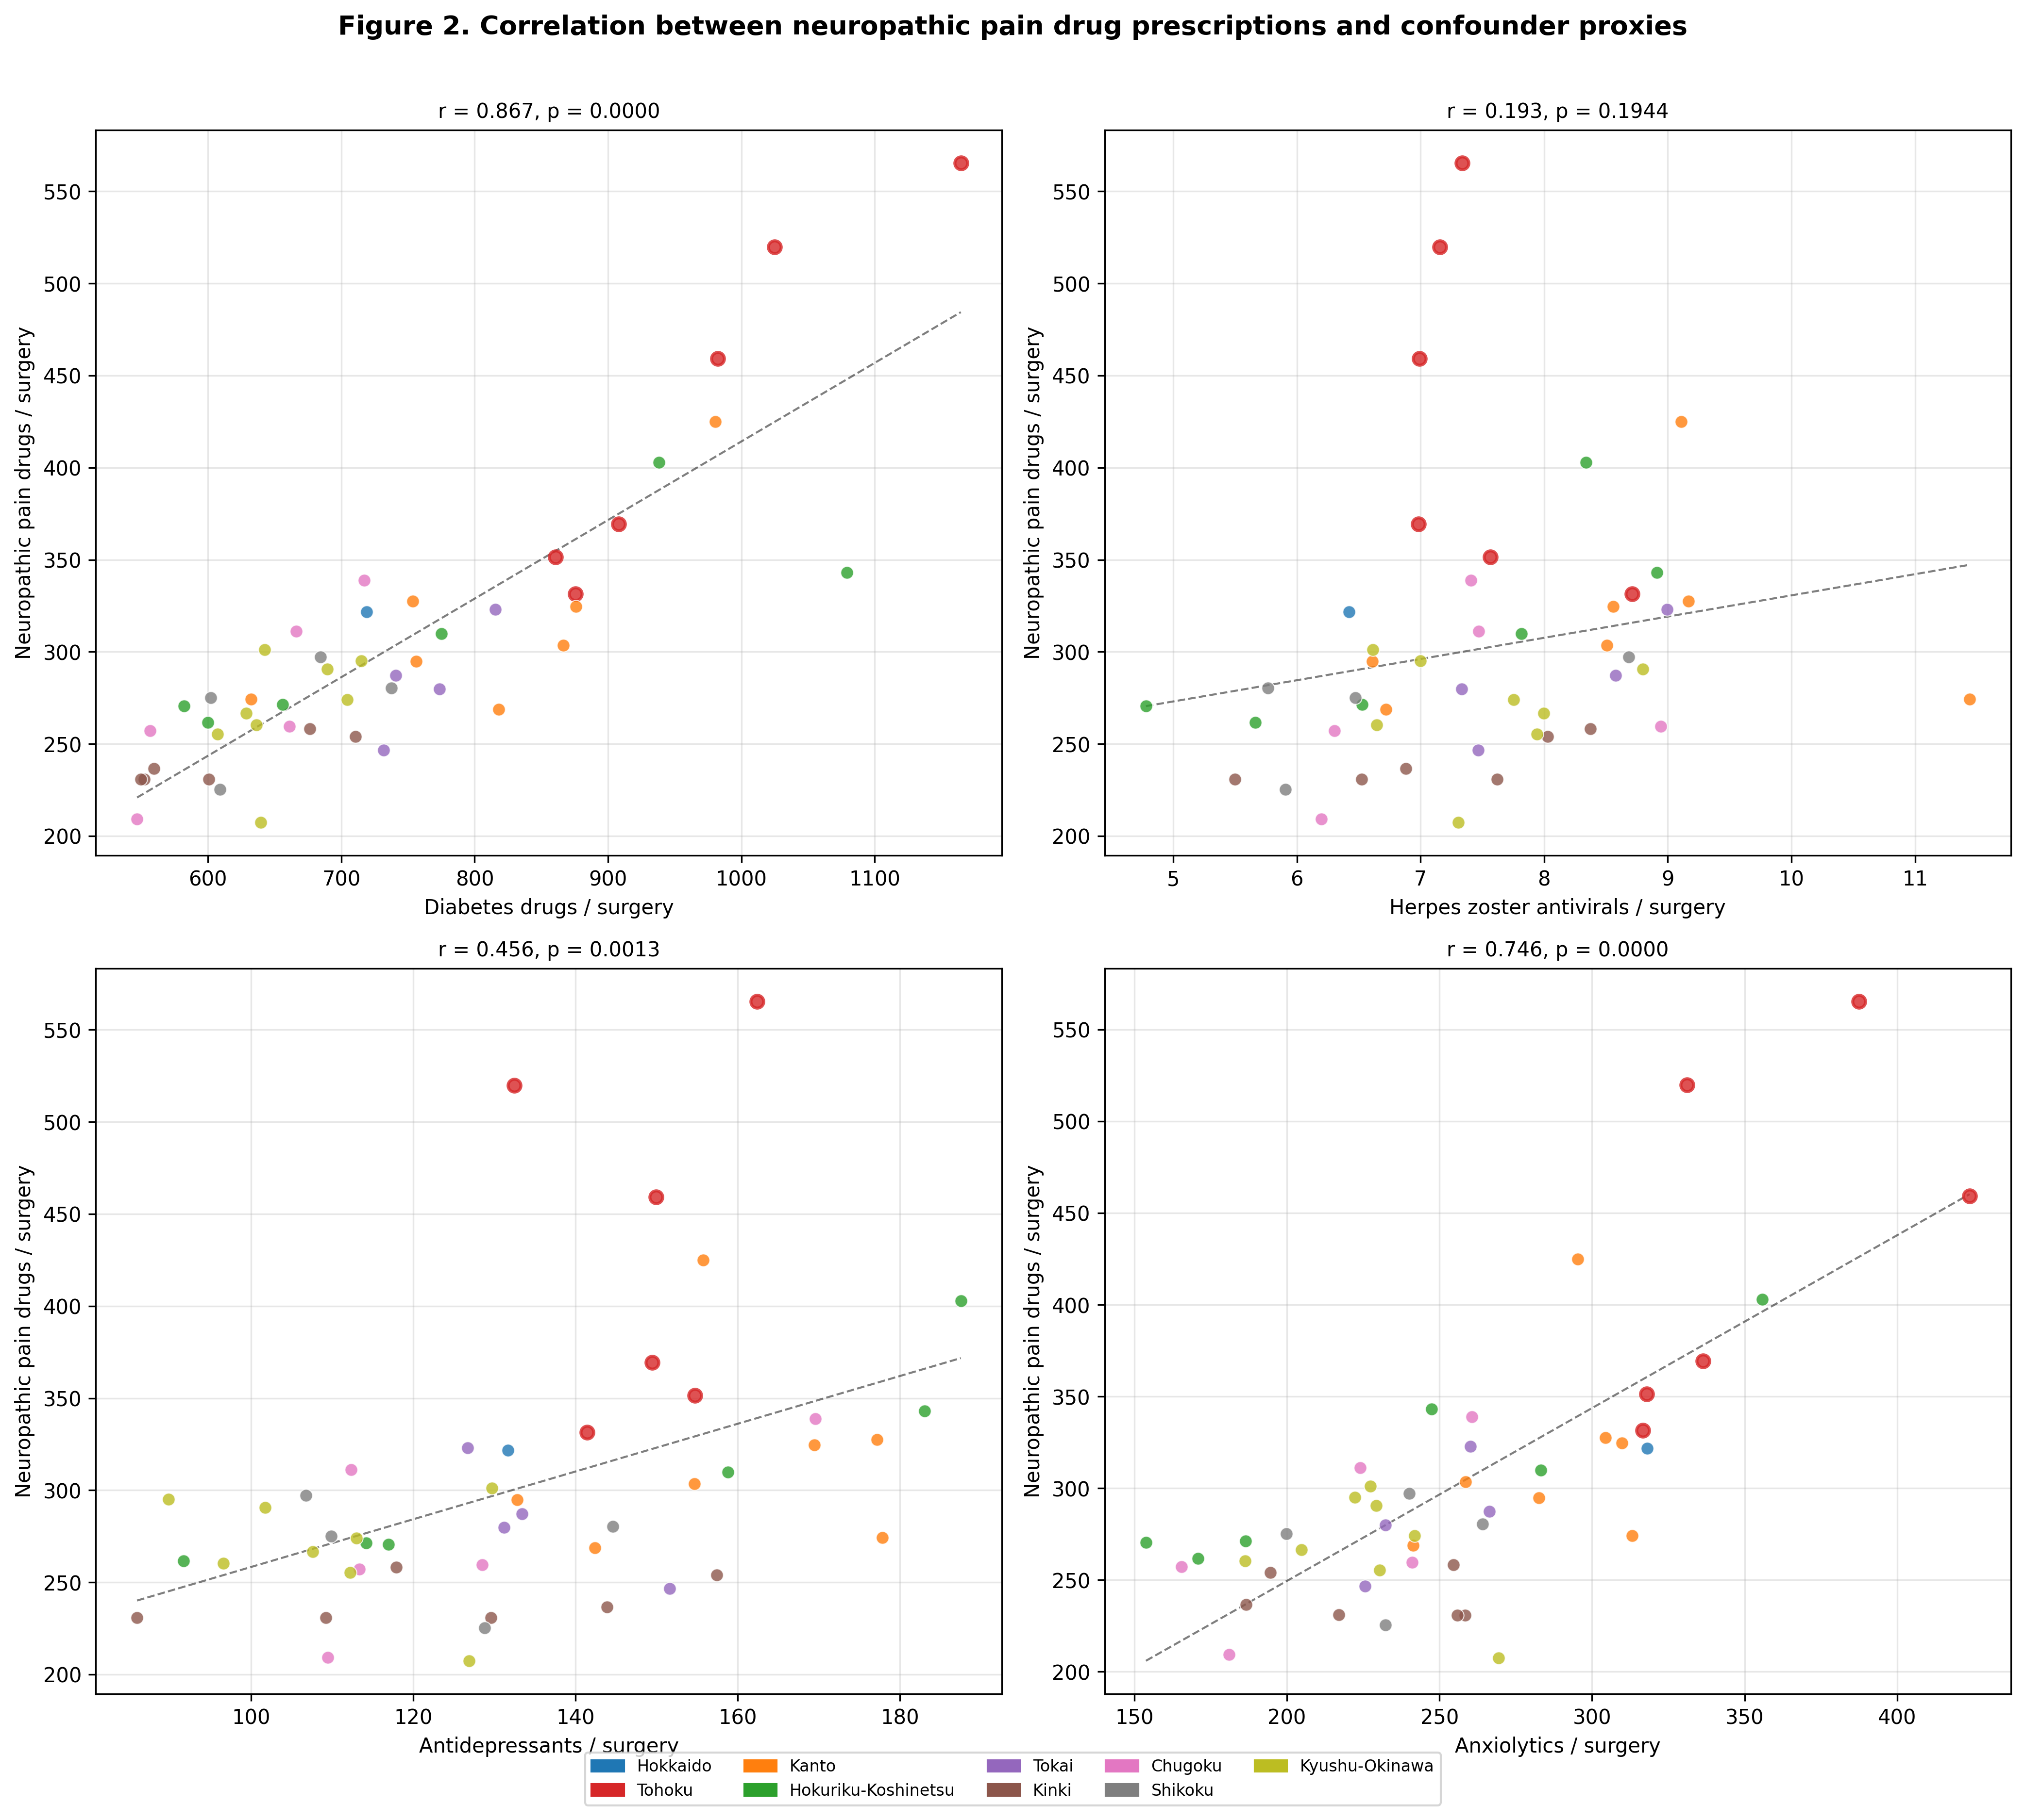
Figure 2
Correlation between neuropathic pain prescribing and confounder disease proxies. Each dot represents one prefecture. Tohoku prefectures have red borders. Diabetes drugs show the strongest correlation (r=0·87).

Slide 3
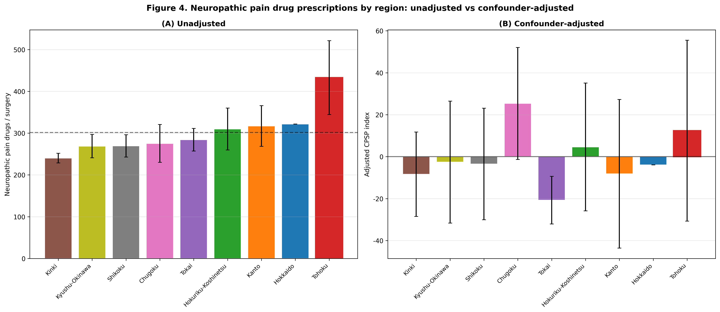
Figure 3
Regional comparison of neuropathic pain prescribing: (a) unadjusted and (b) after confounder adjustment. Tohoku (red) shifts from the highest region to mid-range after adjustment. Error bars = SD.

