Slide 1
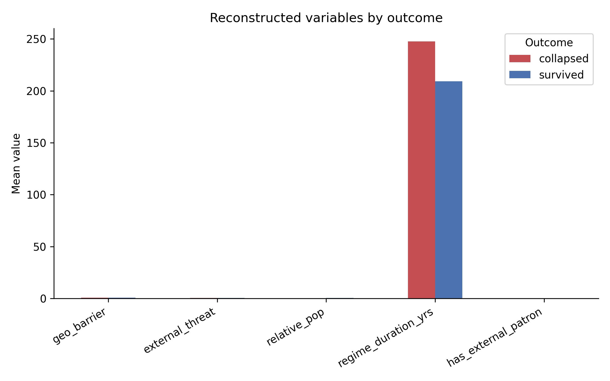
Figure 1
Caption and full source notes are in manuscript.docx.

Slide 2
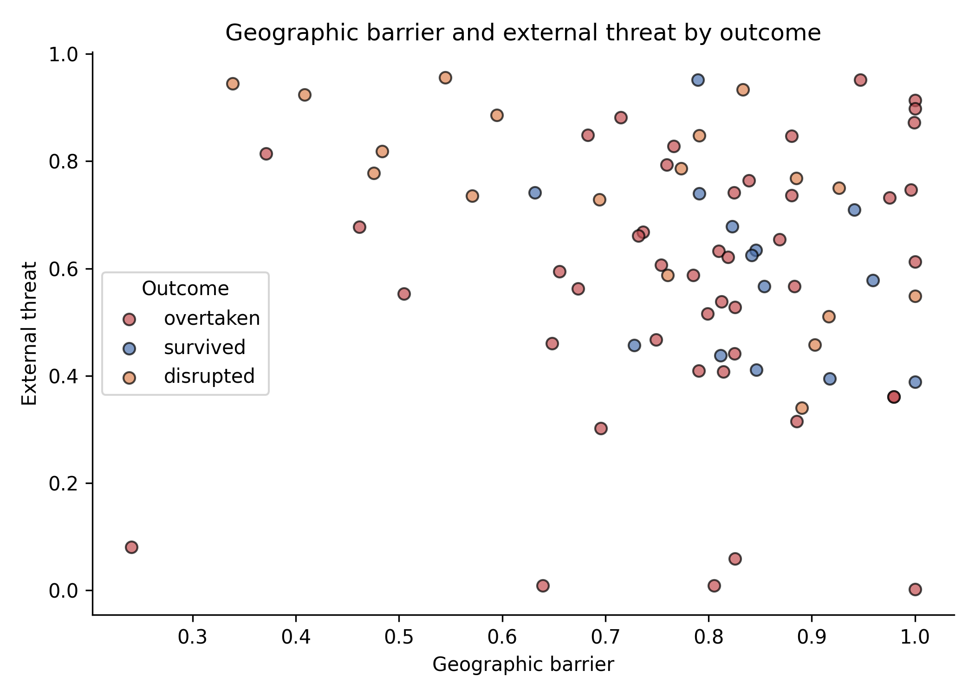
Figure 2
Caption and full source notes are in manuscript.docx.

Slide 3
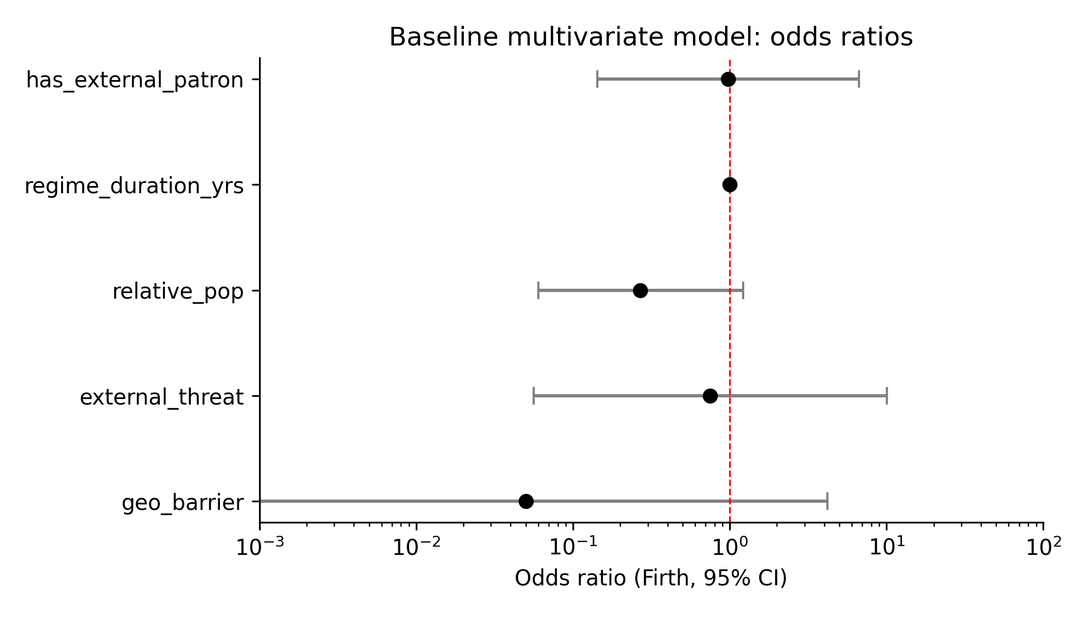
Figure 3
Caption and full source notes are in manuscript.docx.

Slide 4
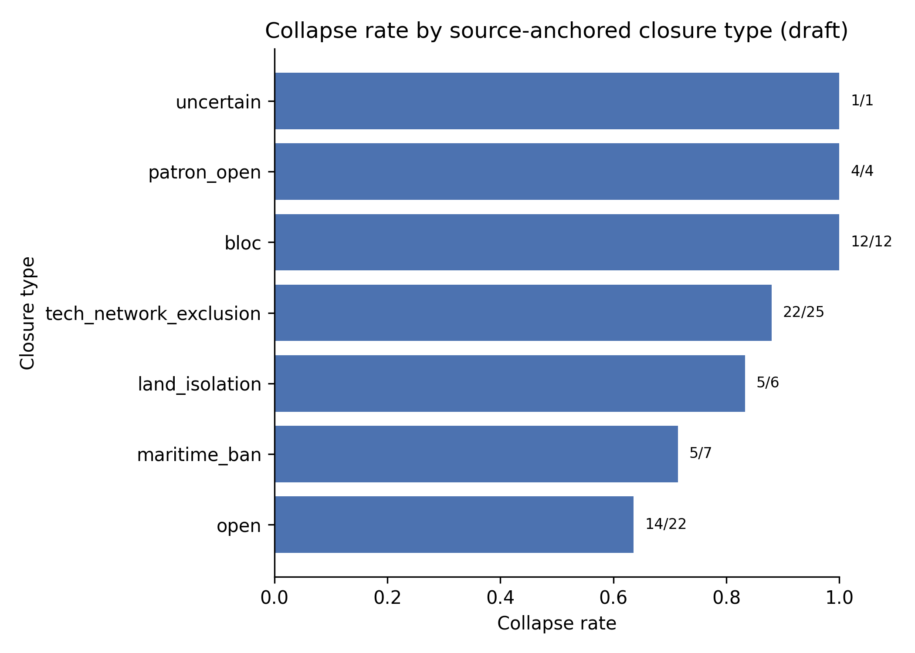
Figure 4
Caption and full source notes are in manuscript.docx.

Slide 5
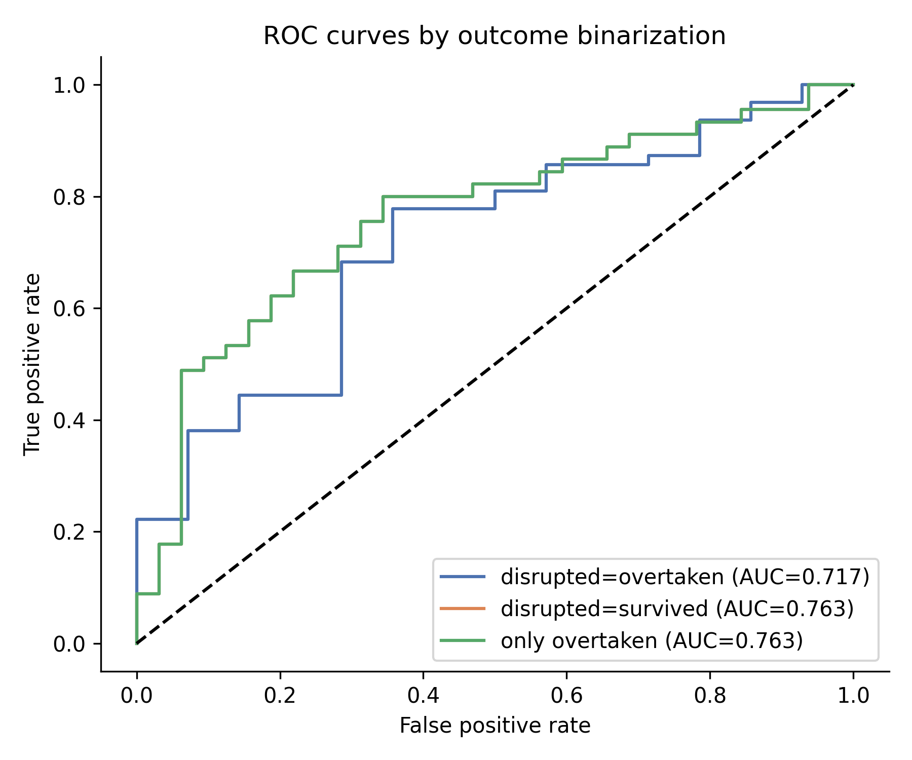
Figure 5
Caption and full source notes are in manuscript.docx.

Slide 6
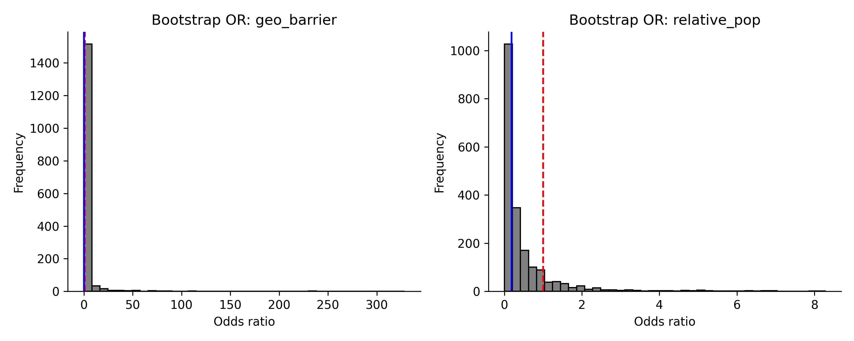
Figure 6
Caption and full source notes are in manuscript.docx.

Slide 7
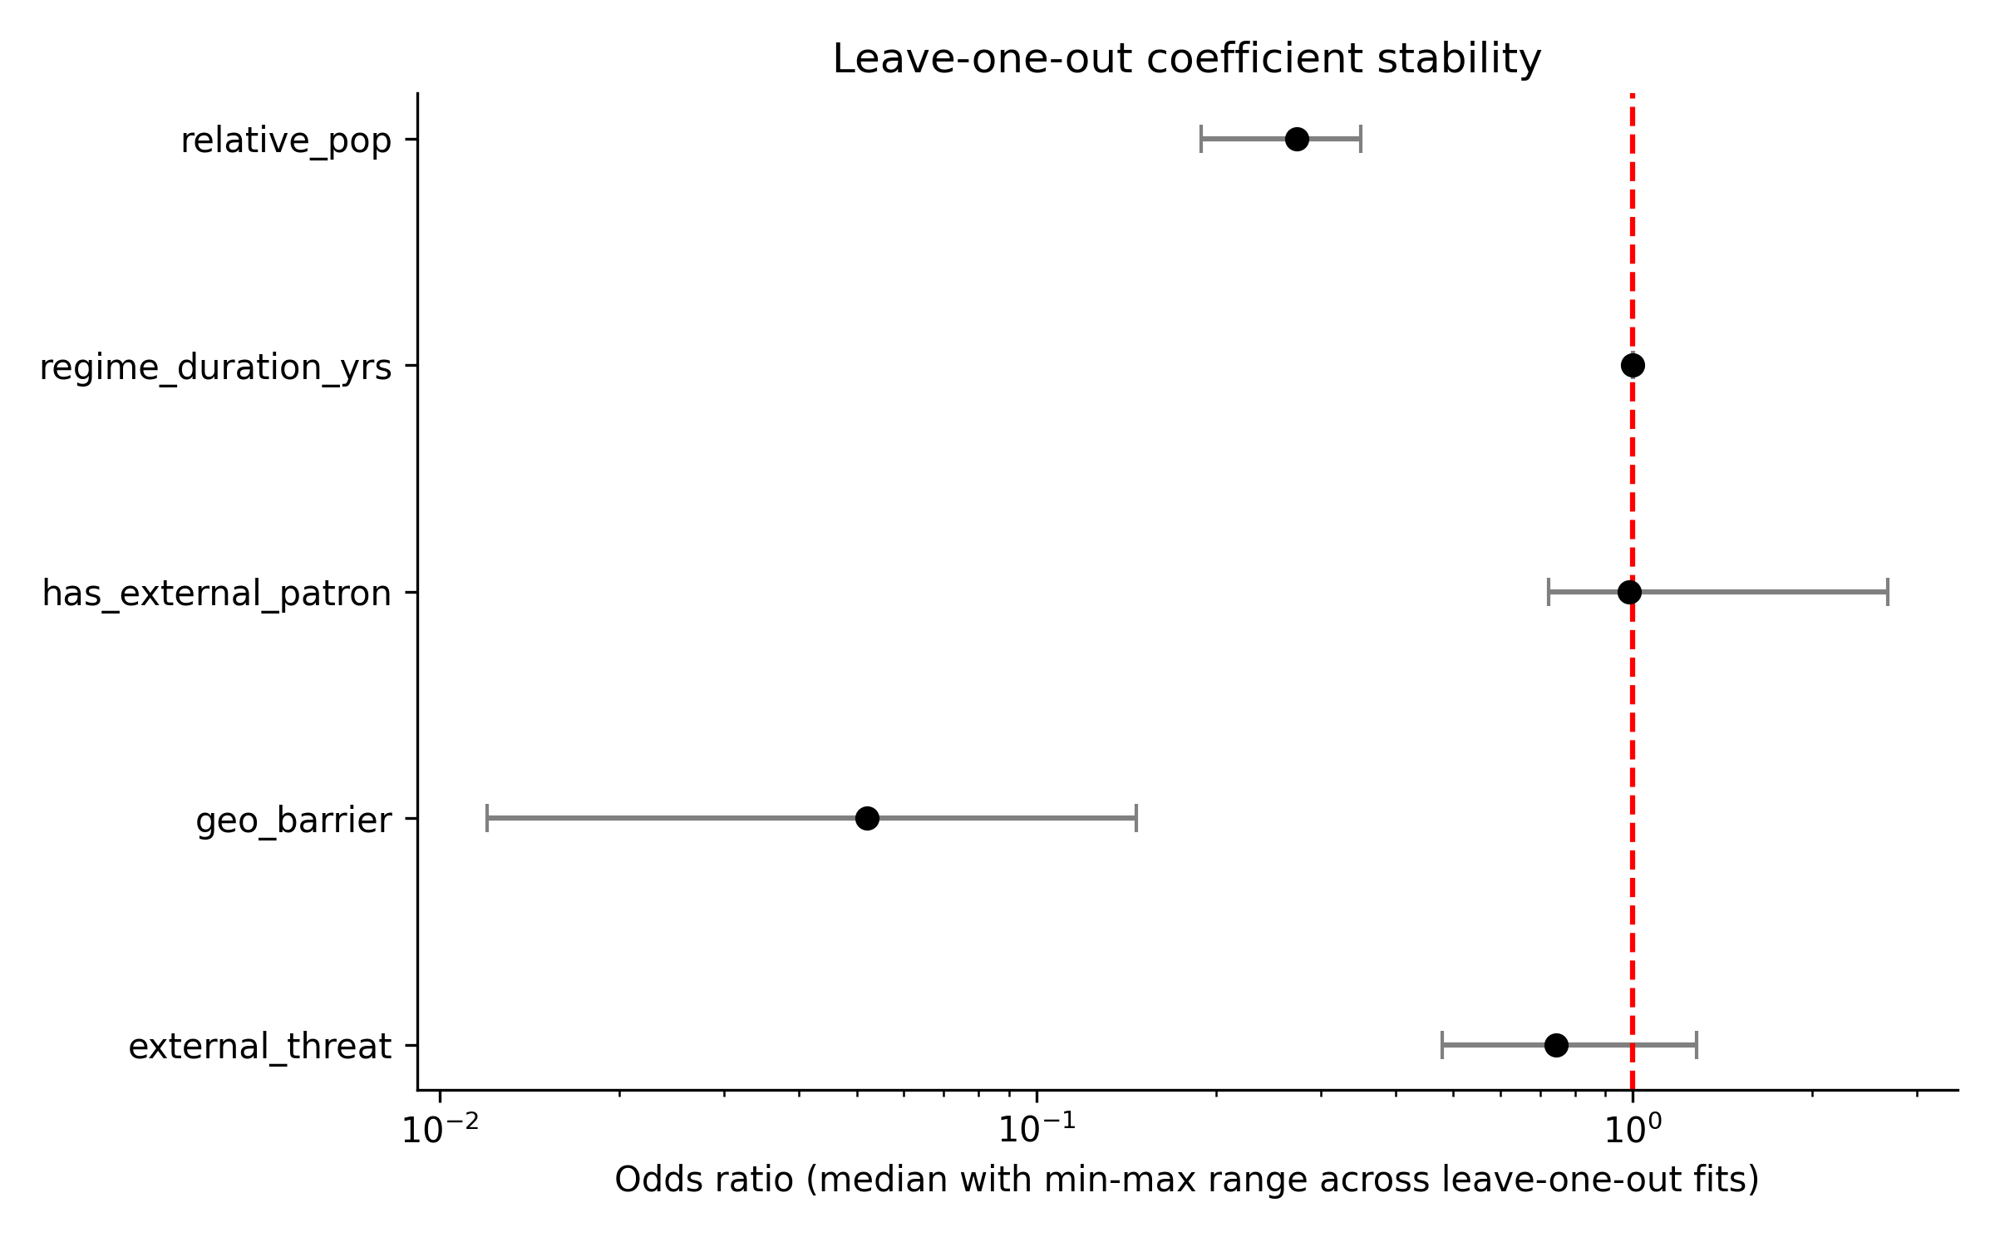
Figure 7
Caption and full source notes are in manuscript.docx.

