Slide 1
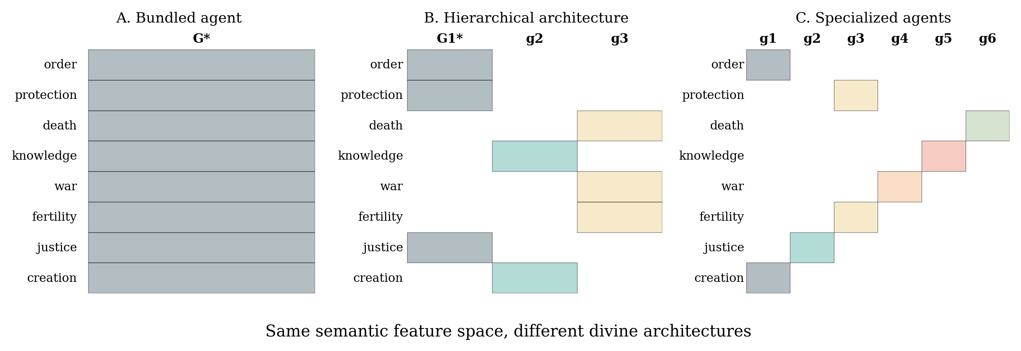
Figure 1. Three partitions of the same schematic semantic feature space across divine agents.

Slide 2
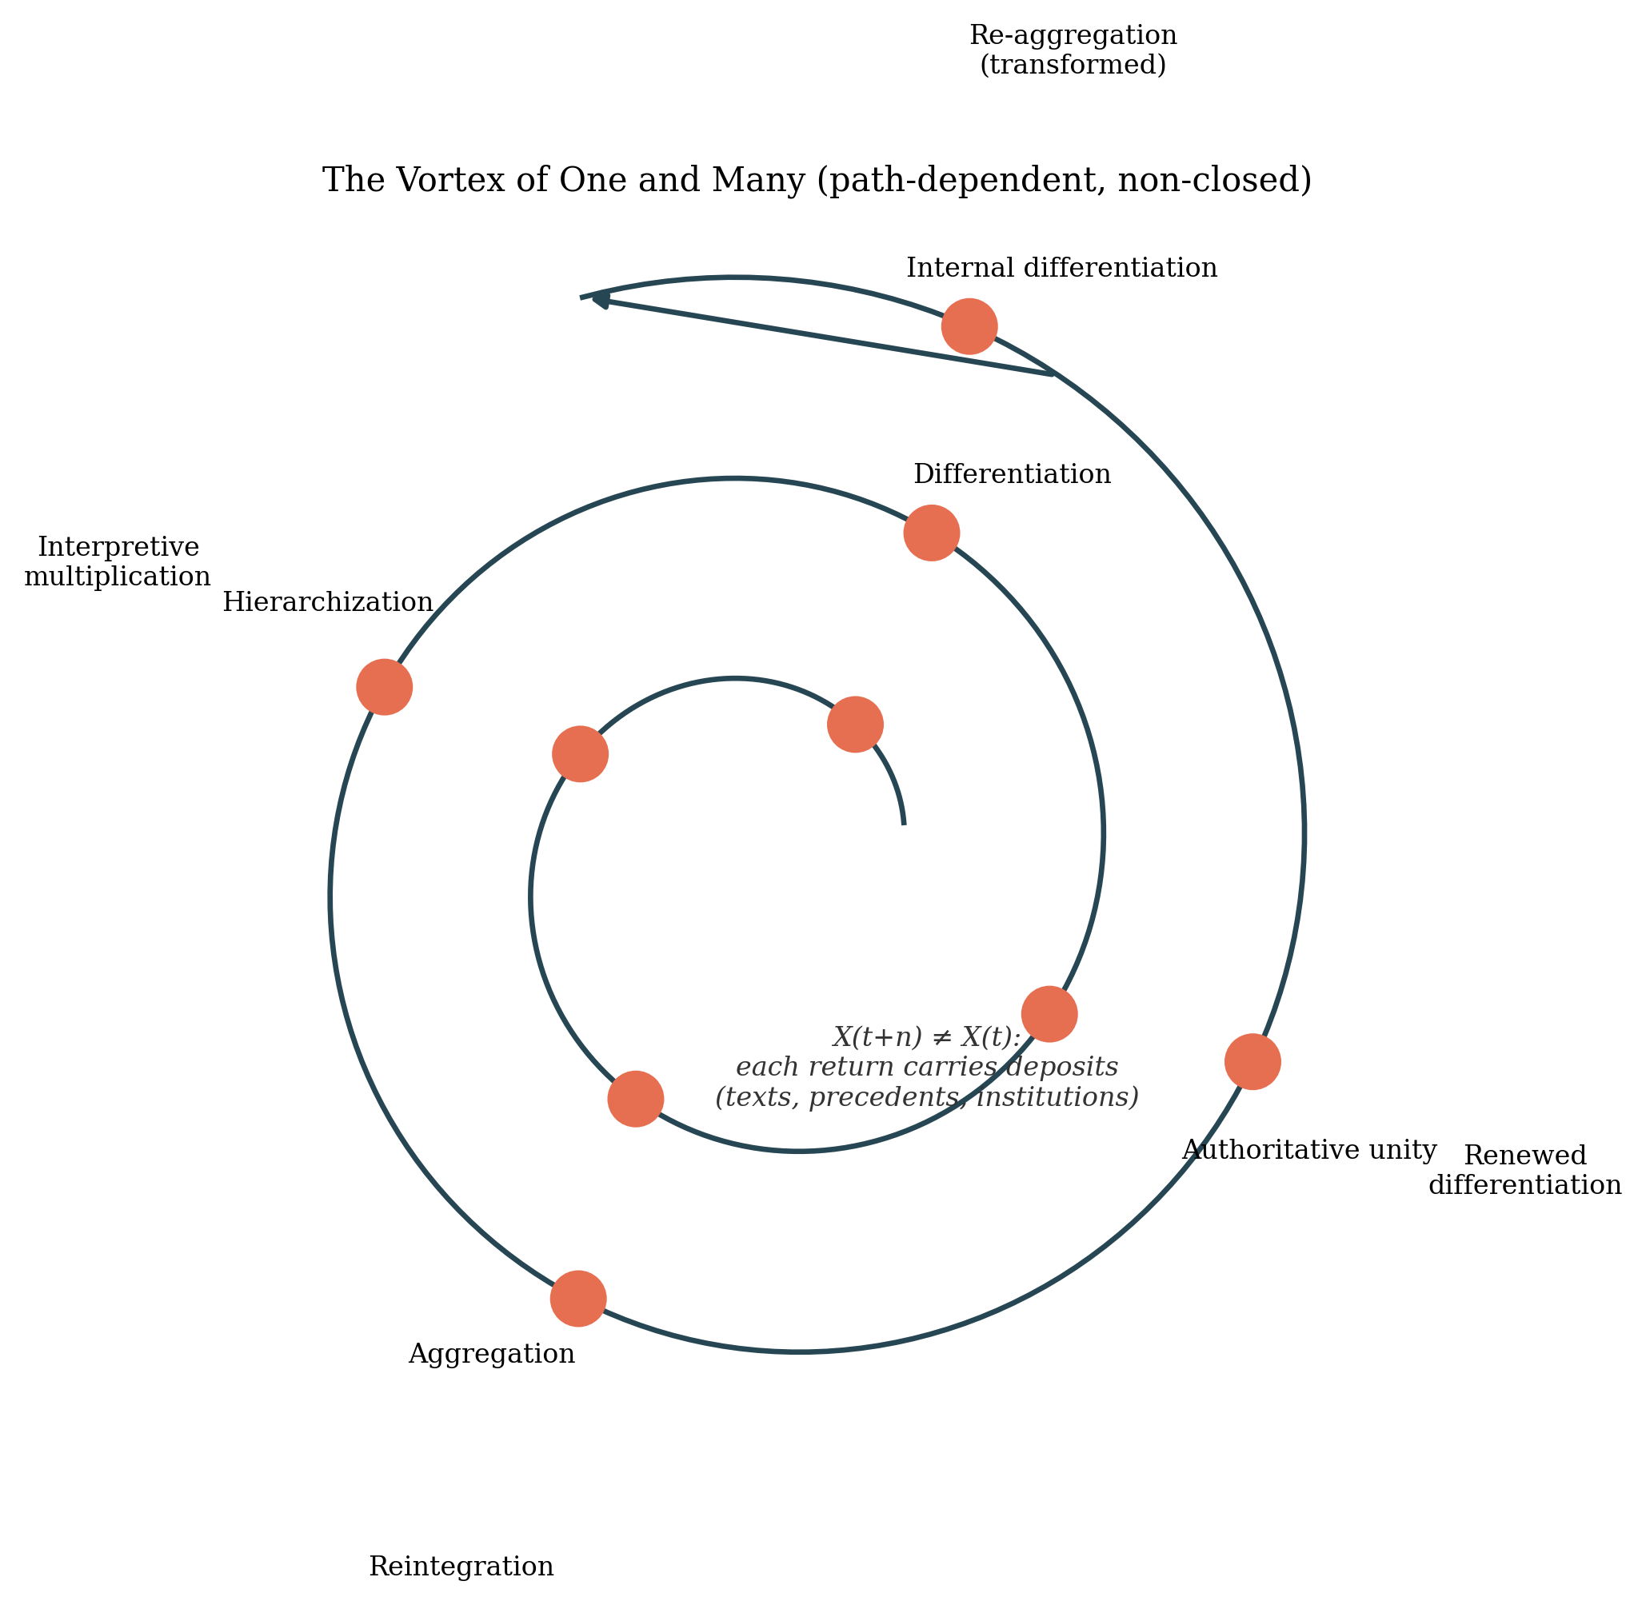
Figure 2. The Vortex of One and Many (path-dependent, non-closed).

Slide 3
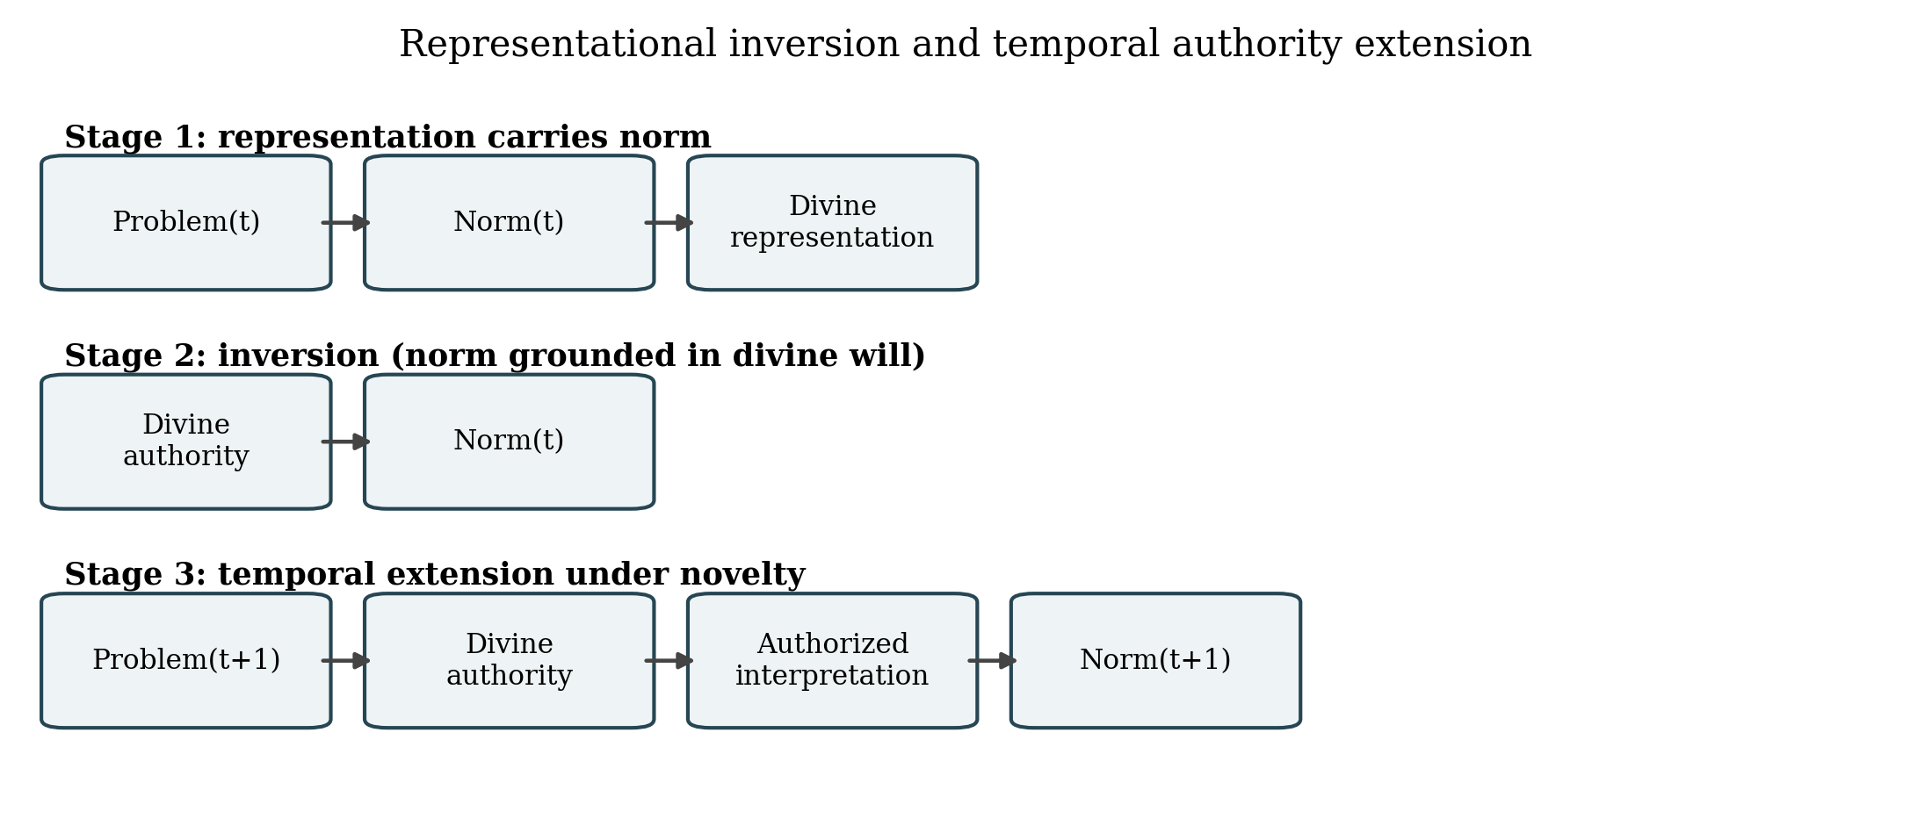
Figure 3. Representational inversion and temporal authority extension.

Slide 4
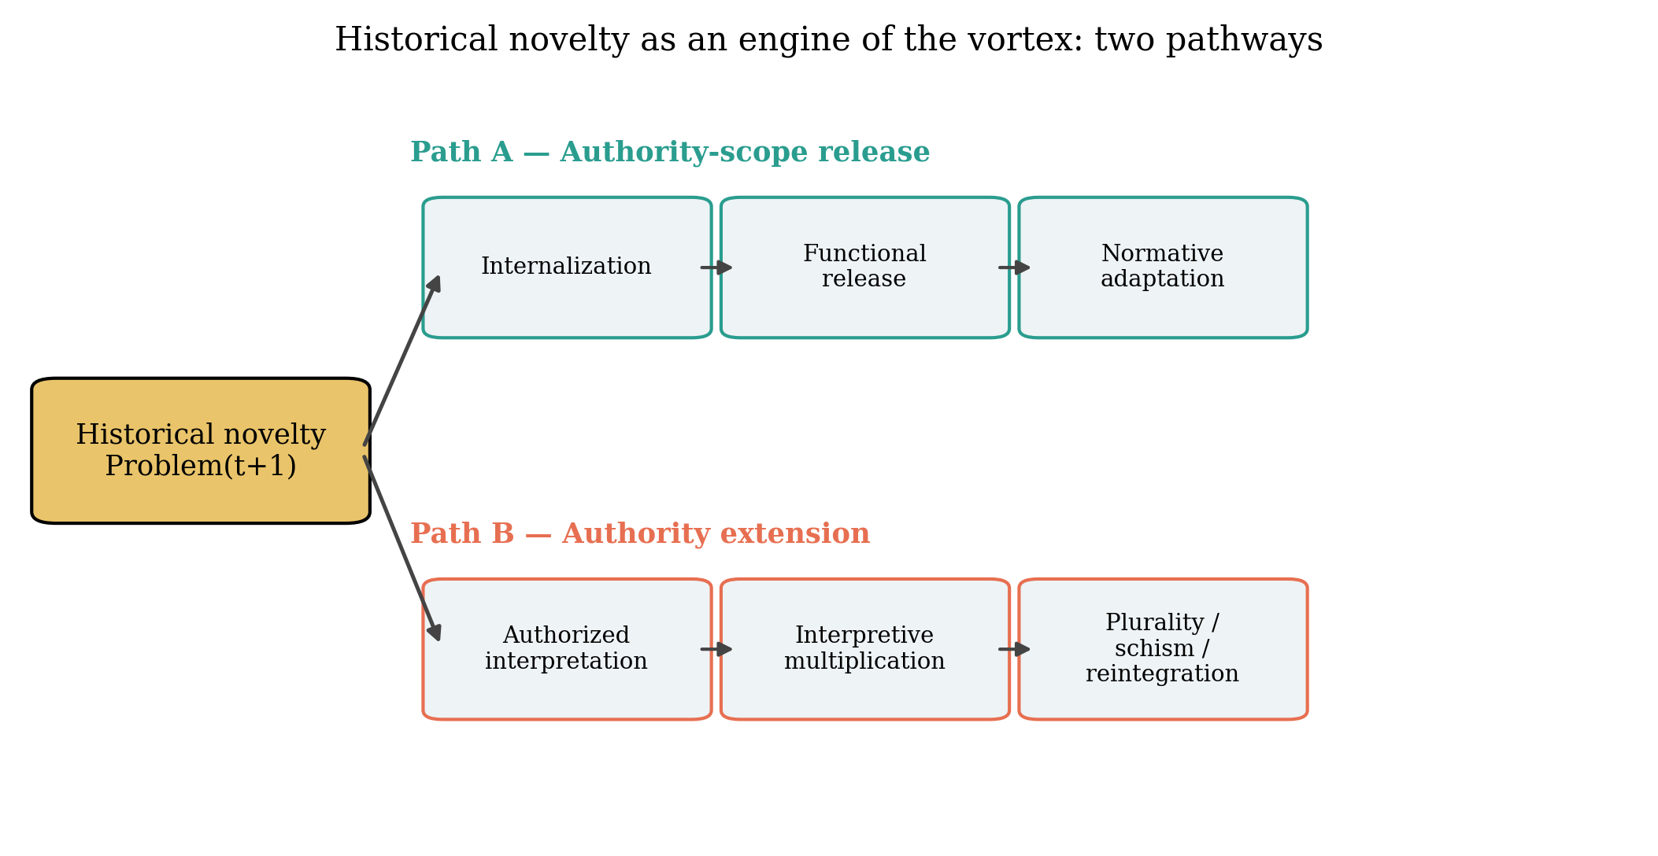
Figure 4. Historical novelty: Path A (authority-scope release) vs Path B (authority extension).

Slide 5
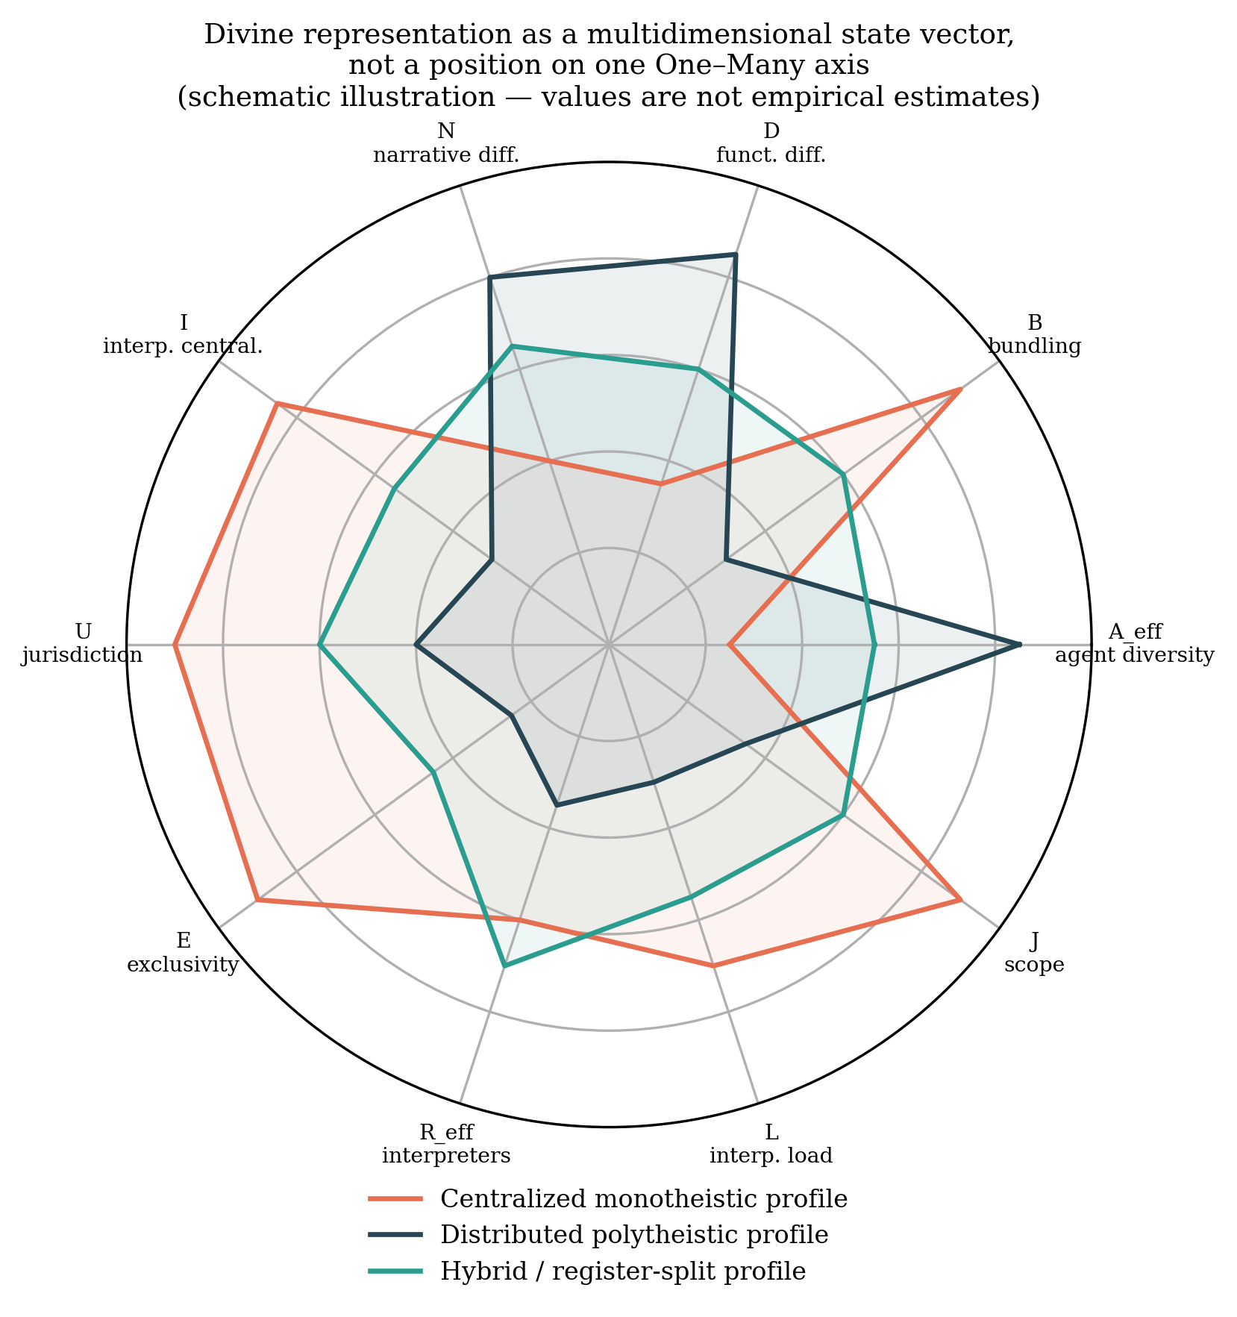
Figure 5. Multidimensional state vector (schematic illustration; not empirical estimates).

