Slide 1
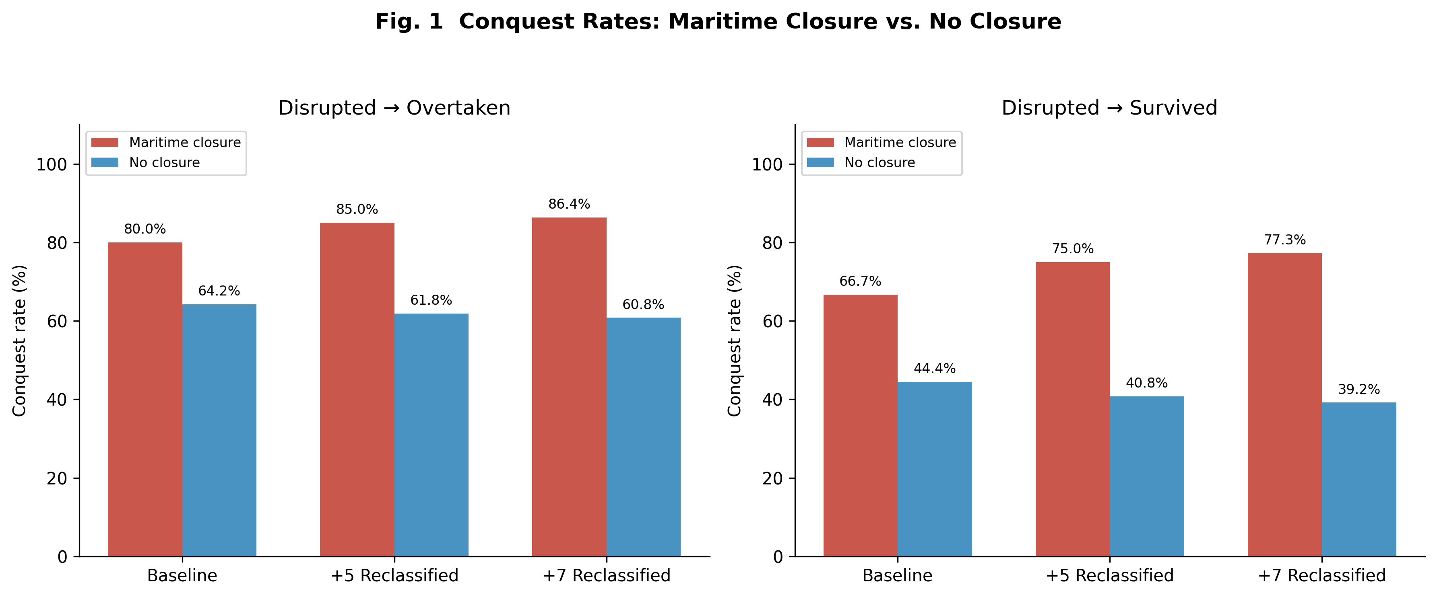
Fig1
Fig. 1 Conquest rates comparing network closure vs. open polities across three reclassification scenarios.

Slide 2
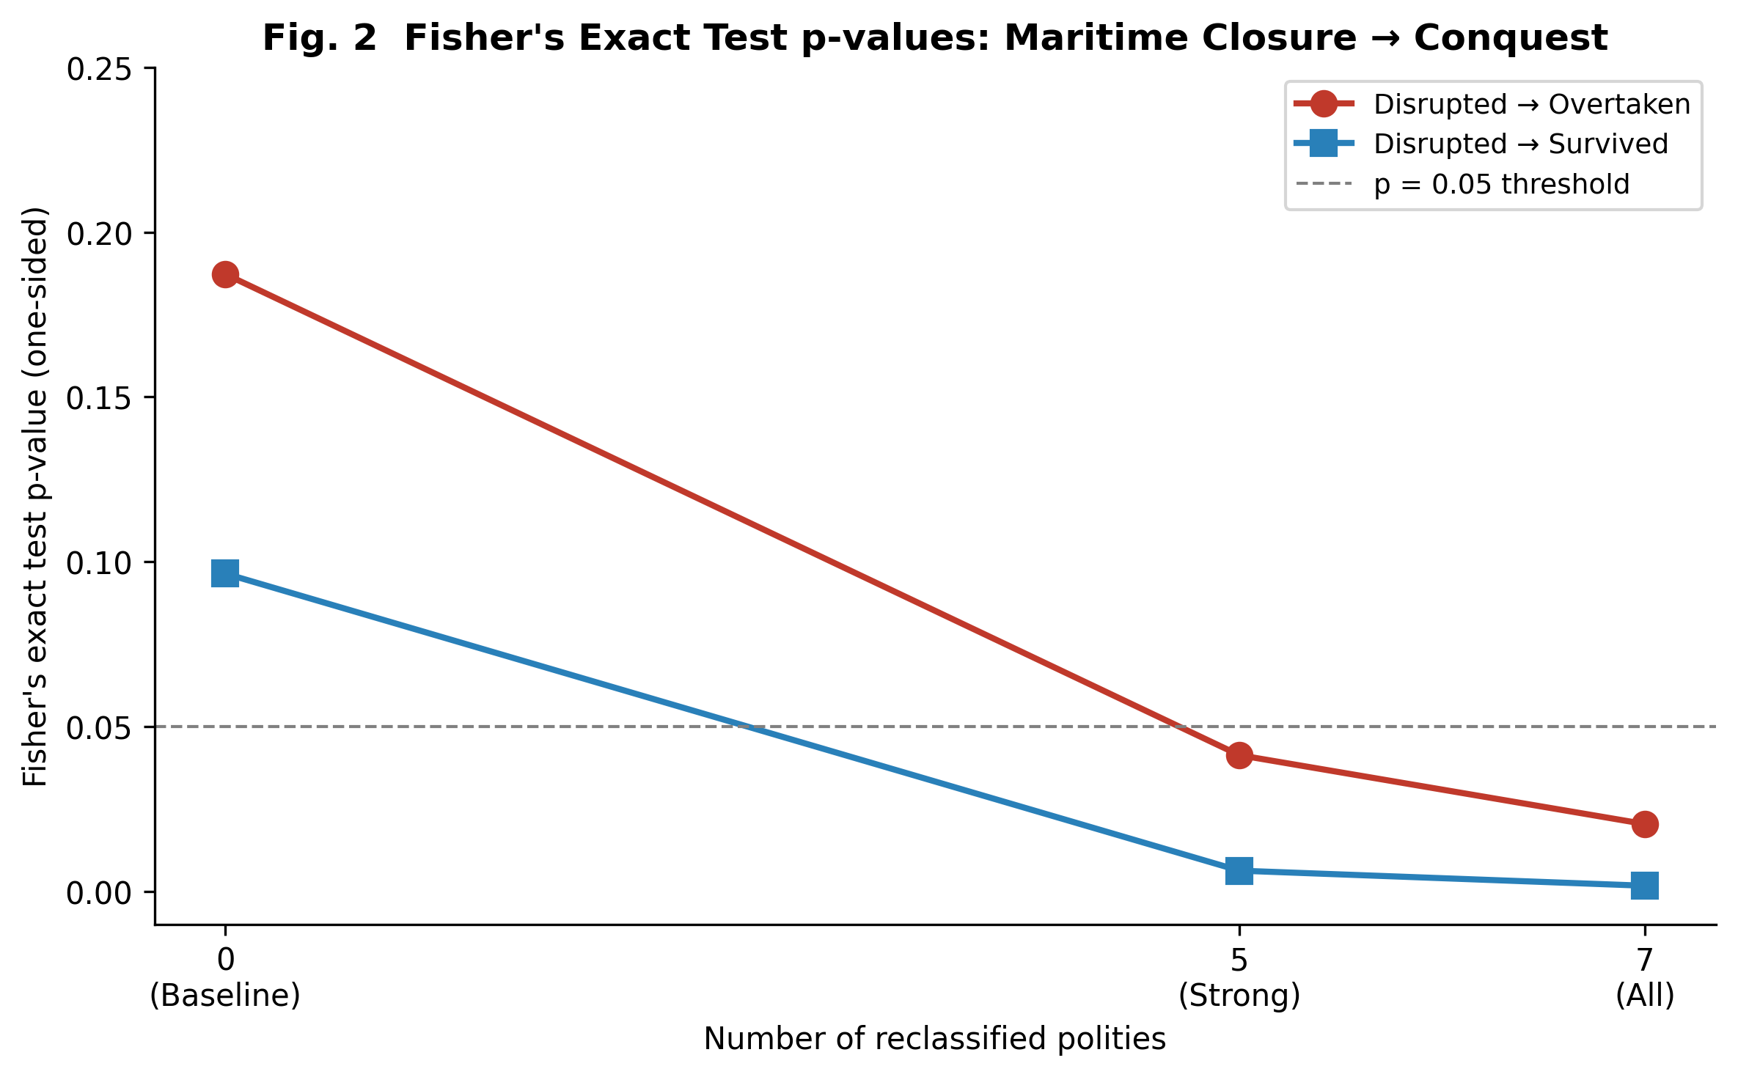
Fig2
Fig. 2 Fisher's exact test p-values for network closure → conquest association, showing transition to significance with reclassification.

Slide 3
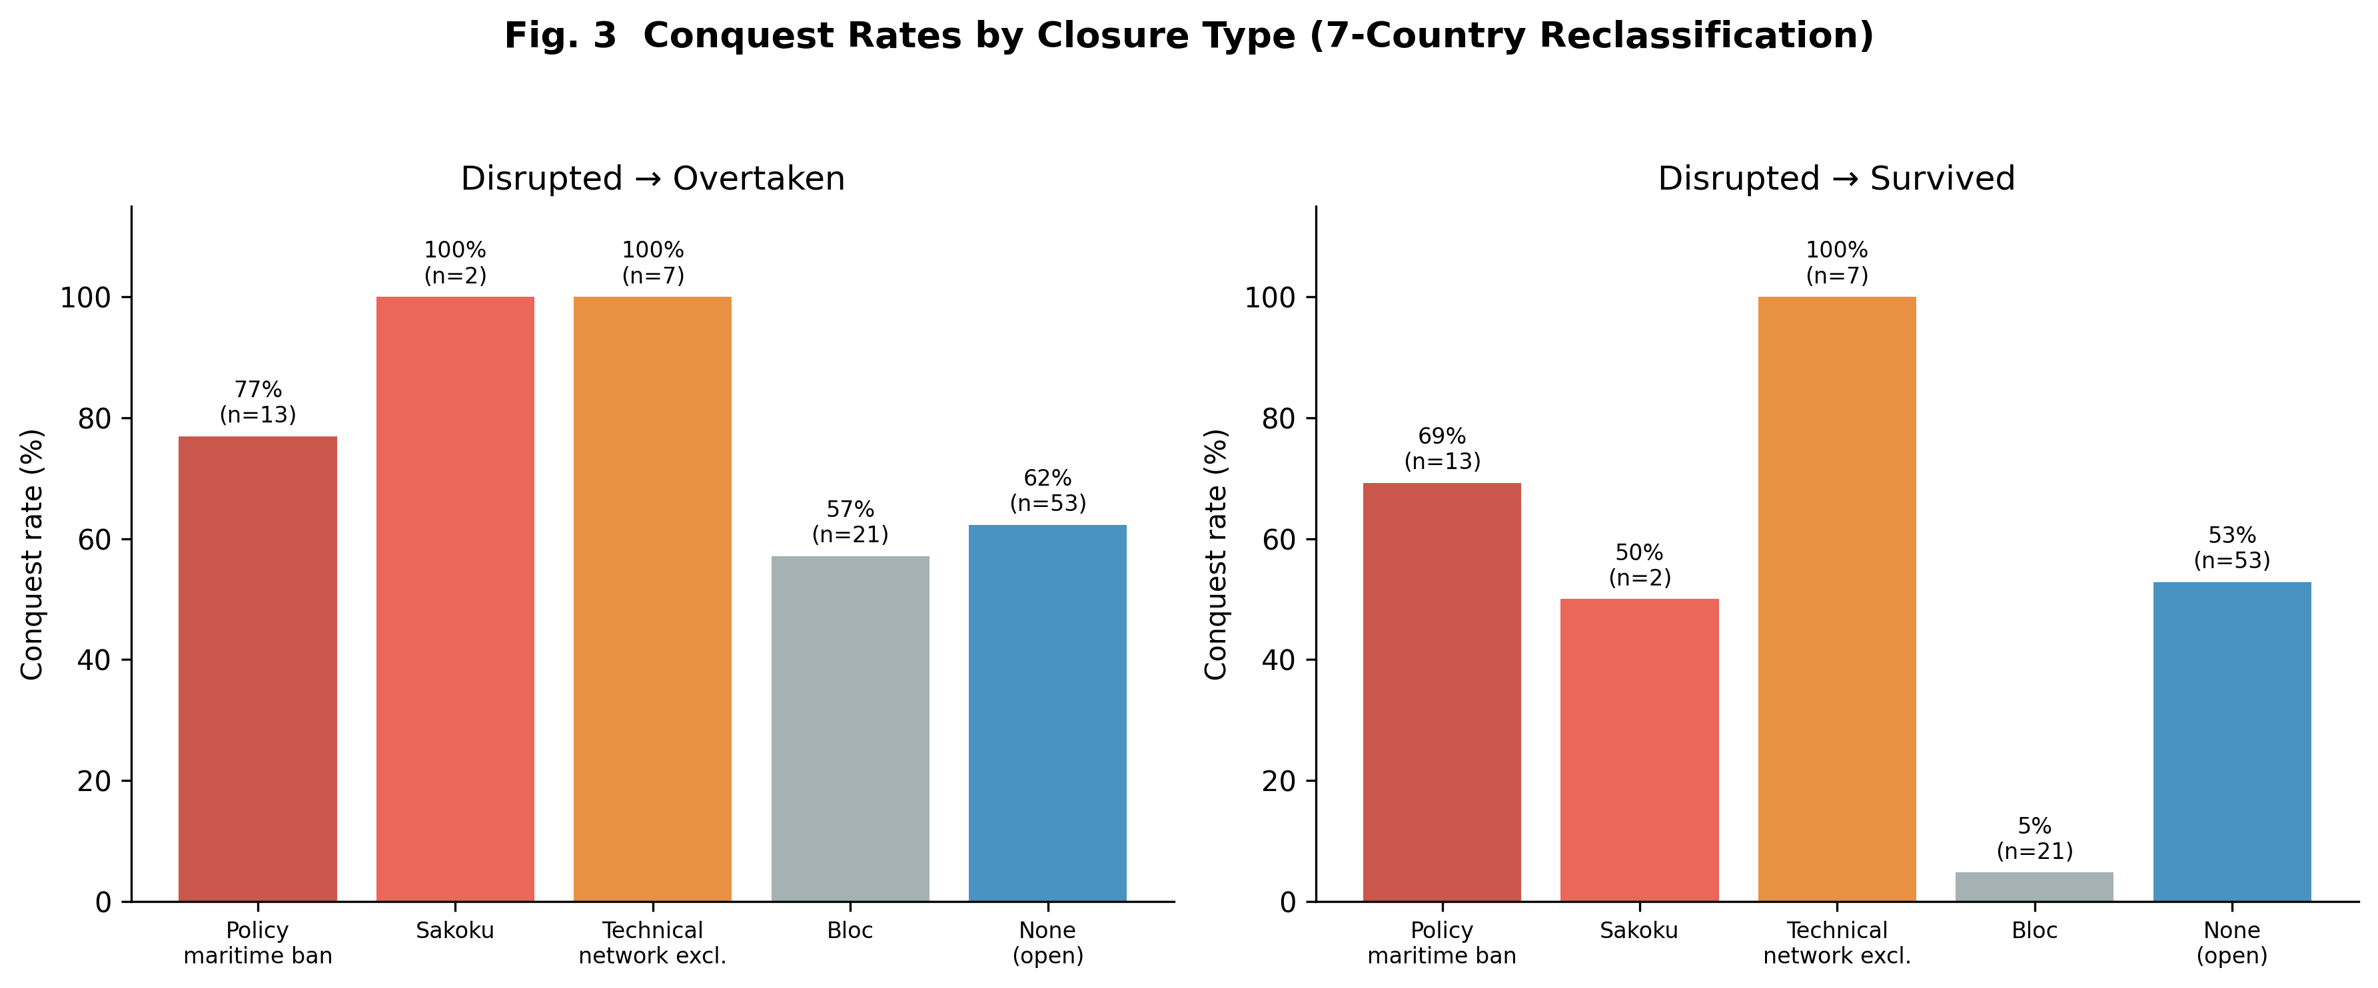
Fig3
Fig. 3 Conquest rates by closure type under the 7-country reclassification scenario.

Slide 4
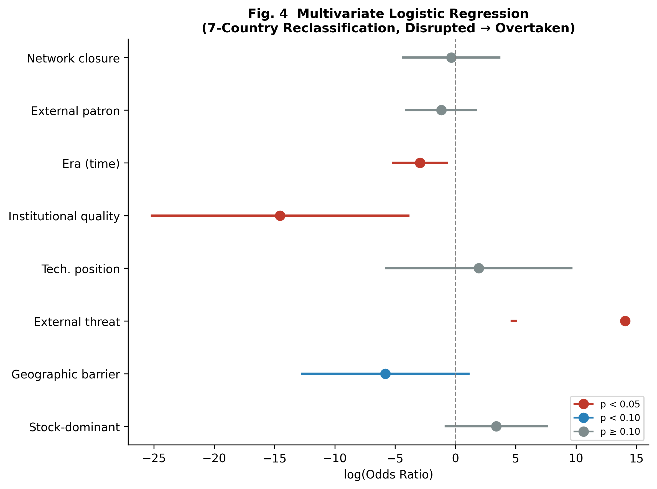
Fig4
Fig. 4 Forest plot of multivariate logistic regression odds ratios (7-country reclassification, disrupted→overtaken).

