Slide 1
Three Analytical Frameworks: LINKO, IONE, KOTHA
Components of the ONISHI Integrated Framework (Optimal Normalization, Incoherence Stratification, and Harmonized Integration)
LINKO
Latent Information Normalization for Key Outcomes
ICR (Information Contribution Ratio)
Meta-analysis validity diagnostic
Prism Forest Plot visualization
ICR-weighted pooling
IONE
Incoherence-Oriented Neutralization and Extraction
Coherent subgroup detection
C1 coherence index
Simpson's paradox resolution
Hidden structure identification
KOTHA
Knowledge-driven Observational-Trial Harmonization Approach
Module K: Counterfactual power sim.
Module T: Bayesian integration
Module H: Guideline interpreter
RCT-observational harmonization
Target: Meta-analysis level
Target: Individual study level
Target: Evidence synthesis level
Common Data Sources
RCT published data (Table 1) | Individual Patient Data (IPD) | Observational cohort data

Slide 2
Combination 1: LINKO + IONE
ICR-guided Subpopulation Analysis
Step 1: LINKO identifies anomalous ICR across studies in meta-analysis
Step 2: IONE decomposes each study into coherent subgroups
Step 3: ICR recalculated per subgroup reveals hidden heterogeneity sources
Step 4: Subgroup-specific ICR-weighted meta-analysis
Gain: Root cause identification of heterogeneity

Slide 3
Combination 2: LINKO + KOTHA
Information-Aware Evidence Synthesis
Step 1: LINKO quantifies information contribution of endpoints
Step 2: ICR feeds into KOTHA Module K for refined power simulation
Step 3: Module T uses ICR as Bayesian prior weight for integration
Step 4: Module H reports ICR alongside OIS and TSA assessments
Gain: Quantitative precision in evidence synthesis

Slide 4
Combination 3: IONE + KOTHA
Population-Harmonized Evidence Integration
Step 1: IONE detects incoherent subgroups in observational data
Step 2: Subgroup risk profiles inform KOTHA Module K simulation
Step 3: Module T integrates subgroup-specific effects with RCT data
Step 4: Module H assesses representativeness using IONE's C1 index
Gain: External validity through population harmonization

Slide 5
Combination 4: LINKO + IONE + KOTHA = ONISHI
Comprehensive Evidence Assessment Pipeline (Optimal Normalization, Incoherence Stratification, and Harmonized Integration)
Phase 1
IONE
Population Decomposition
Detect incoherent populations → Extract coherent subgroups → Compute C1 index
Phase 2
LINKO
Information Quantification
Compute ICR per subgroup → Assess ICR discrepancy → Prism Forest Plot
Phase 3
KOTHA
Evidence Harmonization
Module K: Power simulation → Module T: Bayesian synthesis → Module H: Guidelines
Output
Integrated Decision Support
Subgroup-specific recommendations with full uncertainty quantification
Gain: Comprehensive multi-level evidence assessment

Slide 6
Synergy Matrix: What Each Combination Enables
Combination | New Capability | Primary Gain
LINKO + IONE | Subgroup-level ICR analysis reveals why meta-analysis heterogeneity arises | Root cause identification
LINKO + KOTHA | ICR-informed power simulation and Bayesian weighting improve precision | Quantitative precision
IONE + KOTHA | Population decomposition feeds counterfactual simulation & representativeness | External validity
ONISHI (All three) | Full pipeline: detect heterogeneity → quantify information → harmonize evidence | Comprehensive assessment

Slide 7
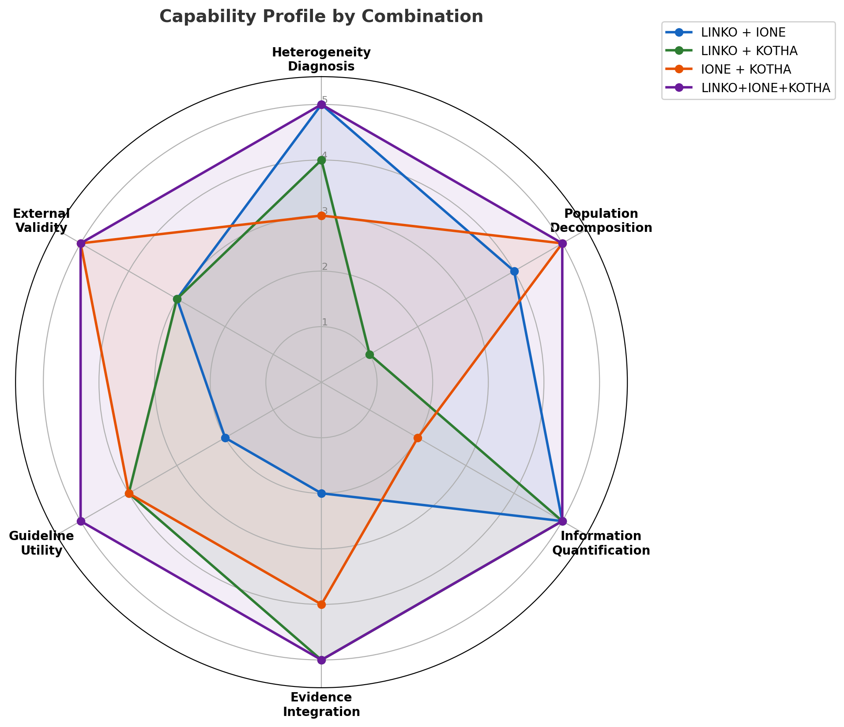
Capability Profile by Combination
Comparative radar chart across 6 dimensions

