Slide 1
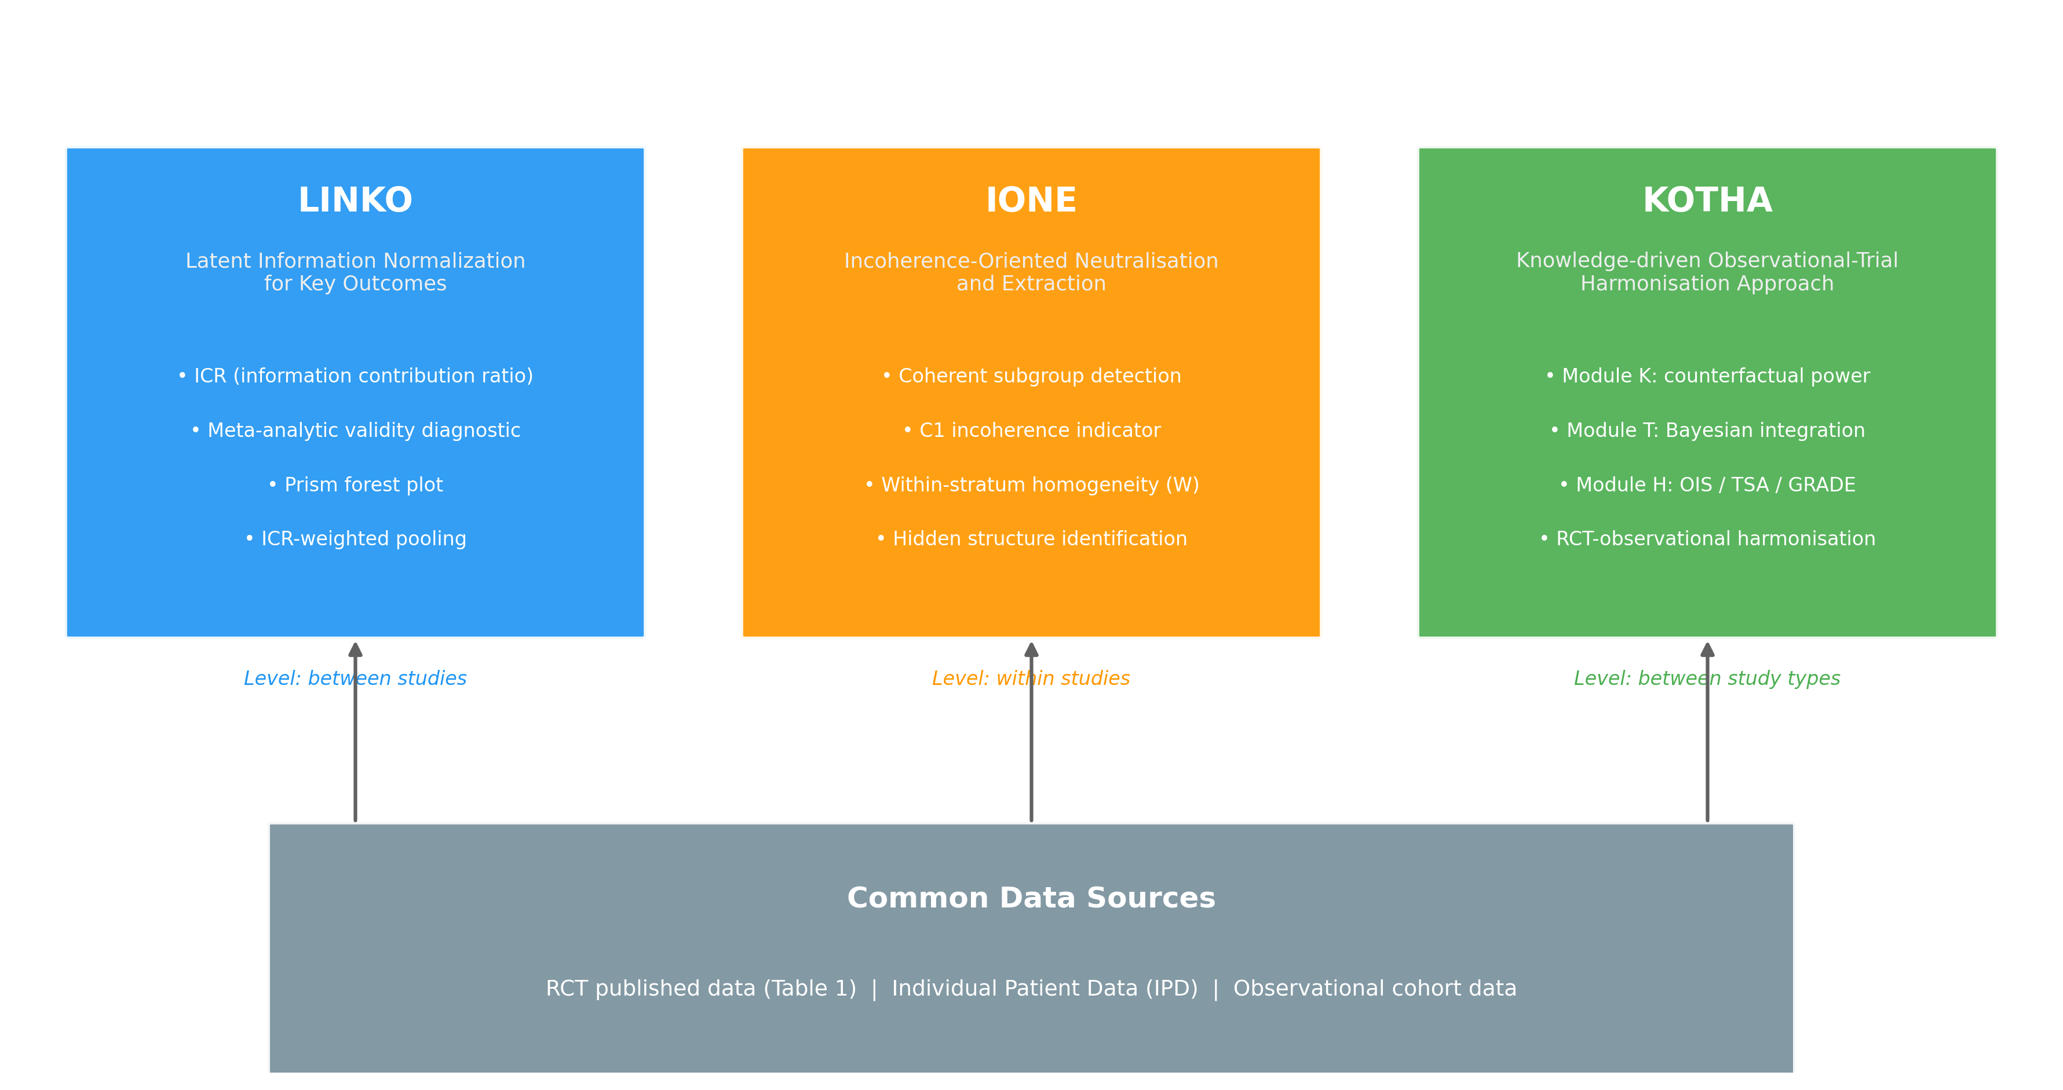
Figure 1
Figure 1. Overview of the ONISHI framework. Three levels at which an evidence synthesis can be compromised are matched to three component methods operating on a common data basis: LINKO between studies, IONE within studies, and KOTHA between study types. ICR, information contribution ratio; IPD, individual patient data; OIS, optimal information size; TSA, trial sequential analysis; GRADE, Grading of Recommendations Assessment, Development and Evaluation.

Slide 2
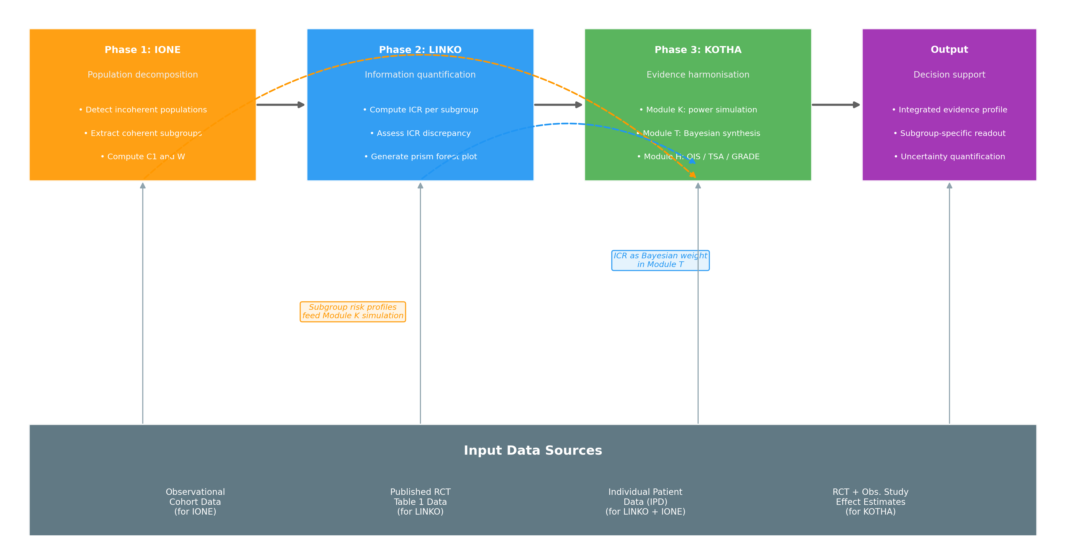
Figure 2
Figure 2. The integrated ONISHI pipeline. Data flow runs IONE → LINKO → KOTHA, with two cross-phase hand-offs shown as dashed arrows: IONE subgroup risk profiles parameterize the KOTHA Module K power simulation, and the LINKO information contribution ratio (ICR) enters the KOTHA Module T Bayesian integration as a prior weight.

Slide 3
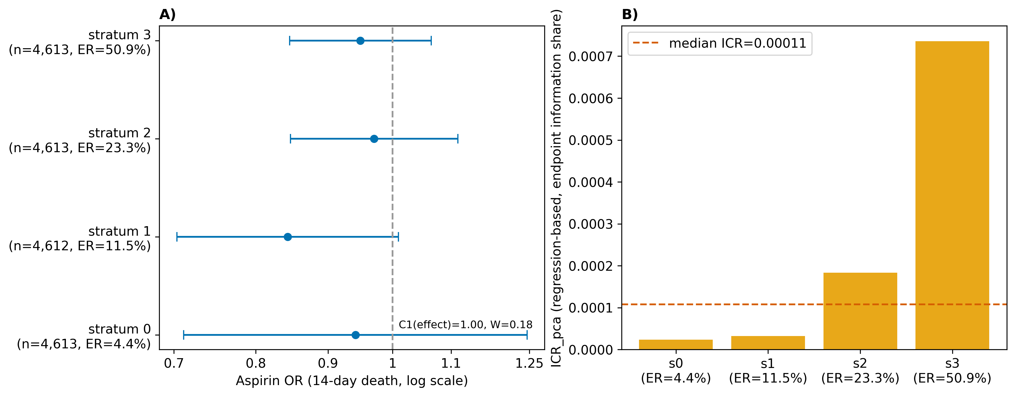
Figure 3
Figure 3. LINKO + IONE on the International Stroke Trial (18,451 patients; randomized aspirin allocation, 14-day death). A) aspirin odds ratios are coherent across four latent risk strata (C1 [effect] = 1.00, W = 0.18); B) the per-stratum information contribution ratio (ICR) increases with baseline risk, so a coherent effect coexists with a risk-dependent information contribution. OR, odds ratio; ICR, information contribution ratio; ER, event rate.

Slide 4
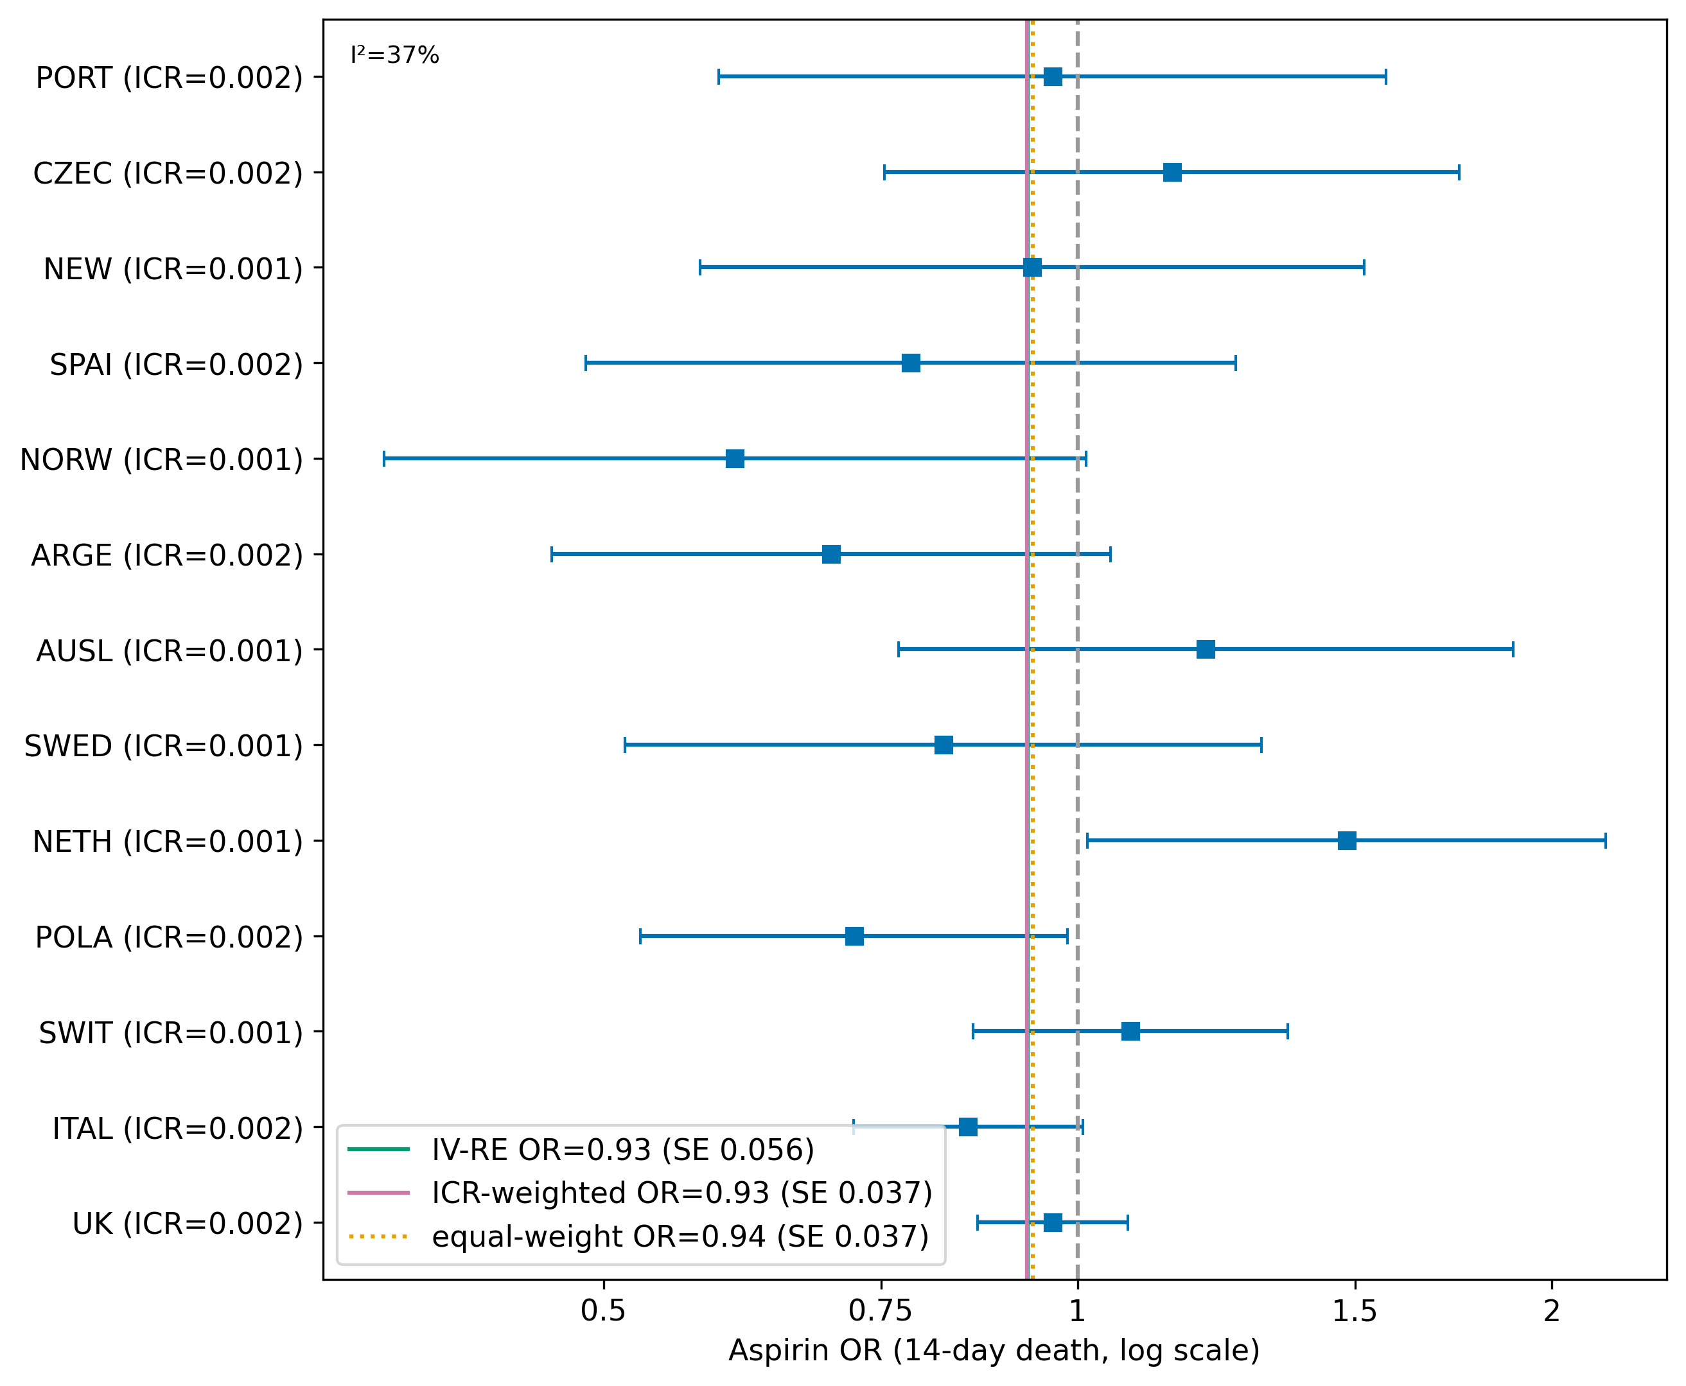
Figure 4
Figure 4. LINKO + KOTHA on the International Stroke Trial: pooling across 13 national sub-studies by inverse-variance random effects, ICR weighting, and equal weighting. The ICR-weighted and equal-weight point estimates coincide, so information weighting demonstrates robustness rather than a change in estimate. OR, odds ratio; ICR, information contribution ratio.

Slide 5
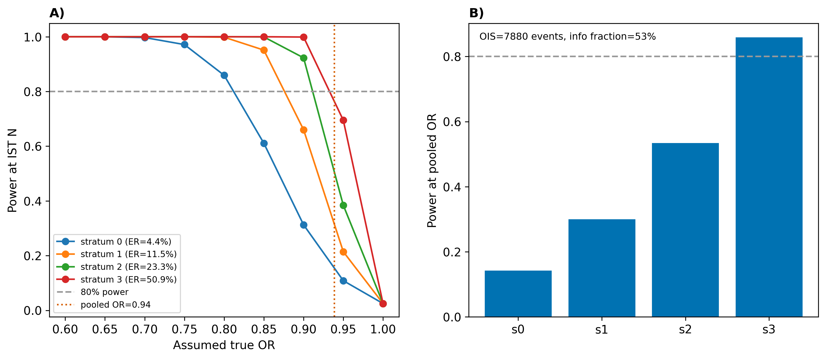
Figure 5
Figure 5. IONE + KOTHA on the International Stroke Trial: A) statistical power at the observed effect against the assumed true odds ratio for each risk stratum; B) power at the trial-wide pooled odds ratio per stratum, quantifying how event scarcity—not absence of effect—drives the flat result. OIS, optimal information size.

Slide 6
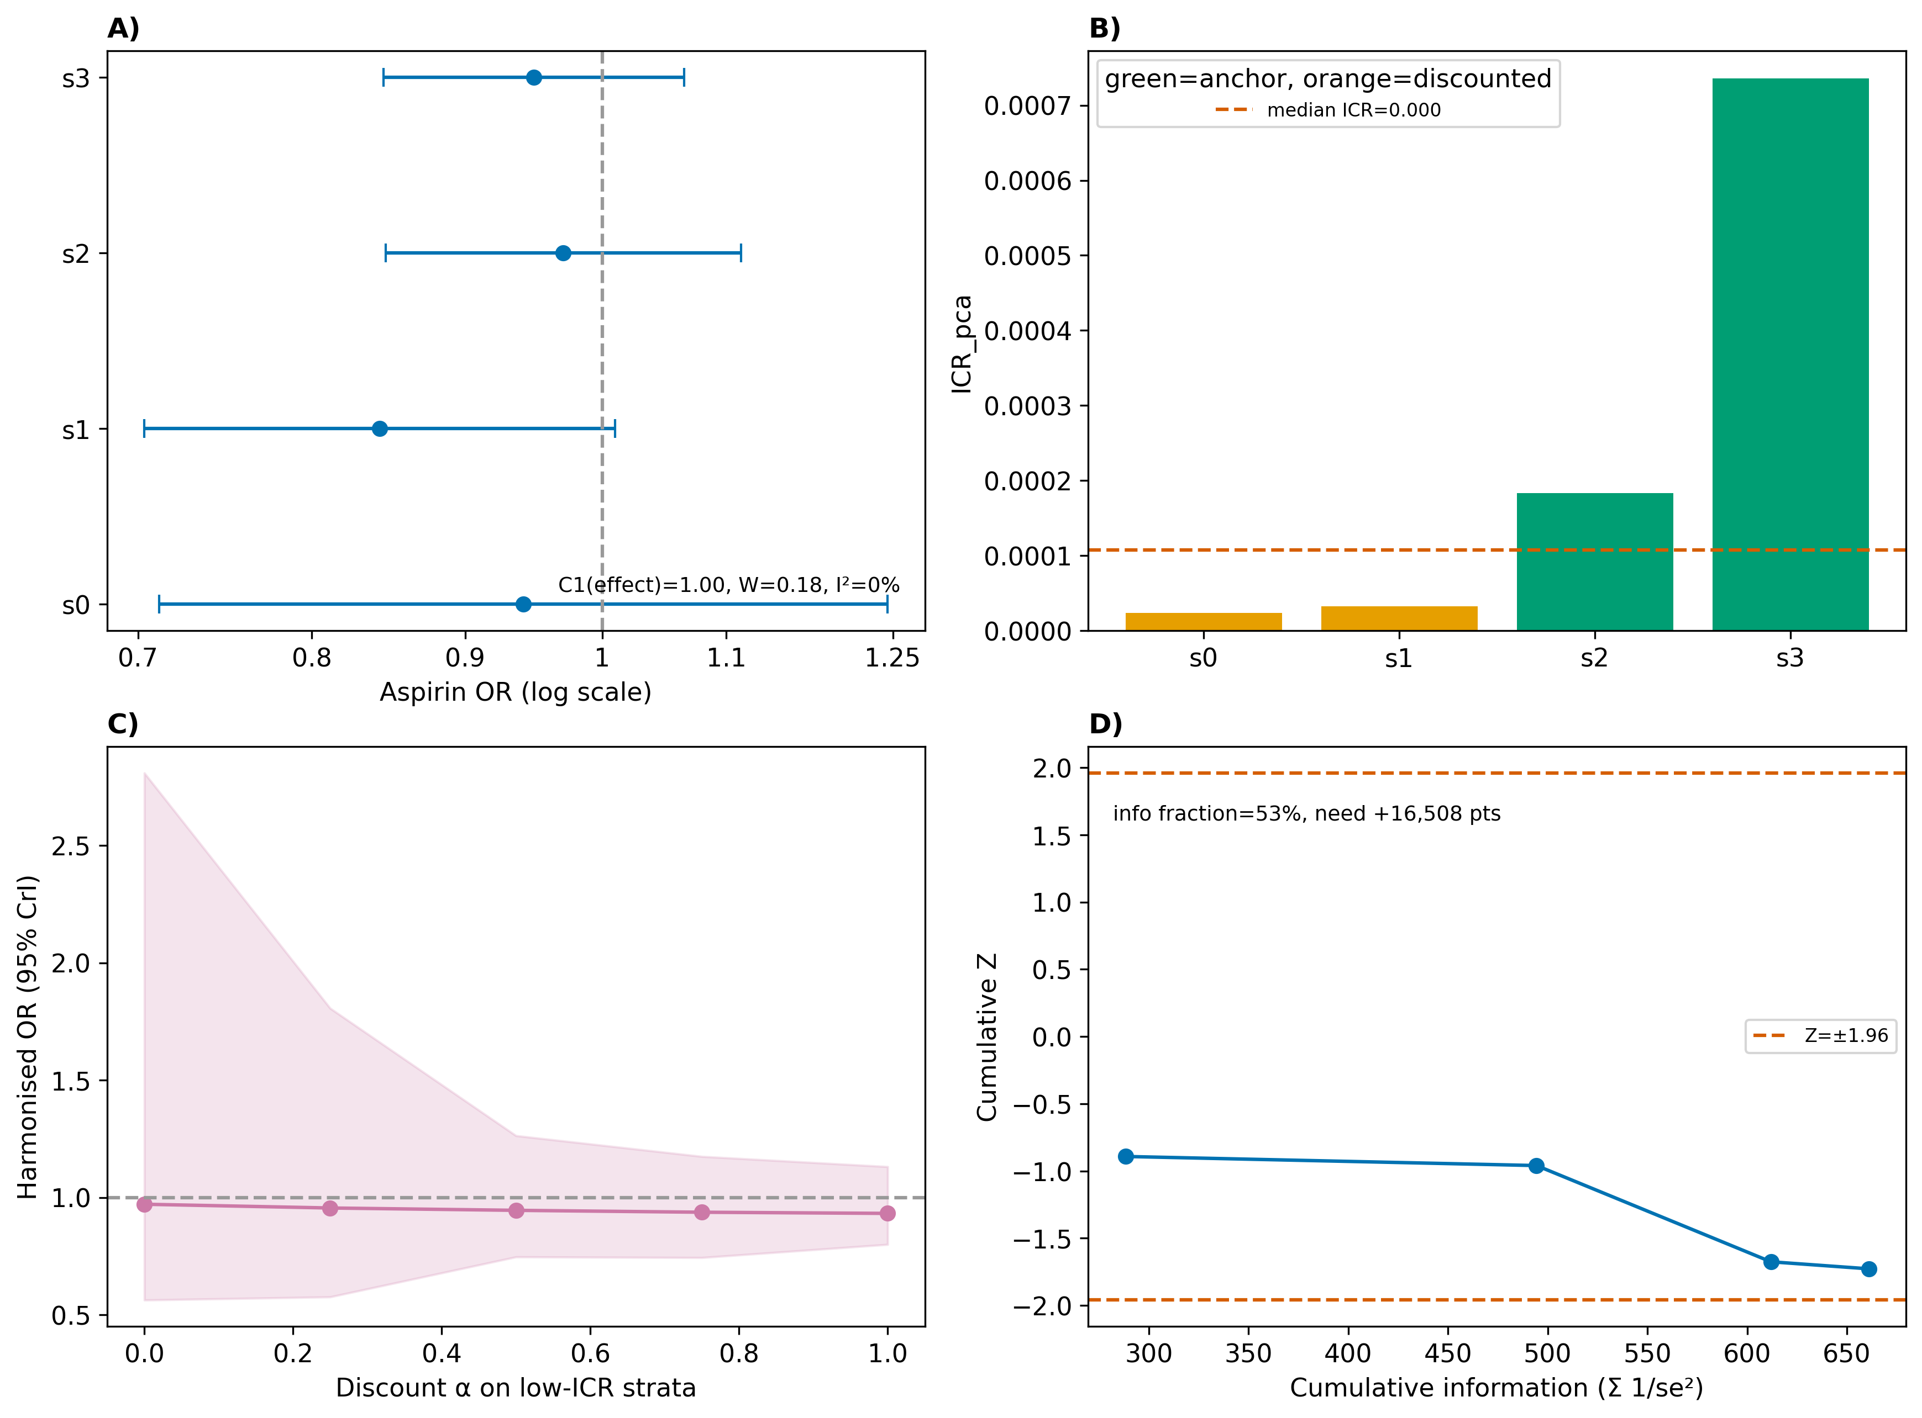
Figure 6
Figure 6. Full ONISHI pipeline on the International Stroke Trial: A) IONE subgroup aspirin odds ratios by stratum; B) LINKO per-stratum information weights; C) KOTHA ICR-guided power-prior harmonization (harmonized odds ratio with 95% credible band across the discount on low-ICR strata); D) trial sequential analysis (cumulative Z = −1.73, within the ±1.96 boundary; information fraction 53%). OR, odds ratio; ICR, information contribution ratio.

