Slide 1
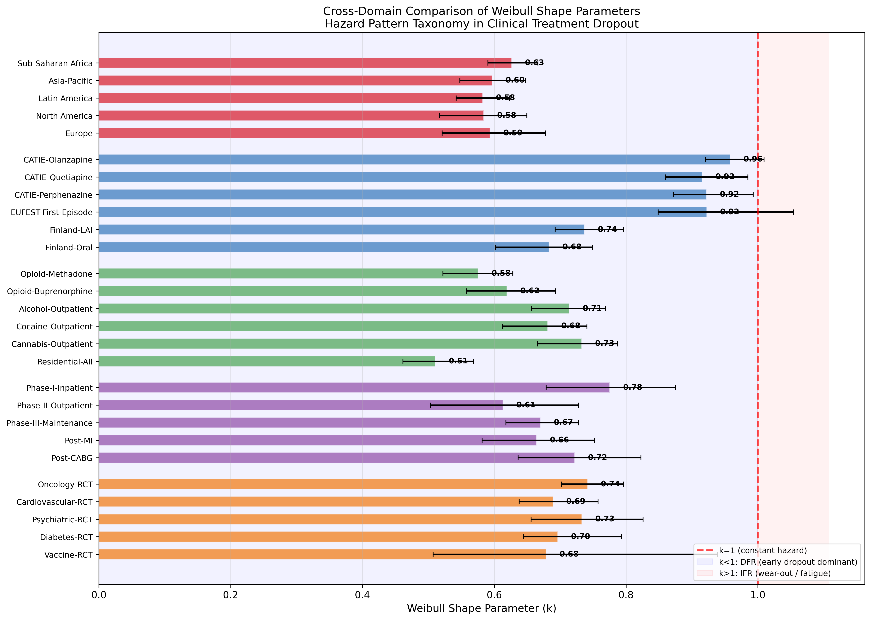
Fig. 1: Cross-Domain k Comparison
Weibull shape parameters (k) with 95% CI across all 28 datasets and 5 domains.

Slide 2
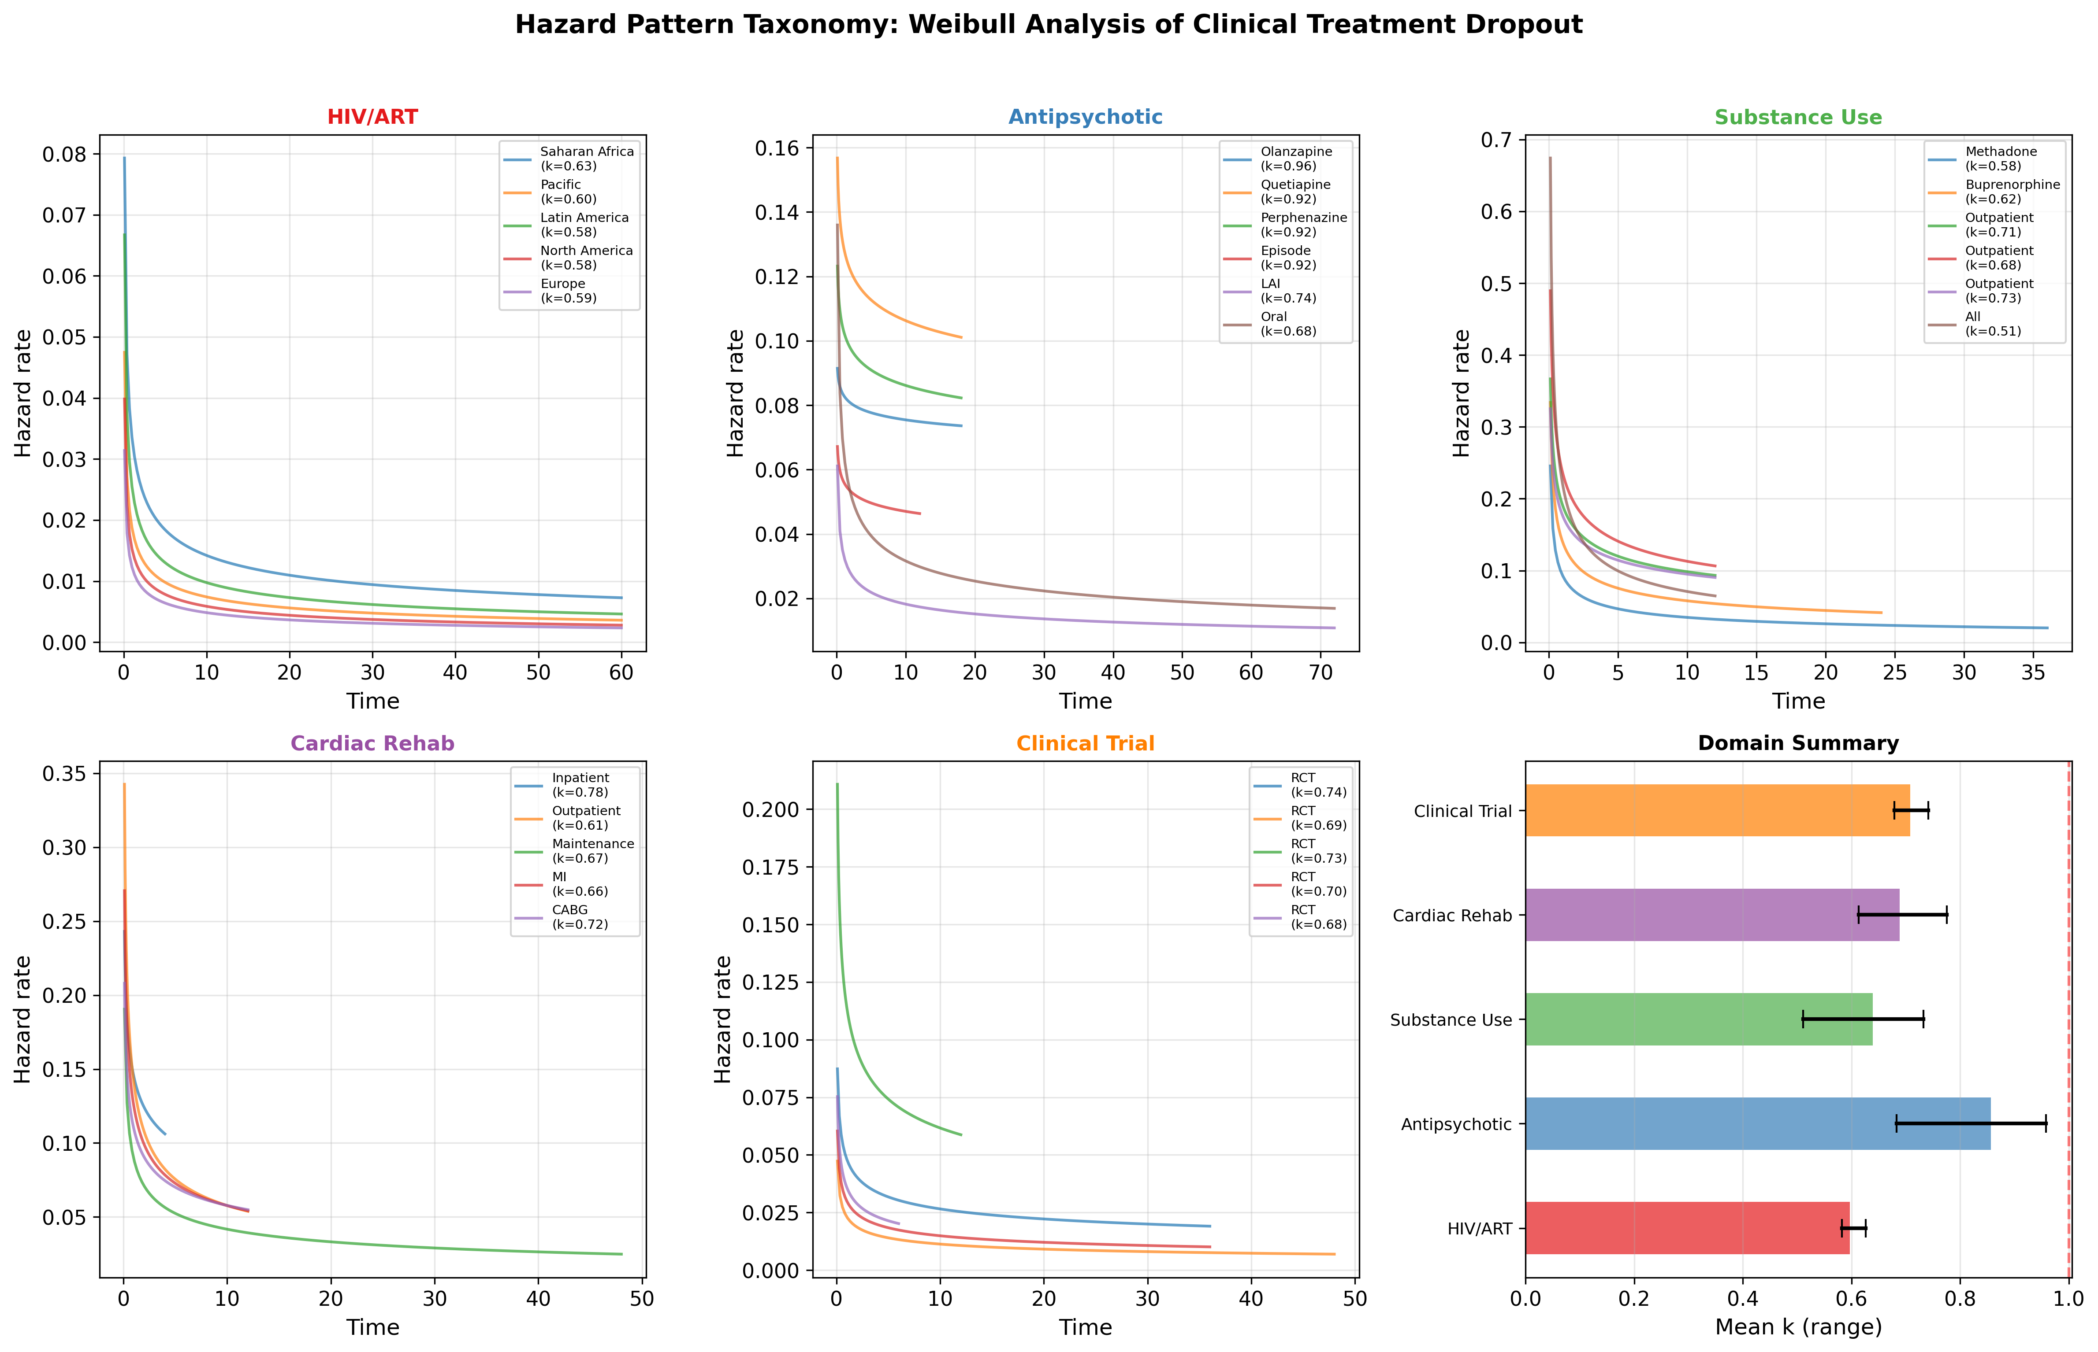
Fig. 12: Hazard Pattern Taxonomy
Domain-specific hazard functions and summary comparison.

Slide 3
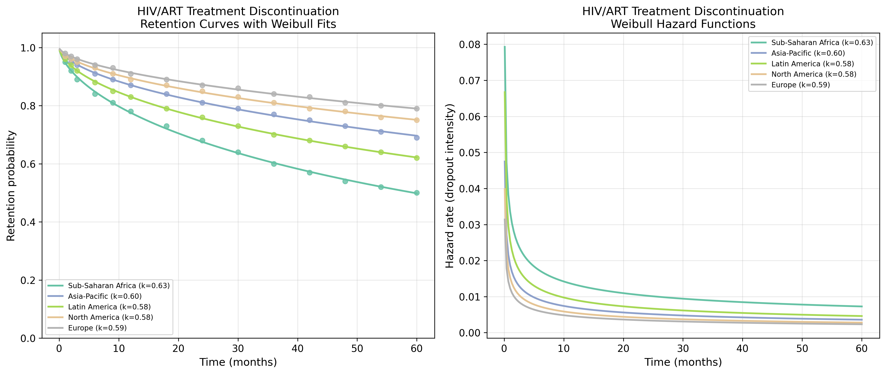
Fig. 2: HIV/ART Retention & Hazard
Retention curves with Weibull fits and hazard functions, 5 IeDEA regions.

Slide 4
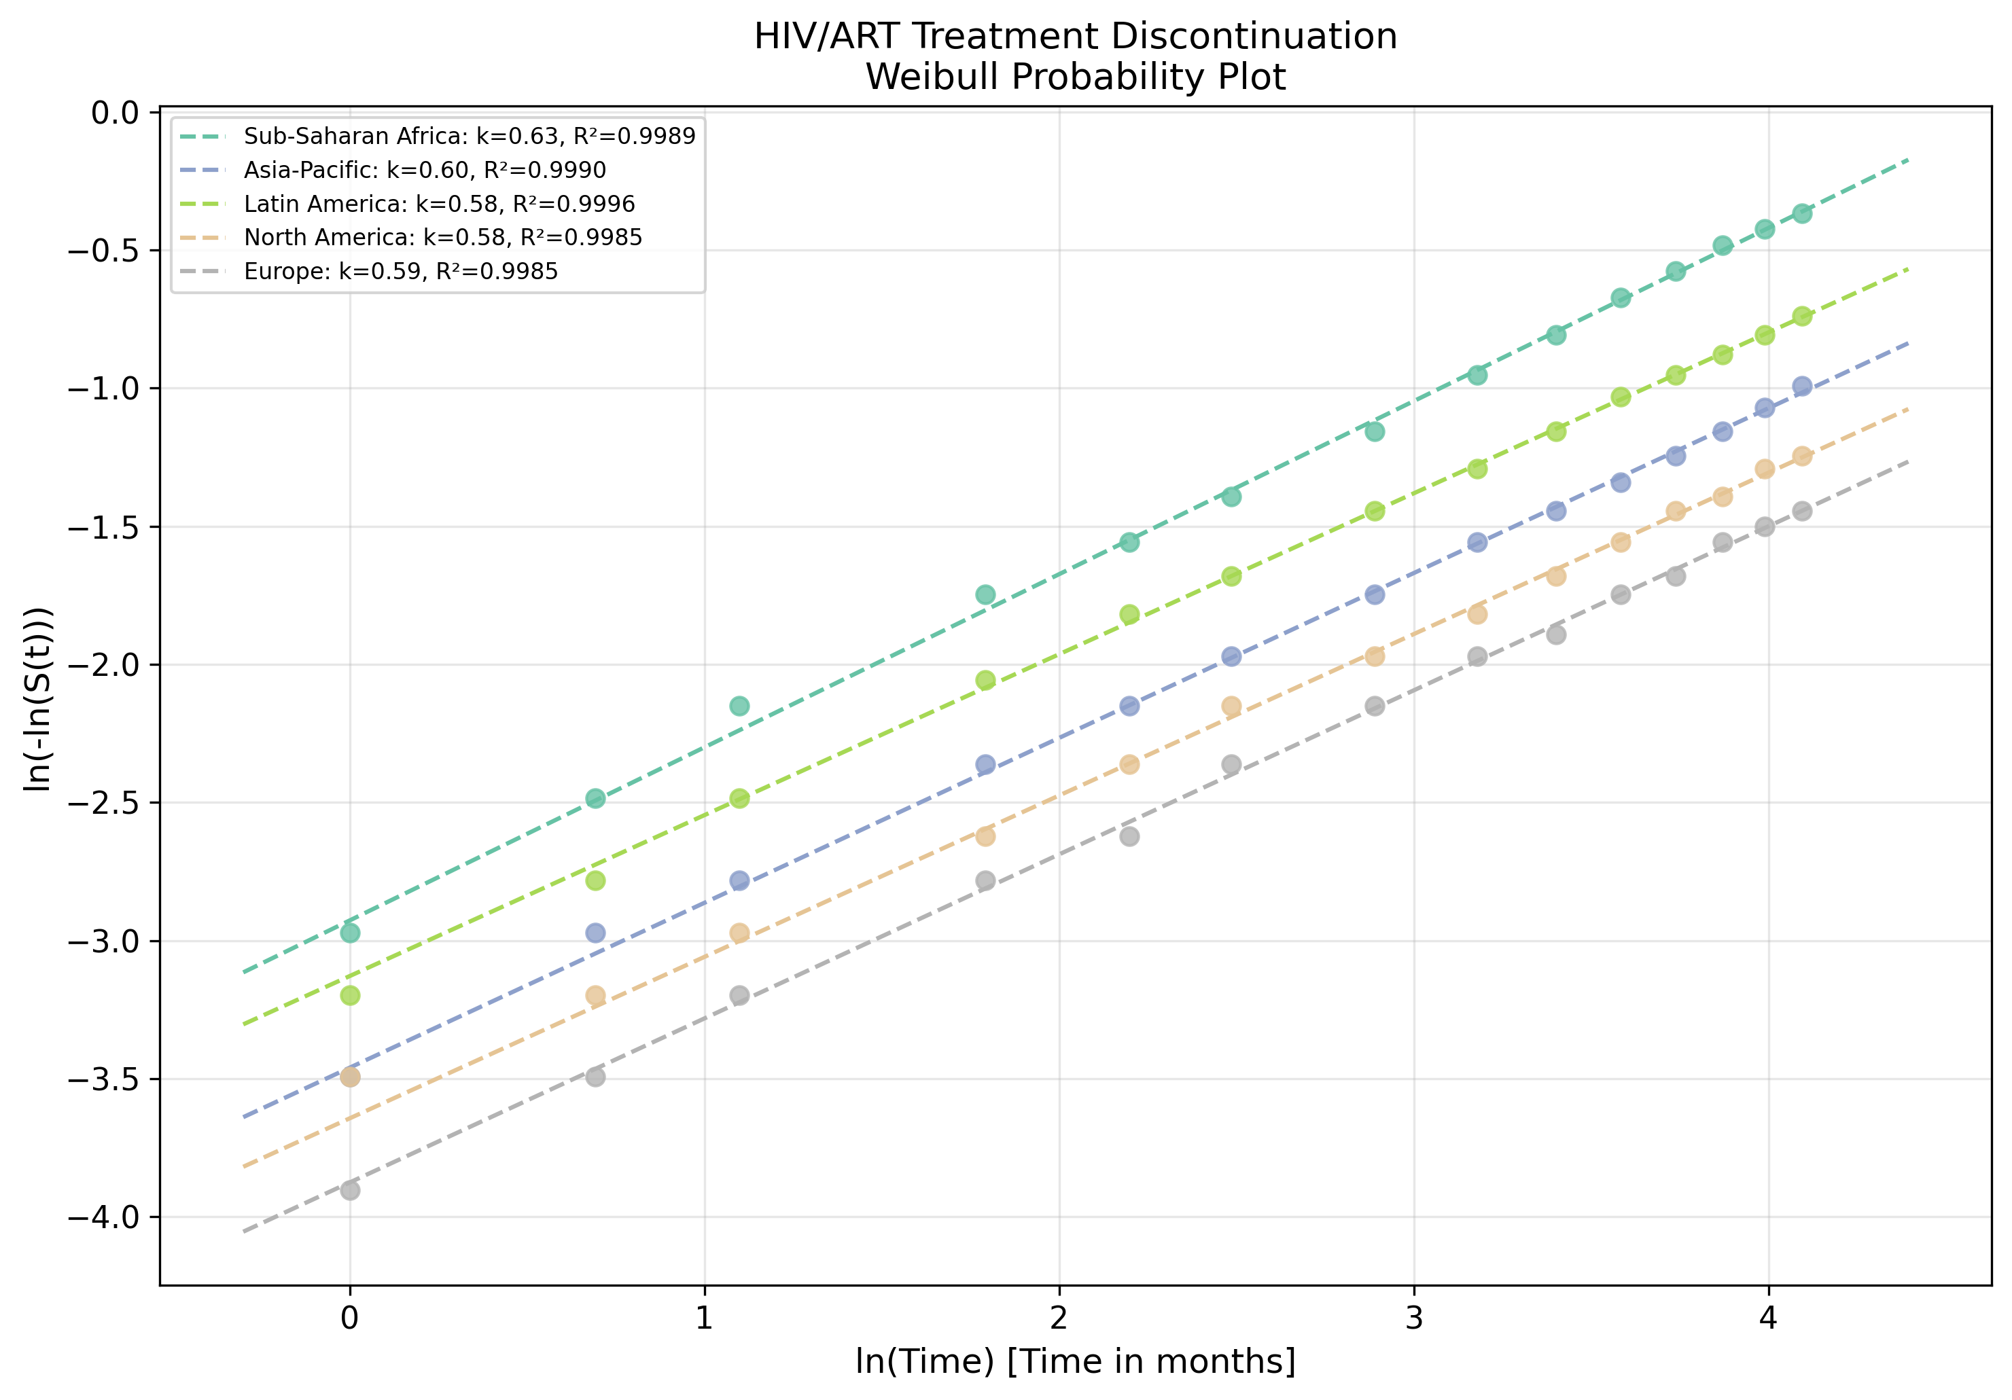
Fig. 3: HIV/ART Weibull Probability Plot
Linearised goodness-of-fit assessment for HIV/ART datasets.

Slide 5
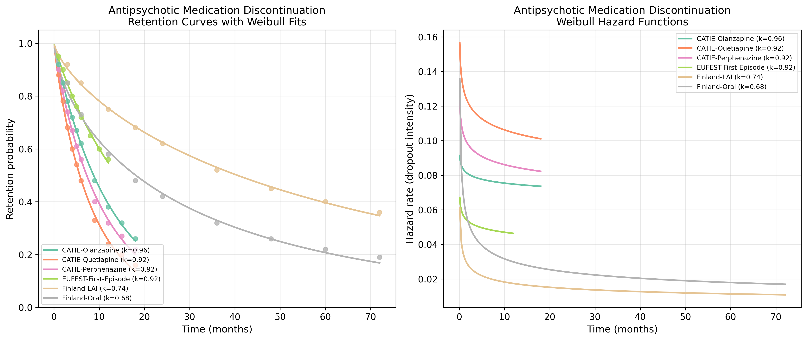
Fig. 4: Antipsychotic Retention & Hazard
CATIE, EUFEST, and Finnish cohort retention curves and hazard functions.

Slide 6
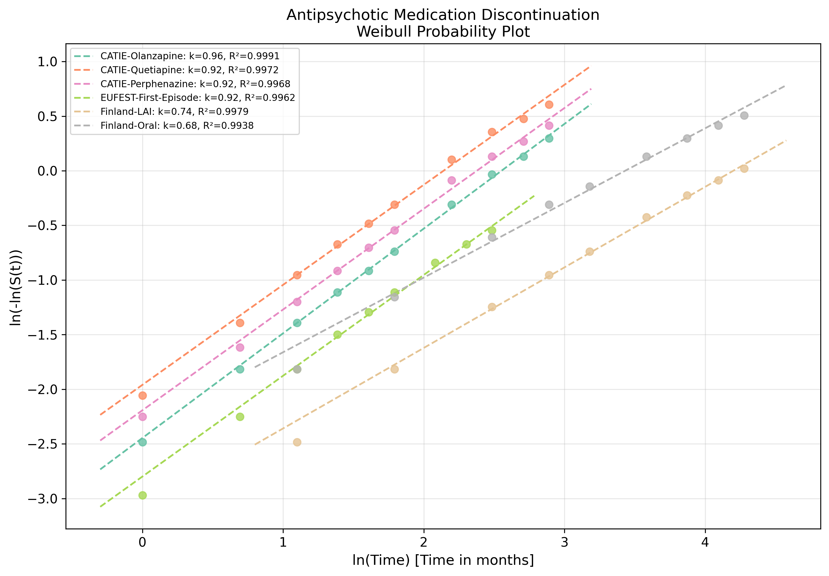
Fig. 5: Antipsychotic Weibull Probability Plot
Linearised goodness-of-fit for antipsychotic datasets.

Slide 7
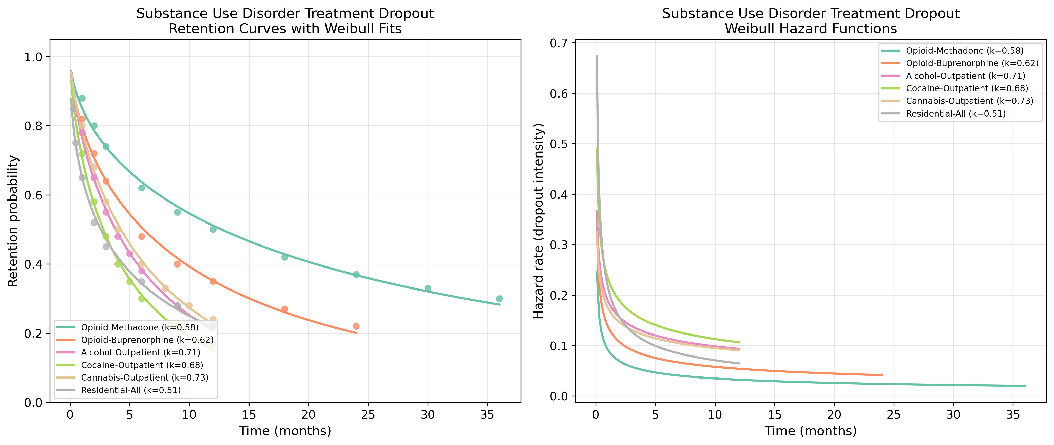
Fig. 6: Substance Use Retention & Hazard
Substance-specific retention curves and hazard functions.

Slide 8
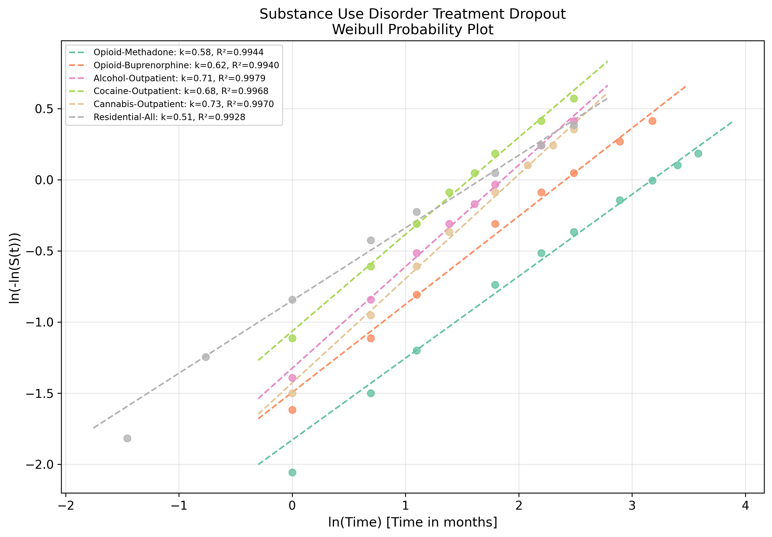
Fig. 7: Substance Use Weibull Probability Plot
Linearised goodness-of-fit for substance use datasets.

Slide 9
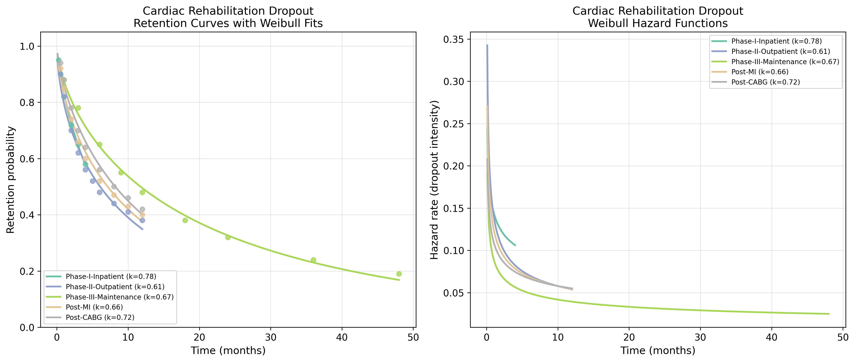
Fig. 8: Cardiac Rehab Retention & Hazard
Phase-specific and indication-specific retention and hazard.

Slide 10
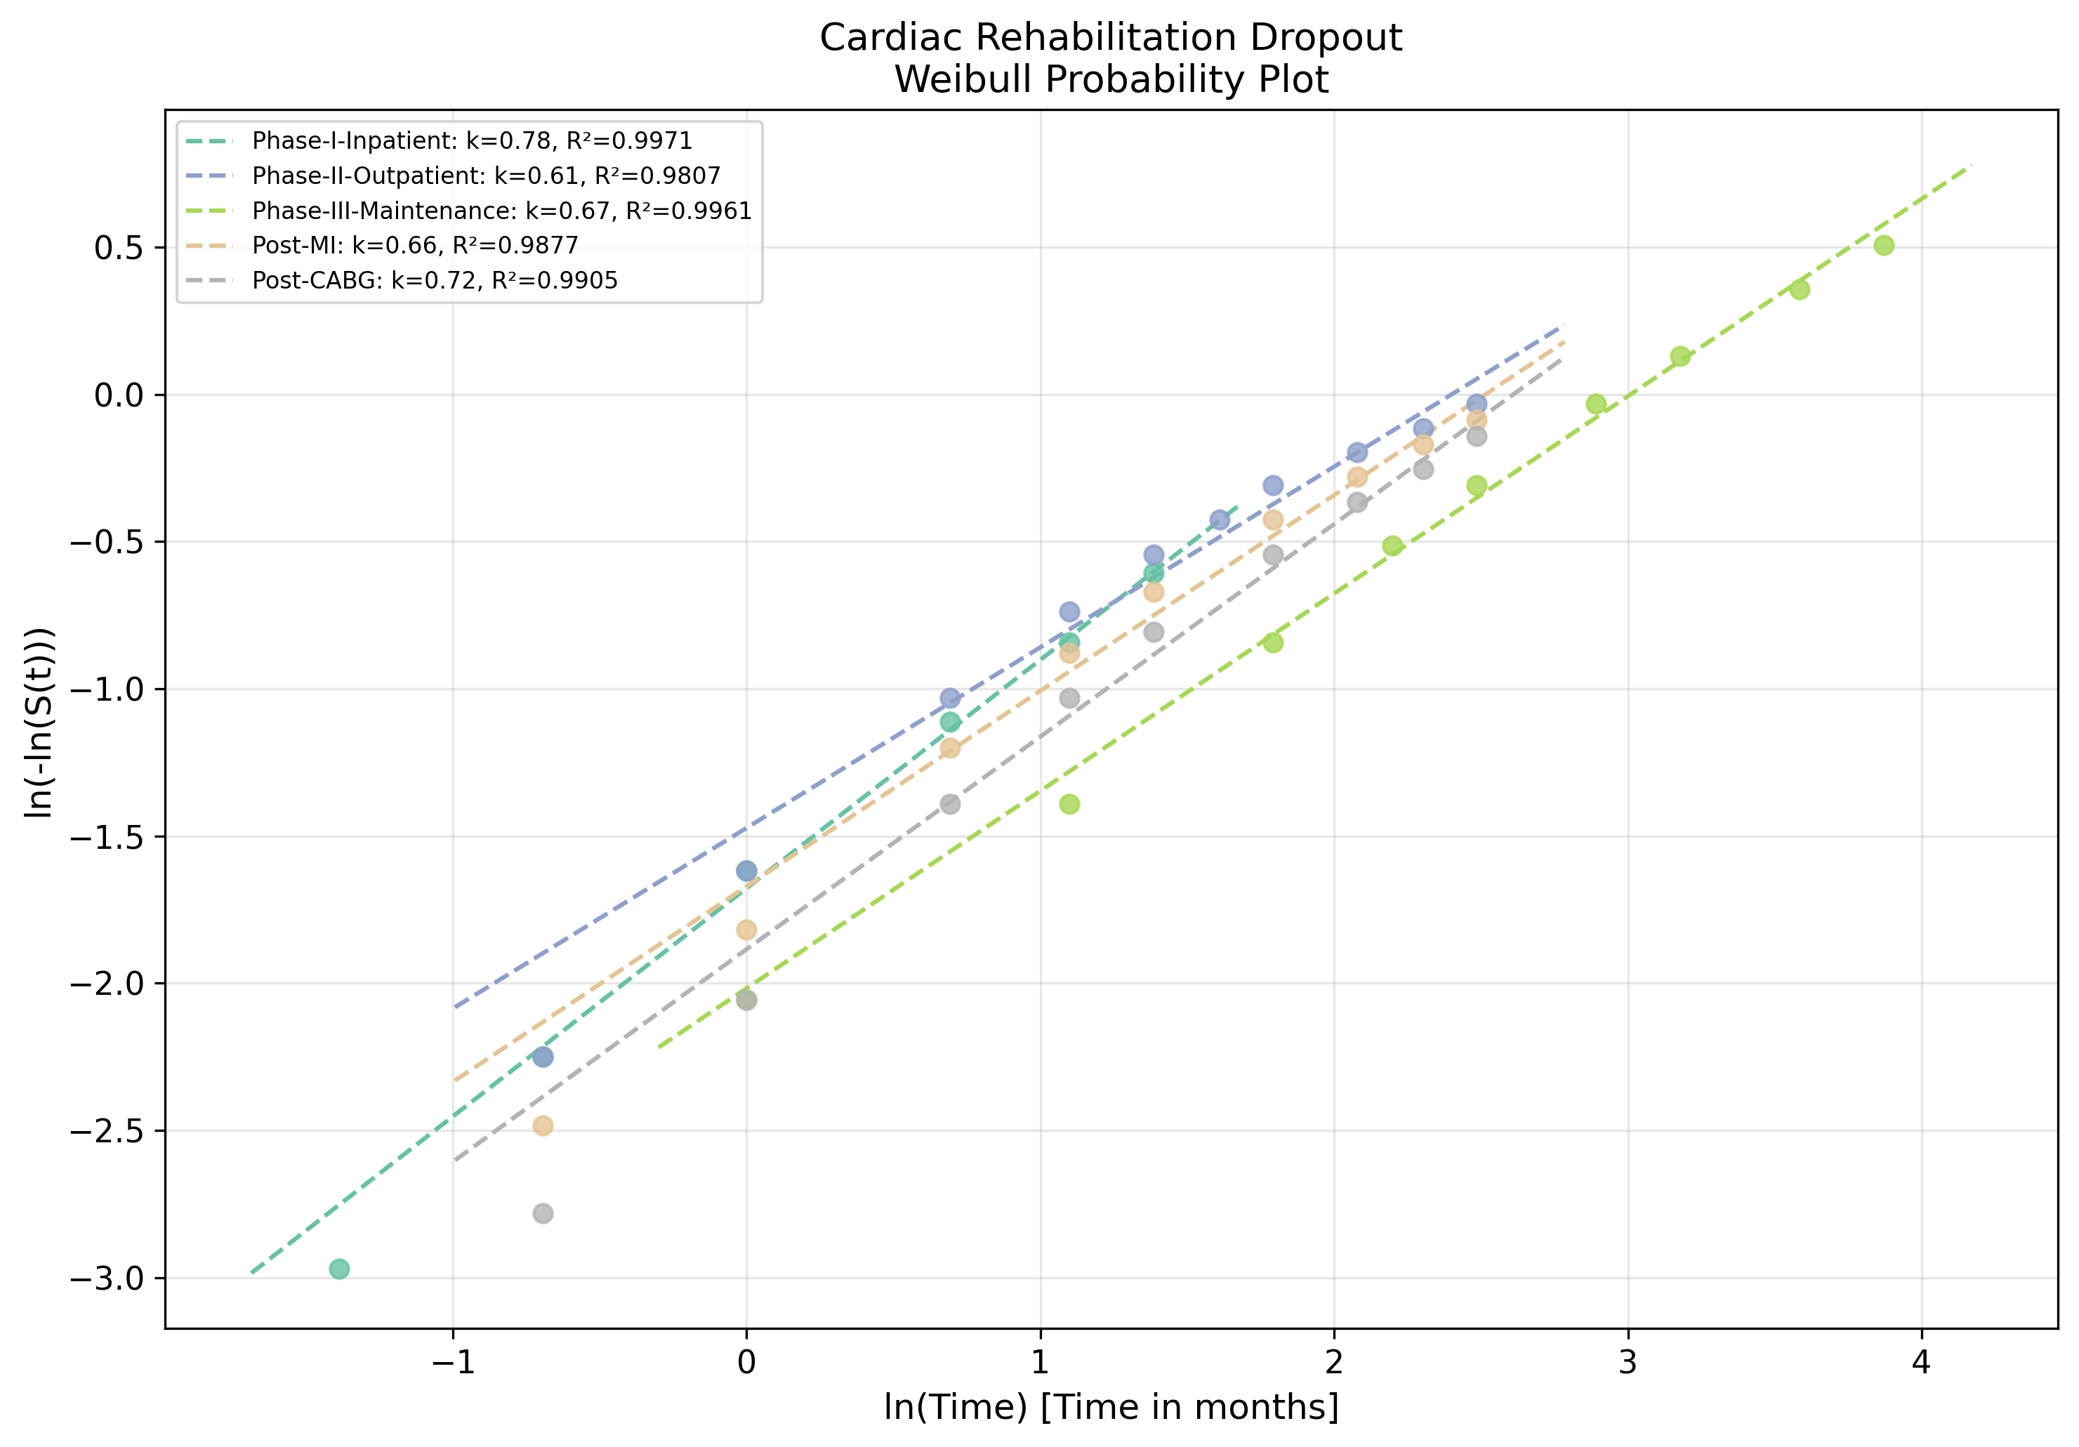
Fig. 9: Cardiac Rehab Weibull Probability Plot
Linearised goodness-of-fit for cardiac rehab datasets.

Slide 11
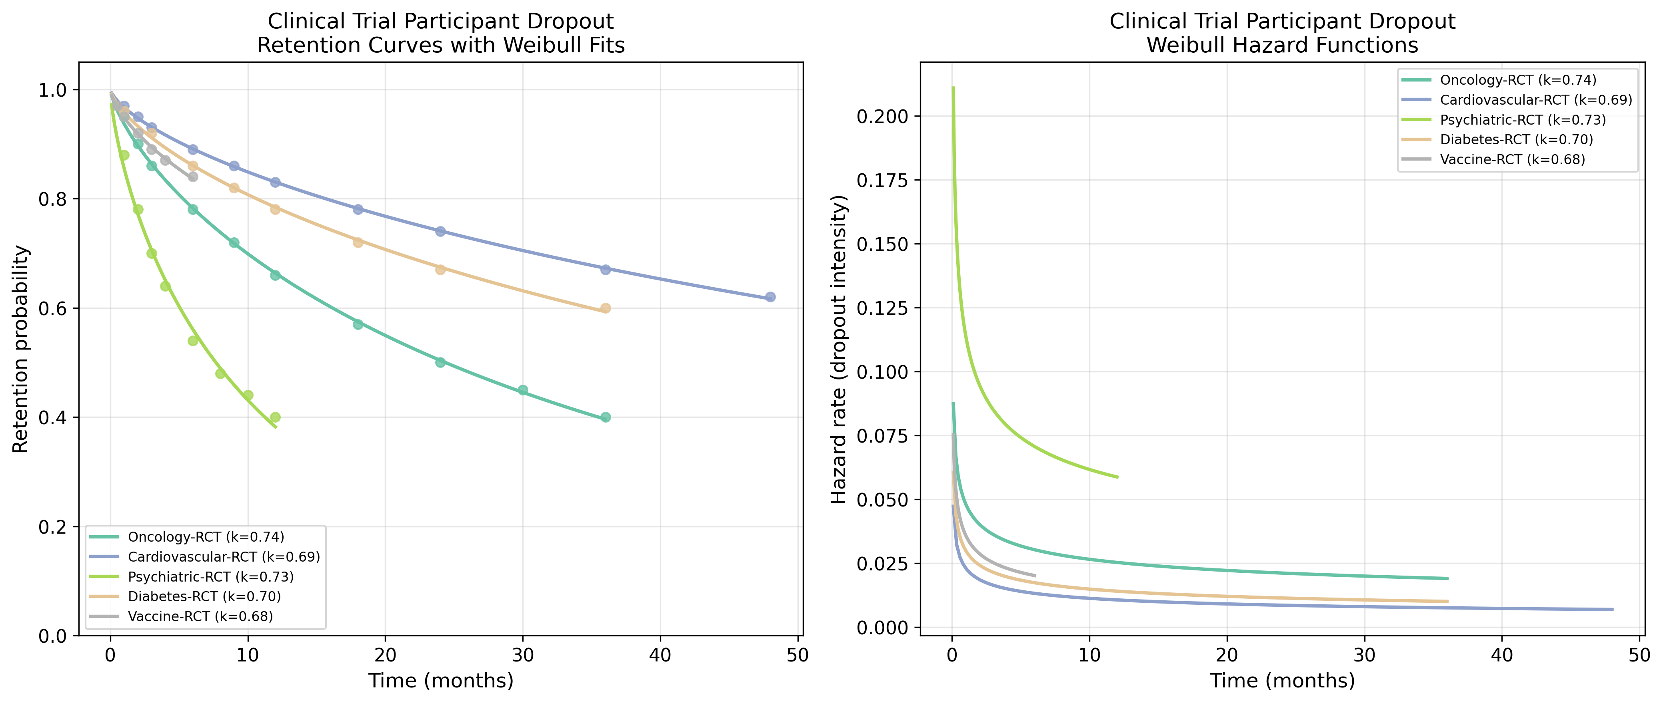
Fig. 10: Clinical Trial Retention & Hazard
Therapeutic area-specific trial dropout and hazard functions.

Slide 12
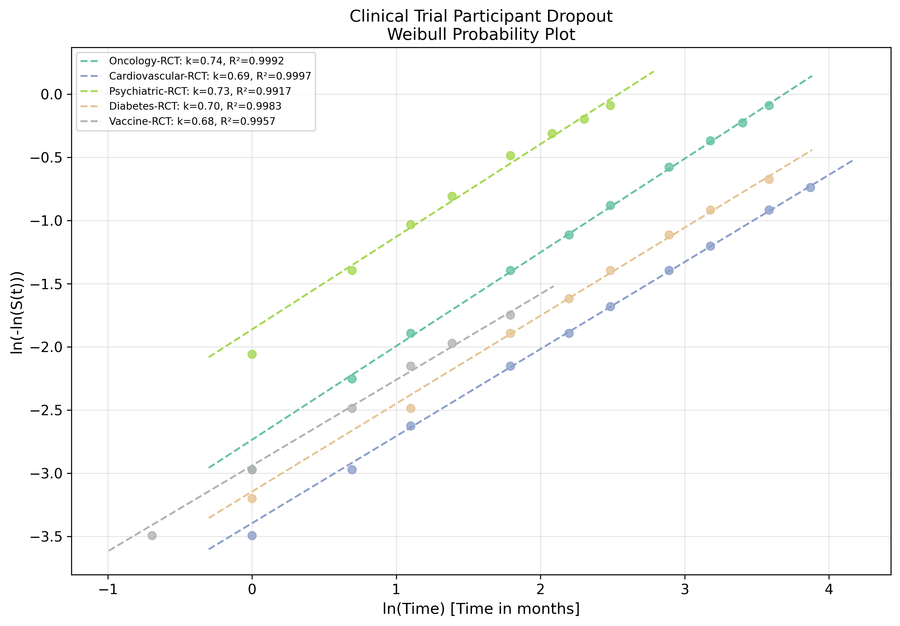
Fig. 11: Clinical Trial Weibull Probability Plot
Linearised goodness-of-fit for clinical trial datasets.

