Slide 1
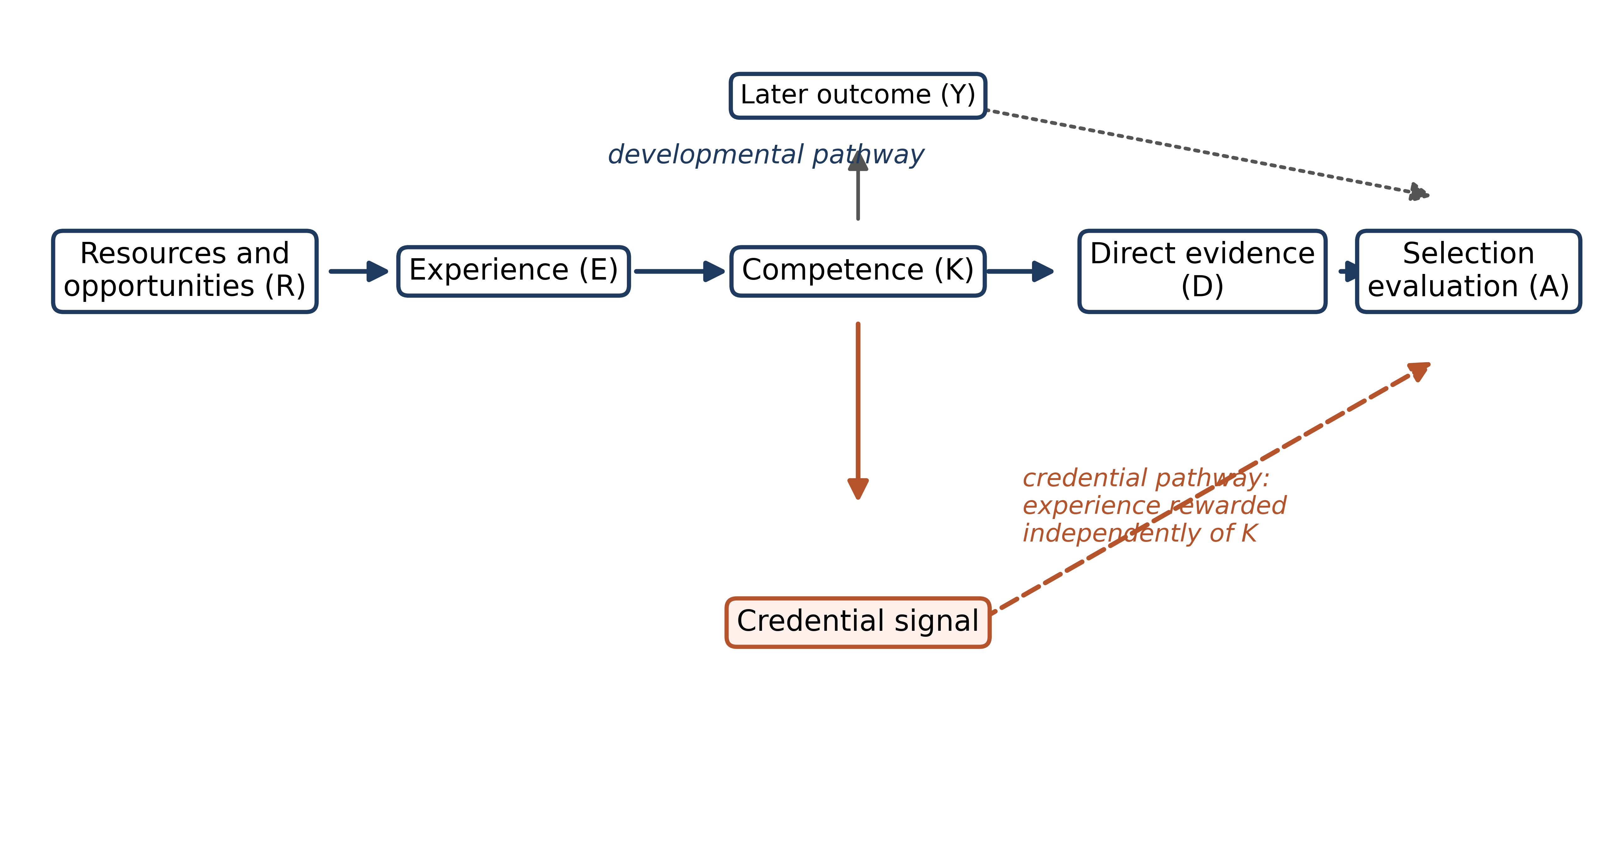
Figure 1. The two pathways from experience to selection

Slide 2
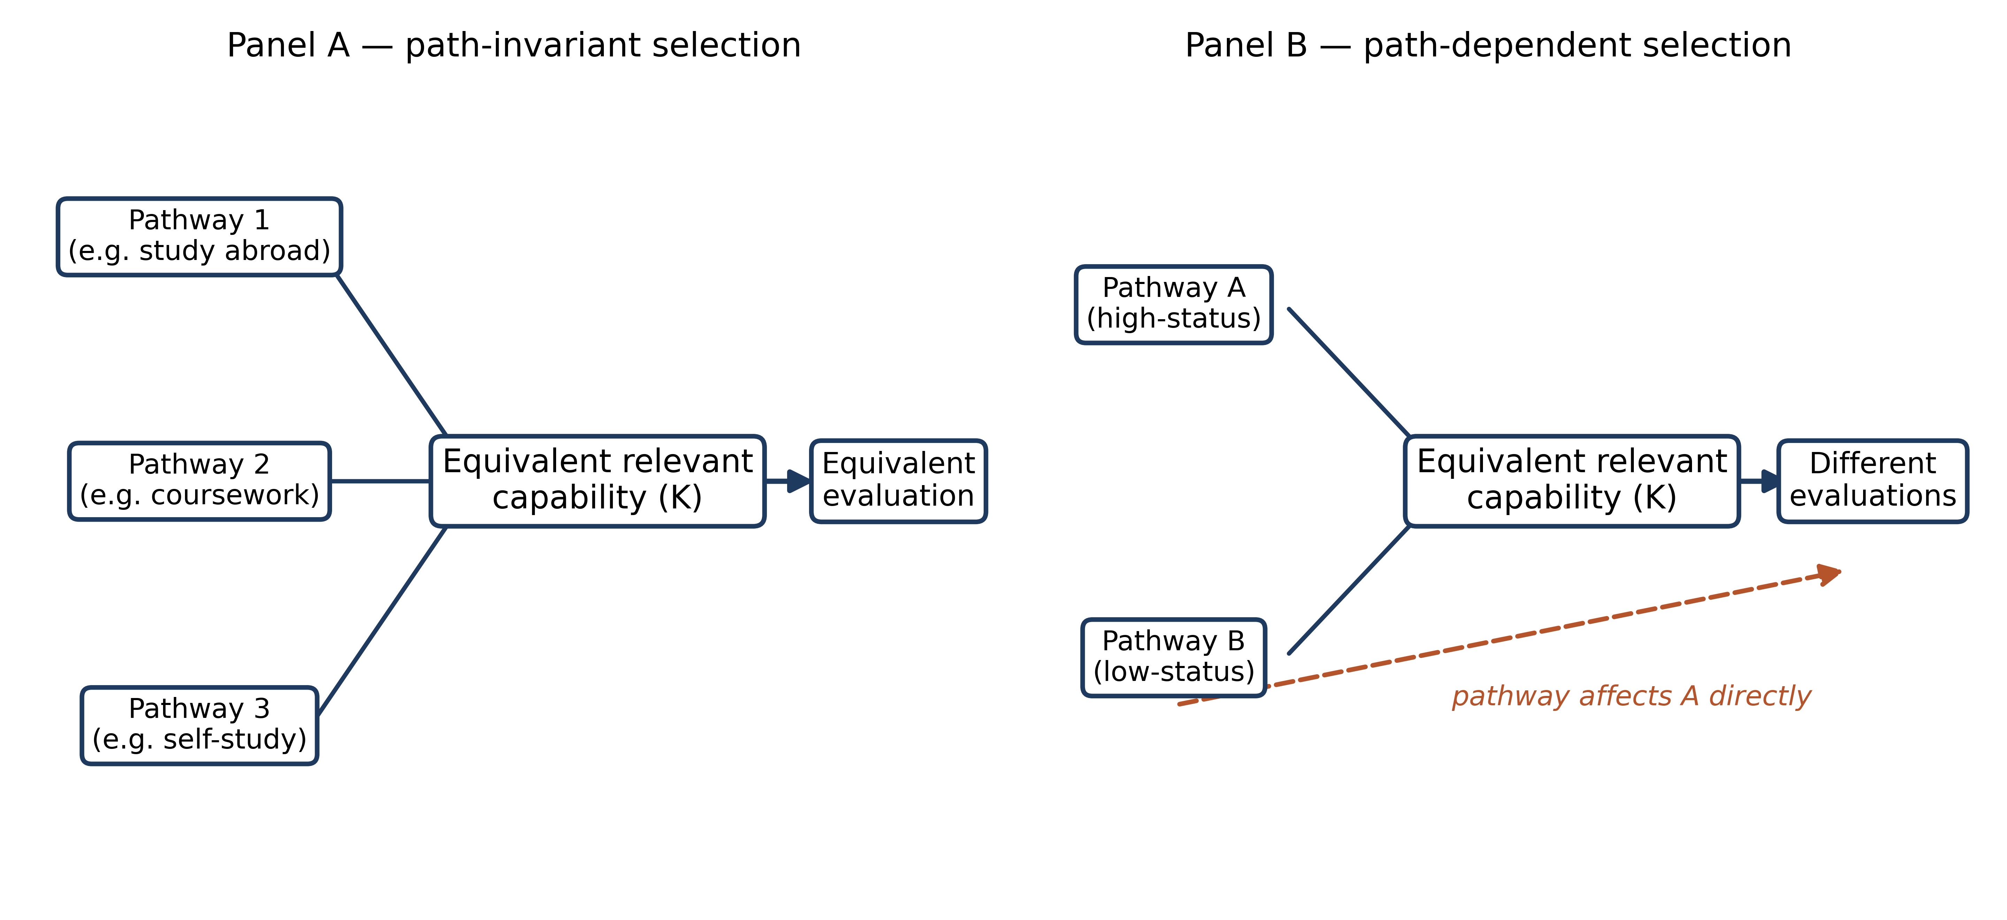
Figure 2. Path-invariant versus path-dependent selection

Slide 3
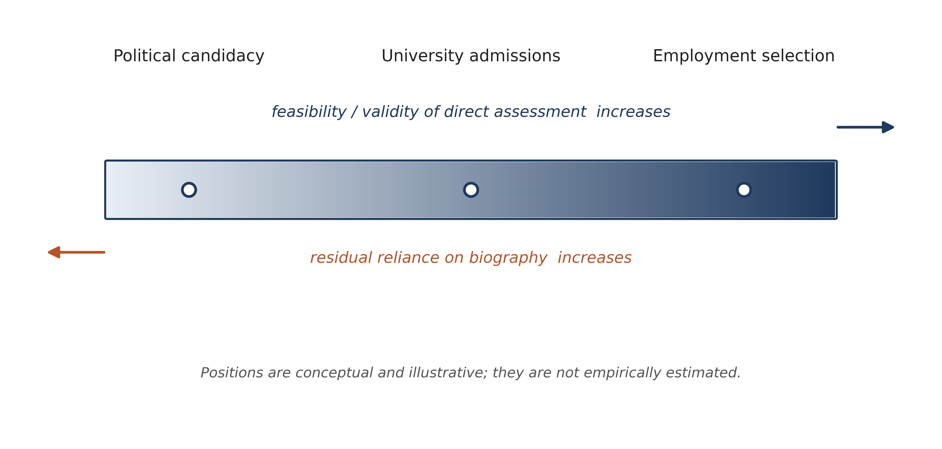
Figure 3. The direct-measurement continuum

