Slide 1
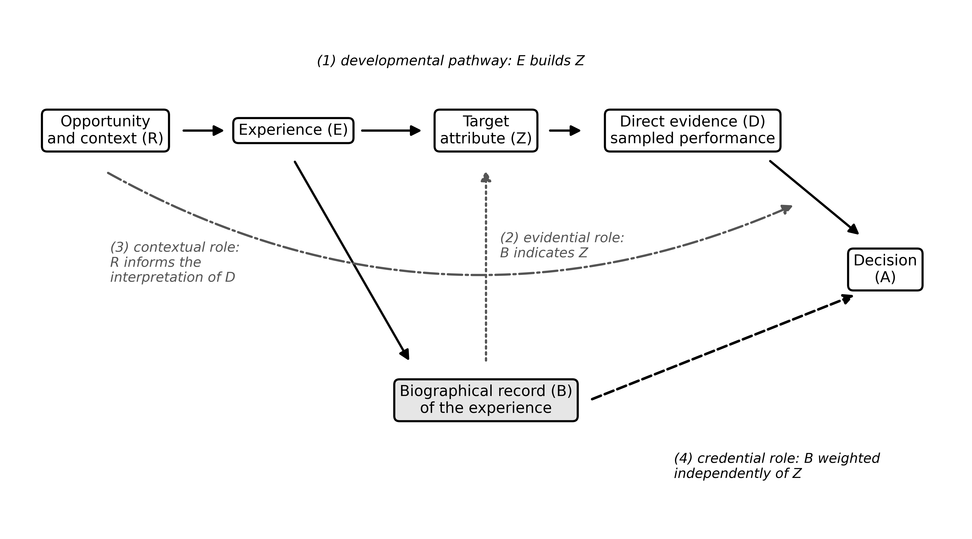
Figure 1
Figure 1. Four roles a biographical record can play in a selection decision. Solid arrows show the developmental pathway from opportunity and experience to the target attribute and its direct evidence. The dotted arrow shows the evidential role (the record as an indicator of the target attribute), the dash-dot arrow the contextual role (opportunity informing the interpretation of direct evidence), and the dashed arrow the credential role (the record weighted independently of the target attribute). The diagram is conceptual and contains no data.

Slide 2
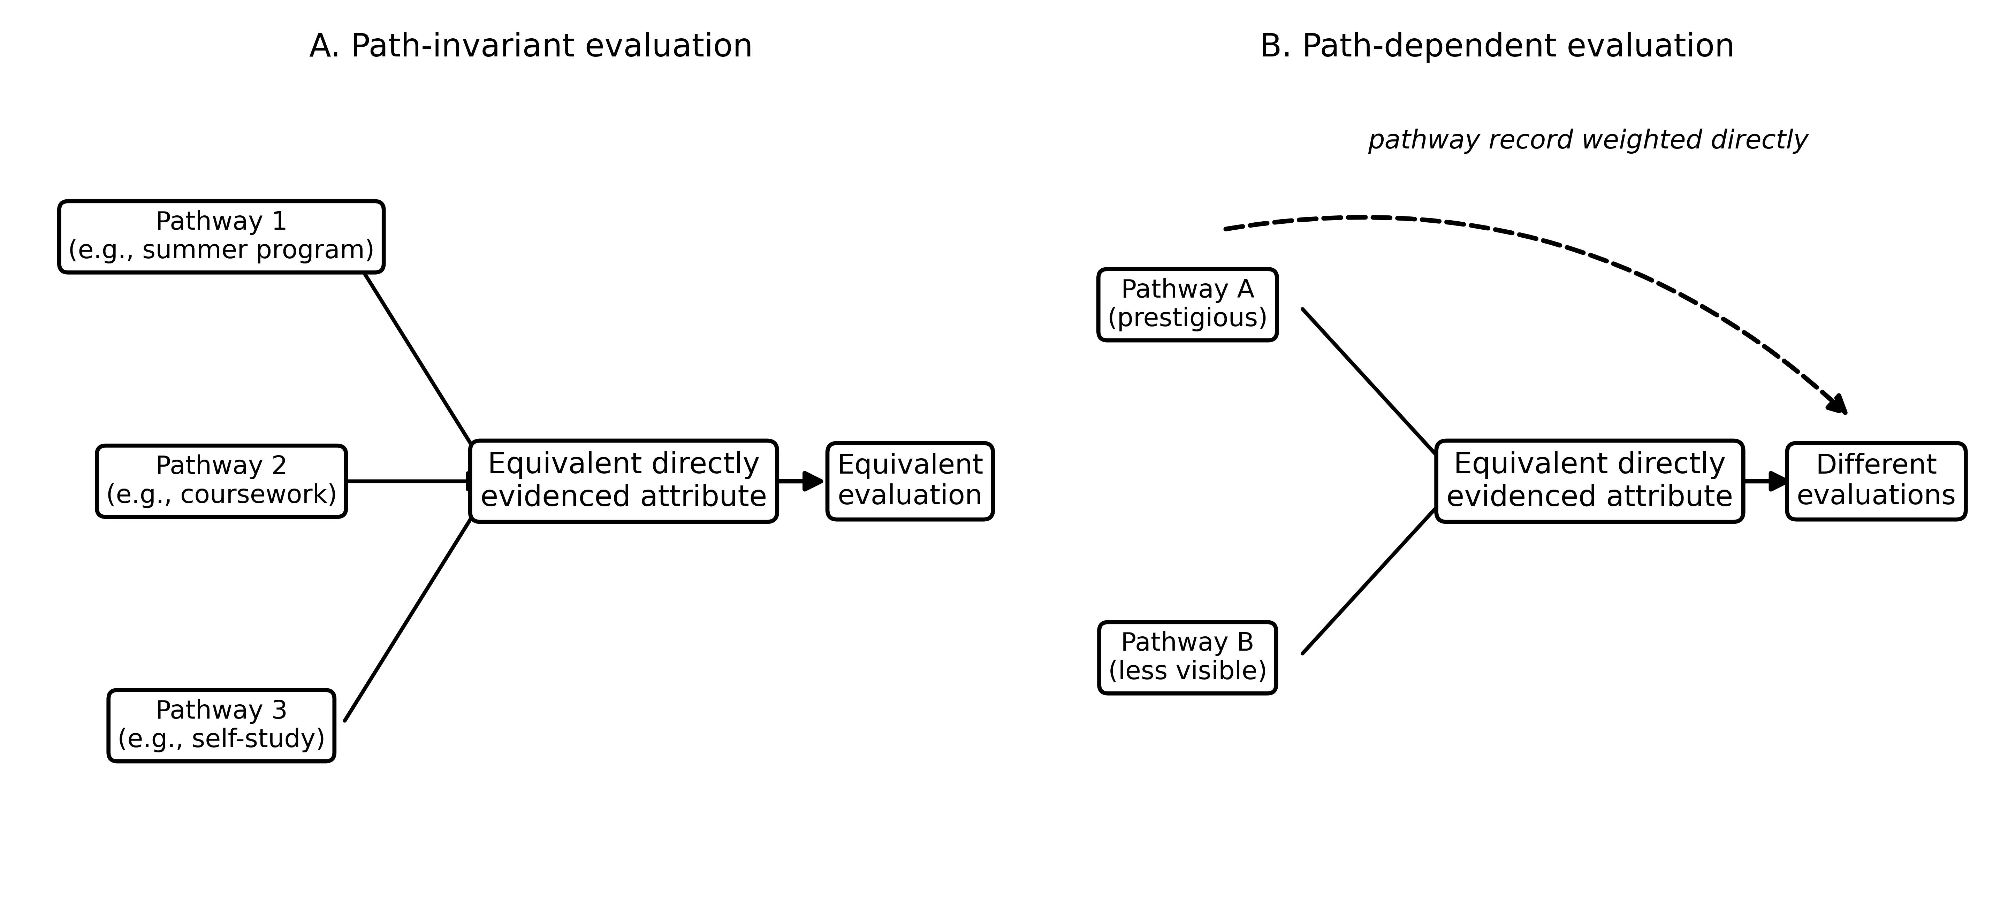
Figure 2
Figure 2. Path-invariant and path-dependent evaluation. In Panel A, equivalent directly evidenced attributes acquired through different pathways receive equivalent evaluations. In Panel B, the record of the pathway affects the evaluation directly (dashed arrow), so equivalent evidence yields different evaluations. The diagram is conceptual and contains no data.

Slide 3
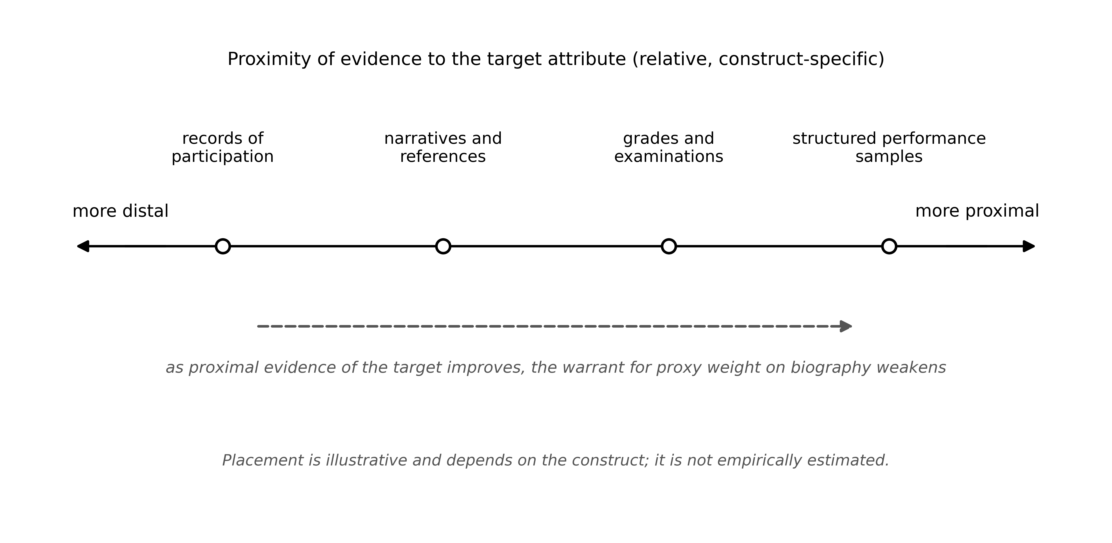
Figure 3
Figure 3. A continuum of evidential proximity. Evidence sources differ in how closely they sample the target attribute, and proximity is relative and construct-specific. As proximal evidence of an attribute that can be sampled improves, the warrant for proxy weight on biography weakens. Placements are illustrative and not empirically estimated.

