Slide 1
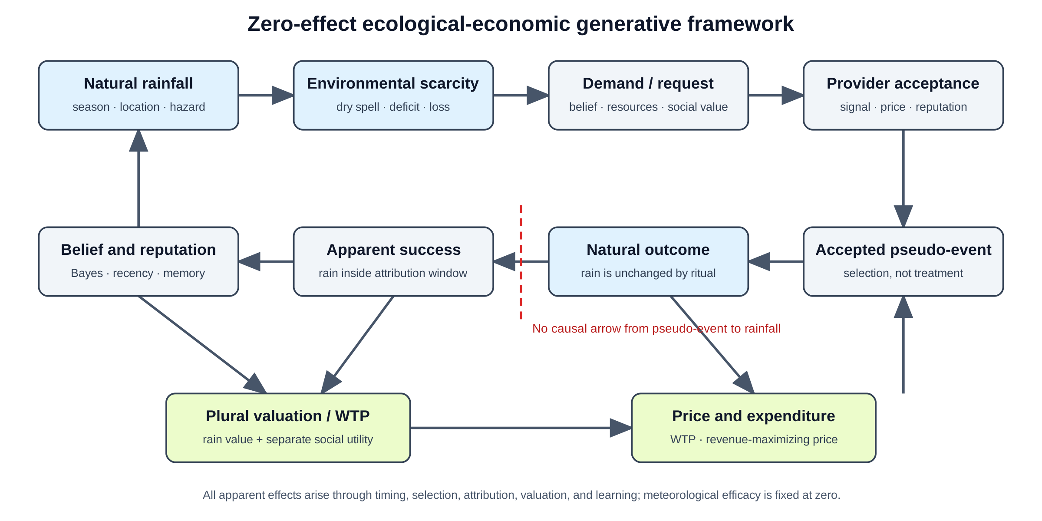
Figure 1
Conceptual framework. Environmental hazard enters demand, provider selection, valuation, attribution, and reputation, while ritual never changes rainfall.

Slide 2
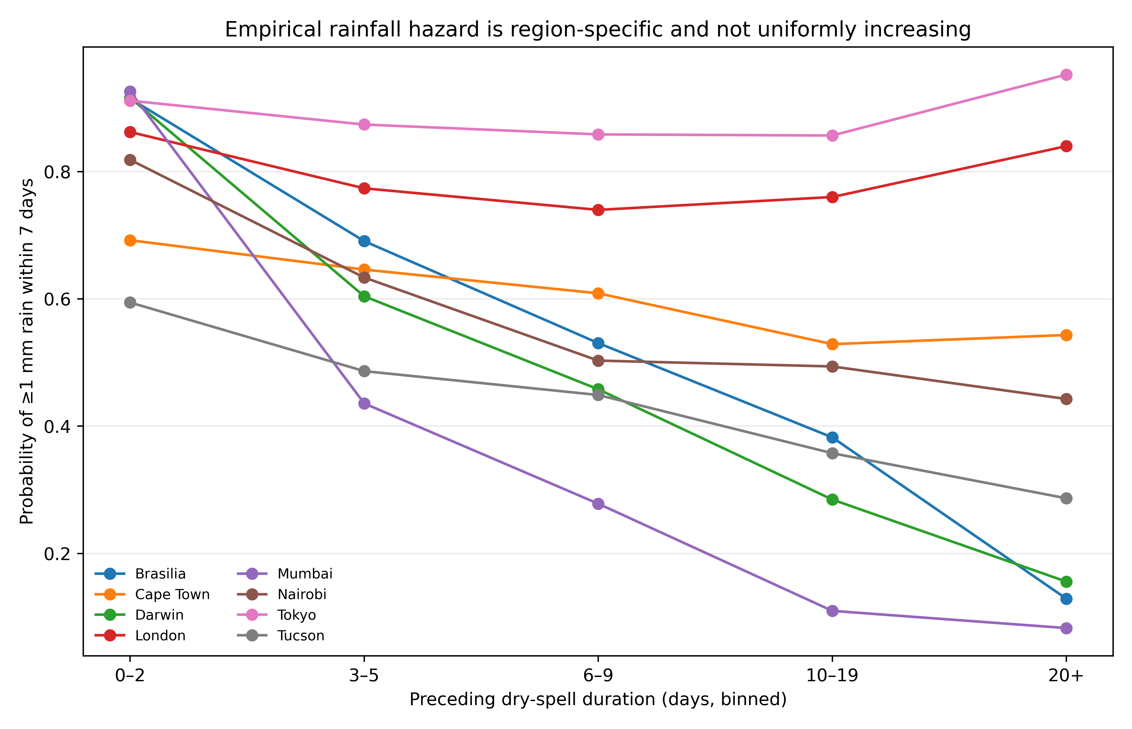
Figure 2
Estimated seven-day rainfall hazards by preceding dry-spell duration and location in the 1991–2010 training period. The eight locations are pre-specified mechanism stress tests, not a representative global sample.

Slide 3
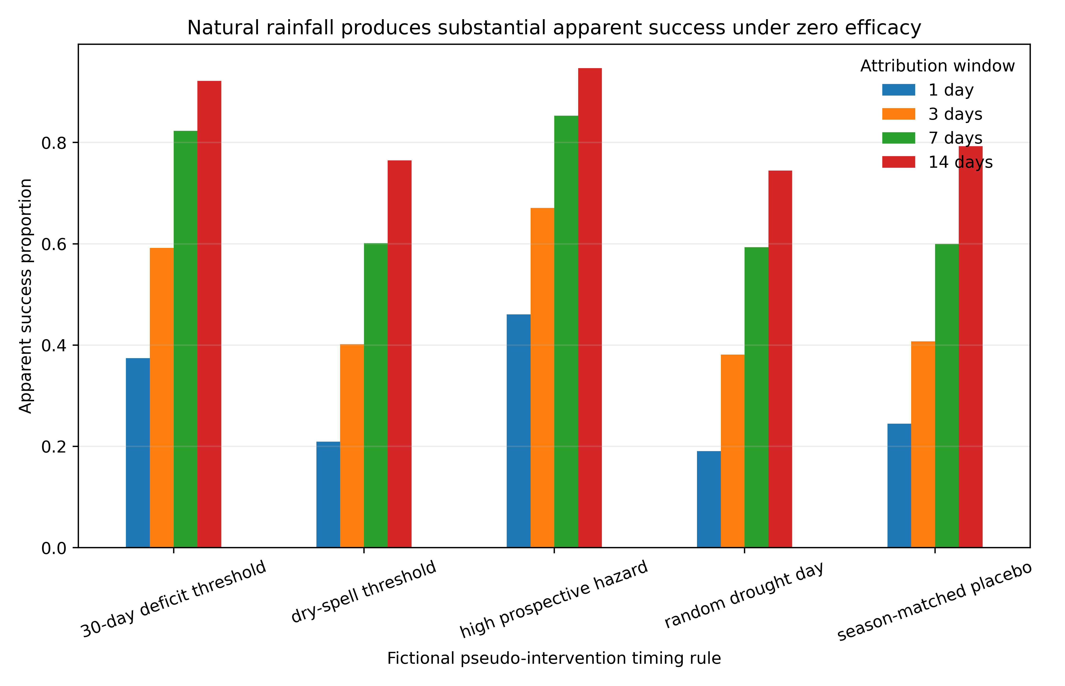
Figure 3
Natural rainfall following fictional zero-effect pseudo-events in 2011–2020, shown as apparent success by prospective event-selection rule.

Slide 4
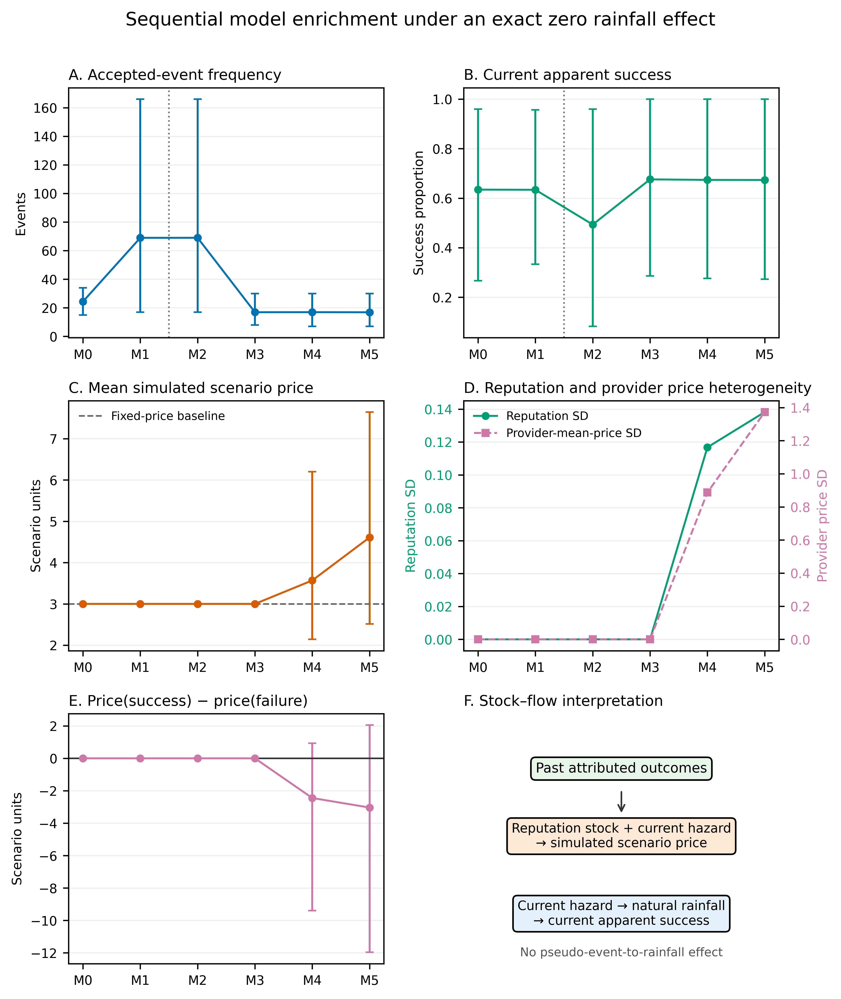
Figure 4
Sequential Monte Carlo model enrichment under M0–M5. M0–M1 shuffle rainfall outcomes within sampled years; M2–M5 retain observed local and seasonal ordering. Strategic selection changes accepted-event composition and current apparent success. In M4–M5, past attributed outcomes accumulate in reputation stocks that create price premia and provider-price heterogeneity, while current success remains a natural-rainfall flow governed by current hazard. Mean price(success) minus price(failure) is negative in M4–M5. Error bars are 2.5th and 97.5th Monte Carlo percentiles, not confidence intervals for historical parameters.

Slide 5
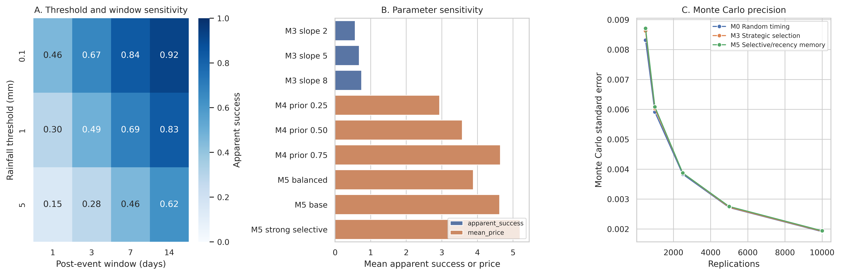
Figure 5
Robustness. Apparent success across rainfall thresholds and windows, selected parameter sensitivity, and Monte Carlo precision.

