Slide 1
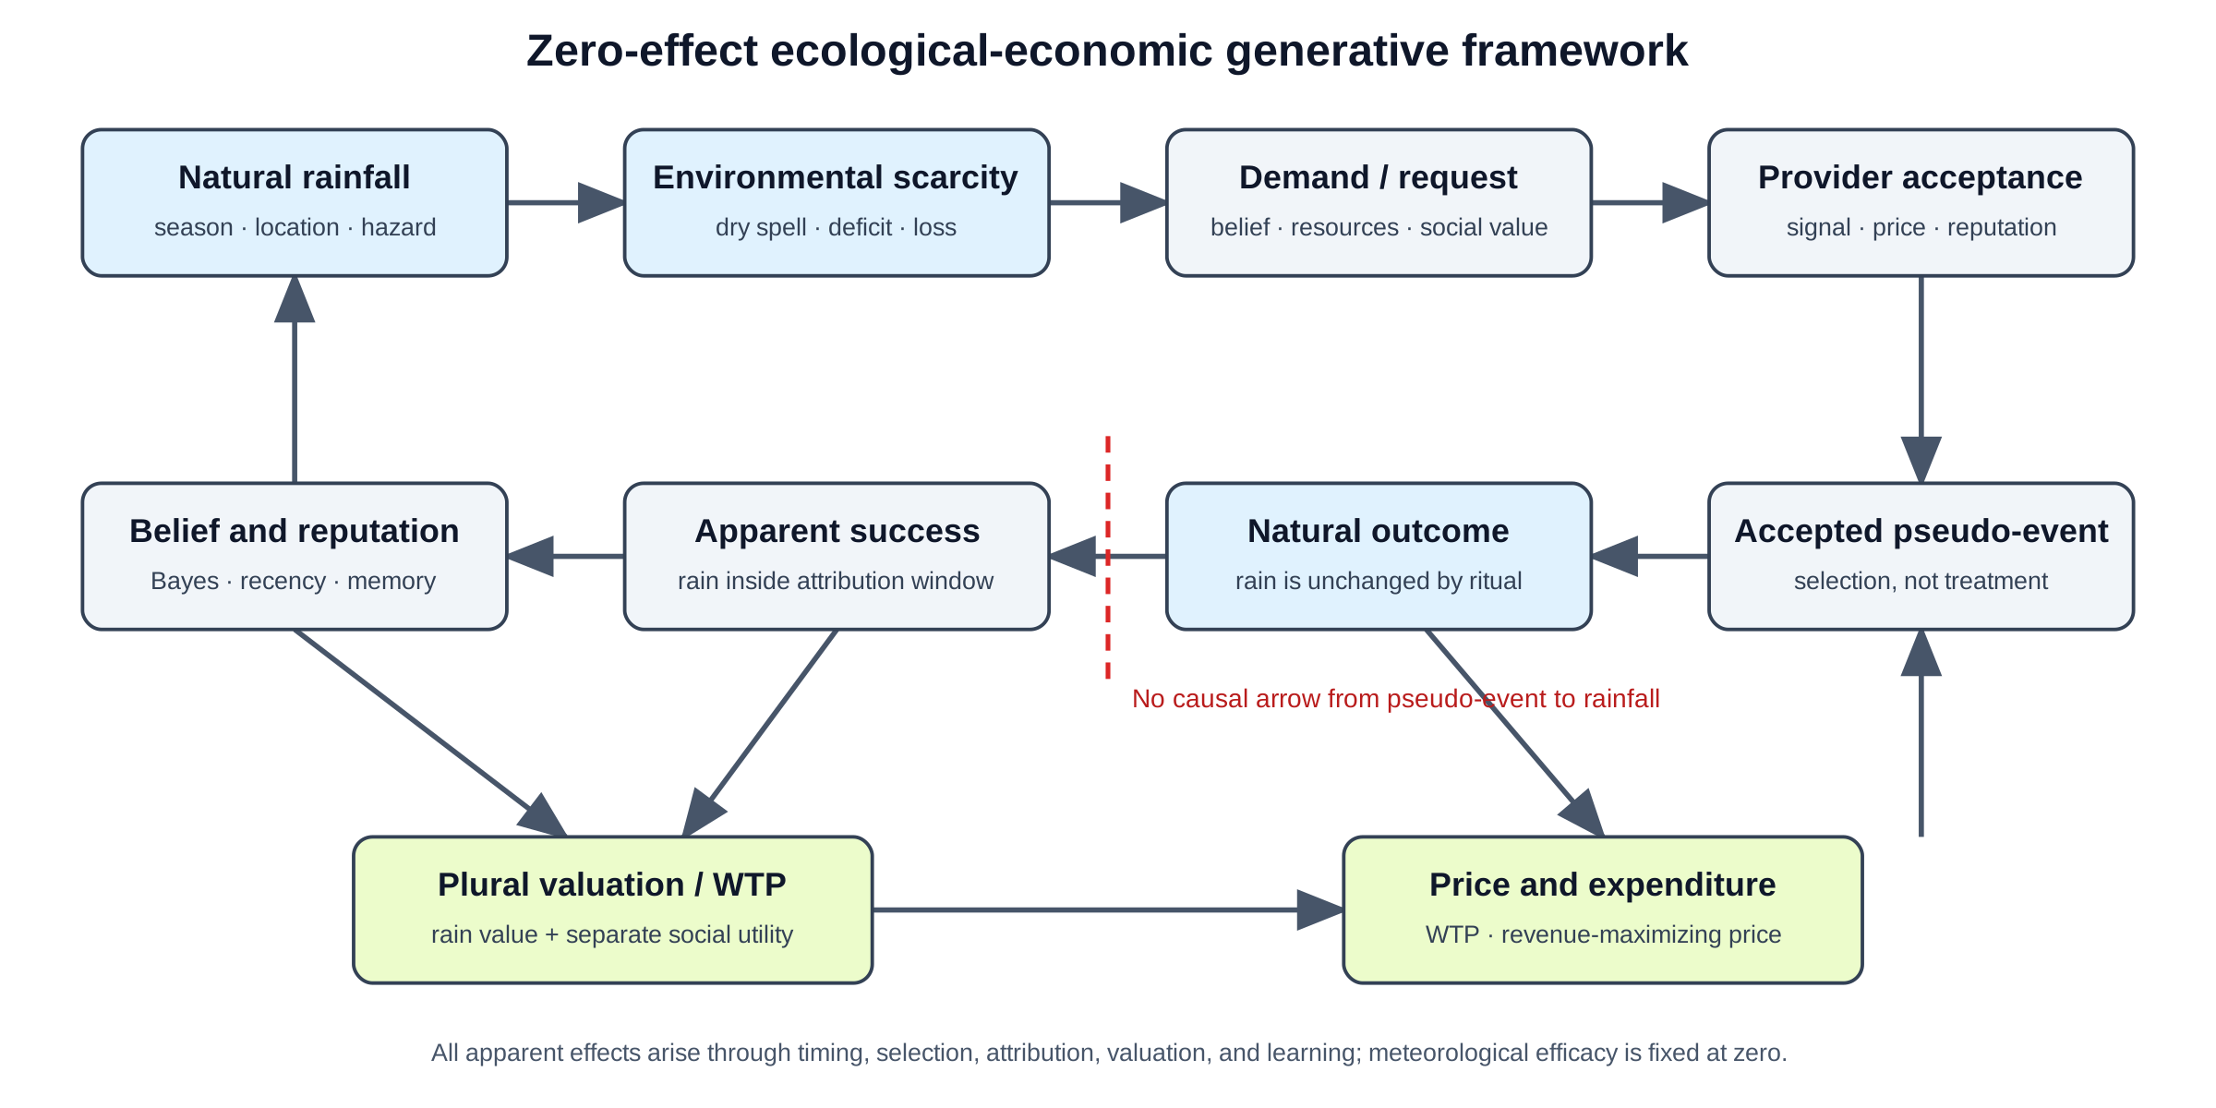
Figure 1
Conceptual framework. Baseline environmental hazard enters demand, provider acceptance, valuation, attribution, and reputation, while the pseudo-intervention never changes rainfall.

Slide 2
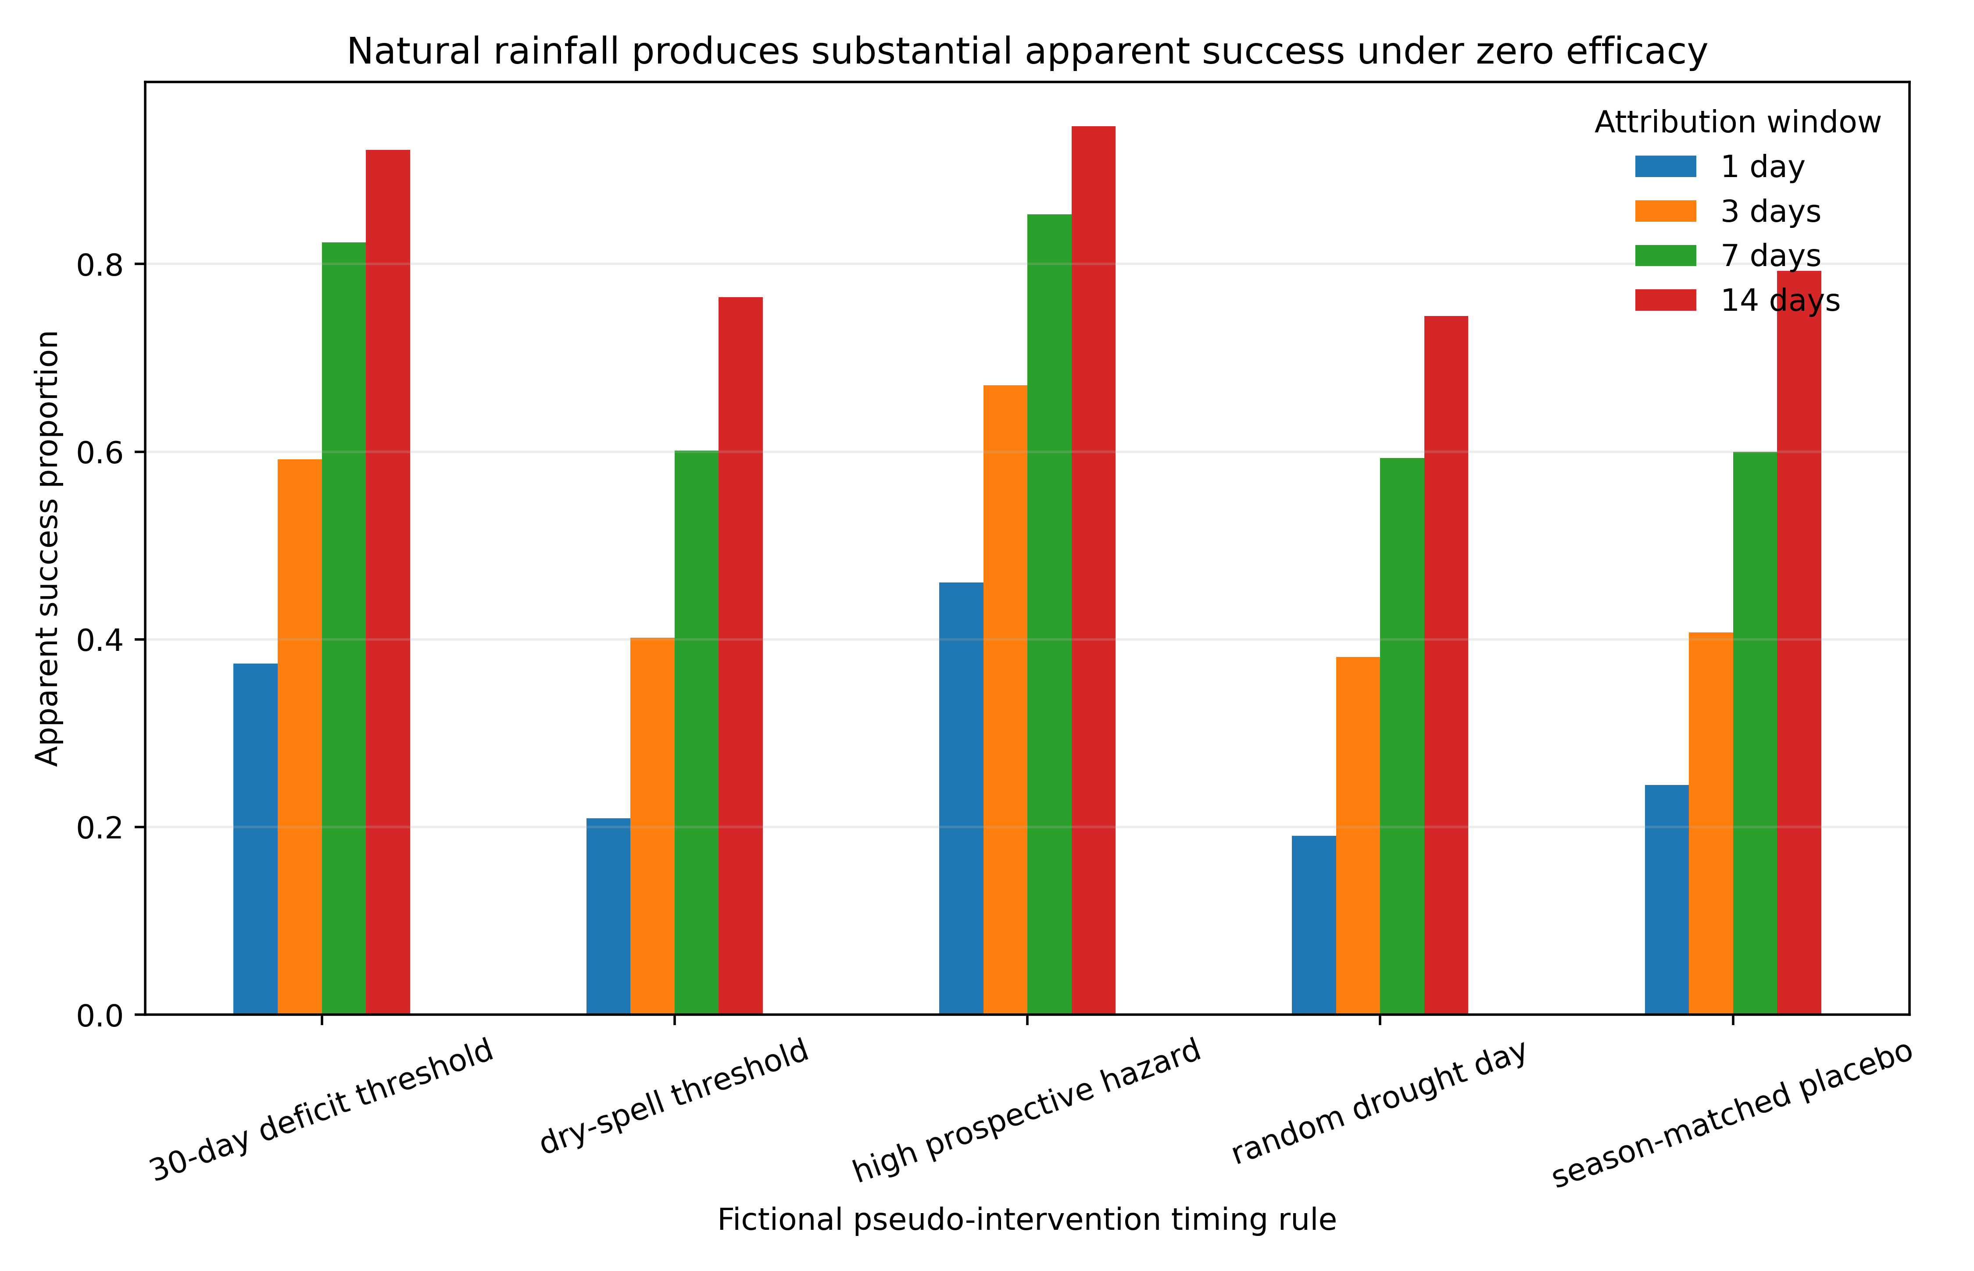
Figure 2
Natural rainfall following fictional known-zero-effect stress tests in 2011–2020, shown as apparent success by prospective event-selection rule. Apparent successes are observed rainfall events; causal attribution to intervention is false by construction.

Slide 3
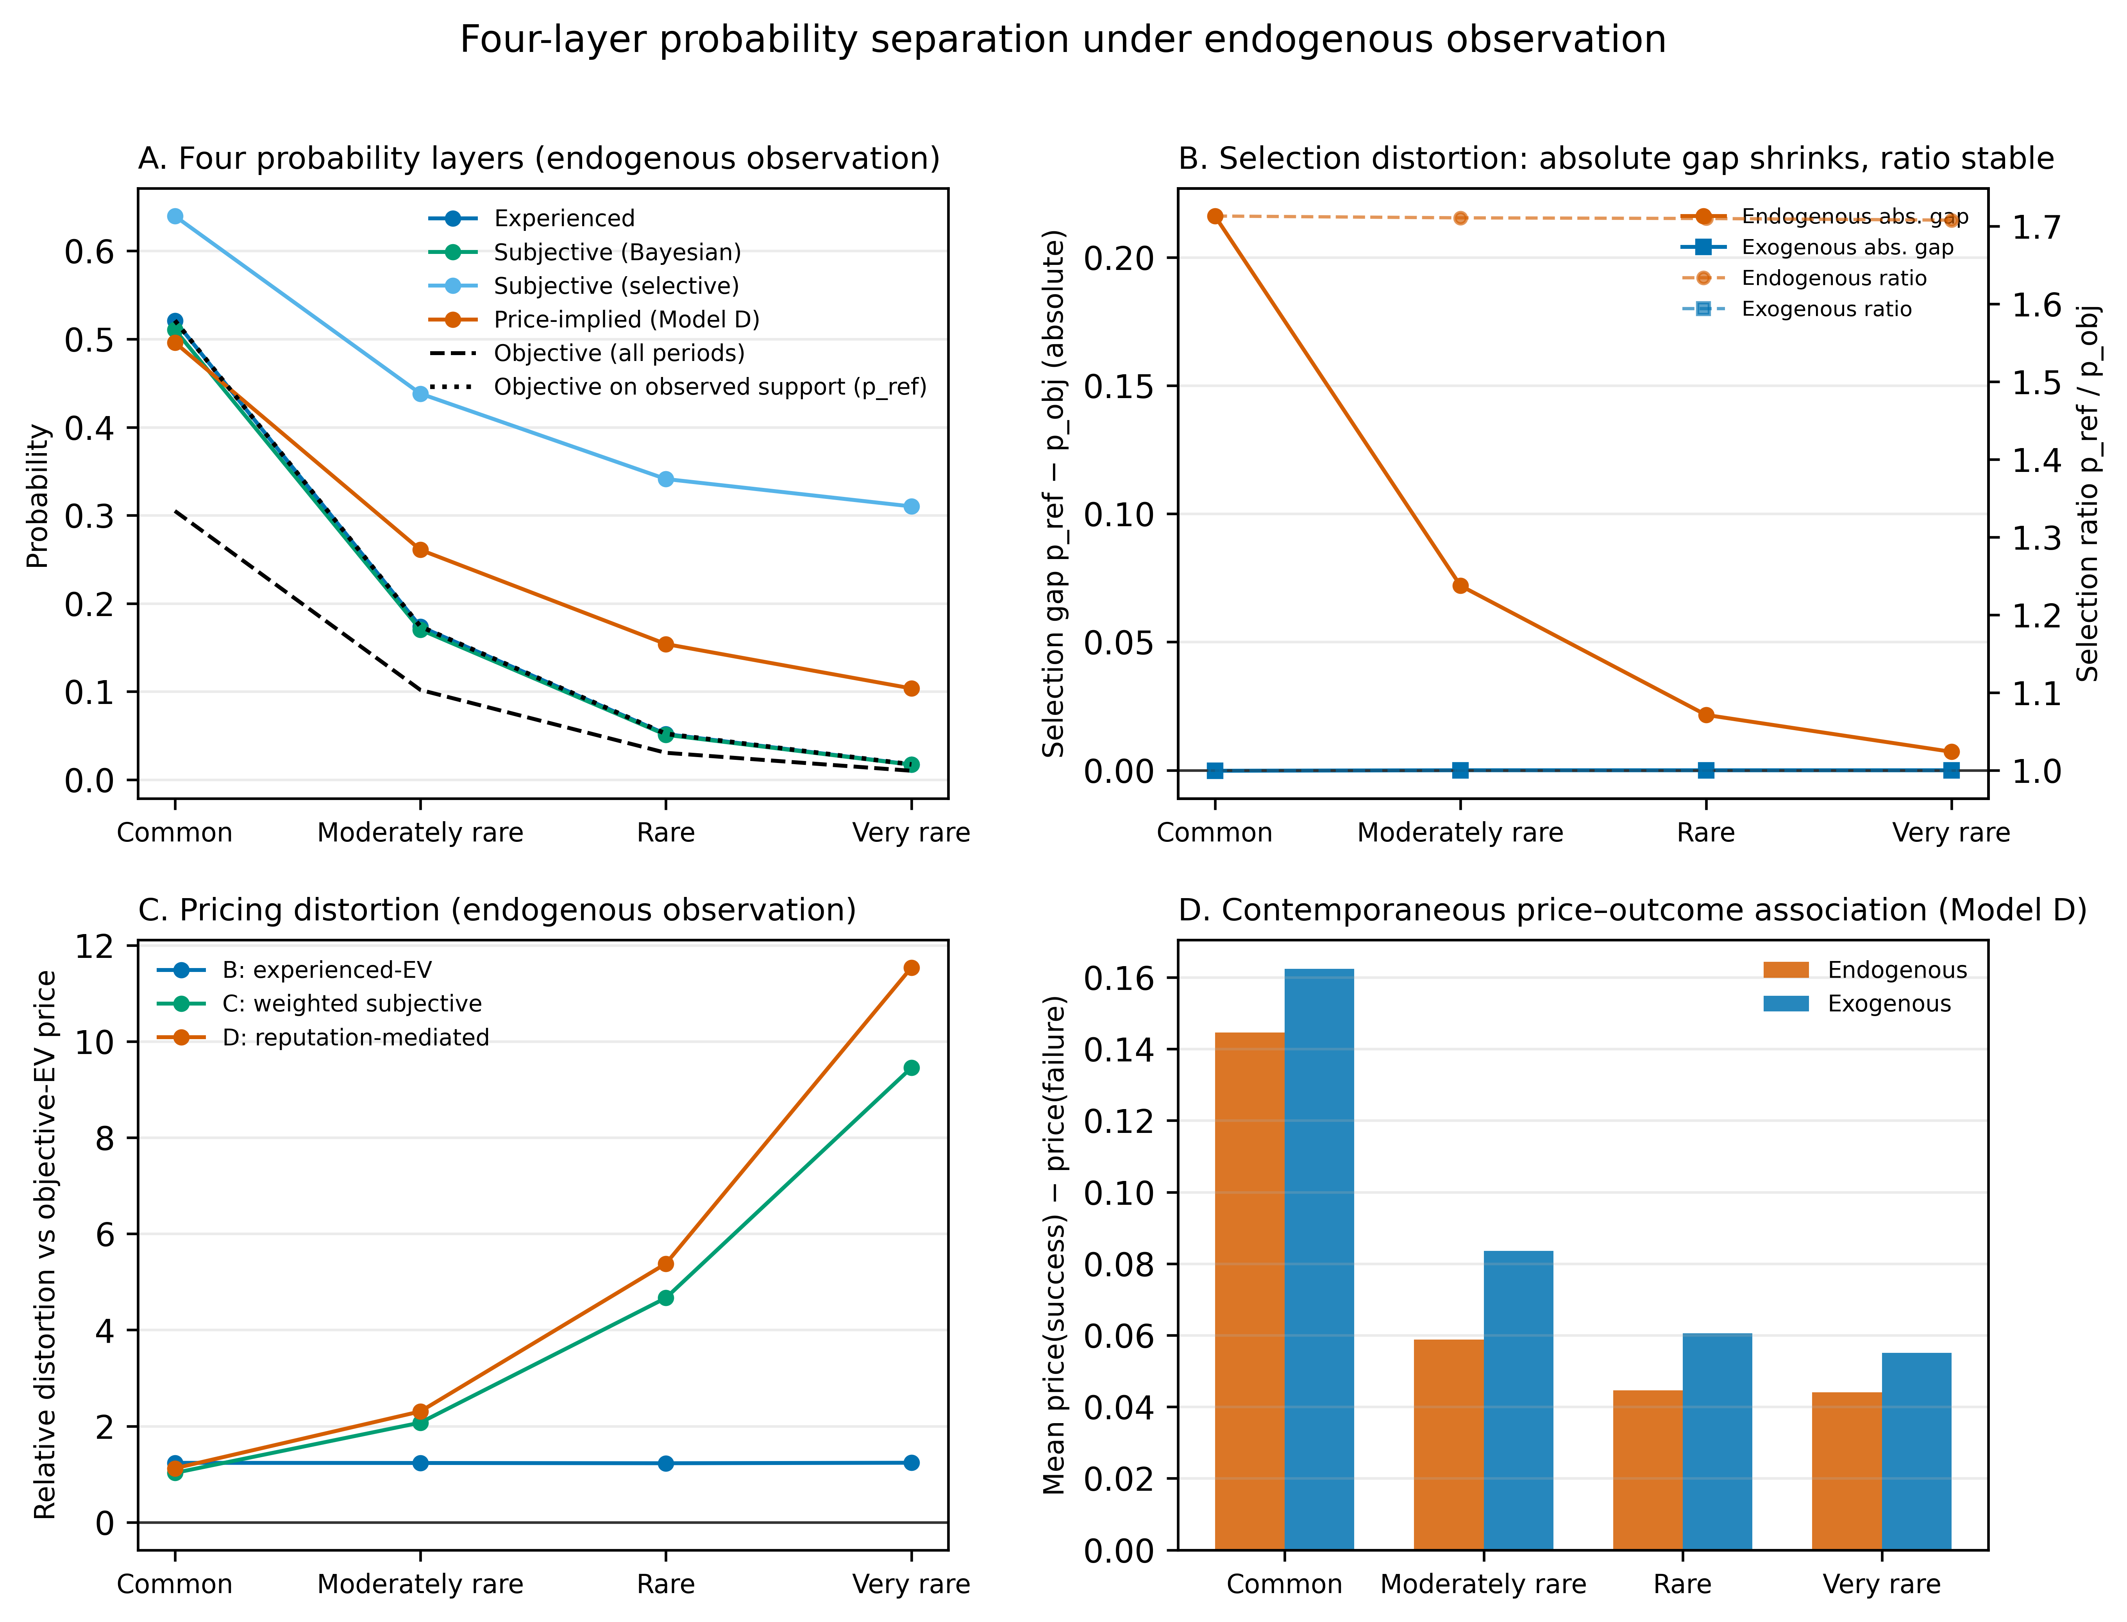
Figure 3
Four-layer separation in the generic rare-event simulation. Panel A compares the objective probability, experienced frequency, subjective probability, and price-implied index under endogenous observation across rarity regimes; panel B shows the absolute selection gap p_ref − p_obj and the selection ratio p_ref / p_obj under endogenous versus exogenous observation; panel C shows relative price distortion against objective expected-value pricing for models B–D; panel D shows the contemporaneous price–outcome association under Model D. All quantities are generated (simulation evidence, not empirical estimates).

Slide 4
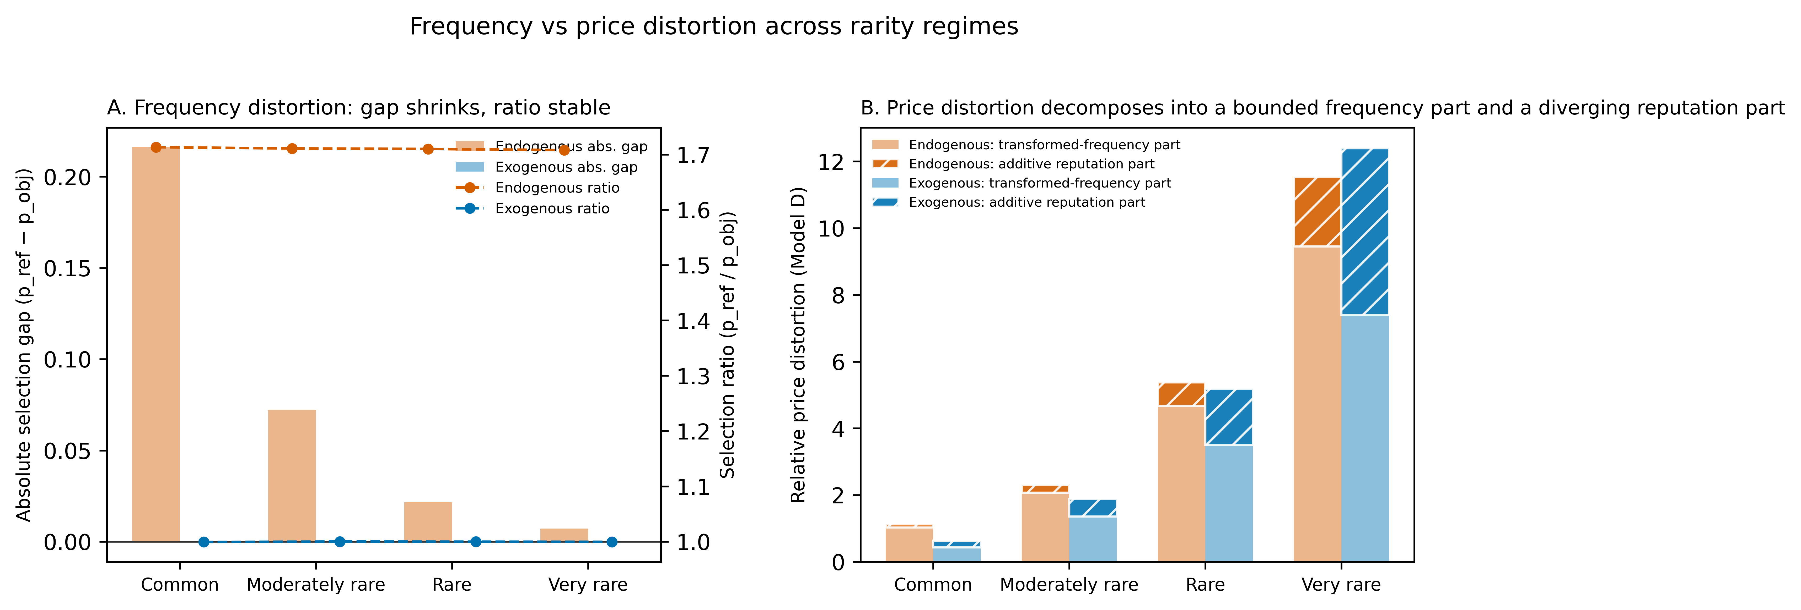
Figure 4
Frequency distortion versus price distortion across rarity regimes. Panel A: absolute selection gap (bars, left axis) shrinks with rarity while the selection ratio (lines, right axis) is stable at approximately 1.7 under endogenous observation and 1.0 under exogenous observation—the analytically derived invariance of Lemma 1. Panel B: relative price distortion under Model D decomposes into a transformed-frequency part that is quantitatively dominant in every simulated regime and an additive reputation part whose share rises as objective expected value shrinks; neither part is bounded relative to the shrinking benchmark. The relative-distortion rise is a denominator-scaling effect in both non-scaling components, not growing frequency bias and not growing absolute mispricing.

Slide 5
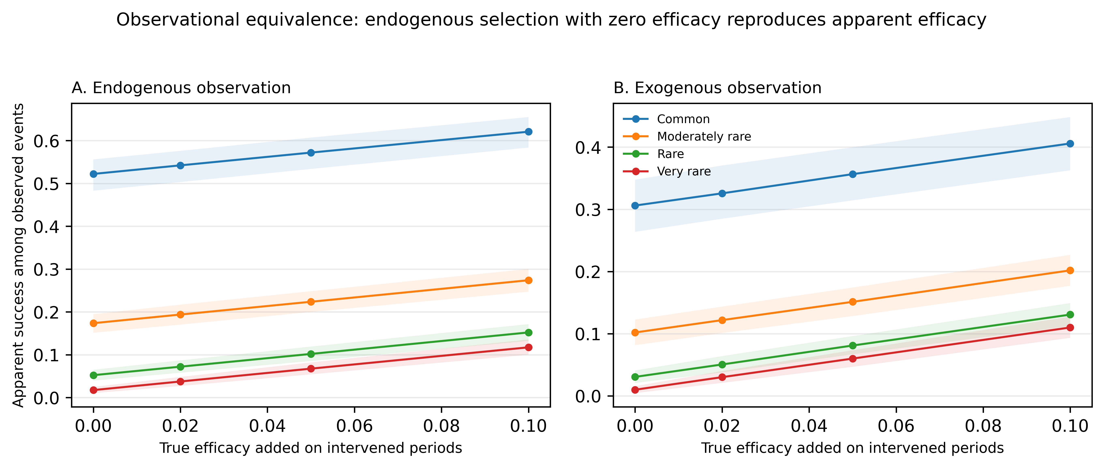
Figure 5
Mean-performance equivalence map. Mean apparent success among observed events as true efficacy added on intervened periods varies, under endogenous (A) and exogenous (B) observation. Endogenous selection with zero true efficacy reproduces the MEAN apparent success of positive efficacy under exogenous observation (first-moment equivalence only).

Slide 6
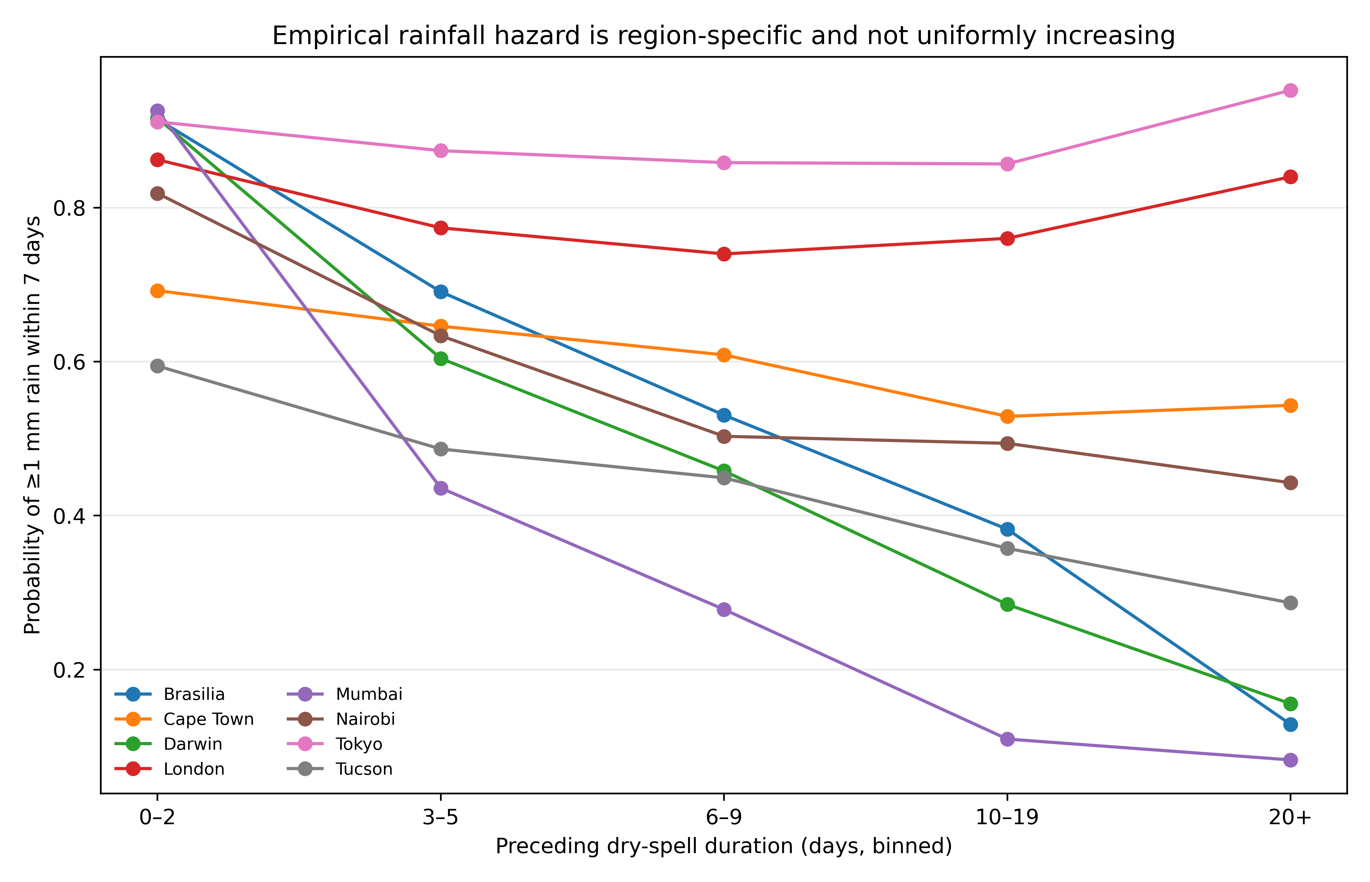
Figure S1
Estimated seven-day rainfall hazards by preceding dry-spell duration and location in the 1991–2010 training period. The eight locations are pre-specified mechanism stress tests, not a representative global sample.

Slide 7
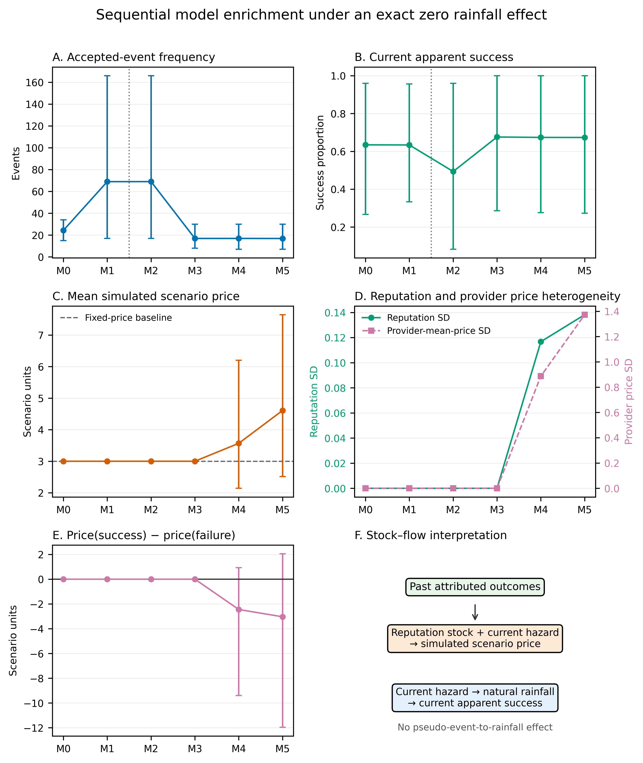
Figure S2
Zero-effect benchmark: sequential Monte Carlo pricing-rule enrichment under M0–M5 on fictional rainmaking pseudo-events over observed weather. M0–M1 shuffle rainfall outcomes within sampled years; M2–M5 retain observed local and seasonal ordering. Selective acceptance changes accepted-event composition and current apparent success. In M4–M5, past attributed outcomes accumulate in reputation stocks that create price premia and provider-price heterogeneity, while current success remains a natural-rainfall flow governed by current hazard. Mean price(success) minus price(failure) is negative in M4–M5. Error bars are 2.5th and 97.5th Monte Carlo percentiles, not confidence intervals for historical parameters.

Slide 8
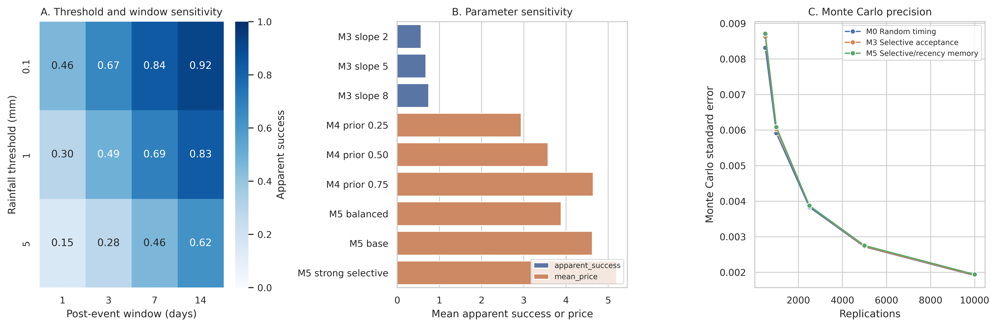
Figure S3
Robustness. Apparent success across rainfall thresholds and windows, selected parameter sensitivity, and Monte Carlo precision.

