Slide 1
The Hidden Cost of Reproducibility: Commercial Software Dependency in Published Research
N=10,000 papers | PubMed Stratified Random Sampling (2020–2025)

Slide 2
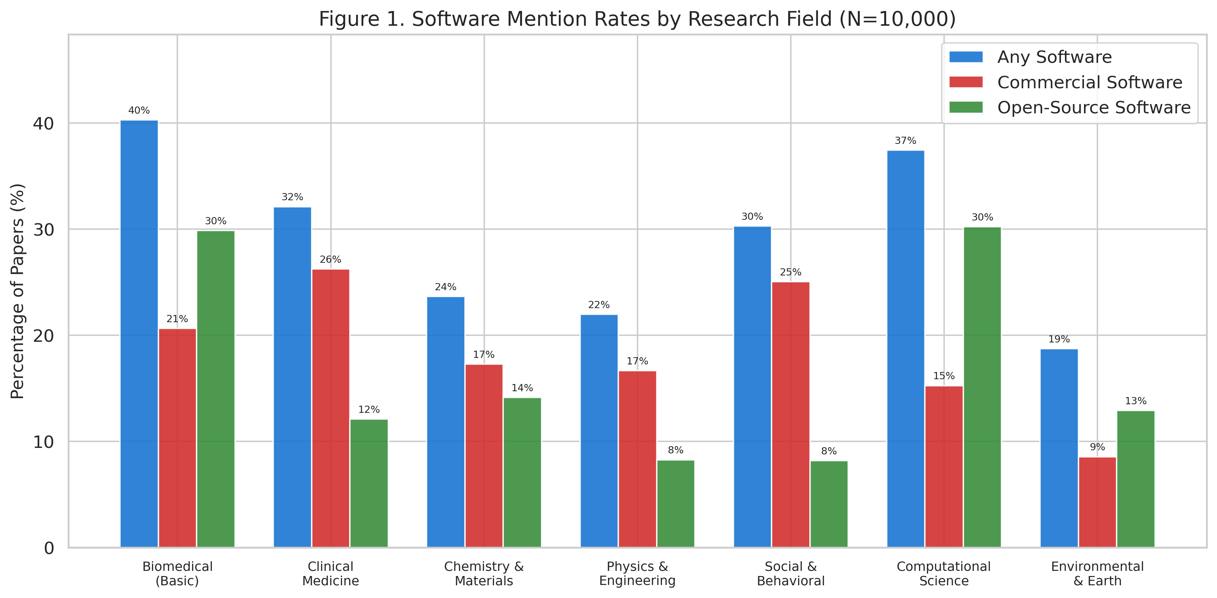
Figure 1. Software Mention Rates by Research Field
Grouped bar chart showing the percentage of papers mentioning any software, commercial software only, and open-source software only, across seven research fields. N=10,000 papers.

Slide 3
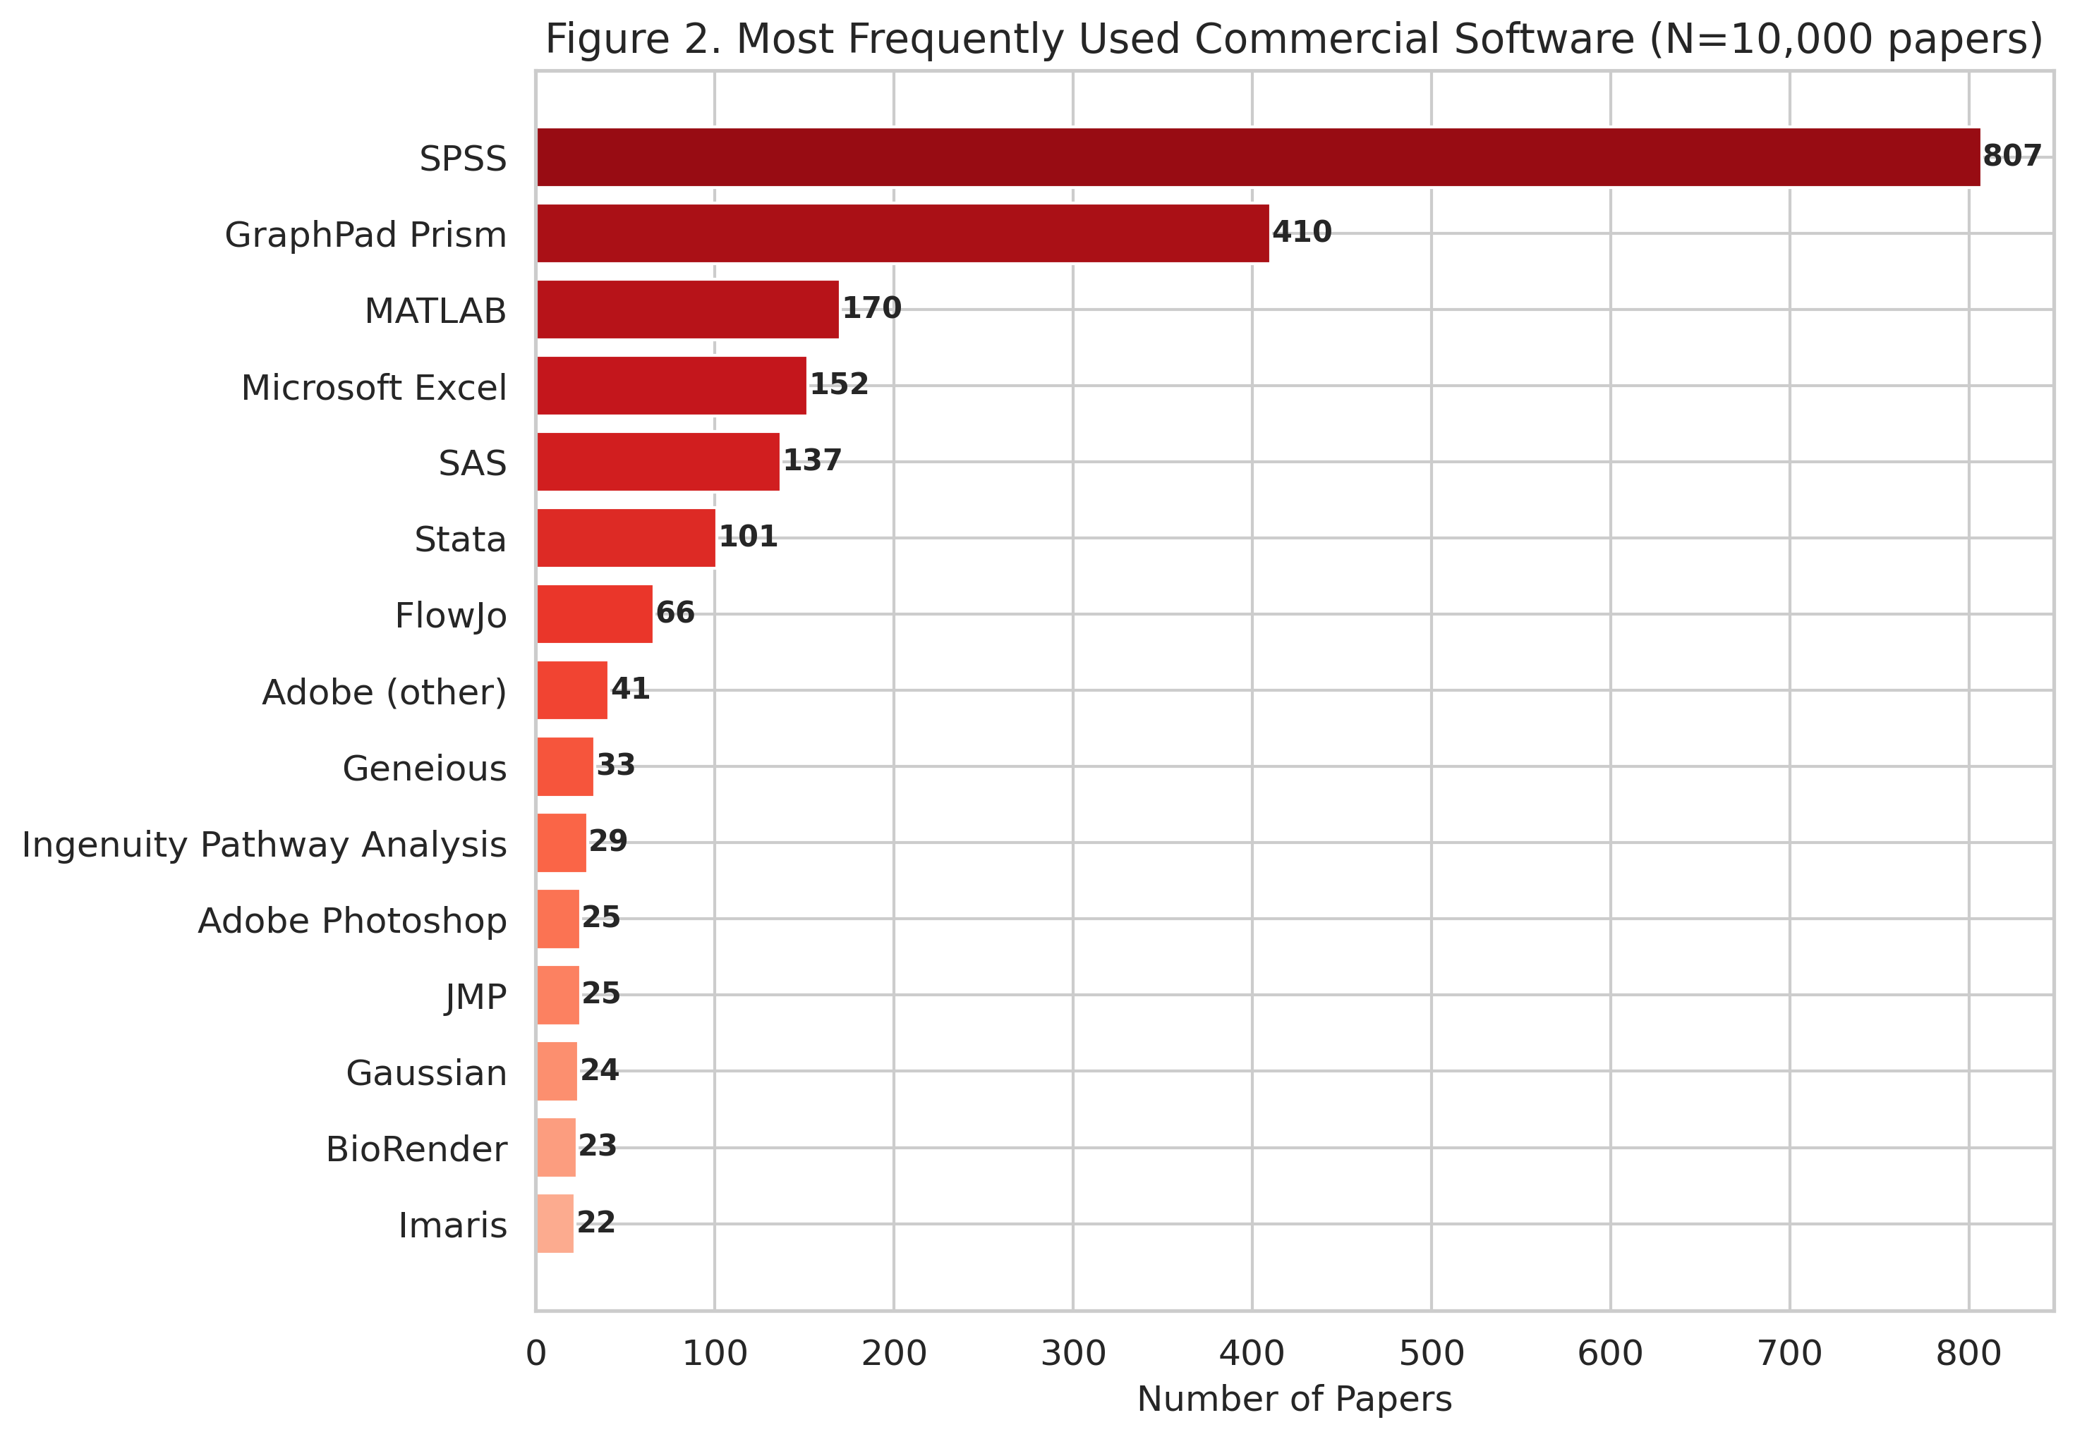
Figure 2. Most Frequently Used Commercial Software
Horizontal bar chart of the top 15 commercial software tools by frequency of citation. N=10,000 papers.

Slide 4
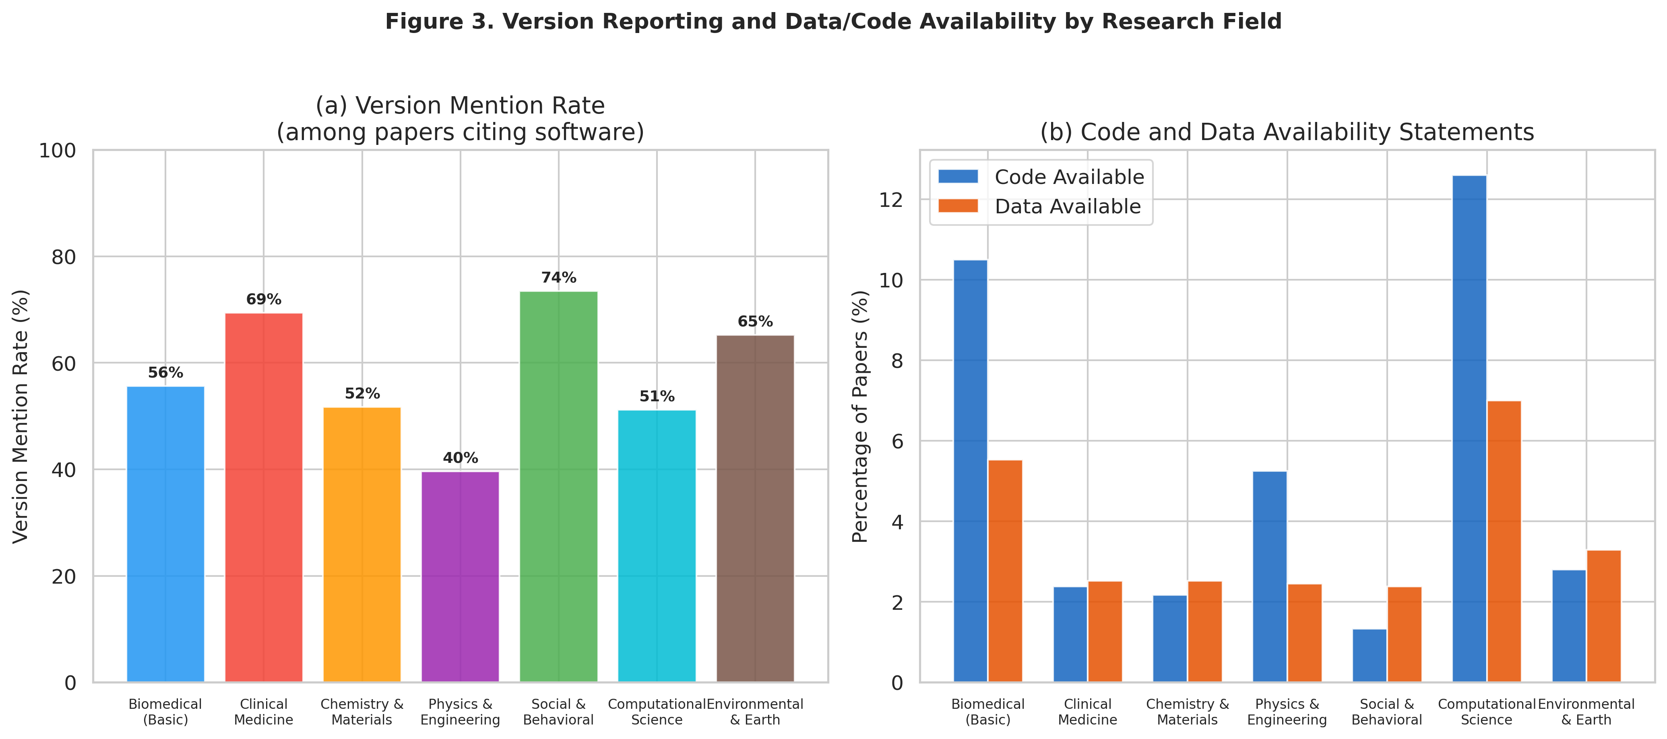
Figure 3. Version Reporting and Data/Code Availability
(a) Version mention rate among papers citing software, by research field. (b) Code and data availability statement rates by research field.

Slide 5
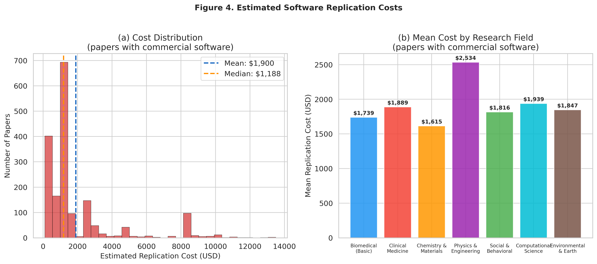
Figure 4. Estimated Software Replication Costs
(a) Distribution of estimated replication costs among papers using commercial software. (b) Mean replication cost by research field.

Slide 6
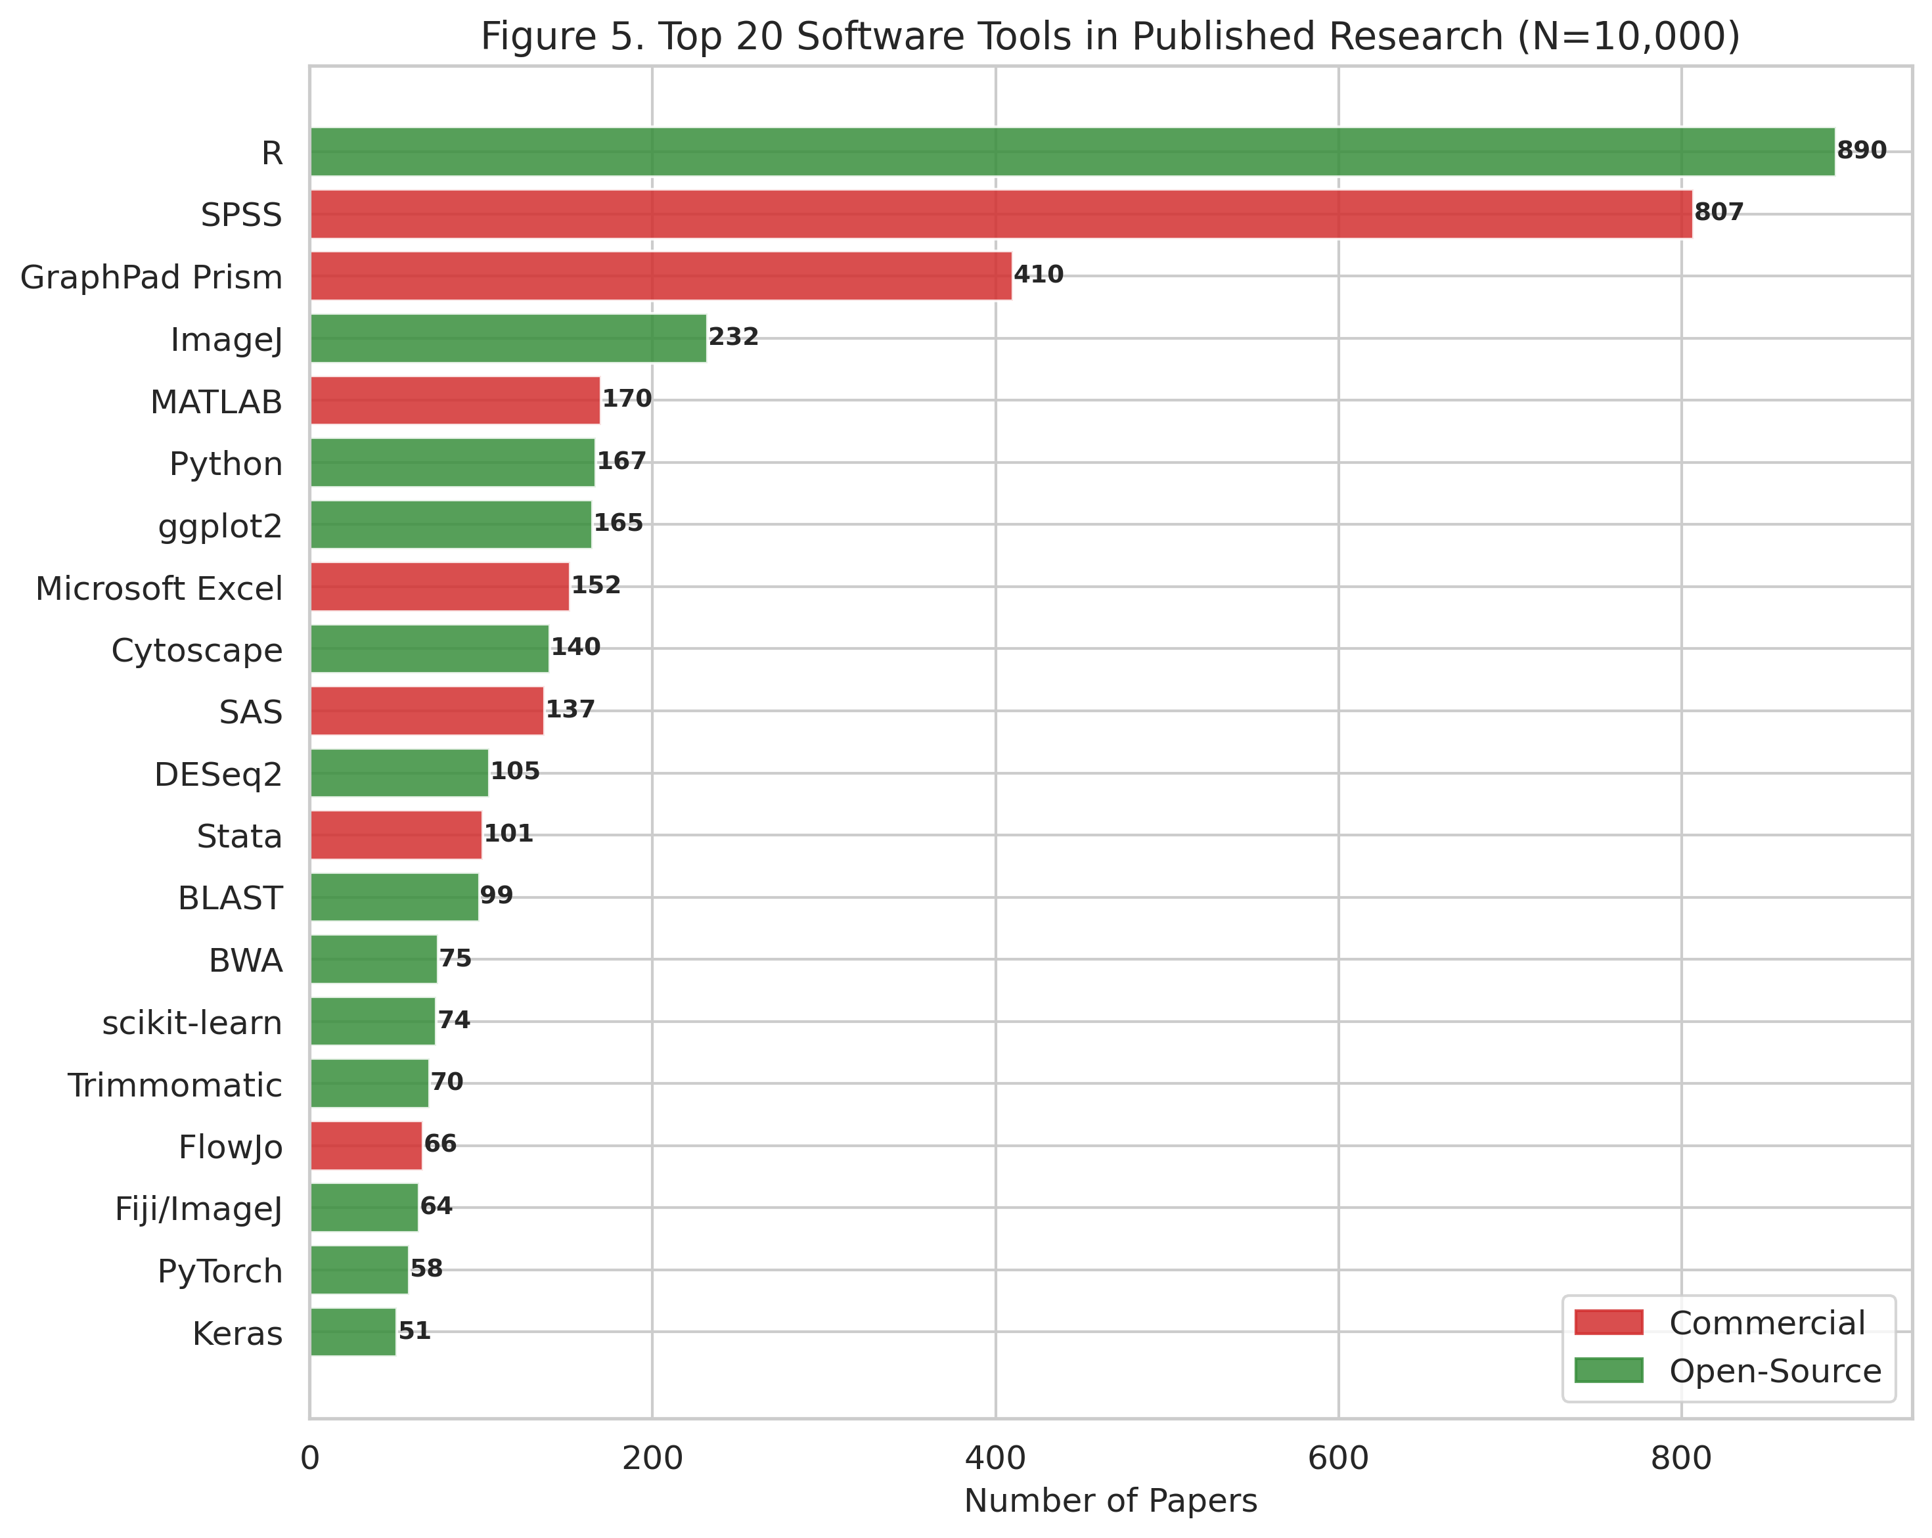
Figure 5. Top 20 Software Tools in Published Research
Horizontal bar chart of top 20 software tools colored by license type (red = commercial, green = open-source). N=10,000 papers.

Slide 7
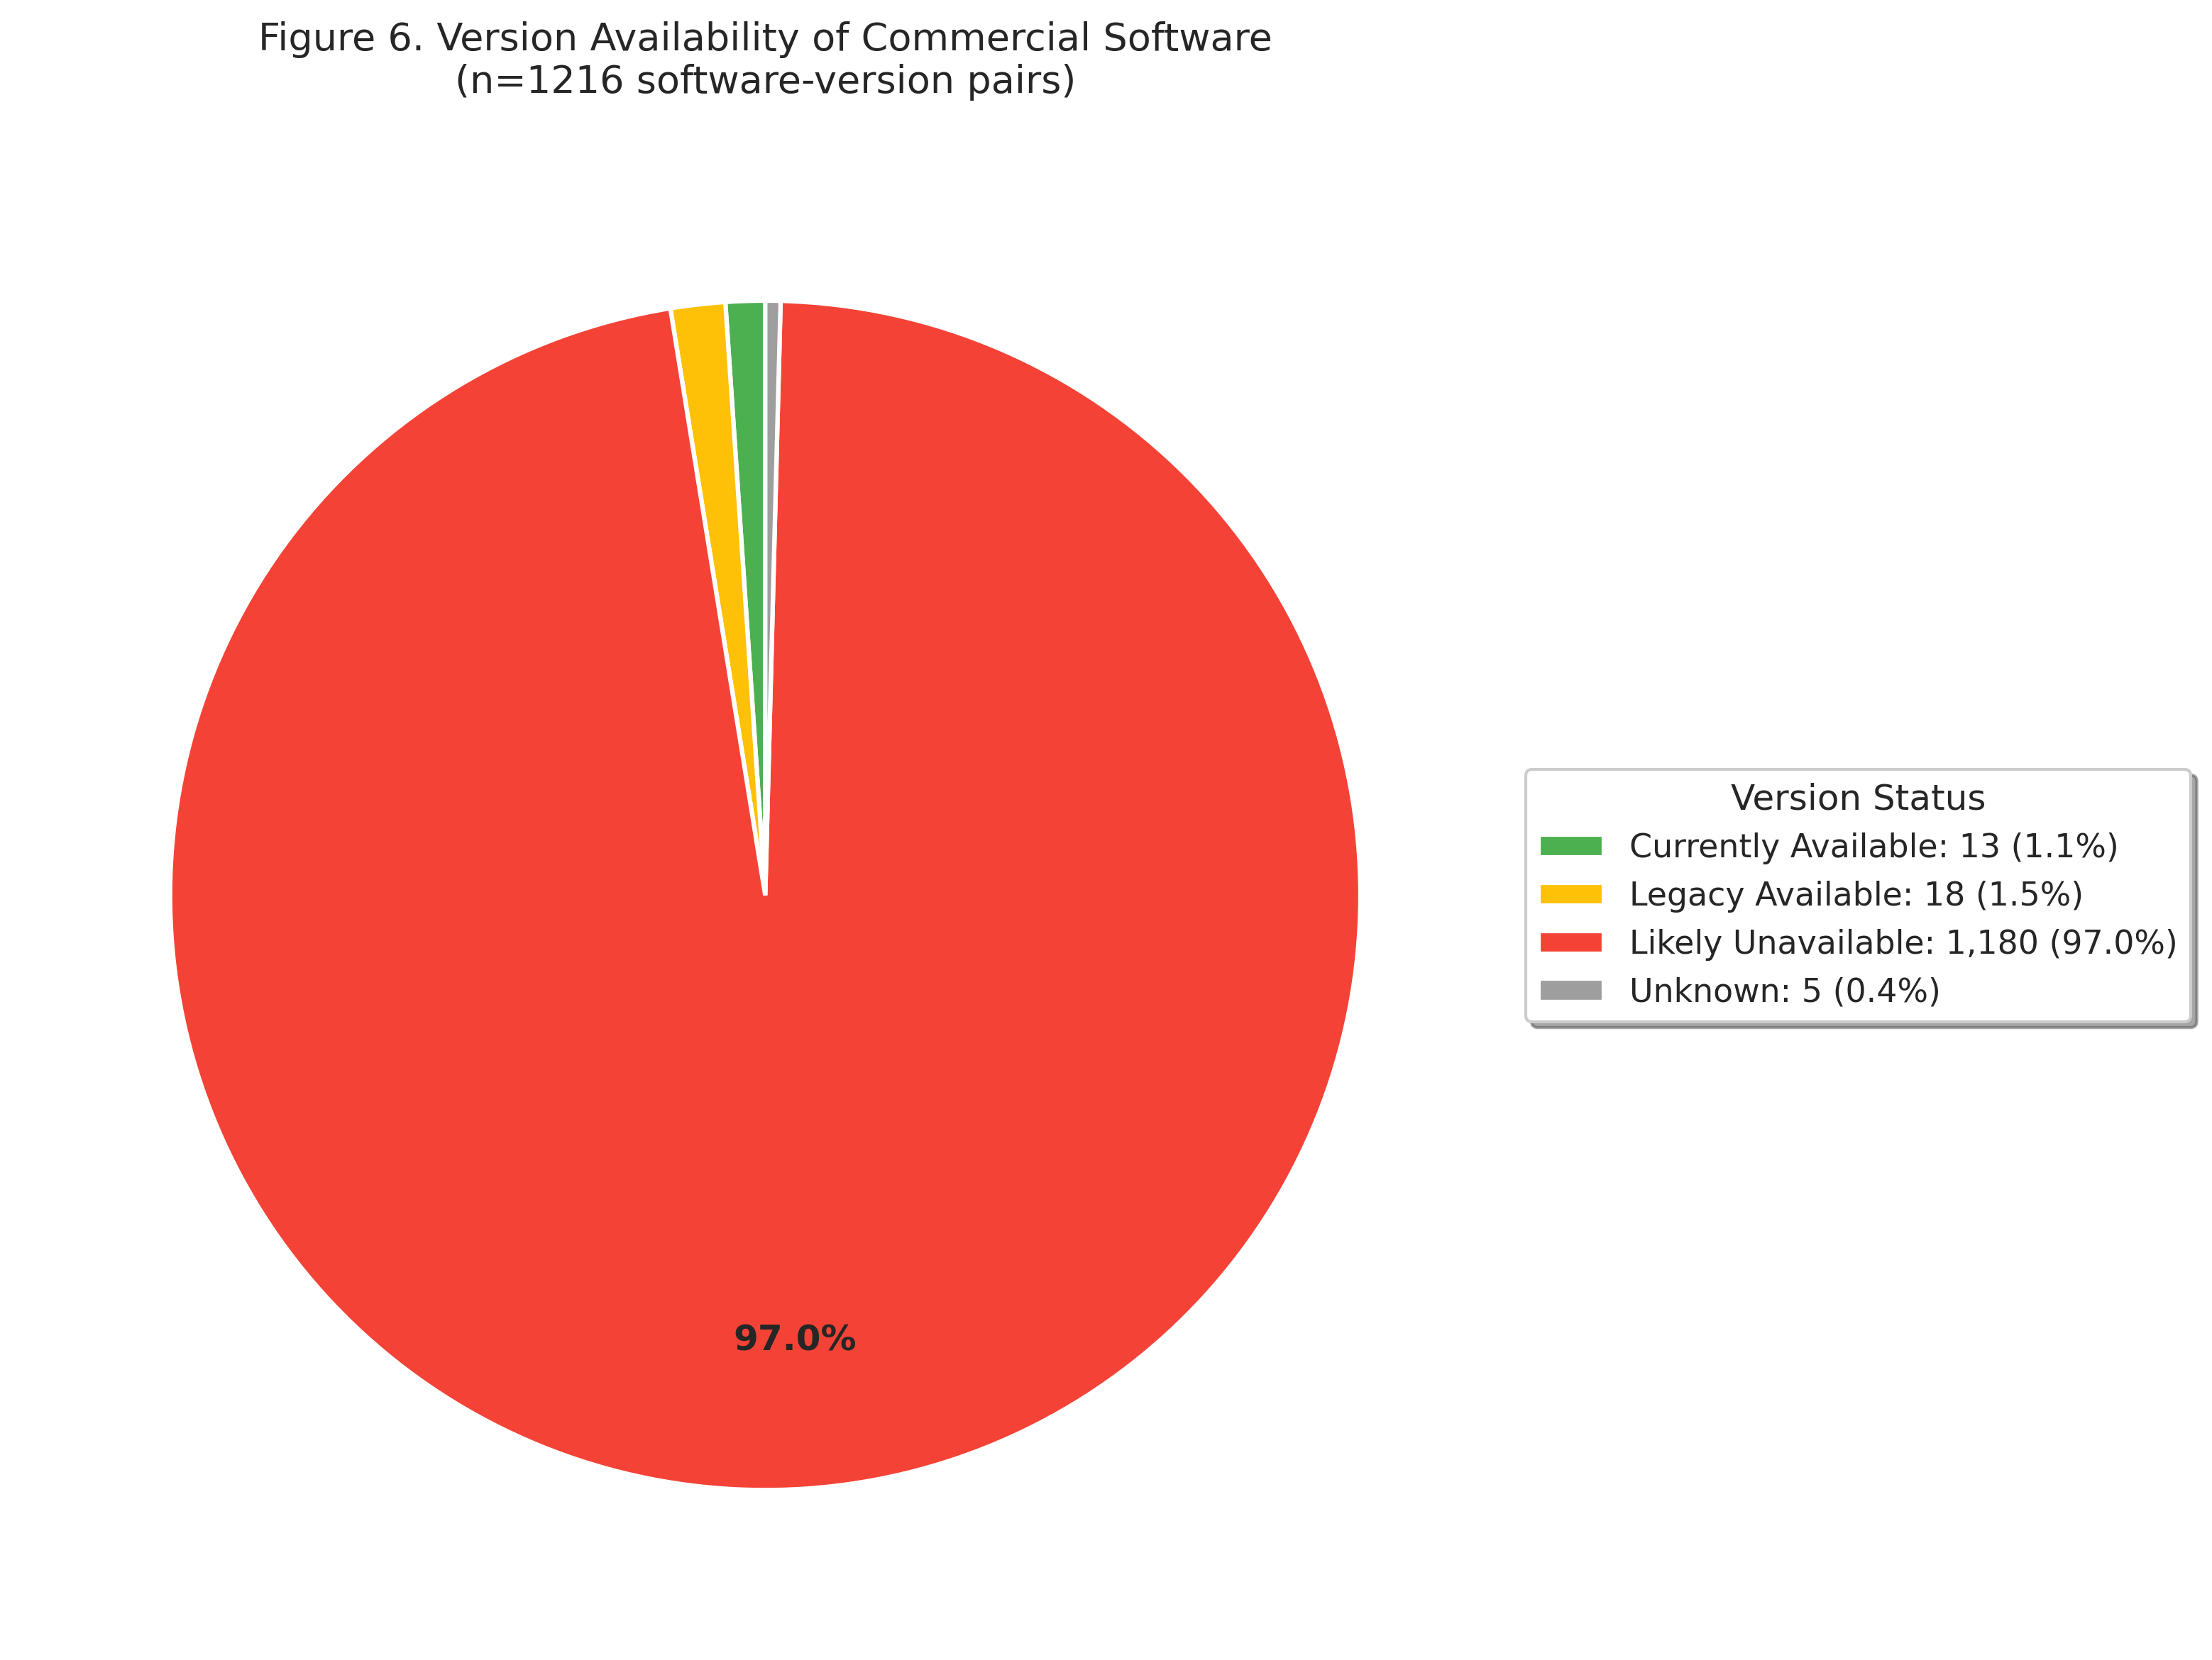
Figure 6. Version Availability of Commercial Software
Pie chart showing the availability status of commercial software versions cited in published papers. Legend indicates counts and percentages.

Slide 8
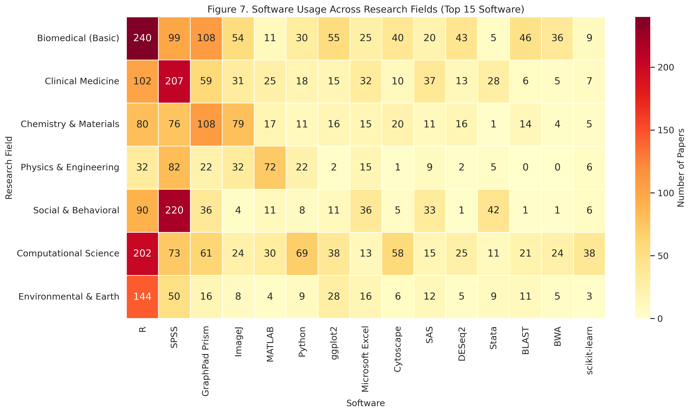
Figure 7. Software Usage Across Research Fields
Heatmap of top 15 software tools across seven research fields, showing field-specific software usage patterns.

Slide 9
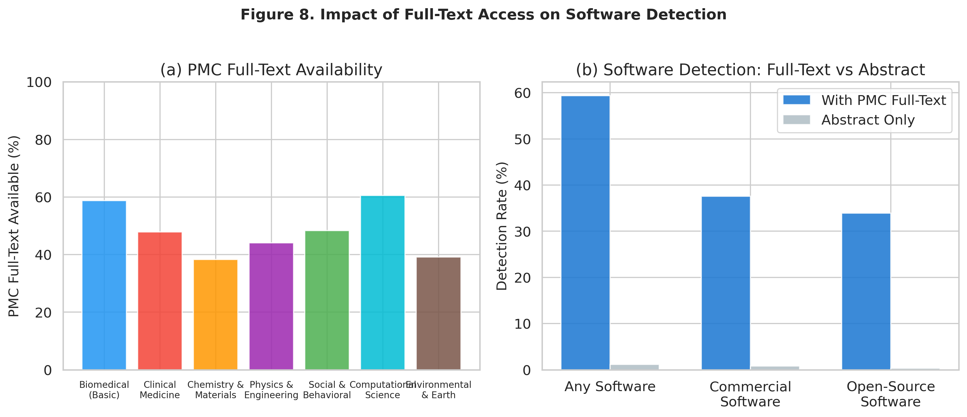
Figure 8. Impact of PMC Full-Text on Software Detection
(a) PMC full-text availability rate by research field. (b) Comparison of software detection rates with and without PMC full-text access.

