Slide 1
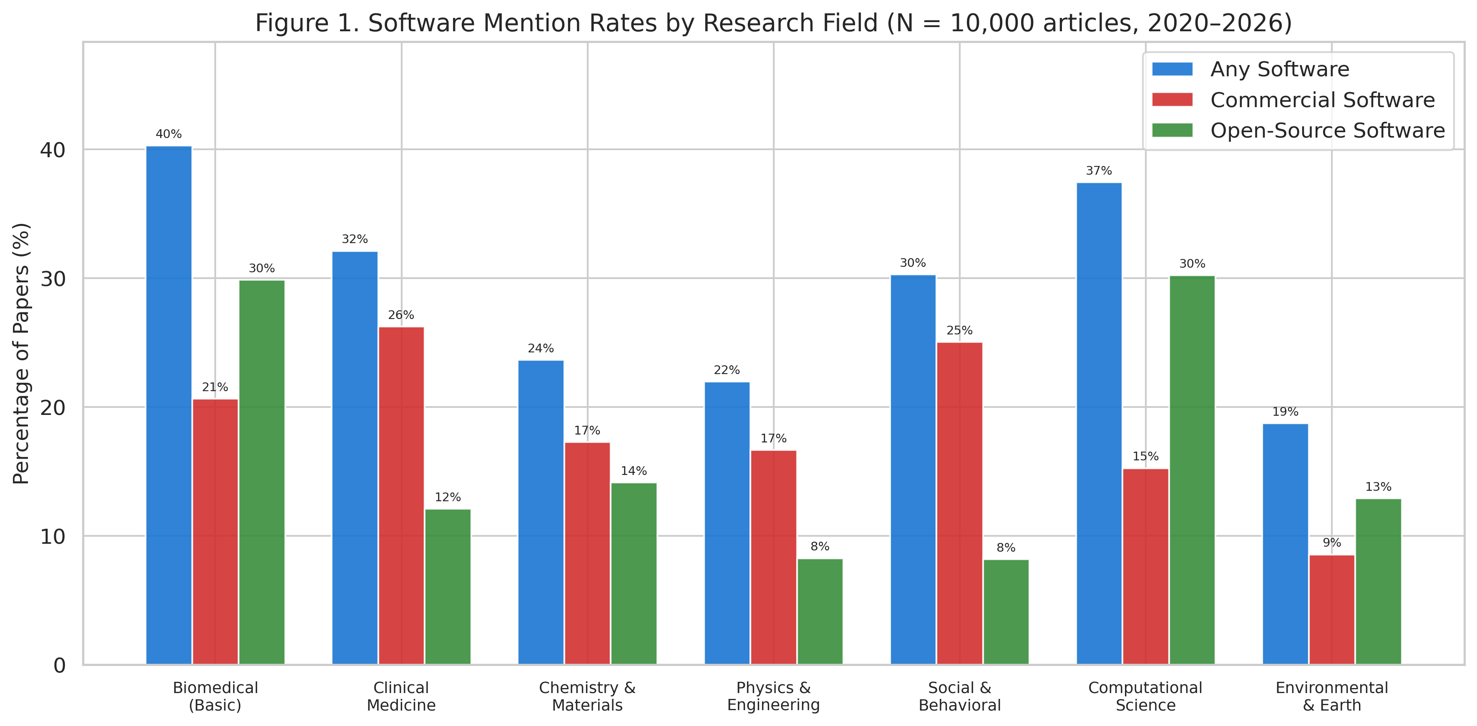
Figure 1
Figure 1. Software mention rates by research field, stratified by software type (N = 10,000 articles, 2020–2026).

Slide 2
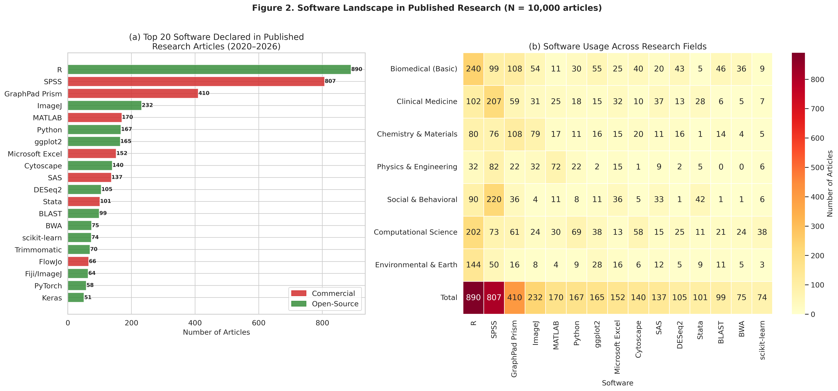
Figure 2
Figure 2. (a) Top 20 software tools declared in published research articles, coloured by licence type. (b) Usage heatmap across seven research fields with Total row.

Slide 3
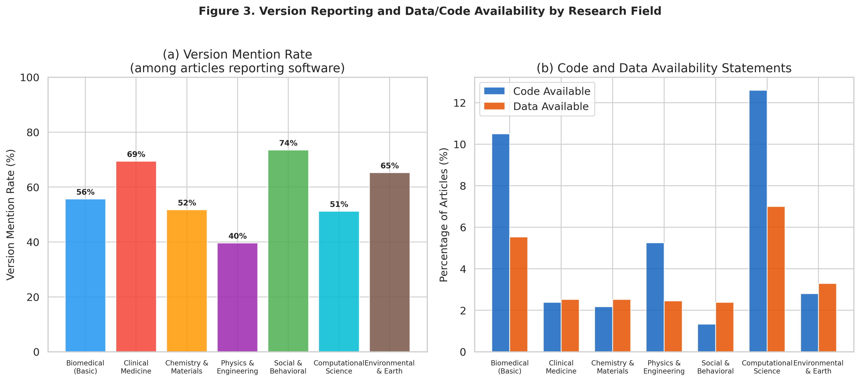
Figure 3
Figure 3. (a) Version mention rates among articles reporting software, and (b) code and data availability statement rates, by research field.

Slide 4
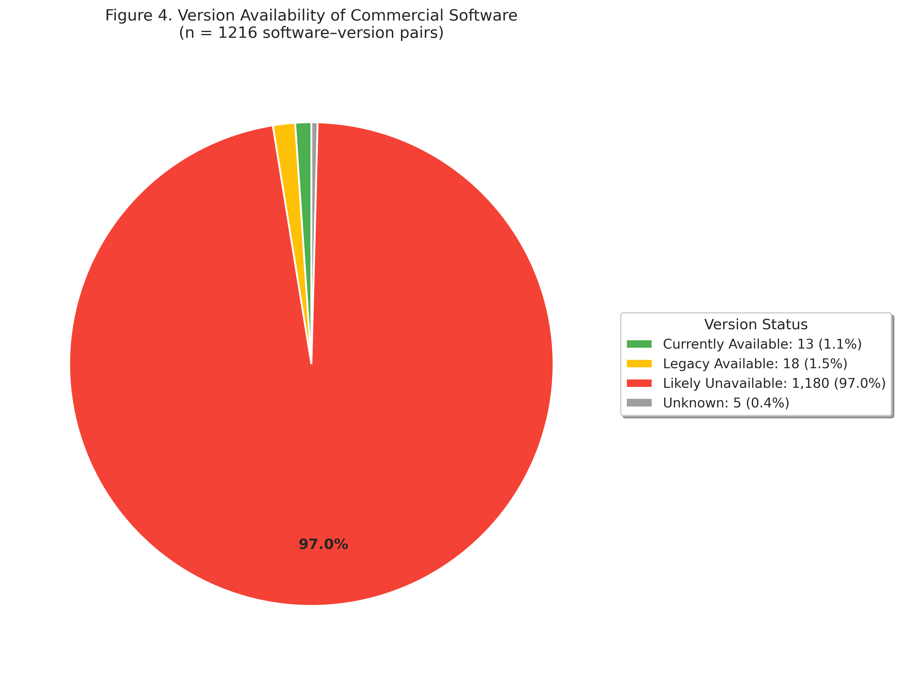
Figure 4
Figure 4. Availability assessment of commercial software versions cited in published articles.

Slide 5
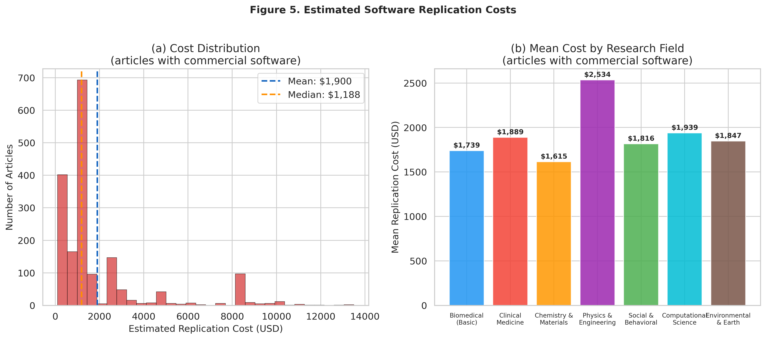
Figure 5
Figure 5. (a) Distribution of estimated replication costs among articles using commercial software, and (b) mean replication cost by research field.

Slide 6
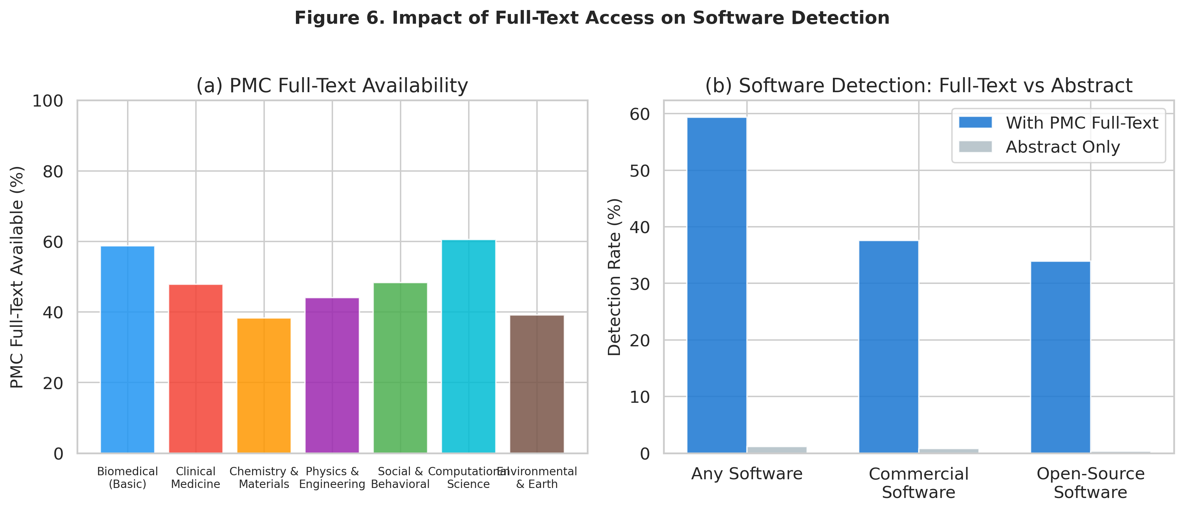
Figure 6
Figure 6. Impact of PMC full-text availability on software detection rates.

Slide 7
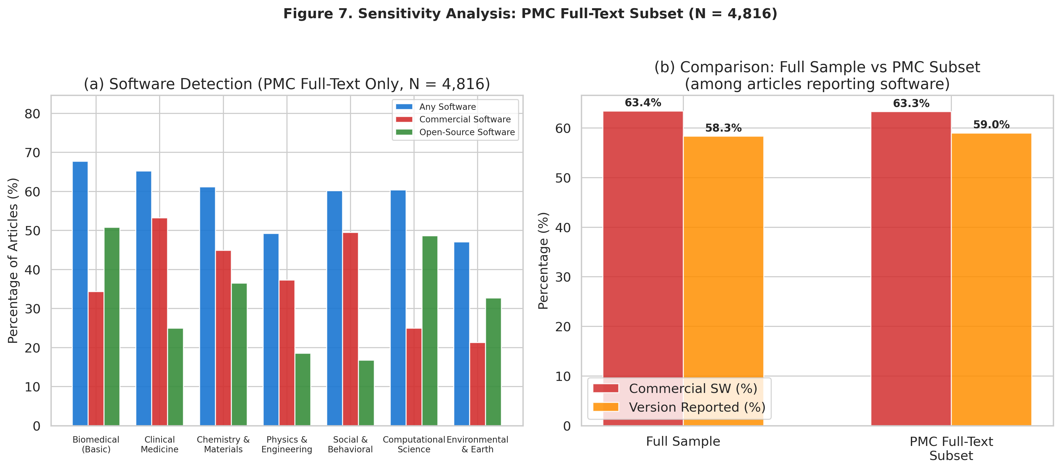
Figure 7
Figure 7. Sensitivity analysis restricted to the PMC full-text subset.

Slide 8
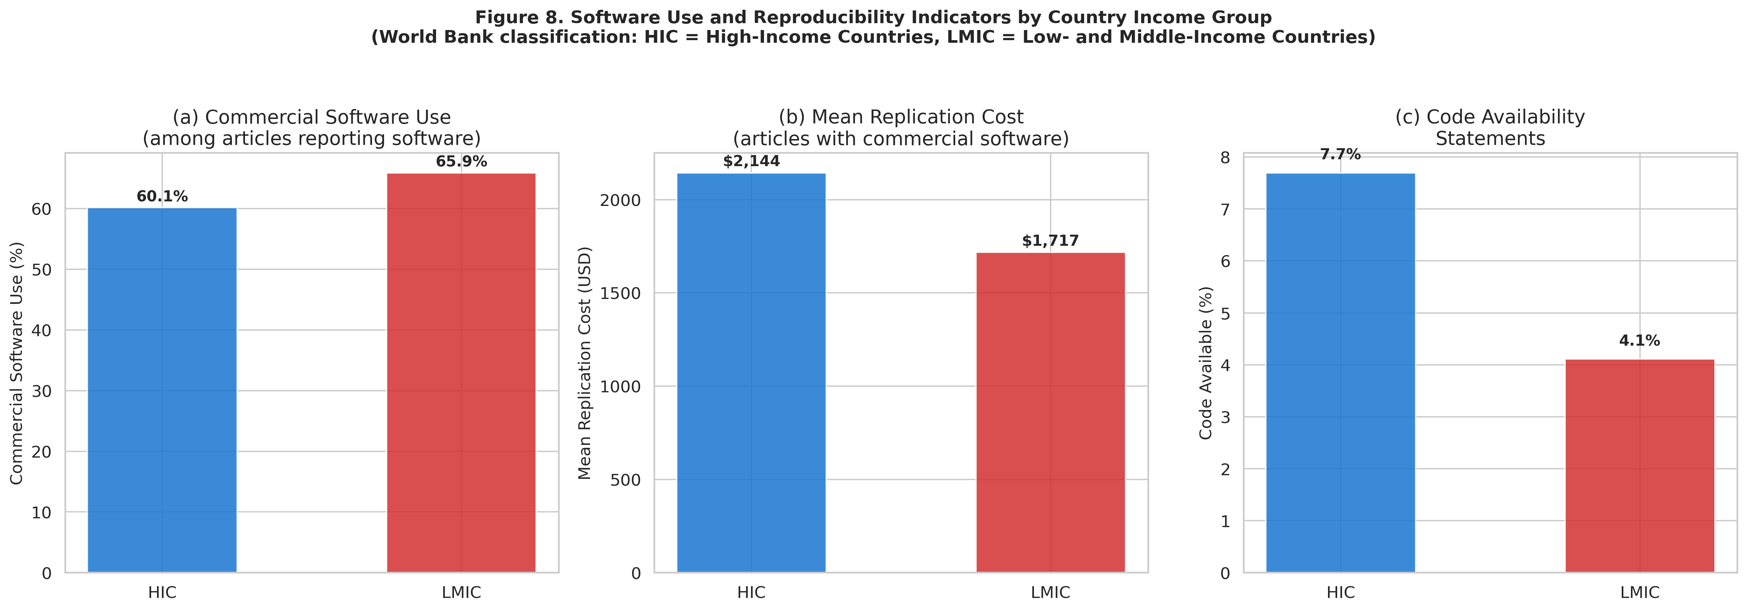
Figure 8
Figure 8. Software use and reproducibility indicators by country income group (World Bank classification).

