Slide 1
AI researchers as the next coal: transition rates, minimum viable research communities and the preservation of variety in global AI/ML
Data-driven manuscript figures and tables

Slide 2
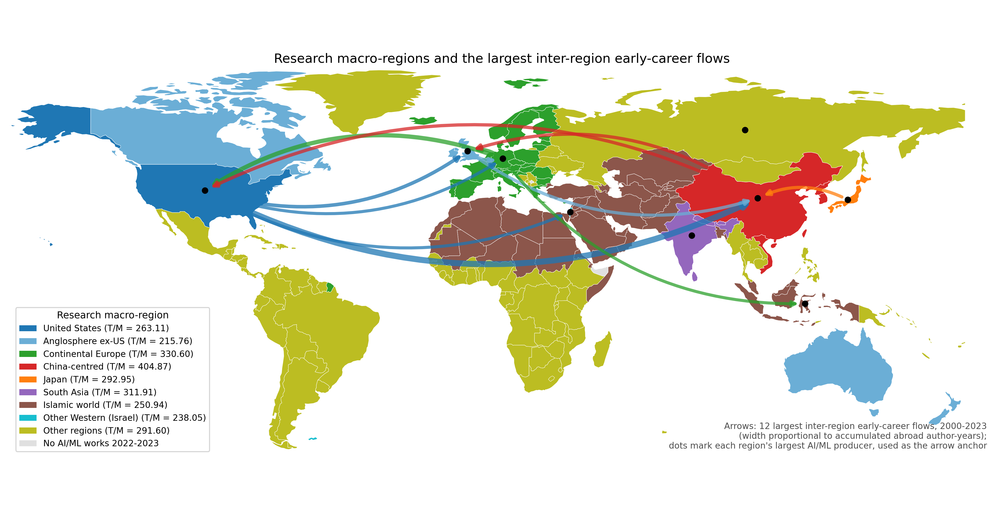
Figure 1: Research macro-regions and inter-region flows
Countries coloured by research macro-region; arrows show the 12 largest observed inter-region early-career flows (width proportional to accumulated abroad author-years). Legend gives equilibrium T/M.

Slide 3
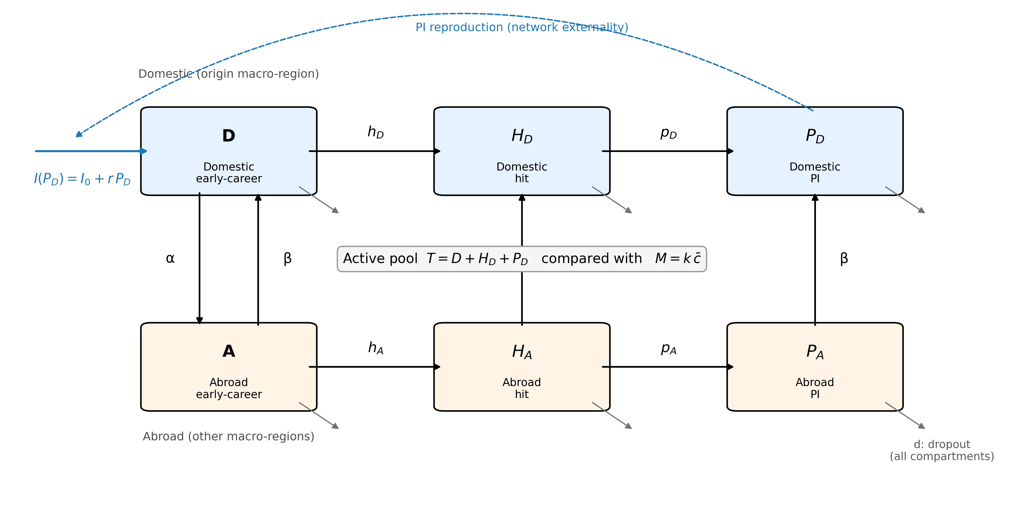
Figure 2: Compartment model (image)
Six compartments per macro-region with transition rates, endogenous recruitment from the domestic PI stock, dropout from every compartment and the threshold test T versus M.

Slide 4
Figure 2 (editable shapes): Compartment model
Inflow I(P_D) = I_0 + r·P_D
r (feedback)
D
Domestic early-career
H_{D}
Domestic hit
P_{D}
Domestic PI
h_D
p_D
α ↓ β ↑
β
β
Active pool T = D + H_D + P_D compared with M = k·c̄; d = dropout from every compartment
A
Abroad early-career
H_{A}
Abroad hit
P_{A}
Abroad PI
h_A
p_A

Slide 5
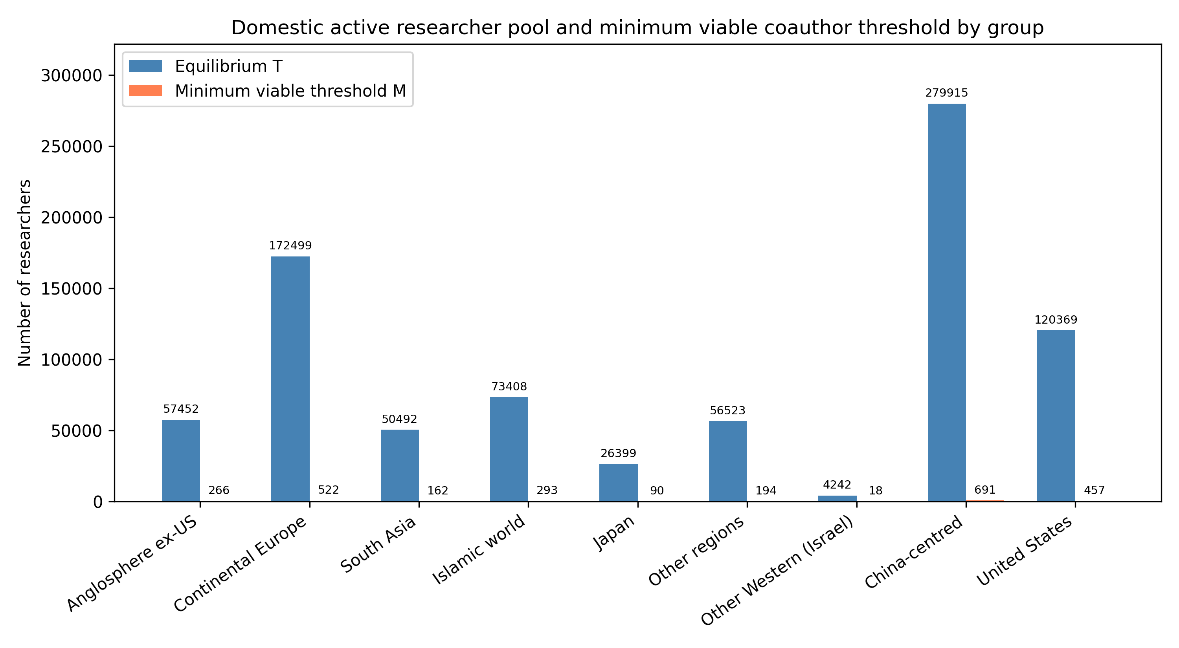
Figure 3: Equilibrium T vs minimum viable threshold
Blue bars: equilibrium T; orange bars: threshold M. All groups remain above the threshold, but margins vary widely.

Slide 6
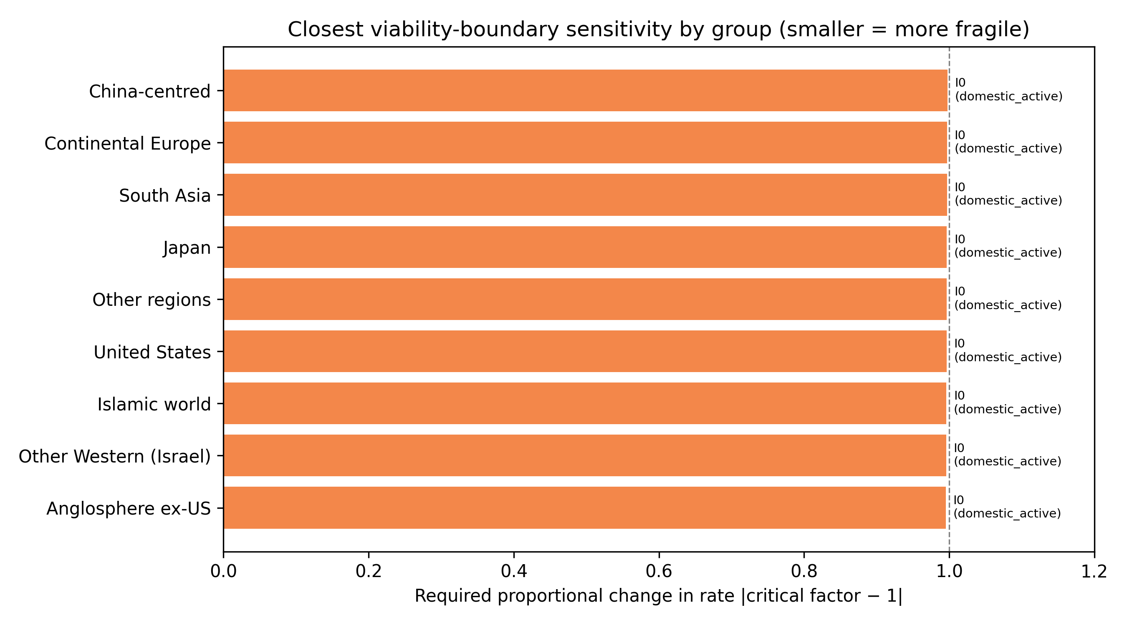
Figure 4: Closest viability-boundary proximity
Smaller values mean a smaller proportional change in the listed rate is required to reach the threshold for the stated target pool.

Slide 7
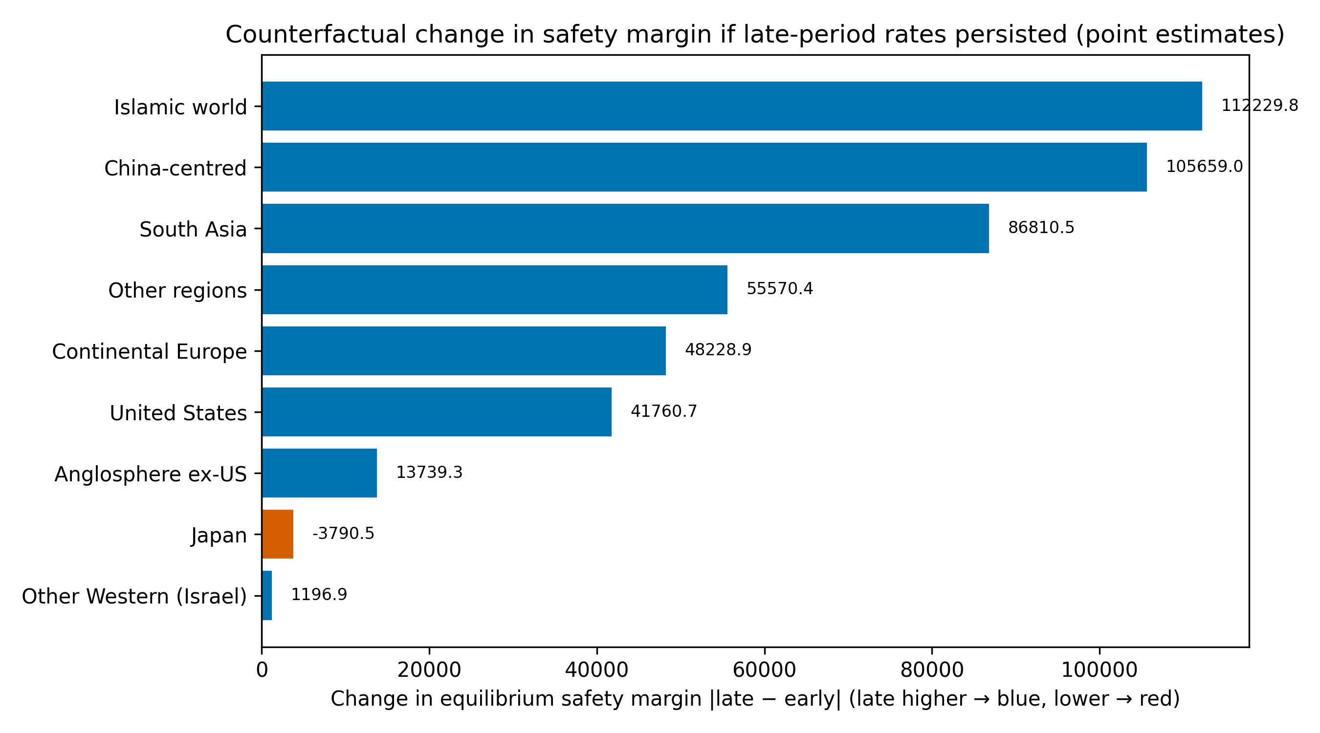
Figure 5: Historical counterfactual margin change
Positive values mean the late-window rates would produce a larger safety margin than the early-window rates if they persisted; negative values mean the margin would shrink. The comparison is across point estimates; uncertainty is substantial.

Slide 8
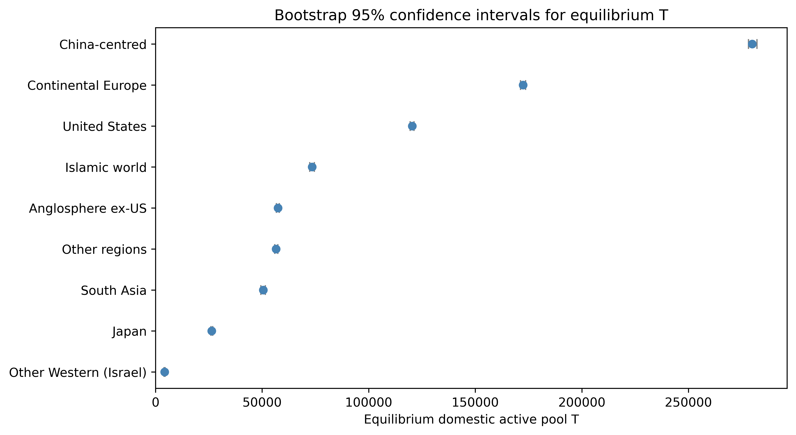
Figure 6: Bootstrap 95% CI for equilibrium T
Intervals are asymmetric and wide, reflecting model uncertainty.

Slide 9
Table 1: Descriptive cohort statistics
Group | n | works | active | hits | pis | career_start_mean | abroad
Anglosphere ex-US | 54017 | 701927 | 23366 | 32061 | 36149 | 2007.4 | 12564
China-centred | 163971 | 1556825 | 91523 | 56710 | 116531 | 2009.1 | 15962
Continental Europe | 147366 | 1853004 | 63639 | 83782 | 97387 | 2008.0 | 17174
Islamic world | 45983 | 381930 | 25466 | 18556 | 31215 | 2011.2 | 6363
Japan | 28681 | 309340 | 10165 | 9390 | 15905 | 2006.8 | 2695
Other Western (Israel) | 3685 | 52066 | 1661 | 2303 | 2284 | 2007.4 | 1008
Other regions | 46189 | 383971 | 21030 | 14511 | 29822 | 2009.9 | 4471
South Asia | 26869 | 243272 | 16064 | 11657 | 18214 | 2011.5 | 3117
United States | 106415 | 1224020 | 45631 | 65018 | 70141 | 2007.4 | 15733

Slide 10
Table 2: Equilibrium and inflow parameters
Group | T_eq | M | Margin | T/M | I0 | r | r_obs | r_crit
Anglosphere ex-US | 57452 | 266 | 57185 | 1588.74 | 0 | 0.08790 | 0.12311 | 215.75932
Continental Europe | 172499 | 522 | 171977 | 4334.29 | 0 | 0.08901 | 0.11465 | 330.60293
South Asia | 50492 | 162 | 50330 | 790.26 | 0 | 0.08678 | 0.05601 | 311.91046
Islamic world | 73408 | 293 | 73116 | 1352.44 | 0 | 0.08665 | 0.07335 | 250.94375
Japan | 26399 | 90 | 26309 | 1005.22 | 0 | 0.10607 | 0.26244 | 292.95428
Other regions | 56523 | 194 | 56329 | 1358.50 | 0 | 0.09111 | 0.14089 | 291.59617
Other Western (Israel) | 4242 | 18 | 4225 | 108.38 | 0 | 0.09491 | 0.11606 | 238.04837
China-centred | 279915 | 691 | 279223 | 4822.68 | 0 | 0.08277 | 0.07498 | 404.87036
United States | 120369 | 457 | 119912 | 3129.85 | 0 | 0.08924 | 0.11811 | 263.10668

Slide 11
Table 3: Top transition-rate elasticities
Group | 1st | el1 | 2nd | el2 | 3rd | el3
Anglosphere ex-US | d | -2.658 | h_D | 0.438 | p_D | 0.347
China-centred | d | -2.634 | h_D | 0.374 | p_D | 0.253
Continental Europe | d | -2.647 | h_D | 0.364 | p_D | 0.357
Islamic world | d | -2.600 | h_D | 0.397 | p_D | 0.240
Japan | d | -2.305 | h_D | 0.399 | p_D | 0.301
Other Western (Israel) | d | -2.726 | p_D | 0.368 | h_D | 0.332
Other regions | d | -2.795 | h_D | 0.493 | p_D | 0.324
South Asia | d | -2.516 | h_D | 0.348 | p_D | 0.213
United States | d | -2.640 | h_D | 0.377 | p_D | 0.374

Slide 12
Table 4: Closest model-implied viability boundary
Group | Target | Rate | Current | Crit.factor | Proximity
Anglosphere ex-US | domestic_active | I0 | 1588.7353 | 0.005 | 0.995
Other Western (Israel) | domestic_active | I0 | 108.3824 | 0.004 | 0.996
Islamic world | domestic_active | I0 | 1352.4412 | 0.004 | 0.996
United States | domestic_active | I0 | 3129.8529 | 0.004 | 0.996
Other regions | domestic_active | I0 | 1358.5000 | 0.003 | 0.997
Japan | domestic_active | I0 | 1005.2177 | 0.003 | 0.997
South Asia | domestic_active | I0 | 790.2647 | 0.003 | 0.997
Continental Europe | domestic_active | I0 | 4334.2941 | 0.003 | 0.997
China-centred | domestic_active | I0 | 4822.6765 | 0.002 | 0.998

Slide 13
Table 5: Saturating inflow extension
Group | Linear T | Saturating T | ε
Anglosphere ex-US | 57452 | 57452 | 0.00001
Continental Europe | 172499 | 172499 | 0.00000
South Asia | 50492 | 50492 | 0.00001
Islamic world | 73408 | 73408 | 0.00001
Japan | 26399 | 26399 | 0.00001
Other regions | 56523 | 56523 | 0.00001
Other Western (Israel) | 4242 | 4242 | 0.00009
China-centred | 279915 | 279915 | 0.00000
United States | 120369 | 120369 | 0.00000

Slide 14
Table 6: Historical counterfactual
Group | n_early | n_late | T early | T late | delta_T | ΔT (%) | M_early | M_late | Margin early | Margin late | Δ margin
Anglosphere ex-US | 36619 | 17398 | 53748 | 67487 | 13739.330973466946 | 25.6 | 266.2767950052029 | 266.2767950052029 | 53481 | 67221 | 13739.3
Continental Europe | 94112 | 53254 | 156777 | 205006 | 48228.90276317328 | 30.8 | 521.7708402524079 | 521.7708402524079 | 156255 | 204484 | 48228.9
South Asia | 8576 | 18293 | 20498 | 107308 | 86810.54602064603 | 423.5 | 161.88066298342542 | 161.88066298342542 | 20336 | 107146 | 86810.5
Islamic world | 16960 | 29023 | 34790 | 147020 | 112229.80809028892 | 322.6 | 292.5278323510151 | 292.5278323510151 | 34498 | 146727 | 112229.8
Japan | 20894 | 7787 | 27891 | 24101 | -3790.51365324578 | -13.6 | 90.11282545805209 | 90.11282545805209 | 27801 | 24011 | -3790.5
Other regions | 22244 | 23945 | 37346 | 92916 | 55570.351670830445 | 148.8 | 193.84 | 193.84 | 37152 | 92722 | 55570.4
Other Western (Israel) | 2463 | 1222 | 3901 | 5097 | 1196.8848823157305 | 30.7 | 17.82127659574468 | 17.82127659574468 | 3883 | 5080 | 1196.9
China-centred | 99830 | 64141 | 244735 | 350394 | 105659.0497260816 | 43.2 | 691.368248100226 | 691.368248100226 | 244043 | 349702 | 105659.0
United States | 71613 | 34802 | 108959 | 150719 | 41760.6682840531 | 38.3 | 457.4921998643455 | 457.4921998643455 | 108501 | 150262 | 41760.7

Slide 15
Table 7: Top policy intervention
Group | Lever | Direction | Change (%) | Margin gain | Gain per 10%
Anglosphere ex-US | d | decrease | -10 | 6509 | 6508.6
Continental Europe | d | decrease | -10 | 19429 | 19428.7
South Asia | d | decrease | -10 | 5773 | 5773.0
Islamic world | d | decrease | -10 | 8400 | 8399.6
Japan | d | decrease | -10 | 2875 | 2875.0
Other regions | d | decrease | -10 | 6312 | 6312.4
Other Western (Israel) | d | decrease | -10 | 495 | 494.8
China-centred | d | decrease | -10 | 31801 | 31800.6
United States | d | decrease | -10 | 13537 | 13536.9

Slide 16
Table 9: Transition levers, policy instruments and principal actors
Lever | Policy instrument | Management action
Dropout (d) | Early-career fellowships, childcare and dual-career support, stable non-tenure tracks | Retain researchers in the domestic pipeline beyond the first career years
Exogenous entry (I_0) | Research-master and undergraduate pipelines, doctoral fellowships, recruitment visas | Widen the base of incoming researchers before they select a field or location
Return from abroad (β) | Return grants, diaspora networks, dual appointments, overseas-experience recognition | Encourage mobile researchers to re-establish domestic research groups
Domestic hit generation (h_D) | Independent-lab programmes (e.g. SPREAD-style), doctoral/postdoctoral training, compute access | Translate junior capacity into visible, high-impact work and independent research lines
PI promotion (p_D) | Tenure-track conversion, startup packages, project-based PI status | Create durable principal-investigator positions that train the next cohort

Slide 17
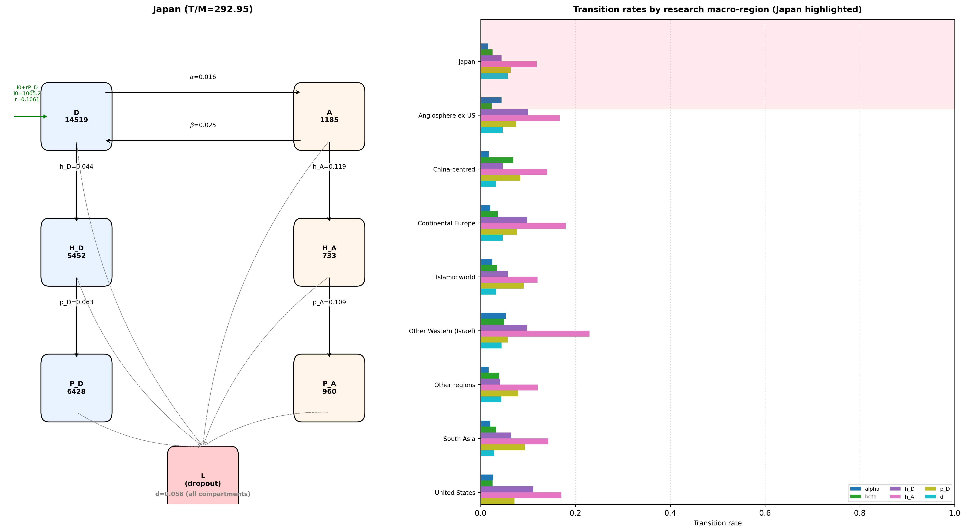
Figure 7: Japan compartment model and cross-region transition-rate ladders
Left: Japan's six compartments; right: Japan highlighted against other macro-regions on each transition rate.

Slide 18
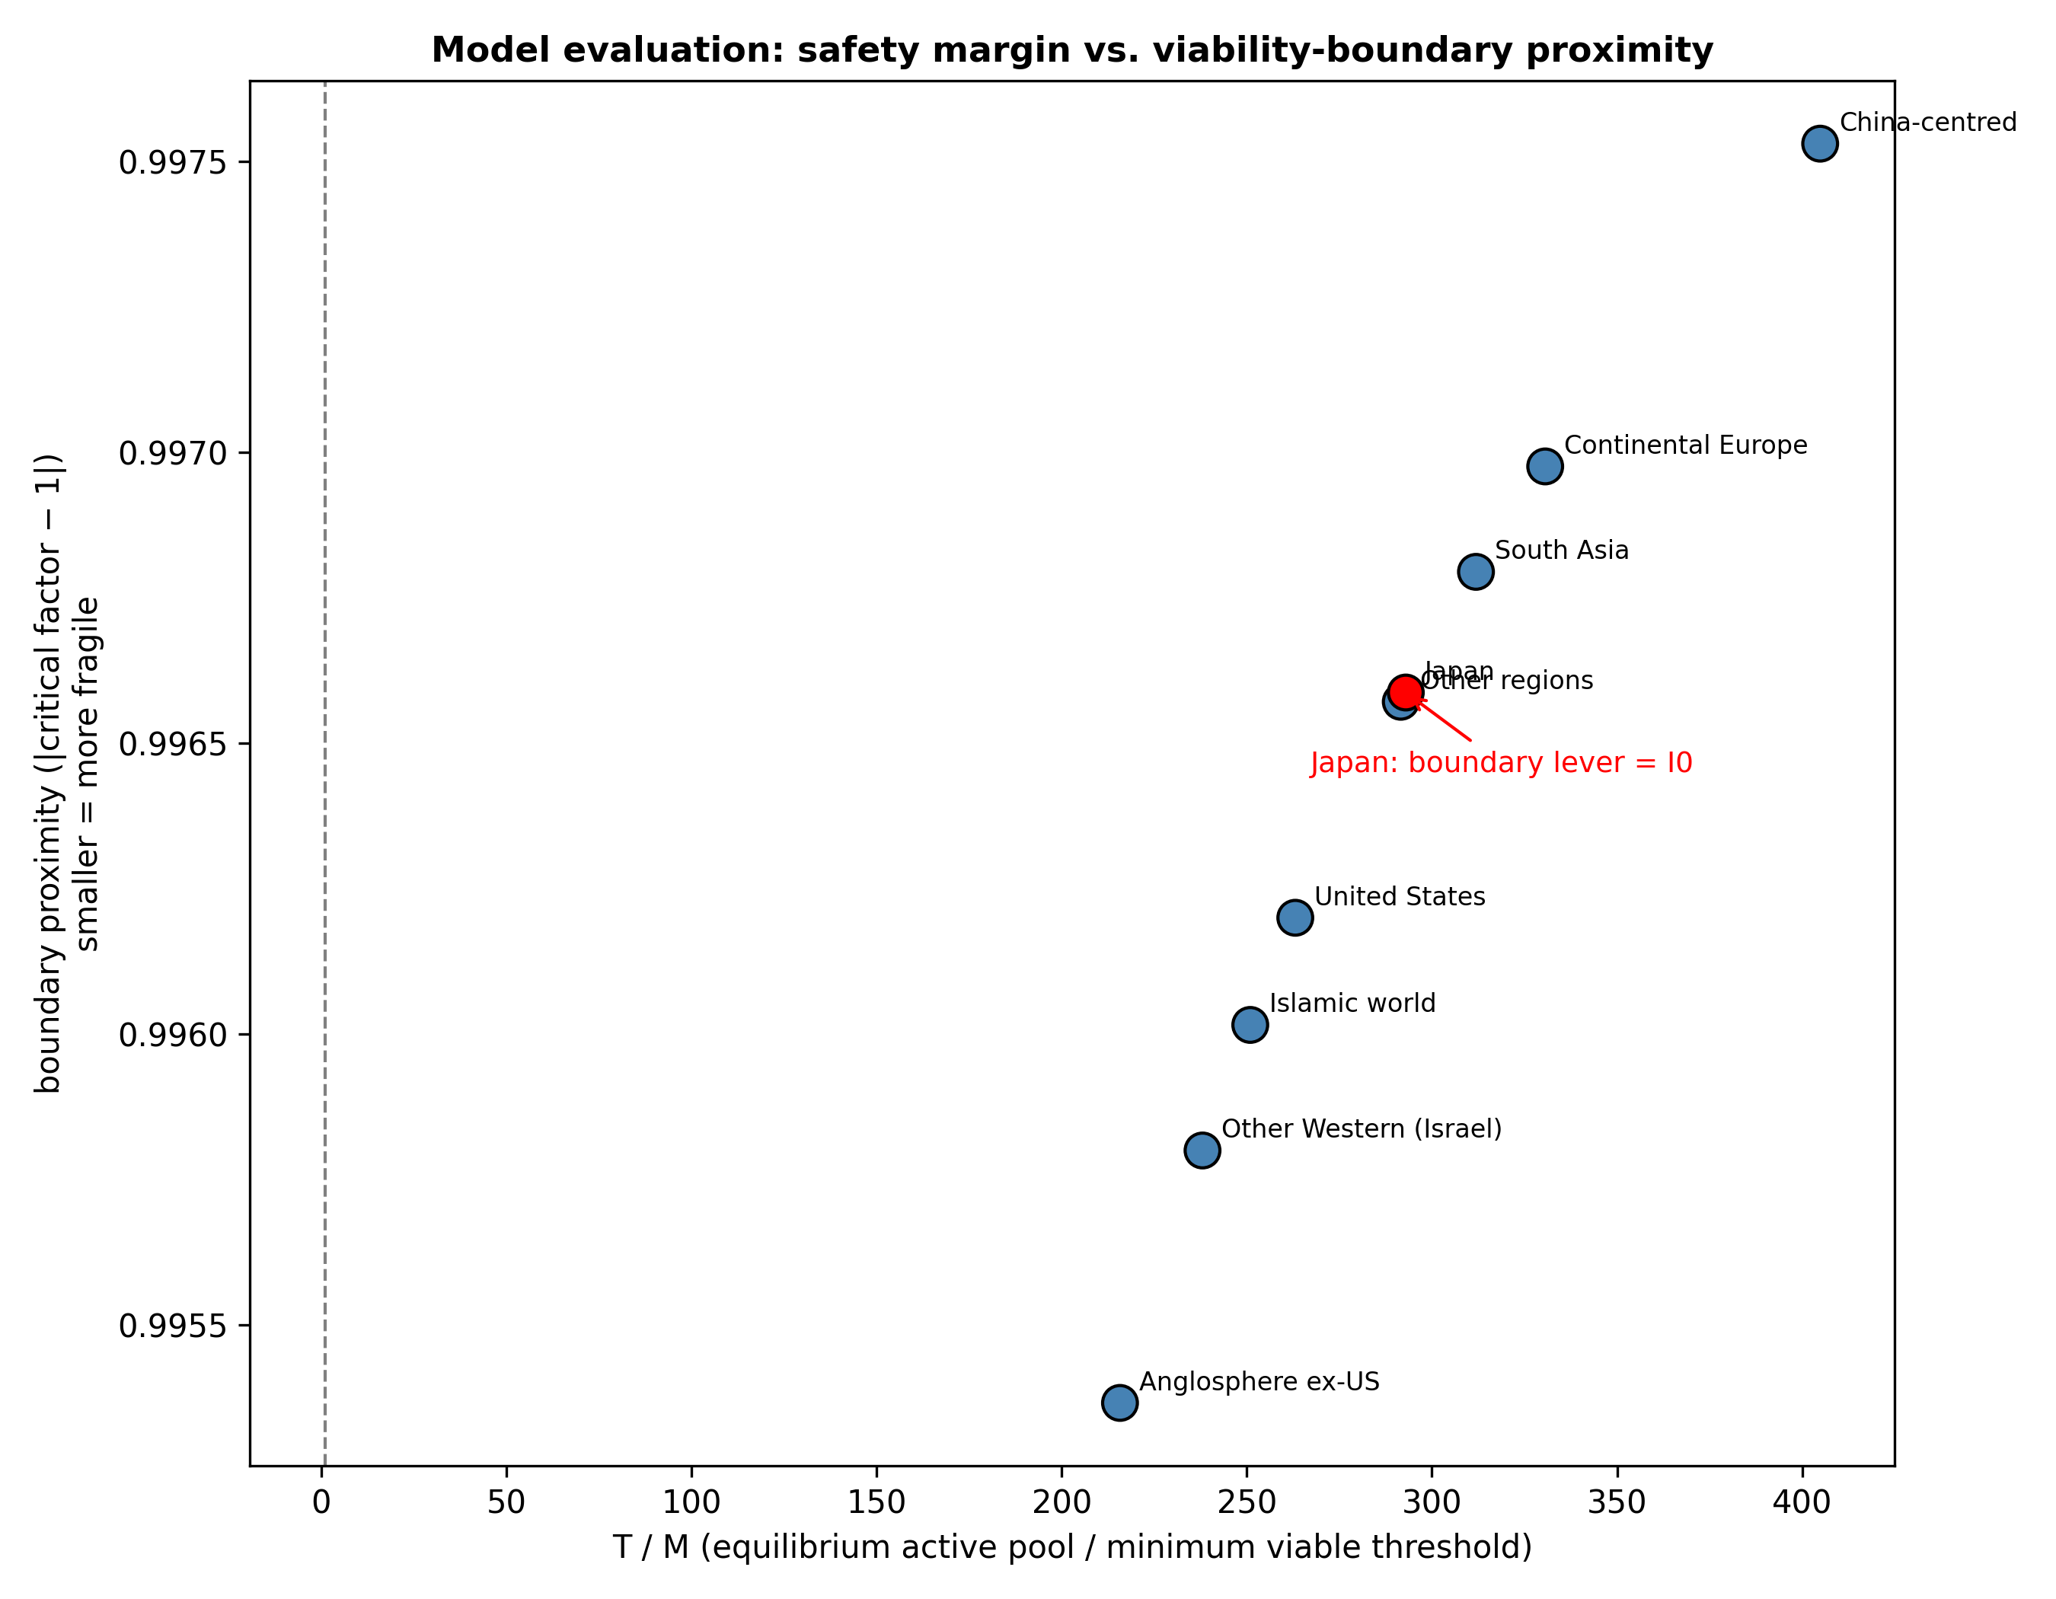
Figure 8: T/M safety margin versus closest boundary proximity
Lower-left points are the most fragile. Japan is highlighted in red.

Slide 19
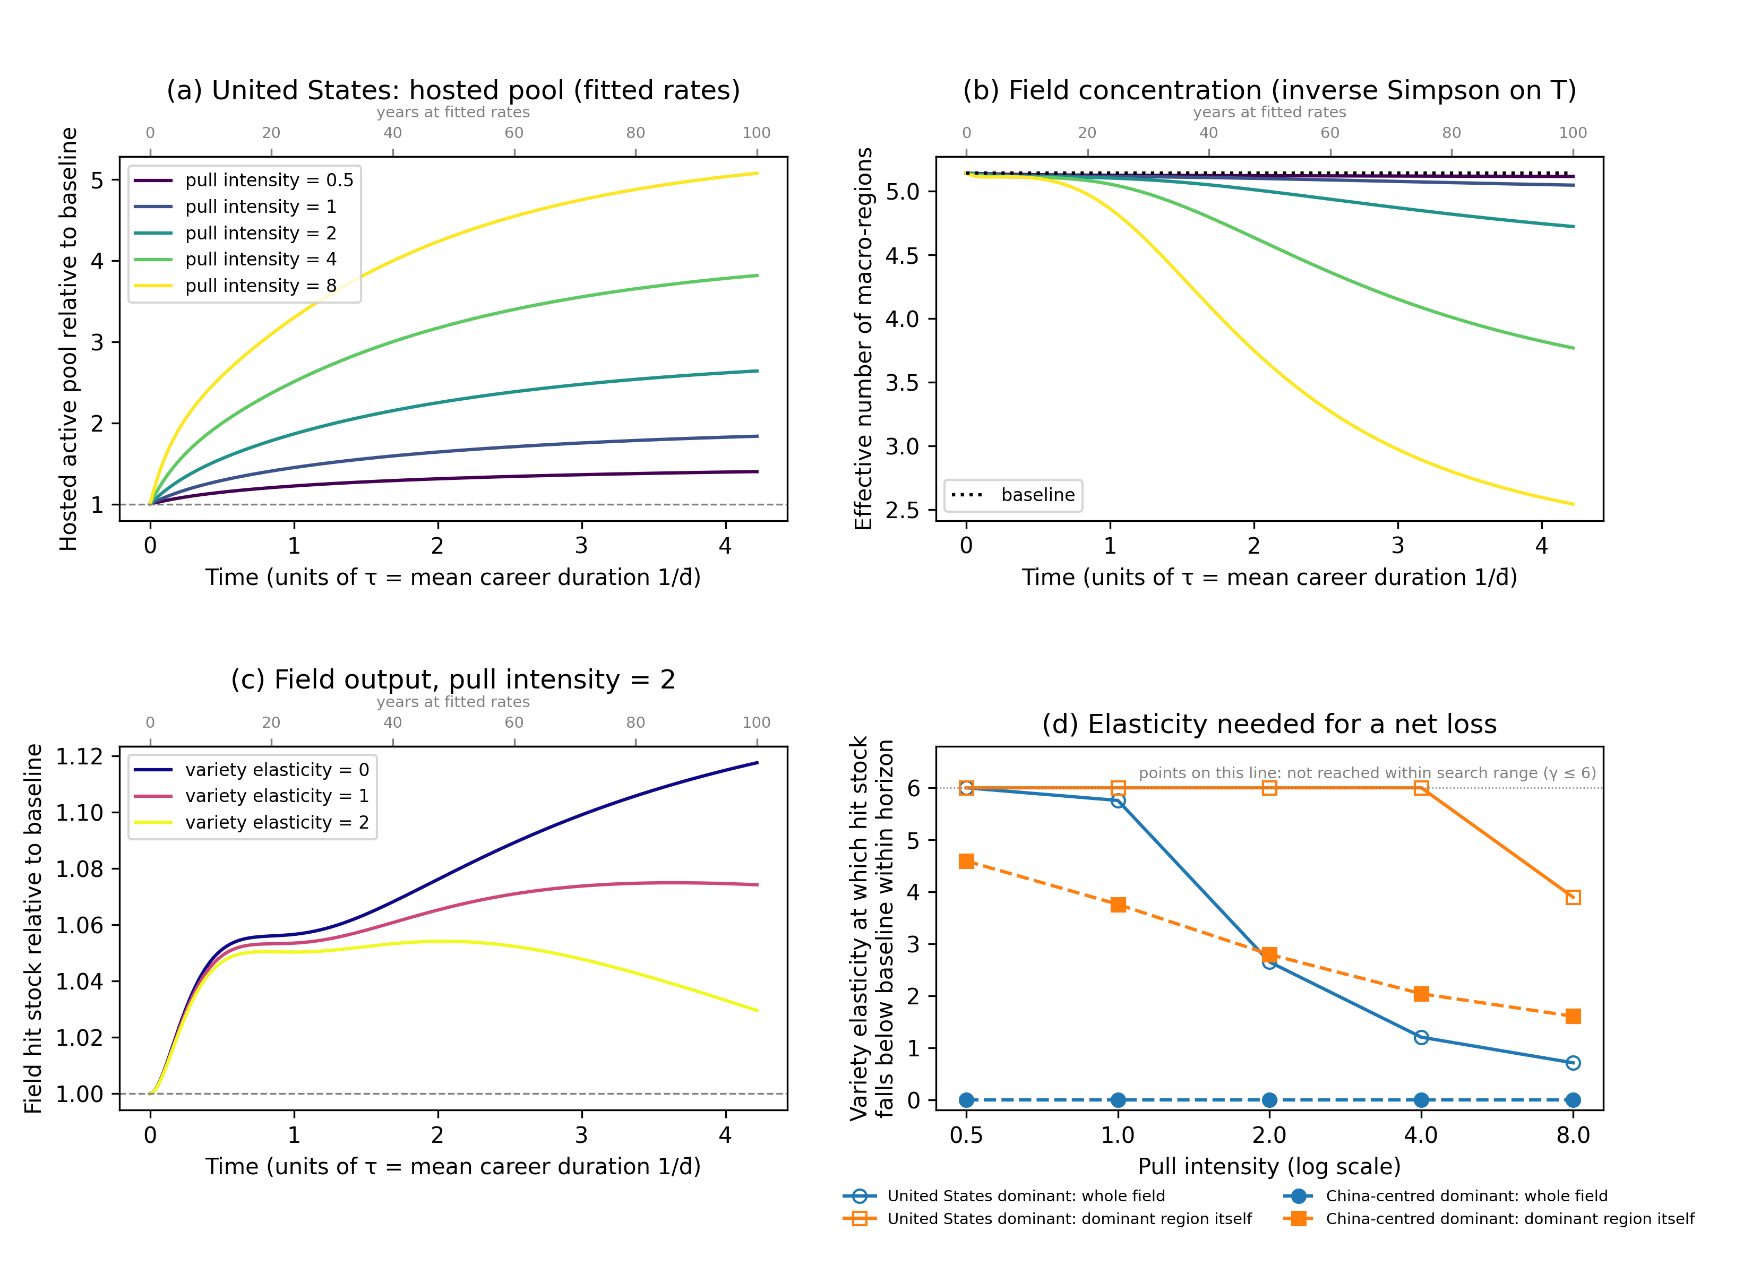
Figure 9: Talent-concentration scenario (coupled nine-region model)
(a) hosted pool of the dominant region; (b) effective number of macro-regions; (c) field hit stock for three variety elasticities; (d) elasticity threshold for a net loss. Pull intensity and variety elasticity are stylised.

Slide 20
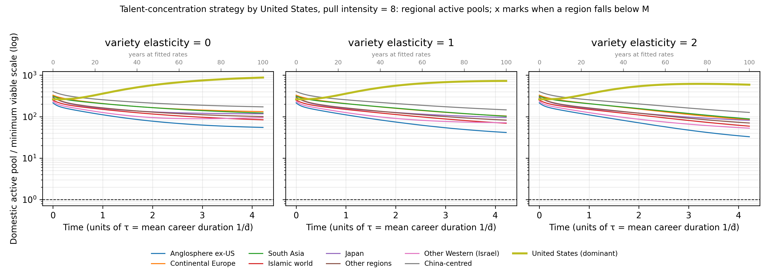
Figure 10: Regional time paths under the talent-concentration strategy
Domestic active pool of each macro-region as a multiple of its minimum viable scale M, one panel per variety elasticity; time in units of the characteristic time τ = 1/d̄; crosses would mark a crossing below M and loss of PI-driven recruitment under the scenario's collapse rule, but no region crosses within the horizon in any run.

Slide 21
Table 8: Talent-concentration scenario at the end of the horizon (fitted rates, γ = 0)
Dominant region | Pull intensity φ | Hosted pool at end of horizon (× baseline) | Share of hosted researchers at end of horizon (%) | Effective number of regions at end of horizon | Regions below M | Field hit stock at end of horizon (× baseline) | γ* field | γ* dominant region
United States | 0.5 | 1.40 | 21 | 5.1 | 0 | 1.03 | not reached | not reached
United States | 1.0 | 1.84 | 27 | 5.0 | 0 | 1.06 | 5.76 | not reached
United States | 2.0 | 2.64 | 38 | 4.7 | 0 | 1.12 | 2.65 | not reached
United States | 4.0 | 3.81 | 53 | 3.8 | 0 | 1.20 | 1.20 | not reached
United States | 8.0 | 5.07 | 68 | 2.5 | 0 | 1.28 | 0.71 | 3.90
China-centred | 0.5 | 1.16 | 37 | 4.8 | 0 | 1.00 | 0 (fitted model) | 4.59
China-centred | 1.0 | 1.33 | 42 | 4.4 | 0 | 1.00 | 0 (fitted model) | 3.76
China-centred | 2.0 | 1.60 | 50 | 3.7 | 0 | 0.99 | 0 (fitted model) | 2.79
China-centred | 4.0 | 1.98 | 62 | 2.8 | 0 | 0.97 | 0 (fitted model) | 2.04
China-centred | 8.0 | 2.36 | 74 | 2.0 | 0 | 0.95 | 0 (fitted model) | 1.61

Slide 22
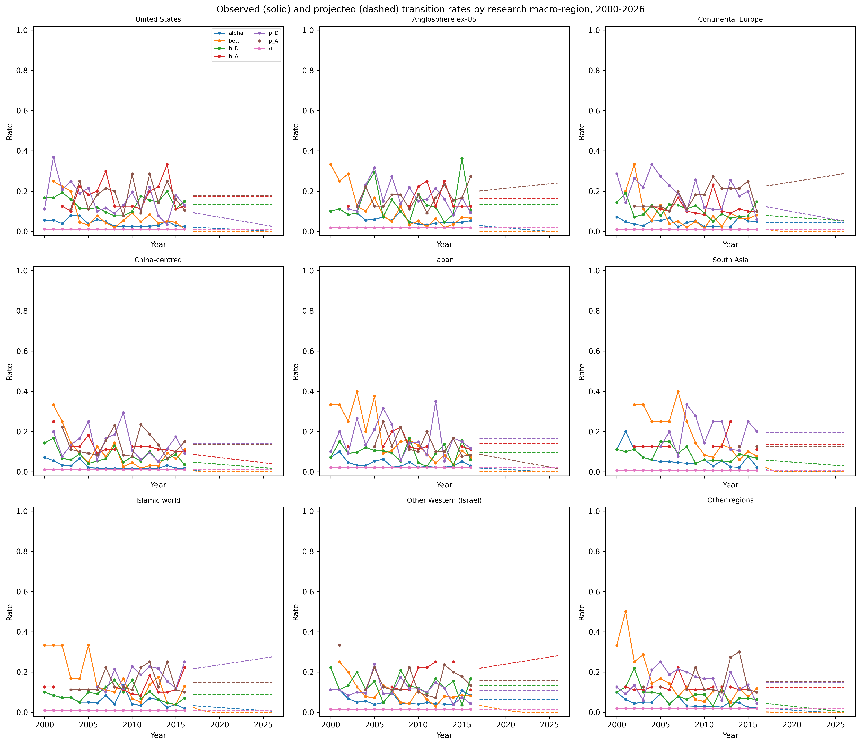
Supplementary Figure S1: Observed and projected transition rates
Solid lines mark observed 2000-2016 rates; dashed lines mark projected 2017-2026 rates.

Slide 23
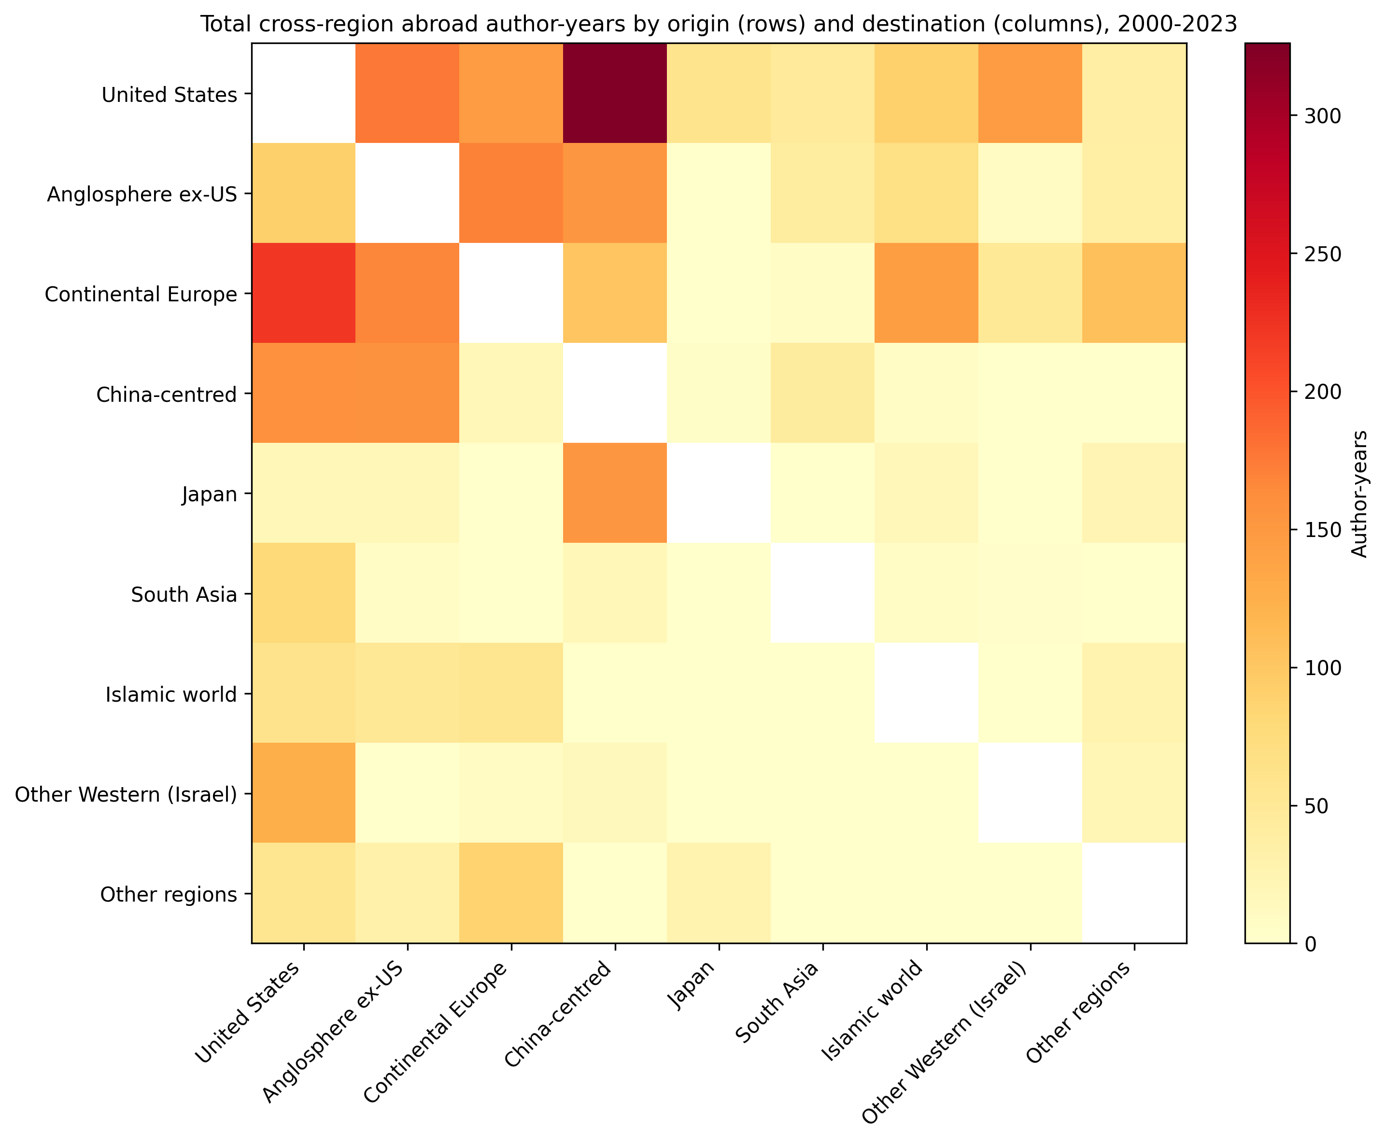
Supplementary Figure S2: Cross-region abroad author-years
Rows are origin macro-regions; columns are destination macro-regions approximated by recent_group. Same-region cells and Unknown destinations are excluded.

Slide 24
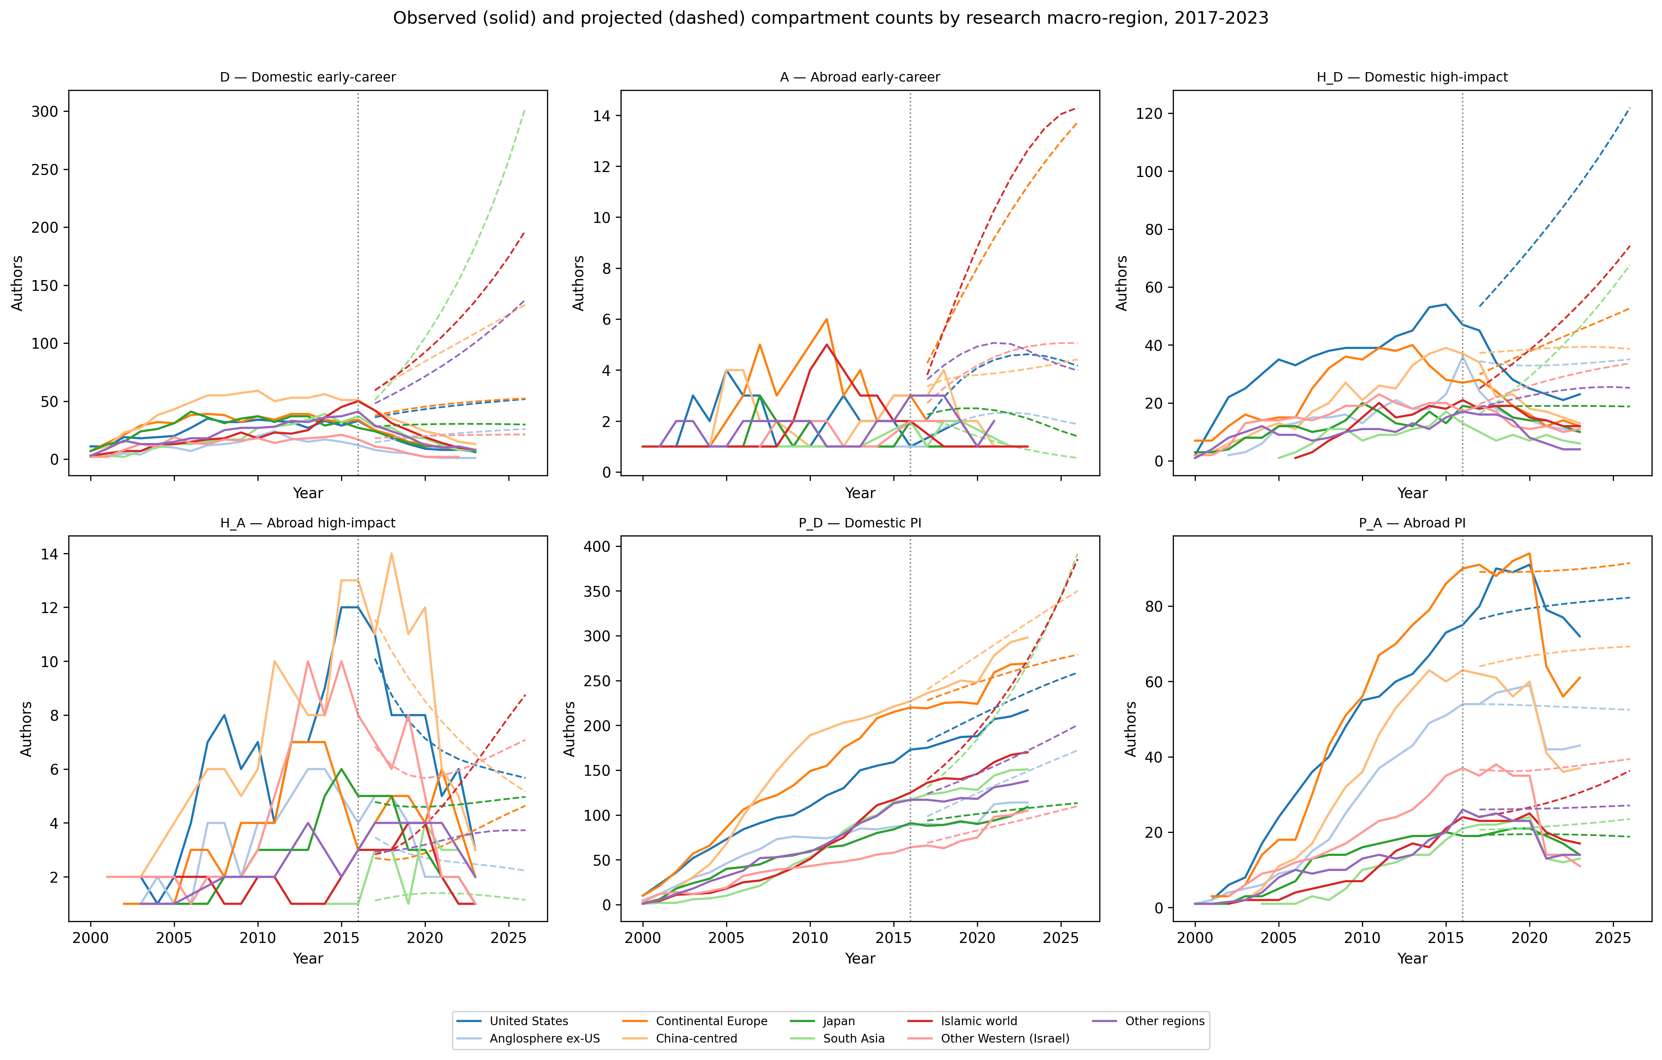
Supplementary Figure S3: Observed vs projected compartment counts
Solid lines are observed counts; dashed lines are 2017-2026 projections. The vertical dotted line is 2016.

Slide 25
Supplementary Table S4: Mean observed annual transition rates, 2000-2016
Group | α | β | h_D | p_D | d | I_total
Anglosphere ex-US | 0.06257351495456662 | 0.10983429271246005 | 0.1357868295252049 | 0.17054184438464143 | 0.0177512599059688 | 13.647058823529411
China-centred | 0.027905505739057253 | 0.10134825763533387 | 0.0776746225605149 | 0.13865034669762127 | 0.0101289753774419 | 25.647058823529413
Continental Europe | 0.04320086199356293 | 0.08781562773134019 | 0.1050959325754213 | 0.19507818104249897 | 0.0097869320416158 | 24.647058823529413
Islamic world | 0.059551279467679415 | 0.16517127244171212 | 0.08822724203490051 | 0.1761728064576239 | 0.0092400675248618 | 14.470588235294118
Japan | 0.040827110546142326 | 0.17372205509502958 | 0.0935818272053857 | 0.16571153170133315 | 0.0213310501604 | 12.058823529411764
Other Western (Israel) | 0.06258196478145325 | 0.09879833832937603 | 0.13389076254805155 | 0.10886142795349953 | 0.0150047950311889 | 9.823529411764707
Other regions | 0.047169799706557825 | 0.15948227802671436 | 0.08658427633805578 | 0.1487145205206578 | 0.0189773167626335 | 13.705882352941176
South Asia | 0.06285240811030914 | 0.1900675141851612 | 0.0859360250526997 | 0.1935221333247649 | 0.007418410701362299 | 12.117647058823529
United States | 0.04167518846310302 | 0.08183892379618432 | 0.13608500730240958 | 0.16000400559013017 | 0.0115999823367656 | 23.294117647058822

Slide 26
Supplementary Table S5: Top origin-destination abroad author-year pairs
Origin | Destination | Author-years
United States | China-centred | 326
Continental Europe | United States | 221
United States | Anglosphere ex-US | 176
Anglosphere ex-US | Continental Europe | 170
Continental Europe | Anglosphere ex-US | 167
China-centred | United States | 159
China-centred | Anglosphere ex-US | 157
Anglosphere ex-US | China-centred | 152
Japan | China-centred | 152
United States | Other Western (Israel) | 146

Slide 27
Supplementary Table S2: Projection accuracy by research macro-region, 2017-2023
Group | RMSE | MAPE | direction_agreement | threshold_alarm_accuracy | threshold_alarm_sensitivity | threshold_alarm_specificity | threshold_alarm_precision | threshold_alarms_obs | threshold_alarms_proj
Anglosphere ex-US | 14.97 | 159.5% | 0.5277777777777778 | 1.0 | nan | 1.0 | nan | 0.0 | 0.0
Continental Europe | 18.73 | 137.6% | 0.3333333333333333 | 1.0 | nan | 1.0 | nan | 0.0 | 0.0
South Asia | 52.11 | 201.3% | 0.4722222222222222 | 1.0 | nan | 1.0 | nan | 0.0 | 0.0
Islamic world | 42.66 | 233.7% | 0.25 | 1.0 | nan | 1.0 | nan | 0.0 | 0.0
Japan | 8.16 | 74.8% | 0.6388888888888888 | 1.0 | nan | 1.0 | nan | 0.0 | 0.0
Other regions | 27.84 | 154.9% | 0.4722222222222222 | 1.0 | nan | 1.0 | nan | 0.0 | 0.0
Other Western (Israel) | 11.57 | 201.9% | 0.4166666666666667 | 1.0 | nan | 1.0 | nan | 0.0 | 0.0
China-centred | 29.28 | 104.1% | 0.4166666666666667 | 1.0 | nan | 1.0 | nan | 0.0 | 0.0
United States | 25.26 | 133.7% | 0.5 | 1.0 | nan | 1.0 | nan | 0.0 | 0.0

Slide 28
Supplementary Table S3: Projection accuracy by compartment, 2017-2023
Compartment | RMSE | MAPE | direction_agreement
A | 4.45 | 256.1% | 0.7037037037037037
D | 56.60 | 442.3% | 0.074074074074074
H_A | 2.09 | 45.7% | 0.6851851851851852
H_D | 24.68 | 143.7% | 0.2407407407407407
P_A | 12.21 | 30.6% | 0.5
P_D | 32.68 | 16.0% | 0.4814814814814814

Slide 29
Supplementary Table S6: Bootstrap 95% CI
Group | T median | T 95% CI | P_D mean | P_D 95% CI
Anglosphere ex-US | 57460 | [56692, 58061] | 25801 | [25154, 26345]
Continental Europe | 172433 | [171191, 173627] | 75531 | [74446, 76593]
South Asia | 50534 | [49394, 51488] | 28261 | [27346, 29182]
Islamic world | 73447 | [72351, 74502] | 36927 | [35927, 37819]
Japan | 26382 | [25978, 26816] | 6420 | [6161, 6728]
Other regions | 56514 | [55876, 57346] | 19287 | [18809, 19861]
Other Western (Israel) | 4238 | [4003, 4460] | 1865 | [1681, 2054]
China-centred | 279924 | [278113, 282145] | 128708 | [127109, 130687]
United States | 120403 | [119426, 121245] | 52998 | [52252, 53680]

