Slide 1
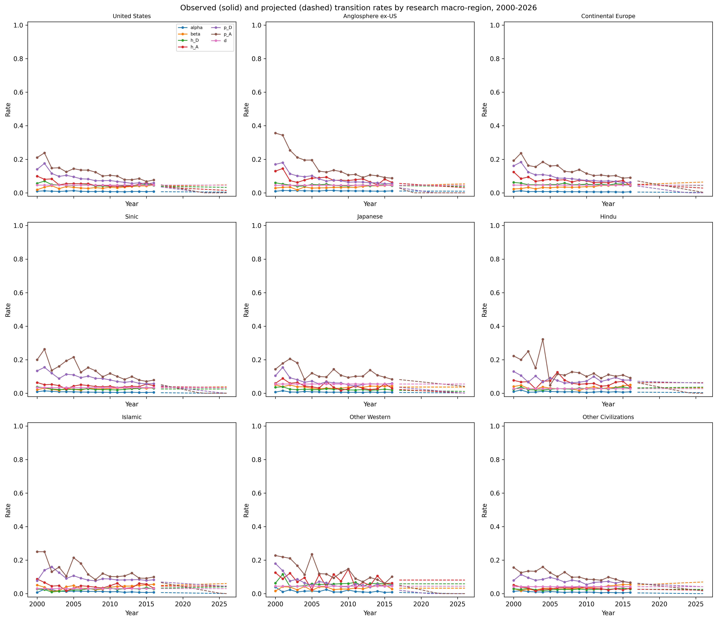
Figure 1. Annual observed and projected transition rates per civilisation
Observed rates (2000-2016) and projected rates (2017-2026) for the six ODE transition parameters, estimated per civilisation. Unreliable trends are replaced by the historical mean.

Slide 2
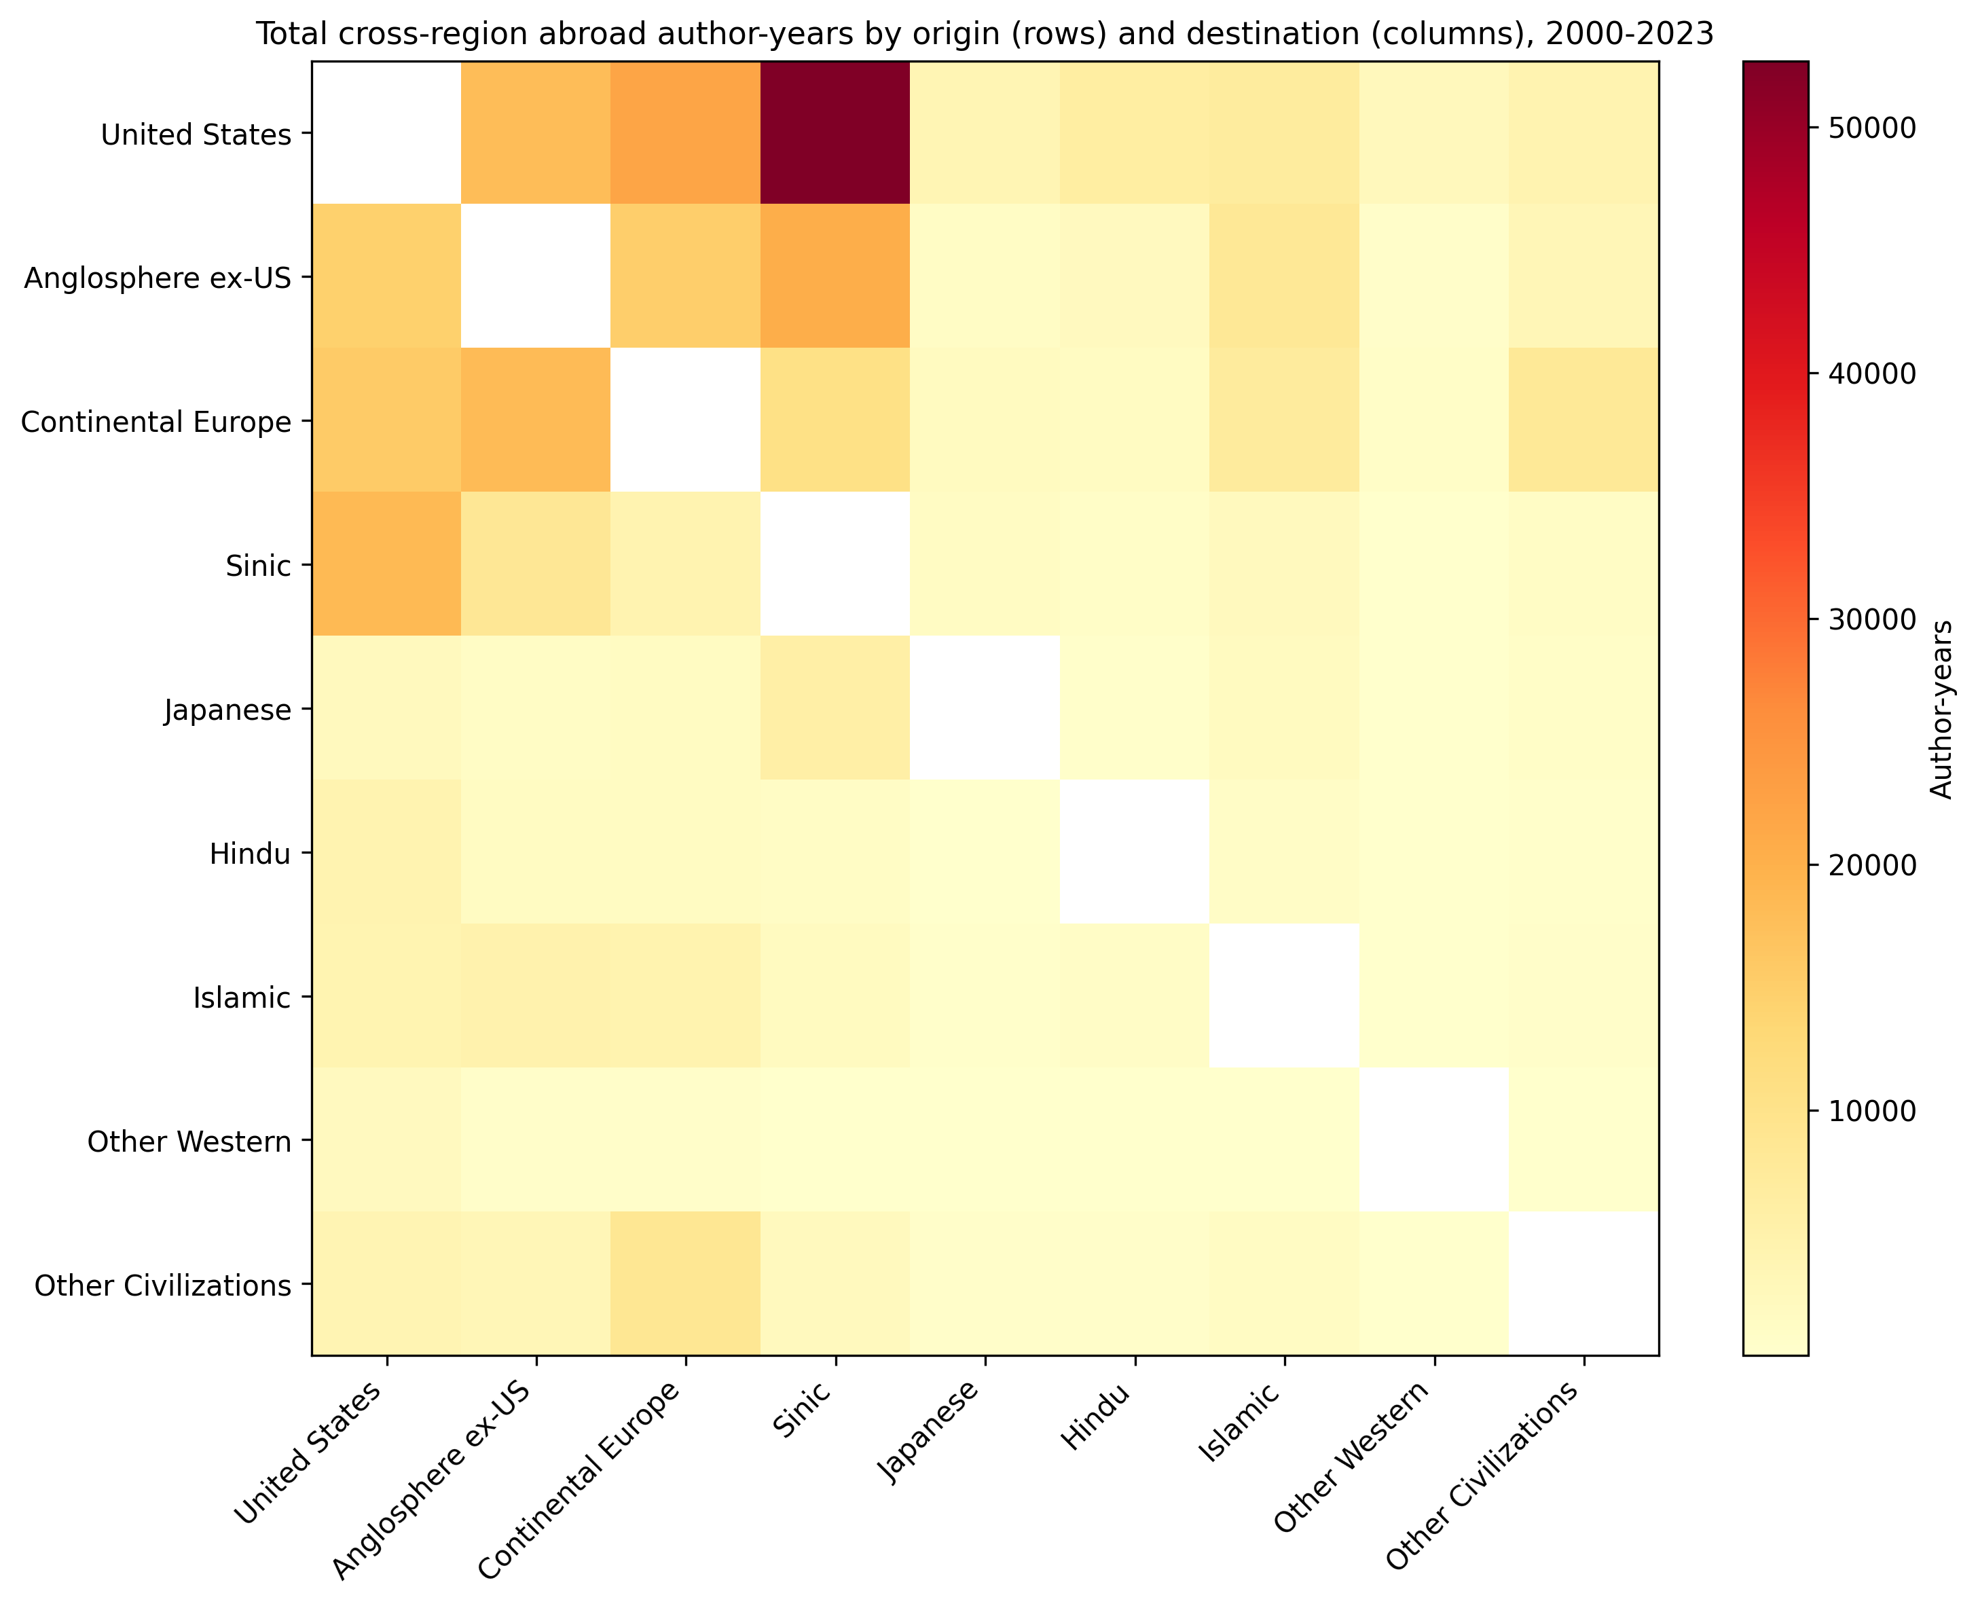
Figure 2. Inter-civilisation abroad stock (origin x destination)
Total abroad author-years accumulated by origin (rows) and destination (columns) civilisation, 2000-2023. Destination is inferred from recent_group during years classified as abroad.

Slide 3
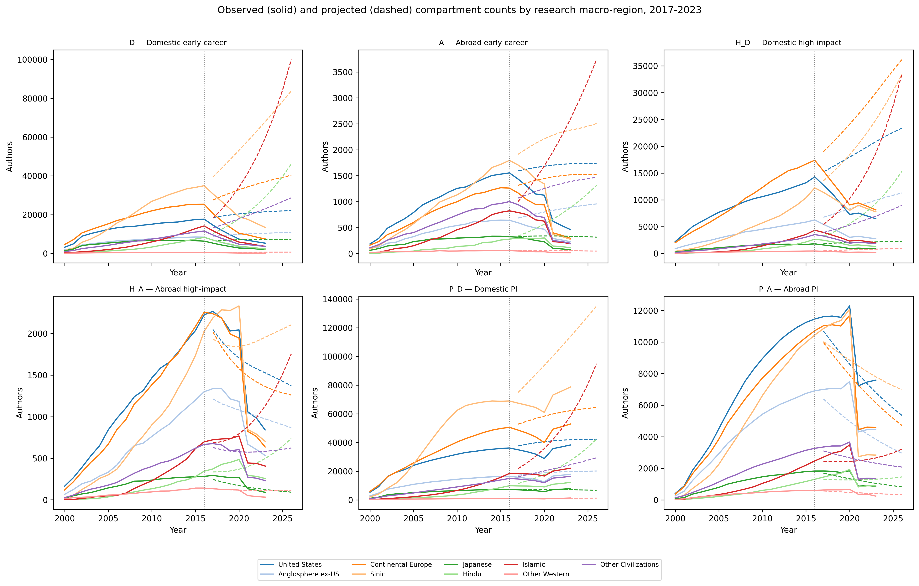
Figure 3. Observed vs projected annual compartment counts
2017-2023 observed counts (solid) and projections from the 2000-2016 model (dashed). The vertical dotted line marks 2016, the end of the training window.

