Slide 1
AI researchers as the next coal: transition rates, minimum viable research communities and the preservation of variety in global AI/ML
Data-driven manuscript figures and tables

Slide 2
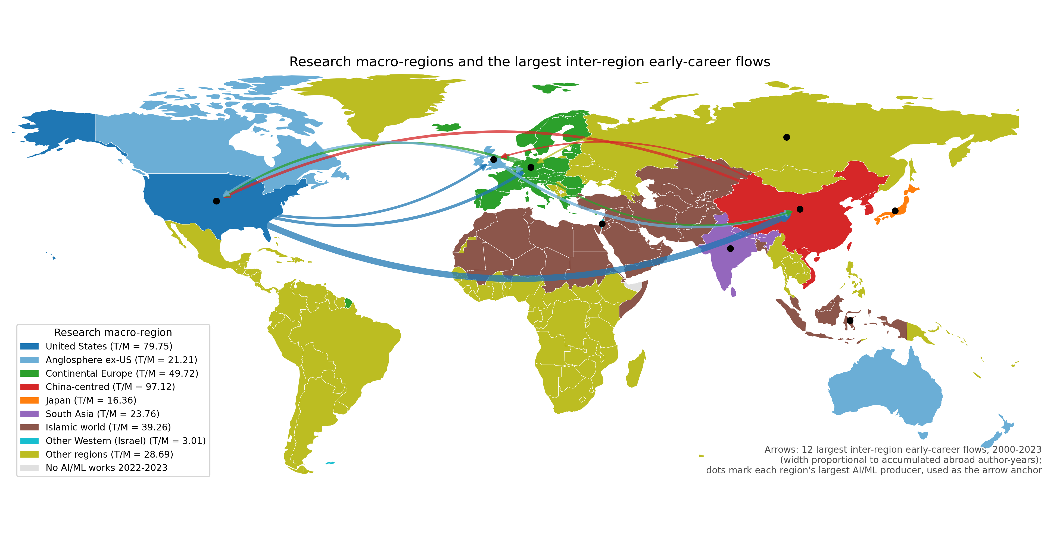
Figure 1: Research macro-regions and inter-region flows
Countries coloured by research macro-region; arrows show the 12 largest observed inter-region early-career flows (width proportional to accumulated abroad author-years). Legend gives equilibrium T/M.

Slide 3
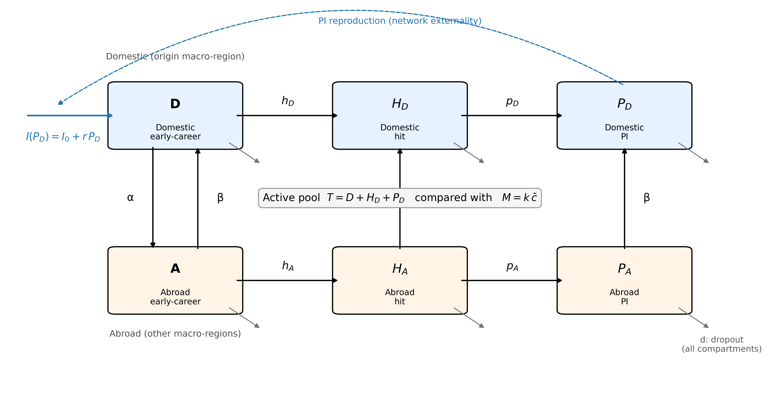
Figure 2: Compartment model (image)
Six compartments per macro-region with transition rates, endogenous recruitment from the domestic PI stock, dropout from every compartment and the threshold test T versus M.

Slide 4
Figure 2 (editable shapes): Compartment model
Inflow I(P_D) = I_0 + r·P_D
r (feedback)
D
Domestic early-career
H_{D}
Domestic hit
P_{D}
Domestic PI
h_D
p_D
α ↓ β ↑
β
β
Active pool T = D + H_D + P_D compared with M = k·c̄; d = dropout from every compartment
A
Abroad early-career
H_{A}
Abroad hit
P_{A}
Abroad PI
h_A
p_A

Slide 5
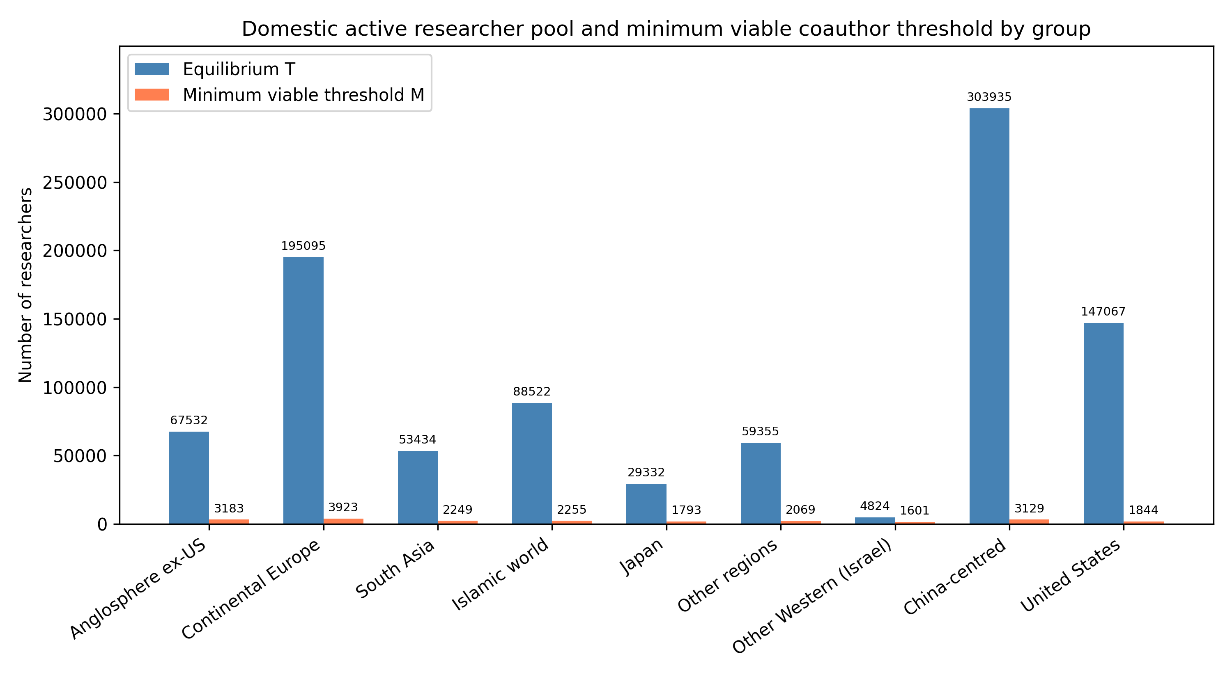
Figure 3: Equilibrium T vs minimum viable threshold
Blue bars: equilibrium T; orange bars: threshold M. All groups remain above the threshold, but margins vary widely.

Slide 6
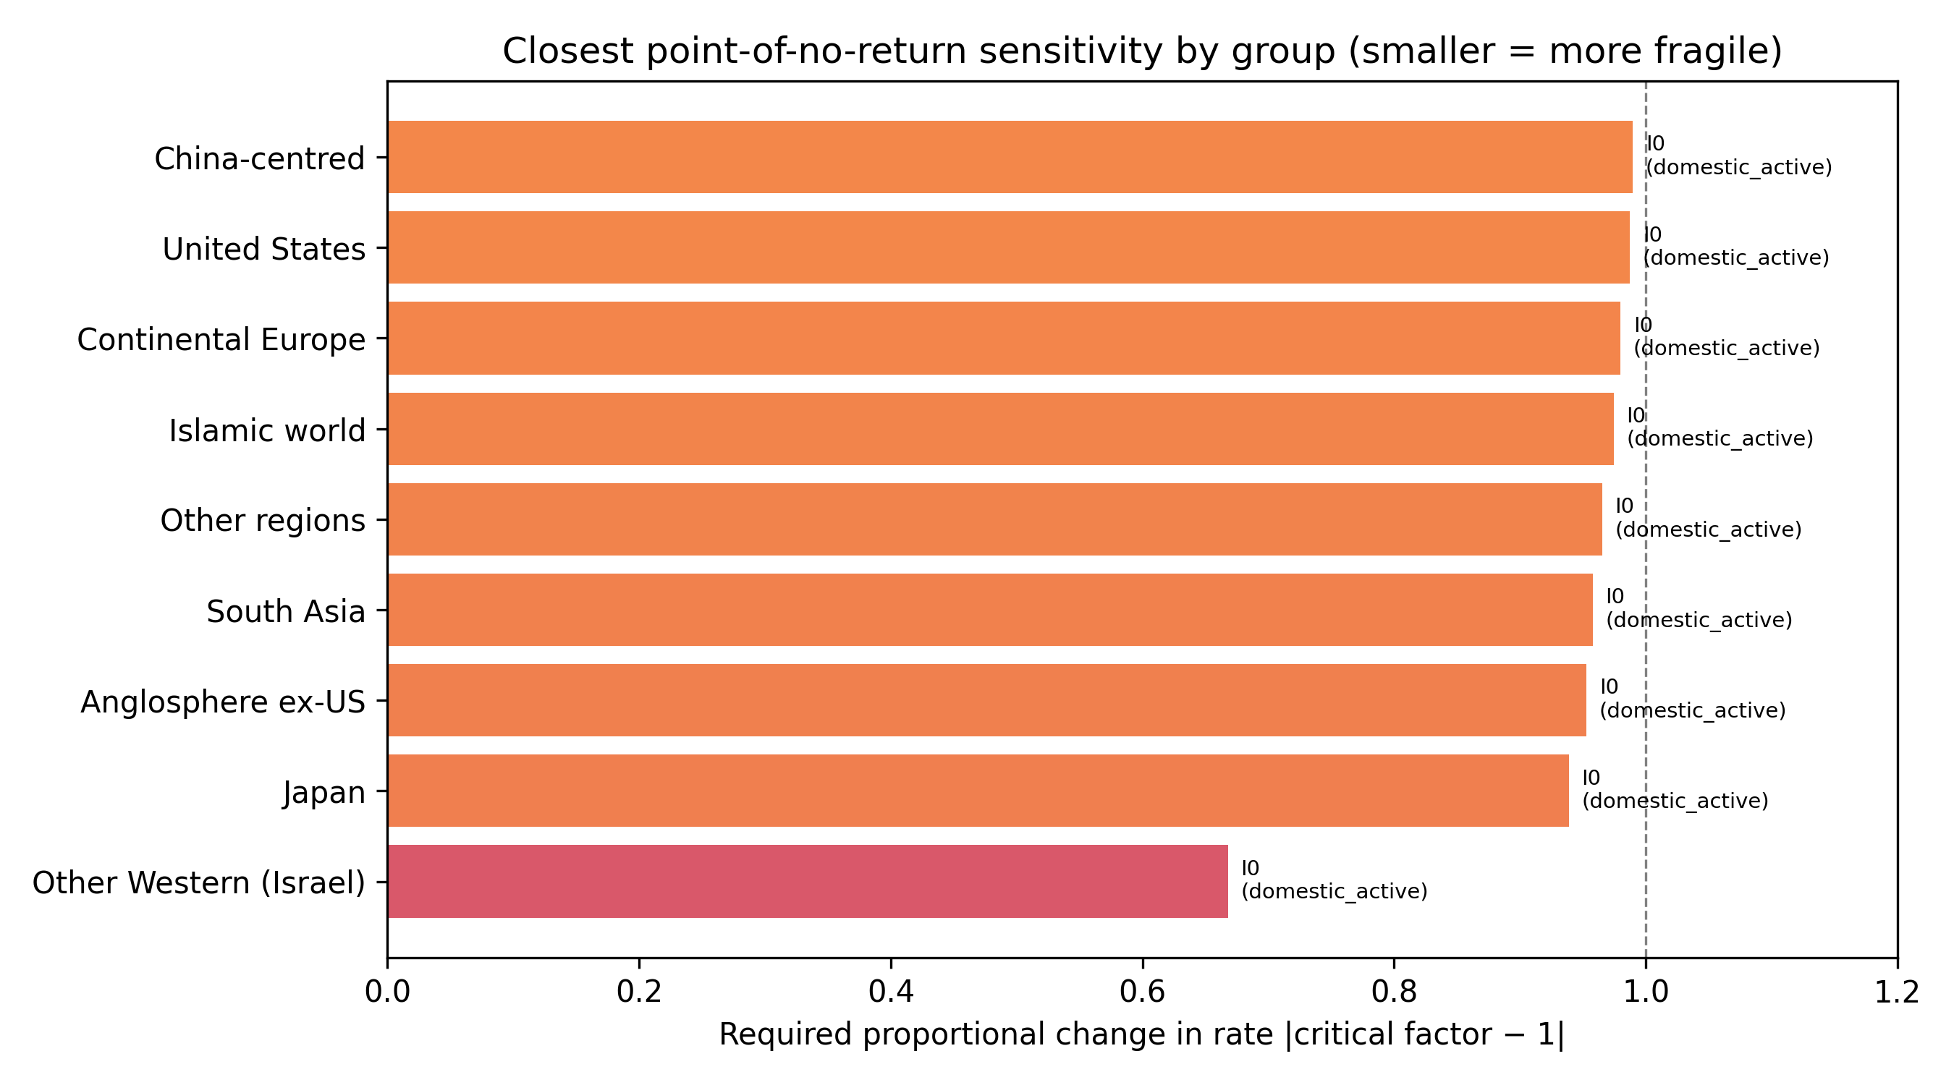
Figure 4: Closest point-of-no-return proximity
Smaller values mean a smaller proportional change in the listed rate is required to reach the threshold for the stated target pool.

Slide 7
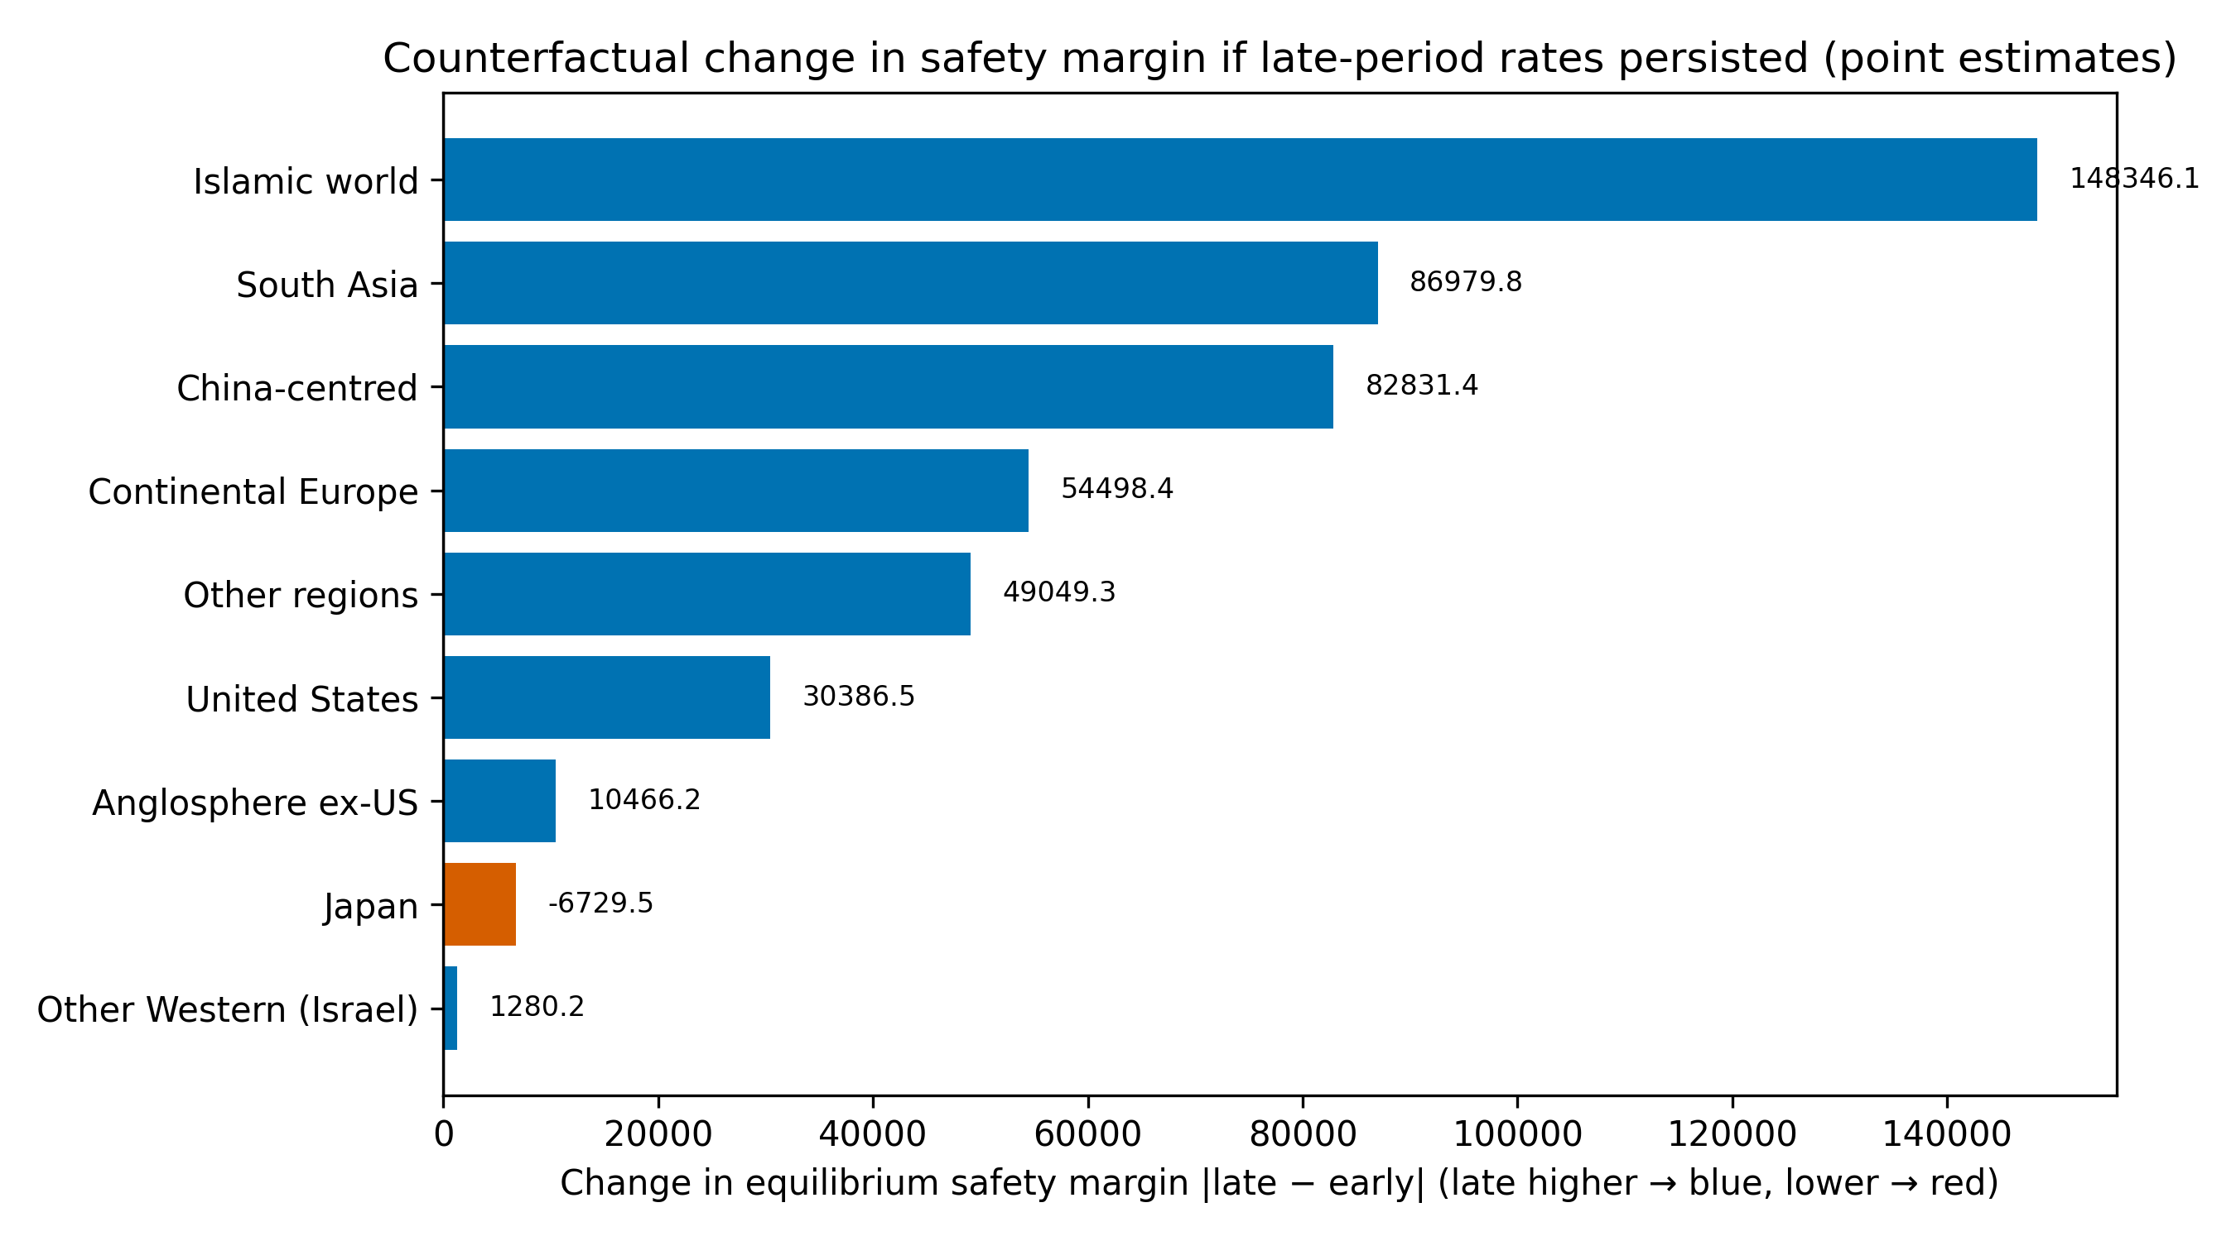
Figure 5: Historical counterfactual margin change
Positive values mean the late-window rates would produce a larger safety margin than the early-window rates if they persisted; negative values mean the margin would shrink. The comparison is across point estimates; uncertainty is substantial.

Slide 8
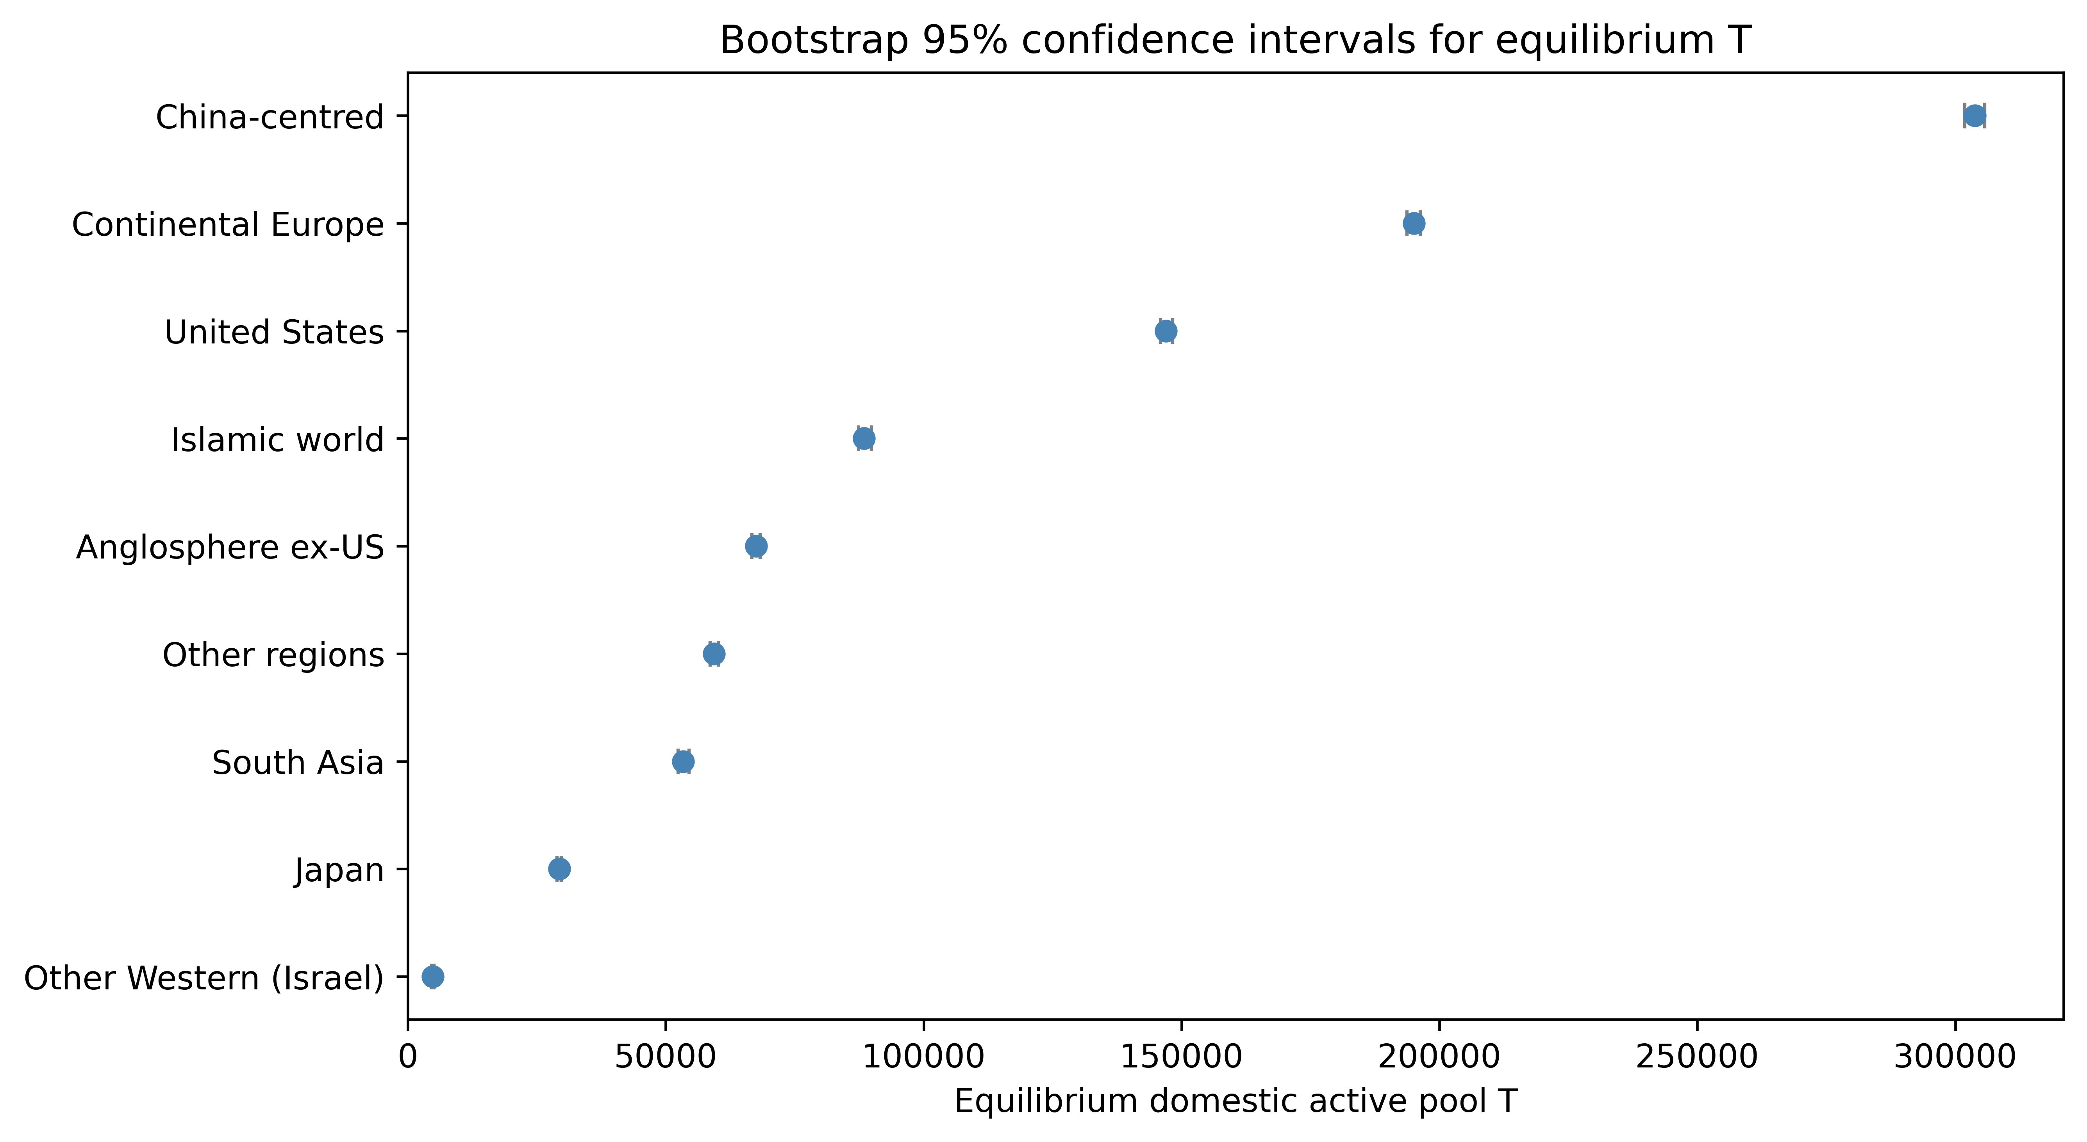
Figure 6: Bootstrap 95% CI for equilibrium T
Intervals are asymmetric and wide, reflecting model uncertainty.

Slide 9
Table 1: Descriptive cohort statistics
Group | n | works | active | hits | pis | career_start_mean | abroad
Anglosphere ex-US | 64122 | 700342 | 28218 | 35822 | 43628 | 2007.3 | 16233
China-centred | 190051 | 1589023 | 103673 | 61738 | 140701 | 2008.7 | 23956
Continental Europe | 168911 | 1766329 | 74004 | 90322 | 111466 | 2008.0 | 26060
Islamic world | 51043 | 387001 | 29703 | 20435 | 35558 | 2011.4 | 8131
Japan | 32007 | 293437 | 11846 | 9915 | 18543 | 2006.7 | 4417
Other Western (Israel) | 4397 | 49748 | 1981 | 2646 | 2848 | 2007.4 | 1414
Other regions | 50240 | 371952 | 23671 | 17128 | 32449 | 2009.2 | 9136
South Asia | 28069 | 225684 | 17047 | 12043 | 19185 | 2011.3 | 4289
United States | 134807 | 1298250 | 58969 | 74972 | 91029 | 2007.3 | 27420

Slide 10
Table 2: Equilibrium and inflow parameters
Group | T_eq | M | Margin | T/M | I0 | r | r_obs | r_crit
Anglosphere ex-US | 67532 | 3183 | 64348 | 1885.94 | 0 | 0.08646 | 0.12652 | 21.21312
Continental Europe | 195095 | 3923 | 191172 | 4967.97 | 0 | 0.08914 | 0.11899 | 49.72481
South Asia | 53434 | 2249 | 51185 | 825.56 | 0 | 0.08606 | 0.05457 | 23.76054
Islamic world | 88522 | 2255 | 86267 | 1501.26 | 0 | 0.08444 | 0.06352 | 39.26079
Japan | 29332 | 1793 | 27539 | 1134.41 | 0 | 0.10154 | 0.25545 | 16.36230
Other regions | 59355 | 2069 | 57286 | 1477.65 | 0 | 0.09108 | 0.13240 | 28.68812
Other Western (Israel) | 4824 | 1601 | 3223 | 129.32 | 0 | 0.09082 | 0.11984 | 3.01286
China-centred | 303935 | 3129 | 300805 | 5589.74 | 0 | 0.07946 | 0.08399 | 97.12154
United States | 147067 | 1844 | 145223 | 3964.91 | 0 | 0.08711 | 0.12404 | 79.75137

Slide 11
Table 3: Top transition-rate elasticities
Group | 1st | el1 | 2nd | el2 | 3rd | el3
Anglosphere ex-US | d | -2.680 | h_D | 0.466 | p_D | 0.341
China-centred | d | -2.685 | h_D | 0.397 | p_D | 0.257
Continental Europe | d | -2.681 | h_D | 0.393 | p_D | 0.355
Islamic world | d | -2.579 | h_D | 0.373 | p_D | 0.220
Japan | d | -2.274 | h_D | 0.393 | p_D | 0.274
Other Western (Israel) | d | -2.744 | h_D | 0.373 | p_D | 0.352
Other regions | d | -2.790 | h_D | 0.486 | p_D | 0.314
South Asia | d | -2.535 | h_D | 0.341 | p_D | 0.212
United States | d | -2.665 | h_D | 0.445 | p_D | 0.357

Slide 12
Table 4: Closest point of no return
Group | Target | Rate | Current | Crit.factor | Proximity
Other Western (Israel) | domestic_active | I0 | 129.3235 | 0.332 | 0.668
Japan | domestic_active | I0 | 1134.4064 | 0.061 | 0.939
Anglosphere ex-US | domestic_active | I0 | 1885.9412 | 0.047 | 0.953
South Asia | domestic_active | I0 | 825.5588 | 0.042 | 0.958
Other regions | domestic_active | I0 | 1477.6471 | 0.035 | 0.965
Islamic world | domestic_active | I0 | 1501.2647 | 0.025 | 0.975
Continental Europe | domestic_active | I0 | 4967.9706 | 0.020 | 0.980
United States | domestic_active | I0 | 3964.9118 | 0.013 | 0.987
China-centred | domestic_active | I0 | 5589.7353 | 0.010 | 0.990

Slide 13
Table 5: Saturating inflow extension
Group | Linear T | Saturating T | ε
Anglosphere ex-US | 67532 | 67532 | 0.00000
Continental Europe | 195095 | 195095 | 0.00000
South Asia | 53434 | 53434 | 0.00001
Islamic world | 88522 | 88522 | 0.00001
Japan | 29332 | 29332 | 0.00001
Other regions | 59355 | 59355 | 0.00001
Other Western (Israel) | 4824 | 4824 | 0.00007
China-centred | 303935 | 303935 | 0.00000
United States | 147067 | 147067 | 0.00000

Slide 14
Table 6: Historical counterfactual
Group | n_early | n_late | T early | T late | delta_T | ΔT (%) | M_early | M_late | Margin early | Margin late | Δ margin
Anglosphere ex-US | 43768 | 20354 | 64779 | 75245 | 10466.24081387803 | 16.2 | 3183.492021276596 | 3183.492021276596 | 61596 | 72062 | 10466.2
Continental Europe | 108135 | 60776 | 177460 | 231958 | 54498.35893829615 | 30.7 | 3923.499485066941 | 3923.499485066941 | 173536 | 228035 | 54498.4
South Asia | 9597 | 18472 | 23397 | 110377 | 86979.76895846531 | 371.8 | 2248.8695652173915 | 2248.8695652173915 | 21148 | 108128 | 86979.8
Islamic world | 17844 | 33199 | 37899 | 186245 | 148346.09206152224 | 391.4 | 2254.7179487179487 | 2254.7179487179487 | 35644 | 183990 | 148346.1
Japan | 23436 | 8571 | 31781 | 25052 | -6729.546240558848 | -21.2 | 1792.6470588235293 | 1792.6470588235293 | 29989 | 23259 | -6729.5
Other regions | 26938 | 23302 | 42881 | 91930 | 49049.28906658018 | 114.4 | 2068.969696969697 | 2068.969696969697 | 40812 | 89861 | 49049.3
Other Western (Israel) | 2932 | 1465 | 4450 | 5731 | 1280.2210739433294 | 28.8 | 1601.2173913043478 | 1601.2173913043478 | 2849 | 4129 | 1280.2
China-centred | 122490 | 67561 | 278159 | 360991 | 82831.4132198458 | 29.8 | 3129.4270557029176 | 3129.4270557029176 | 275030 | 357861 | 82831.4
United States | 92684 | 42123 | 139401 | 169788 | 30386.48166319204 | 21.8 | 1844.0637813211845 | 1844.0637813211845 | 137557 | 167943 | 30386.5

Slide 15
Table 7: Top policy intervention
Group | Lever | Direction | Change (%) | Margin gain | Gain per 10%
Anglosphere ex-US | d | decrease | -10 | 7660 | 7659.7
Continental Europe | d | decrease | -10 | 22093 | 22093.1
South Asia | d | decrease | -10 | 6184 | 6184.2
Islamic world | d | decrease | -10 | 10239 | 10238.9
Japan | d | decrease | -10 | 3194 | 3193.8
Other regions | d | decrease | -10 | 6723 | 6723.1
Other Western (Israel) | d | decrease | -10 | 567 | 567.3
China-centred | d | decrease | -10 | 34739 | 34739.2
United States | d | decrease | -10 | 16560 | 16560.4

Slide 16
Table 9: Transition levers, policy instruments and principal actors
Lever | Policy instrument | Management action
Dropout (d) | Early-career fellowships, childcare and dual-career support, stable non-tenure tracks | Retain researchers in the domestic pipeline beyond the first career years
Exogenous entry (I_0) | Research-master and undergraduate pipelines, doctoral fellowships, recruitment visas | Widen the base of incoming researchers before they select a field or location
Return from abroad (β) | Return grants, diaspora networks, dual appointments, overseas-experience recognition | Encourage mobile researchers to re-establish domestic research groups
Domestic hit generation (h_D) | Independent-lab programmes (e.g. SPREAD-style), doctoral/postdoctoral training, compute access | Translate junior capacity into visible, high-impact work and independent research lines
PI promotion (p_D) | Tenure-track conversion, startup packages, project-based PI status | Create durable principal-investigator positions that train the next cohort

Slide 17
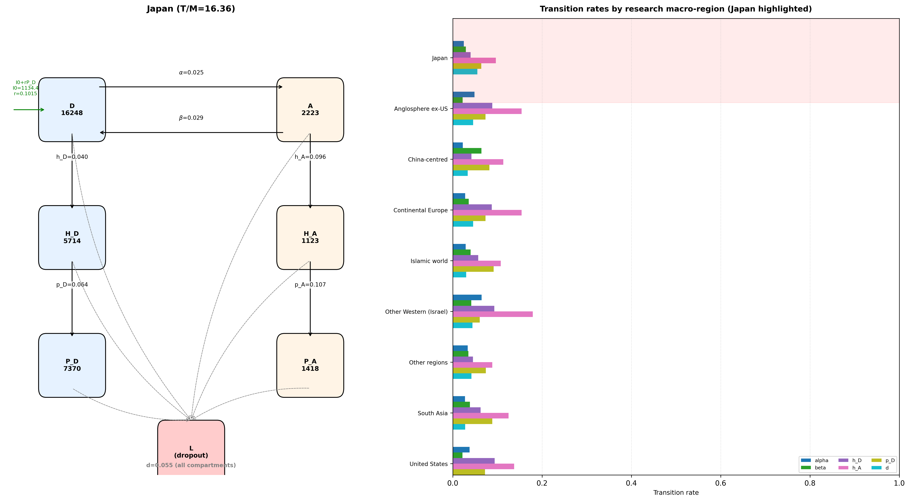
Figure 7: Japan compartment model and cross-region transition-rate ladders
Left: Japan's six compartments; right: Japan highlighted against other macro-regions on each transition rate.

Slide 18
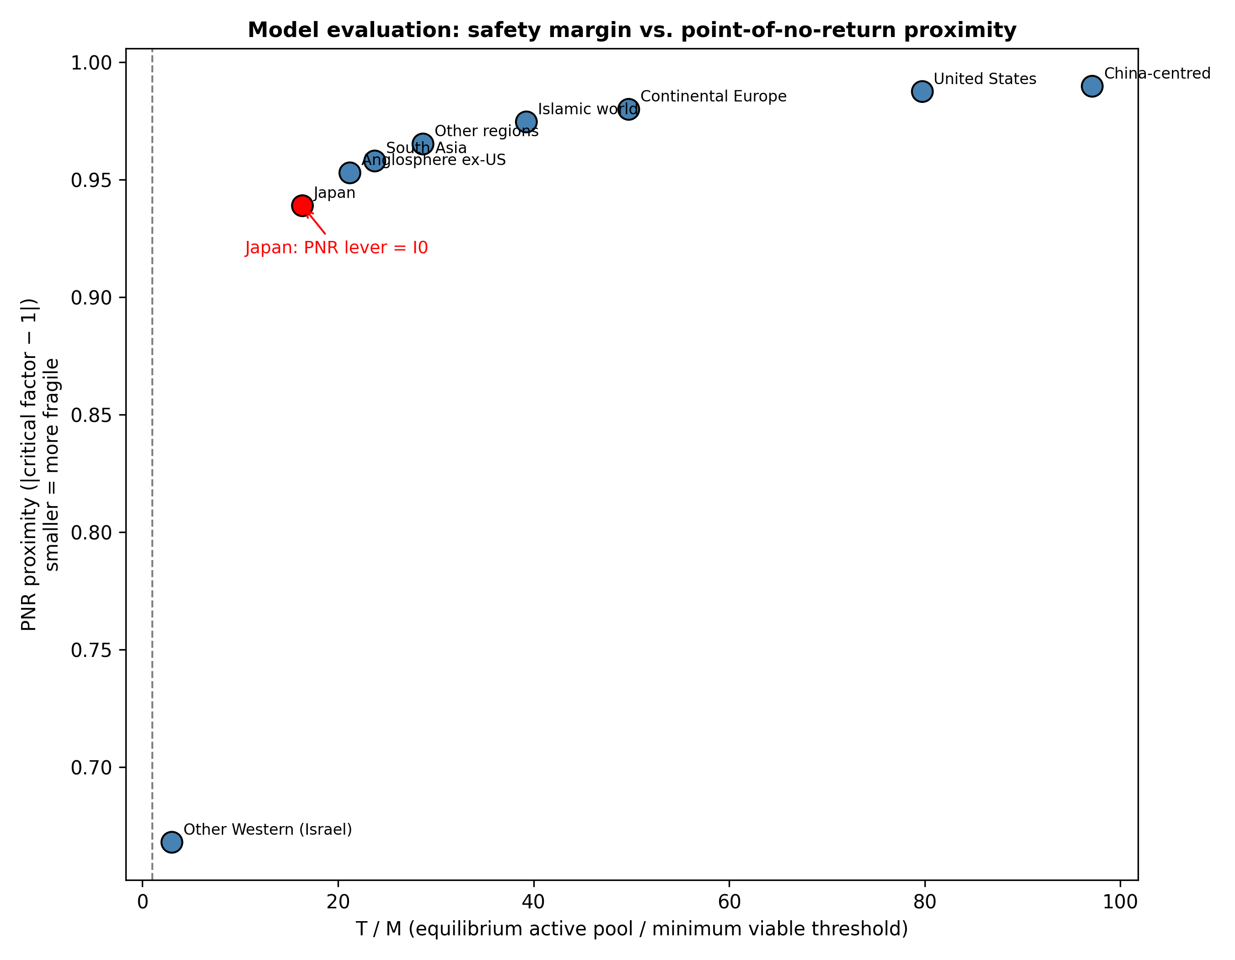
Figure 8: T/M safety margin versus closest PNR proximity
Lower-left points are the most fragile. Japan is highlighted in red.

Slide 19
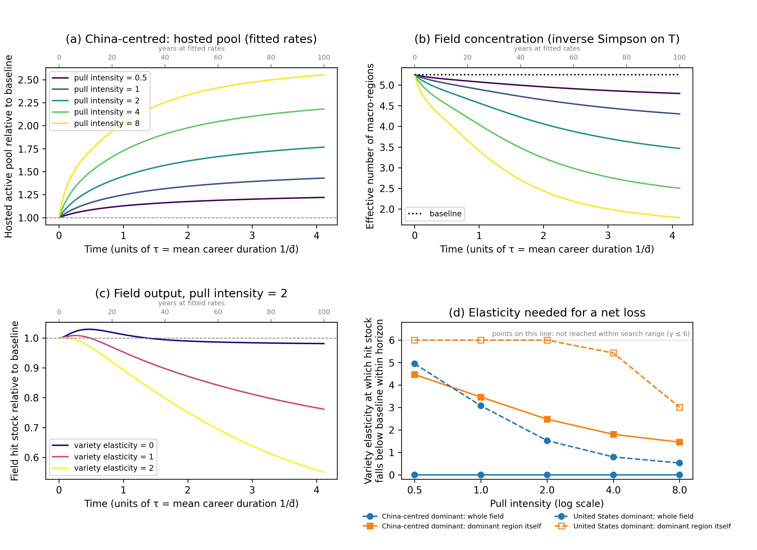
Figure 9: Talent-concentration scenario (coupled nine-region model)
(a) hosted pool of the dominant region; (b) effective number of macro-regions; (c) field hit stock for three variety elasticities; (d) elasticity threshold for a net loss. Pull intensity and variety elasticity are stylised.

Slide 20
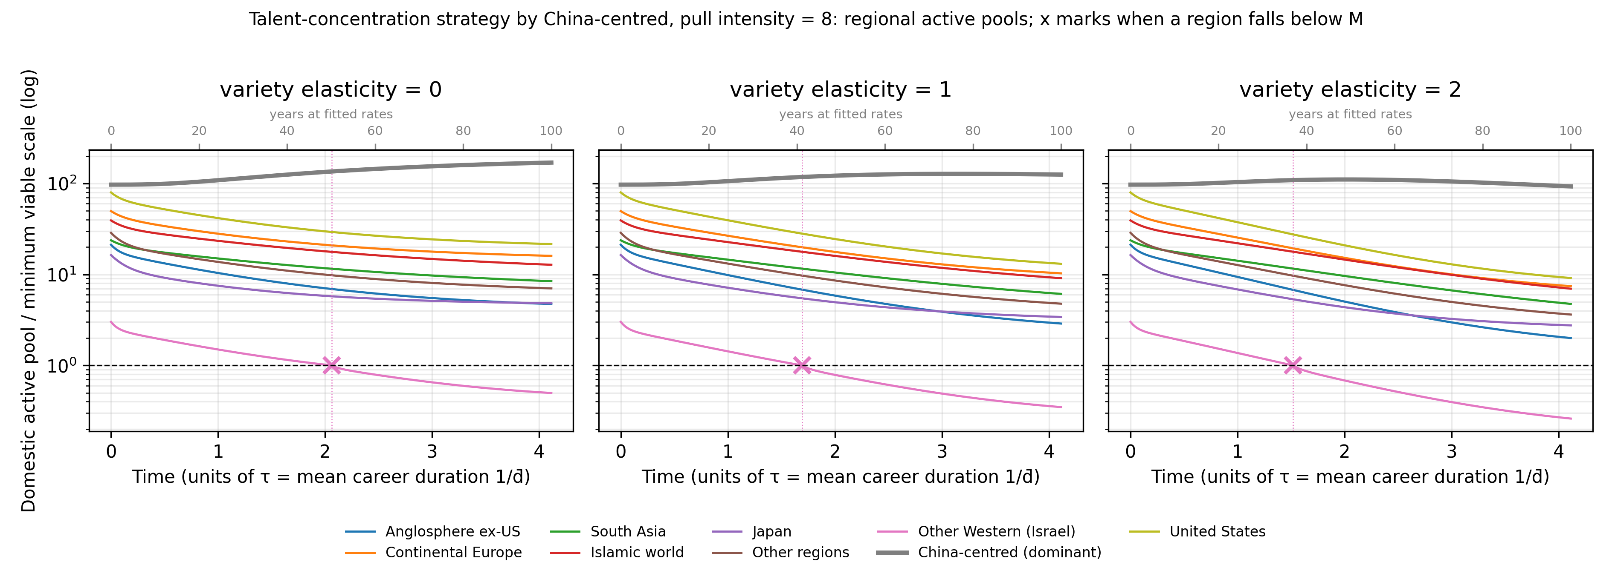
Figure 10: Regional time paths under the talent-concentration strategy
Domestic active pool of each macro-region as a multiple of its minimum viable scale M, one panel per variety elasticity; time in units of the characteristic time τ = 1/d̄; crosses mark when a region falls below M and loses PI-driven recruitment permanently.

Slide 21
Table 8: Talent-concentration scenario at the end of the horizon (fitted rates, γ = 0)
Dominant region | Pull intensity φ | Hosted pool at end of horizon (× baseline) | Share of hosted researchers at end of horizon (%) | Effective number of regions at end of horizon | Regions below M | Field hit stock at end of horizon (× baseline) | γ* field | γ* dominant region
China-centred | 0.5 | 1.22 | 37 | 4.8 | 0 | 1.00 | 0 (fitted model) | 4.47
China-centred | 1.0 | 1.43 | 43 | 4.3 | 0 | 0.99 | 0 (fitted model) | 3.46
China-centred | 2.0 | 1.77 | 53 | 3.5 | 0 | 0.98 | 0 (fitted model) | 2.48
China-centred | 4.0 | 2.18 | 66 | 2.5 | 0 | 0.96 | 0 (fitted model) | 1.80
China-centred | 8.0 | 2.55 | 77 | 1.8 | 1 | 0.94 | 0 (fitted model) | 1.45
United States | 0.5 | 1.46 | 24 | 5.2 | 0 | 1.03 | 4.95 | not reached
United States | 1.0 | 1.93 | 31 | 5.0 | 0 | 1.07 | 3.08 | not reached
United States | 2.0 | 2.76 | 43 | 4.5 | 0 | 1.13 | 1.52 | not reached
United States | 4.0 | 3.87 | 57 | 3.3 | 0 | 1.20 | 0.79 | 5.42
United States | 8.0 | 4.92 | 71 | 2.2 | 1 | 1.27 | 0.52 | 3.01

Slide 22
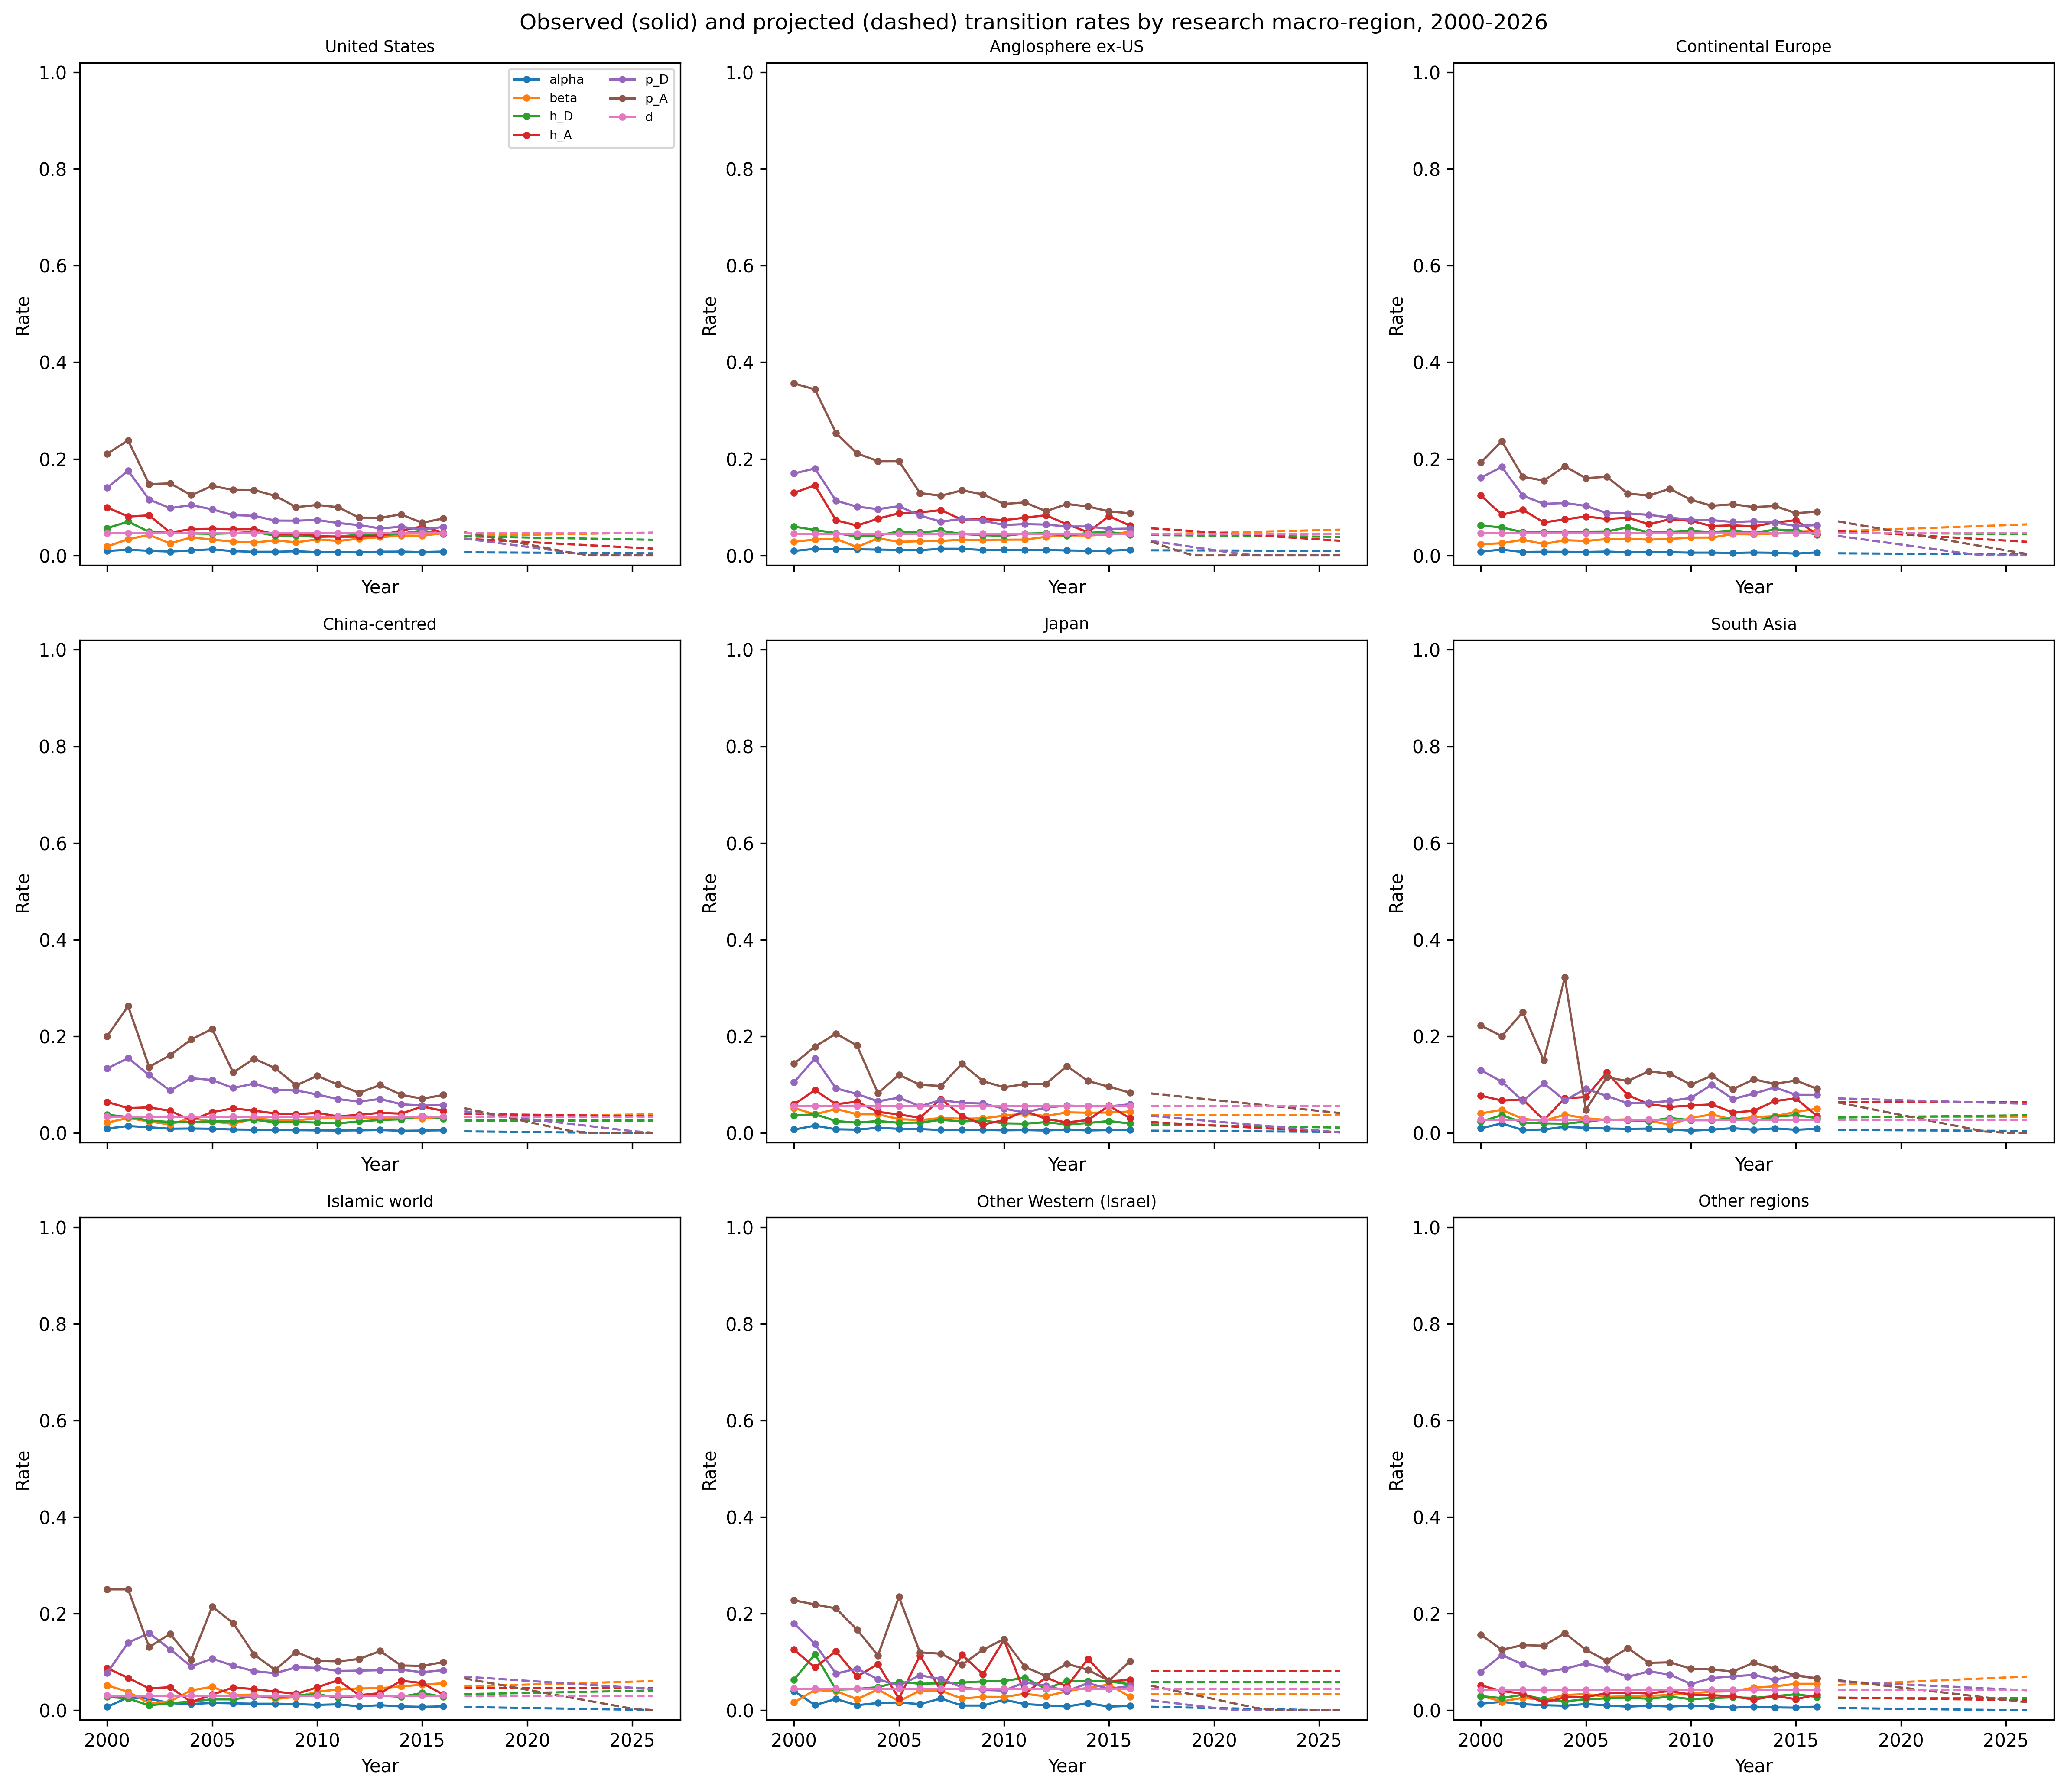
Supplementary Figure S1: Observed and projected transition rates
Solid lines mark observed 2000-2016 rates; dashed lines mark projected 2017-2026 rates.

Slide 23
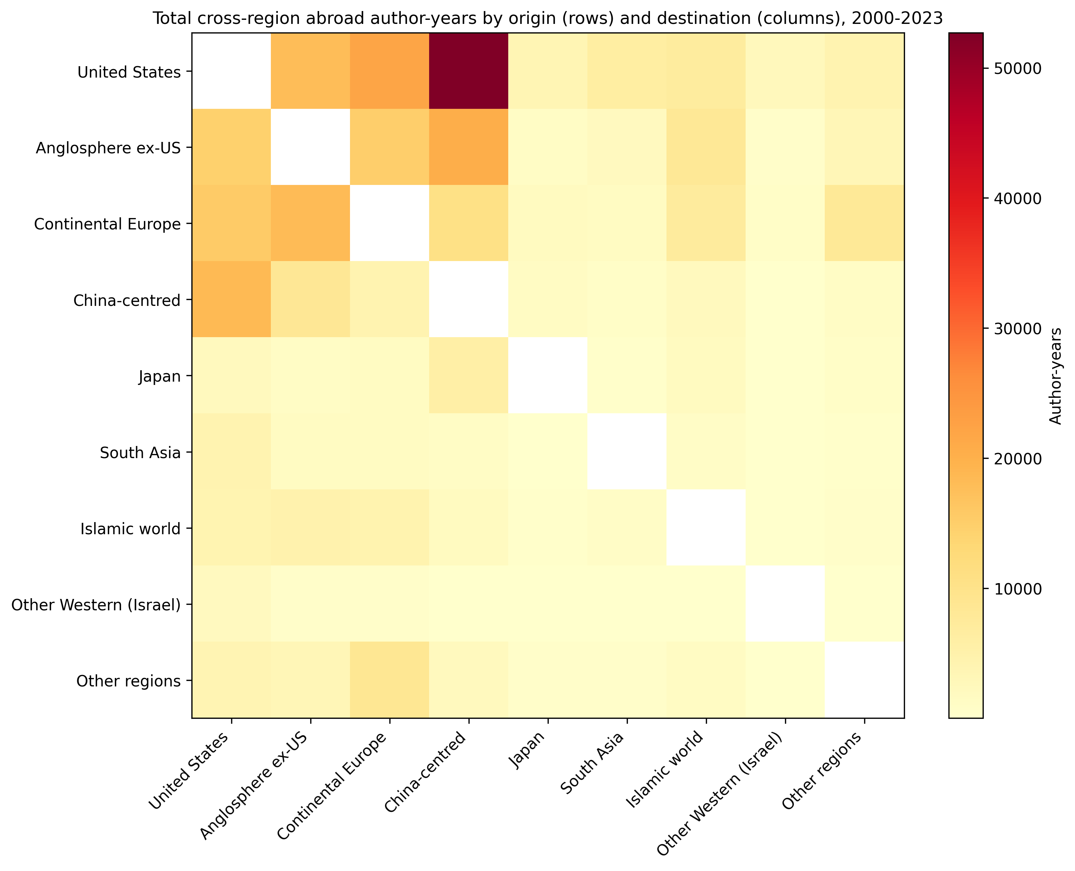
Supplementary Figure S2: Cross-region abroad author-years
Rows are origin macro-regions; columns are destination macro-regions approximated by recent_group. Same-region cells and Unknown destinations are excluded.

Slide 24
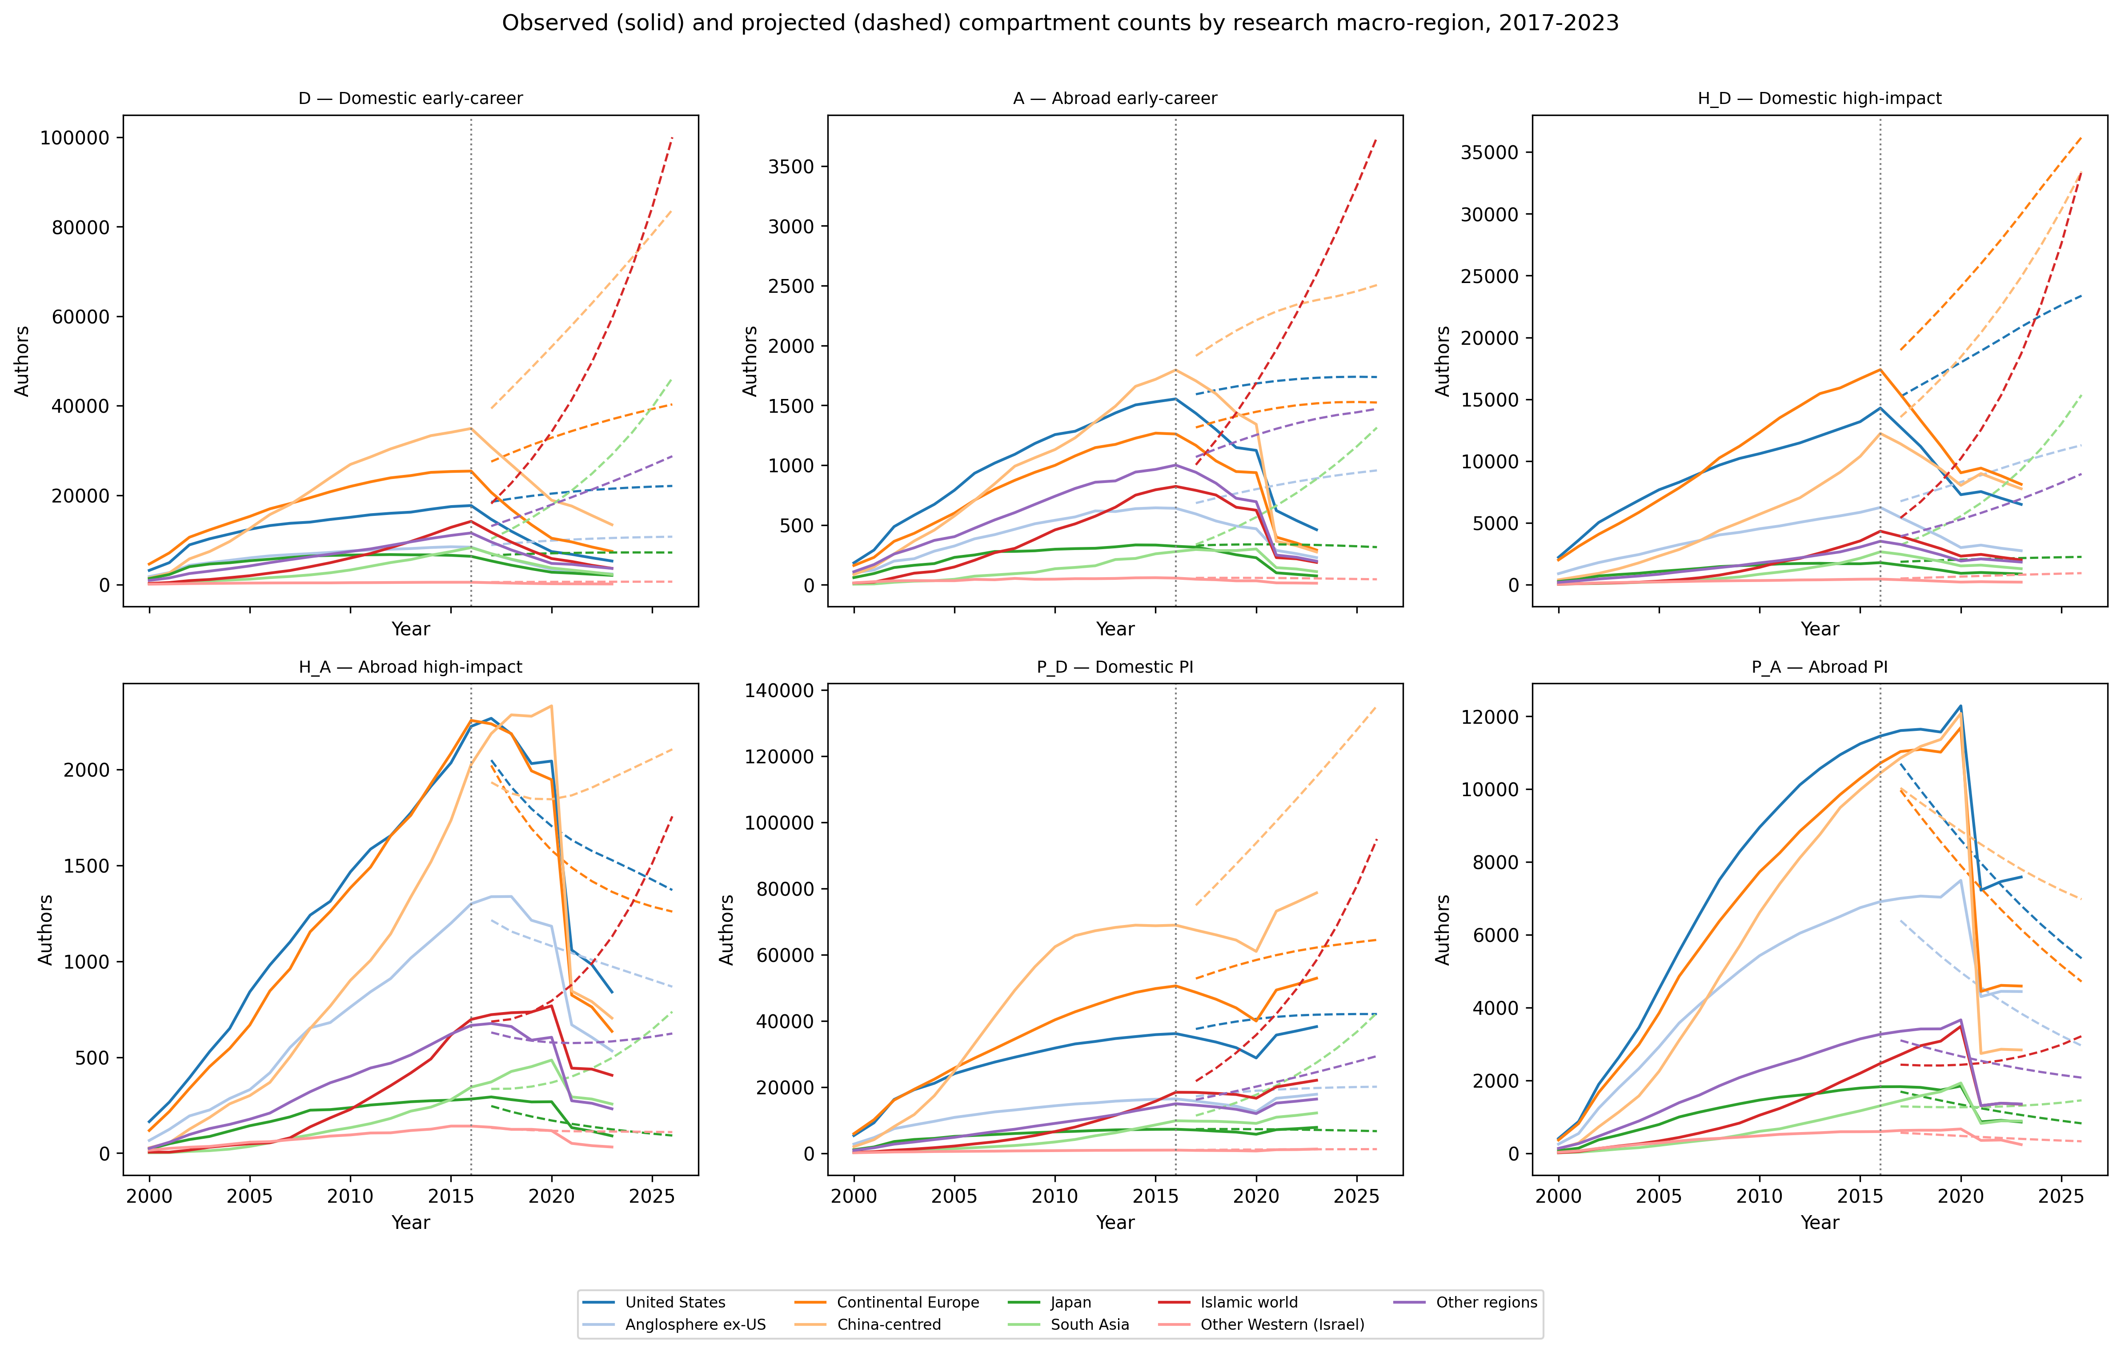
Supplementary Figure S3: Observed vs projected compartment counts
Solid lines are observed counts; dashed lines are 2017-2026 projections. The vertical dotted line is 2016.

Slide 25
Supplementary Table S4: Mean observed annual transition rates, 2000-2016
Group | α | β | h_D | p_D | d | I_total
Anglosphere ex-US | 0.011625124450015864 | 0.03411253799743315 | 0.04616211641533843 | 0.0873092000485382 | 0.0456012888273175 | 3771.8823529411766
China-centred | 0.0069463267399030824 | 0.027227975340917476 | 0.025975223591736964 | 0.09085321057400796 | 0.0336695344484046 | 11179.470588235294
Continental Europe | 0.006761991119387412 | 0.035799512585035644 | 0.05094340242156166 | 0.09422625853124332 | 0.0458472850546197 | 9935.941176470587
Islamic world | 0.012666046927368129 | 0.038401582840796256 | 0.025445116702978474 | 0.09498790956874537 | 0.0300792155414555 | 3002.529411764706
Japan | 0.006917679672886924 | 0.037602085739115054 | 0.02367889326887788 | 0.06960468807321192 | 0.0552190245713187 | 1882.764705882353
Other Western (Israel) | 0.014804380291716199 | 0.033386940704236284 | 0.05892906512509506 | 0.06798731834845337 | 0.0442928225810436 | 258.6470588235294
Other regions | 0.009174917967806347 | 0.034841303799186506 | 0.025794413969593047 | 0.07781467004902813 | 0.0418088008437154 | 2955.294117647059
South Asia | 0.008630402595531753 | 0.03299680283228205 | 0.02691431106611553 | 0.08241584203083246 | 0.0277057844536427 | 1651.1176470588234
United States | 0.008529718608775006 | 0.03333905686691644 | 0.04663252635534043 | 0.08645751258990873 | 0.0459350067675392 | 7929.823529411765

Slide 26
Supplementary Table S5: Top origin-destination abroad author-year pairs
Origin | Destination | Author-years
United States | China-centred | 52689
United States | Continental Europe | 21968
Anglosphere ex-US | China-centred | 20534
China-centred | United States | 18505
Continental Europe | Anglosphere ex-US | 18156
United States | Anglosphere ex-US | 17719
Continental Europe | United States | 15459
Anglosphere ex-US | Continental Europe | 15003
Anglosphere ex-US | United States | 14422
Continental Europe | China-centred | 10535

Slide 27
Supplementary Table S2: Projection accuracy by research macro-region, 2017-2023
Group | RMSE | MAPE | direction_agreement | threshold_alarm_accuracy | threshold_alarm_sensitivity | threshold_alarm_specificity | threshold_alarm_precision | threshold_alarms_obs | threshold_alarms_proj
Anglosphere ex-US | 3544.26 | 86.2% | 0.1944444444444444 | 1.0 | nan | 1.0 | nan | 0.0 | 0.0
Continental Europe | 11674.84 | 103.1% | 0.1944444444444444 | 1.0 | nan | 1.0 | nan | 0.0 | 0.0
South Asia | 7915.72 | 188.4% | 0.1666666666666666 | 1.0 | nan | 1.0 | nan | 0.0 | 0.0
Islamic world | 16757.46 | 273.0% | 0.2222222222222222 | 1.0 | nan | 1.0 | nan | 0.0 | 0.0
Japan | 1677.63 | 69.9% | 0.2777777777777778 | 1.0 | nan | 1.0 | nan | 0.0 | 0.0
Other regions | 6149.73 | 132.4% | 0.1666666666666666 | 1.0 | nan | 1.0 | nan | 0.0 | 0.0
Other Western (Israel) | 256.88 | 98.7% | 0.2777777777777778 | 0.2857142857142857 | 0.0 | 1.0 | nan | 5.0 | 0.0
China-centred | 18771.59 | 132.3% | 0.1944444444444444 | 1.0 | nan | 1.0 | nan | 0.0 | 0.0
United States | 7013.54 | 77.4% | 0.25 | 1.0 | nan | 1.0 | nan | 0.0 | 0.0

Slide 28
Supplementary Table S3: Projection accuracy by compartment, 2017-2023
Compartment | RMSE | MAPE | direction_agreement
A | 849.47 | 215.1% | 0.074074074074074
D | 19801.25 | 263.3% | 0.0185185185185185
H_A | 394.83 | 50.1% | 0.3888888888888889
H_D | 8094.10 | 171.6% | 0.0925925925925925
P_A | 1744.50 | 36.4% | 0.2592592592592592
P_D | 12709.83 | 37.7% | 0.4629629629629629

Slide 29
Supplementary Table S6: Bootstrap 95% CI
Group | T median | T 95% CI | P_D mean | P_D 95% CI
Anglosphere ex-US | 67546 | [66728, 68334] | 29814 | [29158, 30486]
Continental Europe | 195077 | [193718, 196316] | 83476 | [82421, 84527]
South Asia | 53407 | [52402, 54515] | 30277 | [29348, 31258]
Islamic world | 88428 | [87356, 89880] | 47264 | [46155, 48511]
Japan | 29372 | [28932, 29757] | 7387 | [7128, 7662]
Other regions | 59396 | [58590, 60178] | 22326 | [21715, 22975]
Other Western (Israel) | 4829 | [4602, 5077] | 2163 | [1981, 2370]
China-centred | 303843 | [301809, 305720] | 133015 | [131418, 134567]
United States | 146991 | [145947, 148235] | 63906 | [62994, 64906]

