Slide 1
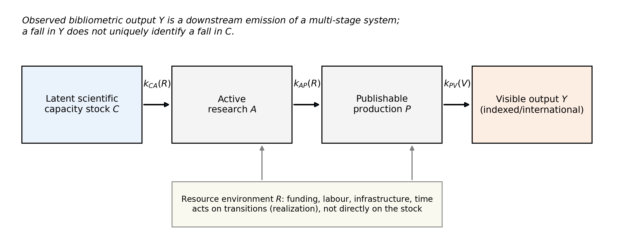
fig1 conceptual model

Slide 2
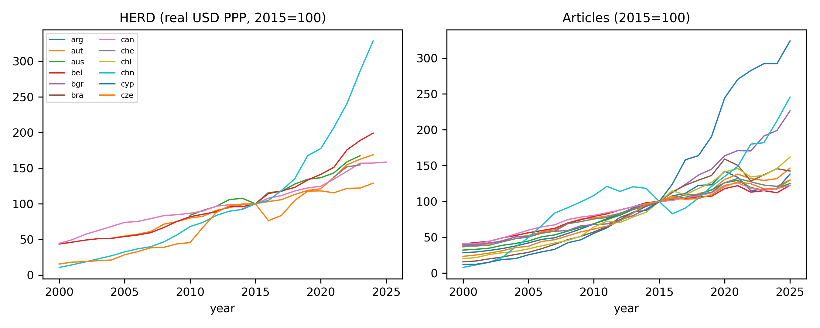
fig2 resource vs output

Slide 3
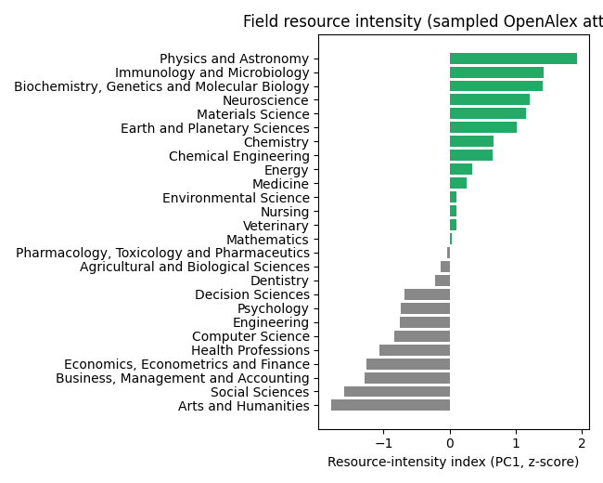
fig3 field intensity

Slide 4
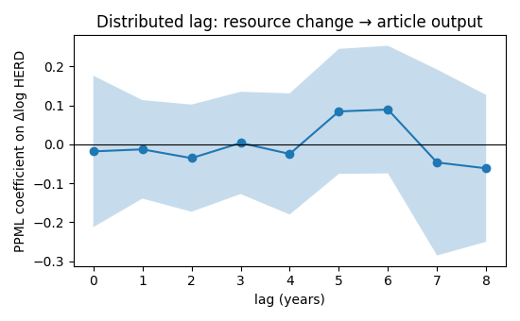
fig4 distributed lag

Slide 5
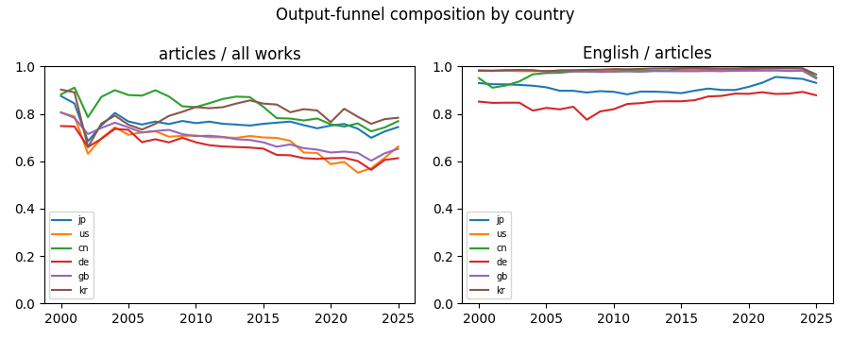
fig5 funnel composition

Slide 6
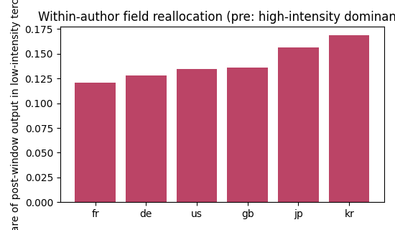
fig6 mobility

Slide 7
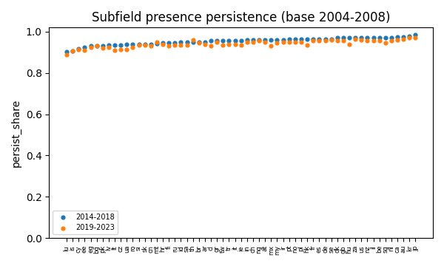
fig7 persistence

