Slide 1
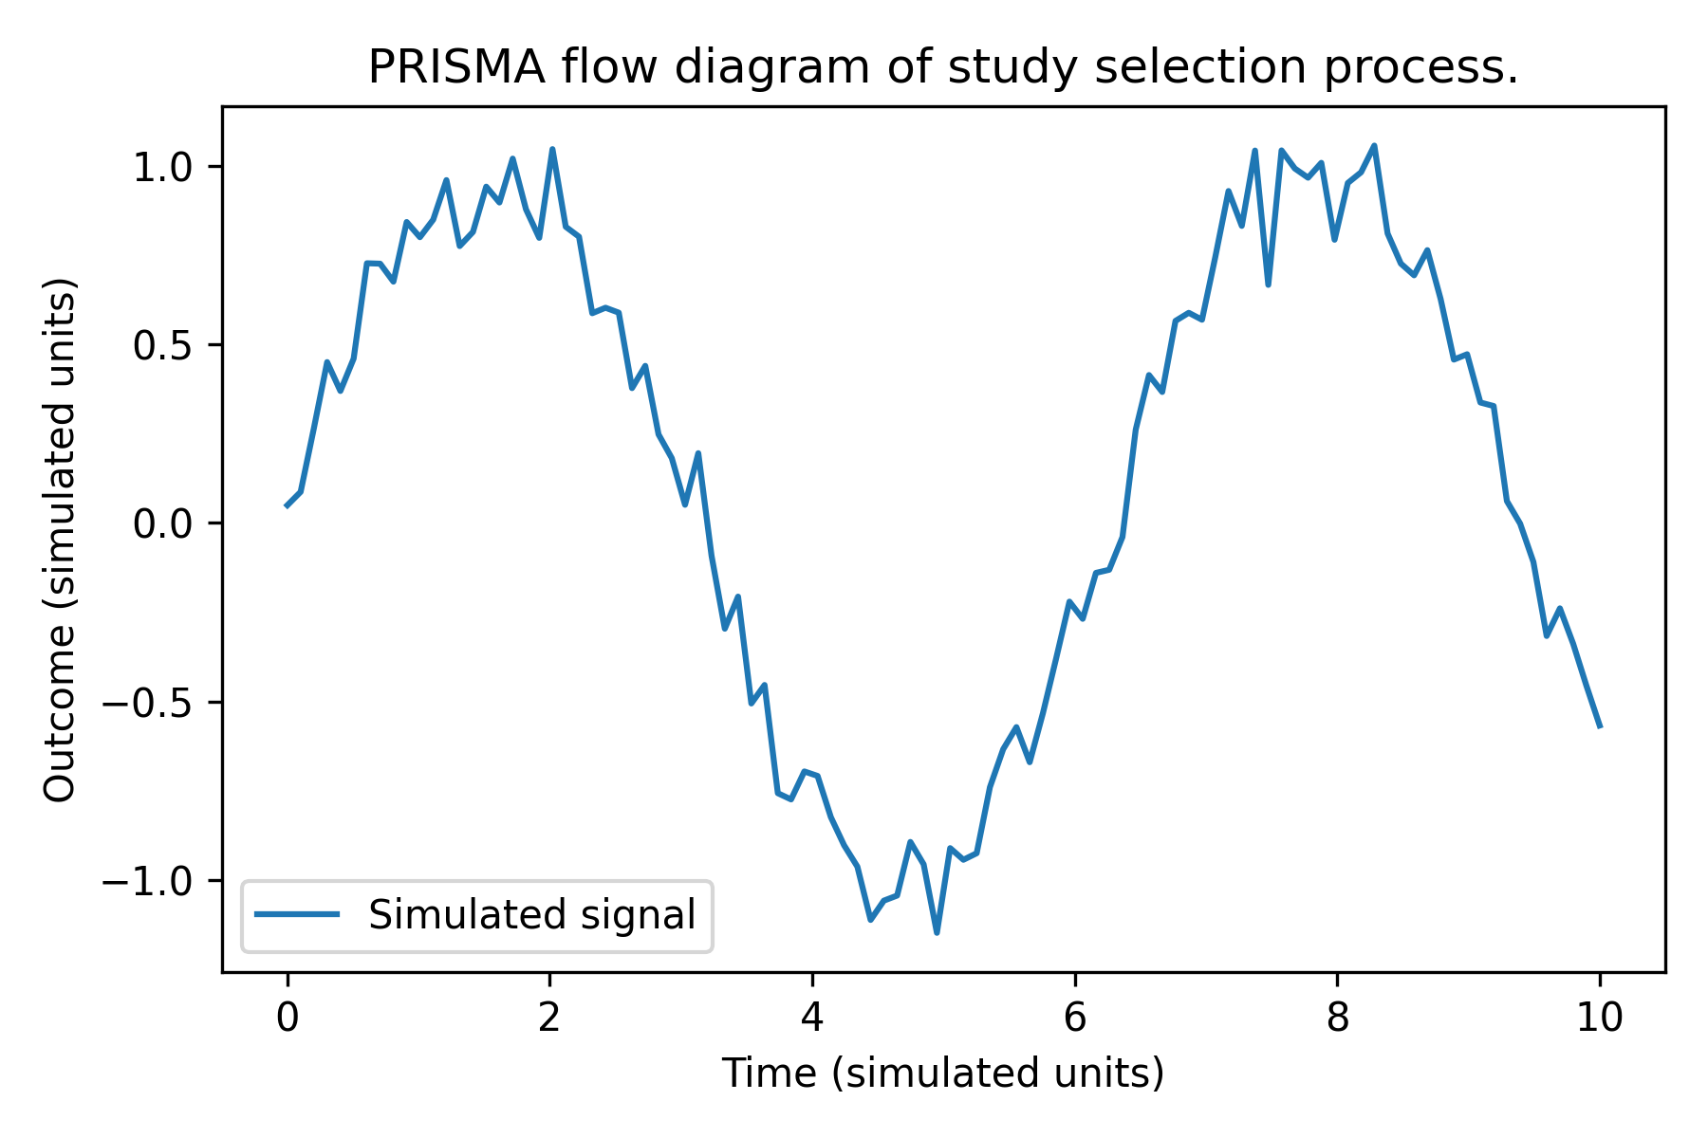
PRISMA flow diagram of study selection process.
PRISMA flow diagram of study selection process.

