Slide 1
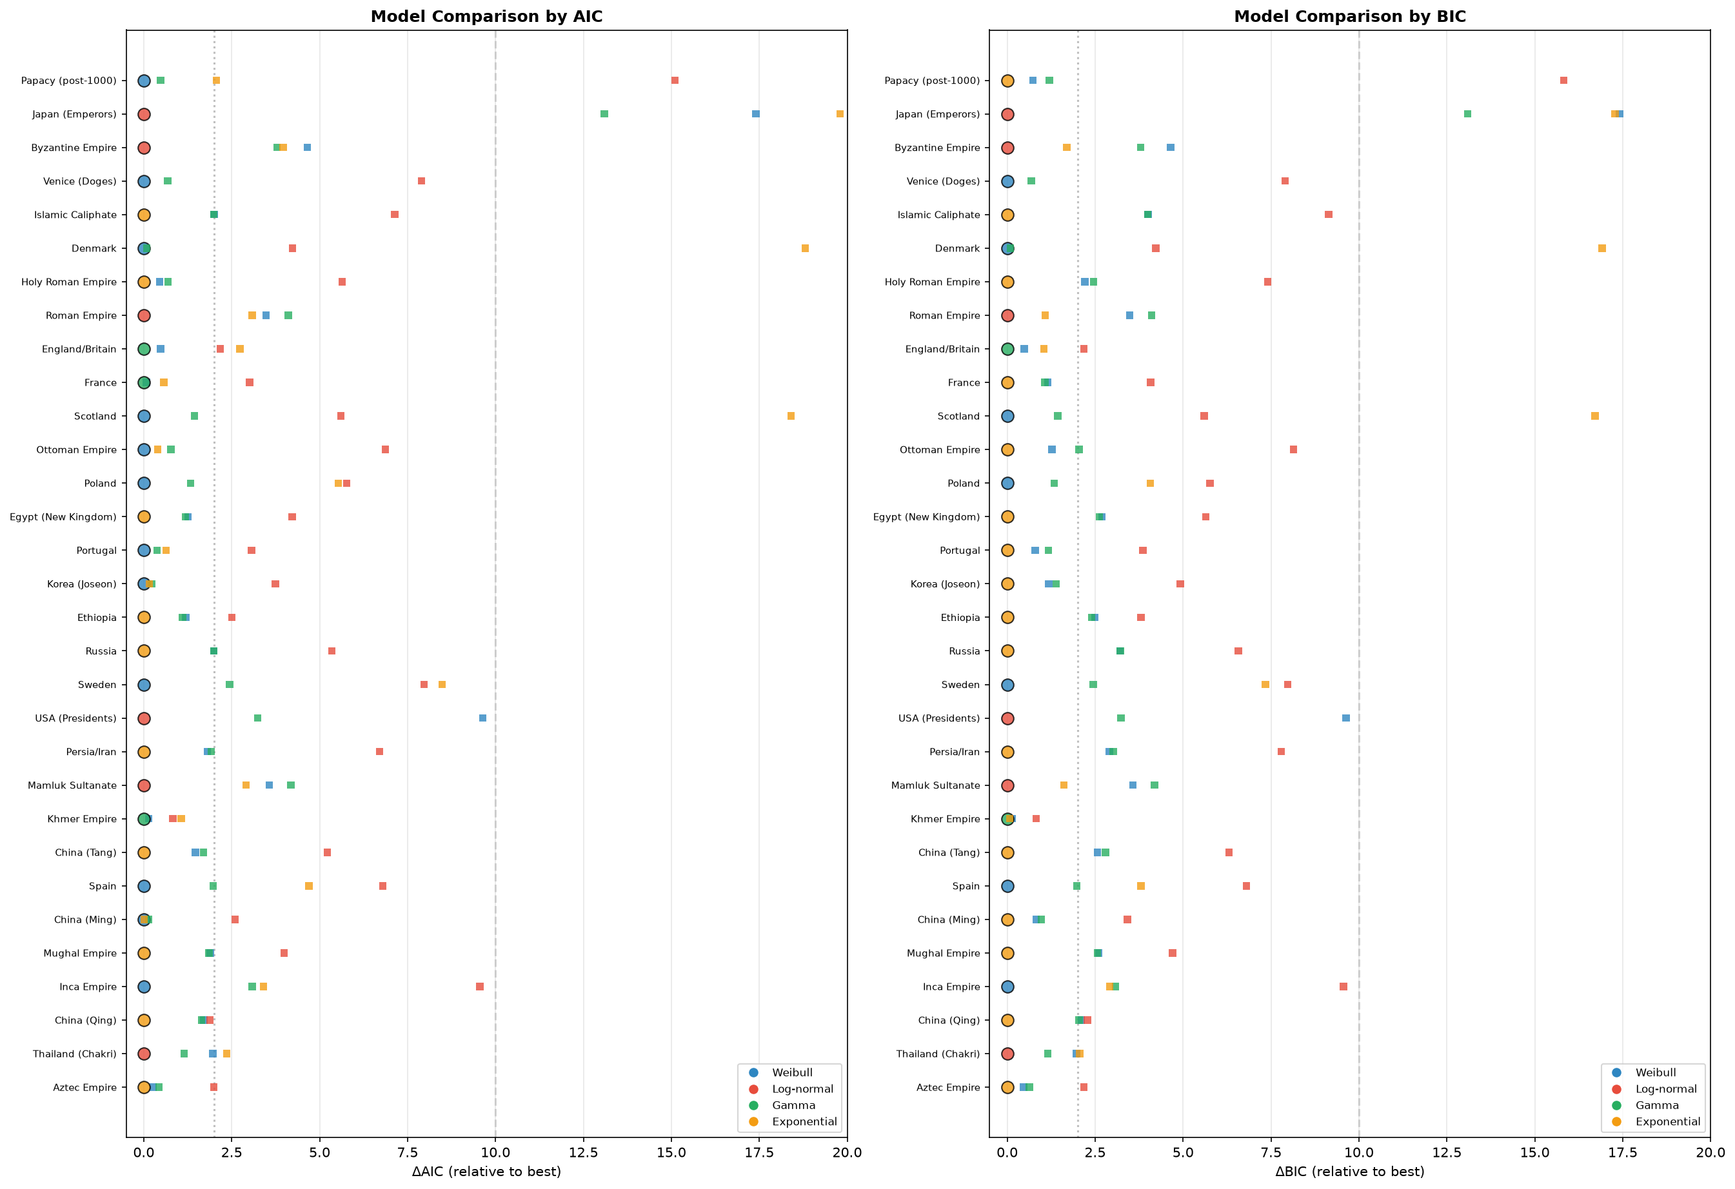
Figure 9. Model Selection: AIC/BIC Comparison
Model selection comparison across Weibull, log-normal, gamma, and exponential distributions for all 31 polities. Left: ΔAIC relative to best-fitting model. Right: ΔBIC relative to best-fitting model. Filled circles = best model; open squares = competitive alternatives (Δ < 2). Vertical dashed lines at Δ = 2 and Δ = 10.

Slide 2
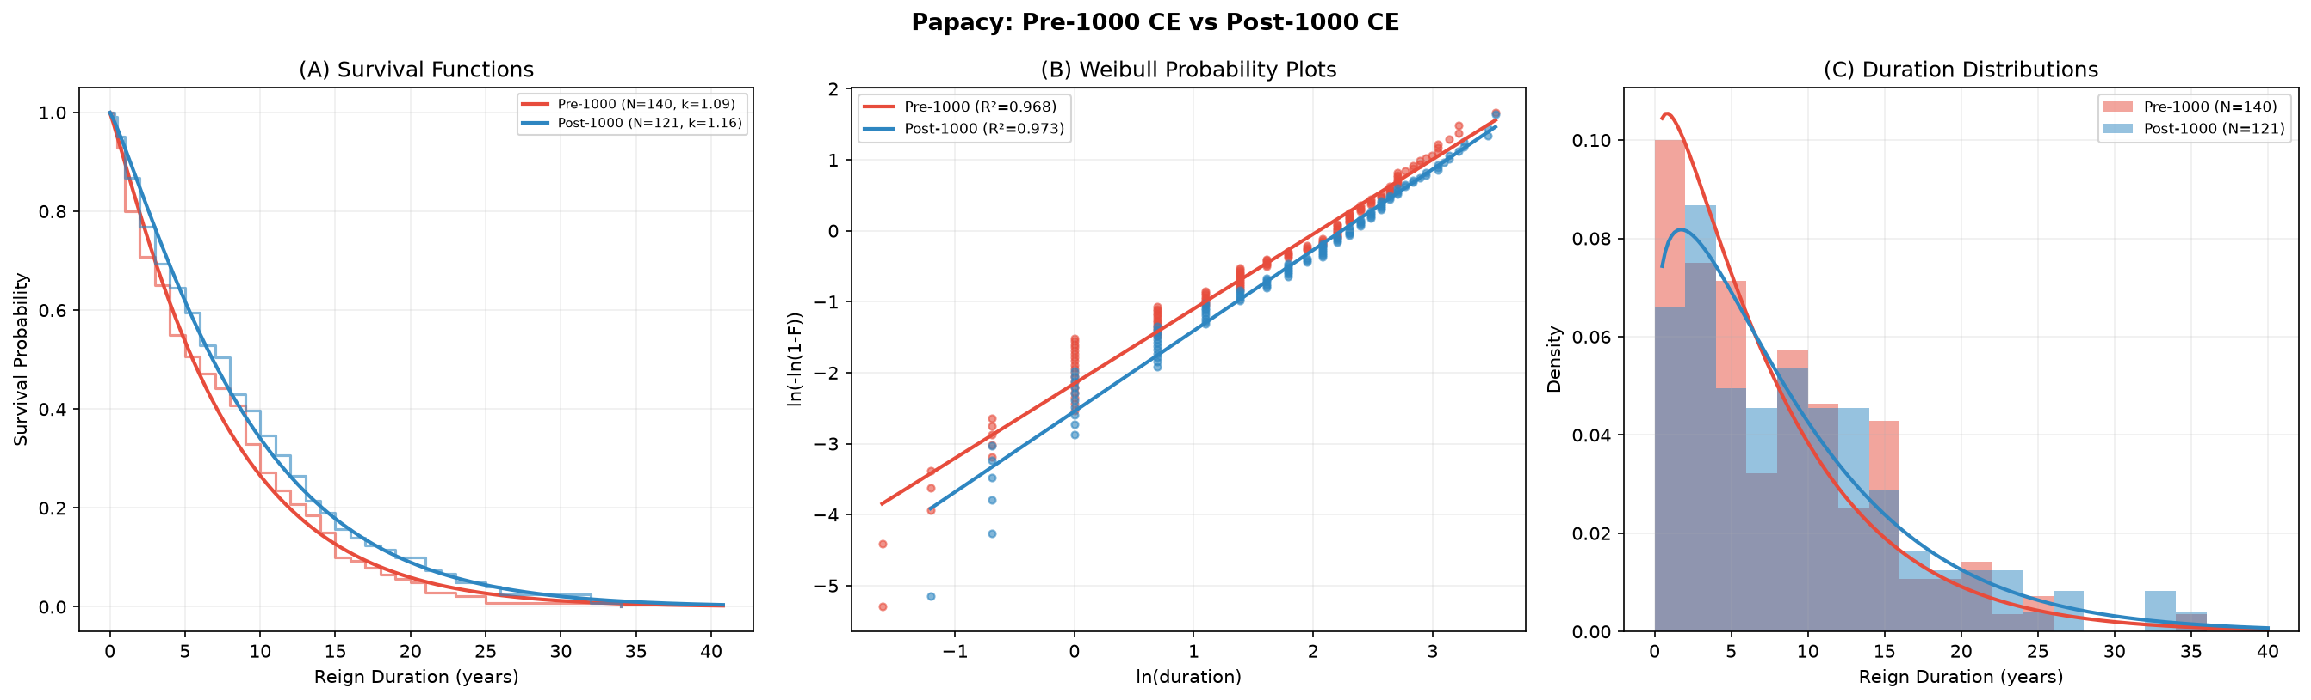
Figure 10. Papacy: Pre-1000 CE vs Post-1000 CE
(A) Kaplan-Meier survival functions with fitted Weibull curves for pre-1000 CE (red, N=140) and post-1000 CE (blue, N=121). (B) Weibull probability plots (linearised ln-ln). (C) Reign duration histograms with fitted Weibull PDFs. Pre-1000 k=1.092 (near-exponential); post-1000 k=1.163 (mildly increasing hazard).

Slide 3
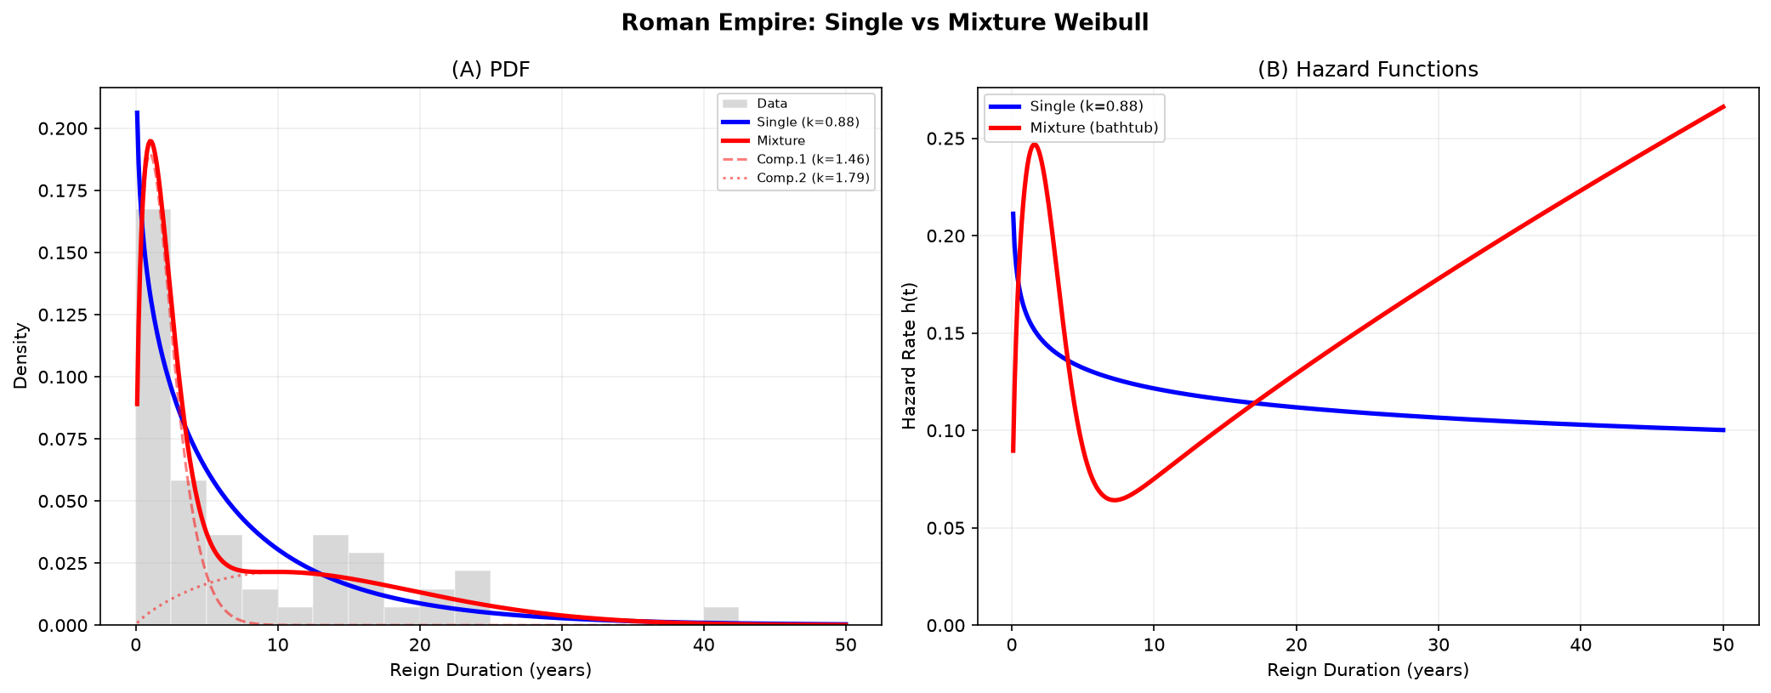
Figure 11. Roman Empire: Single vs Mixture Weibull
(A) Probability density functions: data histogram (grey), single Weibull (blue, k=0.880), two-component mixture (red), with individual components shown. (B) Hazard functions: single model shows monotonically decreasing hazard; mixture produces bathtub curve consistent with Saleh (2019).

Slide 4
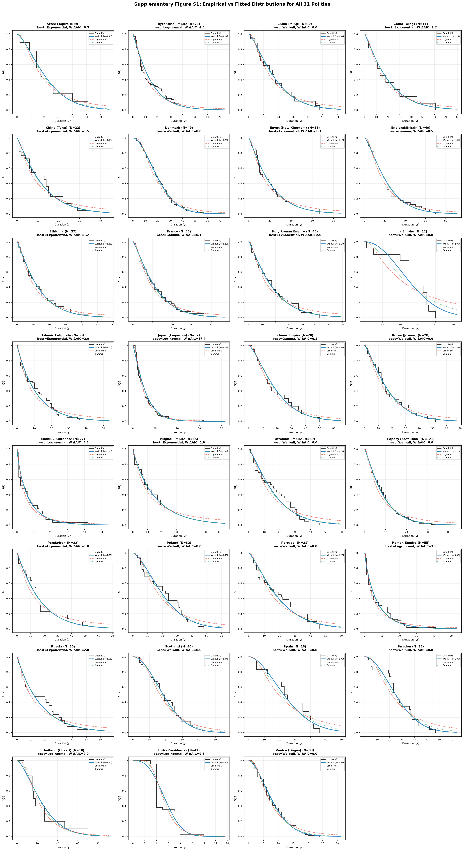
Supplementary Figure S1. Per-Polity Empirical vs Fitted Distributions
Empirical Kaplan-Meier survival curves (black step functions) overlaid with fitted Weibull (blue solid), log-normal (red dashed), and gamma (green dotted) distributions for all 31 polities. Each panel shows polity name, sample size N, best-fitting model by AIC, and Weibull ΔAIC.

Slide 5
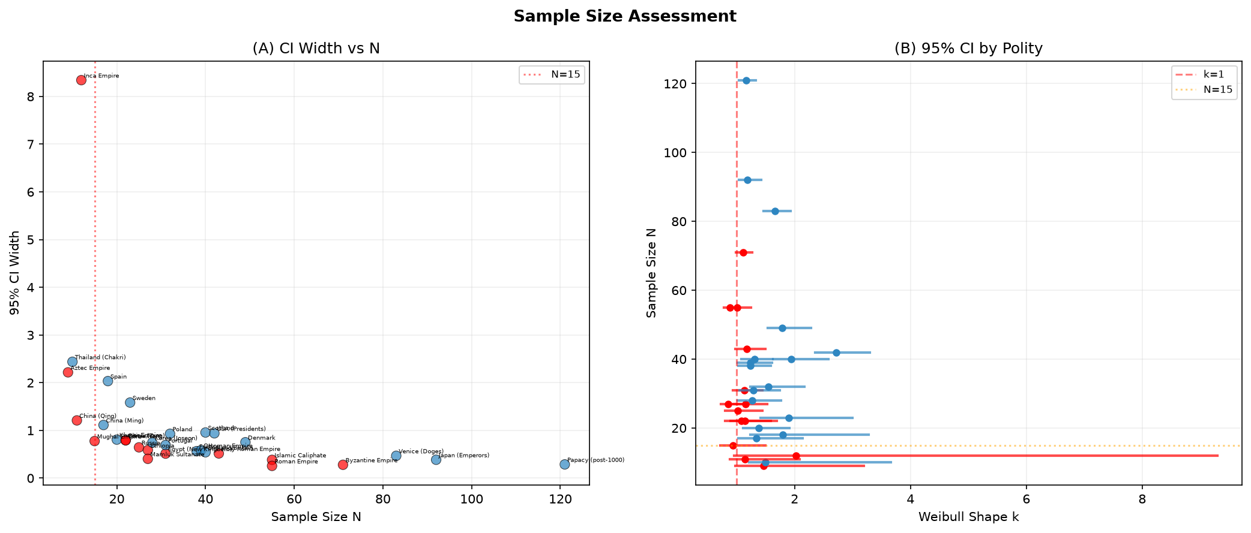
Figure 12. Sample Size Assessment
(A) 95% CI width vs sample size N for all 31 polities (red = CI crosses k=1; blue = does not). Vertical dashed line at N=15 indicates minimum threshold for qualitative interpretation. (B) Forest plot of 95% CIs ordered by sample size, with k=1 reference line.

