Slide 1
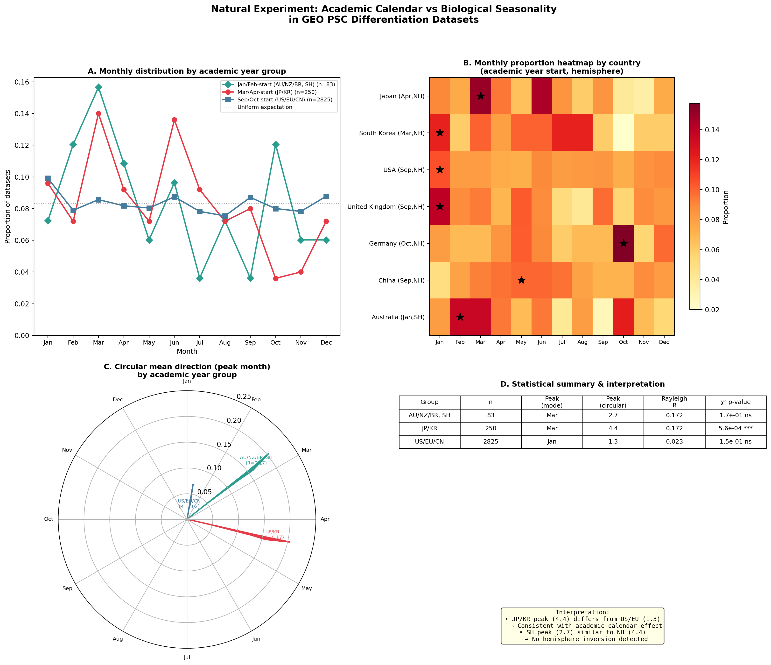
Figure 1. Academic calendar variation as a natural experiment

Slide 2
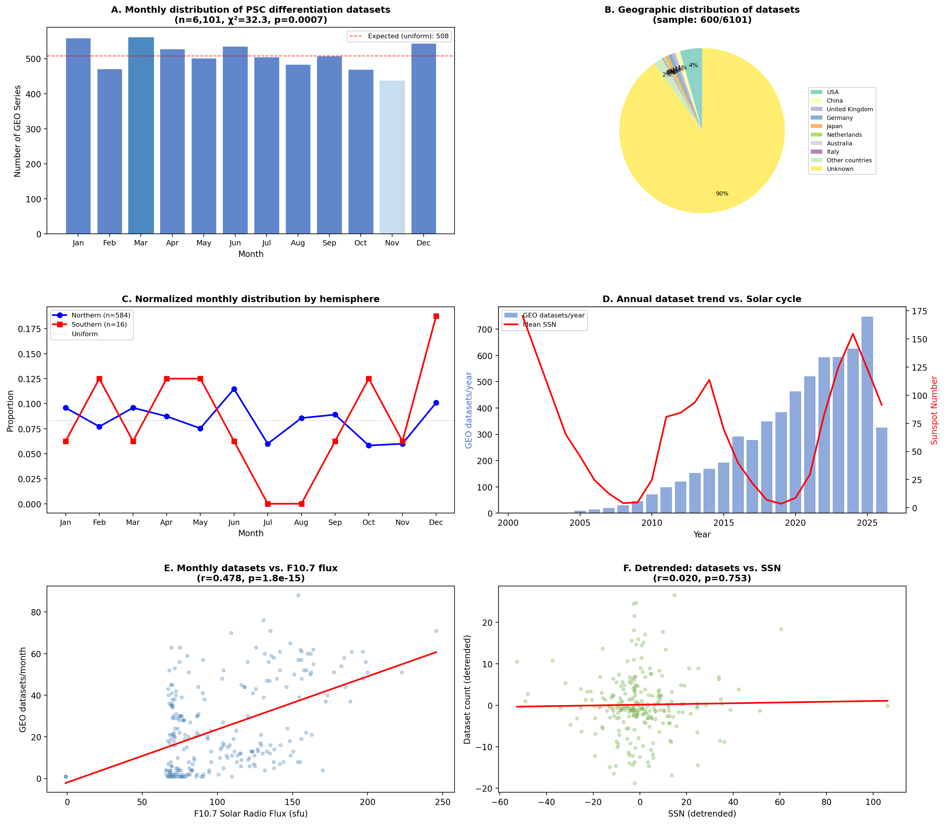
Figure 2. Research roadmap for environmental profiling of PSC culture

