Slide 1
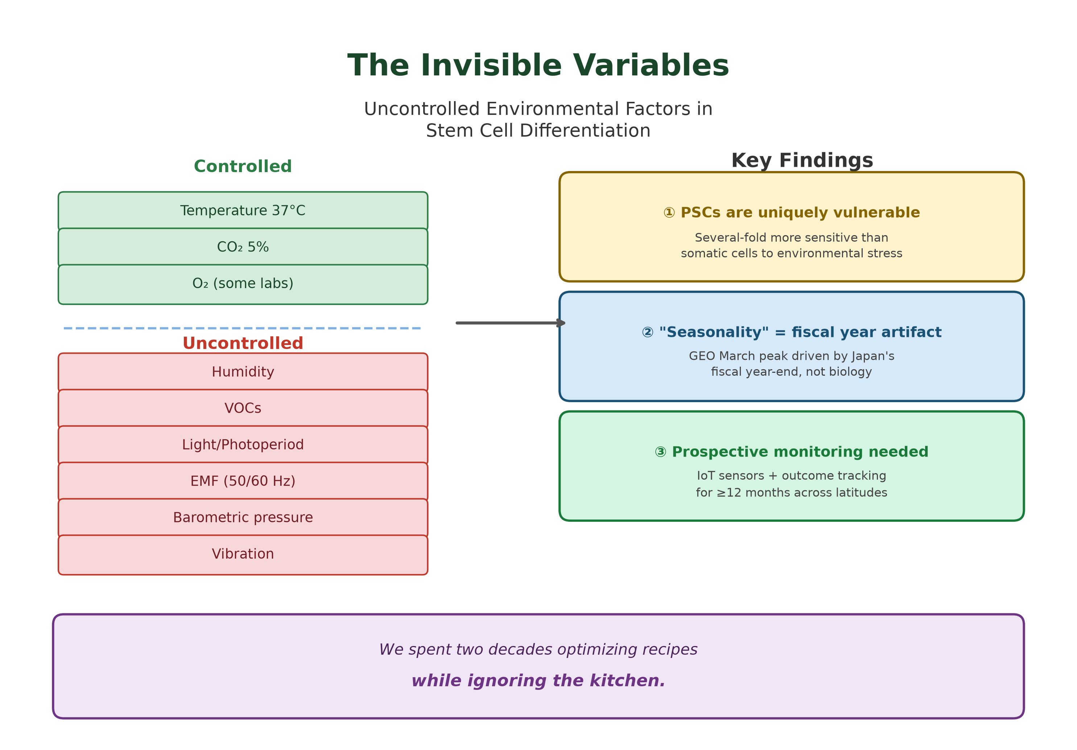
Graphical Abstract
Graphical Abstract. Stem cell laboratories control temperature and CO₂ but leave multiple environmental variables unmonitored; apparent database seasonality is an institutional artifact.

