Slide 1
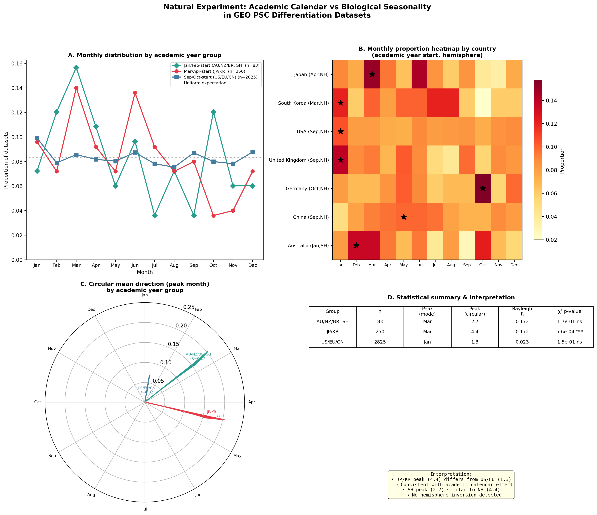
Figure 1 | Academic calendar variation as a natural experiment
a, Normalized monthly distributions of GEO PSC dataset submissions by academic year group. b, Country-level heatmap. c, Circular mean directions (Rayleigh vectors). d, Statistical summary. n=6,101 datasets; 3,195 with country affiliation.

Slide 2
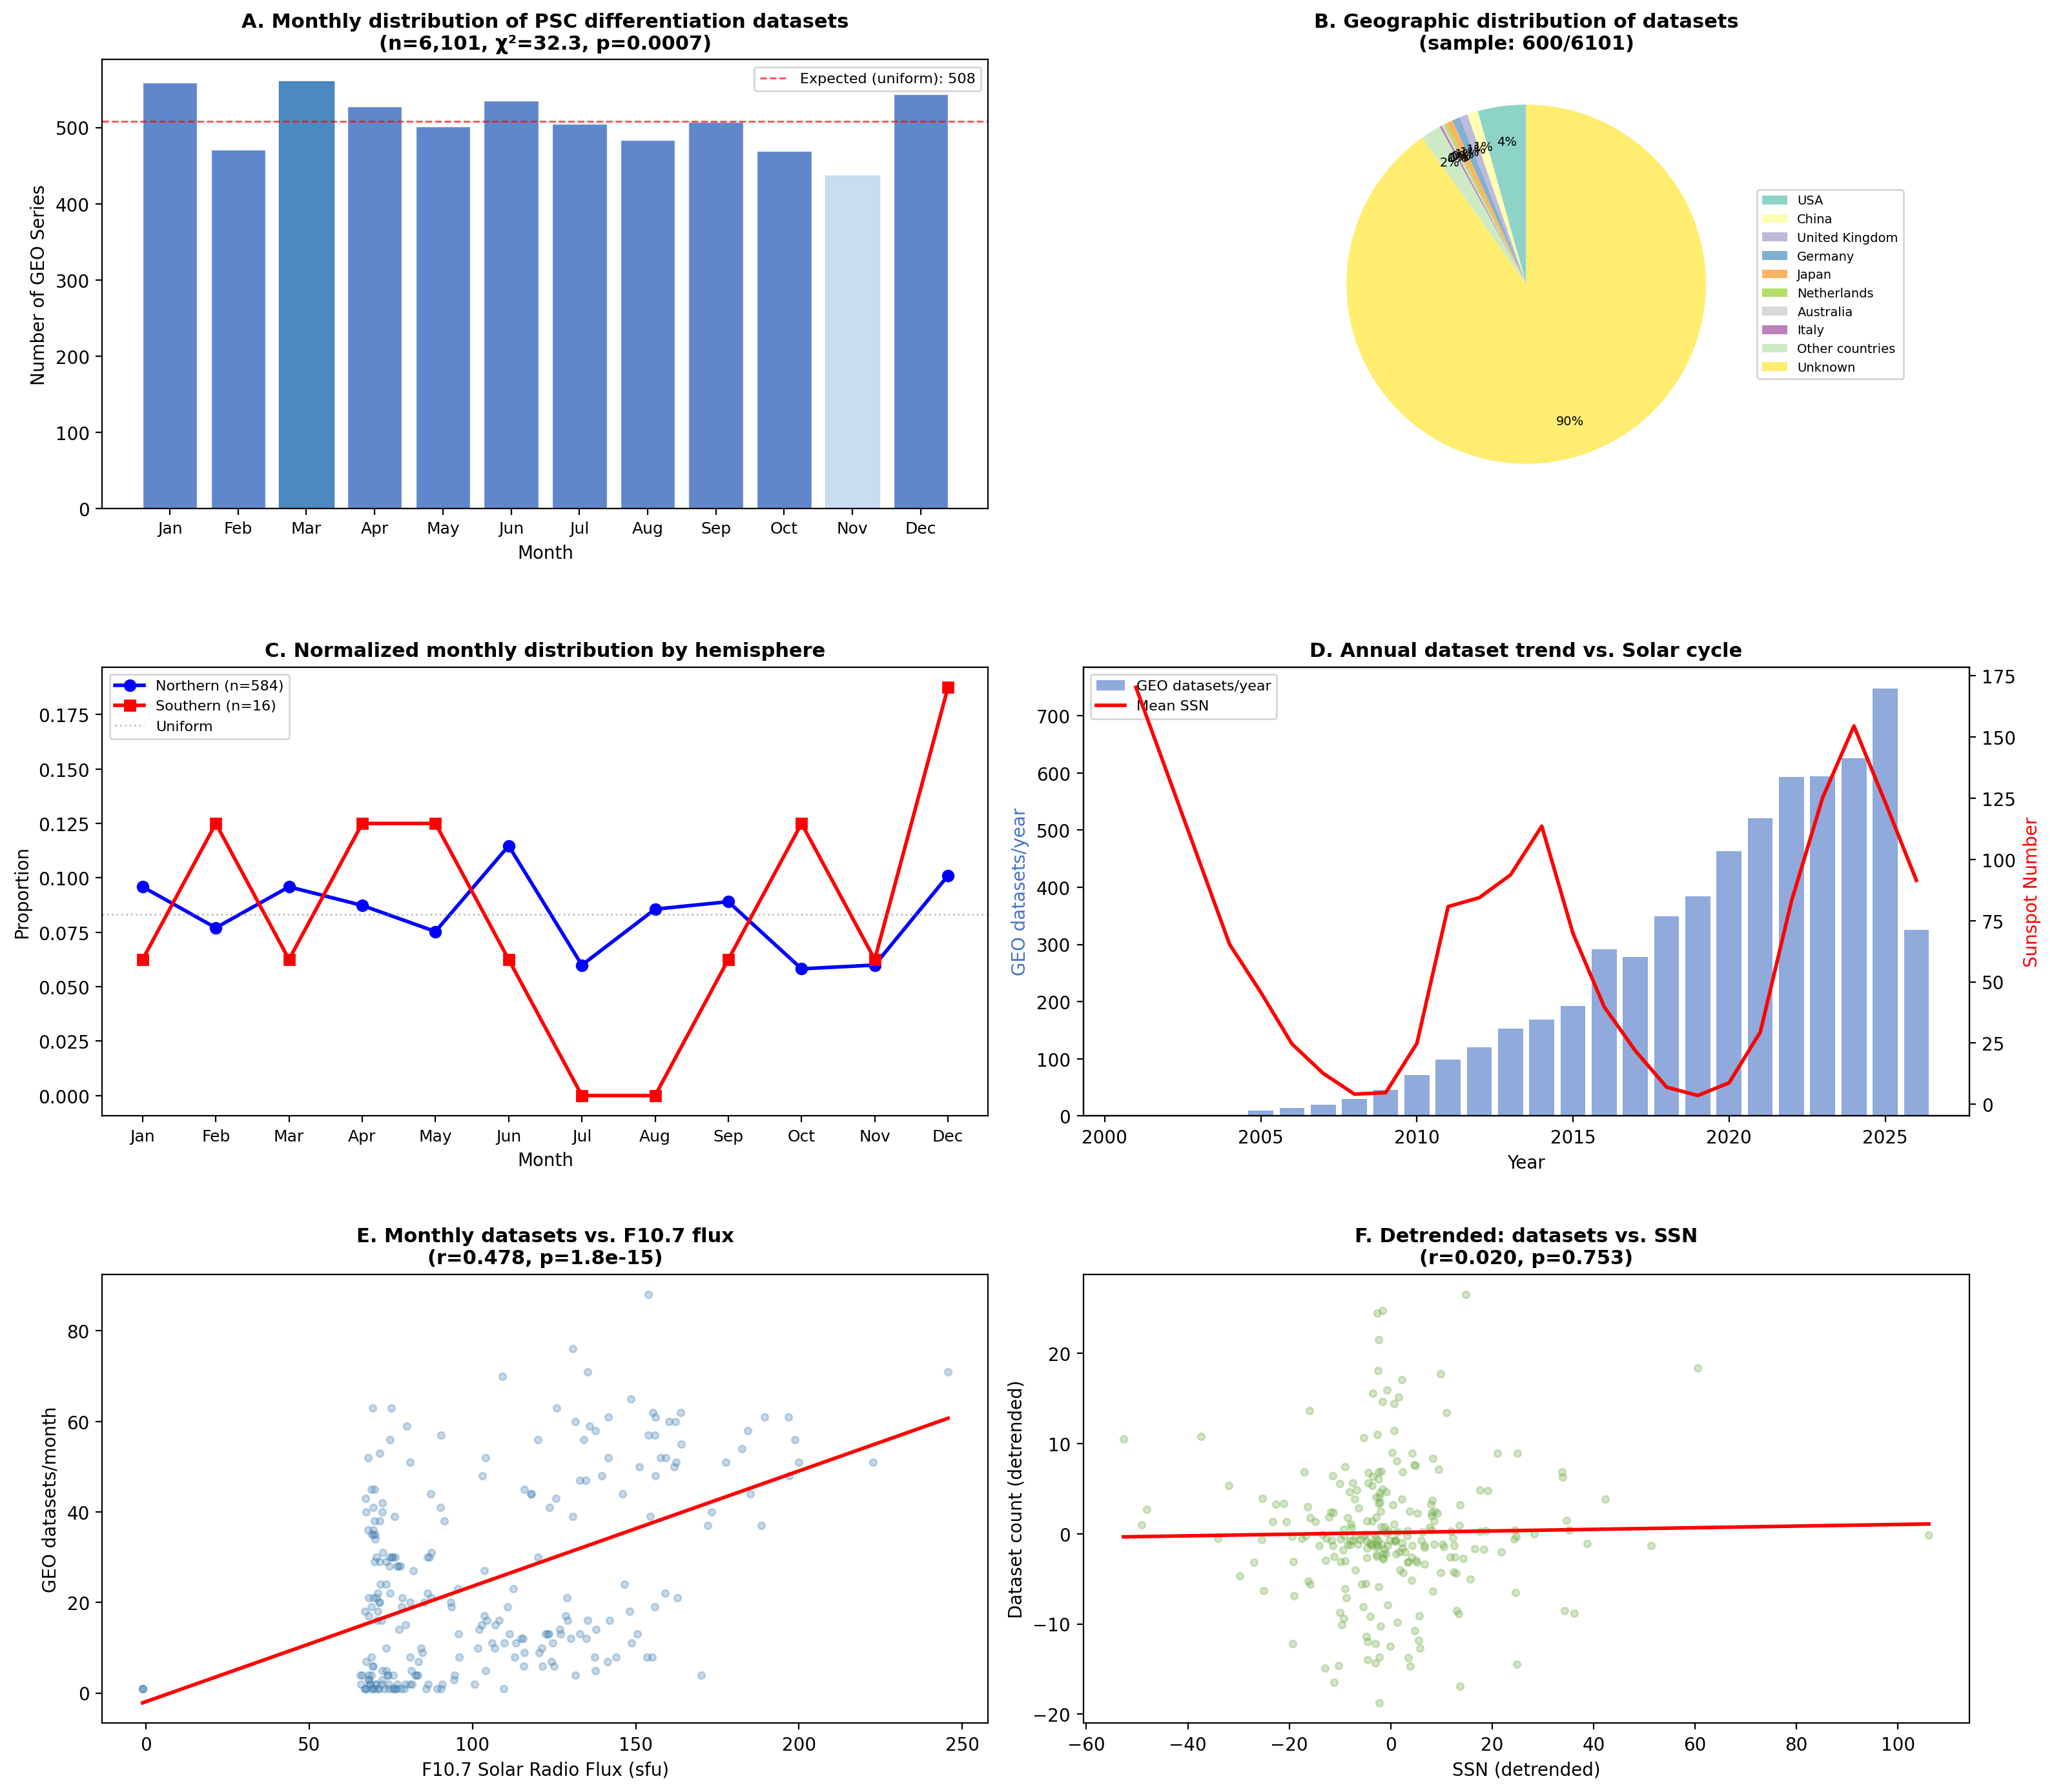
Figure 2 | Research roadmap for environmental profiling of PSC culture
a, Evidence matrix: uncontrolled environmental variables classified by hemisphere-dependence and evidence level. b, Three-phase investigation strategy from passive monitoring through data mining to controlled intervention.

