Slide 1
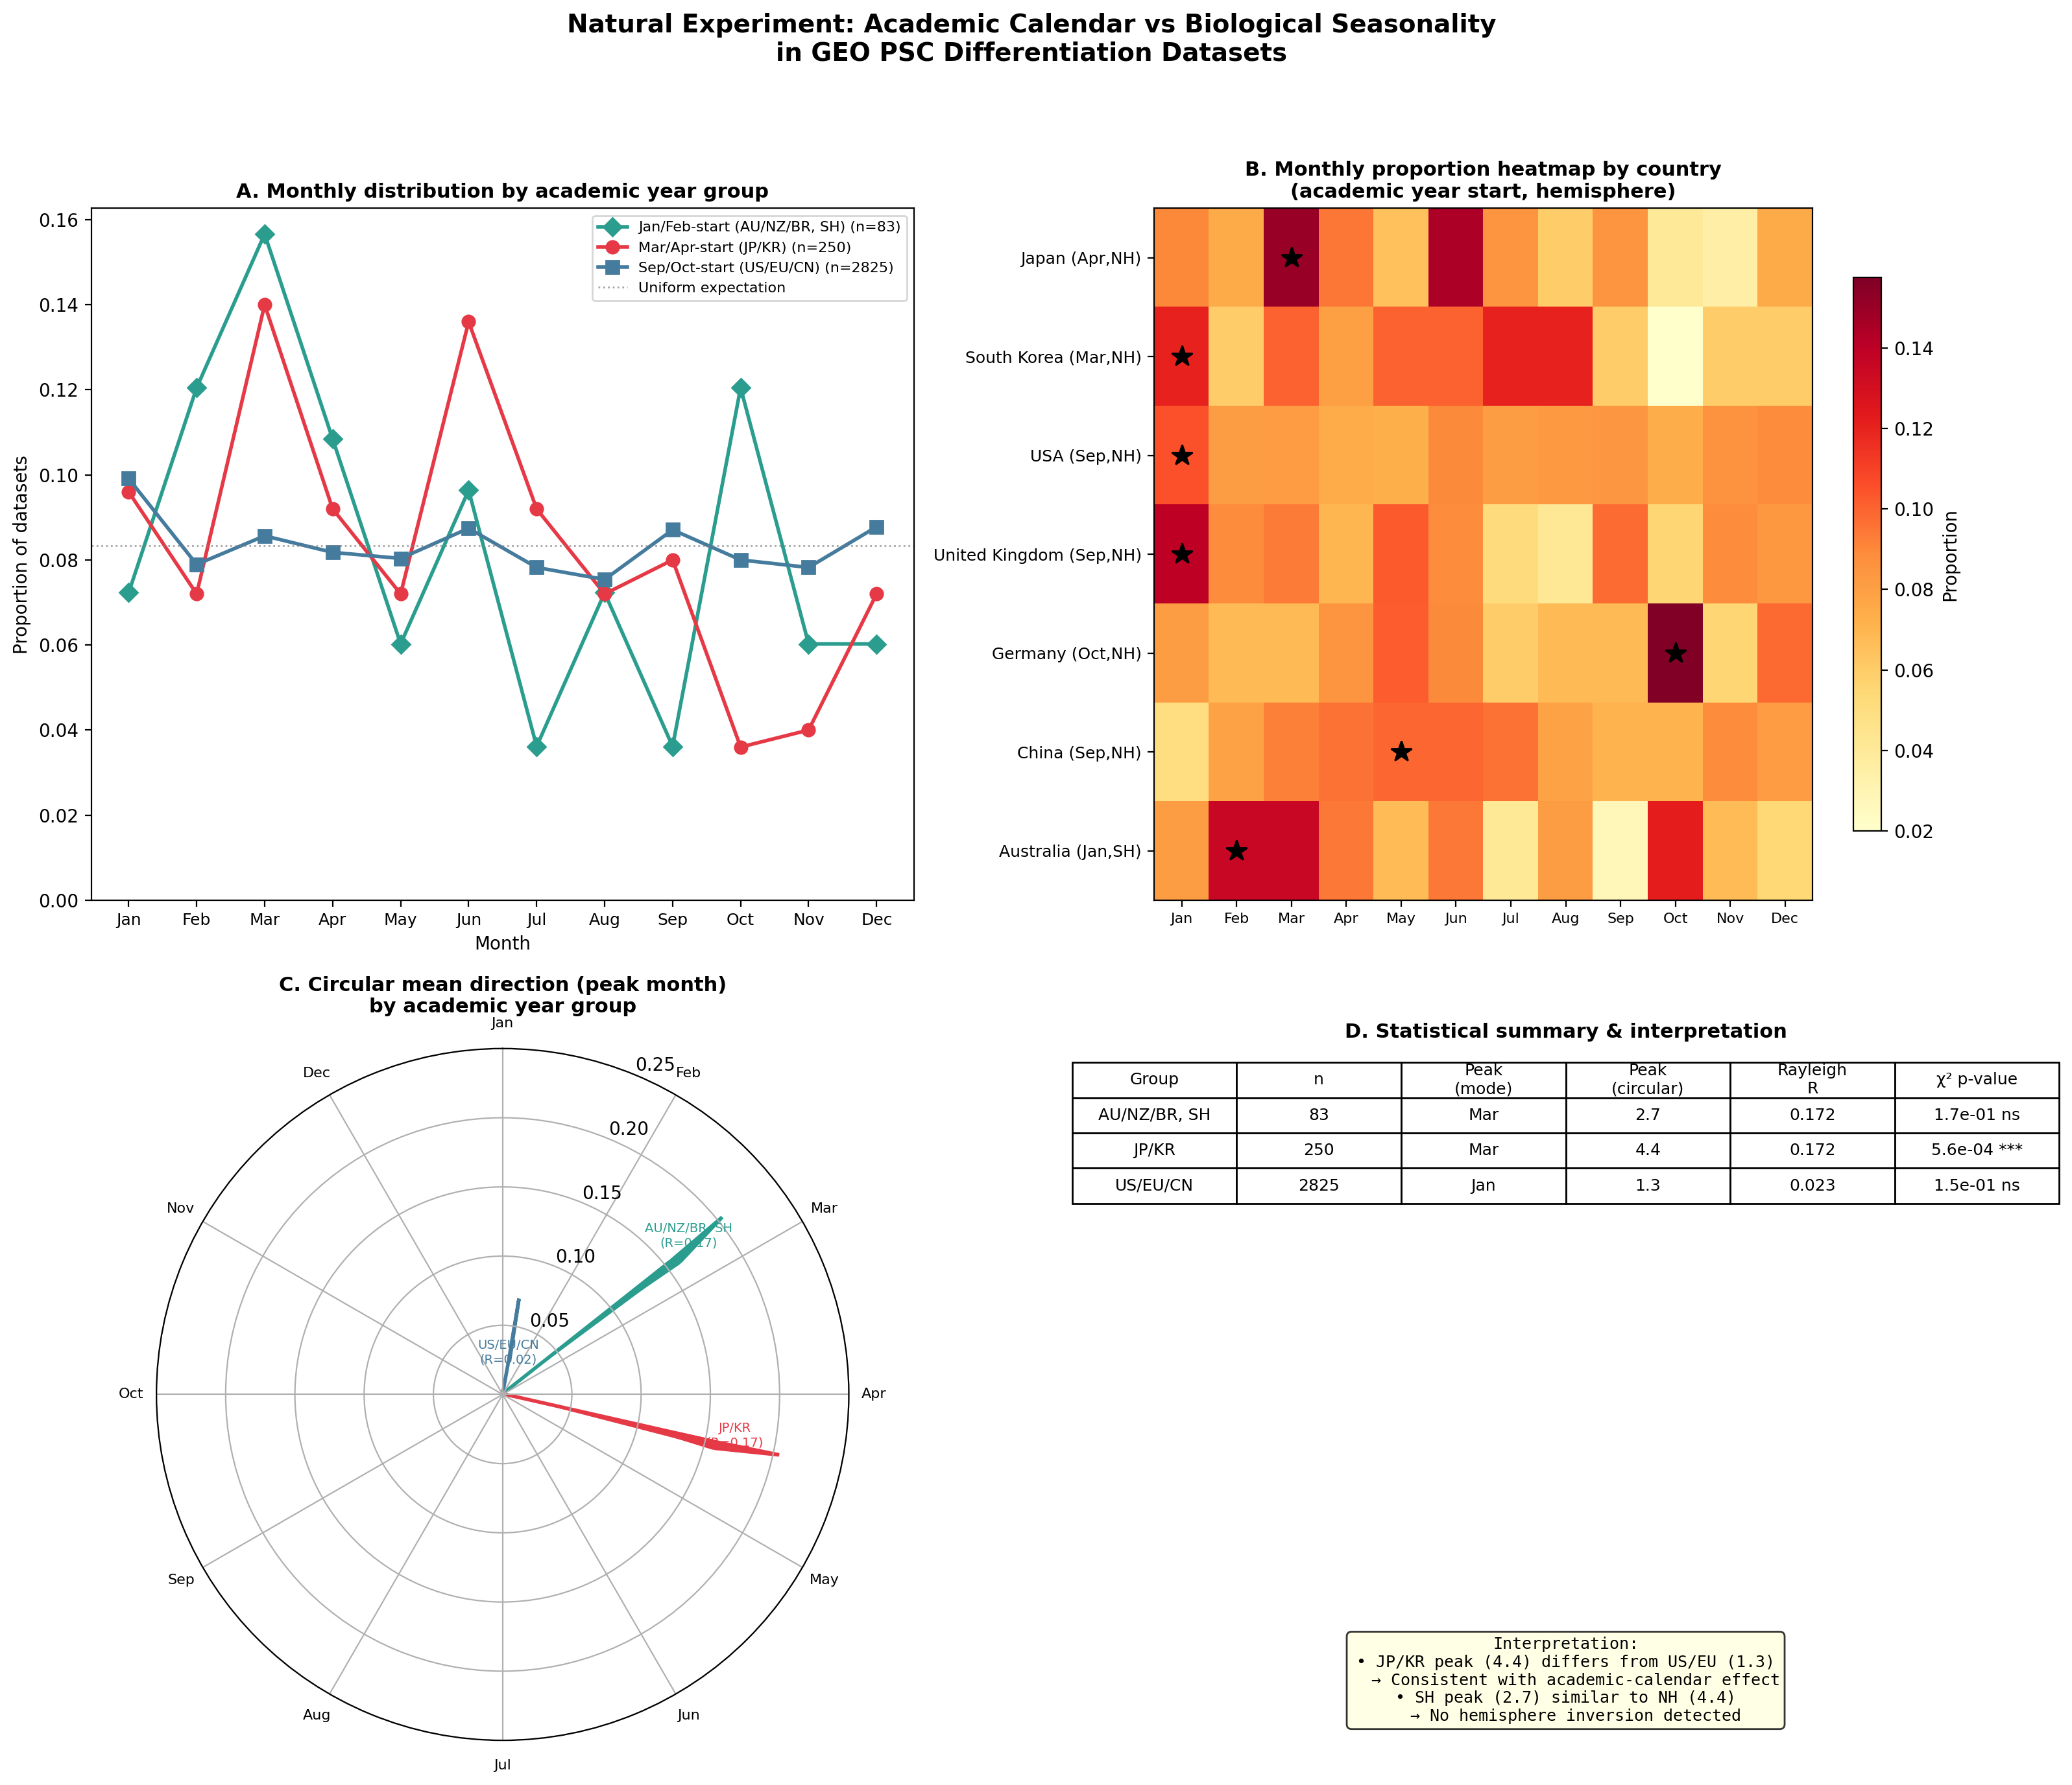
Figure 1. Institutional calendar confounding in GEO PSC datasets
(A) Monthly submission distributions for 6,101 GEO PSC differentiation datasets grouped by country academic-year start. (B) Country-level heatmap of submissions. (C) Circular Rayleigh vectors showing mean submission direction. (D) Statistical summary: only Japan/Korea shows significant seasonality, aligned with Japan's March 31 fiscal year-end.

Slide 2
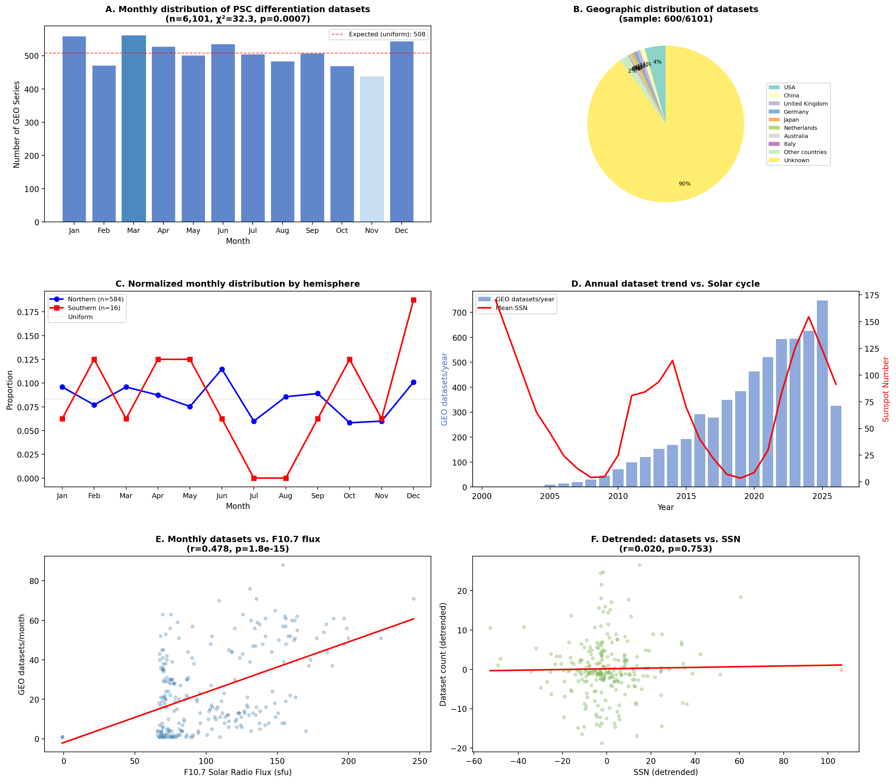
Figure 2. Proposed research roadmap for environmental profiling
(A) Evidence matrix classifying uncontrolled environmental variables by hemisphere-dependence and strength of existing evidence. (B) Three-phase investigation strategy: Phase I (passive IoT monitoring), Phase II (IVF registry analysis), Phase III (controlled intervention).

