Slide 1
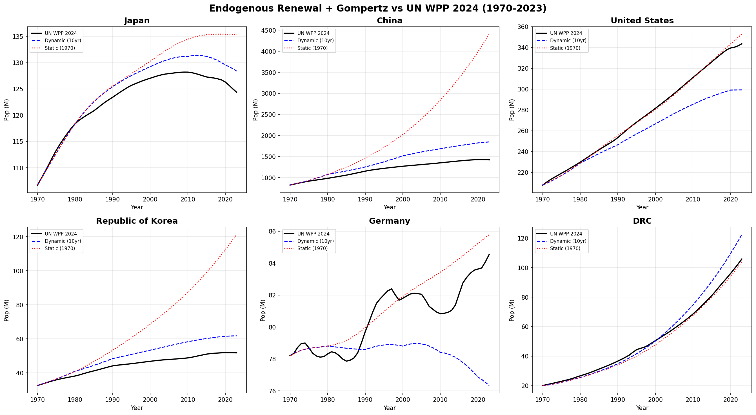
Figure 1. Model vs Observed Population: Six Representative Countries (1970–2023)
Dynamic model (blue dashed) updates parameters every 10 years; static model (red dotted) uses fixed 1970 parameters. Black line = UN WPP 2024 estimates. Countries: Japan, China, USA, Korea, Germany, DRC.

Slide 2
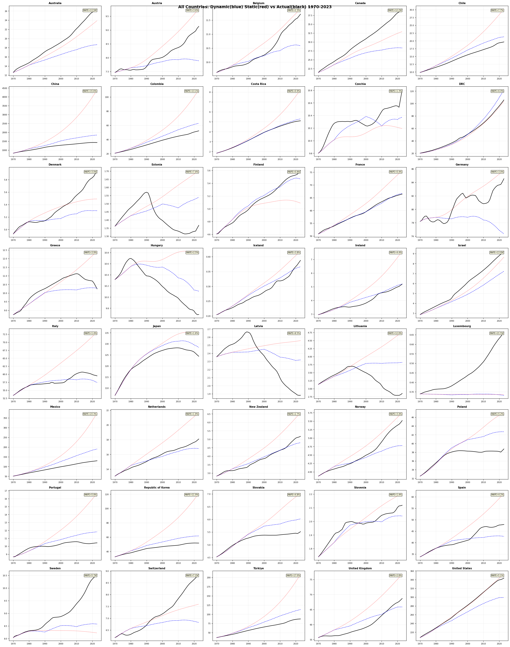
Figure 2. Model Validation Across All 40 Countries
Dynamic model MAPE shown in upper-right corner of each panel. Countries sorted alphabetically. 30 of 40 countries achieve MAPE < 10%; 20 countries < 5%.

Slide 3
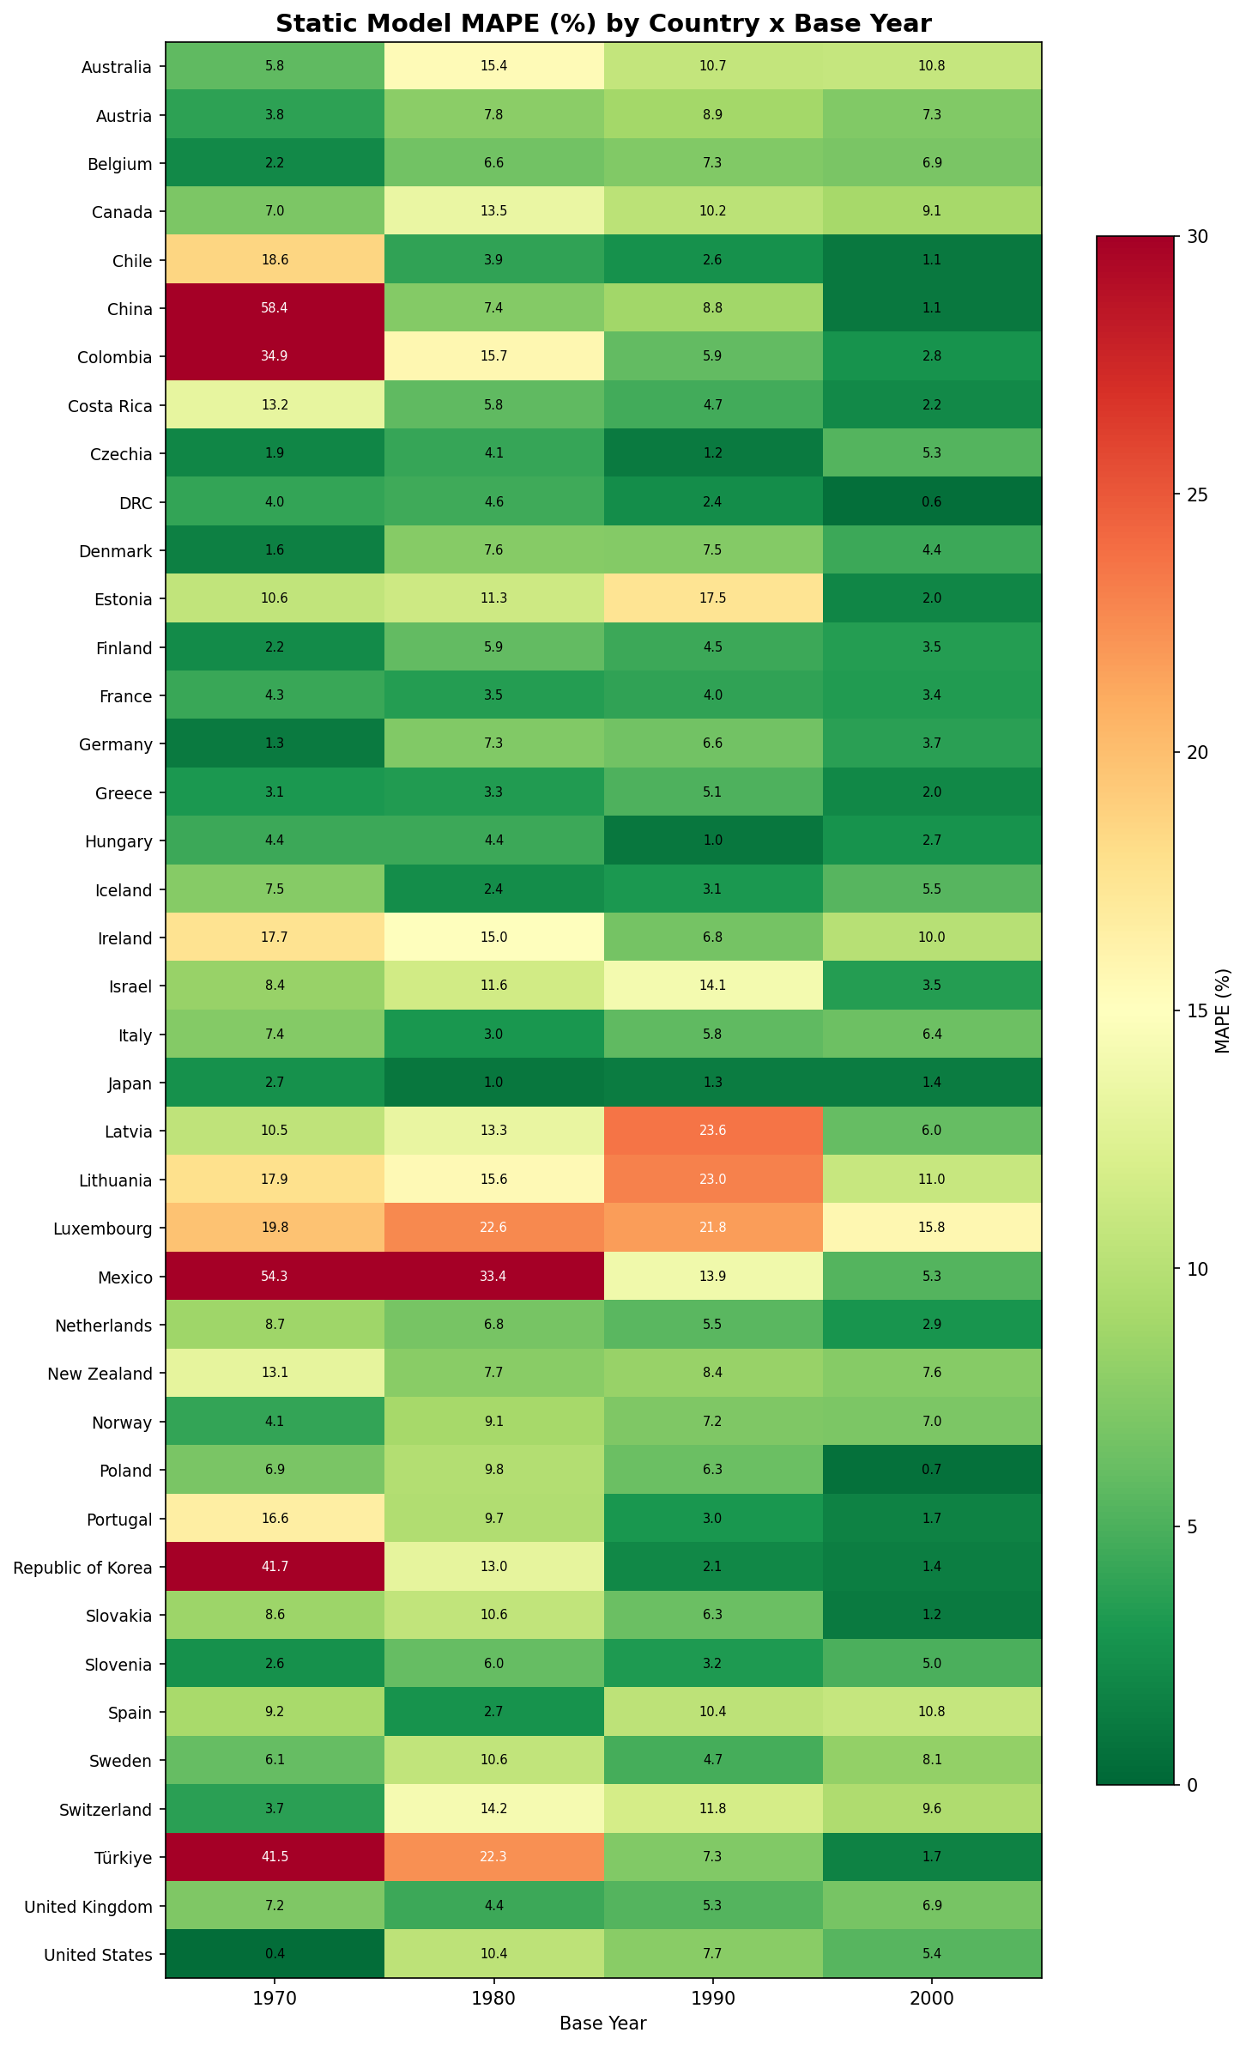
Figure 3. Static Model MAPE (%) by Country and Base Year
Greener cells indicate better fit; redder cells indicate poorer fit. Scale capped at 30%. Fit improves with more recent base years as expected.

Slide 4
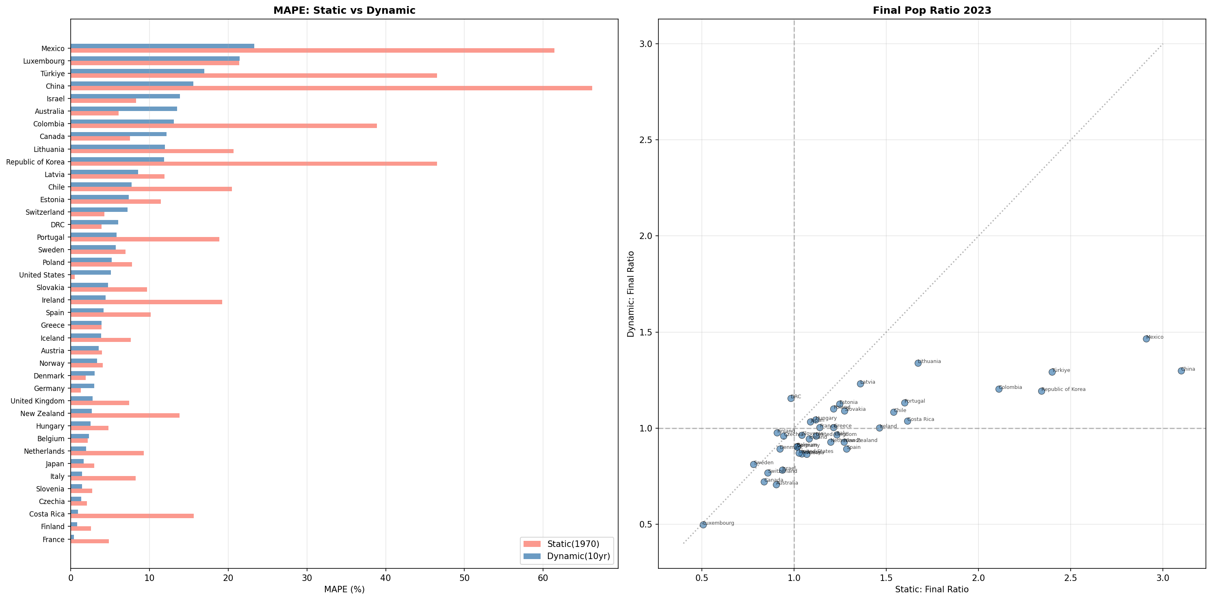
Figure 4. Static vs Dynamic Model Comparison
Left: MAPE by country. Right: final population ratio (model/observed in 2023). Dynamic model consistently outperforms static variant with ~2x improvement in median MAPE.

Slide 5
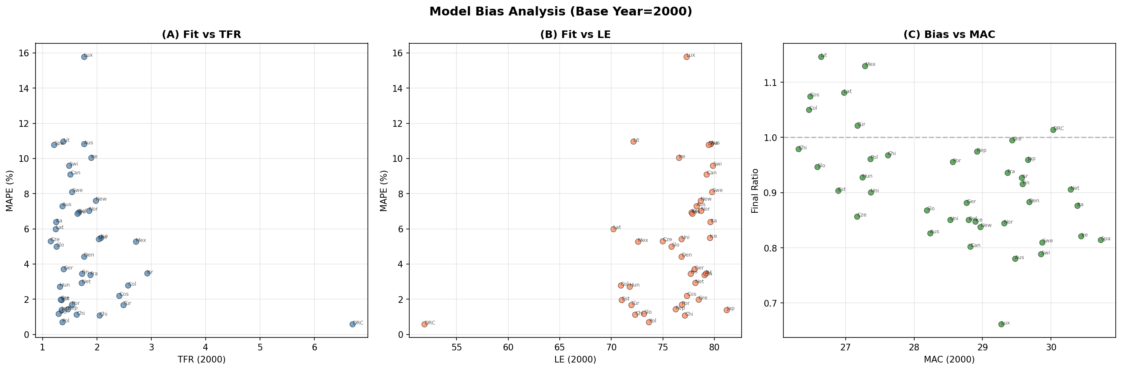
Figure 5. Model Bias Analysis (Base Year 2000)
(A) Fit vs TFR; (B) Fit vs life expectancy; (C) Bias vs MAC. No systematic relationship observed, suggesting robustness across demographic contexts.

Slide 6
Figure 6. Endogenous Renewal Model: Structure and Data Flow
(Editable diagram — all shapes can be moved, resized, and recolored)
INPUT PARAMETERS
TFR (Total Fertility Rate)
e₀ (Life Expectancy)
MAC (Mean Age at Childbearing)
σ (Fertility Schedule Width)
MODEL COMPONENTS
Normal Fertility Schedule ASFR ~ N(MAC, σ²)
Gompertz Survival S(x) = exp[-(a/b) ×(exp(bx)-1)]
Age-Specific Fertility Rate f(x) = TFR × φ(x)
Calibration a: e₀ = ∫S(x)dx b = 0.085 (fixed)
CORE ENGINE
Endogenous Renewal: P(t+1) Births = Σ P_x(t) × f × ASFR(x) | Aging: P_{x+1}(t+1) = P_x(t) × s(x)
Dynamic Update (every 10 years): TFR, e₀, MAC ← WPP
OUTPUT
Simultaneously Living Population (SLP) P(t) = [P₀(t), P₁(t), ..., P₁₀₀(t)]
UN WPP 2024 (Validation Data)

Slide 7
Figure 7. The Tempo Effect on Simultaneously Living Population
(Editable diagram — all shapes can be moved, resized, and recolored)
Scenario A: MAC = 25 years
Scenario B: MAC = 30 years
Gen 1 (age 75)
Gen 1 (age 90)
Gen 2 (age 50)
Gen 2 (age 60)
+5 years MAC shift
Gen 3 (age 25)
Gen 3 (age 30)
Gen 4 (age 0)
Gen 4 (age 0) — partial*
→ 4 generations simultaneously alive → Higher SLP
→ ~3.3 generations simultaneously alive → Lower SLP (≈1/6 reduction)
*Same TFR in both scenarios
KEY INSIGHT: A 5-year increase in MAC reduces SLP by ~1/6, independent of TFR. This controls the SPEED of demographic transition, compressing the time available for institutional adaptation.

Slide 8
Figure 8. Policy Framework: Tempo-Sensitive Population Management
(Editable diagram — all shapes can be moved, resized, and recolored)
CURRENT APPROACH (Quantum-only)
Pronatalist Policies
Raise TFR (↑ Births)
Increase Population Size
Overestimates impact (ignores tempo)
PROPOSED APPROACH (Quantum + Tempo)
Quantum: Raise TFR
OUTCOME: • Managed pace of demographic transition • Time for institutional adaptation • Sustainable SLP path
Tempo: Lower MAC/AFB
Combined Effect: ↑ Generational Overlap ↓ Speed of Decline
Affordable Housing
Universal Childcare
Educational Pathway Reform

