Slide 1
Quantifying the feasibility boundary of localized thermospheric density enhancement for selective orbital debris decay
• T. Onishi et al. — boundary study, synthetic targets only
• Question: can a localized thermospheric density increase selectively de-orbit LEO debris without dragging protected spacecraft?
• Approach: NRLMSISE-00 climatology, validated J2-secular and Cowell propagators, abstract Gaussian density perturbations
• All numbers regenerate from code (make all)

Slide 2
Key results
• Earth-fixed pulse: 3.98e-3 m/s per event (4.4% duty cycle) = 3.5% of natural drag over the same window
• Idealized co-location bound: 6.87 m/s/day = delta x natural drag — an upper bound, not a mechanism
• Gap decomposition: duration 12x x occupancy 22.5x x in-patch amplitude 6.3x closes to 1.5%
• Localization buys collateral suppression, not benefit; the comparison depends on the matching convention
• Transport: 11/27 surveyed design combinations survive 1 h; none when selective patches meet 100 m/s winds
• Energetics: ~5.80e7 W sustained (thermodynamic lower bound) for delta=5 over a 200 km patch at 400 km
• Co-orbital protected twins absorb comparable delta-v — selectivity fails by geometry

Slide 3
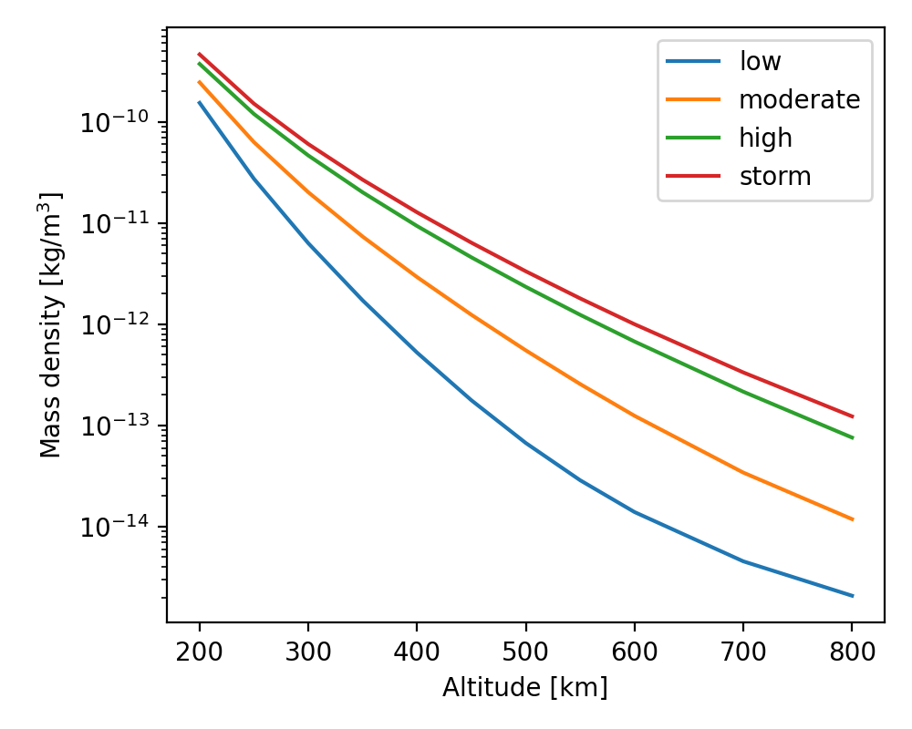
Figure 1
Figure 1. NRLMSISE-00 climatological mass-density profiles (200-800 km) for the four solar/geomagnetic regimes used here.

Slide 4
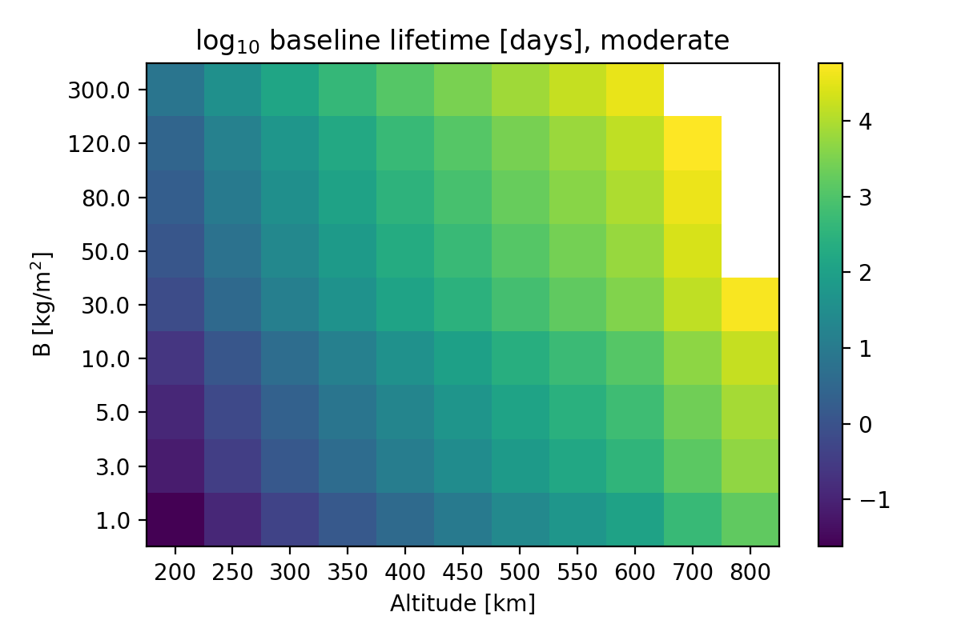
Figure 2
Figure 2. Baseline decay lifetime (log10 days) over altitude and ballistic coefficient B in the moderate regime; cells at the horizon are right-censored.

Slide 5
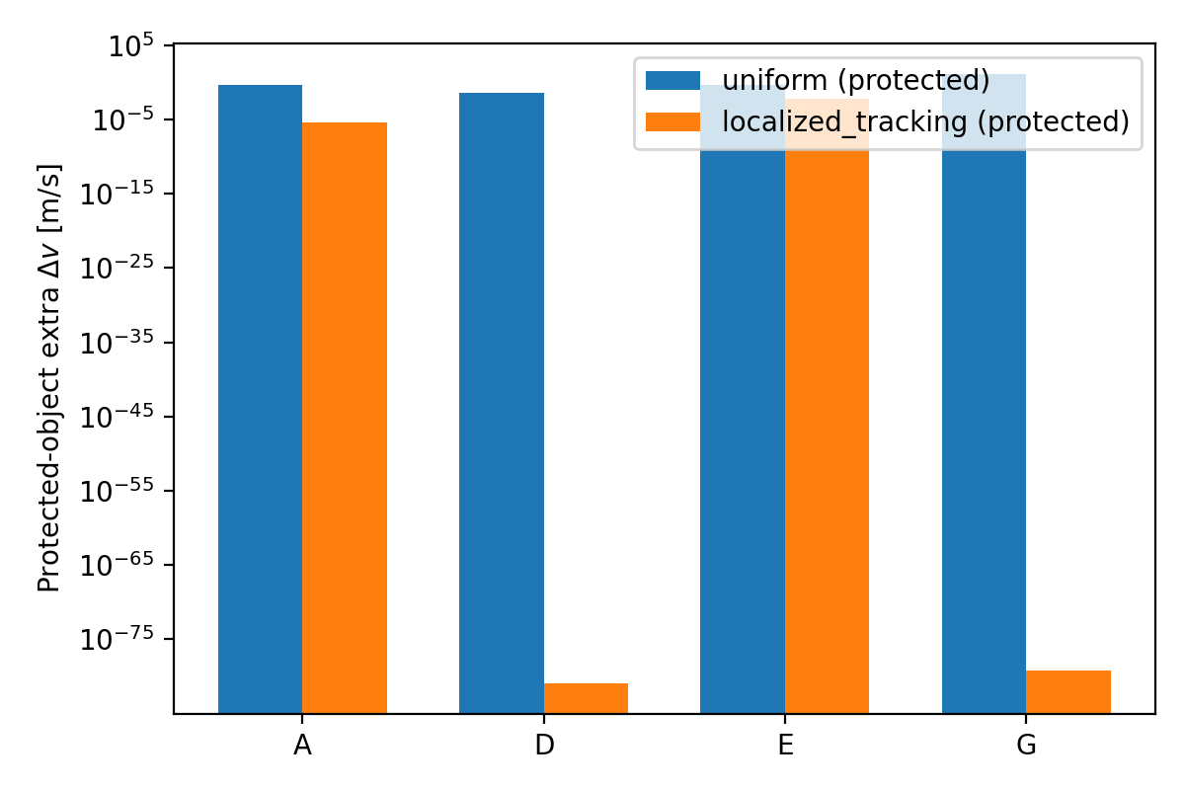
Figure 3
Figure 3. Absolute collateral delta-v imparted to protected objects under uniform versus localized enhancement, by case pair.

Slide 6
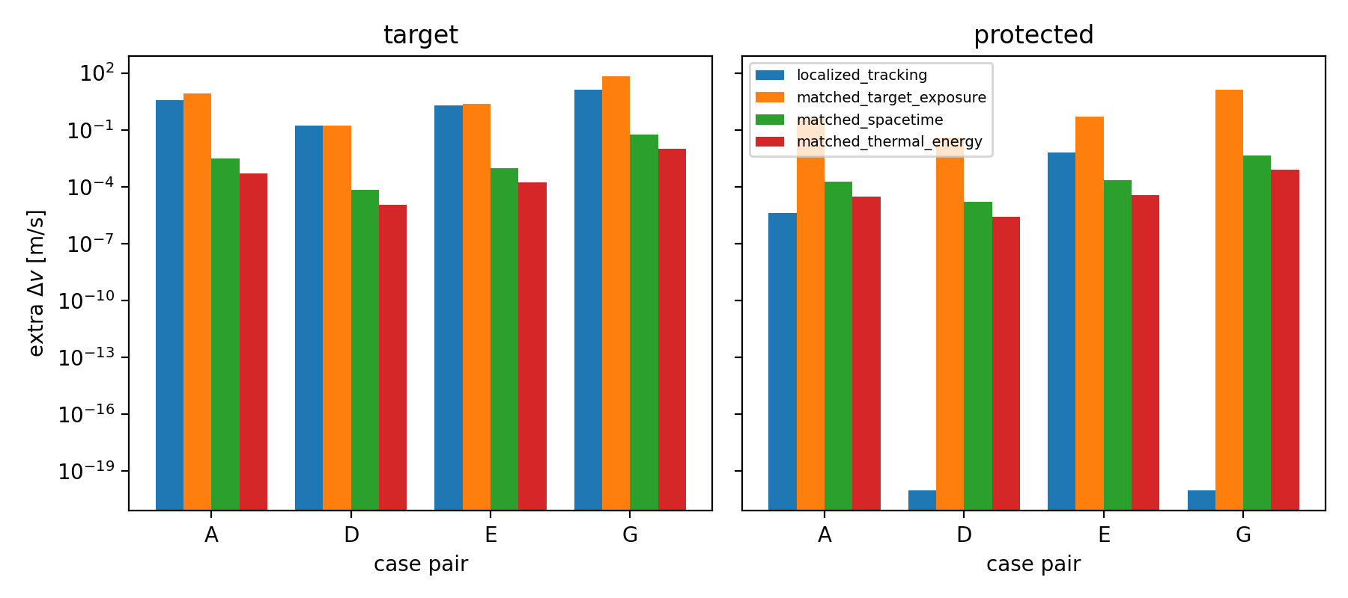
Figure 7
Figure 7. Target benefit (left) and protected-object collateral (right) under four matching conventions: the idealized localized bound, matched target exposure, matched enhanced spacetime volume, and matched lower-bound thermal energy.

Slide 7
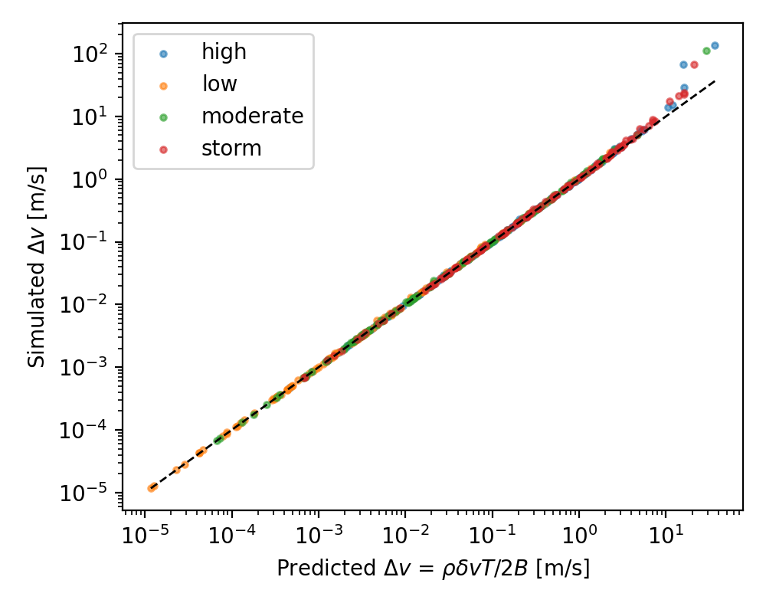
Figure 6
Figure 6. Simulated extra delta-v against the predicted value rho*delta*v_rel^2*T/(2B); all regimes, altitudes and ballistic coefficients collapse onto the identity line.

Slide 8
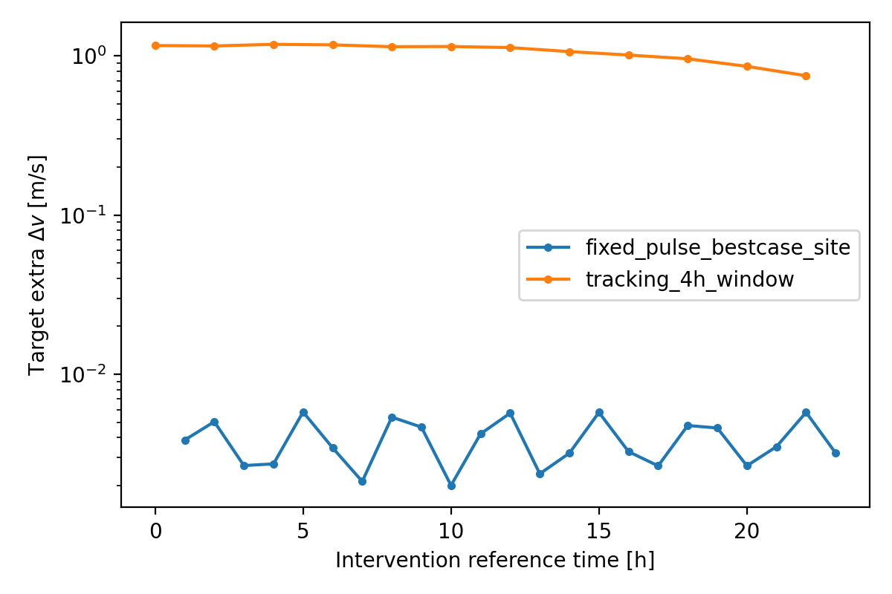
Figure 4
Figure 4. Target extra delta-v versus intervention reference time for a best-case-sited fixed pulse and for a 4 h tracking window.

Slide 9
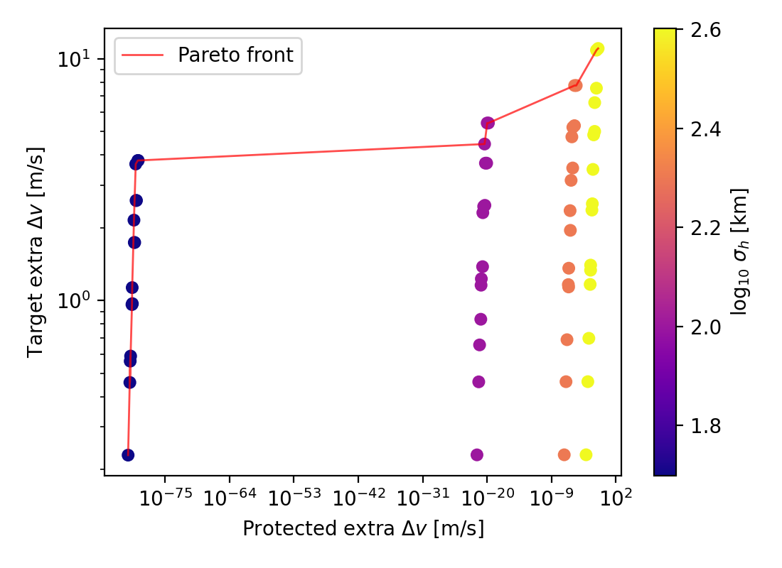
Figure 5
Figure 5. Target benefit against protected-object collateral over the design sweep; the Pareto front is highlighted and colour encodes horizontal patch scale.

Slide 10
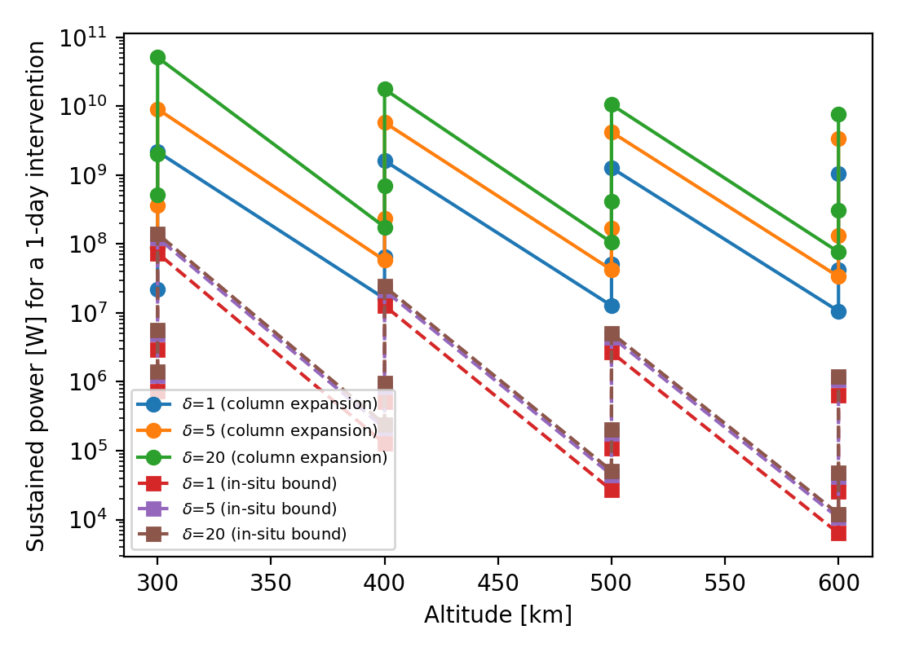
Figure 8
Figure 8. Sustained power corresponding to the thermodynamic lower bounds of Table 8, versus altitude and enhancement amplitude.

Slide 11
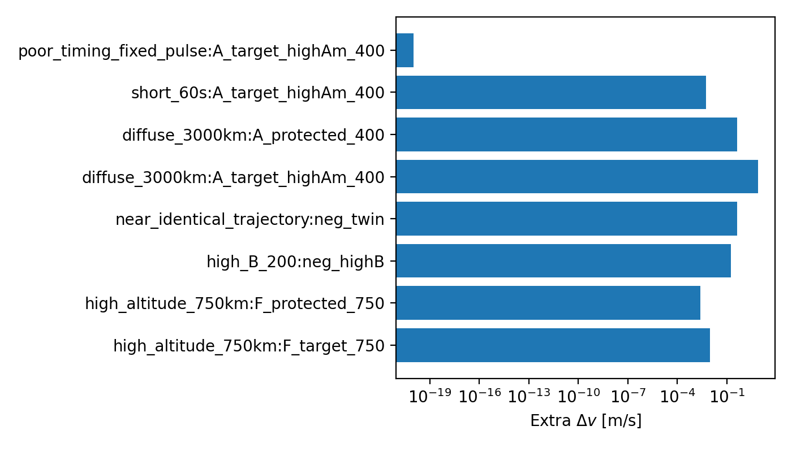
Figure S1
Figure S1. Extra delta-v for each mandatory negative control.

Slide 12
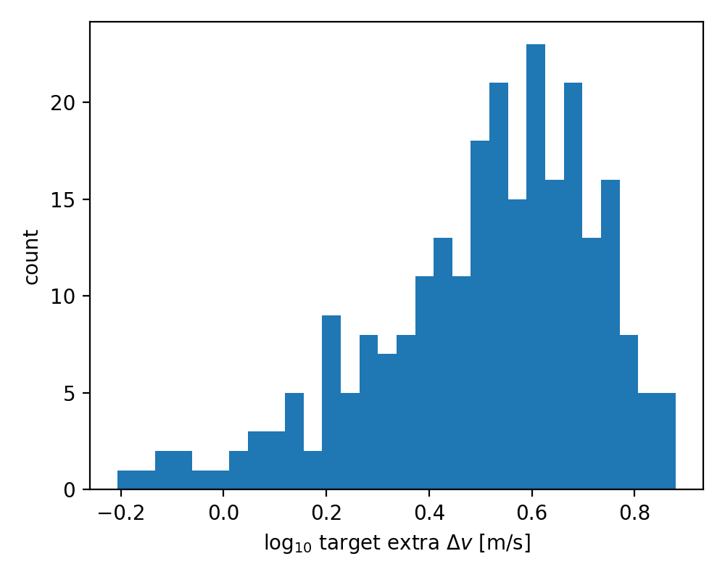
Figure S2
Figure S2. Monte Carlo distribution of target extra delta-v.

Slide 13
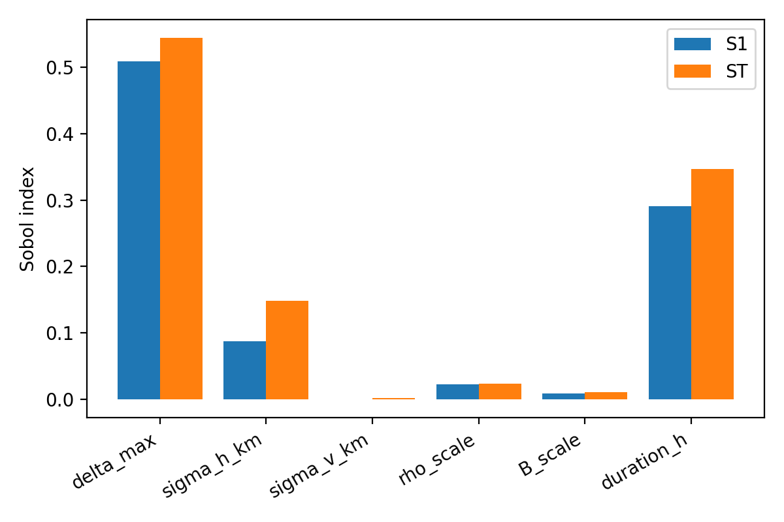
Figure S3
Figure S3. Sobol' first-order and total-order indices.

Slide 14
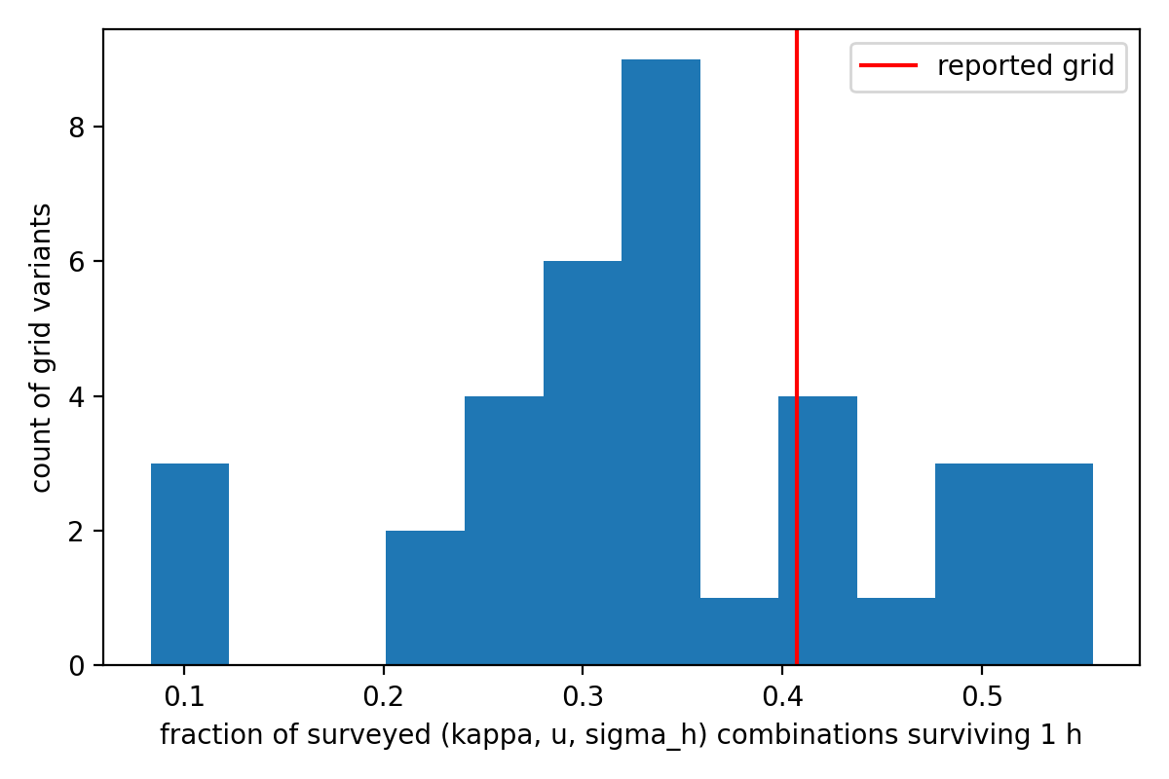
Figure S4
Figure S4. Transport-grid sensitivity of the surviving fraction.

Slide 15
Conclusions
• Selective thermospheric drag is mathematically well-posed and energetically quantifiable
• It is bounded by three gates: transit geometry, atmospheric transport, and shared-trajectory collateral
• Feasibility window is narrow and likely closed by transport physics — a quantitatively bounded negative result
• No hardware, no operational spacecraft targeted; synthetic objects only

