Slide 1
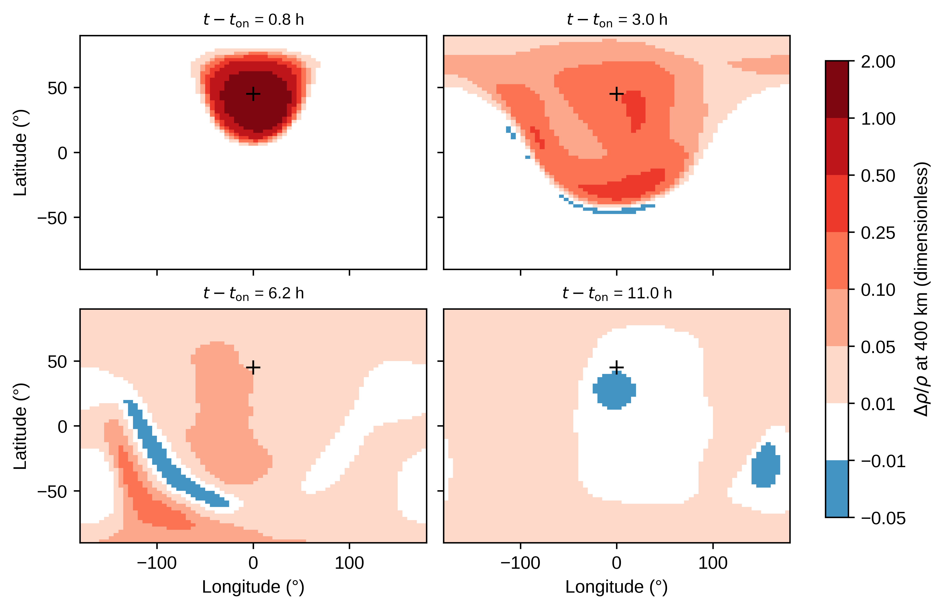
Fig. 1. Relative neutral mass-density perturbation Δρ/ρ (heated minus control, divided by control) at 400 km in the fine-grid (5°×2.5°) GITM pair, at four times after the onset of the 100 GW, 1 h heat source centred at 45°N, 0°E, 300 km (cross). Densities are interpolated log-linearly in altitude to 400 km; times are the nearest 10 min model outputs. The colour scale is non-linear and common to all panels; values between −0.01 and 0.01 are white. All plotted values (−0.030 to 1.94) lie inside the colour range (−0.05 to 2.0), so no cell is saturated.

Slide 2
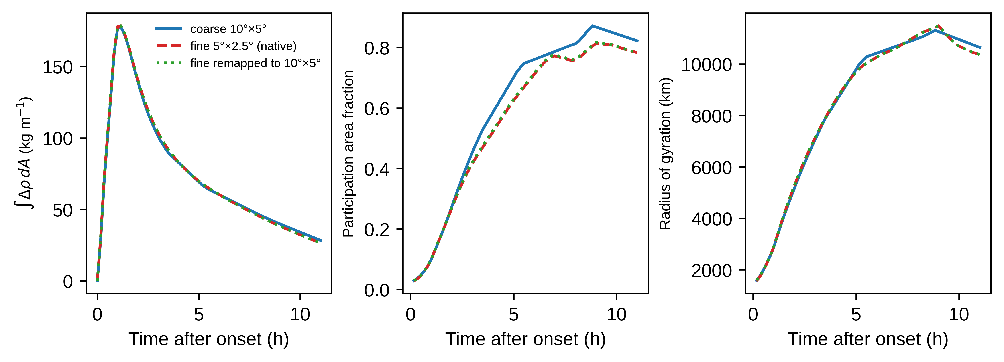
Fig. 2. Redistribution of the 400 km density perturbation for the 100 GW, 300 km case: (a) area-integrated excess ∫Δρ dA over the 400 km shell (kg m−1), (b) participation area fraction, (∫Δρ+ dA)2/(A∫Δρ+2 dA), where Δρ+ is the positive part of Δρ and A the shell area, (c) anomaly-weighted radius of gyration about the anomaly centroid. Solid: coarse grid (10°×5°); dashed: fine grid (5°×2.5°); dotted: fine grid conservatively remapped (area-weighted 2×2 means of ρ) to the coarse grid before differencing.

Slide 3
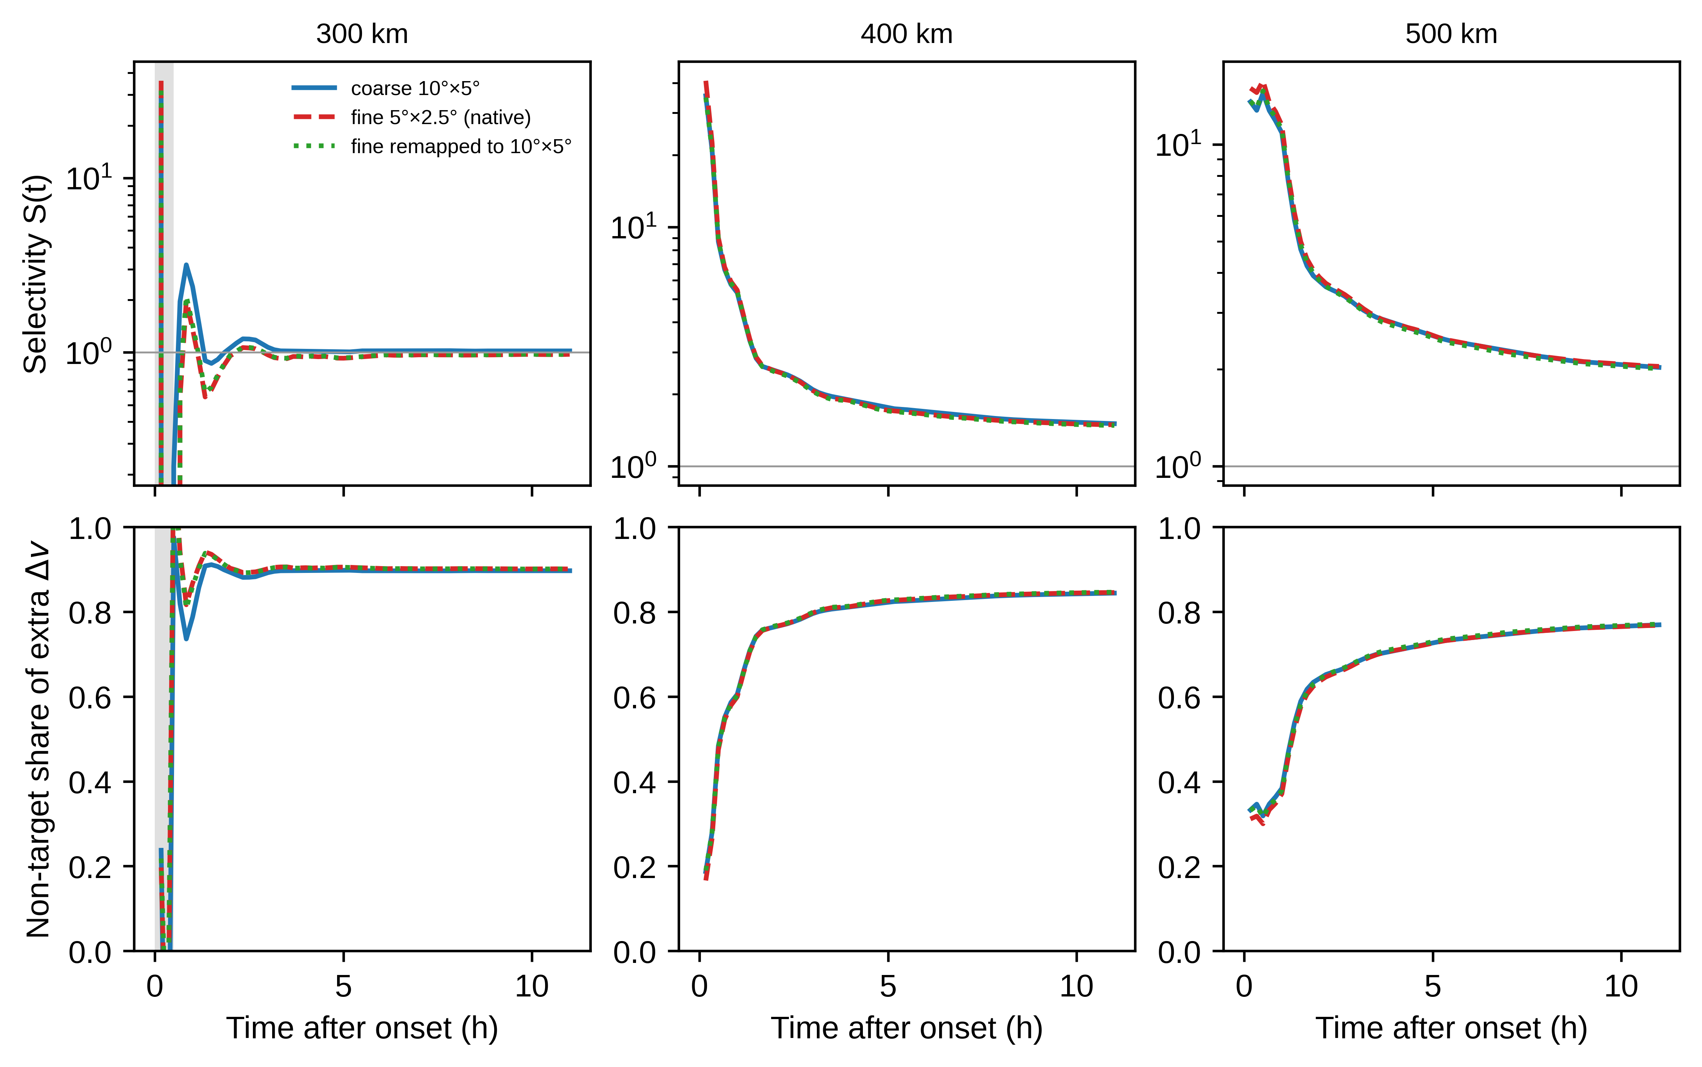
Fig. 3. Time evolution of the cumulative drag selectivity S(t) (mean extra Δv of target objects divided by that of non-target objects; top) and the non-target share of the total extra Δv (bottom) for 256 synthetic circular orbits per shell at 300, 400 and 500 km (B = 30 kg m−2). Line styles as in Fig. 2. Grey shading marks the first 30 min at 300 km, during which the cumulative extra Δv of the target or non-target group is still zero or negative in at least one run, so the ratio has no defined sign; values outside the shading are not filtered. Non-positive ratios cannot appear on the logarithmic axis.

Slide 4
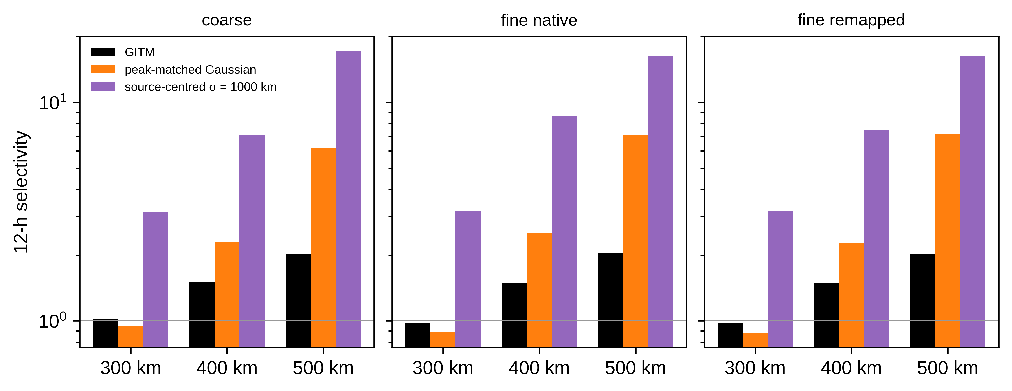
Fig. 4. Selectivity over the 12 h case window (11 h after onset) from GITM and from two static Gaussian density patches imposed on the GITM control atmosphere: a peak-matched fit (amplitude, centre and e−1/2 width of the GITM perturbation at its peak, switched on while the GITM peak exceeds half its maximum) and a source-centred patch with σ = 1000 km and the same amplitude and window. Panels: coarse grid, fine grid on its native grid, and fine grid remapped to the coarse grid. Logarithmic ordinate. The patches are diagnostic comparators for the prescribed-field assumption, not alternative physical solutions or upper bounds.

Slide 5
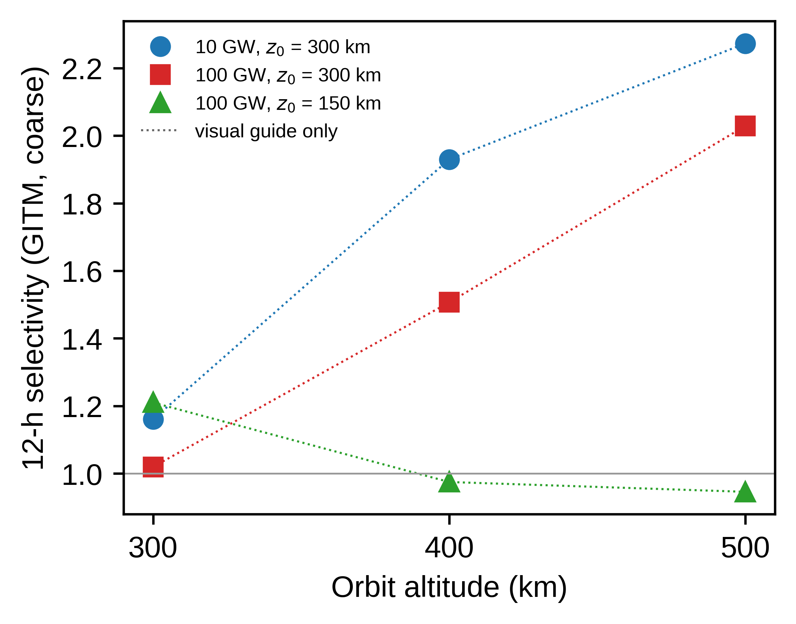
Fig. 5. Dependence of the 12 h GITM selectivity on heating power and deposition altitude (coarse grid only, two levels per factor): 10 GW and 100 GW deposited around 300 km (σz = 50 km), and 100 GW deposited around 150 km (σz = 20 km); same horizontal source shape, timing and orbit population in all cases. Markers are the three simulated orbit altitudes; dotted lines only guide the eye and do not imply a continuous altitude or power response.

