Slide 1
Figure 1. PRISMA-ScR Flow Diagram
IDENTIFICATION
Records identified through
database searching
(n = 847)
Additional records from
grey literature & guidelines
(n = 156)
SCREENING
Records after duplicates removed
(n = 724)
Records screened by
title/abstract
(n = 724)
Records excluded
(n = 518)
ELIGIBILITY
Full-text articles assessed
for eligibility
(n = 206)
Full-text excluded (n = 138)
Reasons:
- Not athlete-specific (n=42)
- Outdated guidelines (n=31)
- Not TUE-related (n=38)
- Duplicate data (n=27)
INCLUDED
Sources included in review
(n = 68)
WADA regulatory
documents (n=18)
Clinical practice
guidelines (n=22)
Peer-reviewed
articles (n=28)

Slide 2
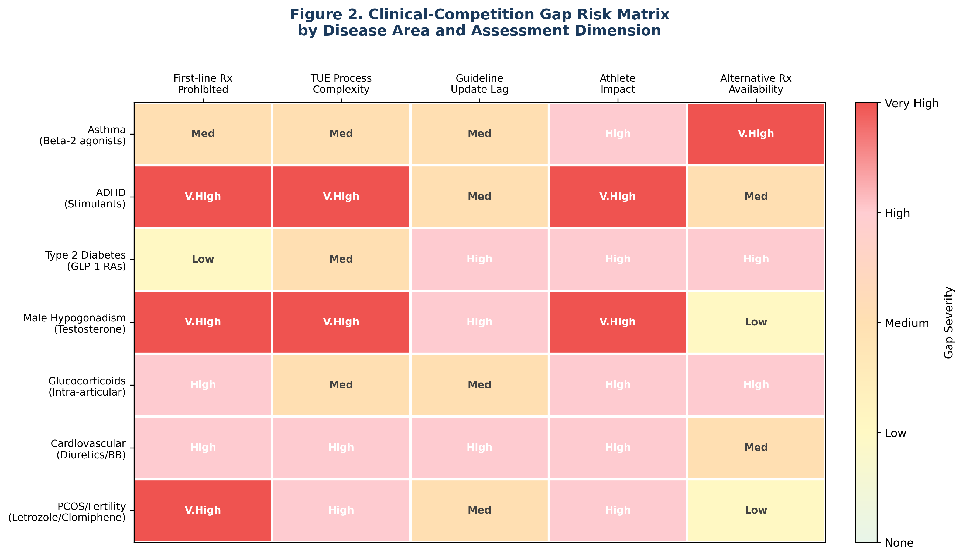
Figure 2. Clinical-Competition Gap Risk Matrix

Slide 3
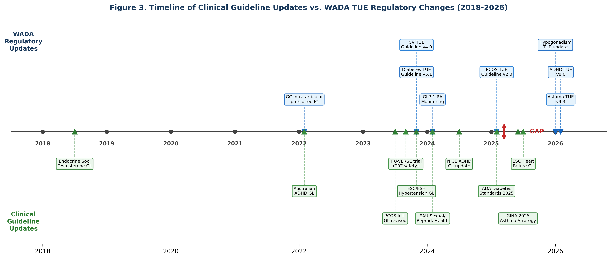
Figure 3. Timeline: Clinical Guidelines vs WADA Regulatory Changes (2018–2026)

Slide 4
Figure 4. Conceptual Framework: The Clinical-Competition Gap
CLINICAL PRACTICE
GUIDELINES
WADA ANTI-DOPING
REGULATIONS
CLINICAL-COMPETITION
GAP
GINA (Asthma) ADA (Diabetes) Endocrine Society (Testosterone) ESC/ESH (Cardiology) NICE (ADHD) PCOS Intl. Guideline
→
←
Prohibited List (annual) ISTUE Standards TUE Physician Guidelines Monitoring Program ADAMS System
• Update timing lag • Divergent diagnostic criteria • Prohibited first-line therapies • TUE process barriers
IMPACT ON ATHLETES
Suboptimal treatment | Delayed care access | ADRV risk | Privacy concerns | Geographic disparities | Career impact
RECOMMENDATIONS: Harmonize updates | Streamline TUE | Educate clinicians

Slide 5
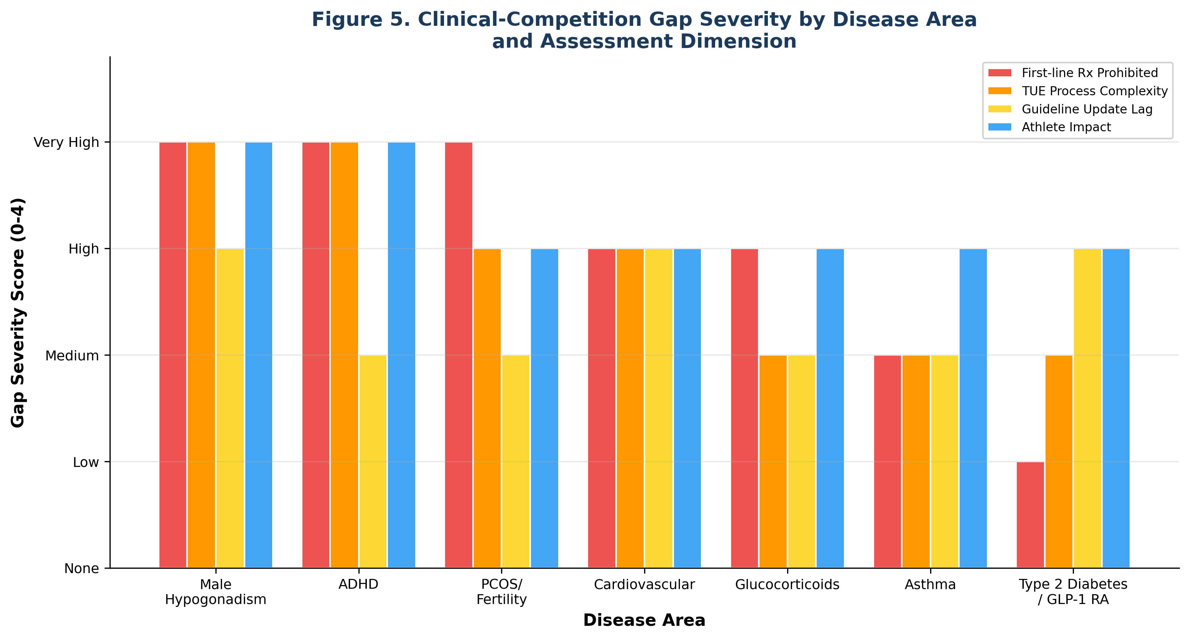
Figure 5. Clinical-Competition Gap Severity by Disease Area

