Slide 1
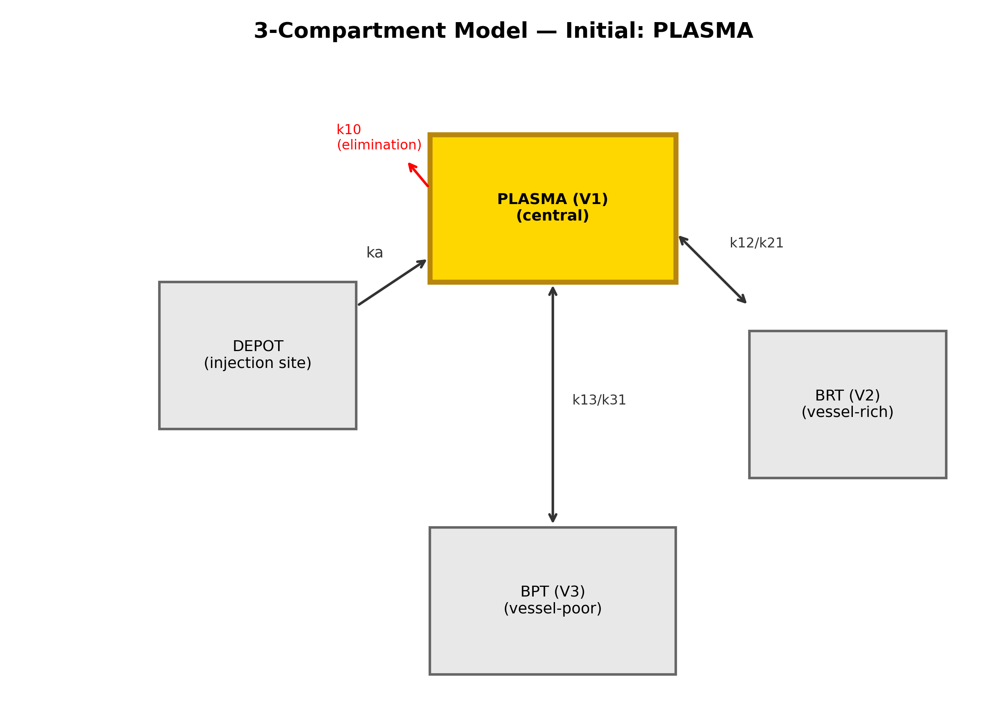
Figure 1
Figure 1. Three-compartment model with selectable initial compartment (plasma highlighted).

Slide 2
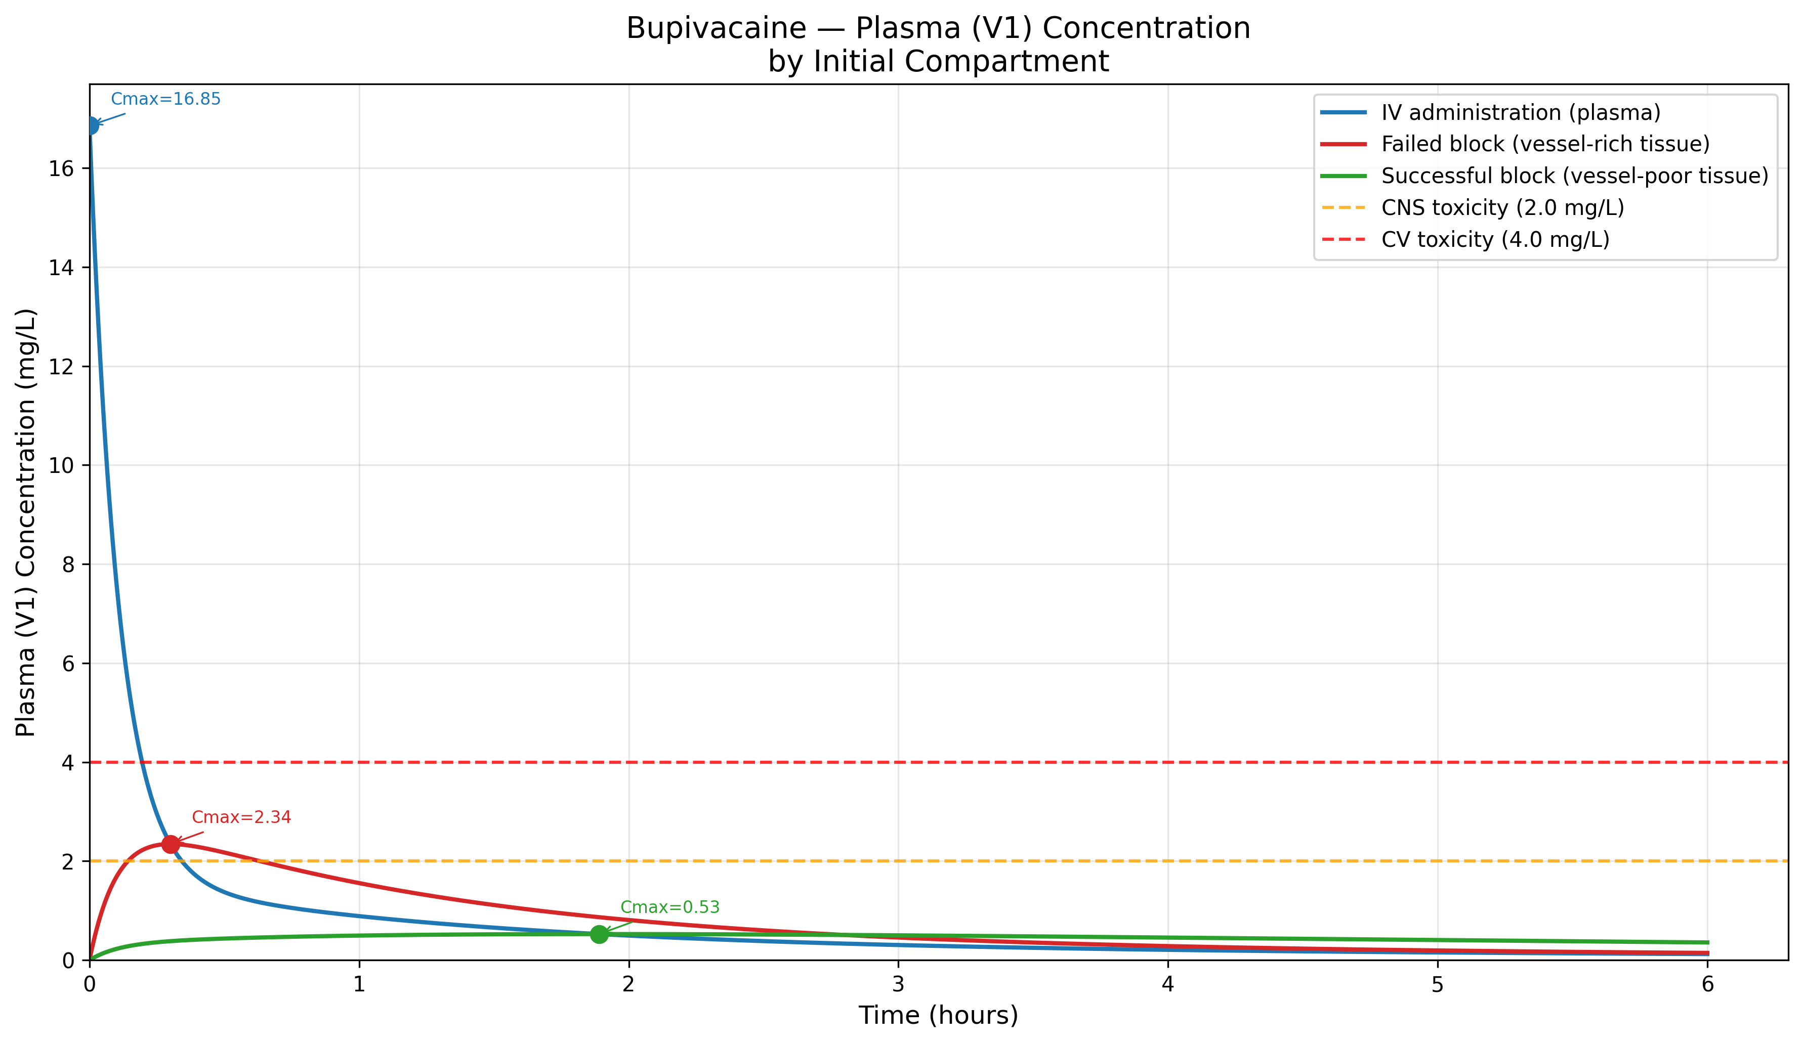
Figure 2
Figure 2. Bupivacaine 150 mg — Plasma concentration by initial compartment with toxicity thresholds.

Slide 3
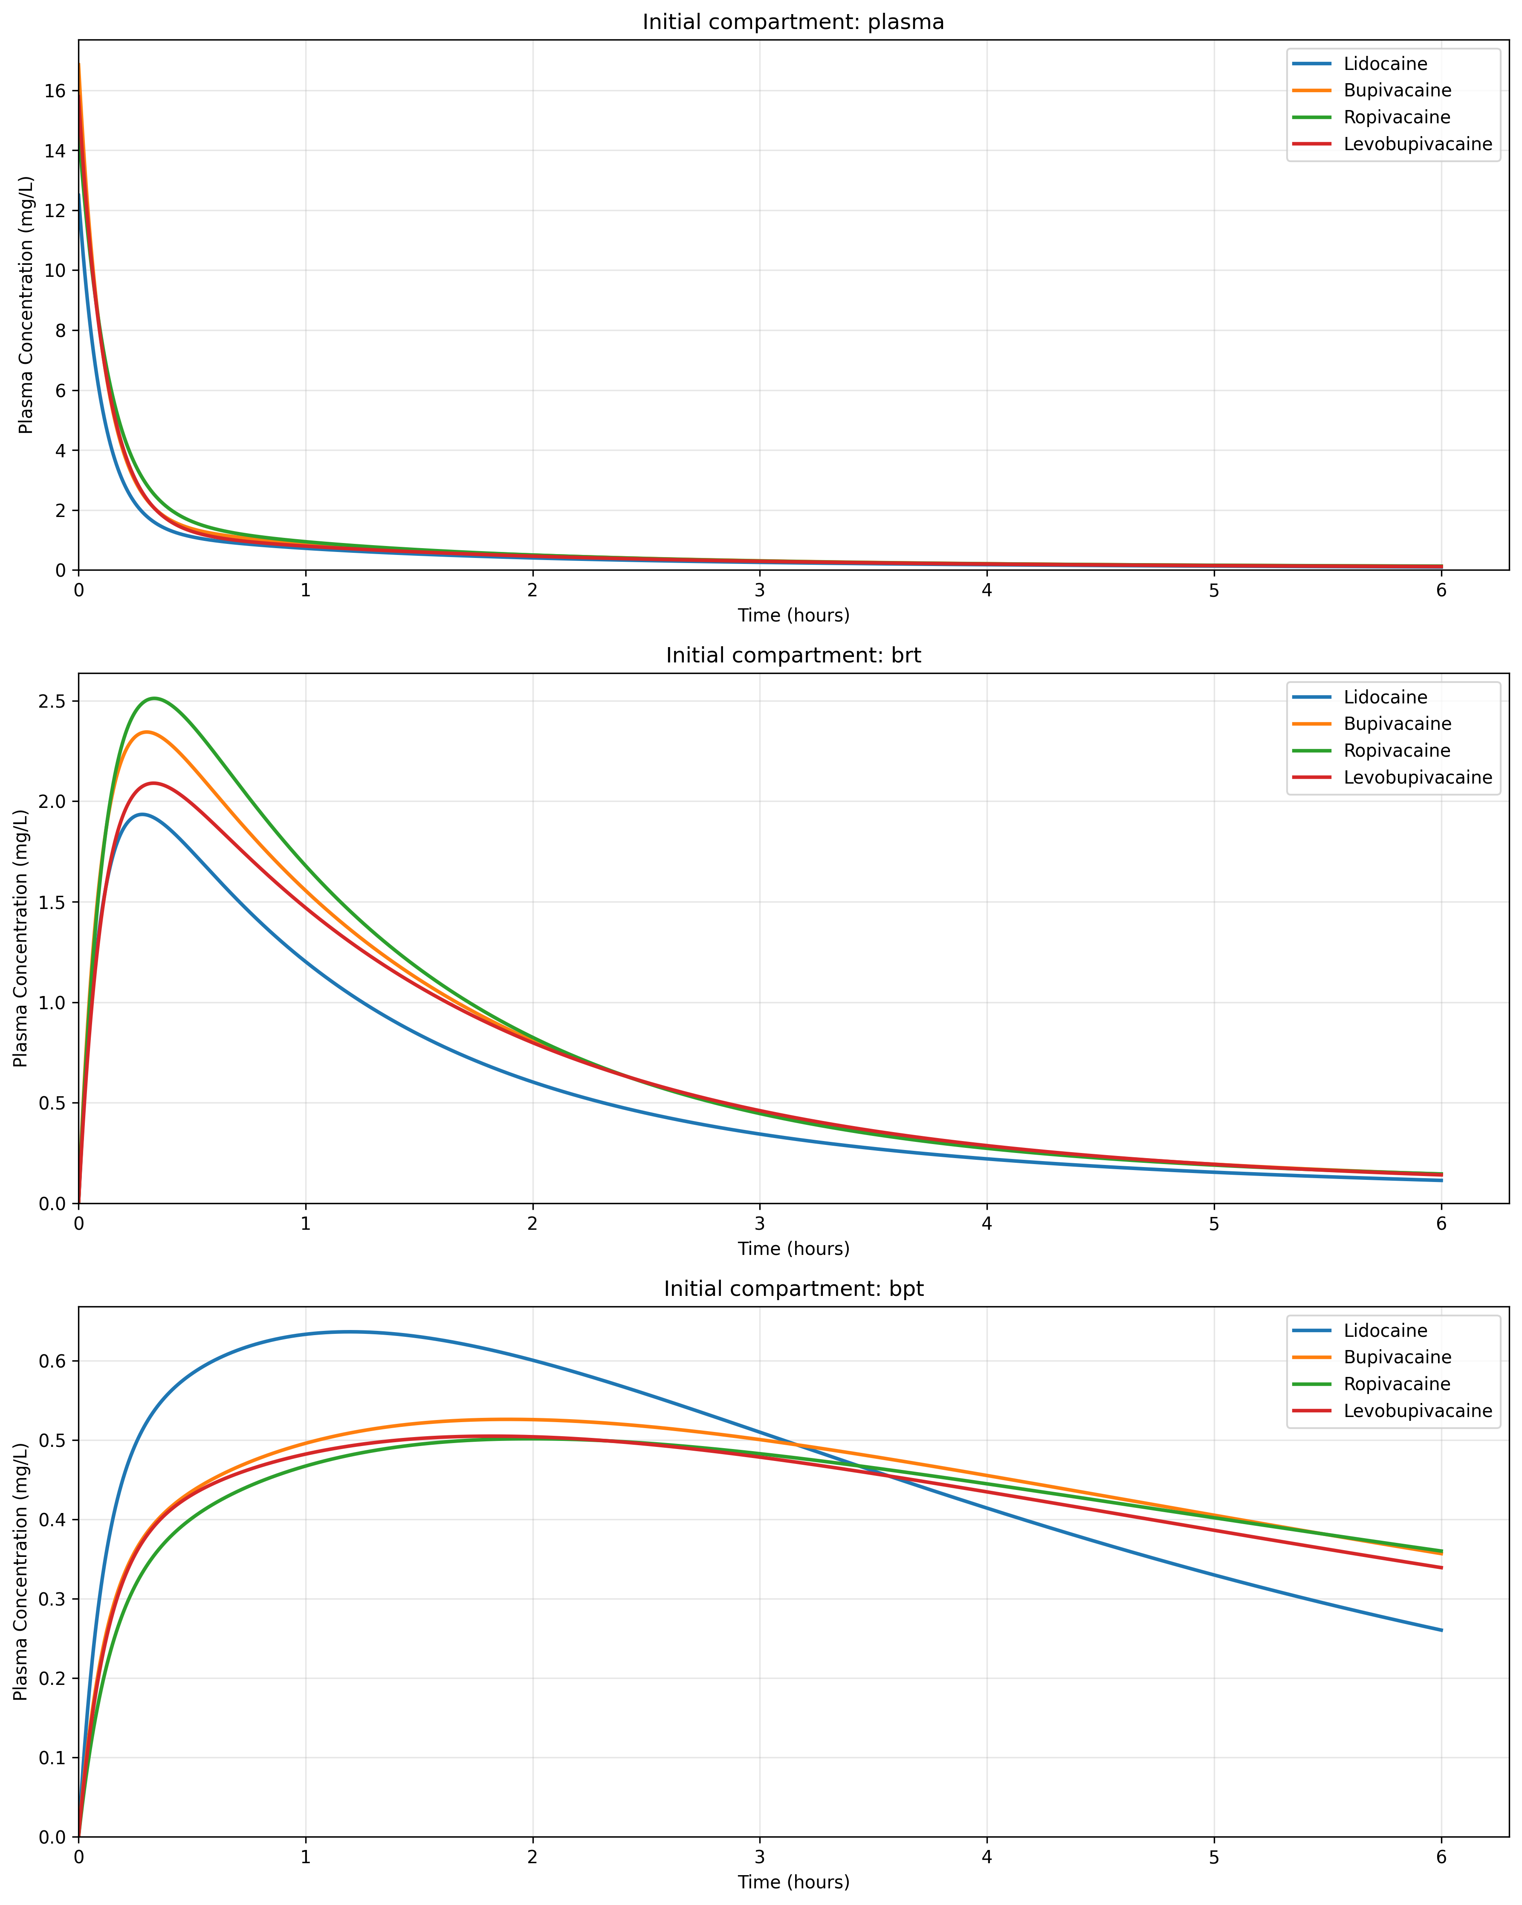
Figure 3
Figure 3. Plasma concentration comparison for all four local anesthetics by initial compartment.

Slide 4
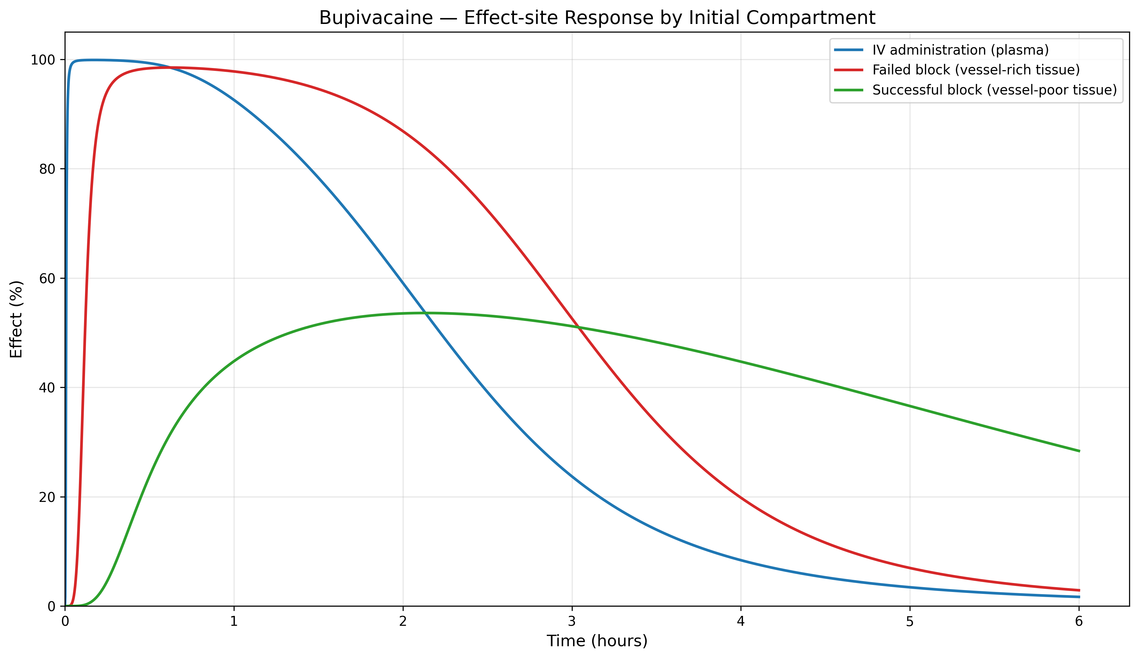
Figure 4
Figure 4. Bupivacaine — Effect-site response by initial compartment.

Slide 5
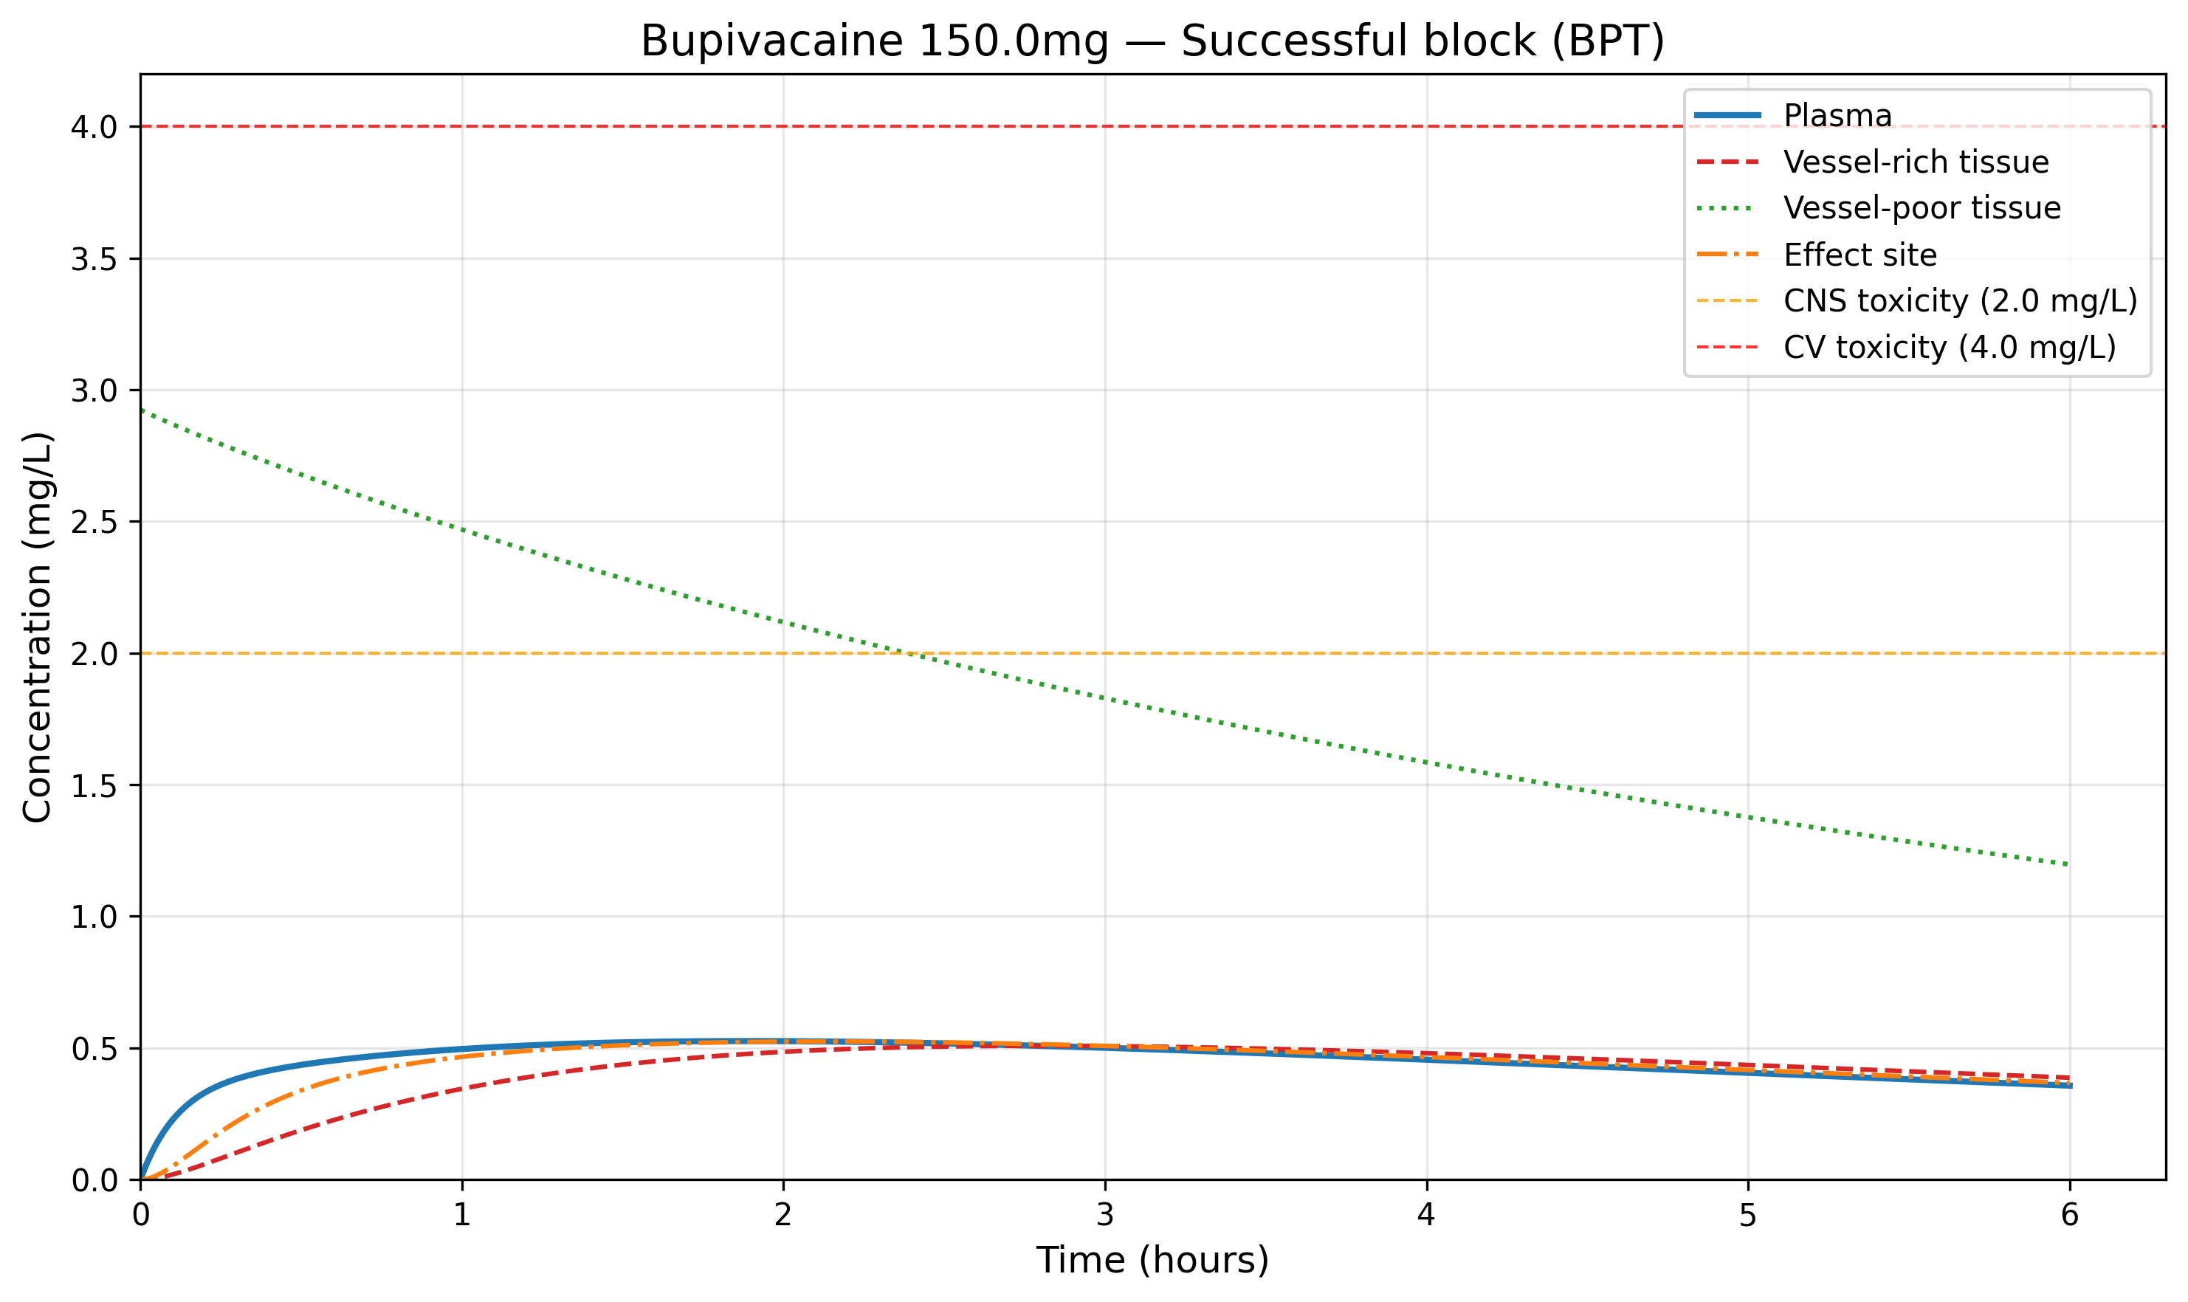
Figure 5
Figure 5. Bupivacaine 150 mg from BPT — Full compartment concentration profile.

Slide 6
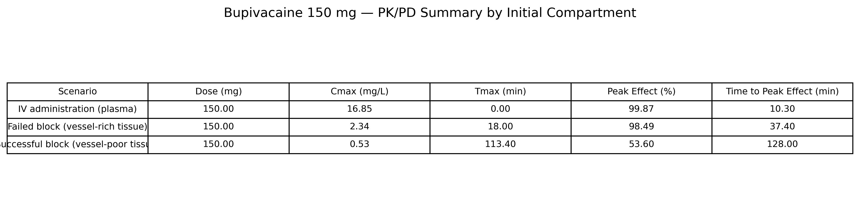
Figure 6
Figure 6. Bupivacaine 150 mg — PK/PD summary by initial compartment.

