Slide 1
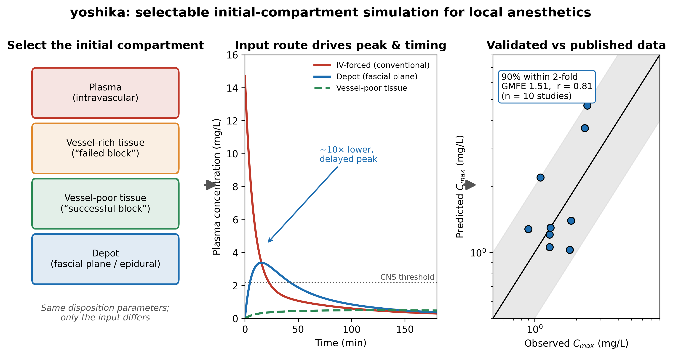
Graphical Abstract
Selectable initial compartment -> order-of-magnitude effect on predicted peak and timing -> external validation against published data (90% within two-fold; GMFE 1.51; r = 0.81).

Slide 2
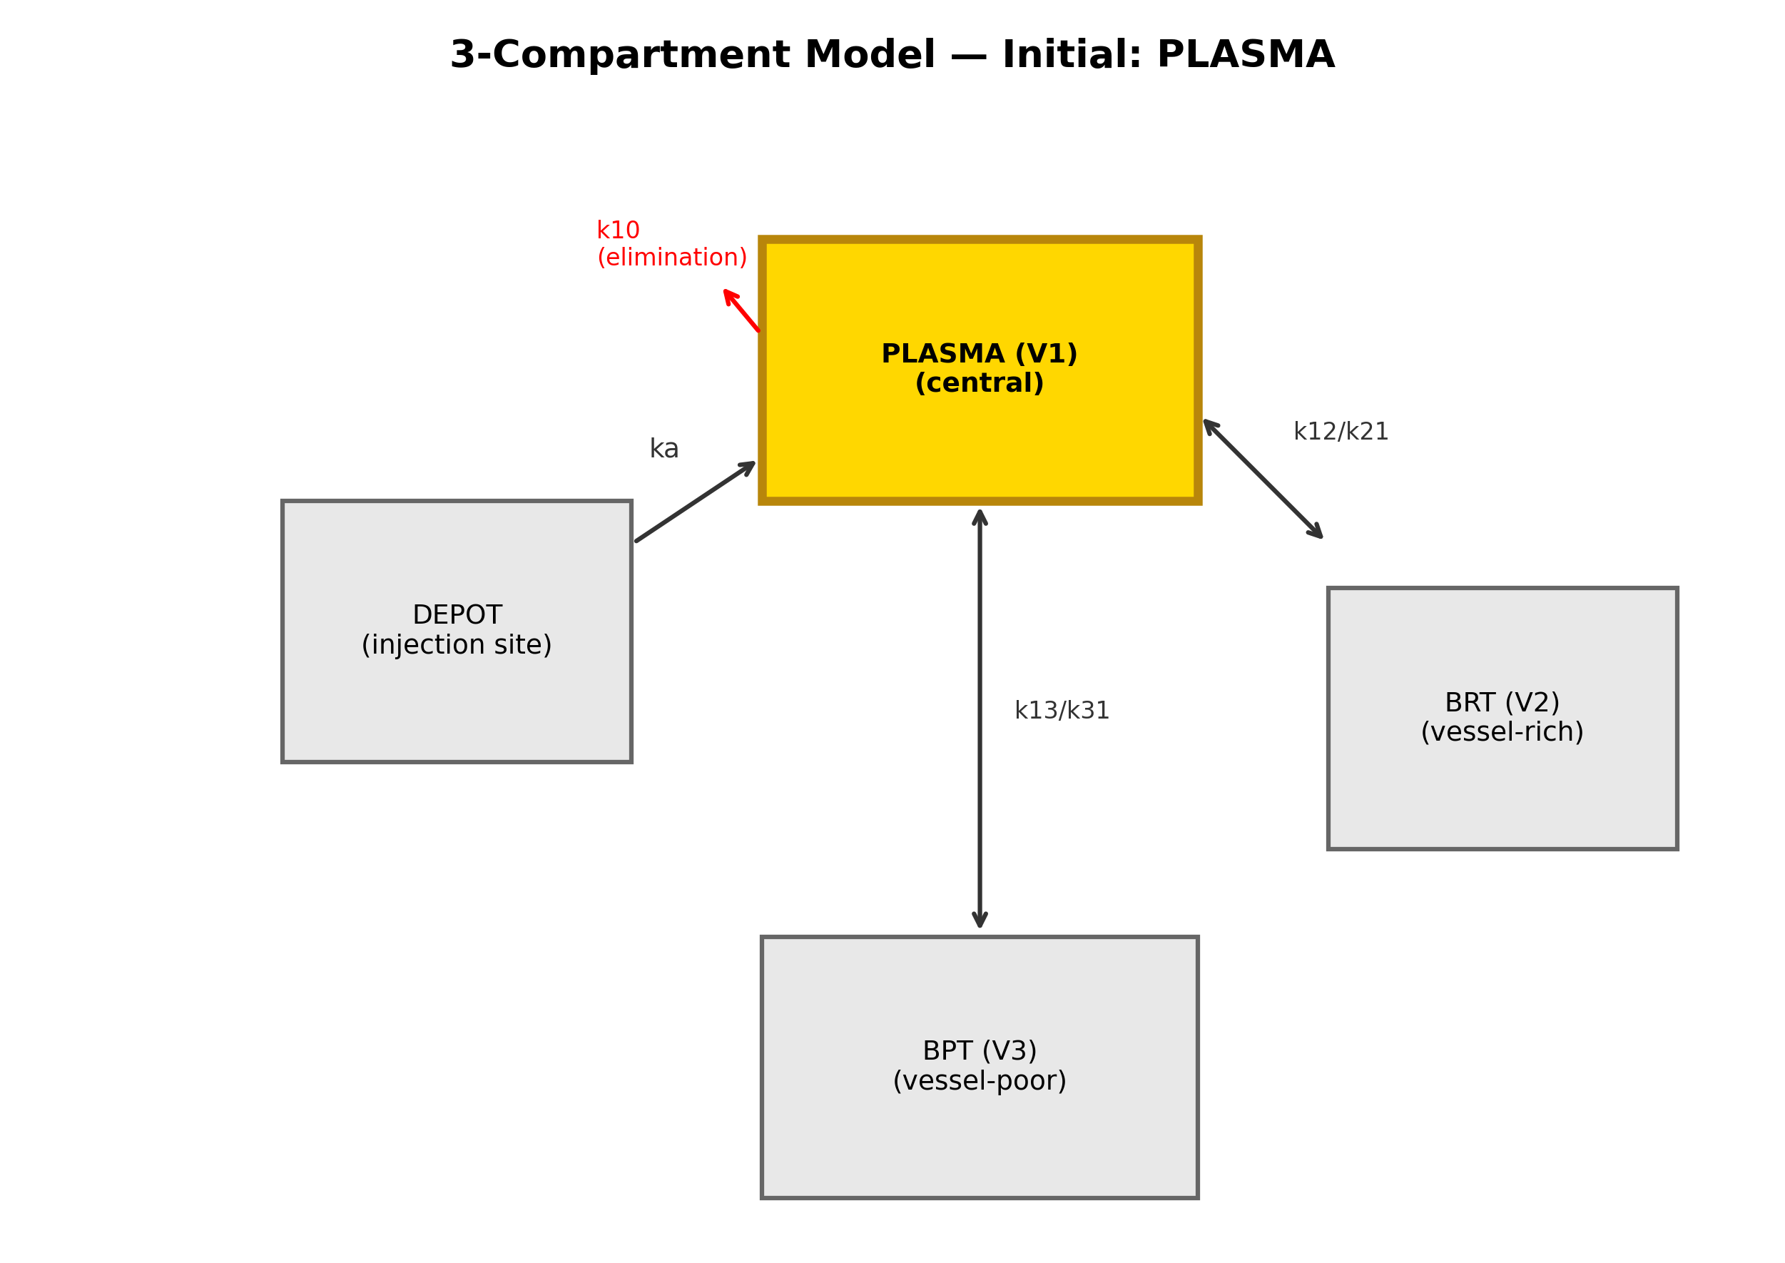
Figure 1: Three-compartment model
Three-compartment model with selectable initial compartment (plasma highlighted).

Slide 3
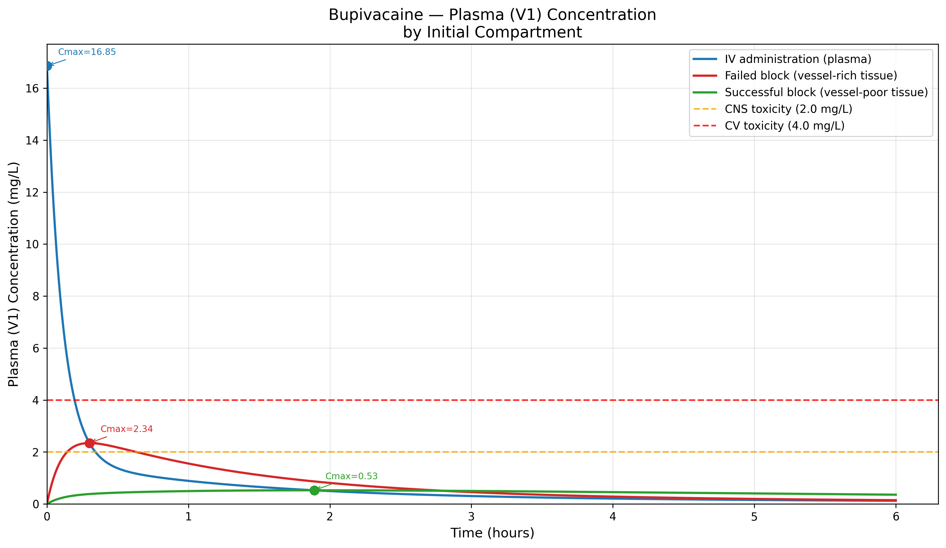
Figure 2: Bupivacaine by initial compartment
Bupivacaine 150 mg: plasma concentration by initial compartment with toxicity thresholds.

Slide 4
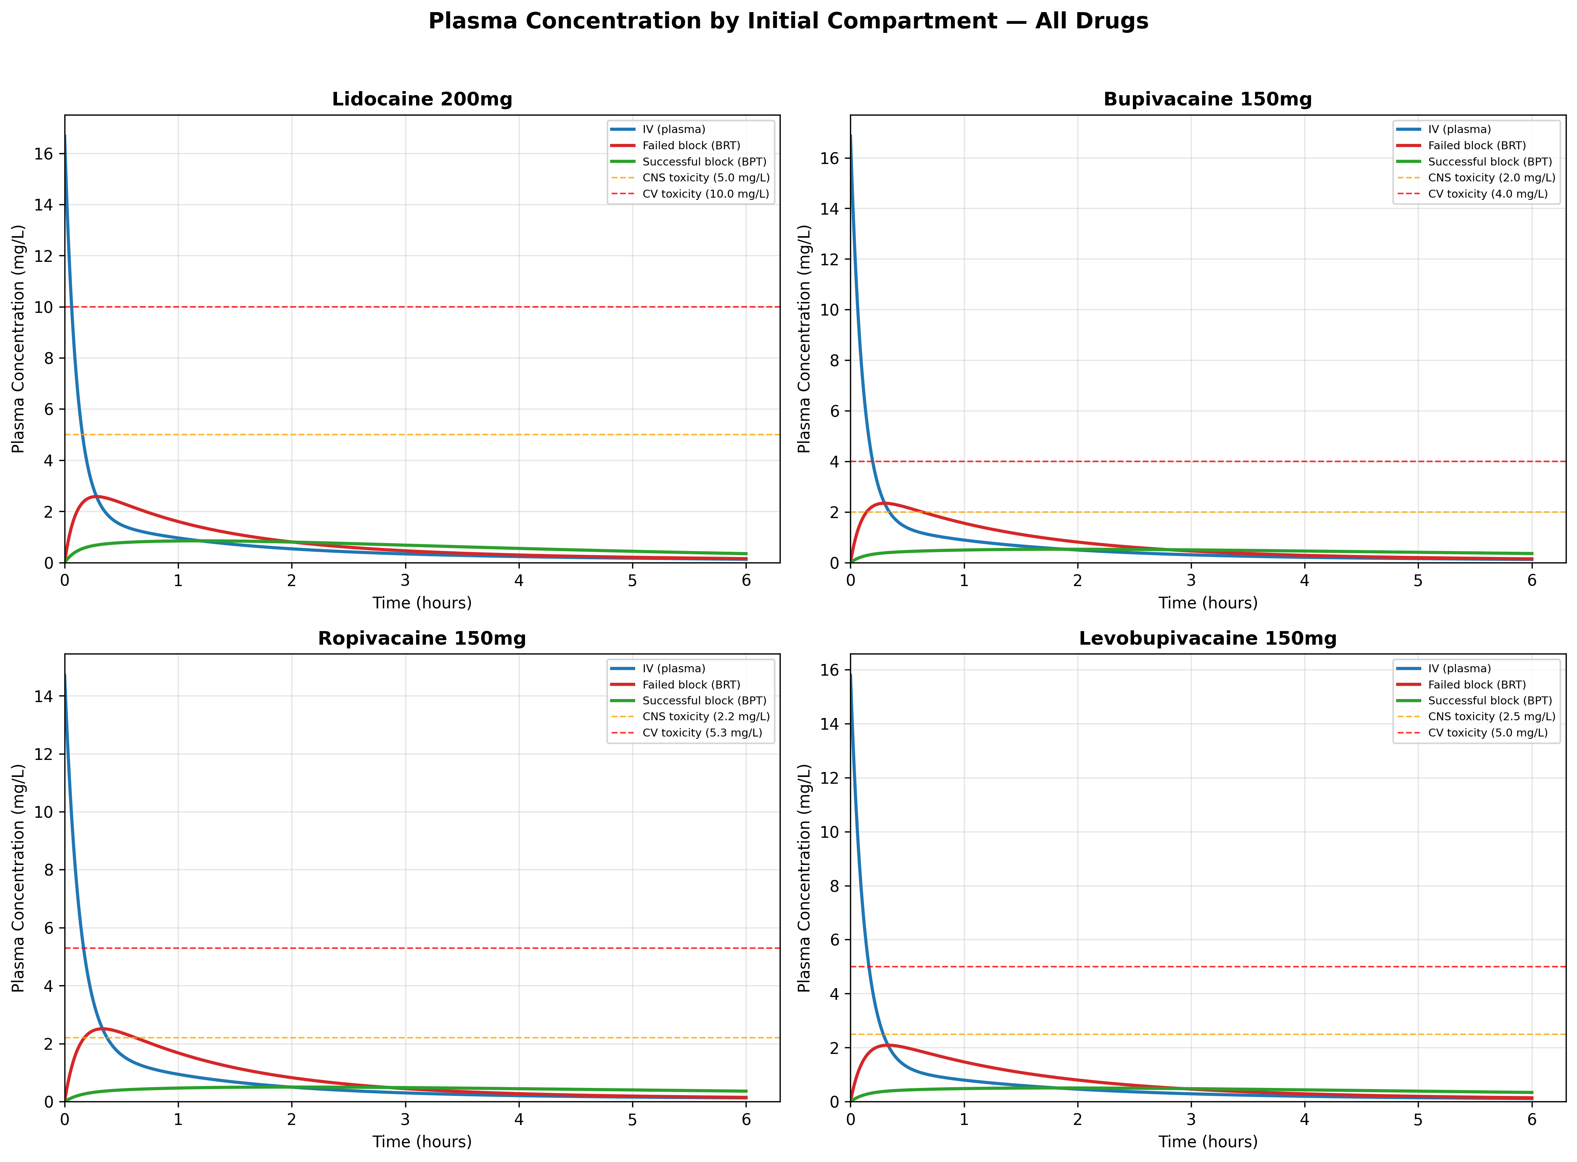
Figure 3: Four local anesthetics
Plasma concentration comparison for all four local anesthetics by initial compartment.

Slide 5
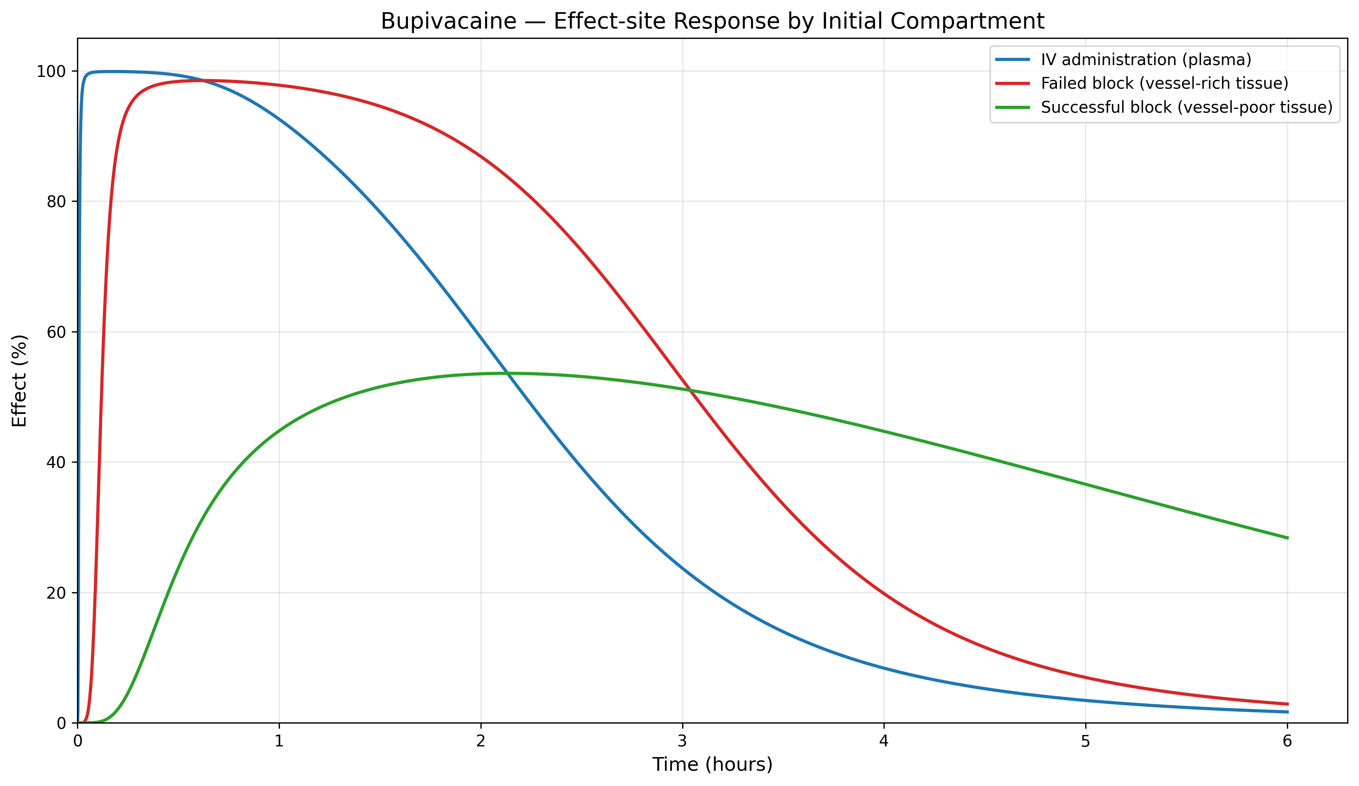
Figure 4: Effect-site response
Bupivacaine: effect-site response by initial compartment.

Slide 6
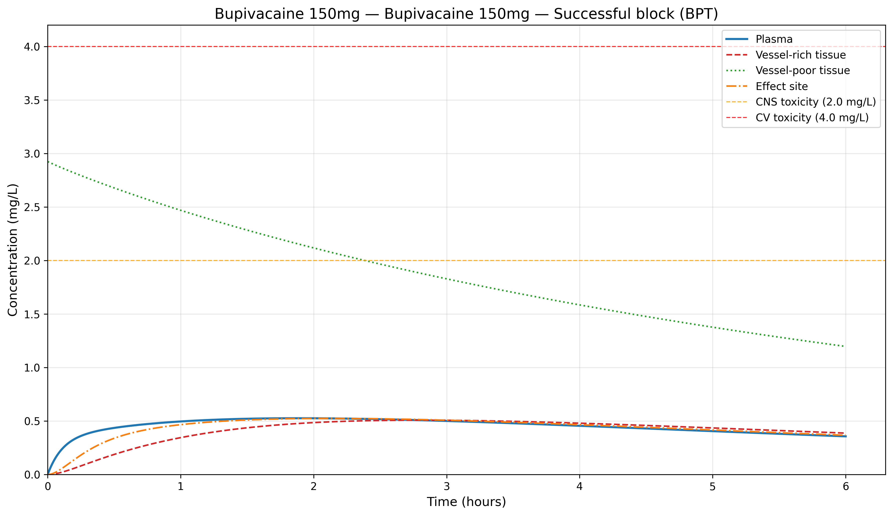
Figure 5: Full compartment profile
Bupivacaine 150 mg from vessel-poor tissue (BPT): full compartment concentration profile.

Slide 7
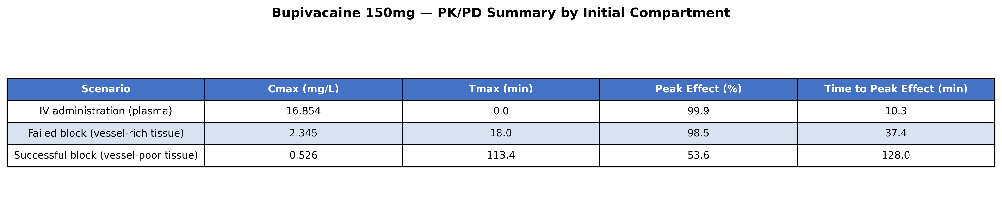
Figure 6: PKPD summary
Bupivacaine 150 mg: PKPD summary by initial compartment.

Slide 8
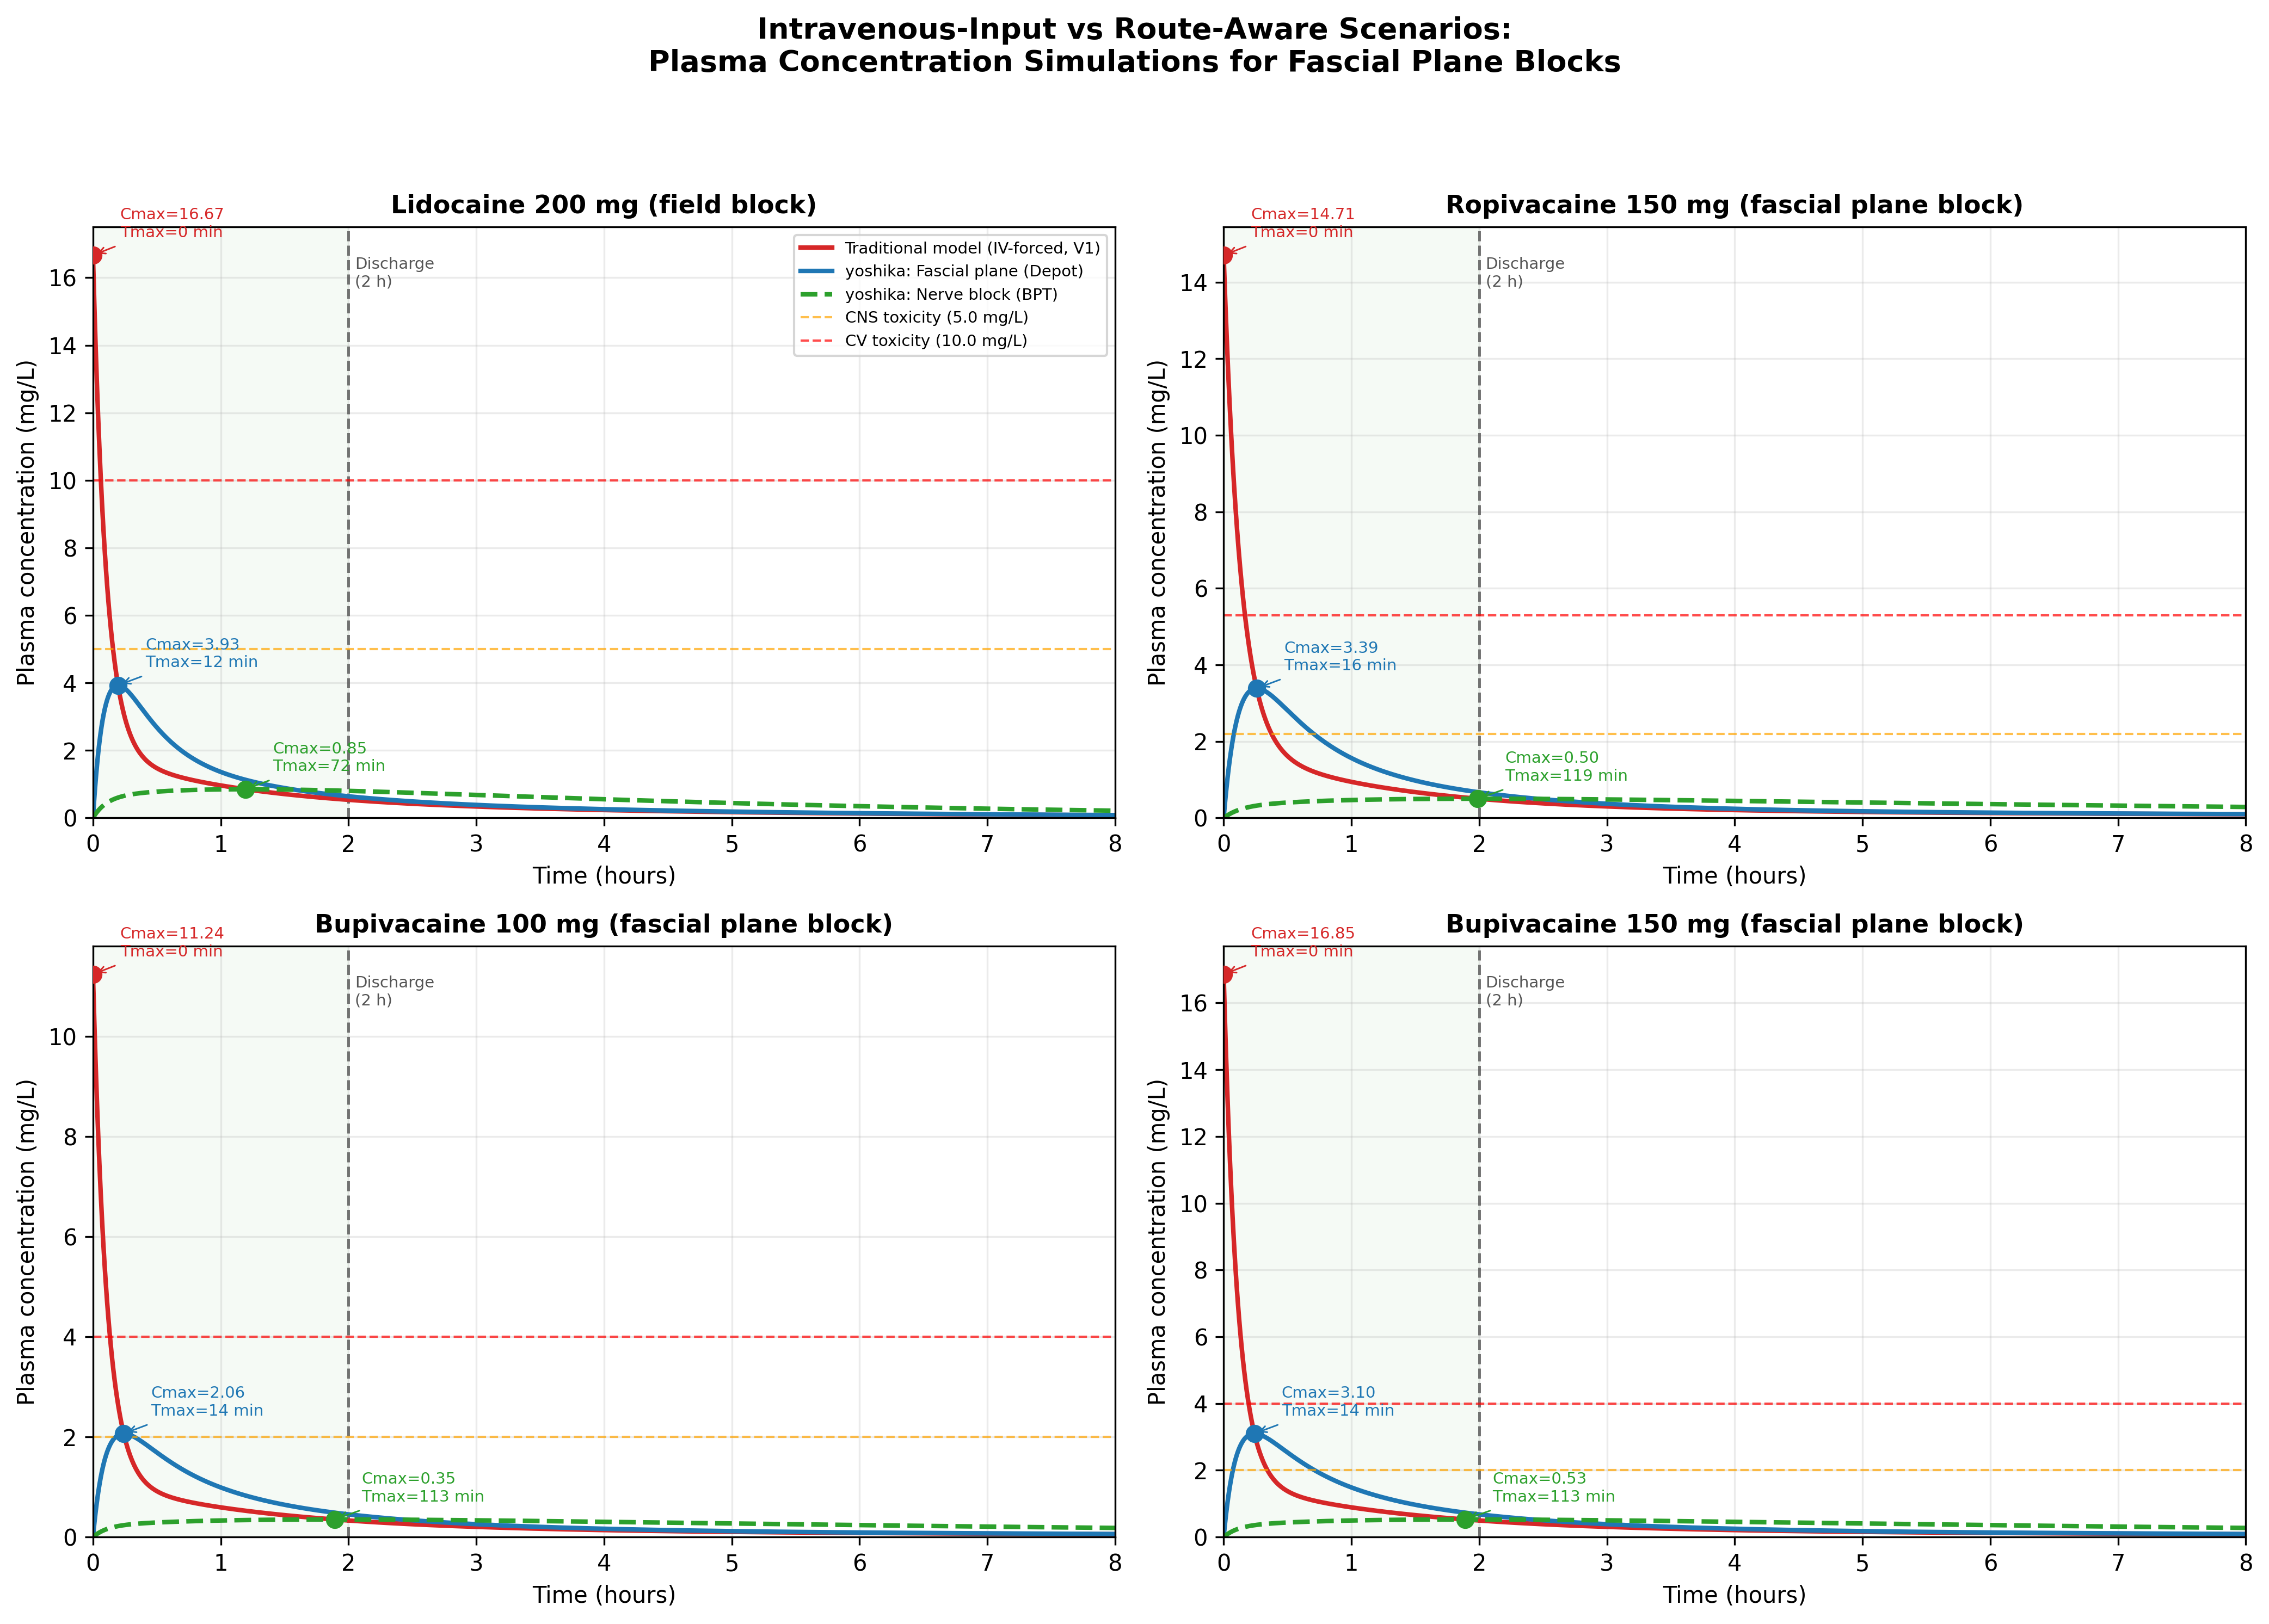
Figure 7: Route-aware scenarios
Plasma concentration-time curves: intravenous-input model (red) vs depot/fascial plane (blue) and vessel-poor tissue/BPT (green dashed). Simulation scenarios; shared rate constants, only the initial compartment differs.

Slide 9
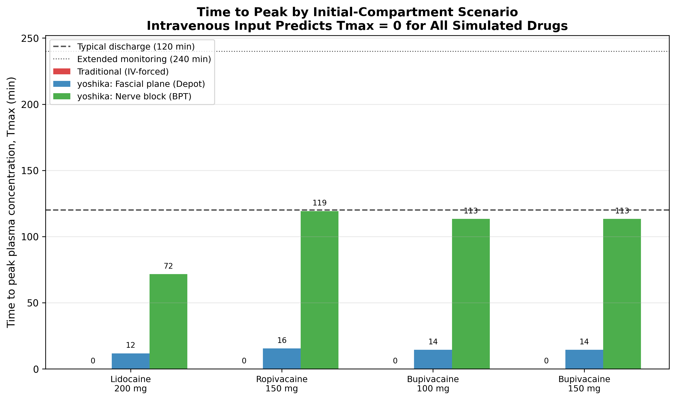
Figure 8: Time to peak (Tmax)
The intravenous-input model predicts Tmax = 0 for all drugs. Route-aware scenarios place the simulated peak tens of minutes later. Simulation outputs, not measured values.

Slide 10
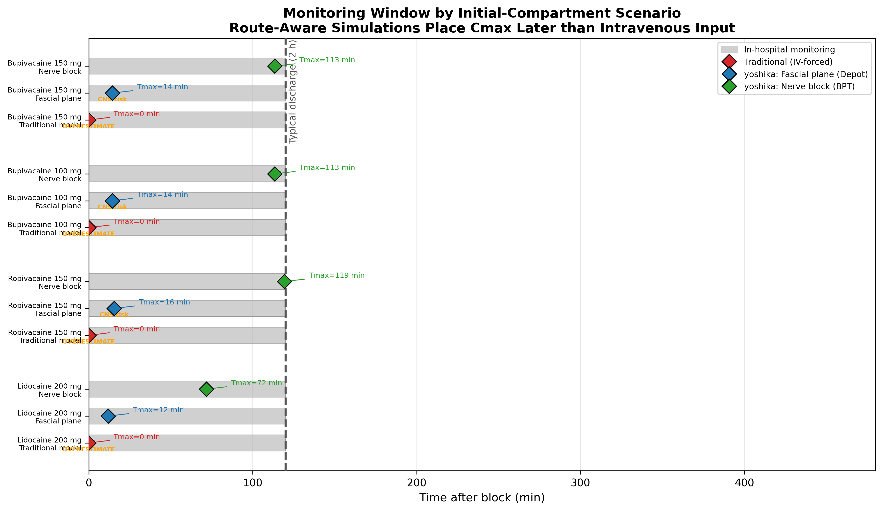
Figure 9: Monitoring window
Simulated peak timing relative to discharge. Diamond markers = Tmax under each scenario. Simulation scenarios, not clinically proven predictions.

Slide 11
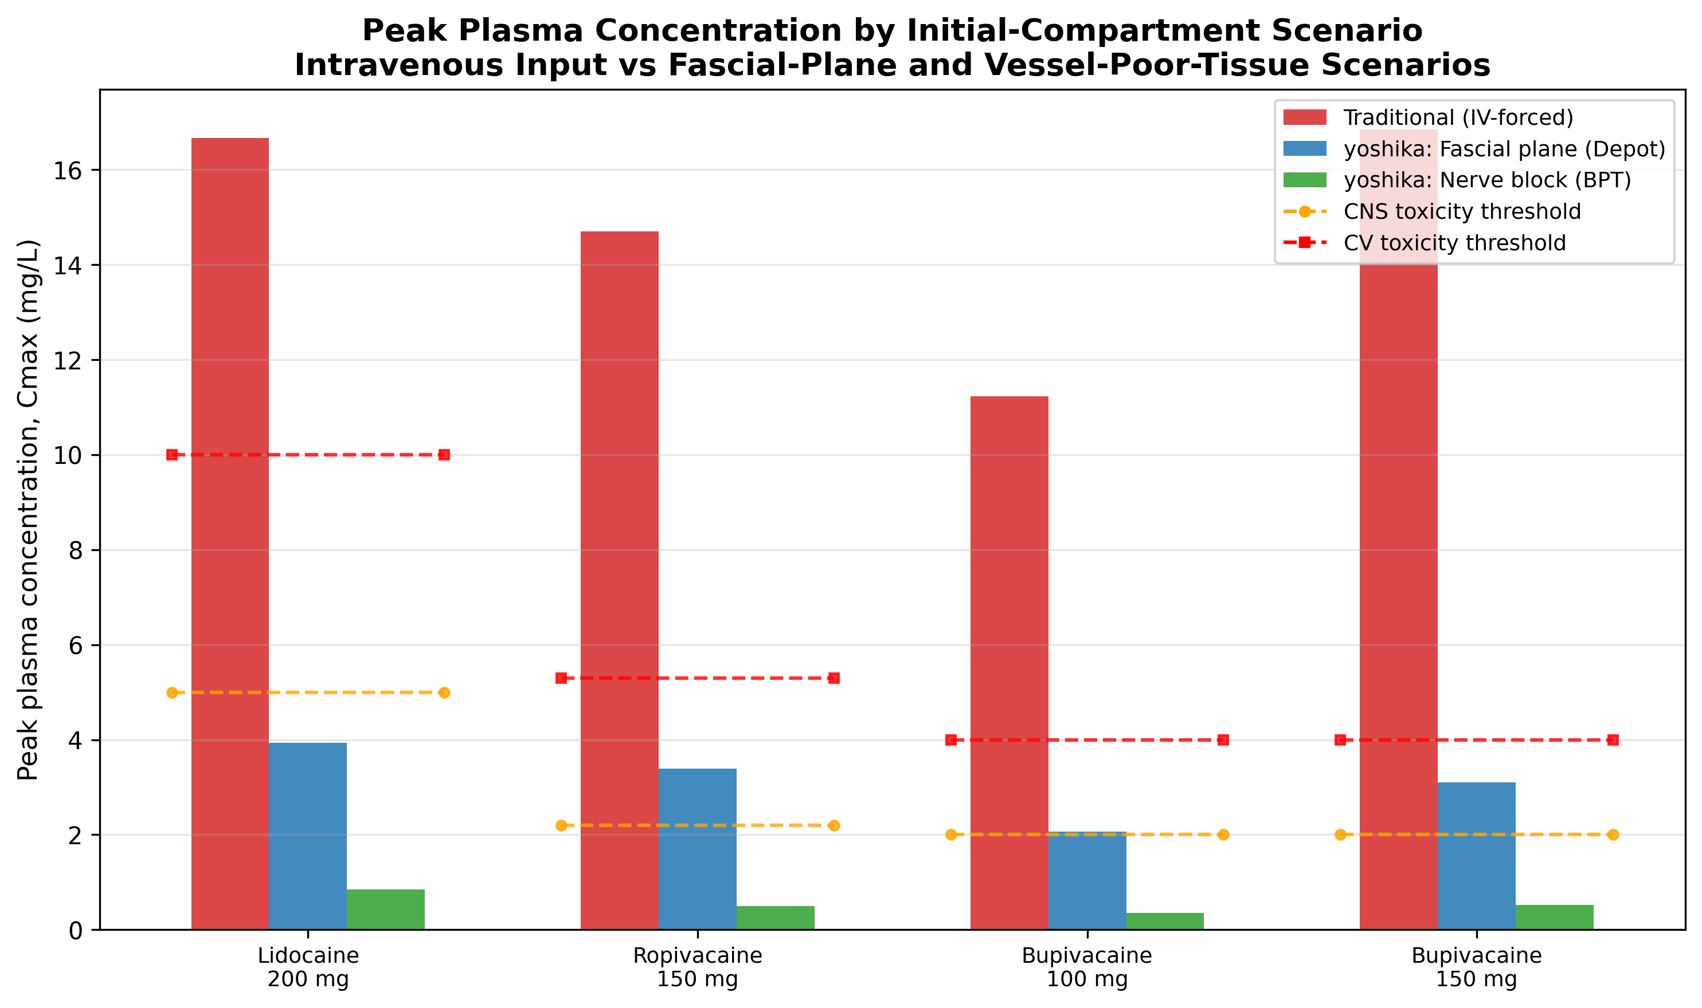
Figure 10: Cmax vs toxicity thresholds
The intravenous-input model predicts Cmax well above thresholds for non-intravenous routes; depot and vessel-poor-tissue scenarios predict lower values closer to published studies. Simulation outputs.

Slide 12
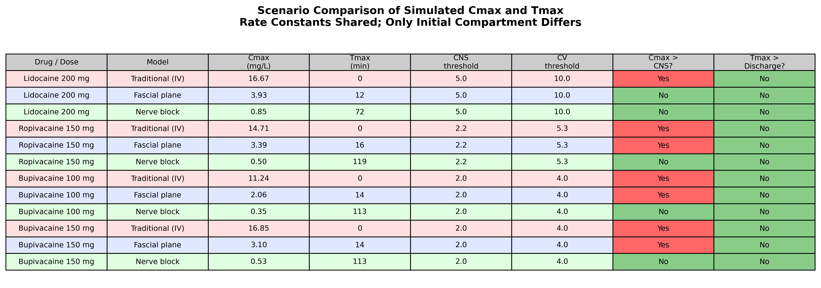
Figure 11: Scenario summary
Rate constants shared across scenarios; only the initial compartment differs. Pink = intravenous-input; blue = depot/fascial plane; green = vessel-poor tissue.

Slide 13
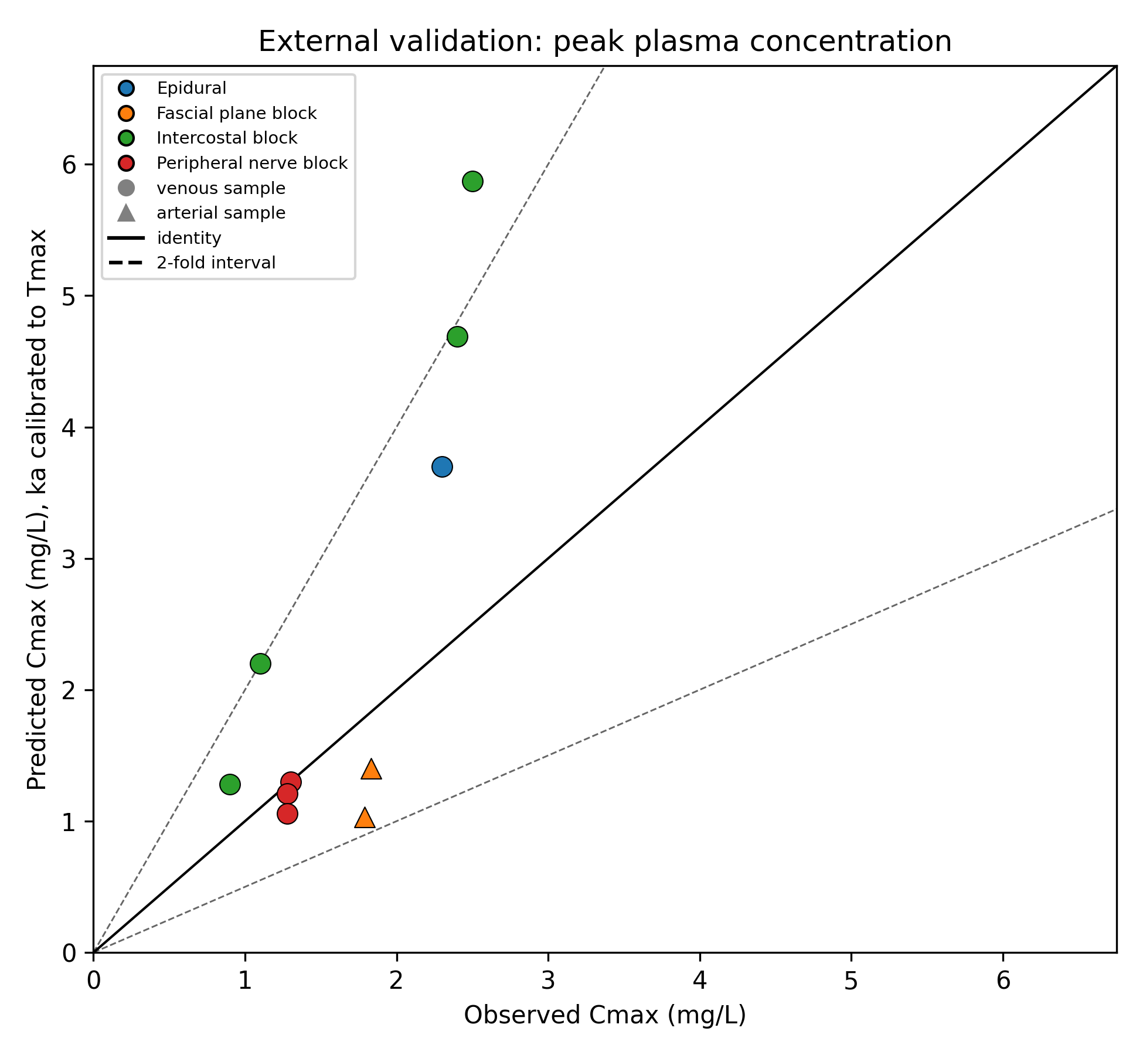
Figure 12: Validation — observed vs predicted Cmax
Observed vs predicted Cmax (depot model, ka calibrated to observed Tmax). Solid line = identity; shaded band = two-fold. 90% within two-fold (GMFE 1.51; r = 0.81). Circle = venous, triangle = arterial sampling.

Slide 14
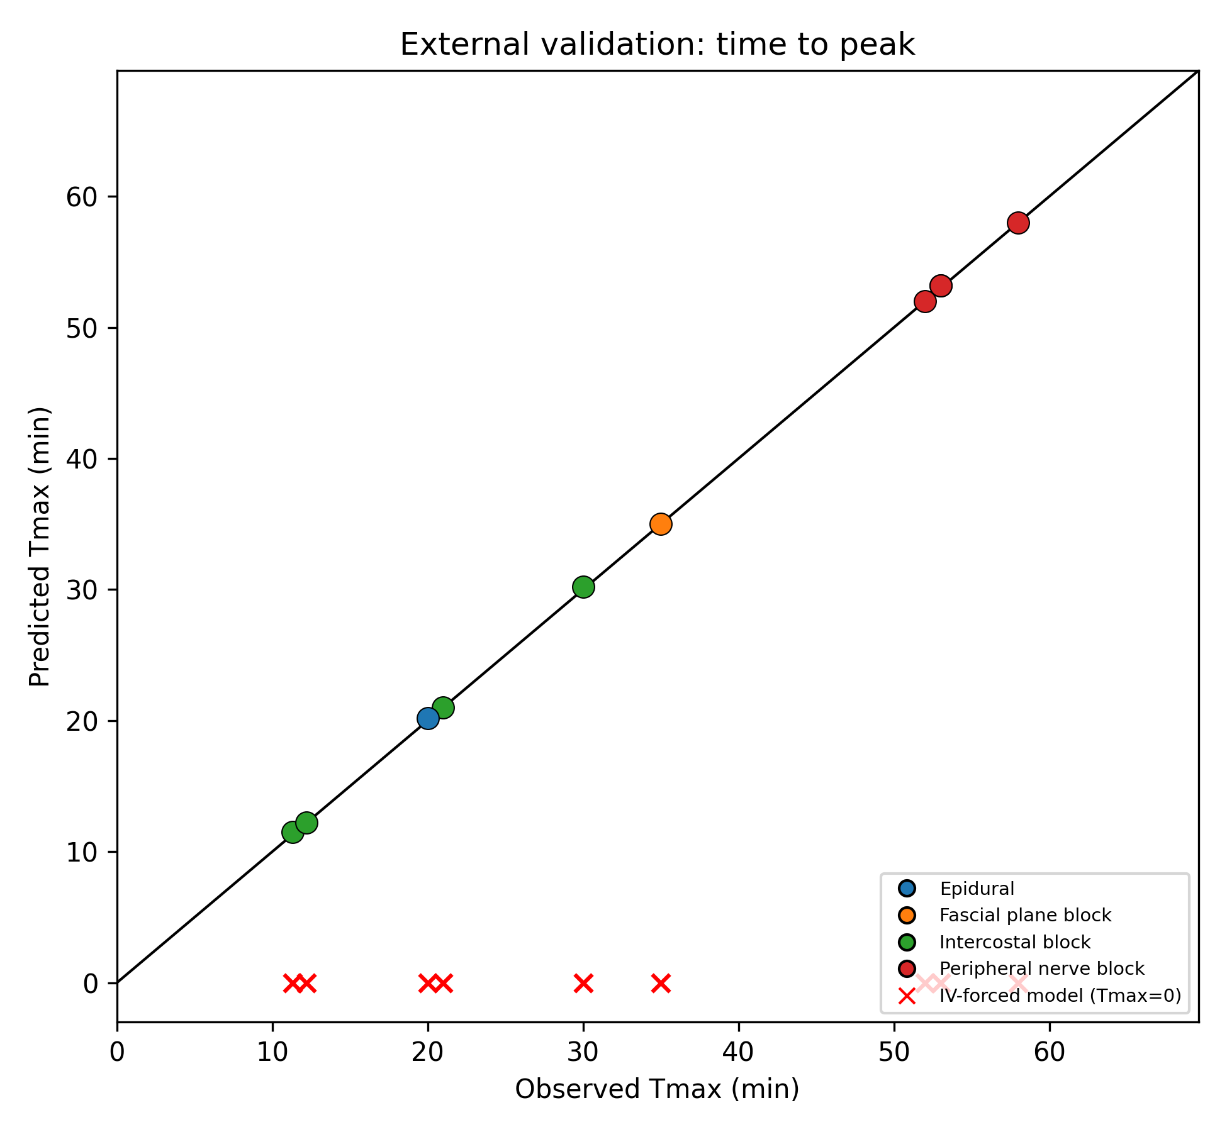
Figure 13: Validation — observed vs predicted Tmax
The depot model reproduces observed 11-58 min peaks; the intravenous-input baseline predicts Tmax = 0 for every study (red crosses on the horizontal axis).

Slide 15
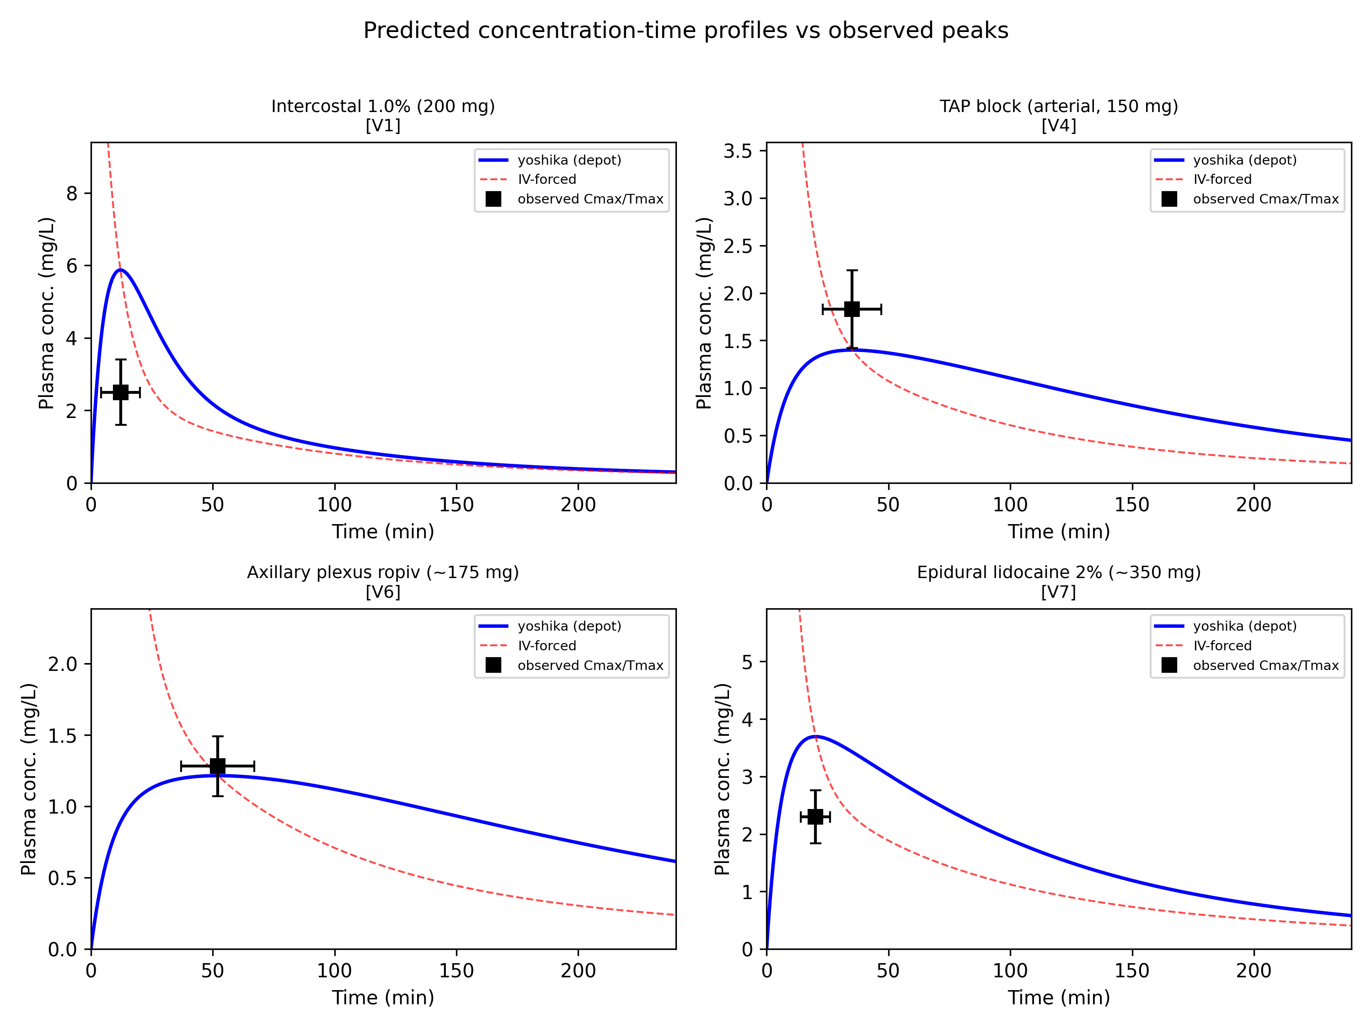
Figure 14: Validation — concentration-time curves
Representative predicted curves (yoshika depot, blue; intravenous-input baseline, red dashed) against observed peak Cmax +/- SD (black squares) for intercostal, TAP, axillary plexus, and epidural cases.

